Slide 1
Q-Router: the complete guide
Every step, every decision, every test and every chart, explained in plain language
A study guide for the team and a reference to open during judges' questions. The 10-slide talk is a separate deck.
Team Q-Router · Florida Atlantic University · Florida Qiskit Fall Fest 2026

Slide 2
How to use this guide
1
The problem
why choosing a quantum computer is hard
8
Running problems together
packing, crosstalk, compute saved
2
Quantum basics
qubits, entanglement, measuring, errors
9
Errors and fixes
mistake-reducing tricks and entanglement test
3
Decisions into math
the score sheet and our four problems
10
Real hardware plan
budget, tests, how to read results
4
The solvers
exact answer, laptop, gate-based, annealing
11
The roadmap chart
what changes as chips improve
5
Fingerprint and AI
how the router learns and how we tested it
12
Limits, prior work, novelty
what's honest and what's new
6
Patterns across industries
twins and copying settings
13
Quick reference
glossary and judge questions
7
Breaking problems down
pieces and the gate-vs-annealing test
Start here
Notes:
Use this deck to study before the event and as a lookup during Q&A. Every slide's footer names its part, and the Parts list here is the table of contents. When a judge asks "how did you...?", find the part, open the slide, and answer from it.

Slide 3
The whole project in one picture
1. Translate
decision → yes/no choices (Part 3)
2. Break down
big problem → pieces of ≤ 8 (Part 7)
3. Describe
9-number fingerprint (Part 5)
4. Choose
AI picks a computer (Part 5)
5. Reuse
copy settings from a twin (Part 6)
6. Run together
several problems, one job (Part 8)
7. Fight errors
fixes on the chip (Part 9)
8. Check
compare to the true best (Part 4)
Bottom line: dense pieces suit gate-based, sparse pieces suit annealing, mixing beats either alone, copying settings saves quantum time, and a normal laptop still wins today.
Start here
Notes:
The one-breath version: "A decision becomes yes/no choices, big problems are split into pieces, each piece is described with 9 numbers, a small AI picks gate-based quantum, annealing quantum or a laptop for each piece, settings are copied from a similar problem in another industry, several problems run together on the chip, and every answer is checked against the true best answer."

Slide 4



Why choosing a quantum computer is hard
Rare and expensive
Two different kinds
They make mistakes
Our free IBM plan: 10 minutes per rolling 28 days
Minutes used today come back only after 28 days
Companies pay for quantum time by the second
Gate-based (IBM, Google): short recipes with tuned settings
Annealing (D-Wave): slow settling toward the best answer
Each suits different problem shapes
Every step on today's chips has a small chance of error
Errors pile up in long recipes
Too many errors → no better than a random guess
Part 1 · The problem
Notes:
Q: What problem are you solving, and for whom?
A: Knowing when and how to use quantum computing, so scarce quantum time isn't wasted. For companies paying for quantum time, for the companies renting quantum computers out, and for researchers.

Slide 5
Who has this problem, and how it's handled today
Who it affects
How it's handled today
Companies trying quantum: drug makers, banks; they pay for every minute
Quantum cloud providers: IBM, D-Wave, Amazon must decide where each job runs
Researchers and students: tiny budgets, like our 10 minutes
People mostly guess, or use the vendor's default
Questionnaires like the Next-Step Quantum Decision Guide rate readiness
D-Wave's hybrid solvers split work internally, but not between gate-based and annealing
The three questions Q-Router answers with data
Is quantum worth it? the router sends a piece to the laptop if no quantum option is predicted to be good enough (Part 5)
Which kind, and for which part? it splits the problem and picks gate-based or annealing for each piece (Part 7)
Part 1 · The problem
Notes:
Q: Is this a real problem if a laptop wins today?
A: Yes. IBM, D-Wave and Amazon already rent different kinds of quantum computers. D-Wave's hybrid solvers already split work between classical and quantum behind the scenes. Today the honest answer is usually "use a laptop", and Q-Router says so; the choice gets more valuable as chips improve.

Slide 6
Bits and qubits
A normal bit
A qubit
A light switch: either 0 (off) or 1 (on)
10 bits hold ONE combination at a time
To check all 1,024 combinations of 10 choices, a laptop checks them one after another (very fast at this size)
Can be 0, 1, or a mix of both until you look at it
When you look (measure), it settles on 0 or 1
In Q-Router, one qubit = one yes/no decision: fund this drug? buy this stock?
Why this matters for us
Our test problems use 3 to 18 qubits. Real company decisions need 50 to 200, plus extra for the chip's wiring.
Part 2 · Quantum basics
Notes:
Q: What is a qubit in your project?
A: One yes/no decision, for example "fund drug 3?". 10 drugs = 10 qubits.

Slide 7
Superposition, entanglement and measuring
Superposition
Entanglement
Measuring and shots
Every qubit starts as a 50/50 mix of yes and no
10 qubits → all 1,024 combinations exist at once
The recipe then makes good combinations more likely and bad ones less likely
Links qubits so they affect each other
Example: two cancer drugs share risk, so their qubits get linked: 'if A is yes, B should lean no'
Done by a two-qubit 'link' step (an RZZ gate) for every connected pair
Looking at the qubits gives ONE answer, like rolling dice
The recipe 'loads the dice' toward good answers
We roll 1,024-4,096 times ('shots') and average the quality of every answer
Part 2 · Quantum basics
Notes:
Q: Why might quantum help here?
A: Superposition holds every combination at once, entanglement links decisions that affect each other, and measuring many times gives many good answers. Whether that beats a laptop on big problems is an open question.

Slide 8
Errors (noise): why quantum chips make mistakes
Where mistakes come from
Why longer recipes are worse
Drift: qubits slowly lose their state while waiting (heat, stray signals)
Imperfect steps: each gate is slightly off; two-qubit link steps are the worst, roughly 10× worse than one-qubit steps
Misreading: the final measurement sometimes reads 0 as 1
Each step works correctly with probability (1 − its error)
The whole recipe works only if every step does, so the chances multiply
Example: 100 link steps at 0.5% error each → 0.995^100 ≈ 0.61, a 39% chance something went wrong
This multiplying rule is exactly how Q-Router predicts the chip's errors (Part 5): it multiplies the chance of success of every step, using IBM's measured error rates for each qubit and gate.
Part 2 · Quantum basics
Notes:
Q: What is noise?
A: Random mistakes in the chip: qubits drift, gates are slightly off, readouts get misread. Every step adds a little, so long recipes collect the most. That's the main reason a recipe that is great on paper can fail on a real chip.

Slide 9
The two kinds of quantum computer
 | Annealing | Gate-based (QAOA)
Picture | A ball rolling slowly into the lowest valley | A short recipe with a few dials
Steps | Many (we use 3-6 rounds) | Few (we use 1-2 rounds)
Settings | Fixed even schedule (a 'ramp'); only the step size is picked | 2 dials per round, tuned by trial and adjustment
Tuning cost | Tiny: try 16 schedules on the simulator | About 60-120 trial runs on the simulator
Error risk | Higher: more steps, more link steps | Lower: fewer steps
Built by | D-Wave (we copy it on IBM's chip) | IBM, Google
Best for (our finding) | Loosely connected (sparse) pieces | Tightly connected (dense) pieces
Part 2 · Quantum basics
Notes:
Q: What's the difference between annealing and gate-based?
A: Annealing settles slowly toward the best answer through many small steps on a fixed schedule; gate-based follows a short recipe whose settings are tuned. Neither is random guessing: both 'load the dice' toward good answers, and only the final measurement is random.

Slide 10
Our annealer is a copy built from gate steps
How the copy works
The choices we made
A real annealer slowly turns down a 'shuffle' force and turns up a 'problem' force
We chop that smooth change into p small rounds, like a flip-book making motion from still pictures
Each round = one shuffle step + one problem step, the same building blocks as gate-based QAOA
Round by round: shuffle strength goes DOWN evenly, problem strength goes UP evenly (a linear ramp)
Rounds (p): 2, 3, 4 or 6; more rounds = smoother sweep but more errors
Step size (Δ): 0.3, 0.6, 0.9 or 1.2; how big each change is
Picking them: try all 16 combinations on the simulator, keep the best average score
For the 60 practice problems: a fixed p = 3, Δ = 0.6, to keep training fast
Flagship result: best was p = 6, Δ = 0.3
Part 2 · Quantum basics
Notes:
Q: Is your annealer real?
A: No. IBM only builds gate-based chips, and we have no D-Wave access. We copy the annealing idea by chopping its slow sweep into small gate steps (a 'digitized anneal', also called linear-ramp QAOA). This method has been run on IBM hardware with 100+ qubits by other researchers. A real D-Wave could plug into the same router.

Slide 11
The score sheet (QUBO)
How it works
In one line
Choices: a list of yes/no switches, one per decision (x = 1 means yes)
Single points: each 'yes' adds its own number (good choices get negative numbers, which lower the total)
Pair points: each pair of 'yeses' adds a number for how they interact (shared risk raises the total)
Goal: find the combination with the LOWEST total
Rules: turned into big penalties so breaking them never pays
Why this format: every solver in the project reads it: the laptop, gate-based and annealing
Total = (sum of each yes's own points) + (sum of each pair of yeses' points) + (penalties for broken rules). Lower is better.
Part 3 · Turning decisions into math
Notes:
Q: What is a QUBO?
A: Our score sheet format: every decision is yes/no, there are points for each yes and for each pair of yeses, and lower total is better. Rules become penalties. It stands for Quadratic Unconstrained Binary Optimization; 'quadratic' means it includes pairs.

Slide 12
A tiny worked example: 3 drugs, fund exactly 2
Funded | Own points | Pair points | Penalty | Total
none | 0 | 0 | 40 | 40
A | −5 | 0 | 10 | 5
B | −4 | 0 | 10 | 6
C | −3 | 0 | 10 | 7
A + B | −9 | +3 | 0 | −6
A + C (best) | −8 | 0 | 0 | −8
B + C | −7 | 0 | 0 | −7
A + B + C | −12 | +3 | 10 | 1
The setup
Drug A: −5 (good)
Drug B: −4
Drug C: −3
A and B together: +3 (same disease)
Rule: fund exactly 2; penalty 10 × (count − 2)²
Part 3 · Turning decisions into math
Notes:
Walk a judge through this if they ask how the score sheet works. Drugs A and B pay the most, but they're for the same disease (shared risk +3), so the best pair is A + C, not A + B. Breaking the "fund 2" rule costs a penalty of 10 × (number funded − 2)², so it never wins.

Slide 13
Rules become penalties
The penalty
How big is P?
Penalty = P × (number chosen − k)²
Exactly k chosen → penalty 0
One too many or too few → P; two off → 4P
Squaring makes it the same kind of math as the score sheet (singles and pairs), so it fits the QUBO format
We set P just above the largest change any single yes/no flip could make to the score
So breaking the rule always costs more than it could gain
Side effect: huge numbers in the score sheet. That's why we score answers against a random guess, not against the worst answer (Part 4)
Part 3 · Turning decisions into math
Notes:
Q: How do you make the computer obey 'fund exactly 4'?
A: Add a penalty of P × (number funded − 4)². It's zero when you fund exactly 4 and grows fast otherwise. P is set bigger than the most any single flip could ever gain, so breaking the rule can never pay off.

Slide 14
Problem 1: which drugs to fund (our main example)
Made-up but realistic data | Value used
Trial phases | Phase I, II or III, picked at random
Chance of approval | Phase I 8% · Phase II 15% · Phase III 55%
Development cost | $30M / $80M / $300M by phase, ±30%
Sales if approved | typical ~$665M, varies randomly
Disease areas | cancer, heart, brain, immune system
The decision
Choices: 10 drugs (8 in some tests), fund exactly 4 (or 3)
Each drug's value: chance of approval × sales if approved − development cost
Each drug's risk: how much its outcome can swing (higher when approval is a coin flip)
Pairs: same disease → outcomes strongly linked (0.6); different diseases → weakly linked (0.1)
Goal: most value for least risk (risk weight 0.5)
Same math as picking stocks (Markowitz portfolio), applied to drugs: the 'money + health' bridge.
Part 3 · Turning decisions into math
Notes:
Q: Is the drug data real?
A: The drug list is made up, but it uses real industry success rates by trial phase. The math is the same portfolio math investors use for stocks.

Slide 15
Problems 2-4: stocks, medical tests, networks
2 · Which stocks
3 · Which medical tests
4 · Splitting a network
Data: real daily prices of 12 healthcare stocks, 2023-2025 (Yahoo Finance)
Value: average yearly return
Pairs: how much two stocks move together (risk)
Rule: hold exactly about a third of them
Data: real breast-cancer dataset (569 patients)
Value: how well a test predicts the diagnosis
Pairs: how much two tests repeat each other
Rule: no fixed count; each test has a small cost
Variety: weak links sometimes dropped to change the shape
Data: made-up networks, links of strength 0.5-1.5
Decision: put each node in group A or B
Goal: as much link strength crossing between the groups as possible (Max-Cut)
Example: trial sites split between two partners
Part 3 · Turning decisions into math
Notes:
Q: Why four different kinds of problem?
A: So the router learns from varied shapes, and so we can test whether patterns learned in one industry help another (Part 6).

Slide 16
Every problem becomes a connection map
8-choice example | Density | Link steps | Recipe length
Drugs (dense) | 1.00 | 99 | 214
Network (sparse) | 0.50 | 49 | 112
Medical tests (trimmed) | 0.61 | 53 | 141
How to read a connection map
Dot = one decision (one qubit)
Line = two decisions affect each other (a pair term in the score sheet)
Density: lines drawn ÷ lines possible (1.0 = everything linked)
Why 'pick exactly k' makes it dense: choosing one item changes whether you can choose any other, so every pair gets a line
Every line costs link steps on the chip, so density drives errors
Link steps and length were counted after fitting each recipe onto IBM's real Torino chip layout. Fewer lines → fewer link steps → fewer errors.
Part 3 · Turning decisions into math
Notes:
Q: What do you mean by the 'shape' of a problem?
A: Draw a dot for each decision and a line between two decisions that affect each other. Density is lines drawn divided by lines possible. Drug and stock problems are fully connected (density 1.0) because the 'pick exactly k' rule links every pair.

Slide 17
Step zero: the true best answer
Checking every combination (brute force)
Combinations grow fast
List every possible combination of yes/no choices
Add up the score sheet for each one
The lowest total is the true best answer
Also keep the average total of all combinations: that's what a random guess scores
Works up to about 20 choices (about a million combinations); our tests use 3-18
10 choices → 1,024
18 choices → 262,144
20 choices → about 1 million
50 choices → about a quadrillion
That explosion is why hard decisions need clever search
Part 4 · The solvers
Notes:
Q: How do you know the right answer?
A: Our problems are small, so a laptop checks every combination and finds the exact best. Every result is compared against it. This only works up to about 20 choices (about a million combinations); real problems need other methods.

Slide 18
How we score every answer
The score (approximation ratio)
Worked example (3 drugs, slide 'tiny example')
Score = (random-guess average − your average) ÷ (random-guess average − true best)
1 = perfect · 0 = random guess · below 0 = worse than random
Your average: over EVERY answer the solver returns (every shot or every run)
Why not 'worst answer' as the zero? penalties make the worst answers enormous, so everything would look like 0.99
Random-guess average of all 8 totals = 4.75
True best = −8
Suppose a solver's answers average −6
Score = (4.75 − (−6)) ÷ (4.75 − (−8)) = 10.75 ÷ 12.75 ≈ 0.84
So it captured 84% of the gap between guessing and perfect
Part 4 · The solvers
Notes:
Q: How do you measure quality?
A: 1 means the true best, 0 means as good as a random guess, below 0 means worse than random. We average over every answer the solver gives, not its luckiest one. With 2,048 shots and only about 1,000 possible answers, the luckiest shot is almost always perfect, so that would be cheating.

Slide 19
Solver 1: the normal laptop (simulated annealing)
Start
a random set of yes/no choices
Flip
change one choice
Keep?
better → keep; worse → sometimes keep
Cool down
accept worse flips less and less
Repeat
100-200 separate runs
Why 'sometimes keep a worse flip'?
How it does
So it can climb out of a small valley and find a deeper one
Early: very willing to accept worse; late: almost never
Scores about 0.95-0.98 on every problem we tried
Takes about 0.01 seconds
This is why we say: no quantum advantage at this size
Part 4 · The solvers
Notes:
Q: What is your classical comparison?
A: Simulated annealing from D-Wave's free software, run on a normal computer. It's the same 'settle slowly' idea as an annealer, but in ordinary code. We also have the exact brute-force answer as a second reference.

Slide 20
Solver 2: the gate-based recipe (QAOA), step by step
1. Mix
every qubit 50/50 yes/no (Hadamard)
2. Nudge
each choice by its value (RZ, dial γ)
3. Link
each connected pair (RZZ = entanglement)
4. Shuffle
let answers explore (RX, dial β)
5. Measure
1,024-4,096 shots
Steps 2-4 are one 'round'. Gate-based uses 1-2 rounds; the annealing copy uses 3-6.
From score sheet to recipe
Fitting the real chip (transpiler)
Each yes/no becomes a qubit; each single point becomes a nudge; each pair point becomes a link
All numbers are scaled to the same size, so settings work across problems
Qiskit rewrites the recipe into the exact steps IBM's chip can do
Qubits that aren't wired together need extra swap steps, which add errors
Part 4 · The solvers
Notes:
Q: Walk me through your circuit.
A: Hadamard gates put every qubit in a 50/50 mix. The cost layer gives each qubit an RZ rotation for its own value and an RZZ link for every connected pair (entanglement). The mixer layer applies RX rotations to shuffle. Repeat p times, then measure. Qiskit builds this with QAOAAnsatz from our score sheet, rewritten as an 'Ising' energy (SparsePauliOp).

Slide 21
Tuning the dials
Try
a setting for the dials
Run
the recipe on the simulator, 1,024-2,048 shots
Score
average quality of all shots
Adjust
the optimizer (COBYLA) picks better dials
Stop
after 60-120 tries; send to chip once
Where tuning starts
What we optimize
From an annealing-like starting point: shuffle starts strong, problem nudge starts weak
That gives the optimizer a sensible first guess
The AVERAGE quality, the same thing we report
An option (CVaR: average of only the best 25%) exists, but it hid a bug and left typical answers poor, so we don't use it
Part 4 · The solvers
Notes:
Q: How are the dials tuned, and why not on the real chip?
A: An optimizer called COBYLA tries settings, runs the recipe on the simulator, reads the average score, and adjusts, about 60-120 times. Doing that on the real chip would burn our whole 10-minute budget, so the chip only ever runs final settings.

Slide 22
The bug that flipped everything
Method | Before the fix | After the fix
Normal laptop | 0.951 | 0.953
Gate-based (2 rounds) | −1.366 | 0.786
Annealing copy (6 rounds) | −1.044 | 0.748
What happened
Scores below 0 = worse than a random guess
The recipe was faithfully steering toward the WORST answers
We were also optimizing a different score (best 25%) than we reported, which hid the problem
Fix: flip one sign, and optimize the same average we report
Lesson
Always compare against a known best answer and a random guess. A score that looks 'fine' on its own can hide a recipe running backwards.
Part 4 · The solvers
Notes:
Q: What was hardest to get working?
A: A sign error. Qiskit's QAOA starts at the TOP of its shuffle step's energy ladder, so with both dials positive the circuit was steered toward the HIGHEST energy, the worst answer. Scores were negative, worse than random. Making the problem dial negative fixed it. We verified it by hand on a one-qubit example.

Slide 23
First result: the 10-drug problem
Method (perfect simulator) | Score | Found the best set?
Normal laptop | 0.948 | Yes
Gate-based (2 rounds) | 0.782 | Yes
Annealing copy (6 rounds, step 0.3) | 0.759 | Yes
The best set
A heart drug in Phase II
A brain drug in Phase III
Two early cancer drugs in Phase I
The laptop, gate-based and annealing all found exactly this set
How to read it
'Found the best set' means the best answer appeared among the shots. The score says how good the TYPICAL answer is, which is the honest measure.
Part 4 · The solvers
Notes:
Q: Does it actually solve the problem?
A: Yes, all three methods found the exact best set of 4 drugs. But the laptop's answers are almost always the best one (0.95), while the quantum recipes give good answers on average but not every time (0.78 and 0.76), and that's before chip errors.

Slide 24
The 9-number fingerprint
# | Number | Plain meaning | Why it matters
1 | Size | how many decisions (qubits) | bigger → longer recipe
2 | Density | lines drawn ÷ possible | more lines → more link steps
3 | Average links | lines per decision | crowding on the chip
4 | Most links | busiest decision's lines | needs extra swap steps
5 | Number spread | biggest ÷ smallest score number (log) | hard-to-tune problems
6 | Success chance, gate | chance the 1-round recipe runs error-free | predicts gate-based errors
7 | Success chance, anneal | same for the 3-round annealing recipe | predicts annealing errors
8 | Link steps | two-qubit gates after fitting the chip | the noisiest steps
9 | Recipe length | steps from start to finish (depth) | time for drift errors
Part 5 · The fingerprint and the AI
Notes:
Q: How does it decide the shape of a piece?
A: It draws the connection map and measures 9 numbers: 5 about the map and 4 about how the recipe would run on IBM's real chip.

Slide 25
How we predict the chip's errors
Build
the recipe for this piece
Fit
onto IBM Torino's real layout
Look up
each step's error rate (IBM calibration)
Multiply
(1 − error) over every step
Result
chance of an error-free run
How it's used
Known weakness
Predicted chip score = perfect-simulator score × chance of an error-free run
A chip with errors drifts toward random answers, so the score shrinks toward 0
Too pessimistic for long recipes: predicted 0.04 for the annealing copy where the full chip simulation gave 0.45
Ignores crosstalk and some error types; that's why we also run full simulations and the real chip
Part 5 · The fingerprint and the AI
Notes:
Q: Where do your noise estimates come from?
A: IBM publishes calibration data: the error rate of every qubit, gate and measurement on each chip. We fit the recipe onto IBM Torino's real layout, then multiply (1 − error) for every step. That's the chance the whole recipe runs with zero mistakes.

Slide 26
Making the 60 practice problems
Pick
a random field (stocks, tests, drugs, network)
Make
a problem with 5-9 choices
Solve 3 ways
gate, annealing, laptop (simulator)
Score
vs. the true best; estimate chip errors
Store
fingerprint, scores, tuned dials
What we ended up with
Settings used
11 stock, 16 drug, 15 medical-test and 18 network problems
For each: 9 fingerprint numbers + 3 scores + the gate-based dials
Gate-based: 1 round, 60 tuning tries, 1,024 shots
Annealing copy: fixed 3 rounds, step 0.6, 1,024 shots
Laptop: 100 runs. Takes about 40 seconds in total
Part 5 · The fingerprint and the AI
Notes:
Q: Were the 60 problems solved on the real chip?
A: No. All 60 were solved on a simulator, three ways each, and we know the true best for each. Real-chip errors were estimated with the formula from the previous slide. They're practice problems, the AI's homework, rebuilt each time the notebook runs.

Slide 27
The AI: a random forest
What the AI relies on | Share
Success chance, annealing | 53%
Success chance, gate-based | 17%
Average links | 7%
Link steps | 5%
Number spread | 5%
Recipe length | 5%
Density, most links, size | 8%
How it works
One tree: a game of 20 questions, e.g. 'is density above 0.8? is the annealing success chance below 0.1?' → predicted scores
300 trees: each trained on a random slice of the 60 problems, so each is a bit different
Prediction: the average of all 300 trees, so one bad tree can't dominate
Output: predicted score for gate-based, annealing and laptop
It learned by itself that 'can the chip afford the annealing recipe?' is the key question.
Part 5 · The fingerprint and the AI
Notes:
Q: How does the AI decide?
A: A random forest: 300 small decision trees, each asking a chain of yes/no questions about the 9 fingerprint numbers, trained on slightly different samples. Their predictions are averaged. It predicts all three scores at once. Its most important input by far is the annealing recipe's success chance.

Slide 28
The routing rule: how the final choice is made
Predict
gate, annealing and laptop scores
Compare
gate vs. annealing: take the higher
Check
is it at least 0.5?
Yes →
send to that quantum kind
No →
send to the laptop
Why 0.5?
Honest caveat
0.5 = the quantum answer captures at least half the gap between a random guess and the perfect answer
Below that, quantum time isn't worth spending
The laptop scores about 0.97, so on pure quality it always wins today
The rule asks 'is quantum good enough to be worth trying?', not 'does quantum beat the laptop?'
Part 5 · The fingerprint and the AI
Notes:
Q: How does it decide to use the laptop?
A: It picks whichever quantum kind has the higher predicted score. If even that is predicted below 0.5 (less than half the way from random to perfect), the piece goes to the laptop. Honest caveat: the rule compares quantum to a fixed bar of 0.5, not to the laptop's own predicted score.

Slide 29
Test 1: are the AI's predictions accurate?
Solver | Average error | Natural spread | Verdict
Gate-based | 0.026 | 0.068 | useful
Annealing | 0.019 | 0.123 | very useful
Laptop | 0.010 | 0.021 | barely varies
How the test works (5-fold)
Split the 60 problems into 5 groups of 12
Train on 4 groups (48), predict the 5th (12)
Rotate 5 times so every problem gets predicted once by a model that never saw it
Compare predictions with the real scores
Good means: the error is much smaller than the natural spread of scores
We first reported a single 'R²' score of −6.2. That was a math artifact: the laptop's scores barely vary, which breaks R². Per-solver error is the honest measure.
Part 5 · The fingerprint and the AI
Notes:
Q: How do you know the AI's predictions are right?
A: 5-fold testing: split the 60 problems into 5 groups of 12, train on 48, predict the other 12, and rotate so every problem is predicted by a model that never saw it. Errors of 0.02-0.03 are small compared with how much scores really vary (0.07-0.12).

Slide 30
Test 2: does it work on an industry it never saw?
Left-out industry | Trained on | Test problems | Average error | Picked better quantum kind
Stocks | drugs, tests, networks | 11 | 0.014 | 100%
Drugs | stocks, tests, networks | 16 | 0.012 | 88%
Networks | stocks, drugs, tests | 18 | 0.048 | 72%
Medical tests | stocks, drugs, networks | 15 | 0.041 | 100%
How to read it
Networks are hardest to predict because they differ most from the other three. An earlier version said '100% correct' everywhere, but that only checked 'laptop wins', which is always true. We now check the harder question: which quantum kind.
Part 5 · The fingerprint and the AI
Notes:
Q: Do patterns really carry across industries?
A: We trained on three industries and tested on the fourth, four times. The AI still chose the better quantum kind 72-100% of the time, with small prediction errors, so what it learns isn't tied to one industry.

Slide 31
Test 3: does the AI beat simple rules?
Strategy (quantum only, fair test) | Average score
Always gate-based | 0.423
Always annealing | 0.305
The AI's choice | 0.436
Perfect cheat (knows the answers) | 0.438
AI picked the better kind | 90% of problems
Industry | Always gate | AI | Cheat
Stocks | 0.483 | 0.483 | 0.483
Drugs | 0.458 | 0.458 | 0.459
Networks | 0.359 | 0.376 | 0.382
Medical tests | 0.418 | 0.451 | 0.451
The AI helps most on networks and medical tests, where annealing sometimes wins. Including the laptop, every strategy that can pick it scores 0.975: the laptop wins every problem.
Part 5 · The fingerprint and the AI
Notes:
Q: Does the router actually help?
A: Among the two quantum kinds, the AI scores 0.436 versus 0.423 for always using gate-based, and a perfect 'cheat' that already knows the answers gets 0.438. So it's near-perfect at choosing, but the gain over 'always gate-based' is small, because gate-based usually wins.

Slide 32
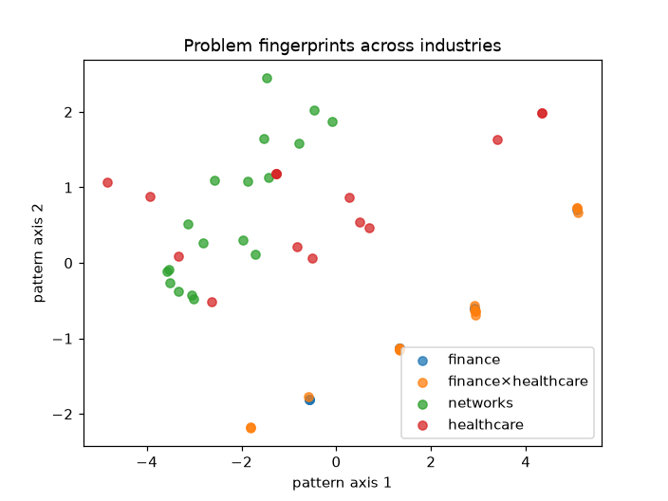
Reading the fingerprint map
How to read it
Each dot: one of the 60 practice problems; color = its industry
Axes: not real units; the 9 numbers squashed into 2 (PCA)
Close dots: similar shape
What we see: stocks and drugs overlap (both fully connected); networks and medical tests overlap (both looser)
So: shape, not industry, decides which solver fits
Part 6 · Patterns across industries
Notes:
Q: What does this chart show?
A: Each dot is one practice problem. Its 9 fingerprint numbers are squashed into 2 axes with a method called PCA, which keeps as much of the difference between problems as possible. Dots close together have similar shapes, even if they come from different industries.

Slide 33
Finding a structural twin
Rescale
each of the 9 numbers to the same scale
Measure
distance between fingerprints
Filter
keep only other industries
Pick
the closest one: the twin
Copy
its tuned gate-based dials
Example: twins of a 7-choice medical-test problem | Choices | Density | Link steps
Medical tests (another one) | 7 | 0.29 | 18
Medical tests (another one) | 6 | 0.47 | 26
Networks | 6 | 0.53 | 28
Why rescale?
Link steps run into the hundreds while density is between 0 and 1. Without rescaling, link steps alone would decide who's 'similar'.
Part 6 · Patterns across industries
Notes:
Q: How do you find a 'similar problem'?
A: Rescale the 9 numbers so none dominates, measure the straight-line distance between fingerprints, and take the closest problem from a DIFFERENT industry. It's a lookup, not training.

Slide 34
Copying settings: how the experiment works
Way of setting the dials | Tries needed | What it tests
Tuned from scratch on this problem | about 60 | the best you can do
Copied from its twin in another industry | 1 | does shape-matching transfer?
Copied from a random problem in another industry (3 tries, averaged) | 1 | the fair comparison (control)
Generic default dials | 1 | no learning at all
Why the random copy matters
Our first version only compared the twin to full tuning and claimed '95% of the quality'. But default dials already got 91%. The random copy shows how much of the gain comes from the matching itself.
Part 6 · Patterns across industries
Notes:
Q: How do you know copying from a twin really helps?
A: We compare four ways of setting the dials on all 60 problems. The key comparison is twin vs. random donor: both cost one run, both come from another industry, so if the twin wins, the matching is what helps.

Slide 35
Copying settings: results
Industry | Tuned | Twin | Random | Default
Stocks | 0.736 | 0.737 | 0.684 | 0.690
Drugs | 0.749 | 0.737 | 0.663 | 0.694
Medical tests | 0.615 | 0.532 | 0.571 | 0.555
Networks | 0.481 | 0.448 | 0.438 | 0.434
Read it as: the gap between 'default' (0.581) and 'tuned' (0.633) is what tuning buys. The twin closes about half of that gap with one try instead of 60. '± 0.02' is the standard error: how much the average could wobble by chance.
Part 6 · Patterns across industries
Notes:
Q: What did you find?
A: Twin 0.599 vs. random 0.577 vs. default 0.581 vs. full tuning 0.633, across 60 problems. The twin beats random by 0.023 ± 0.010 and wins on 65% of problems. So it recovers about half of the tuning gain at 1/60 of the cost. It doesn't help medical-test problems.

Slide 36
Splitting a problem into pieces
Map
connection strength between every pair
Count
pieces needed = size ÷ 8, rounded up
Cut
where links are weakest (spectral clustering)
Trim
any piece over 8 is split again
Analogy
Why at most 8?
Seating a wedding: people who talk the most share a table, so the fewest conversations cross between tables.
Small enough for the recipe to run with few errors
Small enough to check the exact best answer for each piece
Part 7 · Breaking problems into pieces
Notes:
Q: How do you break a problem down?
A: Spectral clustering: it treats the connection map as a network and cuts it where the links are weakest, so decisions that strongly affect each other stay in the same piece. Pieces are at most 8 decisions, small enough for today's chips.

Slide 37
Solving pieces that still affect each other
Start
all choices 'no' (or a quick laptop guess)
Freeze
every other piece's current choices
Solve
this piece with the chosen computer
Keep?
only if the total improves
Repeat
next piece; 2 full rounds
Example: a 16-drug problem, fund 5
Split into 3 pieces: 6, 8 and 2 drugs
The router sent the 6- and 8-drug pieces to the laptop and the 2-drug piece to annealing
Final score 0.998, and the rule 'fund exactly 5' was kept
Part 7 · Breaking problems into pieces
Notes:
Q: If pieces affect each other, how can you solve them separately?
A: Each piece is solved with the other pieces' current choices held fixed; their influence is folded into the piece's score sheet. Then we move to the next piece, keeping a change only if it improves things, and go around twice. This is called block coordinate descent, the same idea D-Wave's qbsolv used.

Slide 38
The gate-vs-annealing test: design
The test problem (18 choices)
What we ran
Part A, dense: which 3 of 8 drugs to fund; every choice affects every other
Part B, sparse: split 10 trial sites between two partners; each site affects only a few neighbors
Links between parts: a small bonus when a funded drug's trial site is chosen
Both parts rescaled to the same size so neither dominates
Split into 3 pieces: drugs (8), sites A (7), sites B (3)
Gate-based: dials tuned on the simulator (80 tries)
Annealing: best of 16 schedules on the simulator
Scored 3 ways: perfect simulator · predicted from IBM's error data · full simulation of IBM Torino with errors
Section 9b repeats it on the real chip in one job
Part 7 · Breaking problems into pieces
Notes:
This is the judge's question: comparing the two kinds of quantum computer piece by piece. We deliberately ran BOTH kinds on EVERY piece to check the router's choices, scoring each three ways.

Slide 39
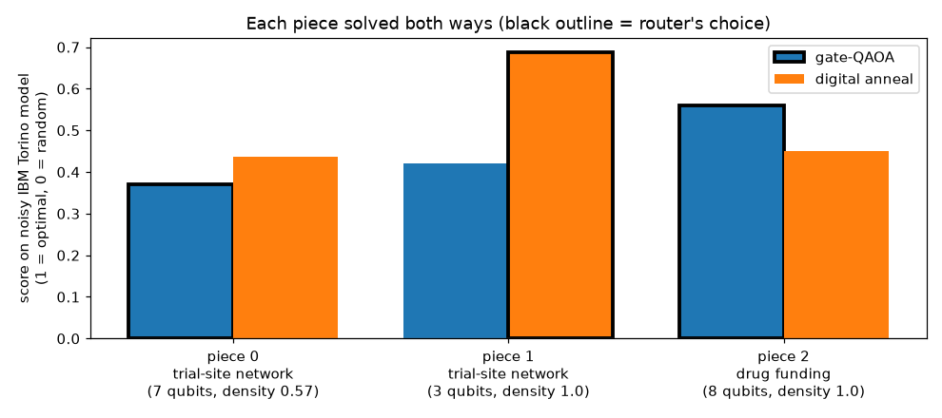
The gate-vs-annealing test: results
Piece | Choices | Density | Link steps gate / anneal | Perfect gate / anneal | With chip errors gate / anneal | Router | Right?
Drugs | 8 | 1.00 | 99 / 685 | 0.69 / 0.80 | 0.56 / 0.45 | gate | yes
Sites A | 7 | 0.57 | 45 / 319 | 0.43 / 0.84 | 0.37 / 0.44 | gate | no
Sites B | 3 | 1.00 | 9 / 60 | 0.44 / 0.93 | 0.42 / 0.69 | anneal | yes
How to read it
Each pair of bars = one piece, solved both ways
Black outline = the router's choice
The miss on sites A: our error estimate predicted 0.21 for annealing; the full simulation gave 0.44
Part 7 · Breaking problems into pieces
Notes:
Q: When was each type effective?
A: Gate-based won the dense drug piece; annealing won both sparse trial-site pieces. With no errors annealing wins everything, but it needs about 7× more link steps, so errors hurt it most where everything is linked. The router's mix (0.539) beat all-gate (0.450) and all-annealing (0.524), and it chose right on 2 of 3 pieces.

Slide 40
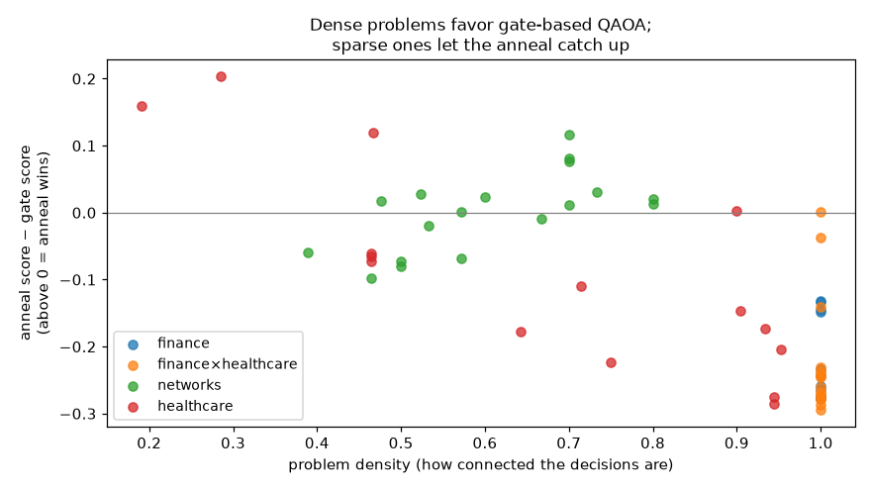
Reading the 'when does each win' chart
How to read it
Each dot: one practice problem
Left → right: more connected (density)
Above the line: annealing scored higher
Below the line: gate-based scored higher
Right edge (1.0): stocks and drugs, almost all below
Annealing won | Stocks 0/11 | Drugs 2/16 | Tests 4/15 | Networks 10/18
Part 7 · Breaking problems into pieces
Notes:
Q: Is this one example or a pattern?
A: A pattern. Each dot is one of the 60 practice problems. Left-right is how connected it is; up-down is how much annealing beat gate-based. Fully connected problems (right edge) sit below zero: gate-based wins. Looser problems spread around zero and above: annealing can win.

Slide 41
Packing several problems onto one chip
Problem (6 choices each) | Kind used | Alone | Together | Lost
Stocks: hold 2 of 6 | gate | 0.585 | 0.596 | −0.011
Medical tests: 6 tests | annealing | 0.577 | 0.581 | −0.004
Drugs: fund 2 of 6 | gate | 0.616 | 0.592 | 0.024
How it works
Each problem gets its own group of qubits; no links between groups
All groups go into ONE recipe and ONE chip job
Each problem's answer is read from its own qubits
Crosstalk: a neighbor's activity disturbing a problem; measured as score alone − score together
Theme fit: 'a decade of quantum on the cloud', many users sharing one machine
Simulation of IBM Torino with errors. Losses of about 0.01-0.02 are within normal run-to-run wobble, so packing cost almost nothing. The real chip may show more.
Part 8 · Running problems together
Notes:
Q: How can different problems run at the same time?
A: IBM's chips have 133-156 qubits and each problem uses 4-8, so each problem gets its own group of qubits inside one big recipe, sent as one job. To measure interference (crosstalk), we also run each problem alone and compare.

Slide 42
One tune, one job: design
4 problems
stocks, tests, drugs, network (4 choices each)
Group
into 2 shape families (k-means on fingerprints)
Tune once
only the most typical member of each family
Share
every member uses its family's dials
One trip
all 4 packed into one 16-qubit recipe
Version | Settings | On the chip | Answers the question
Normal way | each tuned on its own | alone | the baseline
Shared, alone | family's shared dials | alone | does sharing cost quality?
Shared, packed | family's shared dials | all together | does packing cost quality?
Part 8 · Running problems together
Notes:
Q: How does pattern recognition save compute?
A: Group problems by shape, tune only one per group, let the rest share those settings, and send everything to the chip in one trip. Three versions of each problem separate the two savings: own settings alone, shared settings alone, shared settings packed.

Slide 43
One tune, one job: results and the compute ledger
Problem | Family | Own, alone | Shared, alone | Shared, packed
Stocks | 1 | 0.440 | 0.437 | 0.447
Medical tests | 2 | 0.566 | 0.573 | 0.573
Drugs | 1 | 0.521 | 0.517 | 0.515
Network | 1 | 0.571 | 0.470 | 0.483
Average |  | 0.524 | 0.499 | 0.504
Compute ledger | Normal | Q-Router
Problems tuned | 4 | 2
Tuning runs (simulator) | 114 | 55
Recipes sent to chip | 4 | 1
Chip jobs | 4 | 1
Quantum shots | 16,384 | 4,096
Simulation of IBM Torino with errors. Section 11b repeats this on the real chip in one job. 'Quantum shots' are what cost quantum time.
Part 8 · Running problems together
Notes:
Q: How much do you save, and what does it cost?
A: 4× fewer quantum shots and 1 chip job instead of 4, keeping 96% of the quality (0.524 → 0.504). Almost all the loss came from the network problem being grouped with finance problems; packing itself cost nothing.

Slide 44
Four ways we run every important test
Perfect simulator
a normal computer with no errors (Aer)
Copy of the chip
simulator + IBM Torino's error data
Real chip, raw
IBM's quantum computer, no fixes
Real chip + fixes
error-reducing tricks turned on
Gap between... | ...tells us
Perfect → copy of chip | how much errors should hurt
Copy of chip → real chip | whether our error model is realistic
Real raw → real + fixes | whether the fixes help
Part 9 · Errors and how we fight them
Notes:
Q: How do you compare simulator and hardware?
A: The same recipe runs four ways, from ideal to real. The gaps between columns tell us how much errors cost and whether our fixes helped.

Slide 45
Fixes 1 and 2: dynamical decoupling and twirling
Dynamical decoupling
Twirling (gates and measurements)
Problem: qubits waiting their turn slowly drift
Fix: flick them with a timed pattern of pulses (XY4) that cancels the drift, like tapping a spinning top to keep it upright
Cost: none in quantum time
Problem: some errors push the same way every time, so they pile up
Fix: randomly wrap each step in extra flips that cancel out logically, so errors point in random directions and partly cancel
Measurements: random flips before reading out even out the 0-vs-1 bias
Honest note: reshapes errors more than it removes them, so gains may be small
Part 9 · Errors and how we fight them
Notes:
Q: What error mitigation did you use on hardware?
A: Dynamical decoupling (XY4 pulses on waiting qubits) and Pauli twirling on gates and measurements, both built into IBM's sampler. They reduce or reshape errors rather than removing them, so we compare raw and fixed results honestly.

Slide 46
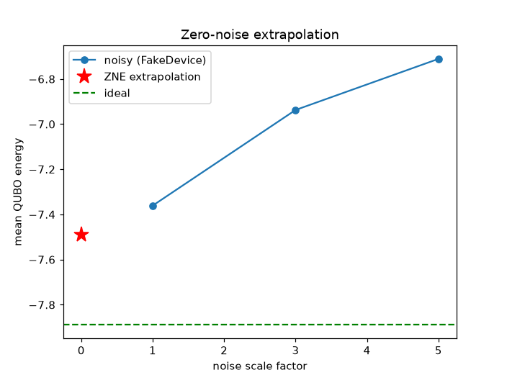
Fix 3: zero-noise extrapolation (ZNE)
How to read it
Up-down: average energy; LOWER is better
Green dashed line: the perfect, error-free result (−7.89)
Blue dots: with 1×, 3× and 5× the errors; it gets worse as errors grow
Red star: the line extended back to 0× (−7.49)
Result: raw −7.36 → corrected −7.49, about 25% of the gap to perfect recovered
Test problem: a 6-node network, simulation only
Part 9 · Errors and how we fight them
Notes:
Q: What is zero-noise extrapolation?
A: Deliberately make errors worse by repeating the recipe forward, backward, forward (3× and 5× the errors, same answer in theory). Measure how the result degrades, draw a line, and extend it back to zero errors. On a simulation of Torino it won back about a quarter of what errors destroyed.

Slide 47
Is entanglement doing any work?
 | With links | Links removed
Score | 0.773 | 0.308
Entanglement (bits) | 1.04 | 0
Link steps on Torino | 408 | 0
How the test works
Problem: 10 drugs, fund 4, gate-based with 2 rounds, perfect simulator
Measure 1: entanglement between drugs 1-5 and drugs 6-10 (entanglement entropy, in bits; 0 = none, 5 = maximum)
Measure 2: delete every link step (all RZZ gates), keep everything else, re-tune the dials, score again
Honest note
This shows entanglement matters for the recipe's score, not that it beats a laptop. And those 408 link steps are also where most chip errors come from.
Part 9 · Errors and how we fight them
Notes:
Q: Where is the quantum part, and does it matter?
A: We measured how entangled the gate-based recipe's state is for the 10-drug problem (about 1 bit between its two halves), then removed every link step and re-tuned. The score fell from 0.77 to 0.31. So the links between qubits do real work.

Slide 48
Our 10-minute quantum budget
Real-chip test | Notebook section | Jobs | Approx. time
Both kinds, raw vs. fixes (10-drug problem) | 9 | 4 | 30 s
The 3 pieces, both kinds | 9b | 1 | 30-60 s
3 industries packed on one chip | 11 | 1 | 20-40 s
One tune, one job | 11b | 1 | 20-40 s
Optional: grow from 6 to 16 qubits | 10 | 2 | 60-90 s
Total |  | 7-9 | about 3-4 minutes
Every real-chip cell was first run against a fake copy of IBM Torino, so none should crash.
Part 10 · Real hardware plan
Notes:
Q: Why not run more on the real chip?
A: The free plan gives 10 minutes per rolling 28 days, so minutes used tonight don't return before the state final on Nov 8. And the free plan has no 'sessions', so we batch many recipes into each job. Everything is tuned on simulators first.

Slide 49
What each real-chip test tells us
Test | The question | If the result is good... | If it's bad...
9: raw vs. fixes | Do the fixes help? | Fixed > raw: mitigation worked | Equal: errors here aren't the kind the fixes target
9: simulator vs. chip | Is our error model realistic? | Chip ≈ copy of chip: we can trust predictions | Chip worse: errors the model ignores (crosstalk, drift)
9b: pieces | Does dense → gate, sparse → annealing hold on real hardware? | Same winners as in simulation | Report it; the pattern may need bigger tests
11: packing | Do problems disturb each other? | Together ≈ alone: packing is free | Measured crosstalk: a real finding
11b: one tune | Is shared + packed still good? | Close to the normal way | Shows where sharing breaks
Part 10 · Real hardware plan
Notes:
Use this slide after the hardware runs to explain the numbers. Whatever the outcome, report it: the handbook rewards honest results.

Slide 50
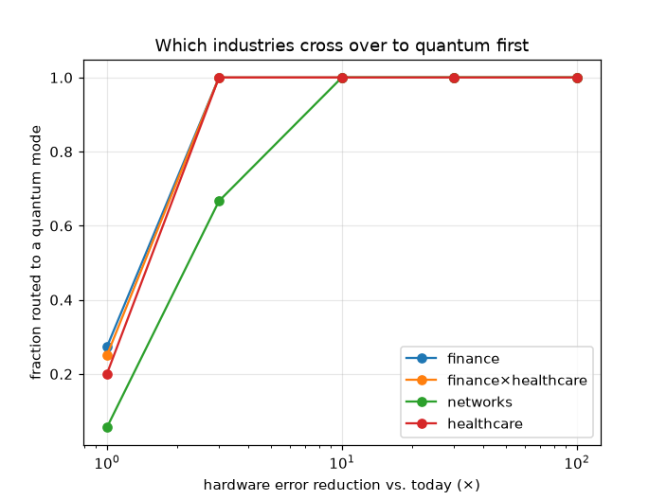
Reading the roadmap chart
How to read it
Left → right: how many times fewer errors than today (1× = today)
Up-down: share of that industry's problems where quantum clears the 0.5 bar
Today: about 20-27% for stocks, drugs and tests; about 5% for networks
3× fewer errors: all of stocks, drugs and tests; 67% of networks
Honest caveat: 'clears 0.5' ≠ 'beats the laptop' (0.97), and it assumes our simple error model
Part 11 · The roadmap chart
Notes:
Q: What would need to change for quantum to be useful?
A: This chart pretends chip errors shrink by 3×, 10×, 30× and 100×, recomputes each practice problem's predicted quantum score, and counts how many clear the 0.5 bar. With about 10× fewer errors, every problem clears it. Caveat: clearing 0.5 means 'worth trying', not 'beats the laptop'.

Slide 51
What we're honest about
Limits of the results
Limits of the method
No quantum advantage: the laptop scores 0.95-0.98 everywhere
Tiny problems: 3-18 choices vs. 50-200 in real portfolios
Our annealing is a copy on IBM's chip, not a D-Wave machine
The drug data is made up (with real success rates)
The break-down test is one example problem
Only 60 practice problems; retrained each run
The error estimate is too pessimistic about long recipes, which biases the router against annealing
The routing rule compares to a fixed bar (0.5), not to the laptop
Copying settings costs some quality and doesn't help medical tests
Limited hardware budget: single runs, no repeats
Part 12 · Limits, prior work, novelty
Notes:
The handbook says: a team that clearly explains why quantum may NOT yet beat classical shows more understanding than one that overclaims. Lead with these, don't hide them.

Slide 52
What already existed (prior work)
Idea | Already known from | What we add
Tuned QAOA settings carry over between similar problems | Brandão et al. 2018; Galda et al. 2023 | tested across real industries with a random-copy control
AI picks donors across problem types | Cross-problem transfer study, 2025 (arXiv 2504.10733) | real-data decisions + a noise-aware fingerprint
Several circuits on one chip | Multi-programming research (e.g. arXiv 2102.05321) | combined with routing and shared settings, with a compute ledger
Choosing a solver with AI | Decades of 'algorithm selection' research | choosing gate-based vs. annealing piece by piece
Digitized annealing on IBM | Linear-ramp QAOA studies | used as the 'annealer' arm of a router
Part 12 · Limits, prior work, novelty
Notes:
Q: Hasn't this been done before?
A: Each ingredient exists, and we cite them. What we didn't find is the combination, tested on real industry decisions and real hardware. We say 'we didn't find prior work testing this', never 'first ever'.

Slide 53




What's new in Q-Router
Piece by piece
Across industries
Gate-based or annealing chosen separately for each piece of one problem, with both measured on every piece
Settings copied between stocks, medical tests, drugs and networks, with a random-copy control proving the matching matters
Chip-aware
Compute measured
The fingerprint includes IBM's real error rates, so the choice depends on the actual hardware
A ledger counts tunings, jobs and shots: 4× fewer quantum shots
Part 12 · Limits, prior work, novelty
Notes:
Q: What makes your approach different?
A: Four things together: (1) gate-based vs. annealing chosen piece by piece inside one problem, (2) settings copied across real industries with a fair random-copy test, (3) routing that uses the real chip's error rates, and (4) the quantum time saved, measured.

Slide 54
What we learned and what's next
What we learned
With another month
Honest scoring matters: our first score made everything look 0.99 and hid a backwards recipe
The best quantum method depends on the problem's shape and the chip's errors, not on theory
How to run real experiments on 10 minutes: tune on simulators, batch, dry-run on a fake chip
Controls matter: the random copy changed our headline claim
Bigger recipes (more rounds), where copying settings should save much more
A real D-Wave annealer as a third option
Real drug-pipeline data from ClinicalTrials.gov
A better error estimate so the router stops underrating annealing
Repeat real-chip runs to measure run-to-run variation
Part 12 · Limits, prior work, novelty
Notes:
Q: What did you learn? What would you do with another month?
A: Use the two cards on this slide.

Slide 55
Glossary (A-N)
Term | Plain meaning
Annealing | Settling slowly toward the best answer; D-Wave builds these machines
Approximation ratio (score) | 1 = true best, 0 = random guess
Calibration data | IBM's daily measurements of every qubit's and gate's error rate
COBYLA | The automatic dial-tuner (an optimizer)
Crosstalk | Problems on the same chip disturbing each other
Density | Lines drawn ÷ lines possible in the connection map
Digitized anneal (LR-QAOA) | Our copy of annealing built from gate steps on IBM's chip
Dynamical decoupling | Timed pulses that stop waiting qubits from drifting
Entanglement | Linking qubits so choices affect each other
Fingerprint | The 9 numbers describing a problem's shape and expected errors
Gate / link step | One operation on qubits; link steps (two-qubit gates) are the noisiest
Max-Cut | Splitting a network into two groups with the most links crossing
Noise | The chip's random mistakes
Part 13 · Quick reference

Slide 56
Glossary (Q-Z)
Term | Plain meaning
QAOA | The gate-based recipe: mix, nudge, link, shuffle, measure
Qiskit | IBM's free software for building and running quantum programs
QPU | The real quantum chip
Qubit | A quantum bit; in Q-Router, one yes/no decision
QUBO | The score sheet: points for each yes and each pair of yeses; lower is better
Random forest | 300 small decision trees whose predictions are averaged
Shot | One measurement of the chip, giving one answer
Simulator | A normal computer pretending to be a quantum computer
Spectral clustering | Splitting a connection map where links are weakest
Superposition | A qubit being yes and no at once until measured
Transpiler | Qiskit's tool that fits a recipe onto the real chip's wiring
Twirling | Randomizing errors so they cancel instead of piling up
Zero-noise extrapolation | Adding extra errors on purpose, then working back to zero errors
Part 13 · Quick reference

Slide 57
Judge questions cheat sheet (1 of 2)
If a judge asks... | Say... (and open)
What problem, and for whom? | Knowing when and how to use quantum so scarce quantum time isn't wasted; for companies, cloud providers, researchers (Part 1)
Why quantum instead of classical? | At this size classical wins, and we show it. Quantum fits the structure (paired choices ↔ linked qubits); the question is bigger problems on better chips (Part 2)
What would need to improve? | About 10-100× fewer chip errors and 50-200 usable qubits (Part 11)
Walk me through your circuit | Mix, nudge, link, shuffle, measure; 1-2 rounds tuned, or 3-6 on a ramp (Part 4)
How does the AI decide? | A random forest on 9 fingerprint numbers; the best quantum kind, or laptop if below 0.5 (Part 5)
How do you know it worked? | Exact best answers, a laptop baseline, 5-fold and leave-one-industry-out tests, a random-copy control (Parts 4-6)
Part 13 · Quick reference

Slide 58
Judge questions cheat sheet (2 of 2)
If a judge asks... | Say... (and open)
When was each quantum type effective? | Dense pieces → gate-based, sparse → annealing; the mix beats either (Part 7)
What's novel? | Piece-by-piece gate vs. annealing, cross-industry copying with a control, chip-aware routing, measured savings (Part 12)
Simulator vs. hardware? | Four columns: perfect, copy of chip, real raw, real + fixes (Parts 9-10)
What was hardest? | The sign bug that sent recipes to the worst answer: −1.37 → 0.79 (Part 4)
What surprised you? | Annealing wins sparse pieces, and random copying helps not at all
What did you build vs. reuse? | Reused Qiskit, D-Wave's laptop solver, scikit-learn; built the translators, fingerprint, router, transfer, break-down, packing, ledger
Another month? | Bigger recipes, real D-Wave, real drug data, better error model, repeated chip runs (Part 12)
Part 13 · Quick reference

