Slide 1
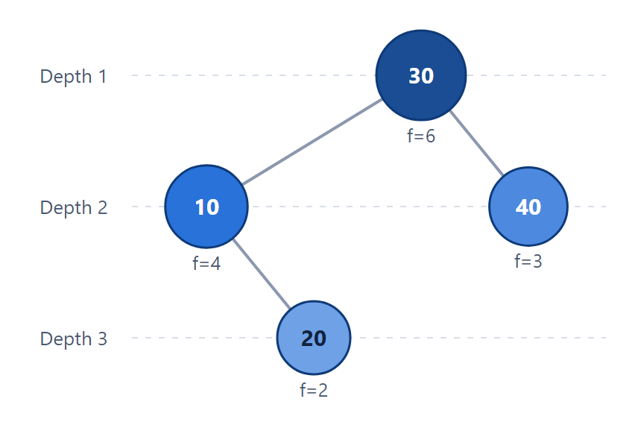
Optimal Binary Search Tree Using Dynamic Programming
An interactive web application that uses interval dynamic programming to build the BST with the minimum expected search cost.
PROJECT TEAM
2520030512 — NIKSHITHA
2520030335 — MANASVI NILESH GHAG
2520030046 — SAI PAVANI
OPTIMAL TREE · KEYS 10, 20, 30, 40
Notes:
Good morning. Our project is an Optimal Binary Search Tree designer built with interval dynamic programming. It is a web application: you enter keys and how often each is searched, and it builds the BST with the lowest expected search cost. The tree on the right is the real output of our app for the example we will use throughout.

Slide 2
EXECUTIVE OVERVIEW
Abstract
Given sorted keys and their search frequencies, our application uses interval dynamic programming to build the binary search tree with the minimum expected search cost, and shows every step of the computation in an interactive web interface.
DP TABLES
INTERVAL DP
TREE CONSTRUCTION
USER INTERFACE
W, C and R Tables
Shortest Ranges First
Recursive Build from R
Interactive React Web Client
W holds range weights, C the minimum costs and R the chosen root for every key range (i, j).
Tables are filled by diagonal j − i = 0, 1, …, n, so every smaller range is solved before it is needed.
R[0][n] gives the root; each subtree is rebuilt the same way from (i, k−1) and (k, j).
Enter keys, then explore the result, tree, DP table, search animation and cost breakdown.
END-TO-END PIPELINE ARCHITECTURE
01
02
03
04
05
06
Keys & Frequencies
Input Validation
Interval DP (W, C, R)
Root Table R
Build Optimal Tree
Visualize & Analyze
Up to 15 keys in the web form
Checked in browser and backend
Filled diagonal by diagonal
Best root k for every range
Recursive build from R[0][n]
Tree, DP table, search, cost
02
Notes:
In one sentence: we take sorted keys with search frequencies and build the BST with the minimum expected search cost using interval DP. The four columns are the building blocks: the W, C and R tables, the diagonal fill order, rebuilding the tree from R, and the React interface. The bottom row is the full pipeline, from the input form to the visualizations.

Slide 3
THE CHALLENGE
Problem Statement
An ordinary BST ignores how often each key is searched.
Frequent keys placed deep in the tree make the average search slow.
There are Catalan(n) possible trees (14 for 4 keys, 9,694,845 for 15), so trying them all is impractical.
The same key ranges repeat as subproblems under different roots.
DESIGN GOAL
Build the BST with the minimum expected search cost using interval dynamic programming, and make the algorithm easy to understand through visualization.
03
Notes:
A normal BST is shaped by insertion order or by balance, never by how often keys are searched, so a popular key can end up deep in the tree. Checking every possible shape is hopeless, because the number of shapes grows as the Catalan numbers. But the subproblems are key ranges that repeat, which is exactly what dynamic programming exploits.

Slide 4








SYSTEM CAPABILITIES
Proposed Functionalities
Eight capabilities connecting user input, the interval DP engine and interactive visualization.
Key & Frequency Input
Input Validation
Interval DP Engine
Course-Format DP Table
Table form that starts with one empty row; add up to 15 key–frequency pairs.
Flags empty, non-integer or duplicate keys and non-positive frequencies; the backend re-checks.
Spring Boot service computes W, C and R in O(n³), keeping the smallest k on ties.
Staircase w / c / r table by diagonal; click any cell to see its working.
Optimal Tree Visualization
Expected Cost Result
Search Simulation
Cost Breakdown & Hover Tooltips
SVG tree with depth guides; larger, darker nodes are searched more often.
Expected search cost to 4 decimals, with minimum cost and total frequency.
Animates the path from the root to a key and counts the comparisons.
Frequency × depth for every key, and details when hovering a node.
END-USER & ALGORITHMIC CAPABILITIES IMPLEMENTED IN THE OBST DESIGNER
04
Notes:
These are the eight things the app does. The input form and validation make sure the DP engine always gets clean, sorted data. The engine runs in our Spring Boot backend, and everything on the bottom row is how the frontend makes the result understandable: the tree, the expected cost, a search animation, and a cost breakdown with tooltips.

Slide 5
TECHNICAL FOUNDATION
Algorithms, Tools & Technologies
DATA STRUCTURES & ALGORITHMS
TOOLS & TECHNOLOGIES
Binary Search Tree
Java 17 · Spring Boot · Maven · JUnit 5 · React 19 · Vite · JavaScript · HTML / CSS · SVG · VS Code · Git / GitHub
Ordered keys; comparisons per search = depth of the key
Interval Dynamic Programming
Architecture
Subproblems are key ranges (i, j), solved shortest first
React Frontend → POST /api/obst/solve → Spring Boot API → DP Solver → Tree Builder → JSON → Visualization
W / C / R Tables (2D arrays)
Weights, minimum costs and chosen roots for every range
Recurrence
Recursion
C[i][j] = min i<k≤j { C[i][k−1] + C[k][j] } + W[i][j]
W[i][j] = W[i][j−1] + p[j] · R[i][j] = the k giving the minimum
Builds the tree from R: root R[i][j], subtrees (i, k−1) and (k, j)
Complexity
O(n³) time · O(n²) space
05
Notes:
The core idea is a BST plus interval DP stored in three 2D tables, and recursion to rebuild the tree. The backend is Java 17 with Spring Boot and Maven, tested with JUnit; the frontend is React with Vite and draws the tree in SVG. The recurrence at the bottom right is the one from our course: try every root k, add the two subtree costs, then add the weight of the range.

Slide 6
PROJECT TARGETS
Objectives
Eight targets that guided the implementation and evaluation of the OBST Designer.
TARGET | CORE OBJECTIVE | TECHNICAL IMPLEMENTATION & SCOPE | CATEGORY
OBJ-01 | Optimal BST algorithm Build the BST with minimum expected search cost. | Frequencies-only OBST (no q values or dummy nodes), solved exactly in the Java backend. | CORE
OBJ-02 | Interval DP fill order Solve shorter key ranges before longer ones. | Diagonal loop d = j − i = 1 … n; each C[i][j] uses only shorter ranges. | ALGORITHM
OBJ-03 | W, C and R tables Store weight, cost and root for every range. | Three (n+1) × (n+1) arrays; minimum over i < k ≤ j, smallest k kept on ties. | DP
OBJ-04 | Tree construction Rebuild the optimal tree from the root table. | Recursive build: root R[i][j], subtrees (i, k−1) and (k, j), in O(n). | DATA STRUCTURE
OBJ-05 | Expected search cost Report average comparisons per search. | C[0][n] / W[0][n] to 4 decimals, plus a frequency × depth breakdown per key. | ANALYSIS
OBJ-06 | Input validation Reject bad input with clear messages. | Whole-number distinct keys, positive frequencies, 1–15 keys; unsorted keys are sorted with a notice. | INPUT
OBJ-07 | Visualization & search simulation Make the tree and each search visible. | React + SVG tree, animated search path with comparison count, hover tooltips. | INTERFACE
OBJ-08 | Course-format DP table Match the W / C / R table taught in class. | Staircase layout by diagonal; clicking a cell shows its full working. | LEARNING
06
Notes:
These eight objectives are what we set out to build and test. The first four are the algorithm itself: the frequencies-only OBST, the diagonal fill order, the three tables and the tree construction. The last four cover the expected cost, input validation, the visual interface and the course-format DP table we use for learning.

Slide 7
EXECUTION ARCHITECTURE
System Flow
Step-by-step request lifecycle, with the search simulation as a side-flow.
1. Input: enter keys and frequencies
2. Validation: checked in the frontend and again in the backend
3. Sort: keys sorted if needed; each frequency stays with its key
4. Compute W: W[i][j] = W[i][j−1] + p[j]
5. Compute C and R: filled diagonal by diagonal, j − i = 1 … n
6. Build tree: recursively from the root table R
7. Expected cost: C[0][n] / W[0][n]
8. Display: result, tree, DP table and cost breakdown
SEARCH SIDE-FLOW
Enter key
↓
Start at root
↓
Compare, go left / right
↓
Highlight path
↓
Show comparisons
07
Notes:
This is what happens after pressing Generate. The input is validated twice, sorted if needed, then the backend fills W, then C and R diagonal by diagonal, rebuilds the tree from R and computes the expected cost. On the right is the search simulation: it starts at the root, goes left or right at each comparison, and highlights the path while counting comparisons.

Slide 8
WORKED EXAMPLE
Keys 10, 20, 30, 40 with Frequencies 4, 2, 6, 3
Values from our backend solver, identical to the hand calculation in our documentation.
26
15
30
f = 6 · 6 × 1 = 6
Depth 1
Minimum cost
Total frequency
C[0][4]
W[0][4]
10
40
1.7333
30
Depth 2
f = 4 · 4 × 2 = 8
f = 3 · 3 × 2 = 6
Expected search cost
Root of the tree
26 / 15
R[0][4] = 3 → key 30
20
Depth 3
COMPARISON
f = 2 · 2 × 3 = 6
Balanced BST (root 20): 2×1 + 4×2 + 6×2 + 3×3 = 31, about 19% more than the optimal 26.
Cost check: 6×1 + 4×2 + 3×2 + 2×3 = 26
08
Notes:
Here is our running example. The DP gives a minimum cost of 26 for a total frequency of 15, so on average a search takes 26 / 15 = 1.7333 comparisons. The root is key 30, the most searched key; 10 and 40 sit on level 2 and the rarely searched 20 on level 3. A balanced tree rooted at 20 would cost 31, about 19 percent more, because it ignores the frequencies.

Slide 9
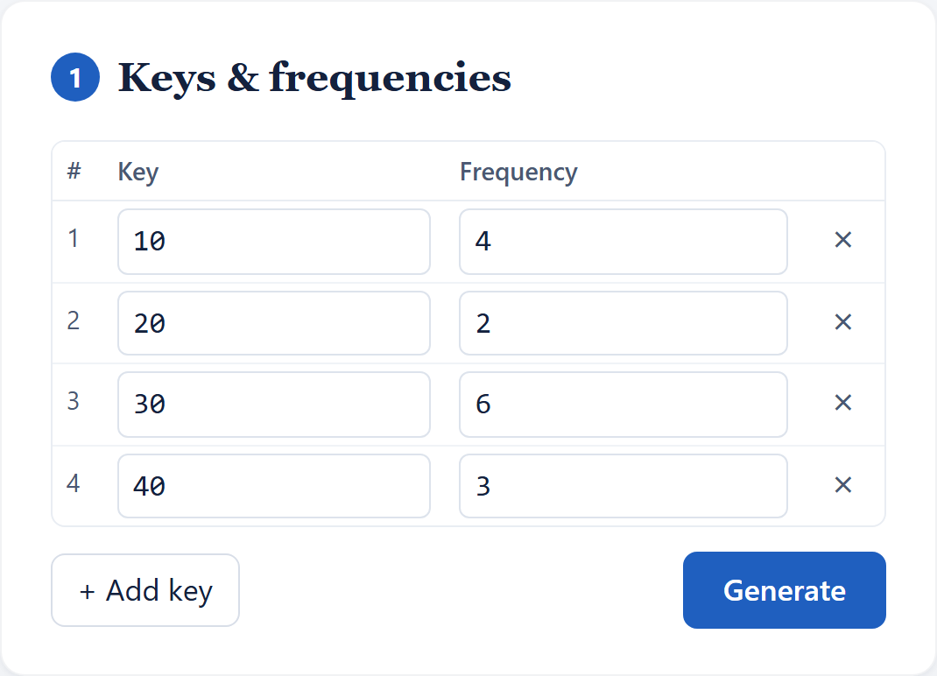
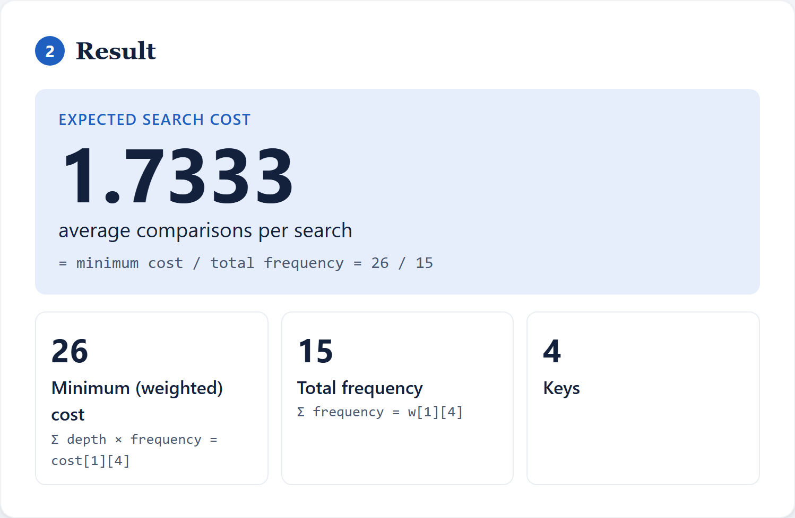
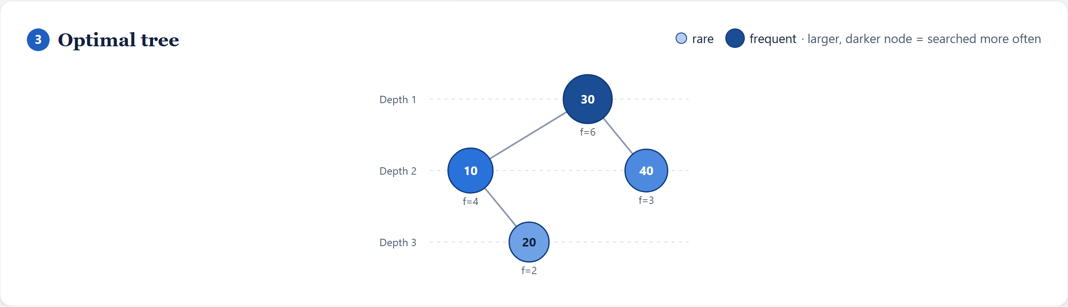
RESULTS
Input, Result and Optimal Tree
Figure 1 · Input form with keys and frequencies
Figure 2 · Result card showing expected search cost
Figure 3 · Optimal tree visualization
09
Notes:
These are screenshots of our running app for the example input. On the left is the input form with the four keys and frequencies; next to it the Result card shows the expected search cost 1.7333, which is 26 / 15. Below is the optimal tree, where node size and colour show how often each key is searched.

Slide 10
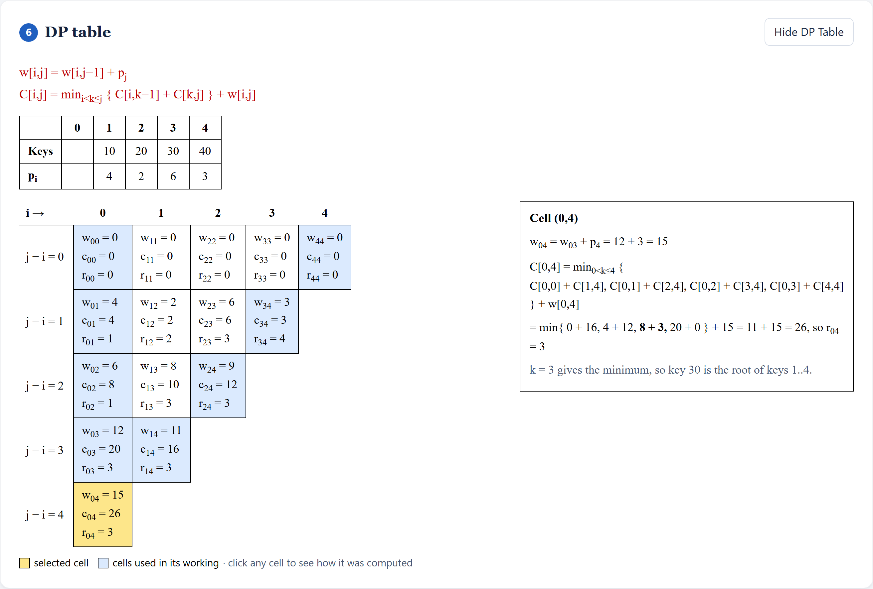
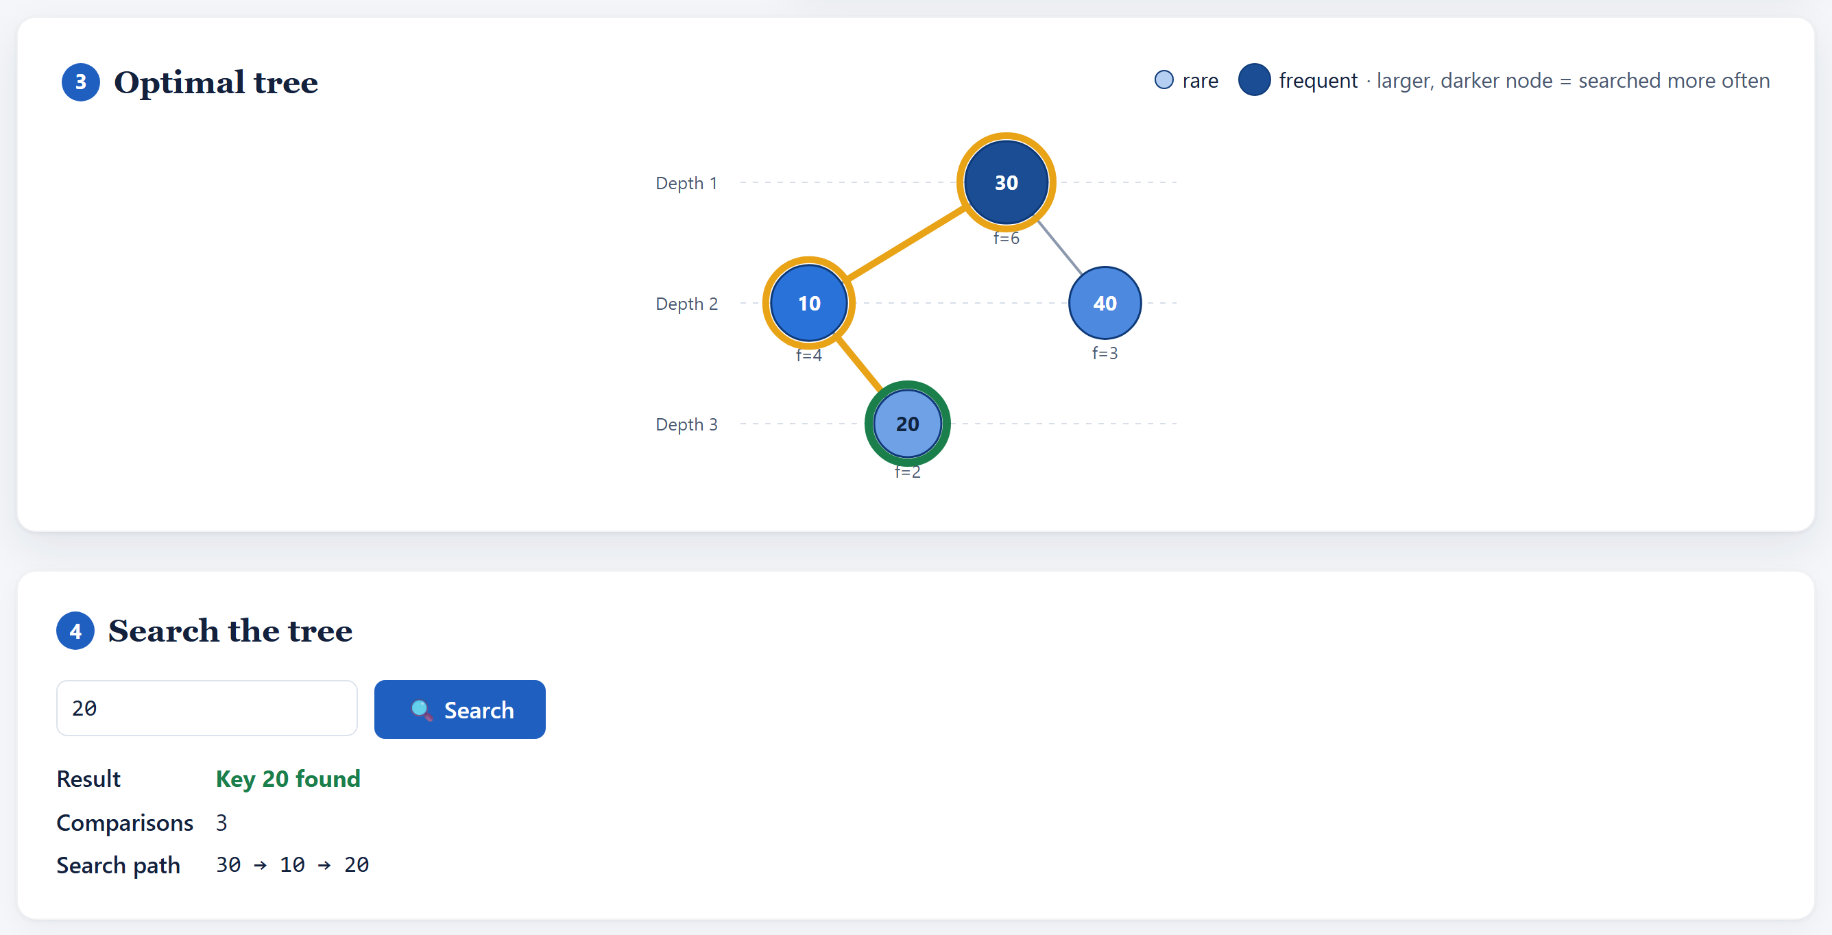
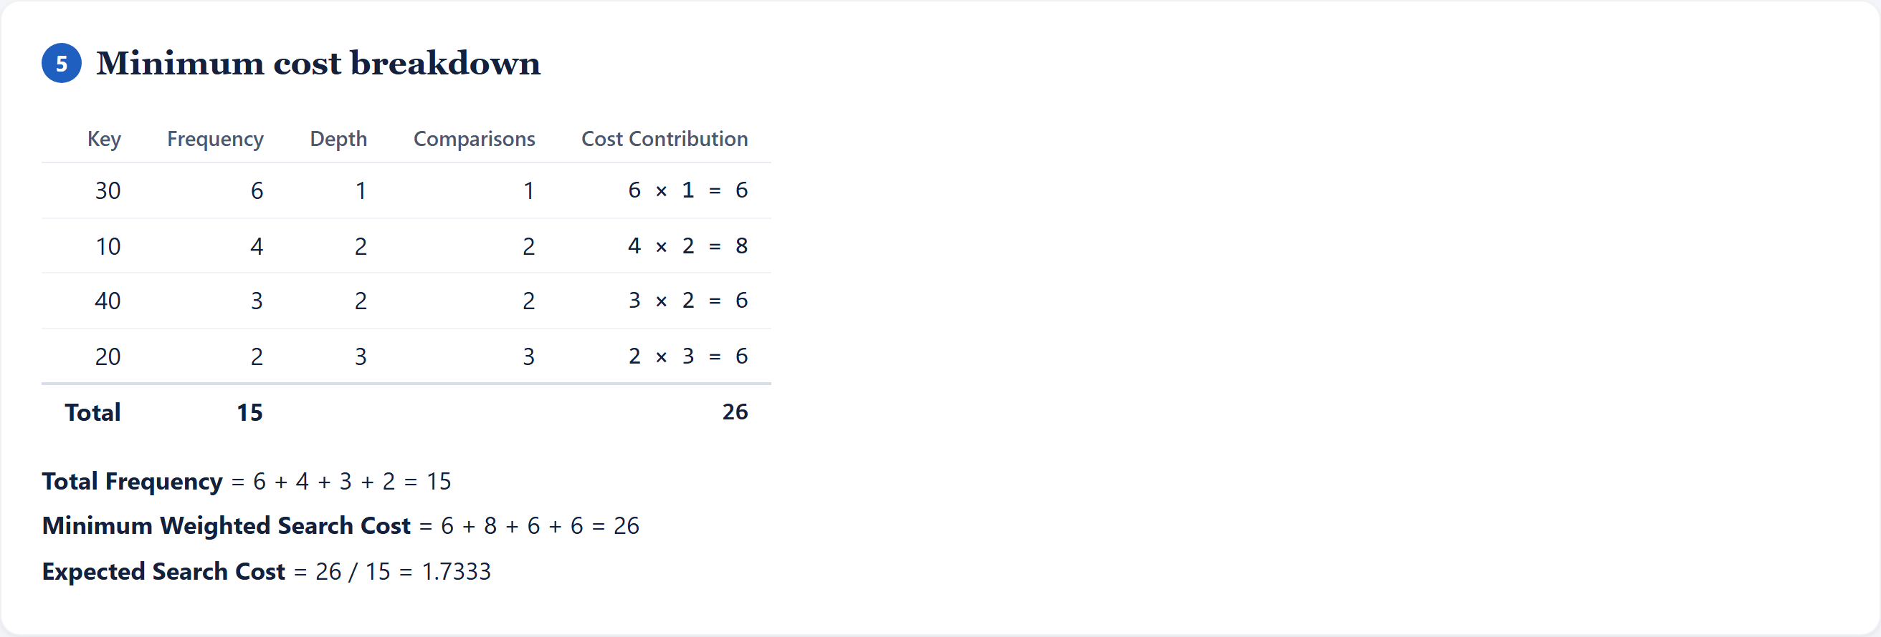
RESULTS
DP Table, Search and Cost Breakdown
Figure 5 · Search simulation for key 20
Figure 4 · DP table in course format, cell (0,4) selected
Figure 6 · Minimum cost breakdown table
10
Notes:
The DP table is shown in the same staircase format as our course, and clicking cell (0,4) shows its full working: k = 3 gives the minimum, so the cost is 11 + 15 = 26. The search simulation for key 20 follows 30, 10, 20 and needs 3 comparisons. The cost breakdown adds frequency times depth for every key and confirms the total of 26.

Slide 11
Conclusion
Future Scope
Interval dynamic programming finds the optimal BST by solving every key range once, shortest first: W, C and R are filled diagonal by diagonal in O(n³), and the tree is rebuilt from R. For our example the cost is 26 against 31 for a balanced tree. Our app makes each step visible through the DP table, tree, search simulation and cost breakdown.
Support unsuccessful search frequencies (q values and dummy nodes).
Apply Knuth's optimization to reduce the time to O(n²).
Add a step-by-step animation of the DP table filling.
Compare with AVL and other balanced trees.
Export results as PDF.
11
Notes:
To conclude: interval DP solves every key range once, from shortest to longest, which gives the provably optimal tree in cubic time, and our app shows each of those steps. For the future we would add unsuccessful searches with q values, Knuth's optimization to bring the time down to O(n squared), an animation of the table filling, comparison with AVL trees and PDF export.

Slide 12
THANK YOU
Notes:
Thank you for listening. We are happy to take questions, and we can show the live application if there is time.

