Slide 1
AI-Driven Predictive Customer Satisfaction and Personalized Experience Recommendations
British Airways Case Study
Student: Gurroop Singh
GitHub: github.com/gurroopsingh/british-airways-ai-csat-system
Notes:
Welcome to the presentation on the AI-Driven Customer Satisfaction project for British Airways.

Slide 2
2. Problem Statement
British Airways processes thousands of reviews daily.
Manual analysis is time-consuming, inefficient, and prone to error.
Crucial pain points (delays, baggage, food) are often missed or addressed too late.
Lack of real-time insights leads to a negative customer experience and potential brand damage.
Need for an automated, AI-driven platform to categorize feedback and propose immediate recovery recommendations.
Notes:
The core problem is the volume of unstructured text data that is currently impossible to analyze manually in real-time.

Slide 3
3. Objectives
Automate Sentiment Analysis to determine review polarity.
Develop a Machine Learning model to predict Customer Satisfaction (CSAT) scores continuously.
Implement Topic Modeling to extract dominant themes from feedback.
Create an AI-driven Recommendation Engine to suggest service recovery actions.
Build a centralized, interactive dashboard for live analysis by customer service teams.
Notes:
Our objectives span from basic NLP to advanced generative AI to provide a holistic solution.

Slide 4
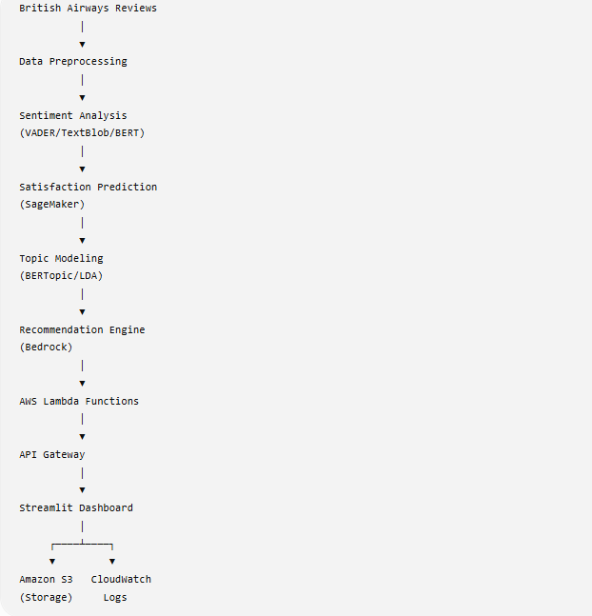
4. System Architecture
Notes:
This architecture diagram illustrates the end-to-end event-driven workflow using AWS serverless technologies.

Slide 5
5. AWS Services Configured
Amazon S3: Data lake for raw/processed datasets and model artifacts.
AWS Lambda: Serverless compute for sentiment, prediction, and recommendations.
Amazon API Gateway: Exposes Lambda functions as REST APIs.
Amazon SageMaker: Experimental notebook environments for model training.
Amazon Bedrock: Explored for generative AI recovery recommendations.
Amazon CloudWatch: Monitoring and logging for Lambda functions.
Streamlit: Frontend interactive dashboard.
Notes:
We utilized a strict serverless approach to ensure cost-efficiency and horizontal scalability.

Slide 6
6. Data Processing and AI Components
Data Preprocessing: Tokenization, lemmatization, and TF-IDF vectorization.
Sentiment Analysis: VADER algorithm deployed for rapid zero-shot polarity classification.
CSAT Prediction: Random Forest & XGBoost models predicting continuous satisfaction ratings.
Topic Modeling: BERTopic evaluated locally to cluster actionable insights.
Generative Recommendations: Prompt engineering tailored for Claude foundation models.
Notes:
The AI pipeline is a multi-stage process starting from raw text and ending in actionable generative insights.

Slide 7
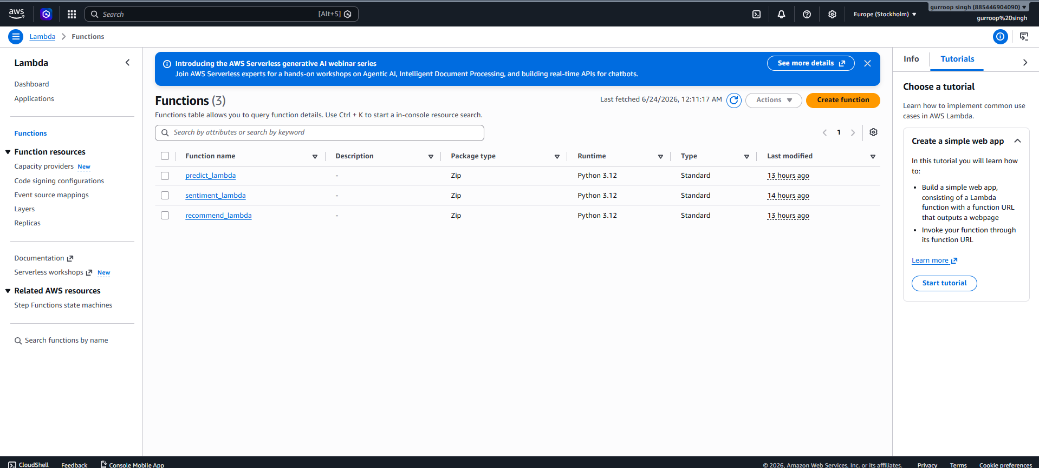
7. Serverless Deployment
Deployed three distinct AWS Lambda functions.
Integrated securely via Amazon API Gateway.
Observability achieved through Amazon CloudWatch logs.
Notes:
The backend is fully serverless. Here we see the deployed Lambda functions that process incoming text in real-time.

Slide 8
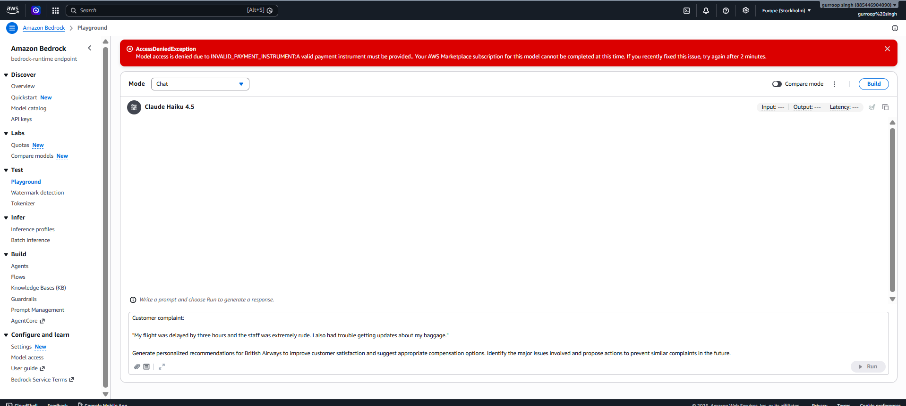
8. SageMaker and Bedrock Integration
SageMaker utilized for notebook-based evaluation of Random Forest models.
Bedrock configured to explore prompt engineering with Anthropic Claude.
Designed to return highly professional recovery actions.
Notes:
We explored SageMaker for robust model training and Bedrock for providing the generative AI capabilities.

Slide 9
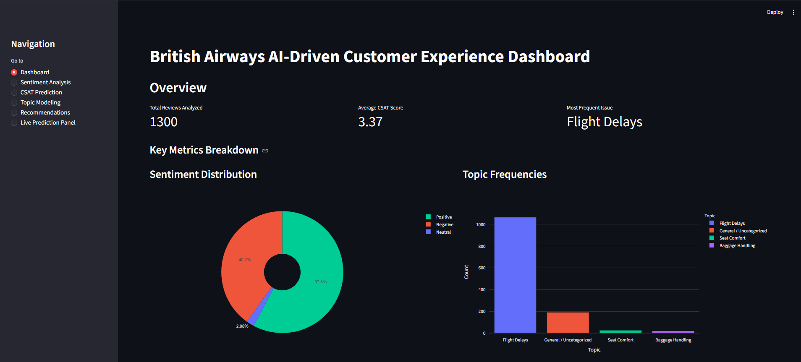
9. Streamlit Dashboard and Results
Unified interface for business users.
Live Prediction Panel for instant review analysis.
Visualizes sentiment, topics, and CSAT scores.
Notes:
The dashboard brings the AWS backend to life, providing customer service agents with a simple, powerful tool.

Slide 10
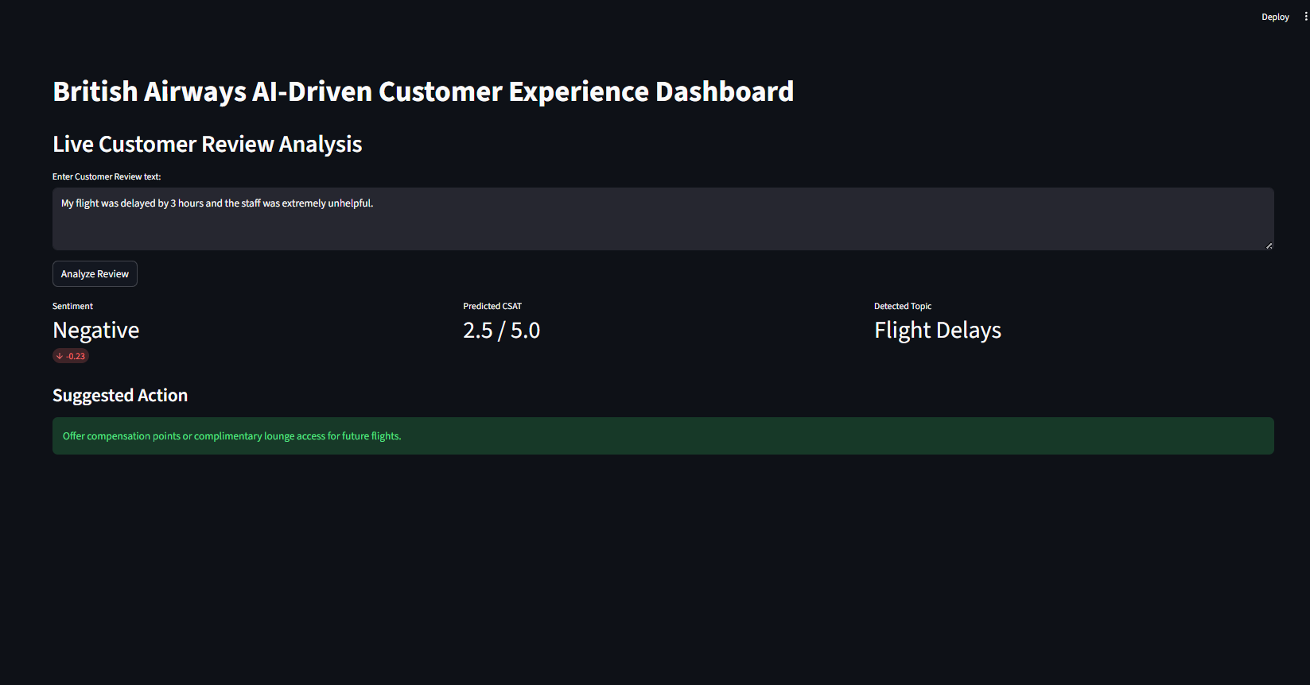
9a. Live Prediction Analysis
Notes:
This screenshot shows the system in action, predicting sentiment, CSAT, and providing a Gen AI recommendation.

Slide 11
10. Challenges and Solutions
Challenge: AWS Lambda deployment package size limits with large ML models.
Solution: Serialized models (joblib) to S3, loaded dynamically at runtime.
Challenge: CORS configuration in API Gateway.
Solution: Explicitly defined Access-Control-Allow-Origin headers in Lambda proxies.
Challenge: Ensuring professional Gen AI outputs.
Solution: Extensive prompt engineering explicitly defining the persona as a BA agent.
Notes:
We encountered several architectural challenges, specifically around serverless constraints, which were solved using S3.

Slide 12
11. Business Impact & Future Enhancements
Business Impact:
- Massively reduces manual triaging time.
- Increases customer loyalty through faster, more tailored responses.
Future Enhancements:
- Fine-tune custom LLMs on historical BA resolution data.
- Implement Infrastructure as Code (IaC) using Terraform.
- Direct integration into ticketing CRMs.
Notes:
The solution provides immediate ROI by reducing manual labor and paving the way for full CRM integration.

Slide 13
12. Conclusion
Successfully provisioned AWS serverless infrastructure.
Integrated NLP and Machine Learning for predictive analytics.
Configured Generative AI for actionable business value.
Delivered a polished, interactive frontend.
GitHub Repository:
github.com/gurroopsingh/british-airways-ai-csat-system
Notes:
In conclusion, the project successfully meets all academic and technical requirements. Thank you.

