Slide 1
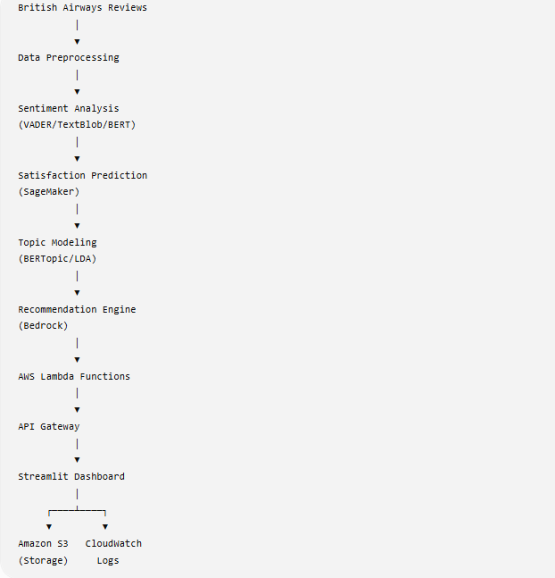
AI-Driven Predictive Customer Satisfaction
Personalized Experience Recommendations for British Airways
Gurroop Singh
Course Project — Build AI with AWS
github.com/gurroopsingh/british-airways-ai-csat-system
Notes:
Welcome. This presentation covers the AI-Driven Customer Satisfaction project for British Airways built on AWS.

Slide 2
Problem Statement
Why does British Airways need AI-driven feedback analysis?
⏱
📉
🎯
💬
Volume Overload
Delayed Response
No Insight Extraction
Generic Responses
Thousands of reviews daily impossible to process manually.
Critical issues like delays and baggage go unresolved for too long.
Pain points in food, service, and seating are buried in free text.
No personalized recovery actions tailored to specific complaints.
Result: Poor customer loyalty, operational inefficiency, and brand damage.
Notes:
BA faces massive volume of unstructured feedback. Manual triage misses critical issues.

Slide 3
Project Objectives
📊
⭐
🏷
🤖
📈
Sentiment Analysis
CSAT Prediction
Topic Modeling
Recommendation Engine
Interactive Dashboard
Classify review polarity automatically
Predict satisfaction scores (1–5)
Extract recurring themes from text
Generate AI-driven recovery actions
Streamlit interface for live analysis
Notes:
Five core objectives spanning NLP, ML, GenAI, and interactive visualization.

Slide 4
End-to-End System Architecture
Event-driven serverless workflow on AWS
Notes:
The architecture diagram shows the full pipeline: S3 storage, Lambda compute, API Gateway routing, SageMaker training, Bedrock GenAI, and Streamlit frontend.

Slide 5
AWS Services Configured
🪣
⚡
🌐
🧪
Amazon S3
AWS Lambda
API Gateway
SageMaker
Data lake for datasets and model artifacts
Serverless compute for API logic
REST API routing to Lambda functions
Notebook-based model training & evaluation
🧠
📋
📊
Bedrock
CloudWatch
Streamlit
GenAI explored for recommendation generation
Monitoring and logging
Interactive frontend dashboard
Notes:
We used seven AWS services. SageMaker for notebook experimentation, Bedrock explored for GenAI.

Slide 6
AI Processing Pipeline
Multi-stage NLP and ML workflow
Raw Reviews
Preprocessing & TF-IDF
Sentiment (VADER)
CSAT Predict (RF/XGB)
Topic Model (BERTopic)
GenAI Recommend
Each stage is encapsulated in a dedicated Lambda function for independent scaling.
Notes:
The pipeline flows from raw text through preprocessing, sentiment analysis, CSAT prediction, topic extraction, and finally GenAI recommendations.

Slide 7
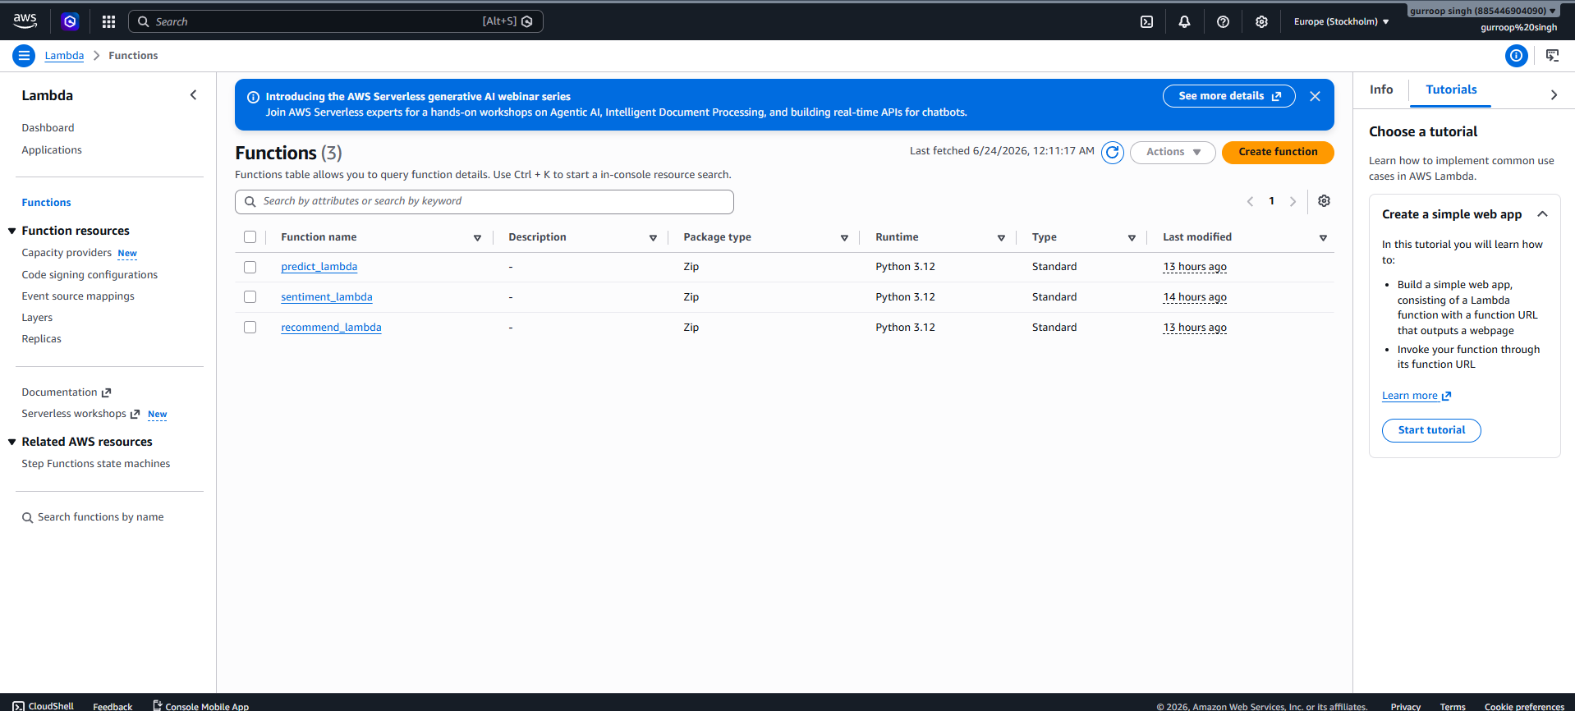
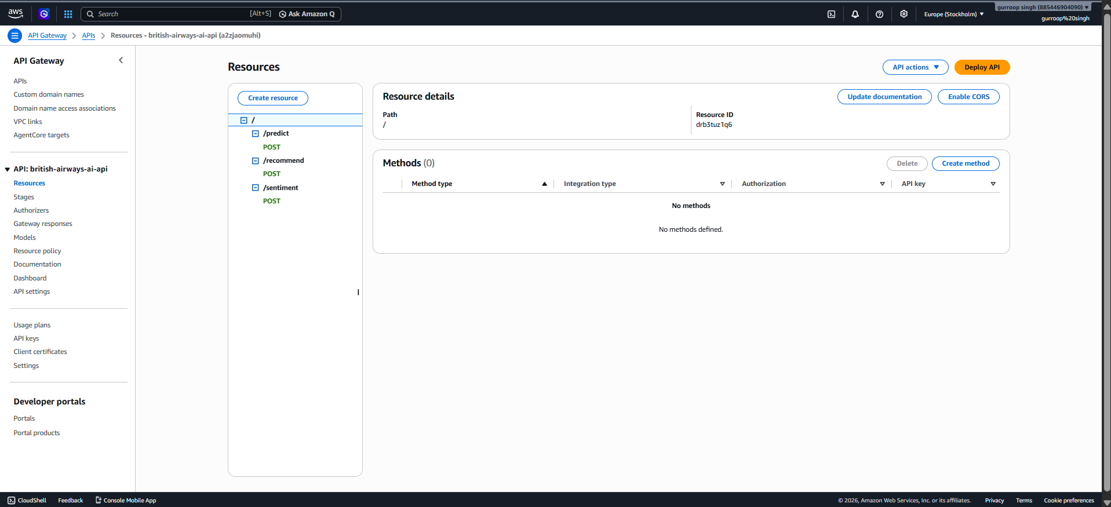
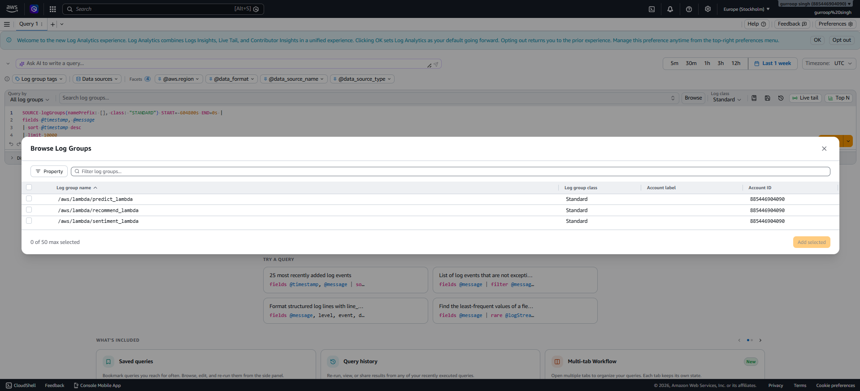
Serverless Deployment
AWS Lambda + API Gateway + CloudWatch
Notes:
Three Lambda functions deployed, API Gateway configured for REST routing, CloudWatch capturing execution logs.

Slide 8
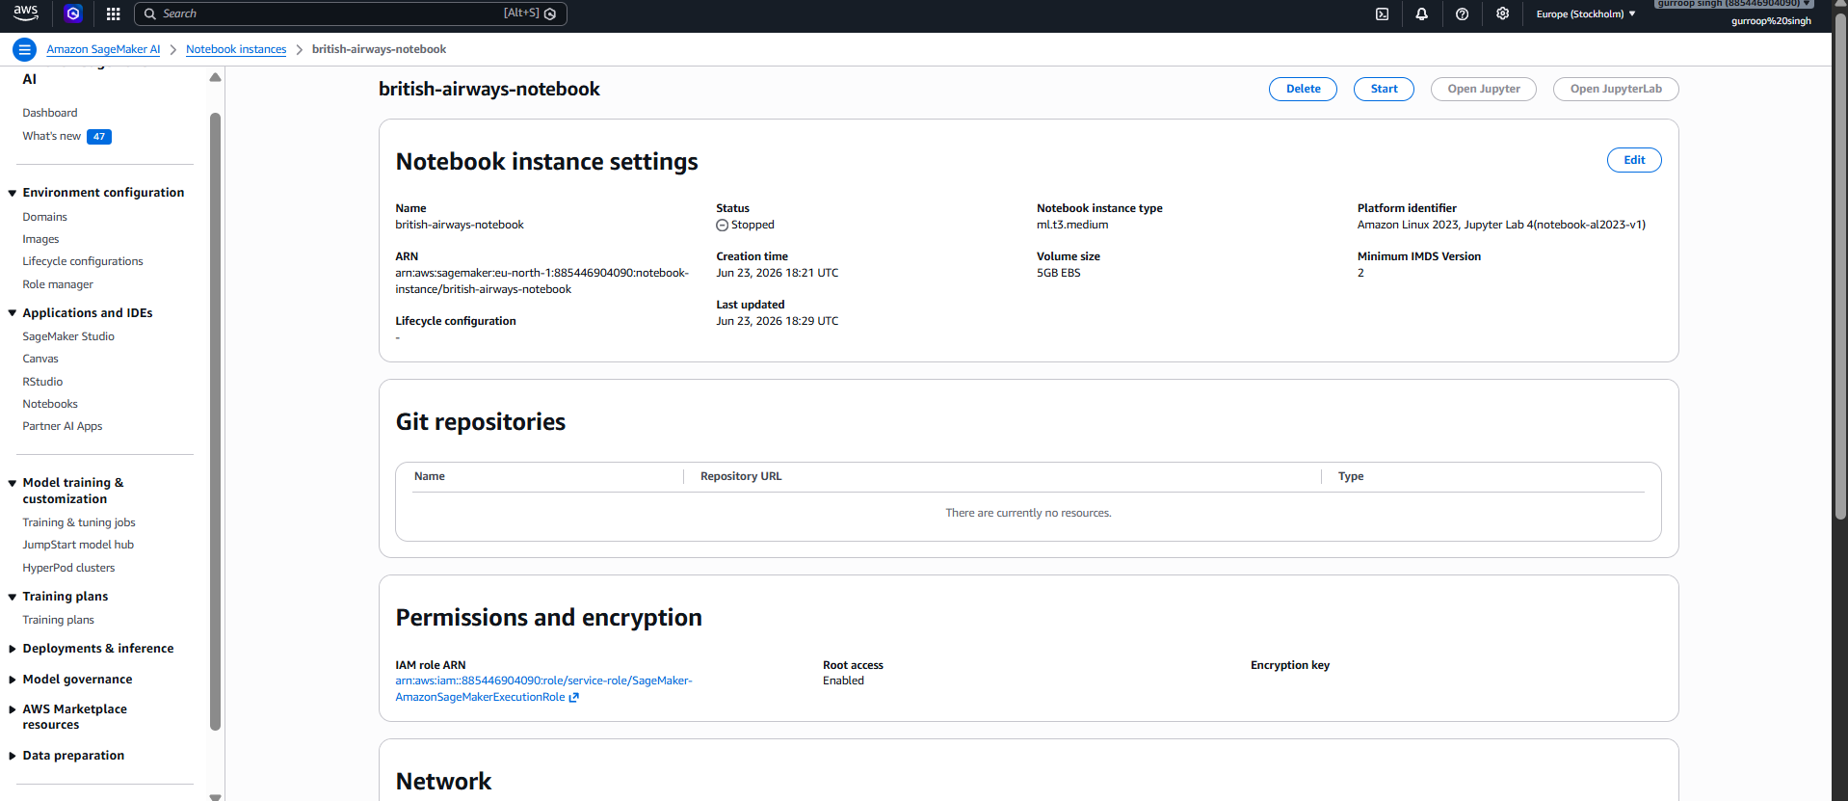
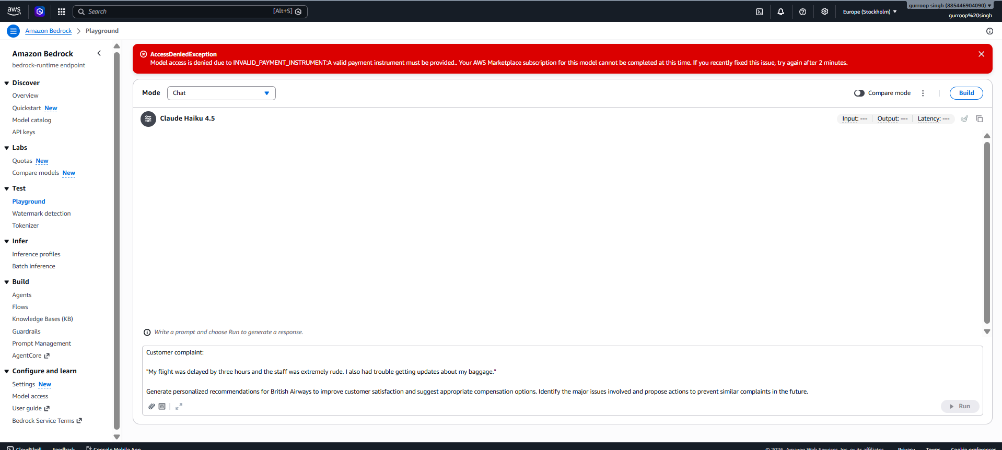
SageMaker & Bedrock
Model experimentation and Generative AI exploration
Amazon SageMaker — Notebook Environment
Amazon Bedrock — Foundation Model Access
Notes:
SageMaker used for notebook-based model training. Bedrock configured to explore Anthropic Claude for recommendation generation.

Slide 9
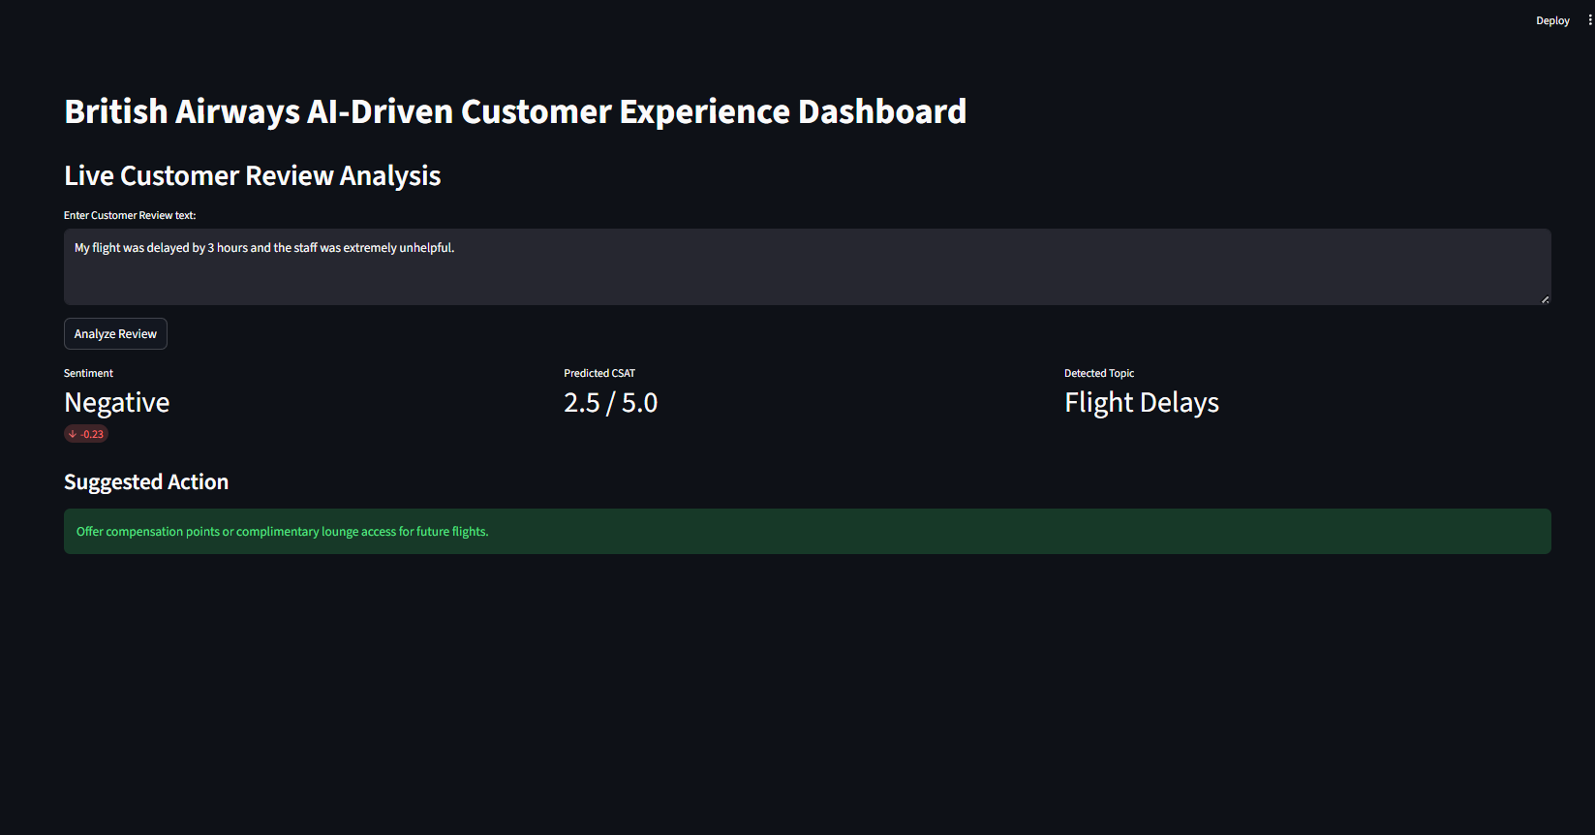
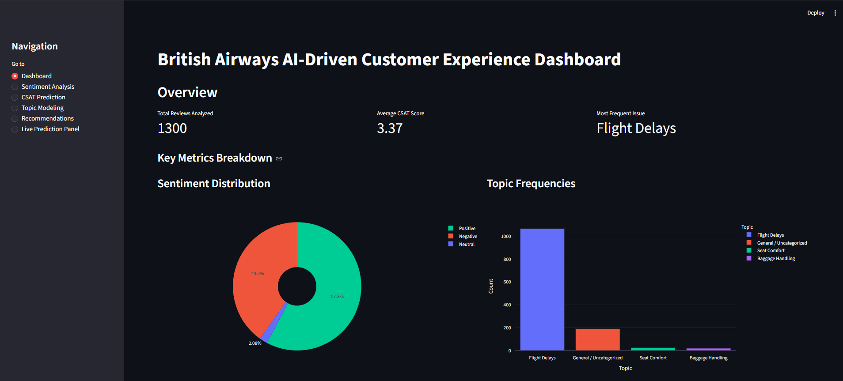
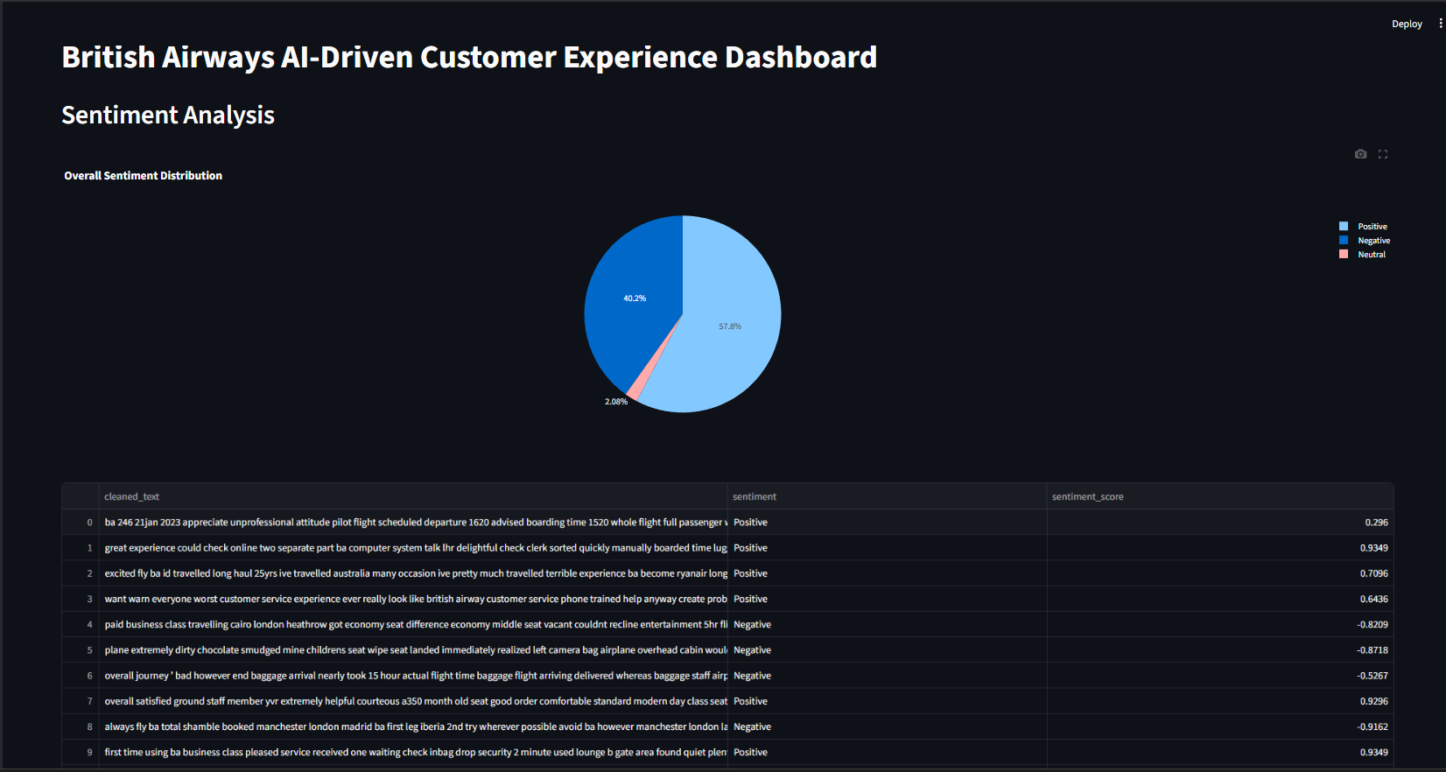
Interactive Streamlit Dashboard
Live analytics and prediction interface
Notes:
The Streamlit dashboard unifies all capabilities. Agents can submit reviews for instant sentiment, CSAT, and topic analysis.

Slide 10
Challenges & Solutions
⚠ CHALLENGE
✅ SOLUTION
Lambda package size limits with large ML models
Serialized models to S3; loaded dynamically at runtime
⚠ CHALLENGE
✅ SOLUTION
CORS configuration blocking frontend requests
Explicit Access-Control-Allow-Origin headers in Lambda proxy
⚠ CHALLENGE
✅ SOLUTION
Ensuring professional GenAI output quality
Extensive prompt engineering with BA-expert persona context
Notes:
Key challenges around Lambda sizing, CORS, and GenAI output quality were systematically resolved.

Slide 11
Business Impact & Future Enhancements
Future Roadmap
⏱
❤
📈
→ Fine-tune custom LLMs on BA resolution data
→ Implement IaC with Terraform / CloudFormation
→ Direct CRM integration for automated ticket tagging
→ Real-time streaming with Amazon Kinesis
Faster Triage
Customer Loyalty
Scalability
Automated analysis reduces manual effort
Timely, personalized recovery actions
Serverless architecture scales on demand
Notes:
The project delivers immediate ROI through automation and sets a strong foundation for future enhancements.

Slide 12
Thank You
✓ AWS serverless infrastructure provisioned
✓ NLP and ML models integrated for predictive analytics
✓ Generative AI explored via Amazon Bedrock
✓ Interactive Streamlit dashboard delivered
github.com/gurroopsingh/british-airways-ai-csat-system
Gurroop Singh • Build AI with AWS • 2026
Notes:
Thank the audience. Summarize key achievements and invite questions. Direct to GitHub for source code.

