Slide 1

Data Lake Value Proposition
Medical Data Processing Company
Gursevak Dhillon
Udacity IPS Version 1.0

Slide 2
Agenda
What is a Data Lake
Components of a Data Lake
Data Lake vs Data Warehouse
Business Value of Data Lake Solution
Proposed Data Lake Architecture for Medical Data Processing system
Udacity IPS Ver. 1 2/2020

Slide 3
What is a Data Lake
Executive summary
Datalake is a centralized object storage. It can store vast amount of structured, semi structured and unstructed data in its raw and well as highly compressed columnar format, thus offering a cost effective and highly scalable alternative to the data warhouses. It uses ‘schema on read’ option to define schema when reading the data, this provider higher flexibilty.

Slide 4
Components of Data Lake
Ingestion layer
Storage layer
Metadata layer
Processing Layer
Serving layer

Slide 5
Data Lake vs Data Warehouse

Slide 6
Data Warehouse
Data Lake
Stores data in strucured table format
Schema on write
No lineage tracking
Not best for historical records
...
Supports Structured, unstructed, and semi structured dat
Schema on read
Data lineage tracking
Can store big data with less cost
...
Udacity IPS Ver. 1 2/2020

Slide 7
Business Value of Data Lake
Easy to store and access all the historical data
Infinite Scale without any bottlenecks
One place shop for all the use cases
On arrival processing of files vs nightly batches
Standard ETL jobs for different types
...

Slide 8
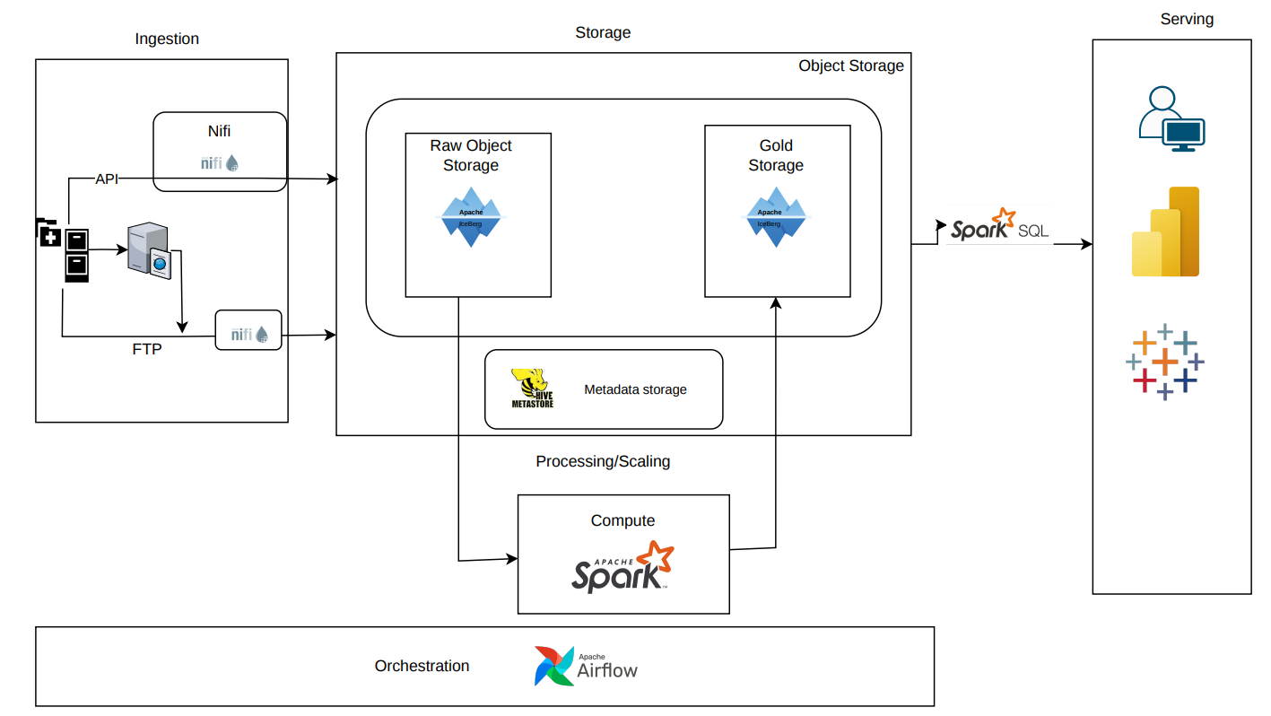
Data Lake Architecture
EMR Data Lake Architecture

Slide 9
THANK YOU
Udacity IPS Version 1.0

