Slide 1

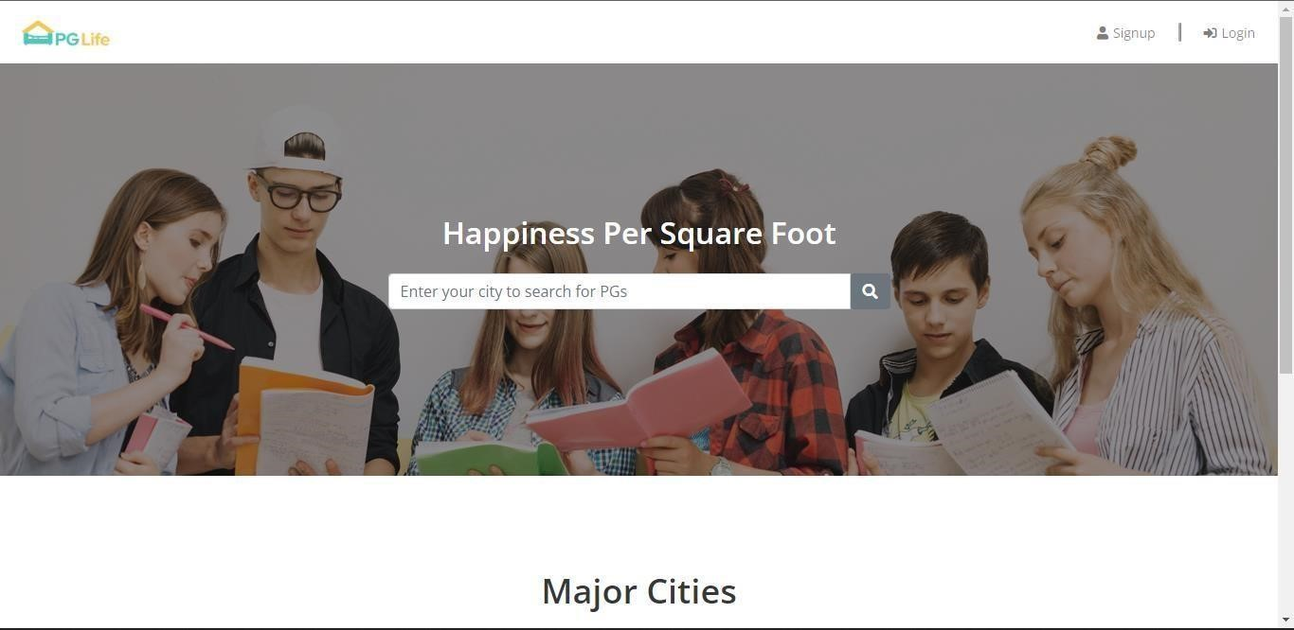
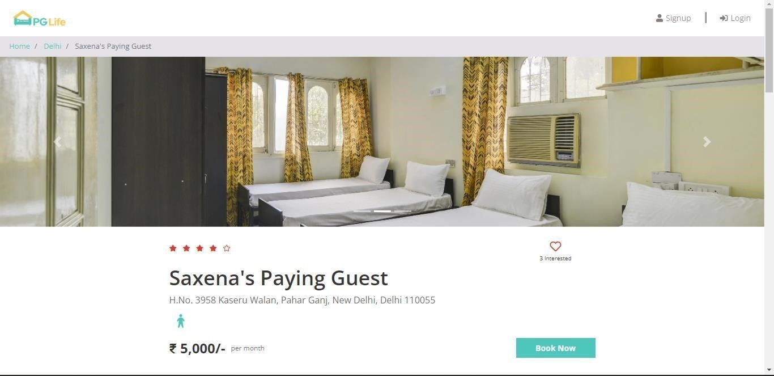
Industrial
Training Project
Presented by – Gursewak Singh
20BCS3288

Slide 2
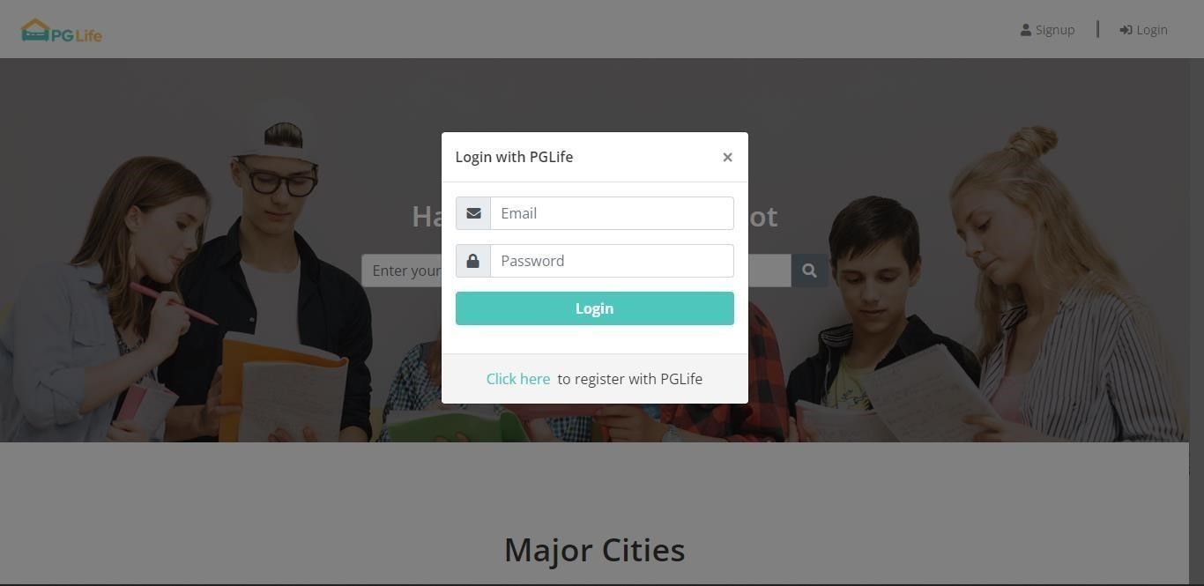
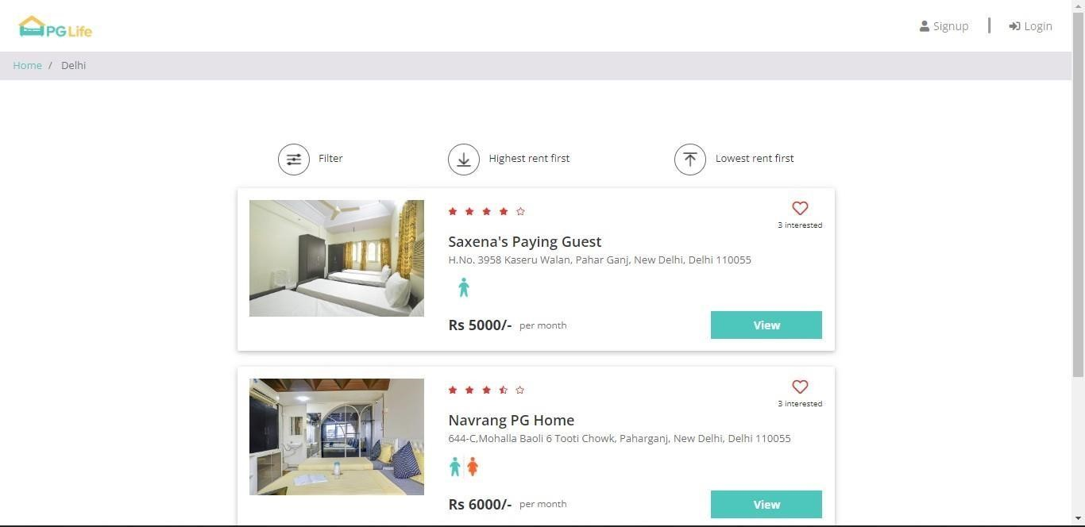
Introduction
Construct the web application with web development tools (HTML, CSS, Js, React, Bootstrap, DBMS, PHP), utilising all the ideas covered in the course and concepts taught in the training, and create the database for the application with PhpMyAdmin.

Slide 3
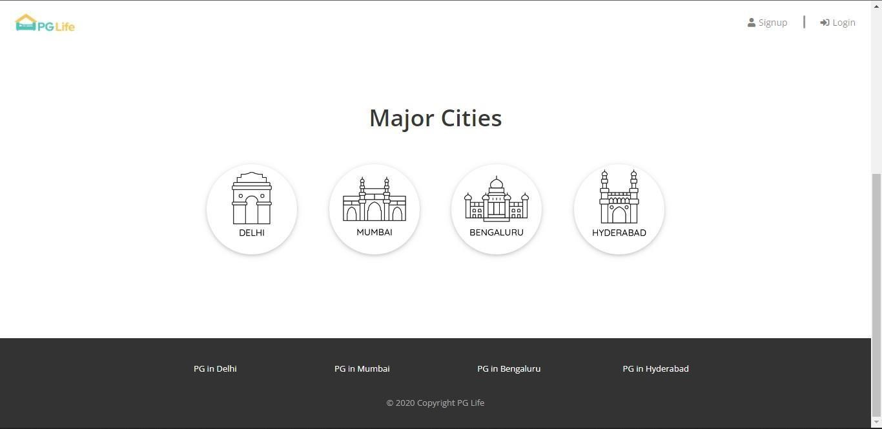
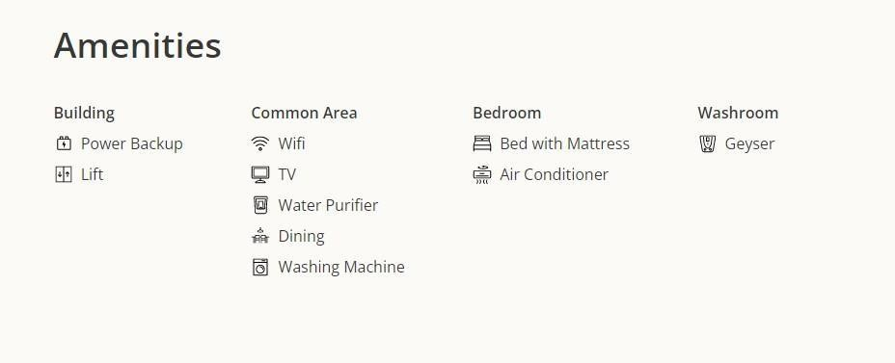
The website is called PGLife. this project keeping in mind how challenging it is for the students to search for good accommodation when they join college/university. I guess we all might also have faced the challenge of finding good accommodation when you joined college.
This web application helps the students to get PGs in their desired cities with wonderful amenities and this web application have fully functional features which meets the requirements of today’s generation.

Slide 4
Index Page

Slide 5
Cities

Slide 6
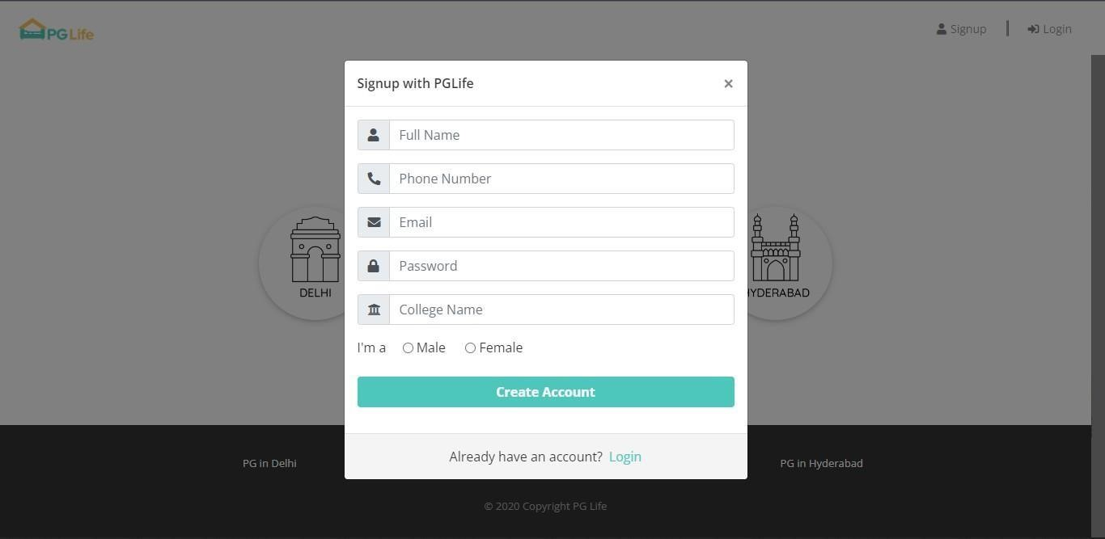
Sign-up Form

Slide 7
Log-in

Slide 8
Listed Property

Slide 9
Properties

Slide 10
Amenities

Slide 11



Thank You
BEST FOR You
ORGANICS COMPANY
Gursewak Singh
+91 6239684307
gursewak8642@gmail.com

