Slide 1
Online Travel Agency Analysis
Key Insights and Recommendations
Presented by : Gursharan Kaur
Date : 11 Sept. 2024

Slide 2
Introduction
Context:
This analysis was conducted on a dataset from an online travel agency, which contains information on bookings, pricing, refunds, and customer behavior over a six-month period.
Objective:
The primary goal of the analysis is to identify key patterns in sales trends, understand the causes behind refund rates, and optimize pricing strategies to enhance overall profitability and customer satisfaction.
Key Questions:
What are the major sales trends and how do they vary over time?
Which booking channels or customer behaviors lead to higher refund rates?
How does markup affect sales across different channels, and how can it be optimized?
Approach:
The analysis includes exploratory data analysis (EDA), visualizations of key metrics (sales, refunds, and markups), and recommendations based on insights gained from the data.

Slide 3
Dataset Overview
Total entries: 32,240
Key columns:
Buyer & Supplier details
Airports, Journey type
Pricing (Cost, Markup, Selling Price)
Booking & Travel Dates
Refund Status, Channel of Booking, Payment Method

Slide 4
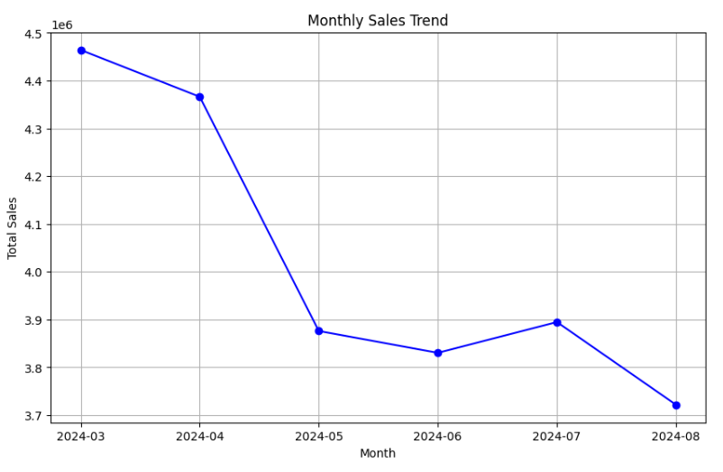
Monthly Sales Trends (Sales Fluctuation)
Analysis Overview: The sales data shows distinct seasonal trends, with significant peaks during certain months, indicating higher demand during holidays or vacation periods.
Insight: Sales are much higher during peak travel months (e.g., summer, holidays), and lower in off-peak times.
Importance: Understanding this trend allows us to optimize pricing and marketing strategies around high-demand periods, ensuring the business maximizes revenue during these months.
Recommendation: Implement dynamic pricing and targeted promotions to capitalize on high-demand periods (holidays, vacation seasons) and incentivize off-peak bookings.
Tactic 1: Offer early bird discounts or special offers in off-peak periods to fill capacity.
Tactic 2: Use predictive analytics to forecast peak travel times and adjust pricing models to optimize revenue during high-demand periods.
Tactic 3: Run targeted marketing campaigns for customers who frequently travel during peak periods, offering limited-time promotions to lock in bookings early.

Slide 5
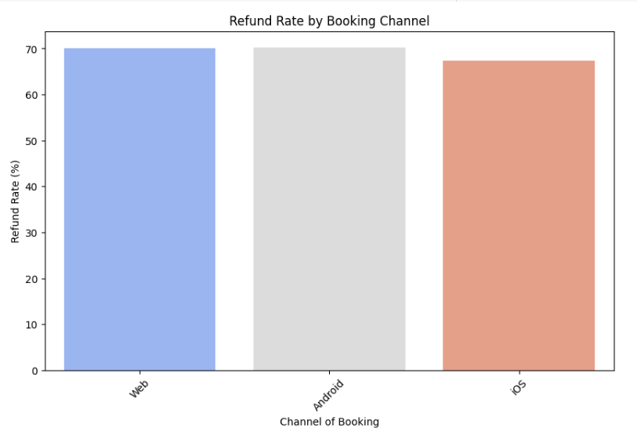
Refund Patterns (Channel-Specific Refund Rates)
Analysis Overview: The analysis of refund rates reveals that some booking channels (such as Web vs. Mobile) have a significantly higher refund rate.
Insight: Channels like web-based bookings have higher refunds compared to mobile-based bookings, potentially due to different user experiences or supplier issues.
Importance: Refunds represent lost revenue and impact profitability. Identifying the root cause of these refunds can help the company minimize losses and improve customer satisfaction.
Recommendation: Improve refund rates by enhancing customer support, optimizing refund policies, and increasing transparency in the booking process, particularly on high-refund channels (e.g., web bookings).
Tactic 1: Implement real-time customer support (via live chat or automated bots) on high-refund channels.
Tactic 2: Introduce flexible, tiered refund policies.
Tactic 3: Improve transparency of refund and cancellation policies during the booking process.
Tactic 4: Use data analytics to identify the most frequent reasons for refunds by channel and address them directly.

Slide 6
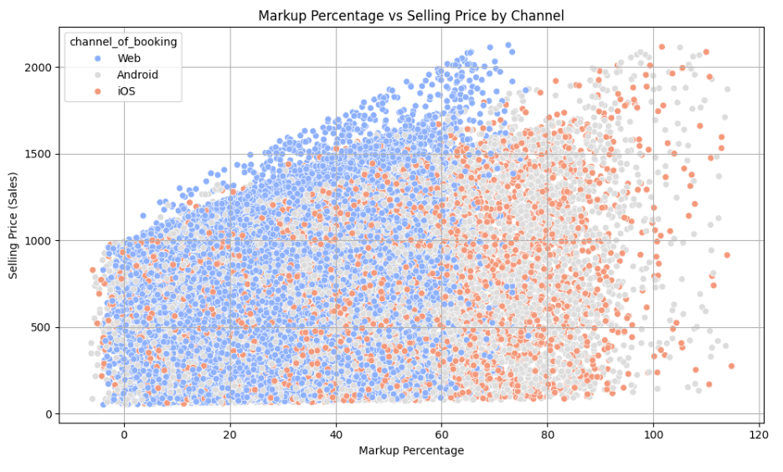
Pricing and Markup Strategies
Analysis Overview: The relationship between markup and sales shows that higher markups on certain channels lead to lower sales, indicating a price sensitivity among customers.
Insight: Channels with higher markups (e.g., certain regions or customer types) tend to have reduced sales, suggesting customers are sensitive to price changes.
Importance: Optimizing the markup strategy is crucial to maintaining competitiveness, especially in highly sensitive markets or with cost-conscious customers.
Recommendation: Optimize markup strategies by analyzing customer preferences and purchasing behaviors in each channel (Web, Android, etc.).
Tactic 1: Use A/B testing to experiment with different markup rates across channels, tracking the effect on booking conversions and profitability.
Tactic 2: Personalize pricing by using historical data on customer preferences to offer personalized offers (e.g., loyalty discounts for frequent users of specific channels).
Tactic 3: Implement a dynamic pricing model where markup fluctuates based on demand (e.g., higher markups during high demand periods but lower in low-demand periods).

Slide 7
Thankyou

