Slide 1
Architecture of microcontroller

Slide 2
Embedded system
Purpose specific computer
In contrast to a general purpose computer.
Used for automation
Router that transmits packets automatically.
A robot that can take judgment according to input form a sensor.
Microcontroller is used in embedded system
Cheap
Consume less power

Slide 3
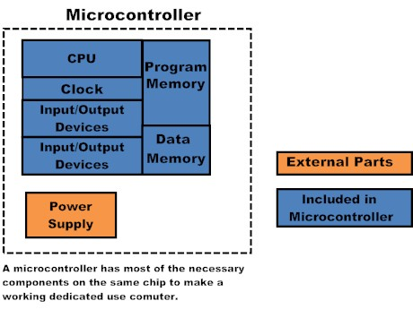
Microcontroller
On chip peripherals and memory
RISC
Harvard architecture
Advantages
Cheap
Less power
Self sufficient

Slide 4
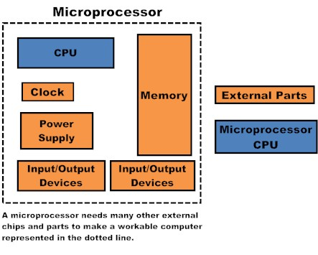
Microprocessor
Perform raw calculation
CISC
Von Neumann architecture

Slide 5
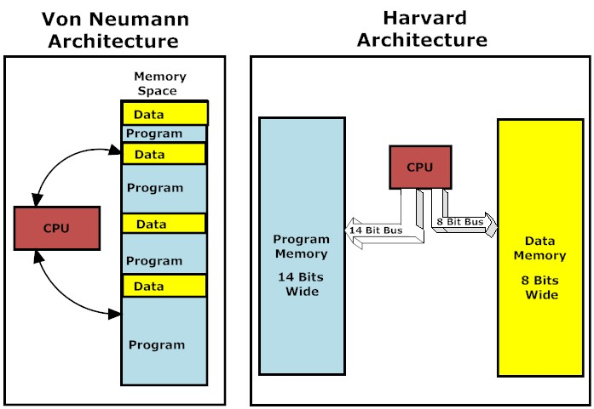

Slide 6
Atmel AVR Atmega8
Advanced RISC 8bit architecture
Executes powerful instruction in one clock cycle.
1 MIPS per Mhz.
32 general purpose registers.
8Kb in system programmable flash
512 bytes of EEPROM
1KB of SRAM
23 general purpose I/O lines
Three flexible timers/counters
Internal and external interupts
SCI - USART
SPI
Two wire serial interface I2C
6 channel ADC with 10 bit accuracy
WatchDog timer
Power modes

Slide 7
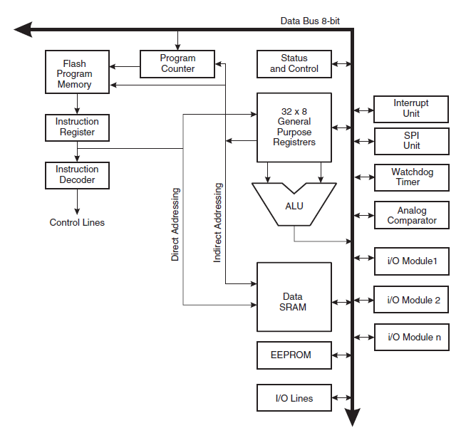

Slide 8
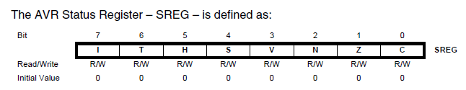
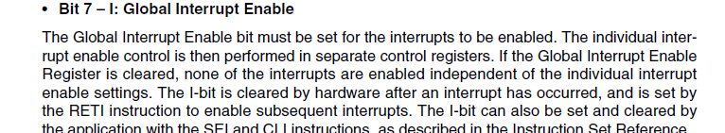
Registers

Slide 9
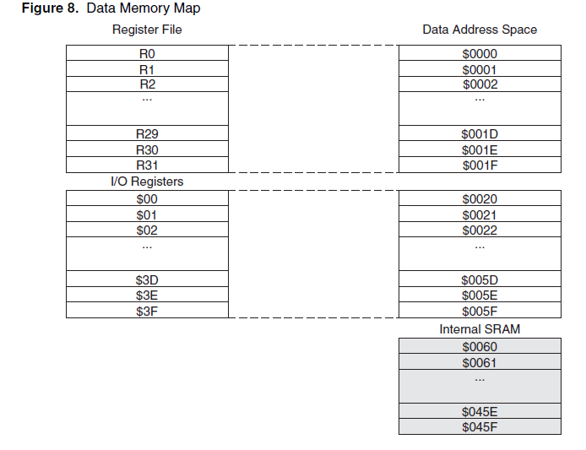

Slide 10
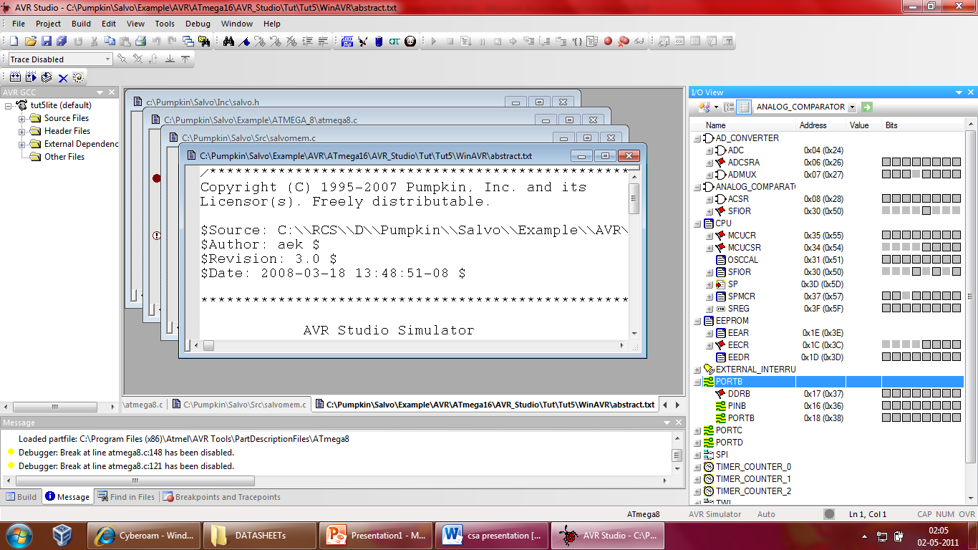

Slide 11
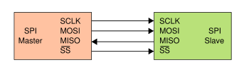
Serial Communication
SPI
Synchronous serial communication
SCI
Asynchronous serial communication
RS232
UART

Slide 12
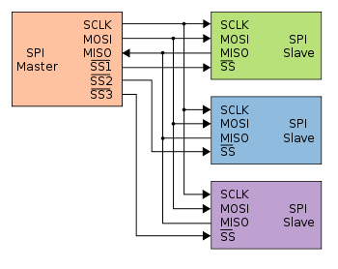

Slide 13
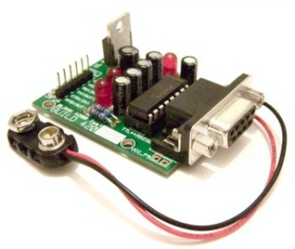

Slide 14
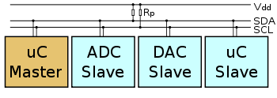
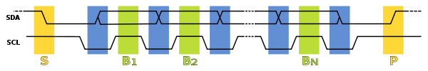
I²C – Inter integrated circuit
Proprietary of Philips
100Kbit/s 3.4 Mbit/s

Slide 15
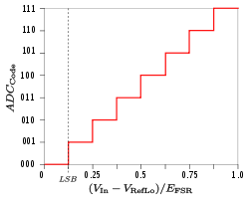
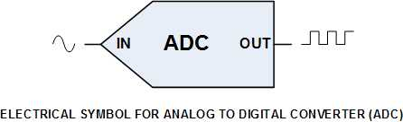
ADC
Digital signal processing.
Interfaces a MCU to physical world.

Slide 16
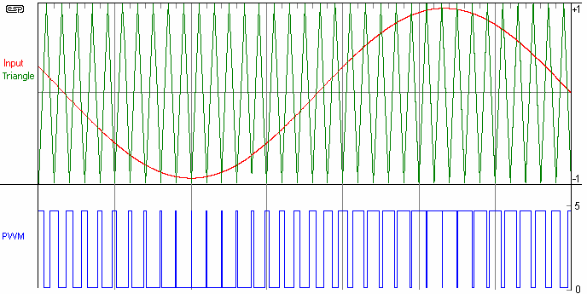
PWM
Reverse process of ADC

Slide 17
Thanks

