Slide 1

Aspiring Minds Research Team (research.aspiringminds.com)

Slide 2

General purpose interpreted programming language
Widely used by scientists and programmers of all stripes
Supported by many 3rd-party libraries (currently 21,054 on the main python package website)
Libraries in python are known as packages.
You can install particular library using pip – this is popular default package manager.
  Eg – pip install numpy

Slide 3

Some useful packages for data science
Numpy
  Numerical library for python
  Written in C, wrapped by python
Scipy
  Built on top of numpy (i.e. Also fast!)
  Common maths, science, engineering routines
Matplotlib
  Hugely flexible plotting library
Pandas
  Easy to use library for data analysis and modelling
  Dataframes are like sql tables and you can perform operations
  Read, write, data reshaping, slicing, joins, pivots, indexing, etc

Slide 4

IPython Notebook is a web-based interactive computational environment
There is a notebook which runs in browser and it connects to a server having a kernel
Containing an ordered list of input/output cells which can contain code, text, mathematics, plots and rich media.
How to start ipython notbook
  $ ipython notebook

Slide 5

Steps
1. Setup your ipython environment and download libraries
2. Setup API keys for your twitter account
3. Fetch tweets from twitter
4. Run sentiment analysis
5. Analyze results

Slide 6

Clone the repo
  git clone https://github.com/gursimar/iPython-workbooks.git
Start your ipython notebook
  Using ipython notebook
  Goto - www.tmpnb.org
Upload the ipynb file from the repo
  twitter_sentiment_analysis.ipynb
Install if any packages are required using pip

Slide 7

It contains cells which may have text/ code
You can add a cell by using the + icon above
Remove a cell using the scissor icon.
Shift+Enter to execute code inside the cell
Exercise –> add a new cell and print ‘hello’
Exercise 2 -> + cell and

Slide 8

Open https://apps.twitter.com/
Click “Create New App”
Fill out the form, agree to the terms, and click “Create your Twitter application”
Click on “Keys and Access Tokens” tab, and copy your “API key” and “API secret”.
Scroll down and click “Create my access token”, and copy your “Access token” and “Access token secret”.
Access Level -> Read, write, and direct messages (modify app permissions)
- https://apps.twitter.com/app/13519590/keys

Slide 9

oAuth is used to authenticate and authorize
Twitter API Objects
  Tweets
  Users
  Entities – hashtags, media, urls, etc
  Places

Slide 10

It is a python wrapper to the twitter API
Create and object
  api = twitter.Api(credentials)
Interact with twitter API through functions
  Api.FetFriends()
  Api.PostUpdate()
  Api.GetSearch()
  Api.GetTrendsCurrent()
  etc

Slide 11

It’s the voice of the customer
  What are people feeling about a particular topic/ product
Classify the polarity of the article
  Positive, negative, neutral
Various techniques

Slide 12

Example
Tokenize and remove stop words
Remove Stop words
POS Tagging – select only adjectives/ adverbs
Pass these tokens to a pretrained sentiment classifier

Slide 13

Trained using a supervised data set
  Movie review dataset
  Each review has a label – positive or negative
We process the text as in the previous slide
Then we use a bag of words approach
These features, along with labels are passed to a Naïve bayes classifier.
It gives a score on a scale of [-1, 1]

Slide 14

It is a package to process textual data.
  NLP, POS tagging, Noun phrase extraction, sentiment analysis, classification, translation.
analysis = TextBlob(clean_tweet(tweet))
if analysis.sentiment.polarity > 0:
return 'positive'
elif analysis.sentiment.polarity == 0:
return 'neutral'
else:
return 'negative'

Slide 15

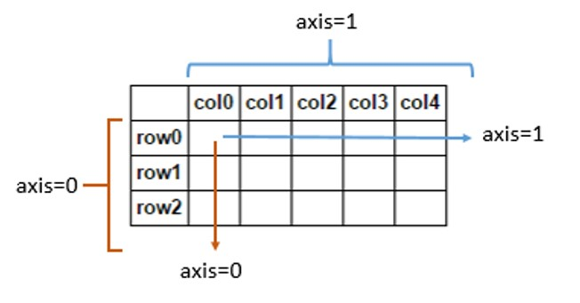
It’s a python package for data manipulation and analysis
  Mainly useful to work on tabular data like in spreadsheets.
A data frame is used for storing data tables

Slide 16
One line commands can be performed
Features – data manipulation
  Loading/ dumping data from/to csv
    pd.from_csv(‘simar.csv’)
  Joins and data merging/ alignment
  Reshaping and pivoting data sets
  Handling missing data
  Advanced indexing and slicing of data

Slide 17

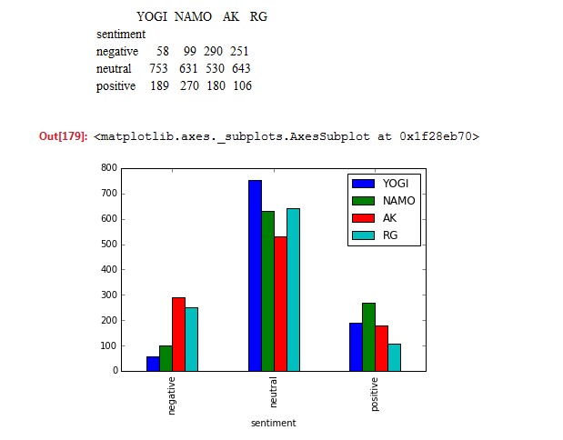

Slide 18

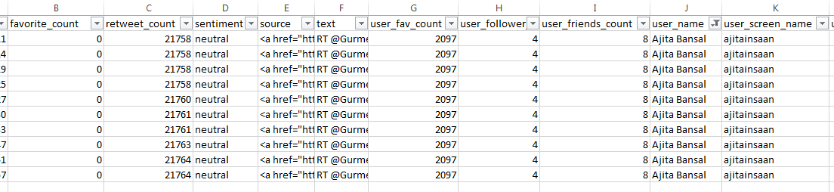
Analyze data in excel
  Same user is doing multiple retweets
  Consider users with fav_count > th | user_follw > th
  Take only one tweet per user; consider retweet count
  See user stats rather than tweet stats
  Implement our own algorithm for sentiment analysis
  Get facebook posts along with twitter

Slide 19


