Slide 1
Smart Car Race India 2010
K Muthukumar

Slide 2
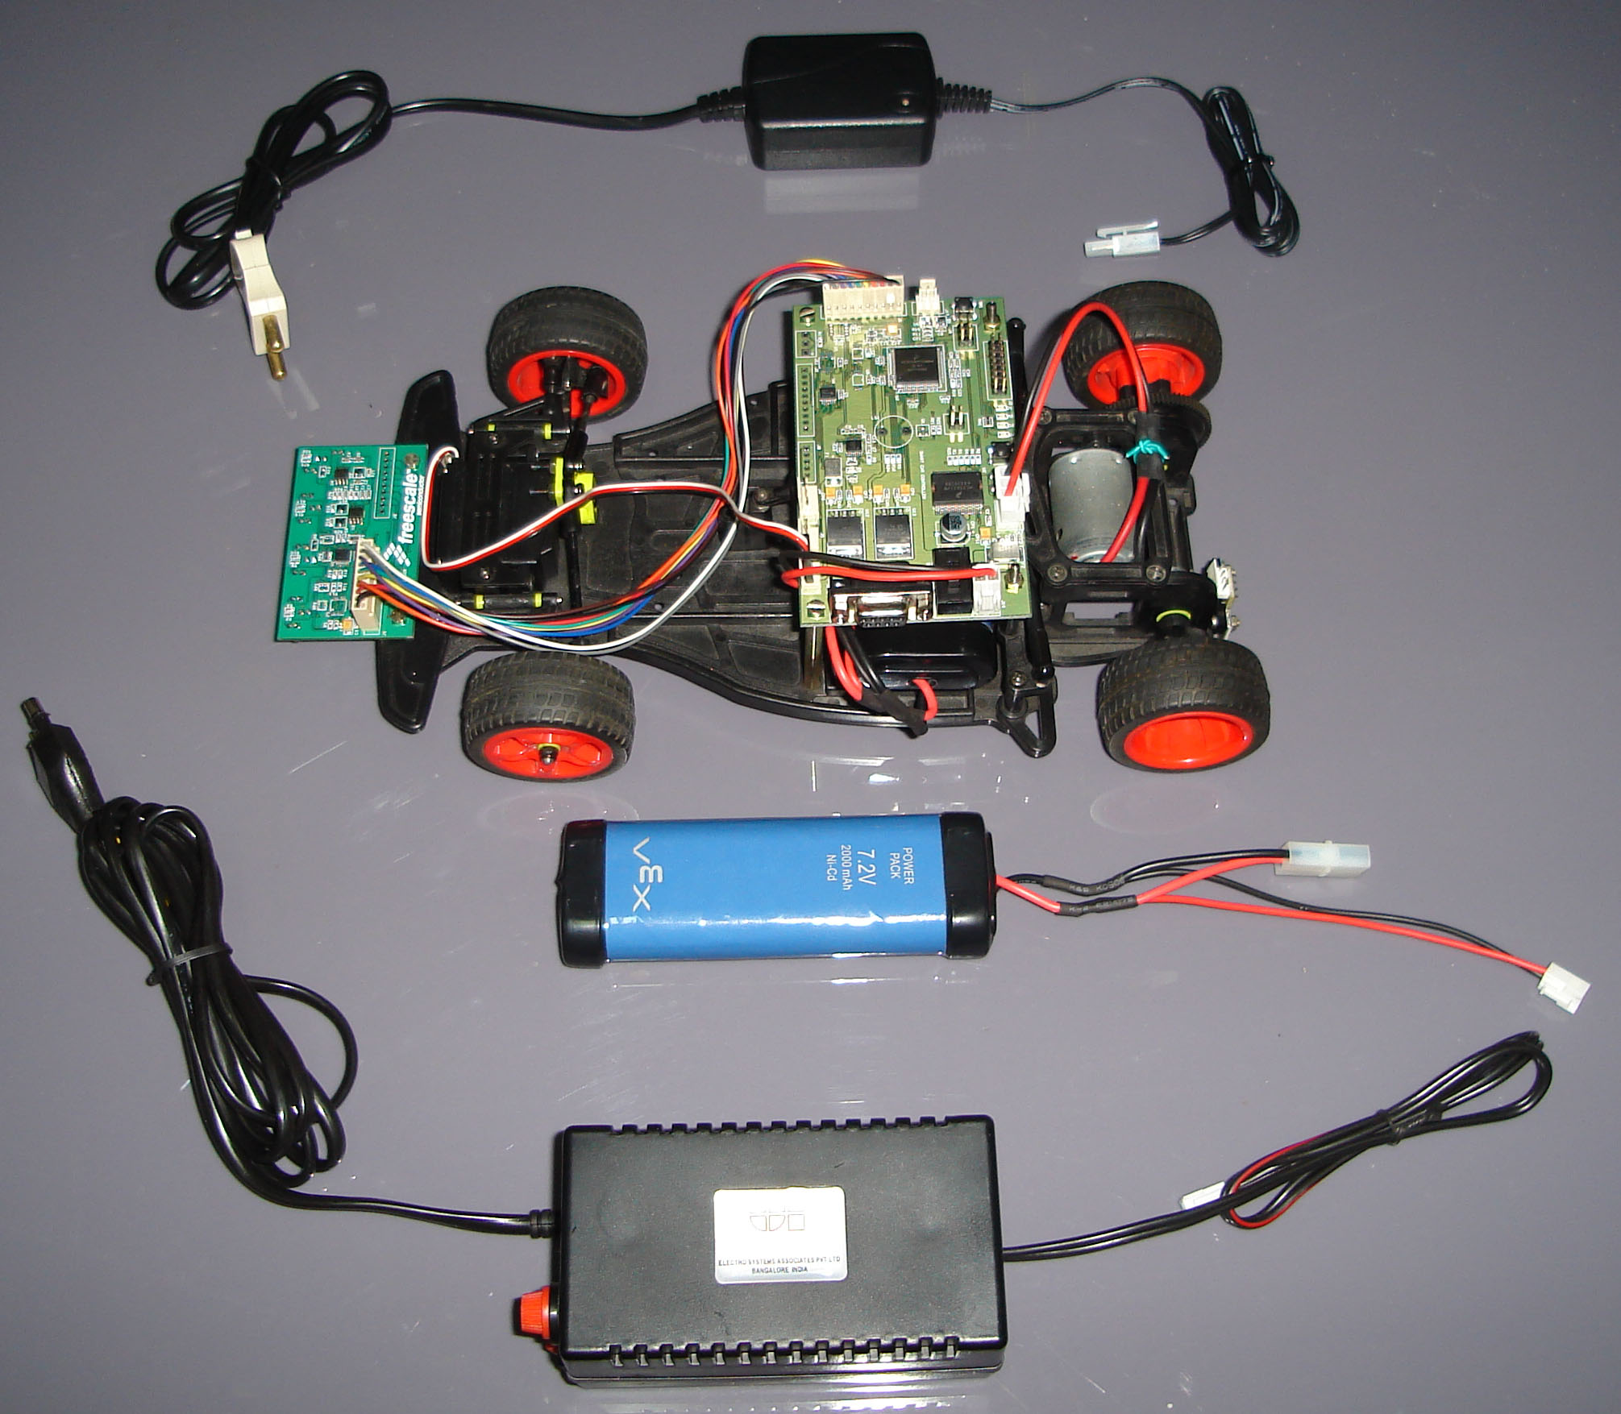
Smart Car Kit

Slide 3
Smart Car Kit Contents
Car Kit
S12X Controller Board
Sensor Board
7.2 Volts 2000 ma NI-Cd Battery
9V 2 Amps Power Supply
Cables

Slide 4
Smart Car Controller
Sensor Input
LM2940 5V Power
MC33931H-Drive
S12X CPU
Drive Motor
Battery
Sensor
LM2940 5V Power
Steering Motor

Slide 5
Racing Track
Surface of the racing track will use base material suitable for racing.
Width of the racing track will not be less than 60 cms.
Specific specification for material used for surface of the racing track will be provided on web site of the event
Surface of the racing track is white, with continuous black line (25 cms.wide) drawn in the middle as the pilot line
The minimum bending radius of the racing track will not be less than 60 cms.
The racing track can intersect with a crossing angle of 90°
There is a starting area of 1 mt. long in the racing track, as shown in figure below. In addition, there is a black starting line 10 cms. long at both side of the starting point. Start time and end time should be determined when front part of the racing car passes the starting line.

Slide 6
Starting Point

Slide 7
Position Sensing Example
Initial Calibration
Read Black and White value of each sensors
Compensation Ratio = 256 / (Black value – White value)
Position Calculation
If Reading > ‘Black value’ , Reading=Black
If Reading < ‘White value’ , Reading=White
Compensated reading = (Reading - White) X Compensation ratio

Slide 8
Position Sensing Example Contd..
Sensor Data
 | Sensor 6 | Sensor 5 | Sensor 4 | Sensor 3 | Sensor 2 | Sensor 1 | Sensor 0
Black | 236 | 223 | 250 | 245 | 250 | 230 | 240
White | 15 | 20 | 16 | 14 | 16 | 16 | 16
Compensation
Ratio | 1.15 | 1.25 | 1.09 | 1.10 | 1.09 | 1.12 | 1.13
Now value
Original | 50 | 50 | 160 | 253 | 240 | 20 | 10
Compensated | 40 | 37 | 156 | 254 | 243 | 4 | 0

Slide 9
Position Sensing Example Contd..
Bubble sort by readings
Value | 254 | 243 | 156 | 40 | 37 | 4 | 0
Sensor | Sensor 3 | Sensor 2 | Sensor 4 | Sensor 6 | Sensor 5 | Sensor 1 | Sensor 0
Bubble Sort By Indices
Value | 243 | 254 | 156
Sensor | Sensor 2 | Sensor 3 | Sensor 4
Position data
 | Sensor 6 | Sensor 5 | Sensor 4 | Sensor 3 | Sensor 2 | Sensor 1 | Sensor 0
Position | 3072 | 2560 | 2048 | 1536 | 1024 | 512 | 0

Slide 10
Racing Restrictions
Position of the center of the black line =
(Index of ‘middle sensor’) * 2 * ATD resolution level + (Largest index sensor reading – smallest index sensor reading)
In Index of middle sensor = ‘3’
ATD resolution level = 256 (8 bit)
Largest index sensor reading = 156
Smallest index sensor reading = 243
Therefore, position = 3 * 2 * 256 + (156 - 243) = 1449
Error = 1536-1449 =87

Slide 11
Racing Restrictions
It is not allowed to change structure of the chassis, distance between wheels, radius of wheel and tire;
It is not allowed to change the components provided in the car kit.
It is not allowed to change drive motor and battery, the car model has to be powered by the DC motor and battery of the car model itself;
It is not allowed to change hardware provided
It is not allowed add any extra components

Slide 12
Rules for Preliminary Competition
Two trial runs will be allowed to tune the parameters of racing car system
There will be one racing track in the racing field.
The racing teams racing order will be determined by drawing lot.
In each racing round, each racing will run for two laps on the racing track. Time will be calculated when the racing car leaves the starting line. After running for two laps, racing cars should stop within the racing track in 3 meters after the starting line. Otherwise, 1 second will be added to the racing time of the car.
Shorter time taken for a single lap will be calculated as the time for that round. The shortest time of the two rounds will be taken as the final time of the racing car.

Slide 13
Rules for Preliminary Competition
Based on number of participating teams, the organizing committee of the event will select certain percentage of racing teams to participate the final based on their scores in preliminary.
The technical judgment group will perform on-site technical inspection for all the wining cars eligible for the final. Qualification for final of racing car that are not compliant with related equipment requirements (article 1 of the rule) will be cancelled and replaced by the next car;
List of finalists will be submitted by the referee group to the organizing committee of the event for approval and announcement.
After preliminary, car prototype and software can be improved (compliant with competition rules) but changes should be reported in the Technical Update Sheet.

Slide 14
Rules for Final Competition
Two trial runs will be allowed to tune the parameters of racing car system
The racing teams eligible for the final will be ordered based on their scores in preliminary and compete in reverse order of their scores in preliminary.
The racing track for the final is different from that used for preliminary in shape and will be larger
Each finalist can only compete for one time.

Slide 15
Rules for Final Competition
Each racing will run for two laps on the racing track. Time will be calculated when the racing car leaves the starting line. After running for two laps, racing cars should stop within the racing track in 3 meters after the starting line. Otherwise, 1 second will be added to the racing time of the car.
The shortest time taken to run a single lap will be taken as the final time of the racing car.
Score in the preliminary will not be included in score of the final; instead, it is used only to determine racing order in final. For racing teams failed to participate or appear in time in the final will be disqualified from the final.

Slide 16
Failure in the Competition
The racing car runs out of the track for more than two times;
The player touches the racing car after beginning of the racing without consent of the referee;
The racing car fails to pass the technical inspection after the race.
No score will be given for a failed team.

