Slide 1
Control
Strategies
By Dr. L.Umanand, CEDT, IISc.

Slide 2
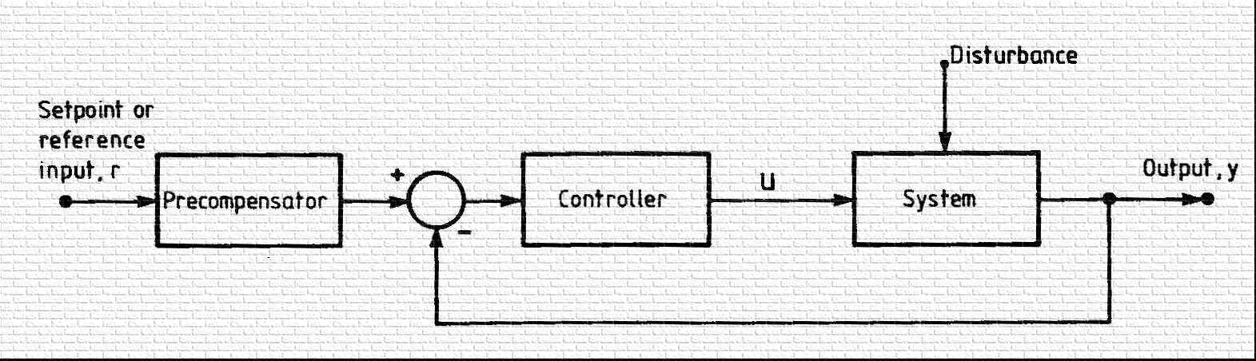
CONVENTIONAL CONTROL SYSTEM

Slide 3
Control problem
Regulator problem
Servo or tracking problem
Disturbance rejection
control energy

Slide 4
ASSUMPTIONS
LINEARITY
TIME INVARIANCE

Slide 5
CONTROL STRATEGIES
ROBUST CONTROL (high gain)
GAIN SCHEDULING
SELF TUNING
ADAPTIVE

Slide 6
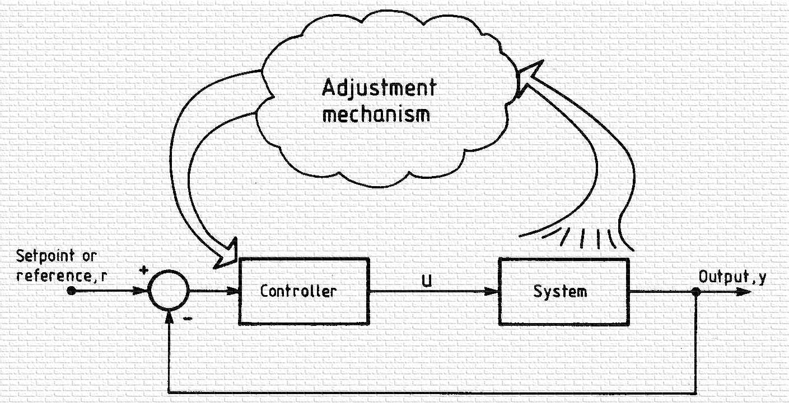
Self tuning/adaption structure

Slide 7
SELF TUNING/ADAPTION APPROACHES
MRAC
KNOWLEDGE BASED SYSTEMS

Slide 8
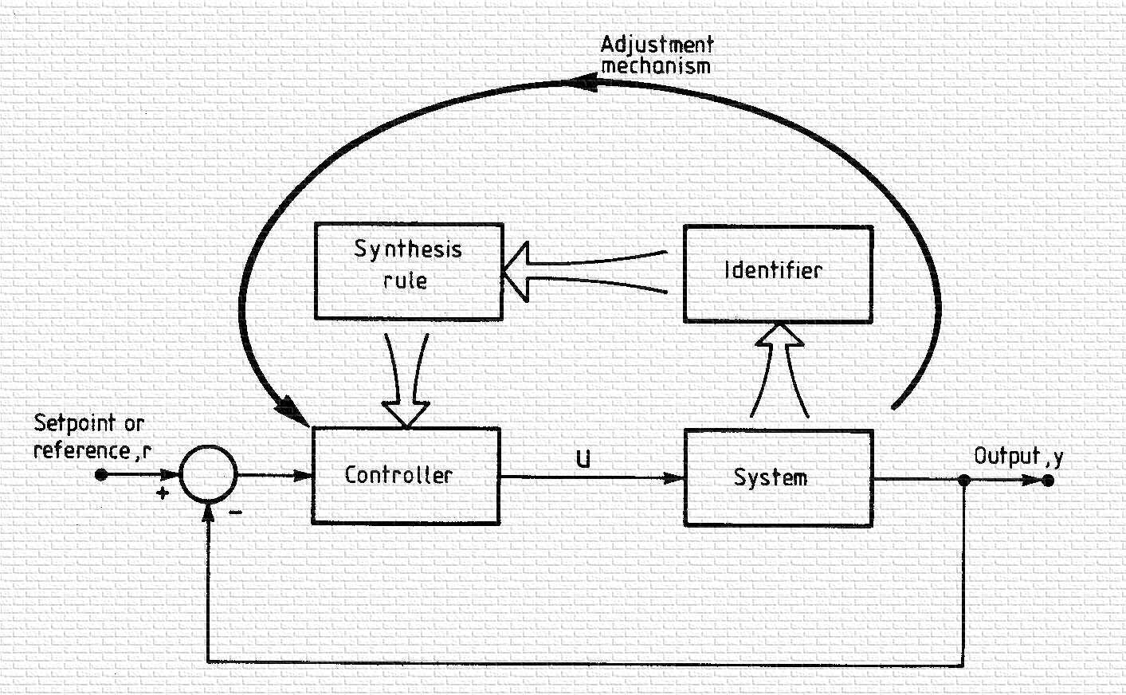
SELF TUNING CONTROL

Slide 9
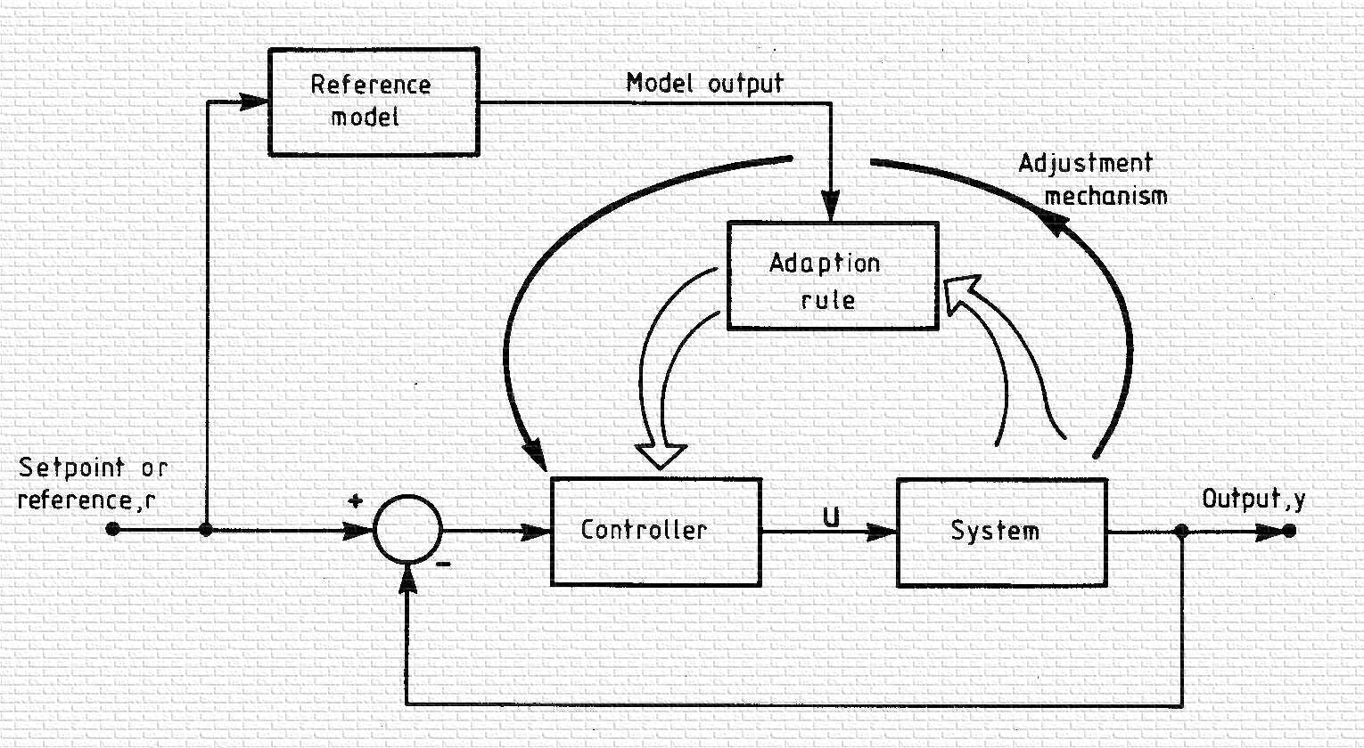
MRAC

Slide 10
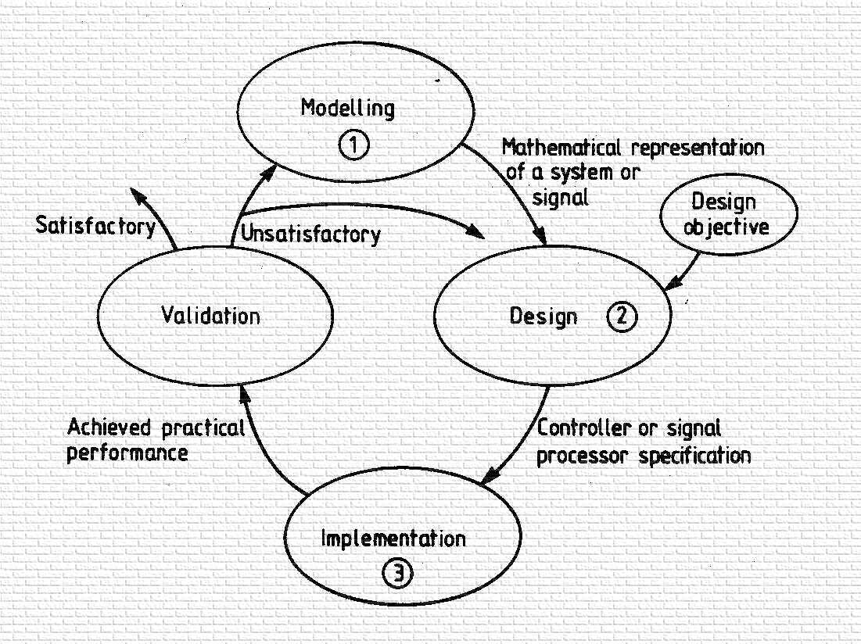
Control System DESIGN Sequence

Slide 11
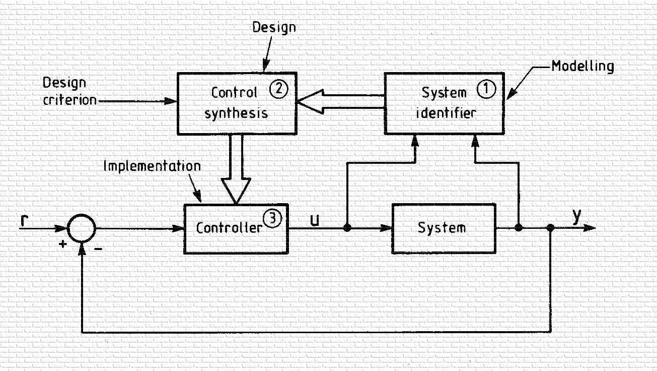
Self tuning structure incorporating the stages of design process

Slide 12
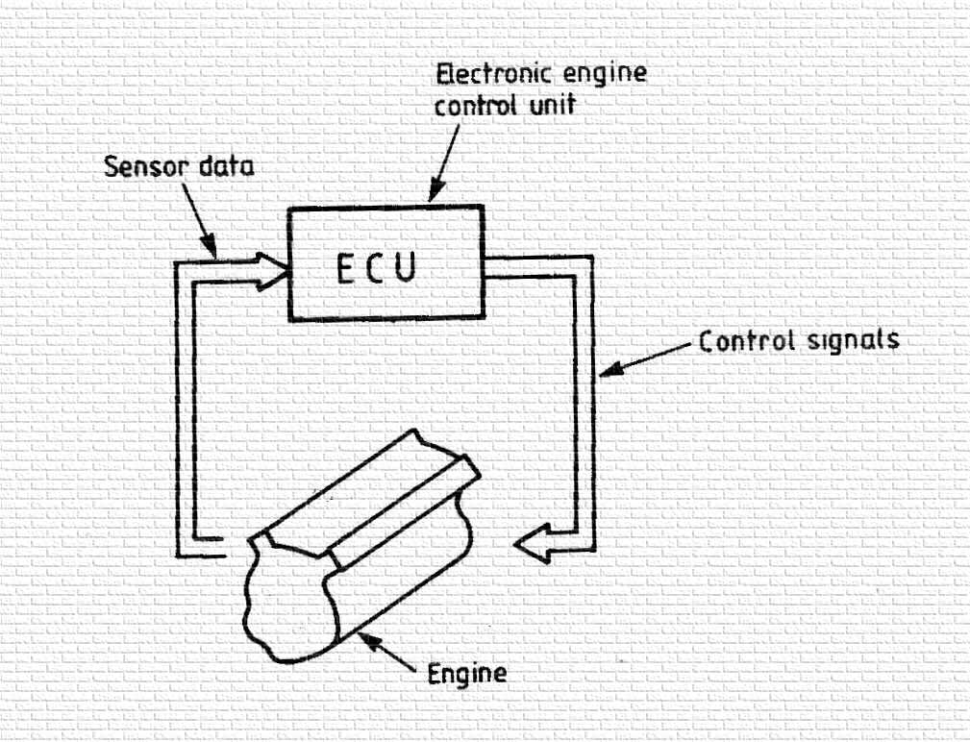
LUCAS AUTOMOTIVE CASE STUDY

Slide 13
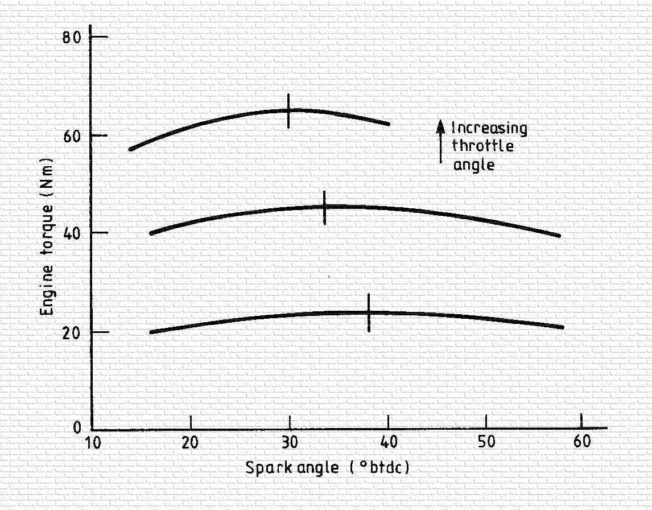

Slide 14
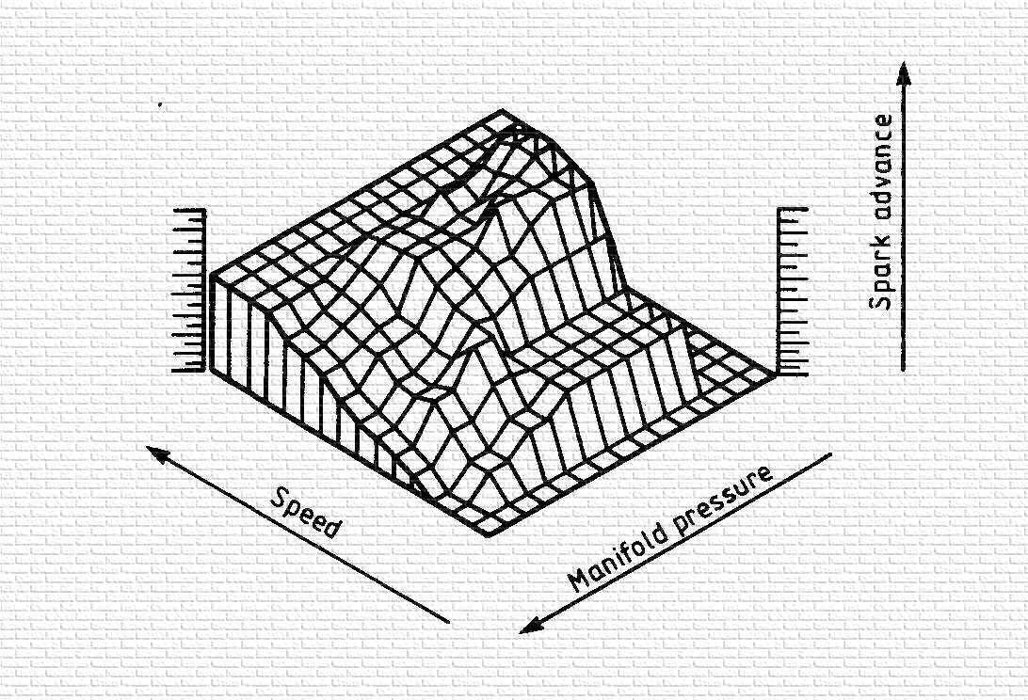
ENGINE SPARK MAP

Slide 15
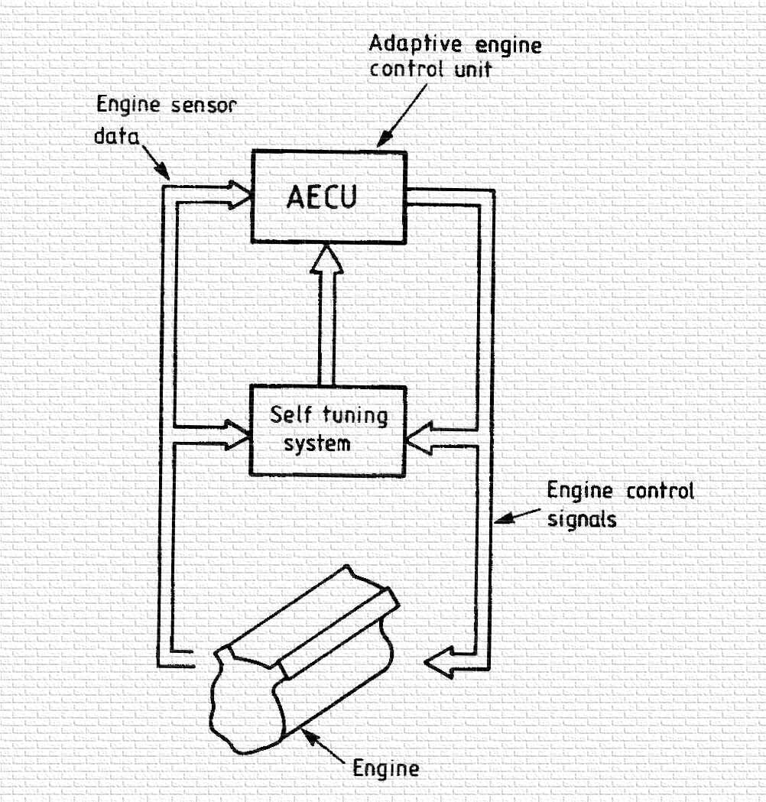

Slide 16
