Slide 1
Z-domain
By Dr. L.Umanand, CEDT, IISc.

Slide 2
Domain Representations
CONTINUOUS TIME SYSTEMS
Time domain (t-domain)
Frequency domain (ω-domain)
s - domain

Slide 3
Domain Representations
DISCRETE TIME SYSTEMS
n - domain
Frequency domain (ω-domain)
z - domain

Slide 4
Domain Representations
n-domain : sequences, impulse responses
ω-domain : frequency responses, spectrums
z-domain : poles and zeros

Slide 5
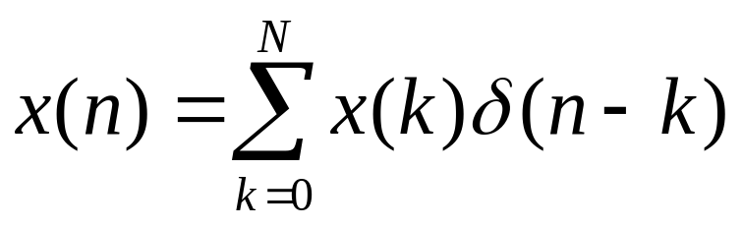
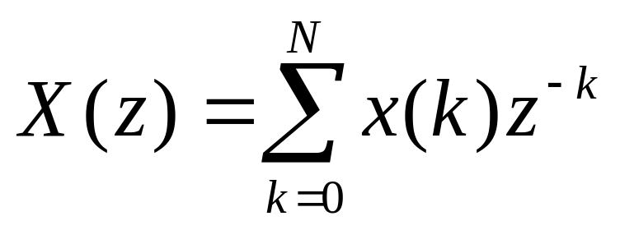
Signal Representation
x(n) = x(0) + x(1) + x(2) + …+x(N)
DEFINITION

Slide 6
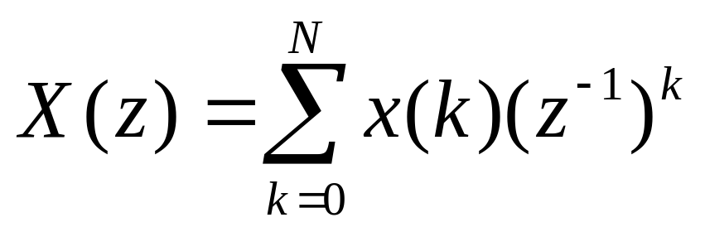
Z-transform
The z-tranform X(z) is SIMPLY a POLYNOMIAL
of degree N in the variable z⁻¹

Slide 7
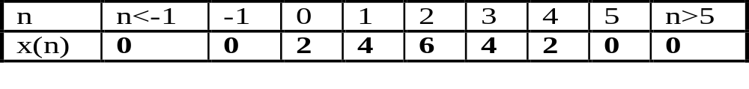
n-domain z-domain
To obtain z-transform, construct a polynomial in z⁻¹
whose coefficients are the values of the sequence x(n).

Slide 8
n-domain z-domain
X(z) = 2 + 4z⁻¹ + 6z⁻² + 4z⁻³ + 2z⁻⁴
To obtain z-transform, construct a polynomial in z⁻¹
whose coefficients are the values of the sequence x(n).

Slide 9
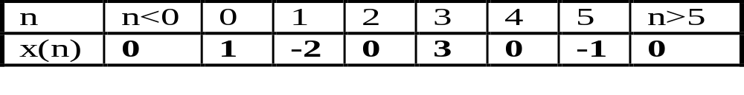
z-domain n-domain
X(z) = 1 - 2z⁻¹ + 3z⁻³ - z⁻⁵
x(n) = δ(n) - 2δ(n-1) + 3δ(n-3) - δ(n-5)
Impulses sequences

Slide 10
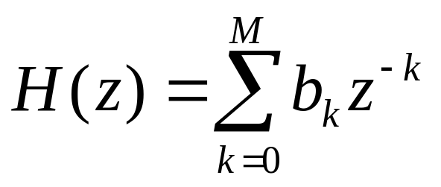
z-transform for LTI systems
The system function H(z) is the z-transform of
the impulse response

Slide 11
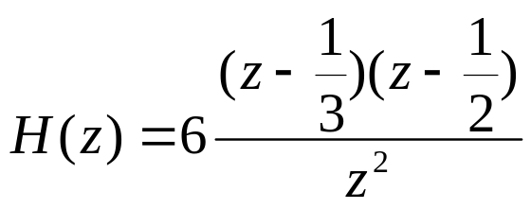
Example : LTI system
x(n) : input sequence to system
y(n) : output sequence from system
y(n)=6x(n) - 5x(n-1) + x(n-2)
H(z) = 6 -5z⁻¹ + z⁻²
The zeros of H(z) are 1/3 and 1/2

Slide 12
Superposition property
ax₁(n) + bx₂(n)
aX₁(z) + bX₂(z)

Slide 13
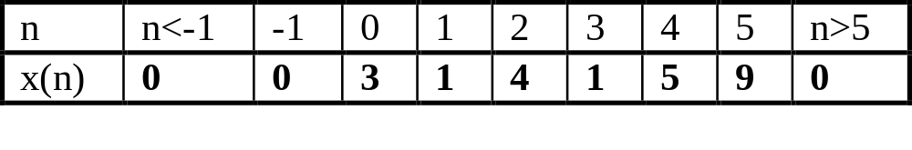
Time delay property
z⁻¹ : Unit delay. Corresponds to a time shift of 1 in n-domain
X(z) = 3 + z⁻¹ + 4z⁻² + z⁻³ + 5z⁻⁴ + 9z⁻⁵
Y(z) = z⁻¹X(z) = 0z⁻¹ +3z⁻¹ + z⁻² + 4z⁻³ + z⁻⁴ + 5z⁻⁵ + 9z⁻⁶
What is y(n)?

Slide 14
Time delay
A delay of one sample multiplies the z-transform by z⁻¹
x(n-1)
z⁻¹X(z)
A time delay of n_{o} samples multiplies the z-transform by z^{-no}
x(n-n_{o})
z^{-no}X(z)

Slide 15
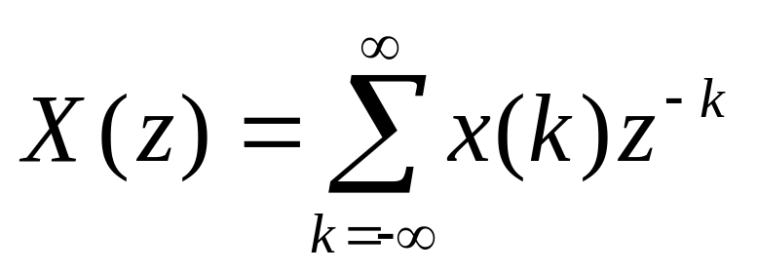
Infinite length signals
Finite length
Signal x(n)
Infinite length
Signal x(n)

Slide 16
Example:
x(n) = δ(n-1) - δ(n-2) + δ(n-3) - δ(n-4)
h(n) = δ(n) + 2δ(n-1) + 3δ(n-2) + 4δ(n-3)
x(n) : input sequence
h(n) : impulse response of the system
X(z) = 0 + 1z⁻¹ - 1z⁻² + 1z⁻³ - 1z⁻⁴
H(z) = 1 + 2z⁻¹ + 3z⁻² + 4z⁻³

Slide 17
y(0) = h(0)x(0) = 1.0 = 0
y(1) = h(0)x(1) + h(1)x(0) = 1.1 + 2.0 = 1
y(2) = h(0)x(2) + h(1)x(1) + h(2)x(0) = 1.(-1)+2.1+3.0=1
y(3) = h(0)x(3) + h(1)x(2) + h(2)x(1) + h(3)x(0) = 2
. = .
. = .
. = .

Slide 18
Y(z) = H(z)X(z)
Y(z) = z⁻¹+z⁻²+2z⁻³+2z⁻⁴-3z⁻⁵+z⁻⁶-4z⁻⁷
Convolution in the n-domain corresponds to
multiplication in the z-domain
Y(n) = h(n) * x(n)
Y(z) = H(z)X(z)

Slide 19
Example:
x(n) = δ(n-1) - δ(n-2) + δ(n-3) - δ(n-4)
H(z) = 1-z⁻¹
Compute the output sequence y(n).

Slide 20
Cascading systems
x(n)
h₁(n)
H₁(z)
w(n)
h₂(n)
H₂(z)
y(n)
δ(n)
h₁(n)
h(n)=h₁(n)*h₂(n)
h(n)=h₁(n)*h₂(n)
H(z) = H₁(z)H₂(z)
n-domain
z-domain

Slide 21
Example:
w(n) = 3x(n) - x(n-1)
y(n) = 2w(n) - w(n-1)
Obtain the overall transfer function, H(z).

Slide 22
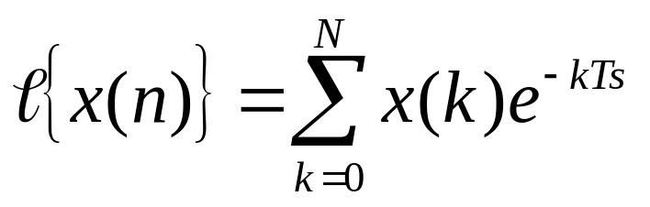
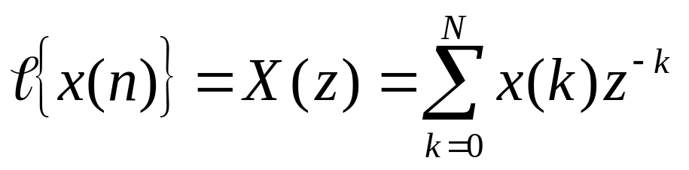
z, s, ω domains
n-domain
z-domain

Slide 23
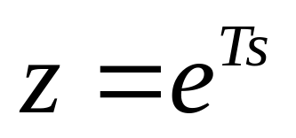
z, s, ω domains
z - s mapping
s = σ + jω
z - ω mapping

Slide 24
z, s, ω domains
Map imag axis of s-plane to z-plane
Map real axis of s-plane to z-plane

Slide 25
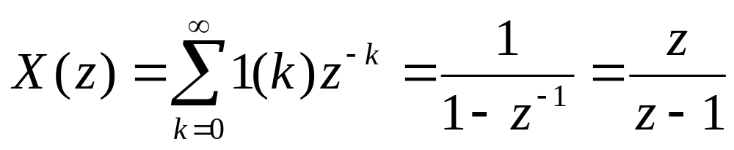
The Unit Step
x(k) = 1 k>=0
= 0 k<0
= 1(k)

Slide 26
Exponential decay
X(z) = z/(z-r)
r is the pole within the unit circle

Slide 27
Digital Filter
Given a continuous filter, H(s), a discrete
equivalent can be built using
1. Numerical Integration
2. Pole-zero mapping
3. Hold equivalence
OR
A direct design of a discrete filter, H(z) can
be made from first principles.

Slide 28
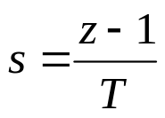
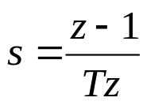
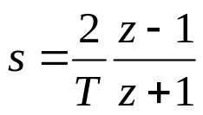
Numerical Integration
1. Forward rule :
2. Backward rule:
Tustin’s method
or
Bilinear transformation
3. Trapezoidal rule:

Slide 29
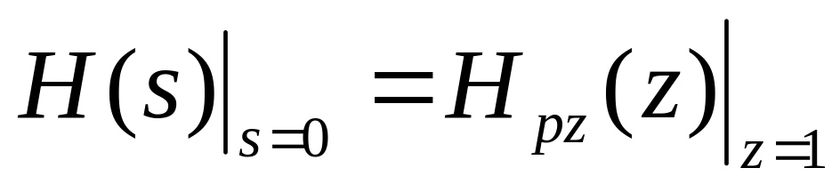
Pole zero mapping
STEPS
1. All poles at s=-a are mapped at z=e-aT
2. All zeros at s=-b are mapped at z=e-bT
3. All zeros at s=inf are mapped at z=-1
4. If a unit delay in the digital filter response is desired
then map one zero at s=inf to z=inf
5. The gain of the digital filter is selected to match
the gain of H(s) at some critical freq. Usually s=0.

Slide 30
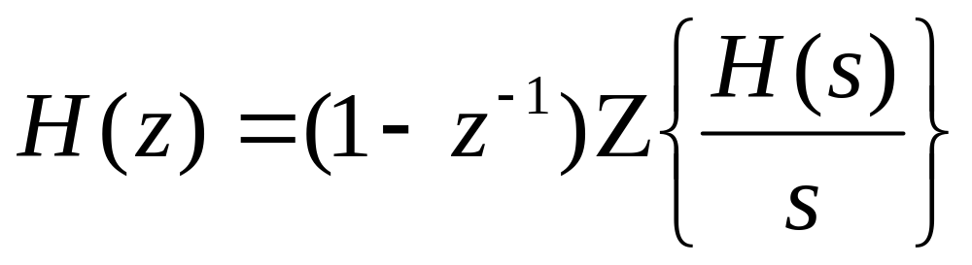
Hold Equivalence
x(t)
y(t)
H(s)
x(t)
x(n)
y(n)
Sampler
Hold
H(s)
Sampler

Slide 31
Demo examples of digital filters in pole zero form
in MATLAB.
Examine their root locus and compare with
continuous domain design using the pole placement
method

