Slide 1

BY:
CHANDRIKA BHARDWAJ

Slide 2
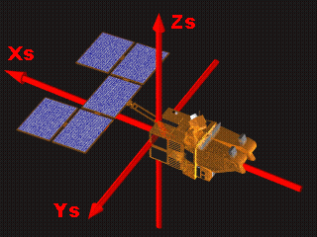
SATELLITE’S ATTITUDE
Orientation of satellite as perceived in a certain frame of Reference

Slide 3
CHANGE IN ATTITUDE
Satellite tends to change its orientation because of environmental torques
  Drag of residual atmosphere
  Solar radiation pressure
  Gravity gradient
  Interaction of Satellite electronics with earth’s magnetic field

Slide 4
ATTITUDE CONTROL
Needed because-
  Payload requirements
    Eg. Focusing the satellite camera to a particular location on earth
  Communication requirements
    Pointing the antenna towards ground
  Power system requirements
    Tracking the sun to achieve maximum power generation

Slide 5
Components of ADCS
Sensors- To determine the orientation and position of the satellite
Algorithms-To calculate the deviation from the desired orientation and to generate actuation command to counter the deviation
Actuators-To act upon the signals given by the control algorithms and to produce the necessary torqes

Slide 6
SENSORS
Measure the attitude of the satellite
Types:
  Gyroscopes:
    Sense rotation in 3-D space without reliance on observation of external objects
    Consists of a spinning mass, also includes laser gyros utilizing coherent light reflected around a closed path
    Gyros require initialization by some other means as they can only measure “changes” in orientation

Slide 7
SENSORS contd…
    All gyro instruments are subject to drift and can maintain orientation for limited times only (typically tens of hours or less)
  Horizon indicators
    Optical instrument that detects light at the horizon
    Can be a scanning or staring instrument
    Infrared is often used which can function even on the dark side of earth
    Tends to be less precise than sensors based on stellar observation

Slide 8
SENSORS contd…
  Orbital gyro compassing
    Uses a horizon sensor to sense the direction of earth’s centre
    Uses a gyro to sense rotation about an axis normal to orbital plane
    Hence it provides pitch and roll measurements
  Sun Sensor
    Senses the direction of Sun
    Can be simple as solar cells and shades or complex as a steerable telescope

Slide 9
SENSORS contd…
  Star Trackers
    Optical device measuring the direction to one or more stars (using a photocell or solid state camera to observe the star)
    Require high sensitivity ,may become confused by sunlight reflected from the exhaust gases emitted by thrusters
  Global Positioning System(GPS)
    Required for position measurements
    Determines position and speed of the satellite in space

Slide 10
CONTROL ALGORITHMS
Control Algorithms are computer programs that receive input data from vehicle sensors and derive the appropriate torque commands to the actuators to rotate the vehicle to the desired attitude

Slide 11
Details of Control Algorithms
“actuator and sensor processing”
  Establishes the interfaces to the sensors and the actuators needed for attitude control
  Determines the necessary commanding for the actuators from the torques computed by the layer estimation prediction control
  Performs the time critical communications with actuators and determinates the state of actuators

Slide 12
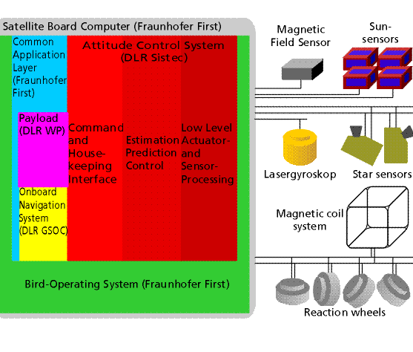

Slide 13
ACTUATORS
Apply the torques needed to re-orient the vehicle to the desired attitude
Types:
  Thrusters (often mono propellant rockets)
    limitation:fuel
  Spin -stabilization
  Momentum wheels
    Electric motor driven rotors made to spin in the direction opposite to that required to re-orient the vehicle

Slide 14
ACTUATORS
Make up a small fraction of the spacecraft’s body, are computer controlled to give precise control
Momentum wheels are generally suspended on ‘magnetic bearings’ to avoid bearing friction and breakdown problem
To maintain orientation in 3D space , minimum of 2 must be used ,additional units provide single failure protection

Slide 15
ACTUATORS
Control Moment Gyros
  Include rotors spun at constant speed mounted on Gimbals
  Provides control about the two axes orthogonal to the gyro spin axes, triaxial control still requires 2 units
  CMG is a bit more expensive in cost and mass since , gimbals and their drive motors must be provided
  Max. torque exerted by CMG is greater than than for a momentum wheel (suitable for larger spacecraft)

Slide 16
ACTUATORS
  Drawback: additional complexity increases failure points
Solar Sails
  Produce thrust as a reaction force induced by reflecting incident light
  Used to make small attitude control and velocity adjustments
  Saves larger amounts of fuel by producing control moments

Slide 17
ACTUATORS
Pure passive Attitude Control
  Gravity gradient Stabilization
  Magnetic Field
Main advantage is that no power or fuel is required to achieve attitude control

Slide 18
REFERENCE SYSTEM
The three critical flight dynamics parameters are rotations in three dimensions around the vehicle’s coordinate system origin ,the centre of mass. These angles are pitch, roll and yaw.
Pitch: rotation around the lateral or transverse axis. Ex. Nose pitches up and the tail down or vice versa.
Roll: rotation around longitudinal axis.
Yaw: rotation about the vertical axis.

Slide 19
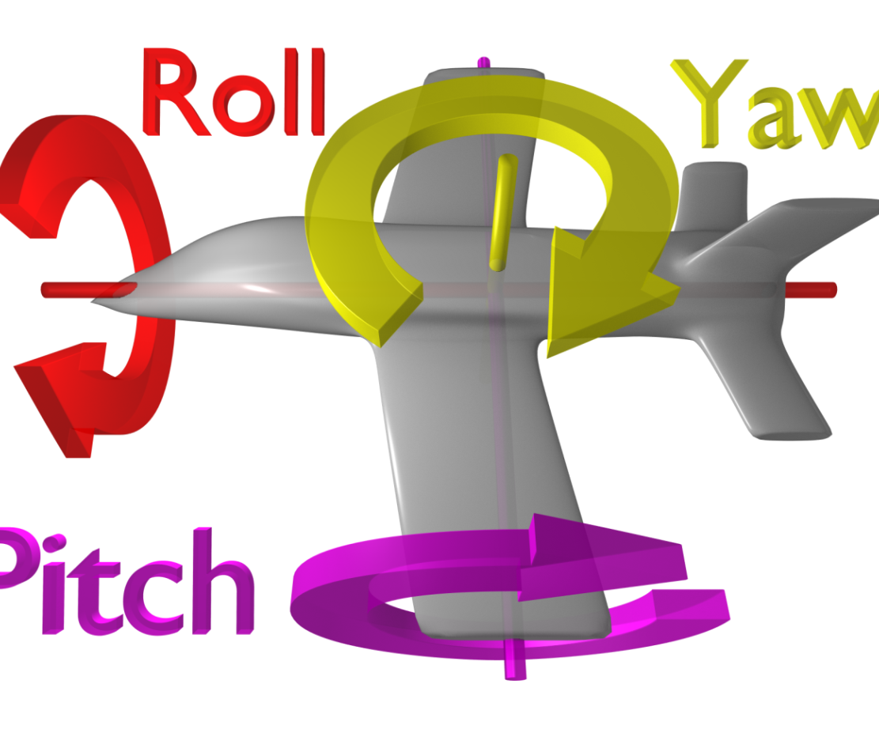
REFERENCE SYSTEM
PITCH , YAW AND ROLL AXES

Slide 20
ADCS of PRATHAM
Sensors finalised :
SunSensors
Magnetometer
GPS
Gyros
Control Law
Actuator finalised:
Magnetorquer
(as on 18 sept 2008)

Slide 21
REFERENCES
wikipedia,the encyclopedia
AAU CUBESAT
SISTEC
www.gpsdaily.com
ncube-norwegian satellite
Spot 4
Pratham, ADCS documentation

