Slide 1

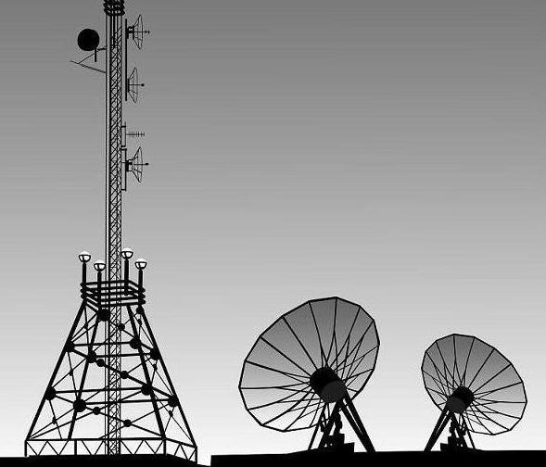
COMMUNICATIONS
We are the Link between our Satellite in space and the Earth
Two major Parts :
On-Board Communications
  Health Monitoring data transmission (FSK)
    To check if the satellite is functioning properly
  Satellite beacon (OOK)
    To identify our satellite amongst the thousands in space
Ground Stations
  Antenna system (Cross Yagi-Uda Antenna)
    To track the satellite and receive data from it
  Signal processing unit
    Decode the signal, measure signal strength, etc
  Computer analysis
    Store all the received data, analyze and understand it.

Slide 2
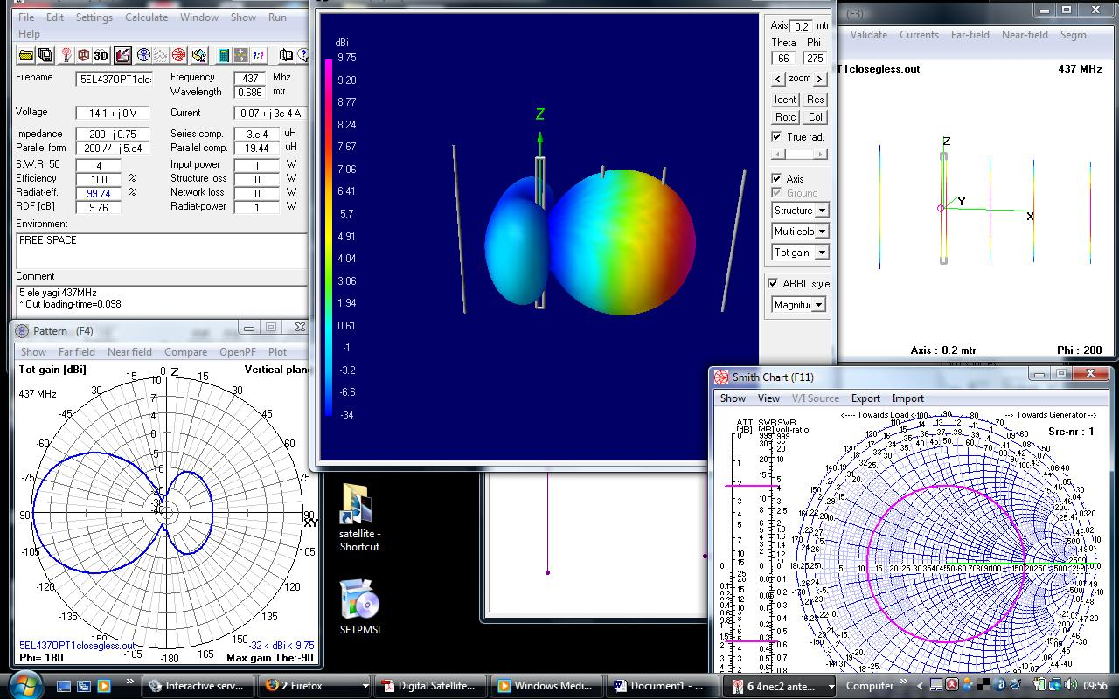
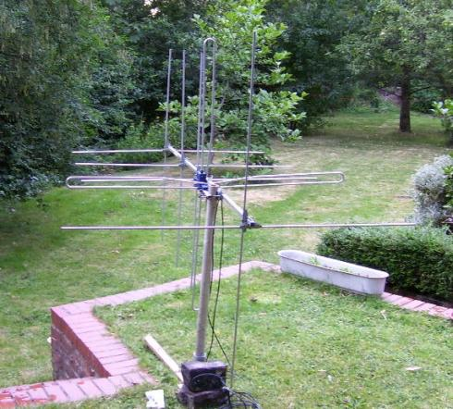
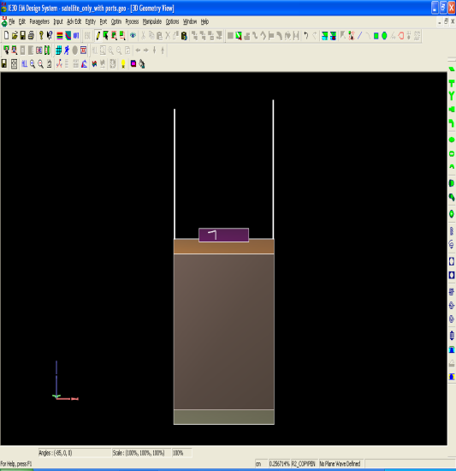
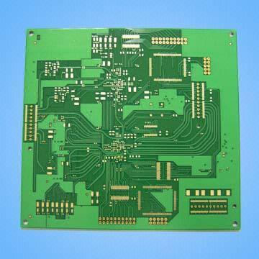
Some work that we have done
ANTENNA SIMULATIONS
AND DESIGN
SATELLITE
MODELLING
DATA TRANSMITTER
AND RECEIVER
AND LOTS MORE !!!!!!!

Slide 3

FUTURE WORK
As we are building the first satellite, we decided to design a minimal, functional communications system.
We plan much more complex and innovative systems for the future satellites.
An essential task for the future team will be ‘UPLINK’
With uplink you have active control over the satellite from the Earth. You can do so many things using uplink like transmit your name all over the world, execute commands in space sitting in front of a computer on Earth, etc.

