Slide 1

Power system

Slide 2
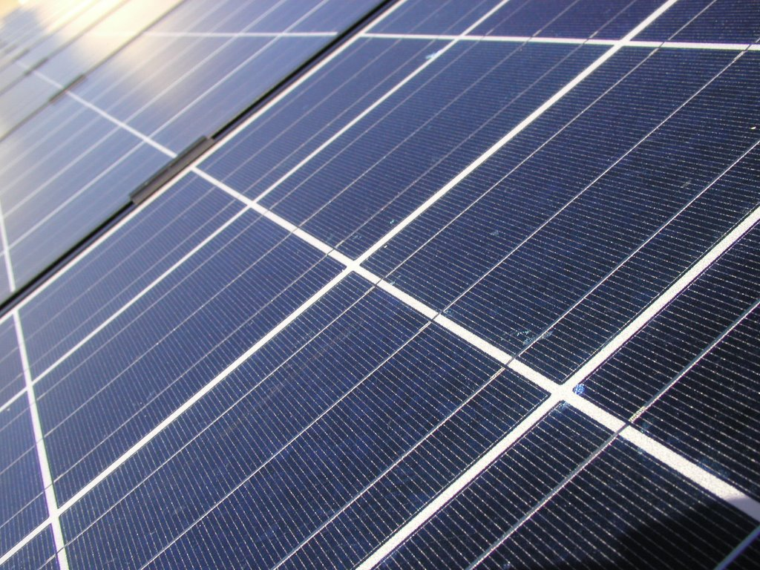
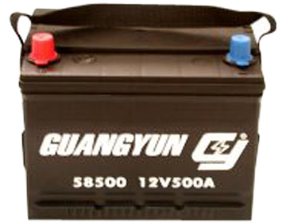

Slide 3
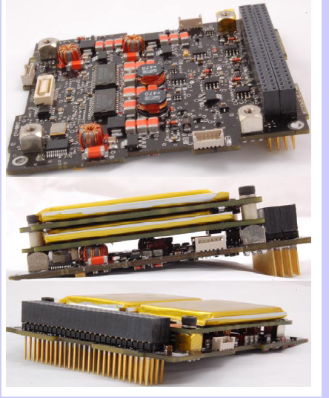
Power management
Maximize power from solar cells
Battery charger
Battery protection
Voltage regulators
Power distribution

Slide 4
What we do
Design a power system with given constraints
Understand the basics of power electronics
Solar cells and battery characteristics
Microcontroller for power management
Circuit simulation
PCB design and testing

