Slide 1
System Engineering
(Pratham and beyond)
- Saptarshi Bandyopdhyay

Slide 2
Major Functions
System Requirements on each Sub-System
Sub-System Requirements to each Sub-System (get detailed simulation results wherever necessary)
Configuration Layout (internal and external)
Routing of wires within the Satellite
Maintain Weight Budget, Power Budget and Data Budget
Nomenclature to sides, position of components, Axis definition
Integration sequence
Maintain document of Interface, connectors and wires

Slide 3






Sub-System Requirements
Struct
Power
Control
Comm
OBC
Payload

Slide 4
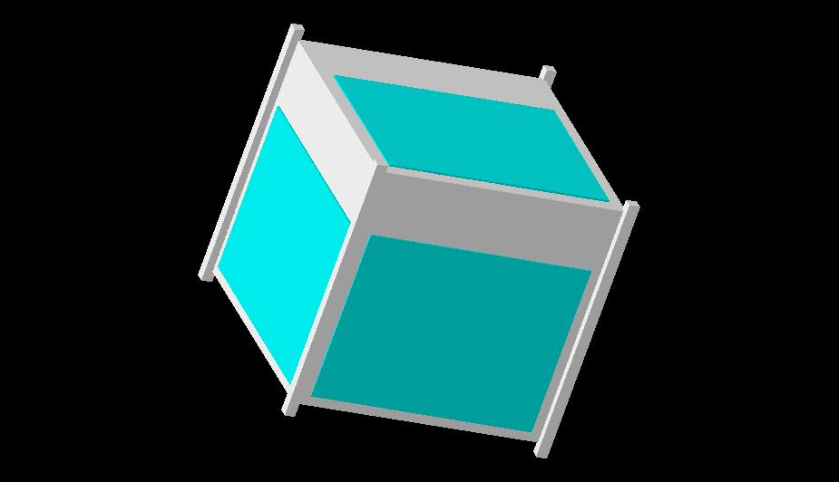
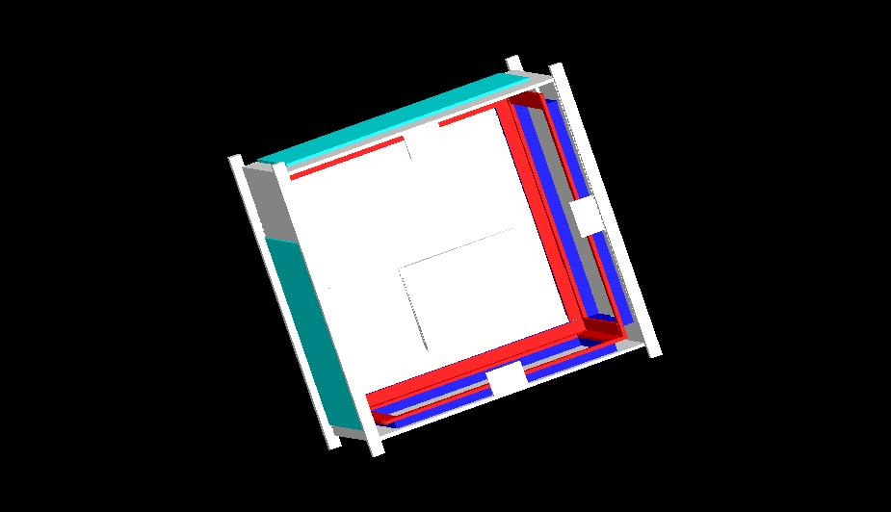

Slide 5
