Slide 1
CAMCube Interim Review 1
Sam Baker
Tom Freestone
Brian Madge
Steve Pfau
Brian Roberts
Jennifer Uchida

Slide 2
Overview
Resolved Issues
  Reaction Wheel
  Software
  Electrical Schematics
Design Summary
Current Issues
  Battery
  Rate Gyro
  Reaction Wheel Design
Schedule Progress
Budget Progress

Slide 3
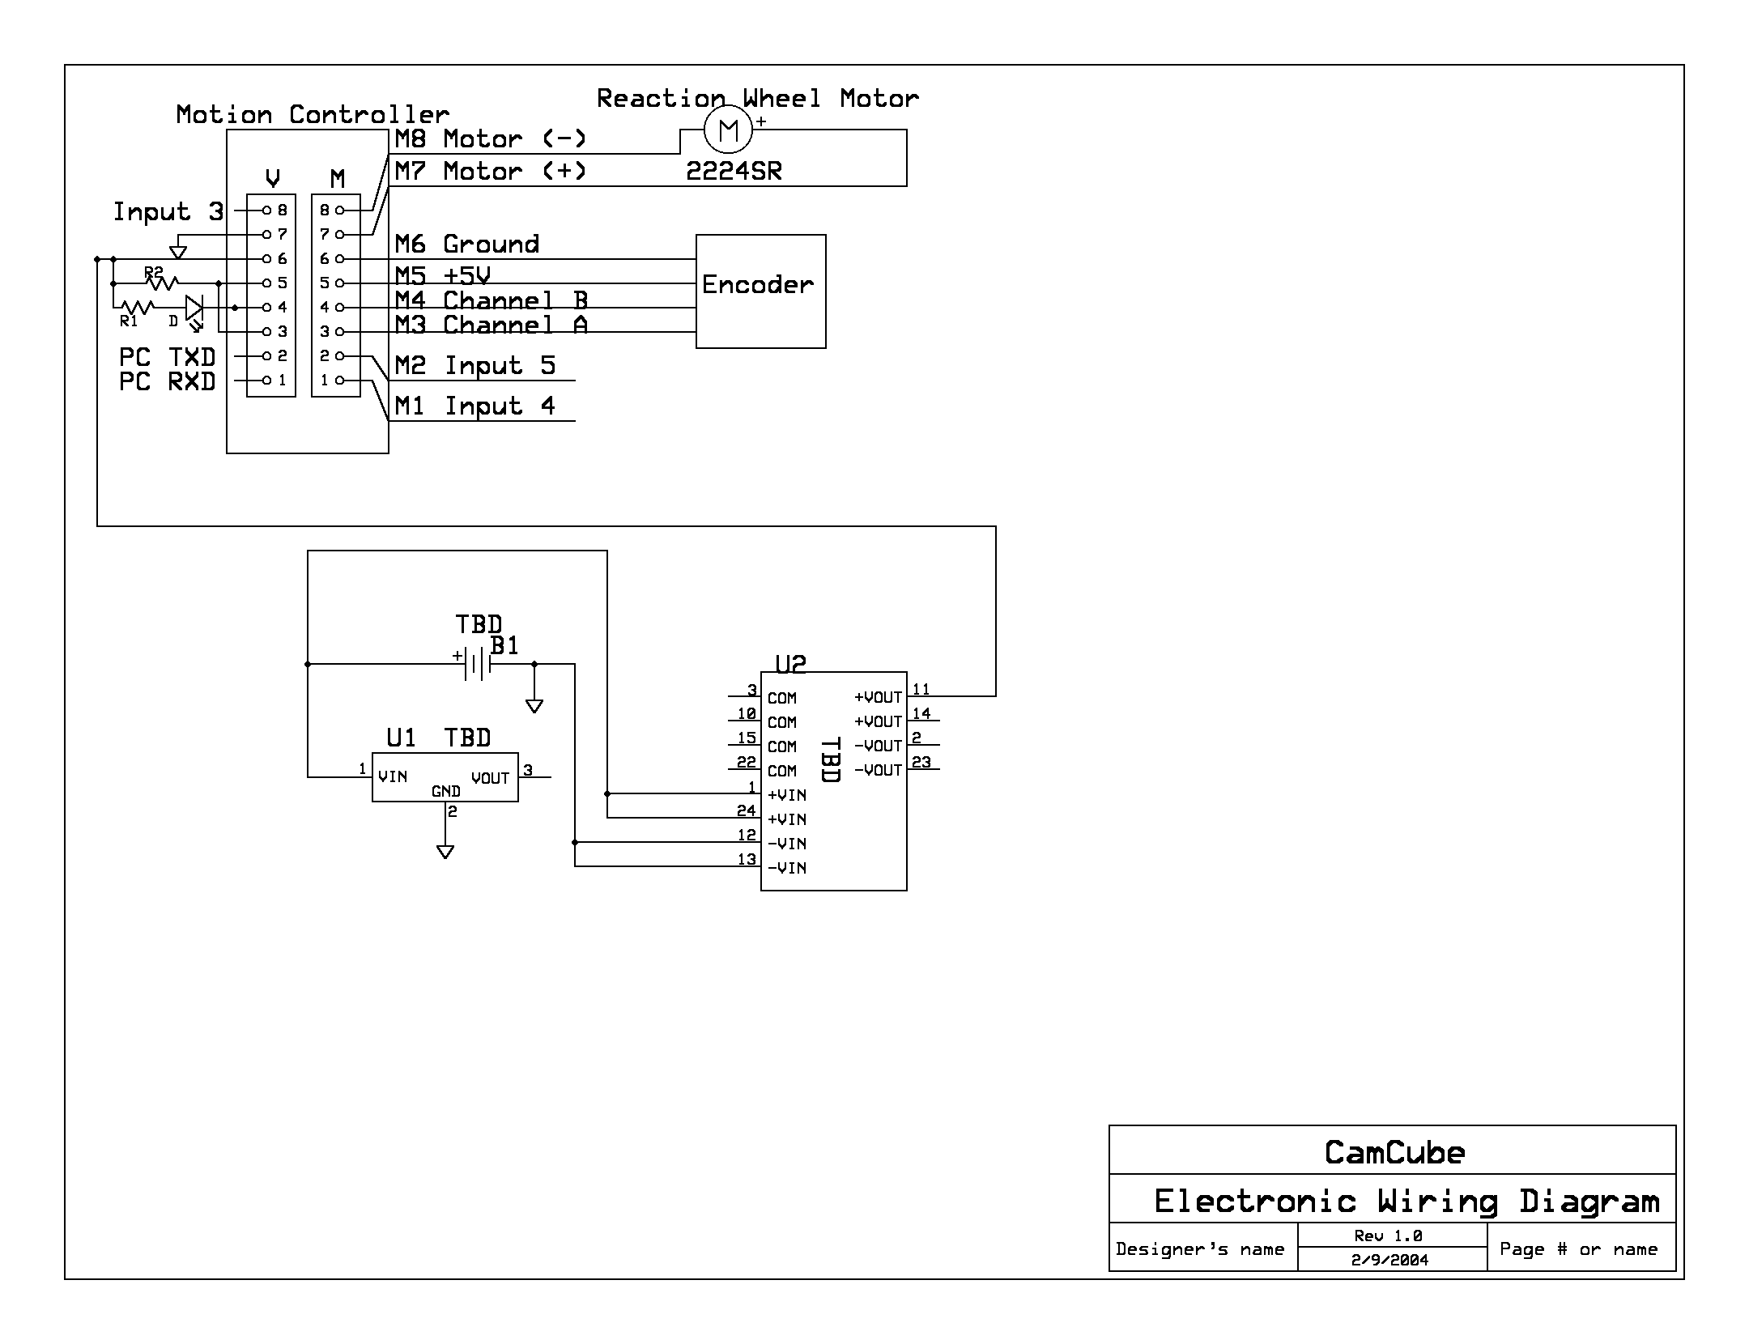
Resolved Issues
Issue:
Reaction wheel size/material questionable
No electronics schematics
Resolution:
Reaction Wheel will be made out of brass
Schematics made

Slide 4
Resolved Issues
Issue:
Concern about software
Resolution:
Wrote and tested software with LabView

Slide 5
Design Summary
Changes:

Slide 6
Current Issues
Batteries
  Ordering process taking longer than expected
  Possible free battery/charger from Eagle Pitcher
Rate Gyro Noise
  Static tests

Slide 7
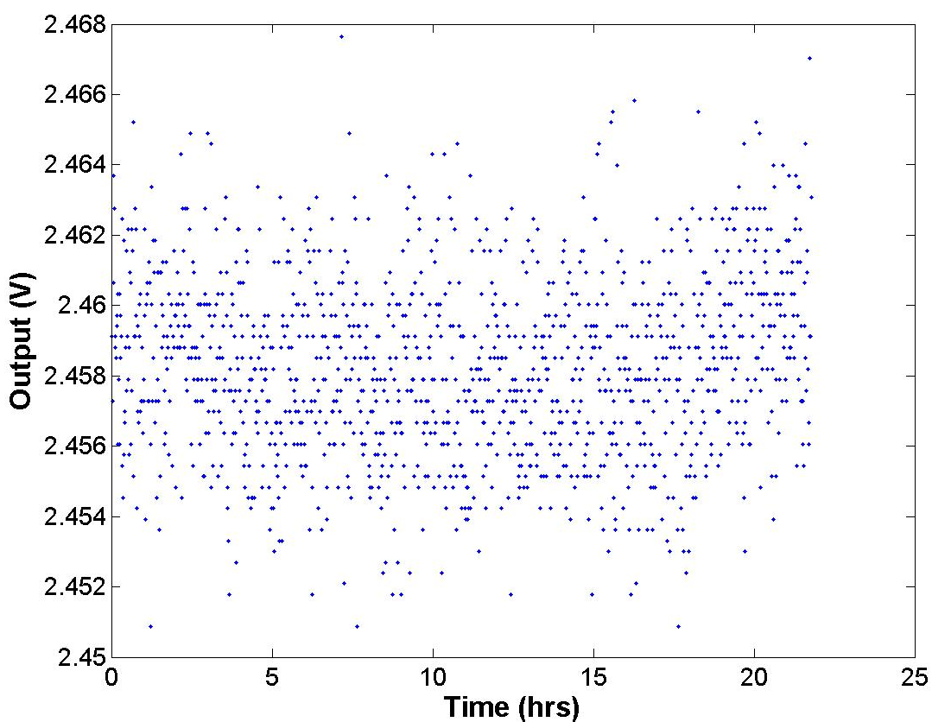
Rate Gyro Static Test 1

Slide 8
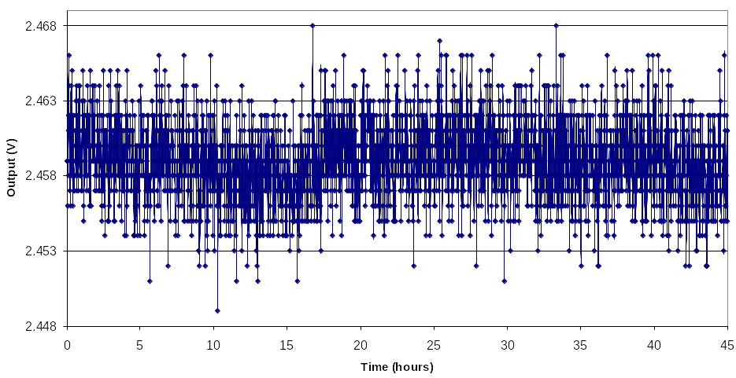
Rate Gyro Static Test 2

Slide 9
Current Issues
Reaction Wheel
  Issue: Press fit onto motor shaft
    Resolution: Slip fit
      Hi Sol 9460 Epoxy “Rhino Snot”
  Issue: Reaction wheel volume problems (multi-axis integration)
    Resolution: Hallowed out shell
    Resolution: Having the motors mounted in the center rather then the sides

Slide 10
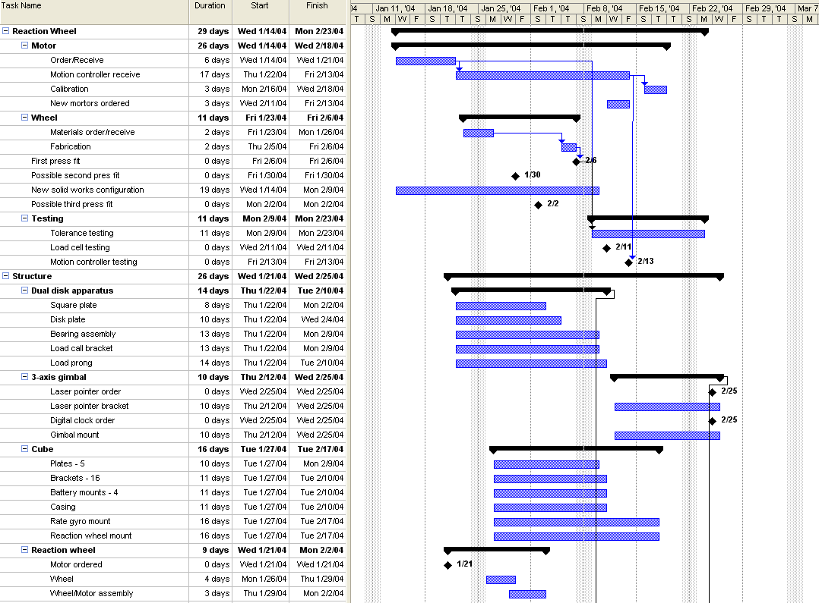

Slide 11
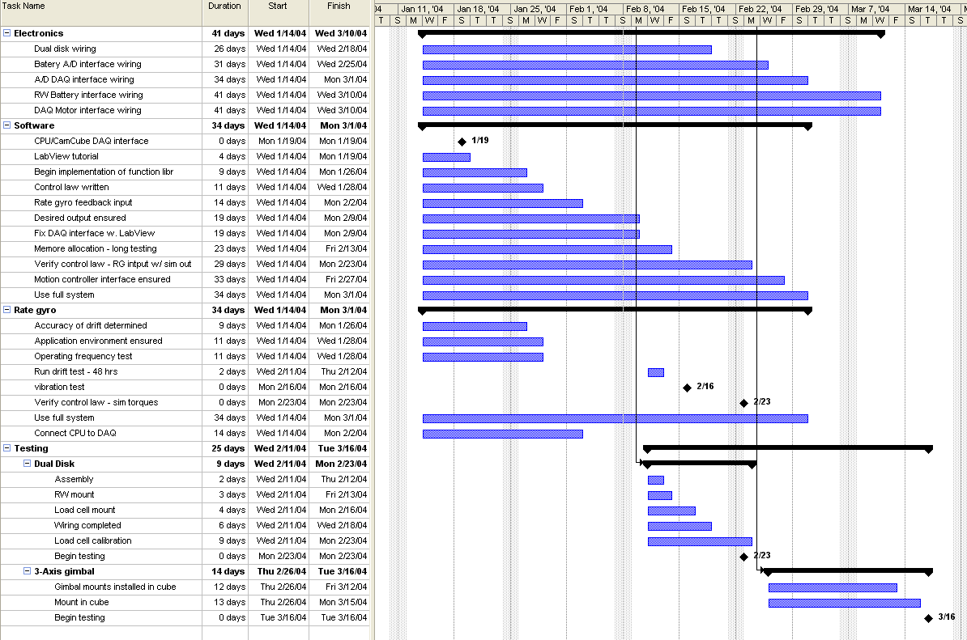

Slide 12
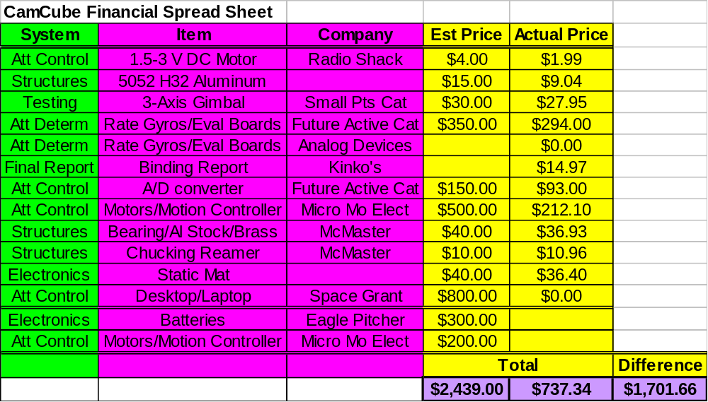
Budget Progress

Slide 13
Conclusion
Resolved Issues
  Reaction Wheel
  Software
  Electrical Schematics
Design Summary
Current Issues
  Battery
  Rate Gyro
  Reaction Wheel Design
Schedule Progress
Budget Progress

Slide 14
Questions

