Slide 1
PHP
By
Gursimar Kaur (1715372), Kunika Malhotra (1706461)

Slide 2
Introduction
"PHP: Hypertext Pre-processor”
Server side scripting language
Helps in making dynamic and interactive web pages
Widely used because
Free and open-source.
Runs on various platforms
Compatible with various servers
Supports wide range od databases
Easy to learn and runs efficiently on server side
PHP 7 is the latest stable version after PHP 5.6
PHP files are saved with ‘.php’ extension

Slide 3

Set up php on your pc
Install a web server
Install PHP
Install a database, such as MySQL

Slide 4
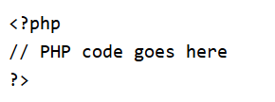
Syntax of php
A PHP script is executed on the server, and the plain HTML result is sent back to the browser.
A PHP script can be placed anywhere in the document.
A PHP script starts with <?php and ends with ?>

Slide 5
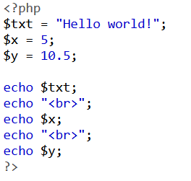
Php variables
Variables are "containers" for storing information.
A variable starts with ‘$’ sign, followed by the variable name.

Slide 6
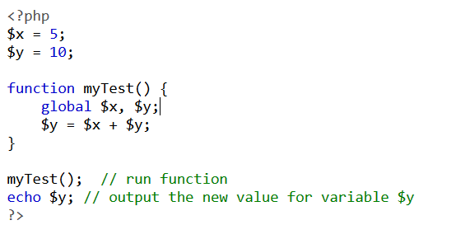
Types of variables
Local variables
Static variables
Global variables

Slide 7
Data types
Variables can store data of different types, and different data types can do different things.
PHP supports the following data types:
String
Integer
Float (floating point numbers - also called double)
Boolean
Array
Object
NULL
Resource

Slide 8
Strings
A string is a sequence of characters, like "Hello world!".
String Functions are as follows:
strlen(text) - Return the Length of a String
str_word_count(text) - Count the Number of Words in a String
strrev(text) - Reverse a String
strpos(text, word) - Search For a Text Within a String
str_replace(word, replaced_word, text) - Replace Text Within a String

Slide 9
Constants
A constant is an identifier (name) for a simple value.
The value cannot be changed during the script.
define() method is used.
Constants are global.
Syntax:
define(name, value, case-insensitive)
Name: Specifies the name of the constant
Value: Specifies the value of the constant
Case insensitive: Specifies whether the constant name should be case-insensitive. Default is false

Slide 10
Control Statements
CONDITIONAL STATEMENTS:
if
if …else
if …elseif…else
Switch statement
LOOPS:
while
do.. While
for
foreach

Slide 11
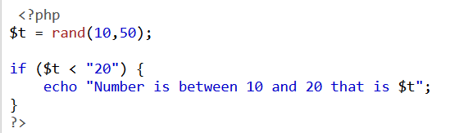
if
if (condition) { code to be executed if condition is true; }

Slide 12
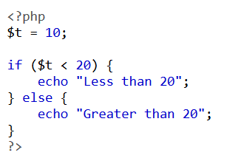
If…else
if (condition) { code to be executed if condition is true; } else { code to be executed if condition is false; }

Slide 13
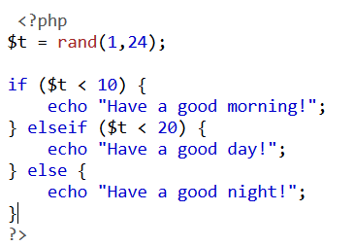
If…elseif…else
if (condition) { code to be executed if this condition is true; } elseif (condition) { code to be executed if first condition is false and this condition is true; } else { code to be executed if all conditions are false; }

Slide 14
switch
switch (n) { case label1: code to be executed if n=label1; break; case label2: code to be executed if n=label2; break; case label3: code to be executed if n=label3; break; ... default: code to be executed if n is different from all labels; }

Slide 15
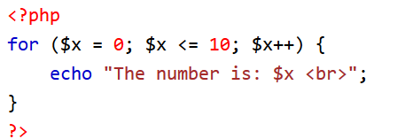
for
for (init counter; test counter; increment counter) { code to be executed; }

Slide 16
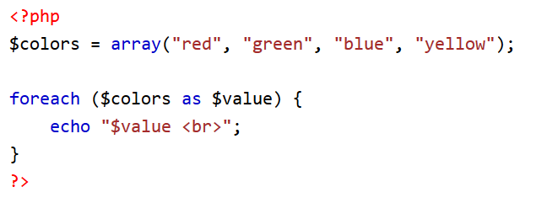
For each
foreach ($array as $value) { code to be executed; }

Slide 17
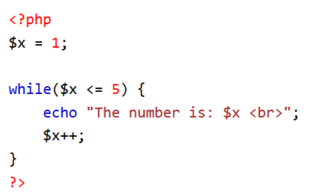
while
while (condition is true) { code to be executed; }

Slide 18
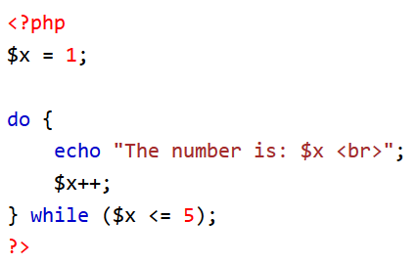
Do while
do { code to be executed; } while (condition is true);

