Slide 1






Ingoude Company
Invictus Presents:
FemmeFund
Startup Pitch Deck
Digital Gateway
For Investments in
Women Entreprenuers
PRESENTATION

Slide 2
Problem
Women Entrepreners face various problems that we aim to solve
01
03
02
Some of the common challenges include limited access to funding, lack of support, and gender biases.
Women may struggle to be taken seriously and earn respect, facing biases and stereotypes.
Limited access to established networks and mentors can hinder business growth for women entrepreneurs.

Slide 3

Our Mission
Providing an environment where businesses can be showcased effeciently
01
We wish to boost opportunities for female lead businesses, providing them seamless scalability on merit basis
02
Providing Investors that have no gender bias to create equal oppurtunities
03
Driving Economic growth for both Investors and Female Business Owners

Slide 4

Our Product
Our vision is a world where every woman with a brilliant business idea has an equal opportunity to turn that dream into reality. We believe that diversity in business is a catalyst for innovation, growth, and positive change. By fostering an inclusive ecosystem, we aim to unleash the full potential of women-led businesses.

Slide 5


Functional Steps
A simple timeline of how your product or service came to be is a helpful way of visualizing your company's origin story.
Interested Investors can view financials and contact the entrepreneur
Step 3
Verified Info is shared and the investment can be made
Step 2
Step 1
Female Business Owners showcase their company’s info

Slide 6

Investment Oppurtunity
Reason 1
Globally, women represent about one in three high-growth entrepreneurs focused on national and international markets
Reason 2
The percentage of women-owned startups has been increasing, with 47% of women starting a business in the last year, compared to 44% of men

Slide 7
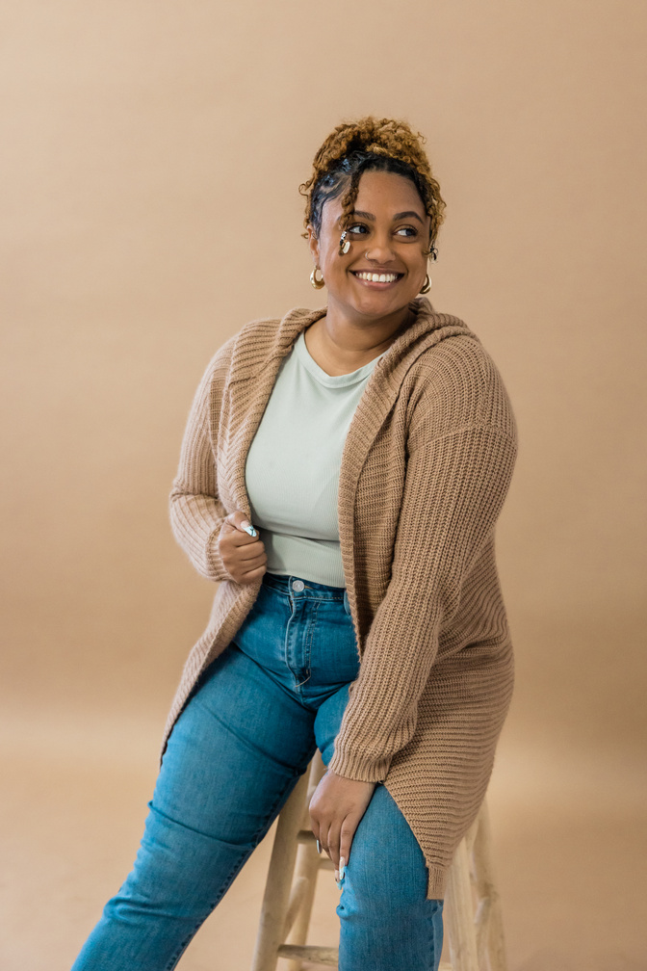

Security in Business
Investors
Business information verification will be done and Government IDs are stored
How entrepreneurs and investors are protected
Entrepreneur
Personal and Investor information is stored with the platform.

Slide 8




Contact Us
Email Address
femmefund@zohomail.in
Phone Number
9289829766
Mailing Address
Guru Tegh Bahadur Institute of Technology, New Delhi

