Slide 1
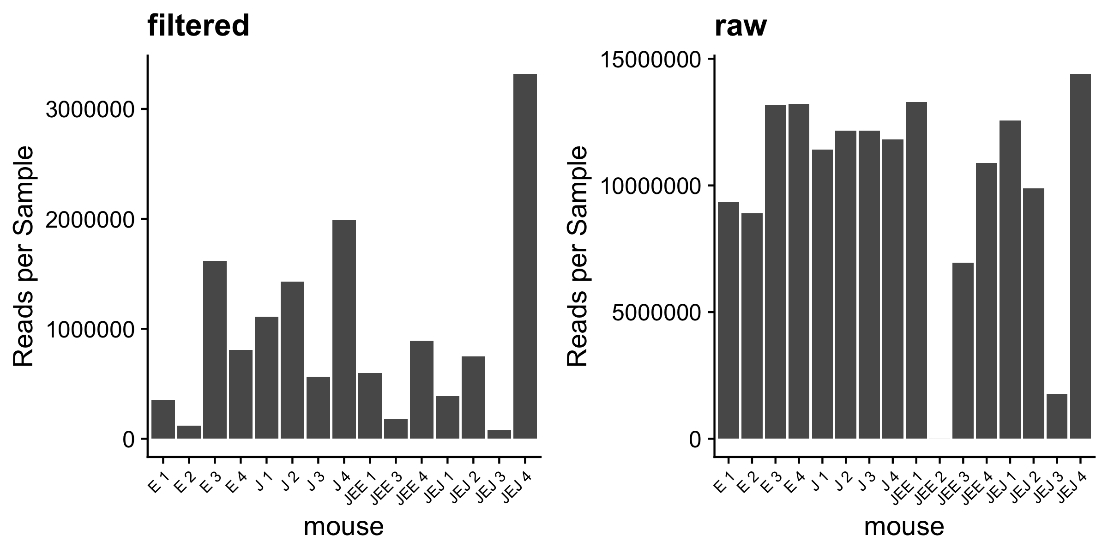
Reads per Sample

Slide 2
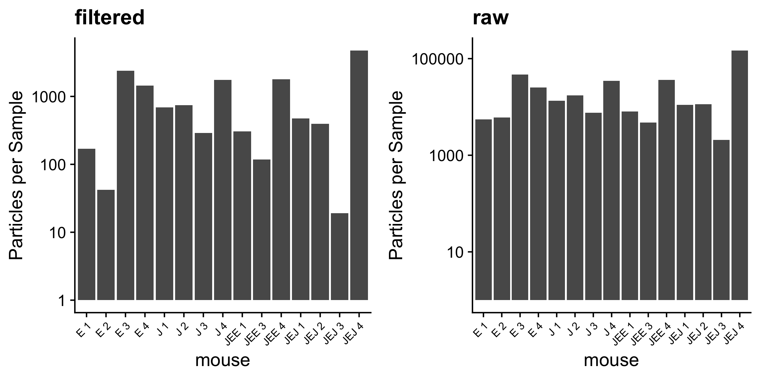
Particles per Sample

Slide 3
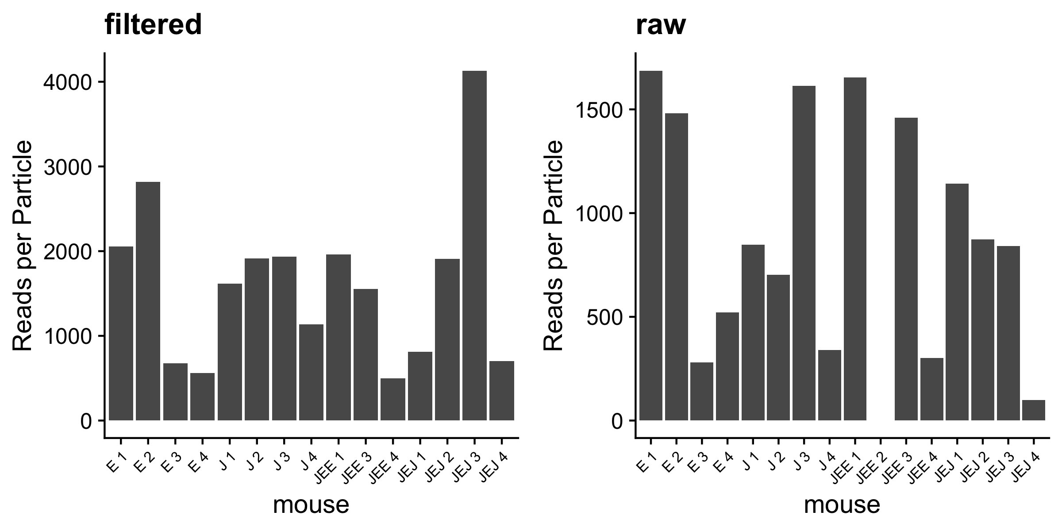
Reads/Particles per Sample

Slide 4
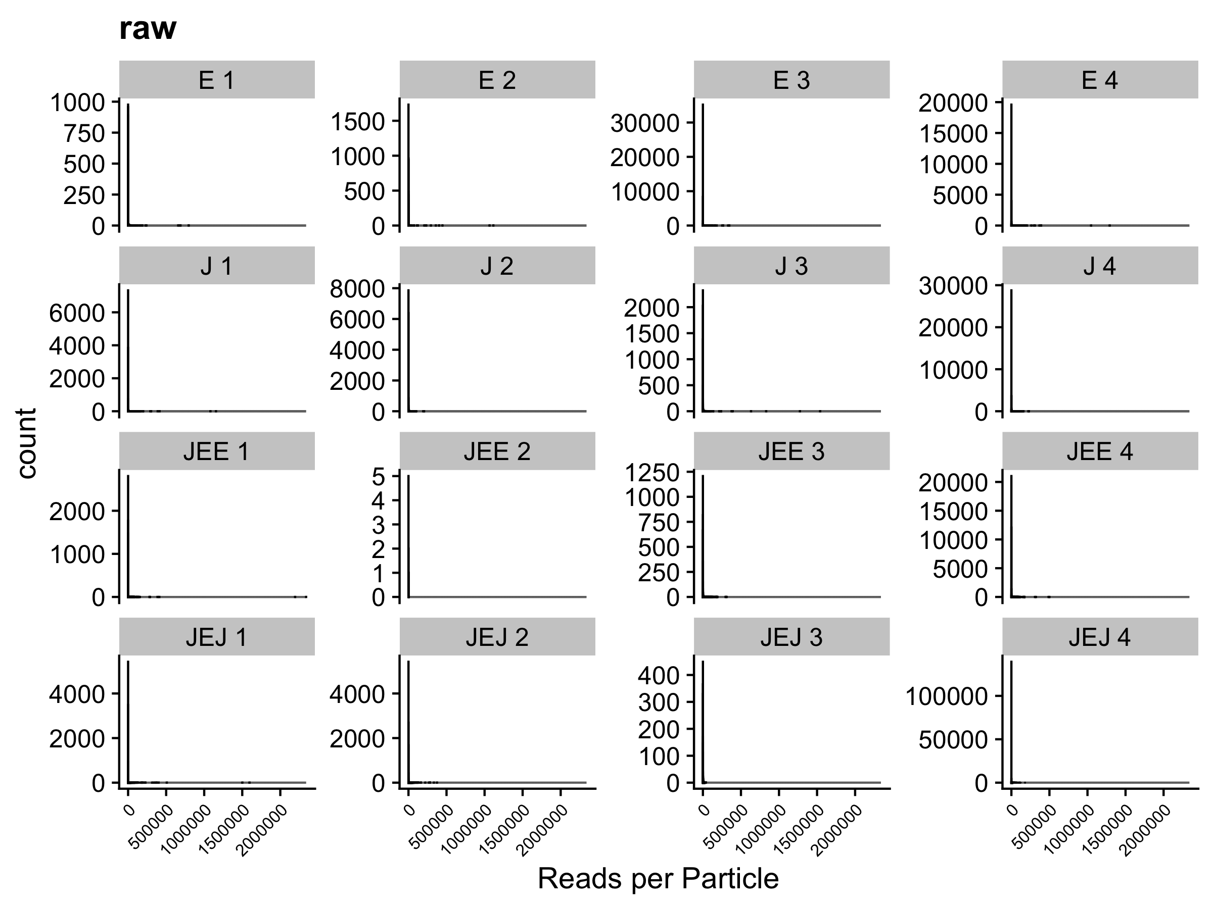
Distributions – Reads per Particle (filtered)

Slide 5
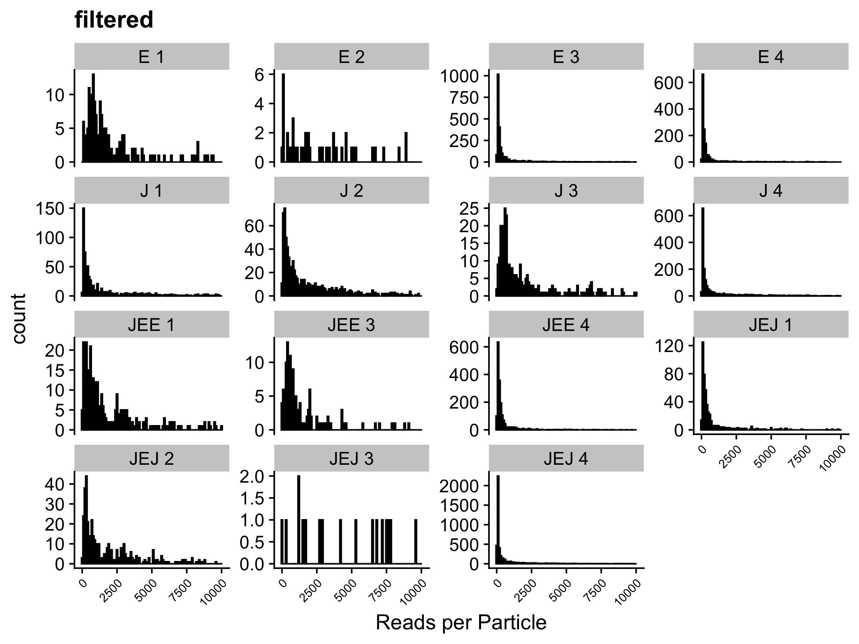
Distributions – Reads per Particle (filtered)

