Slide 1
Feb. 20th Update

Slide 2
Workflow
Tutorials followed:
  https://anvio.org/tutorials/fmt-mag-metabolism/
  https://merenlab.org/data/ibd-gut-metabolism/#normalization-of-pathway-copy-numbers-to-ppcn

Slide 3
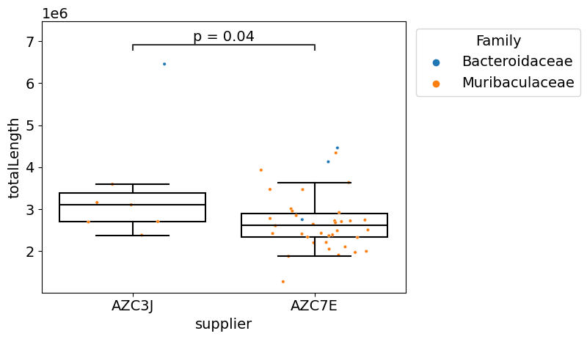
Workflow
Started with estimating the difference in genome length between J and E mice for Bacteroidaceae and Muribaculaceae in Bacteroidales
Mann-Whitney U Test Greater Than, no multi-correction used

Slide 4
Workflow
Started with converting fasta files for each MAG of E and J mice into contig databases
Annotated contig databased with KEGG KOfam hits
Estimate Metabolism → Pathwise genome completeness and stepwise genome completeness score for each module and for each MAG
  Pathwise: each possible enzyme combination in a metabolic pathway, focusing on the specific path an organism uses and reporting the one with the highest completeness.
  Stepwise: whether any enzyme required for each major step of the pathway is present, providing an overall completeness score based on the proportion of complete steps.

Slide 5
Workflow
Enrichment analysis
  Generated a list of highly enriched modules in both cohorts
Performed one-sample t-test between E and J cohort on genome completeness for each highly enriched module, no multi-correction used
M00169, M00621, M00115, M00120, M00003, M00793, M00741, M00011, M00063, M00001, M00093, M00157, M00127, M00166, M00899, M00345, M00051, M00048, M00082, M00549, M00173, M00133, M00307, M00855

Slide 6
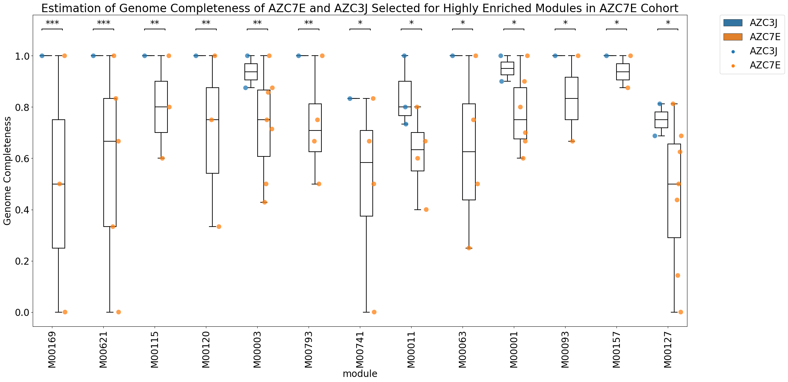

Slide 7
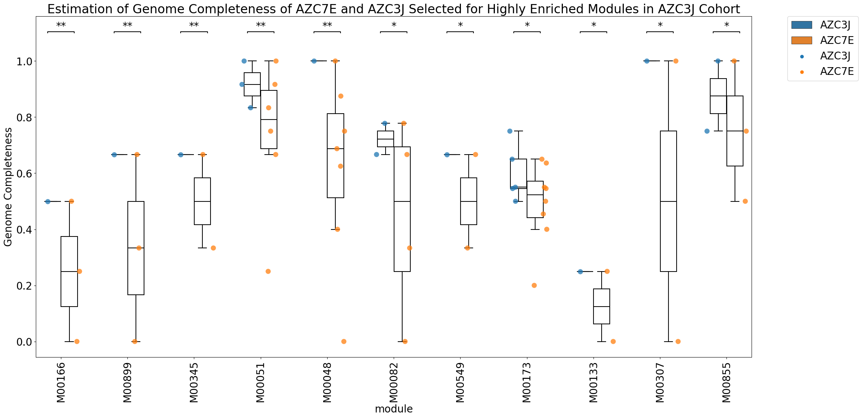

Slide 8
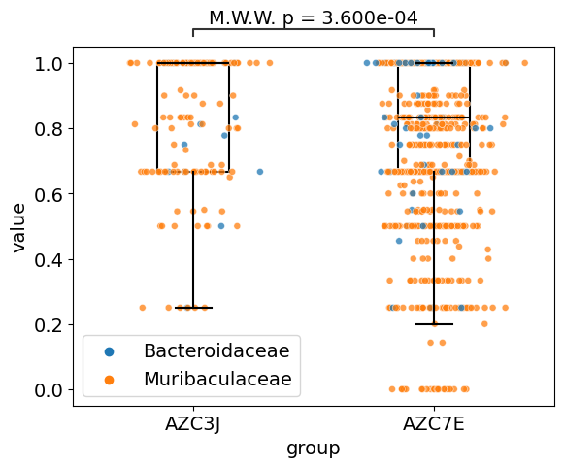
Workflow
Estimation of genome completeness score between two E and J across the selected modules
Mann-Whitney U Test Greater Than, no multi-correction used

Slide 9
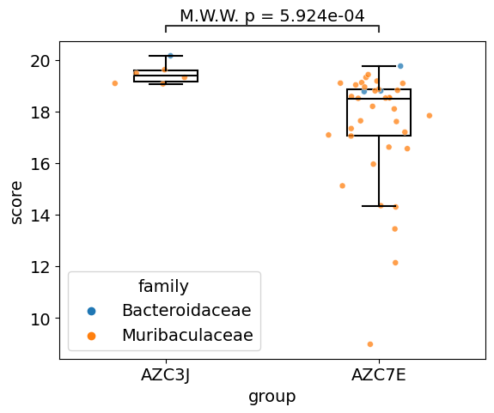
Workflow
Calculated metabolic independence score for the selected modules
Mann-Whitney U Test Greater Than, no multi-correction used

Slide 10

Are Super-Colonizers Metabolically independent?
‘Metabolic Independence’ = Genomes encode complete metabolic modules

Slide 11
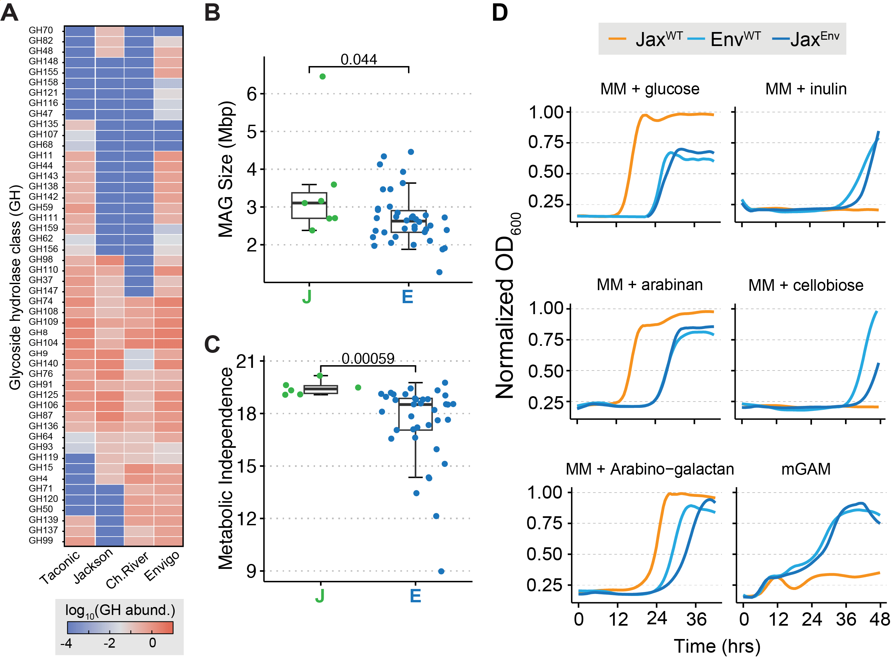
Super-Colonizers have smaller MAGs

Slide 12
Super-Colonizer MAGs have reduced ‘independence’

Slide 13
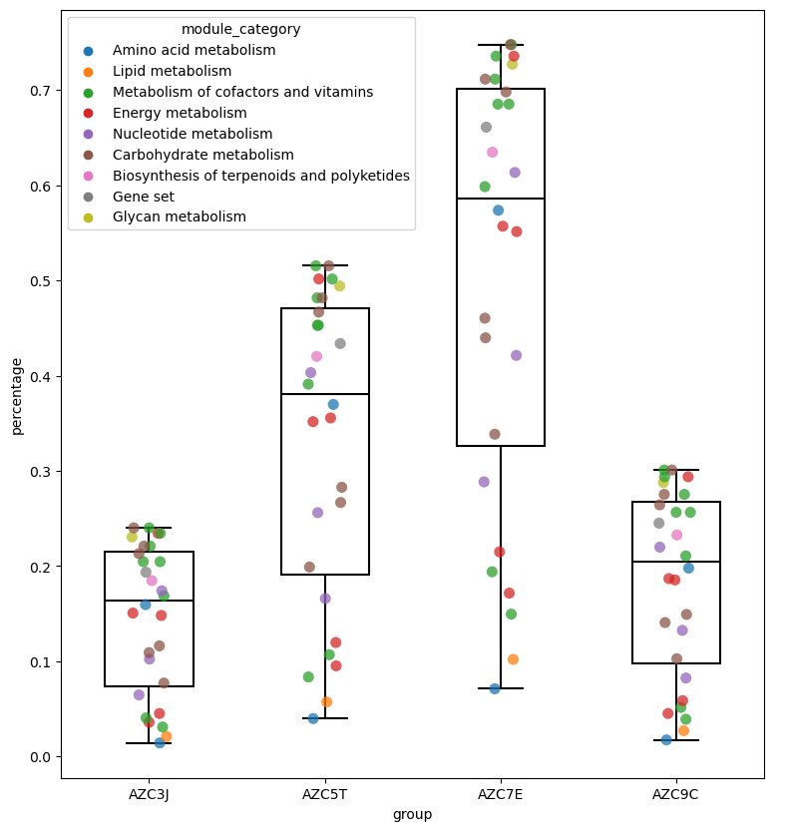
Super-Colonizers communities are
more metabolically complete overall
Community-level ‘Module Completeness’

