Slide 1
HydroCare
Smart Daily Hydration Tracker · Android Application
Gurtej Singh Lamba – 2427030405
Ananya Gupta – 2427030166

Slide 2
Problem Statement
• Dehydration is a widespread, preventable health problem
  – Most people under-drink on hot days without realising it
  – Existing apps use a single fixed daily goal for everyone
  – No awareness of changing environmental conditions
•
Key Facts
• 75% of people are chronically mildly dehydrated
  – Water need increases ~500 ml for every +7°C rise in temperature
  – Simple reminders and visible progress dramatically improve compliance
•
HydroCare addresses this gap
  – Auto-adjusts goal based on real outdoor temperature
  – Tracks consistency with streaks and a 7-day visual chart
  – Sends smart reminders that stop once the goal is met

Slide 3
Proposed Solution
HydroCare: A context-aware hydration companion
•
• Weather-Based Goal
  – Fetches real temperature at user's location via Open-Meteo API
  – Below 25°C → 2,000 ml | 25–32°C → 2,500 ml | Above 32°C → 3,000 ml
•
• One-Tap Logging
  – +250 ml / +500 ml / +750 ml buttons — logs a drink in under 2 seconds
  – Timestamped log saved locally, auto-resets each midnight
•
• Streak Tracking
  – Counts consecutive days the daily goal is met
  – Displayed prominently to motivate return visits
•
• Smart Reminders
  – Hourly push notifications (30 min / 1 hr / 2 hr intervals)
  – Quiet hours 10 PM – 7 AM · Stops if goal already reached
•
• 7-Day History Chart
  – Canvas-drawn bar chart, no external library
  – Goal line per day · Blue = met, light blue = below goal

Slide 4
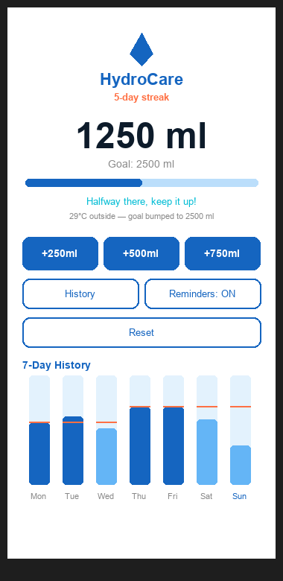
App Features at a Glance
Five core capabilities
•
• Weather-based daily goal (auto)
• One-tap drink logging with timestamps
• Live progress bar against today's goal
• Streak counter — consecutive goal days
• Smart hourly reminders with quiet hours
• 7-day history chart drawn on canvas
• Offline fallback — works without internet
• Auto midnight reset — no user action needed

Slide 5
Feature 1: Weather-Based Goal Setting
How it works
• On launch, app reads device GPS coordinates
  – Uses Android LocationManager (no library needed)
•
• Calls Open-Meteo API in a background thread
  – Free API, no registration or API key required
  – Endpoint: api.open-meteo.com/v1/forecast
•
Goal Thresholds
• Below 25°C → 2,000 ml (default cool)
• 25°C – 32°C → 2,500 ml (warm day boost)
• Above 32°C → 3,000 ml (hot day boost)
•
• Fails silently — defaults to 2,000 ml if
  – location permission denied, no internet,
  – or API times out

Slide 6
Feature 2: Streak Counter
What it tracks
• Consecutive days where the full daily goal was met
  – Displayed prominently below the app title
  – Orange bold text — high visual salience
•
How the streak is calculated
• On midnight reset, app saves previous day's
  – final intake and goal to SharedPreferences
  – Key format: intake_YYYY-MM-DD / goal_YYYY-MM-DD
•
• If previous intake >= goal → streak + 1
• Otherwise → streak resets to 0
•
Motivational impact
• Users are reluctant to break a streak
  – Creates a daily return habit
  – Shown even on Day 1 to encourage early momentum

Slide 7
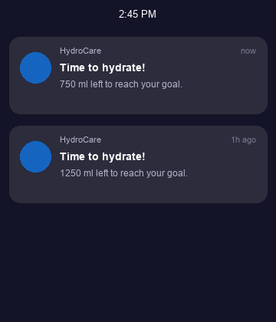
Feature 3: Smart Reminders
User-controlled push notifications
• Toggle button on main screen: Reminders OFF / ON
  – On Android 13+ requests POST_NOTIFICATIONS at runtime
•
Interval selection
• Every 30 minutes / Every 1 hour / Every 2 hours
  – AlarmManager.setInexactRepeating — battery efficient
  – Preference saved; survives app restart
•
Smart suppression
• Quiet hours: 10 PM – 7 AM → notification skipped
  – Goal already met → notification skipped
  – Shows remaining ml in notification body
•
Survives device reboot
• BootReceiver listens for BOOT_COMPLETED broadcast
  – Reschedules alarms automatically after reboot

Slide 8
Feature 4: 7-Day History Chart
Custom canvas-drawn bar chart
• HydroChartView extends android.view.View
  – No external library (no MPAndroidChart dependency)
  – Drawn entirely in onDraw() using Paint + Canvas
•
What it shows
• 7 bars — one per day, oldest left, today right
  – Dark blue bar = goal met that day
  – Light blue bar = below goal
  – Orange dashed line = that day's goal (weather-aware)
•
Data storage
• Each intake update writes intake_YYYY-MM-DD to prefs
  – Goal also written on each refresh
  – Today's bar updates live with every drink logged
•
Today highlighted
• Today's day label shown in bold blue

Slide 9
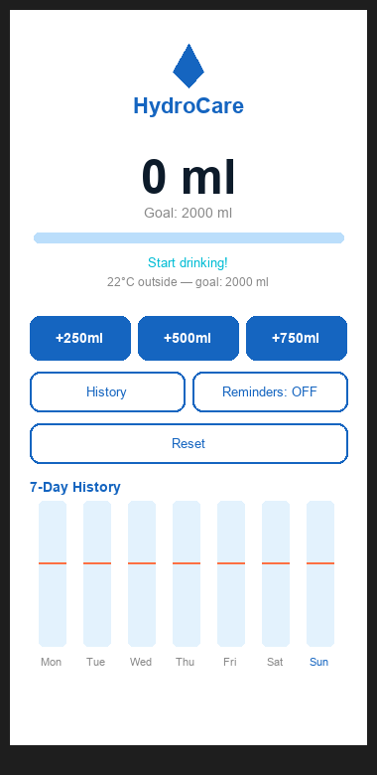
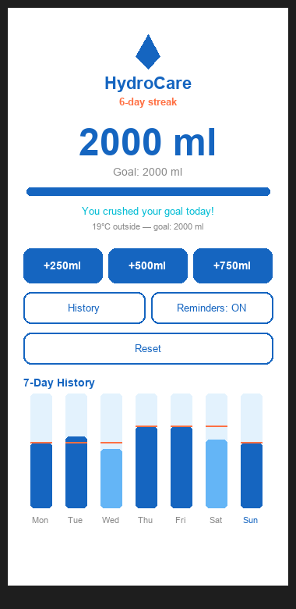
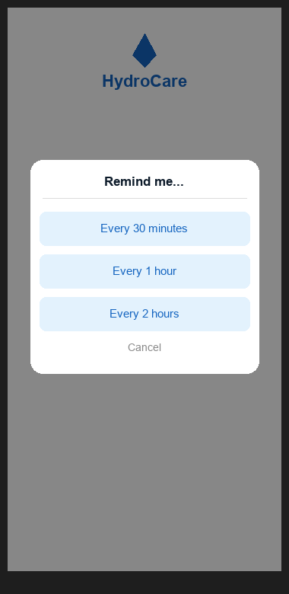
App Screenshots
1. Launch — 0 ml
2. Mid-day + streak
3. Goal reached
4. Reminder setup

Slide 10
App Screenshots (contd.)
5. Push notification
6. 7-day chart view

Slide 11
Architecture & Tech Stack
Android Components
• MainActivity Single Activity, all UI logic
• HydroChartView Custom View — 7-day canvas chart
• ReminderReceiver BroadcastReceiver — fires notification
• BootReceiver BroadcastReceiver — reschedules on reboot
•
Data & Storage
• SharedPreferences intake, goal, streak, history, preferences
  – No external database · Survives app kill, reboot
•
Networking
• HttpURLConnection Built-in, background thread
• Open-Meteo API Free, no key · temperature_2m field
•
Permissions
• ACCESS_COARSE_LOCATION GPS for weather
• POST_NOTIFICATIONS Runtime (Android 13+)
• RECEIVE_BOOT_COMPLETED Reschedule alarms

Slide 12
Technology Stack
• Language Java (Android SDK 26+)
• IDE Android Studio
• Min / Target SDK API 26 (Android 8.0) / API 37
• UI Toolkit XML Layouts + Material Components 3
• Charting Custom Canvas (no third-party library)
• Storage SharedPreferences (on-device key-value)
• Location Android LocationManager
• Networking HttpURLConnection (built-in)
• Weather API Open-Meteo (free, open-source, no key)
• Notifications NotificationCompat + AlarmManager
• Version Control Git
• Build System Gradle (Kotlin DSL)

Slide 13
Future Enhancements
Short-term
• Custom goal calculator (body weight × 35 ml/kg)
  – Custom amount input (any ml, not just presets)
  – Dark mode (Material3 DayNight theme)
•
Medium-term
• Drink type tracking (coffee, juice, tea — hydration multipliers)
  – Milestone badges (first goal, 7-day streak, 1 L by noon)
  – Home screen widget (1×2: progress + one-tap +250ml)
•
Long-term
• Health app integration (Google Fit / Health Connect API)
  – Personalised ML model (learns from past habits)
  – Multi-profile support (family members on one device)
  – Export to CSV (share history with a doctor / trainer)

Slide 14
Conclusion
• HydroCare demonstrates that a focused, well-engineered
  – Android app can be genuinely useful without external libraries,
  – paid APIs, user accounts, or internet connectivity.
•
Key achievements
• Weather-aware dynamic goal — no comparable free app does this
  – Smart reminders that respect user context (quiet hours, goal met)
  – Streak system that converts a passive tracker into a daily habit
  – 7-day chart drawn with zero dependencies on canvas
•
Technical highlights
• Single-Activity architecture — minimal, fast, battery-friendly
  – All data on-device — no privacy concerns, works offline
  – Custom View from scratch — demonstrates Android drawing API
  – Alarm persistence across reboots — production-quality reliability
•
Thank You
• Gurtej Singh Lamba · 2427030405
• Ananya Gupta · 2427030166

