Slide 1
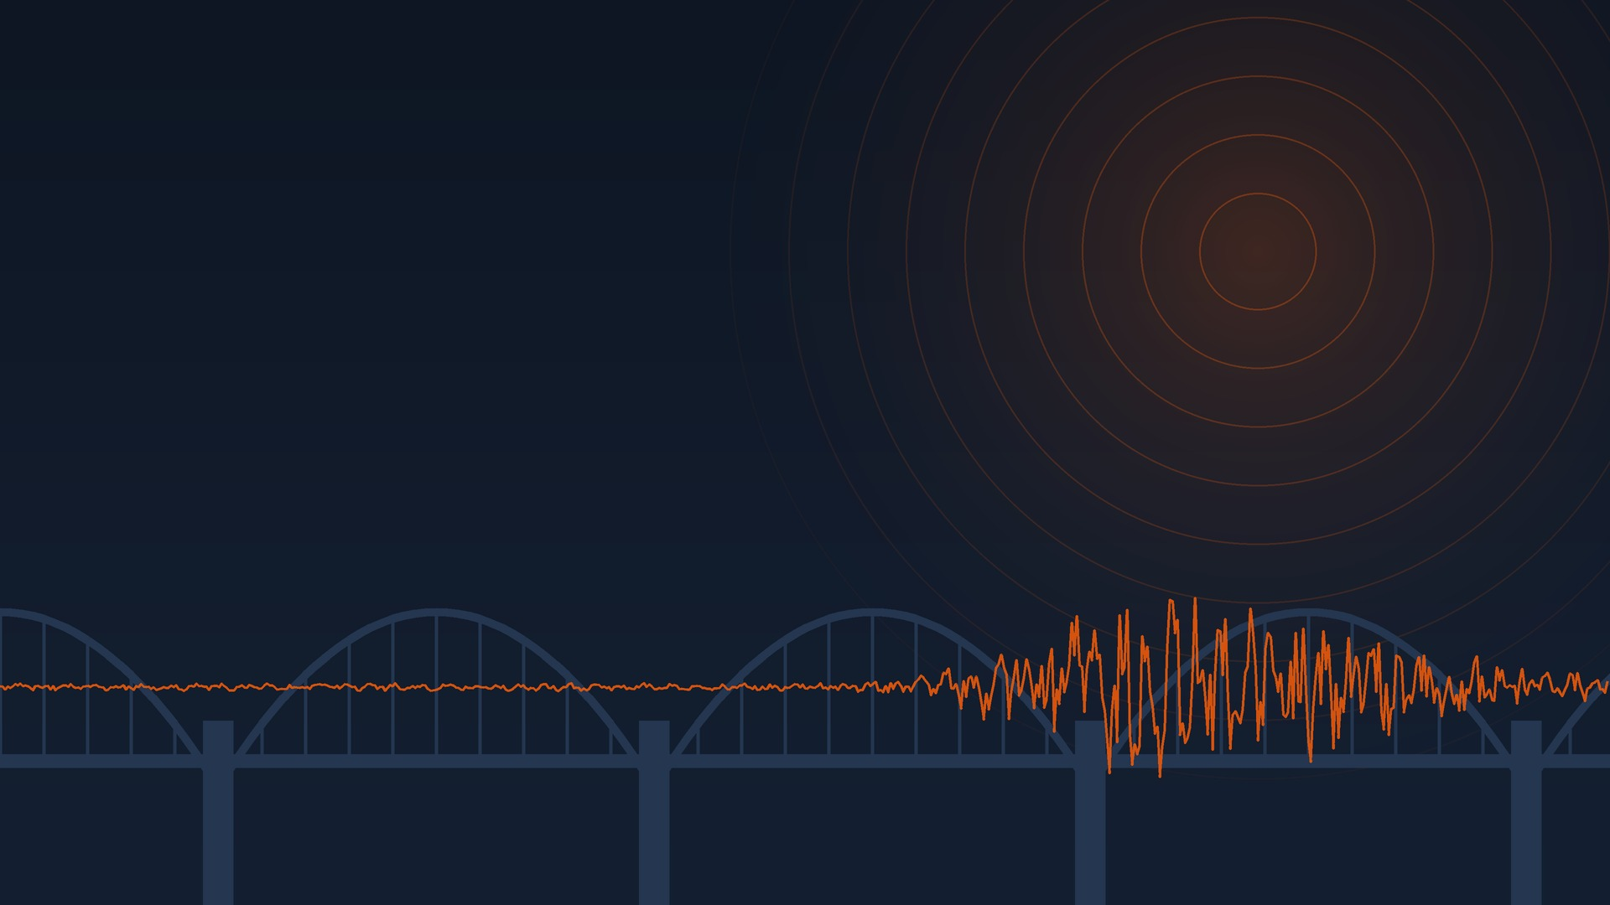
UE24CS352A · MACHINE LEARNING · PROBLEM #27
Predicting Bridge Damage under Earthquakes
Logistic Regression, QDA and KNN on 249 bridge and earthquake records
Guru R Bharadwaj PES1UG24CS177
Chukkapalli Rohan PES1UG24CS135
Section C, Team 3

Slide 2





The problem
Based on Jiang and Zhang, Stanford CS229 (2018)
Bridge age
years since it was built
Damaged (1)
Classifier
Logistic Regression
QDA
KNN
Earthquake magnitude
Richter scale
Undamaged (0)
Distance to epicentre
in miles
Our additions: material and bridge type as extra features, and a second model that predicts the damage level (none, moderate, collapse).

Slide 3

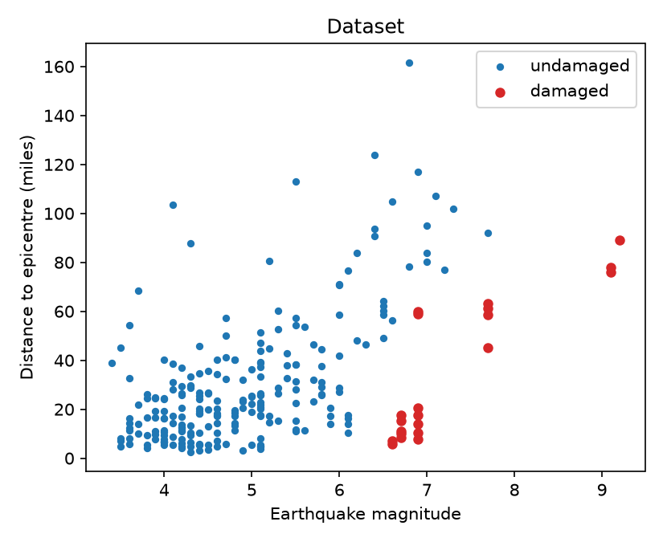
The data
249 bridge and earthquake pairs from the authors' ds2.csv
249
21
7
records
damaged (8.4%)
earthquakes behind every damaged row
Damaged rows come from government reports on famous earthquakes
Undamaged rows are other nearby USGS earthquakes, assuming no report means no damage
We checked our cleaned file against the original, row by row
Damaged bridges cluster at high magnitude and short distance

Slide 4



How we evaluated
The same pipeline for every model, repeated over 100 random splits
1
2
3
4
Split first
Up-sample train only
Fit three models
Score on the test set
Stratified 70/30, so the test set keeps the real 1:10 ratio
Bootstrap the damaged rows to ratios 0.2, 0.5 and 1.0
Scaled LogReg and KNN, QDA with reg_param 0.1, k picked by 5 fold CV on F1
Recall and precision on damaged, F1, balanced accuracy, ROC AUC
92%
accuracy from always saying "undamaged". So we don't rank models on accuracy.
Extra test
Split by earthquake, so no event is in both train and test

Slide 5




Code structure
src/data.py
src/models.py
train_evaluate.py
train_multiclass.py
load, split, bootstrap, group by earthquake
three models, choose k by CV
binary experiment, core or all features
damage level 1, 2 or 3
grouped_split.py
predict.py
results/
data/bridge_data.csv
test on unseen earthquakes
command line demo using the saved best model
every table and plot in these slides
the 249 cleaned records
Flow: data.py → models.py → train_evaluate.py → models/*.joblib → predict.py

Slide 6

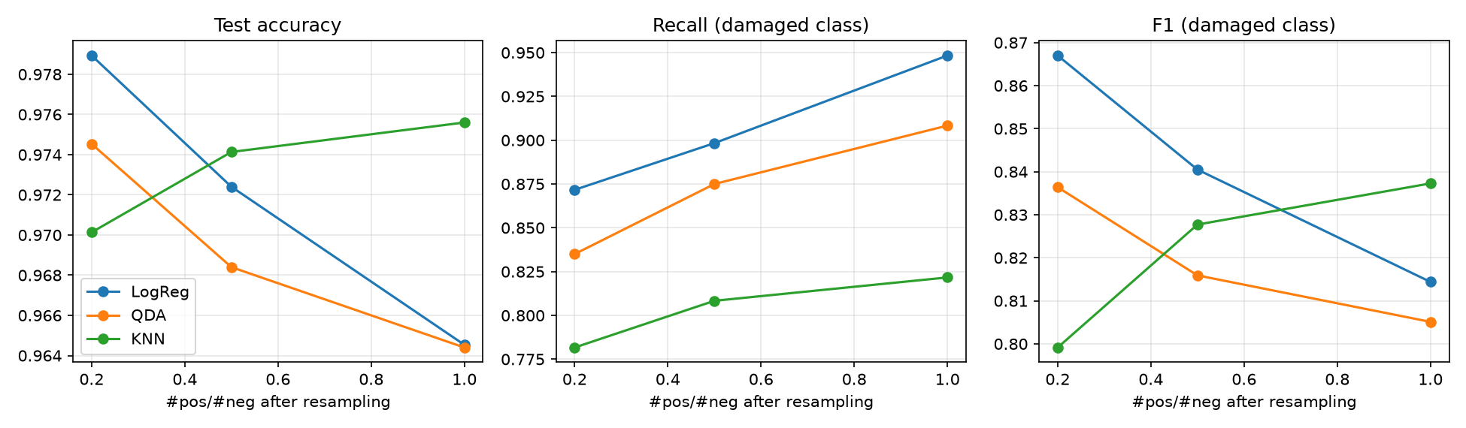
Results on random splits
Core features, mean of 100 runs over three ratios. Best value in each column in orange.
Model | Test acc | Balanced acc | Recall | Precision | F1 | AUC
Logistic Regression | 0.972 | 0.942 | 0.906 | 0.803 | 0.841 | 0.994
QDA | 0.969 | 0.925 | 0.873 | 0.793 | 0.819 | 0.992
KNN | 0.973 | 0.896 | 0.804 | 0.874 | 0.821 | 0.906

Slide 7




Testing on unseen earthquakes
2 of the 7 damaging earthquakes held out per run, 100 runs, up-sampling ratio 0.5
KNN 0.83 → 0.62
It was partly matching rows from the same event
Logistic Regression 0.84 → 0.76
Keeps recall at 0.91, but raises more false alarms
QDA 0.82 → 0.80
Barely moves, and becomes the best model, as the original paper found

Slide 8

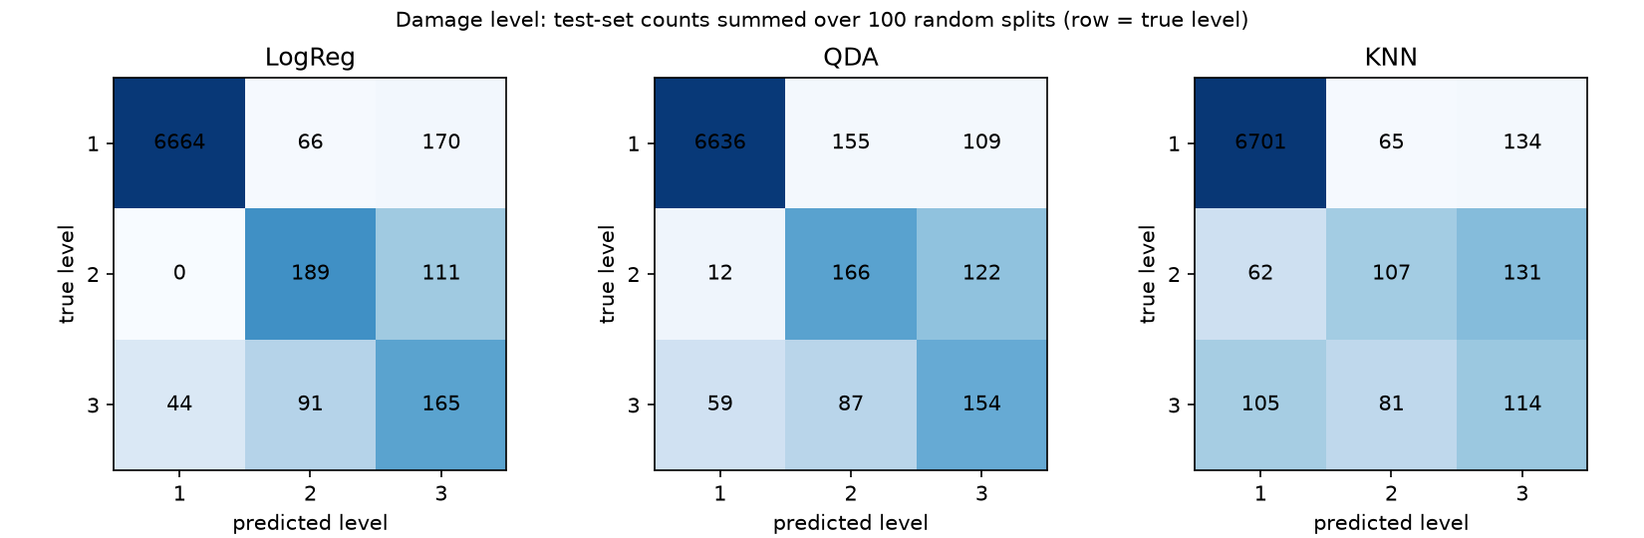
Extensions
Adding material and bridge type, and predicting the damage level
EXTRA FEATURES
DAMAGE LEVEL
SMALL CLASSES
0.841 → 0.849
Logistic Regression F1
0.821 → 0.672
KNN F1
0.66
macro F1, Logistic Regression
11 and 10
moderate and collapse rows
0.36 to 0.63
recall on those levels

Slide 9


Live demo
PowerShell · ML Proj
PS> python predict.py --age 53 --mag 6.9 --dist 60
Step 2: multiply by weights and add ... total (logit) 0.505
Step 3: sigmoid, 1 / (1 + e^-0.505) = 0.624
P(damaged) = 62.4% -> DAMAGED
PS> python predict.py --age 53 --mag 6.9 --dist 60 --material steel --type beam_girder
PS> python predict.py --age 20 --mag 4.5 --dist 40
The first input is the Bay Bridge in Loma Prieta 1989. The script shows each step of the calculation and the three most similar records in the data.

Slide 10

Conclusions
1
Age, magnitude and distance separate the classes well in this dataset
2
Under a fair split by earthquake, QDA is the most dependable model
3
Scores are optimistic: 7 big earthquakes supply every damaged row, so magnitude does most of the work
4
Undamaged labels rest on missing reports, and bootstrap only repeats the same 21 positives
5
More damaging events would help more than a different model

