Slide 1
CROSS LINGUAL TRANSFER
FOR NAMED ENTITY
RECOGNITION
Done by,
R.Guru Ravi Shanker
2018114011

Slide 2
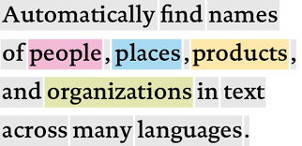
Named Entity Recognition
NER is a task in Information Extraction consisting in identifying and classifying just some types of information elements ,called Named Entities (NE) for example person , Location , Organisation , Association , Facilities , Material , Time , Date , Designation etc.
It is important to recognize NER cause
->The information transfer of sentences would increase.
It helps us in
->Efficient search engines.
->Giving better results for news providers regarding about which person or organisation is news about.

Slide 3
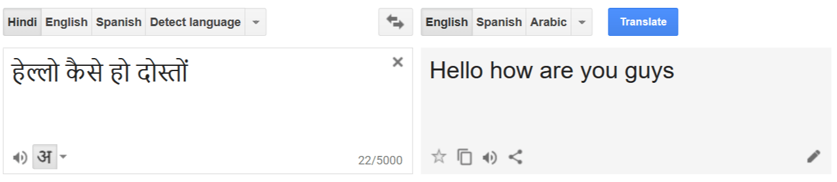
Crosslingual transfer:
->Crosslingual transfer (i.e. transfer from the mother tongue or any other previously learned language) in foreign language learning
->Here Source is Hindi and target is English .
->Considered word level mapping only
DATA USED
->Raw parallel corpus of 4300 English and Hindi were taken to transfer features from Hindi to English as data based on judiciary NER.
(hindi and english)
->A Hindi file with the mapping of NER or not an NER(o) test_file
(judicial-NER-final.txt)
->Took a parallel corpus of 37,729 lines of English and Hindi to find more accurately the word alignments for better performance of NER.
(training.hi-en.en and training.hi-en.hi)

Slide 4
USE OF GIZA++
->Used GIZA++ to find the word alignment between English and Hindi of the big corpus data for more accuracy in alignments.Some of the alignments from al.actual.ti.final
तुक्रिया Tukriya झीलें lakes संगमर्मर marble सफलता success
पोल Pol राहें paths ब्रह्मांडीय cosmic पशुओं animals
सम्भवत Probable 247 247 (२) (2) विनाश्न Vinashn
->Made a dictionary with the Hindi word as Key and value as English word mapped.Only considered alignments having greater than 0.6.
->Found the corresponding English train_data by using the dictionary.
(Commands in giza.txt)

Slide 5
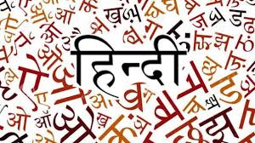
RUNNING Conditonal Random Fields ON HINDI DATA
(commands used in crf.txt)
Created a template_file considering only the present word
Template file: template_hin
Training Data has 2345 words starting of the NER mapping file.
Testing Data has 12470 words ending of the NER mapping file.
ACCURACY : 95.87% (report=eval-report-hin-ner-test and crf_output in pred-hin-ner and model in model-hin-ner)
(commands in crf.txt)

Slide 6

RUNNING Conditional Random Fields ON ENGLISH DATA
(commands used in crf.txt)
->Created template ,considering current,next,next’s next and previous words.
Template_file(template_eng)
->Training data has 12470 words obtained by getting the values from corresponding keys obtained from train-ner-hin if there is not present in dictionary the value is taken as NULL in train-ner-eng.
->Testing data has 2345 words obtained by translating(GOOGLE TRANSLATE) test-ner-hin in test-ner-eng.
ACCURACY - 77.53% (report=eval-report-eng-ner-test and output of CRF in pred-eng-ner and model in model-eng-ner)

Slide 7
CODES USED
1.py - To store in a dictionary of the word aligned with probabilities > 0.6
2.py - To remove the ged 4th columns for words having 3 columns to be consistent
3.py - Accuracy and precision checking code for conllval input to be given by redirection
4.py - To get error analysis for eng generated output model
awk NF file_name - To remove blank lines for input in python file

Slide 8

ERROR ANALYSIS(error.txt):
->The alignments are correct up to certain accuracy so the training data is not 100% correct.
->It is not recognizing the Named Entities separated by spaces.
->Failed to recognize many numbers and years.

Slide 9
IMPROVING ACCURACY
->If number of iterations in GIZA++ is increased then the word alignments would be better and hence the train-ner-eng would be better for interlingual transfer.
->If we consider additional features like suffixes and prefixes of words in CRF or getting alignments by that we can increase the accuracy.

Slide 10


