Slide 1
SEMANTIC TEXTUAL SIMILARITY
TEAM preNLPians
Jashn Arora (2018114006)
Guru Ravi Shanker(2018114011)
Mentor - Prahsant Kodali Sir

Slide 2
What is the task of semantic textual similarity?
Semantic textual similarity is the task of comparing two sentences and identifying the semantic relationship between them.
For example a paraphrase identification task is to identify whether two sentences are paraphrases or not.
Another task is the natural language inference task where the model has to check if the hypothesis sentence can be inferred from a premise sentence.

Slide 3
Datasets
Popular datasets for the task of Semantic Textual Similarities are Stanford Natural Language Inference 1.0(SNLI) dataset, Quora Paraphrases dataset(Quora), Microsoft Research Paraphrase Corpus(MRPC) corpus for paraphrase identification, STS benchmark tasks, SICK relatedness, amongst others.
For our paper we have utilized SNLI and Quora datasets for validating our model.
Note that both the dataset are different with respect to their task they are used for and are important tasks for evaluating Semantic Textual Similarity also known as Natural Language Sentence Matching(NLSM) tasks.

Slide 4
Dataset SNLI
The SNLI corpus (version 1.0) is a collection of 570k human-written English sentence pairs manually labeled for balanced classification with the labels entailment, contradiction, and neutral, supporting the task of natural language inference (NLI), also known as recognizing textual entailment (RTE). After some data preprocessing of removing the sentences in which a label could not be assigned the distribution of the dataset is as follows.We also maintained a balanced test dataset with distribution as follows for better hypotheses.
Total pairs | Train | Dev | Test
569033 | 549367 | 9824 | 9842
Entailment | Neutral | Contradiction
3368 | 3219 | 3237

Slide 5
Dataset Quora
The Quora Question Pairs dataset consists of over 400,000 pairs of questions on Quora. Systems must identify whether one question is a duplicate of the other. The distribution of the dataset is as follows. We can observe that this looks like an imbalanced dataset with a number of non-paraphrases.
But we maintained a balanced testing dataset with 5000 examples of paraphrases and non-paraphrases in the testing dataset.
Total Number | Paraphrases | Non-Paraphrases | Train | Dev | Test
404290 | 149263 | 255027 | 384290 | 10000 | 10000

Slide 6
Models Implemented
Baseline approach : implement a scale down version of the Bilateral multi-perspective matching (BIMPM) model with one matching layer taking reference from the paper titled ‘Bilateral Multi-Perspective Matching for Natural Language Sentences’ (Wang et.al, 2017)
Baseline+ approach : fine tuned on pre-trained transformer models of RoBERTa, XLNet and BERT

Slide 7
BIMPM

Slide 8

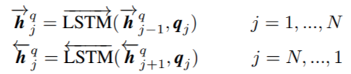
Architecture
The model consisted of five layers.
Word Representation Layer : The goal of this layer is to represent each word of the sentences P,Q with a d-dimensional vector. The d-dimensional vector had 2 components, the word embedding and character embedding concatenated together. The word embeddings were taken from pre-trained Glove vectors and the character embeddings is calculated by feeding each character within a word into a LSTM. The output of this layer are two sequences of word vectors P : [p1 , ..., pM] and Q : [q1 , ..., qN ].
Context Representation Layer : The purpose of this layer is to incorporate contextual information into the representation of each time step of P and Q using 2 BiLSTMs, one for each sentence P,Q.

Slide 9
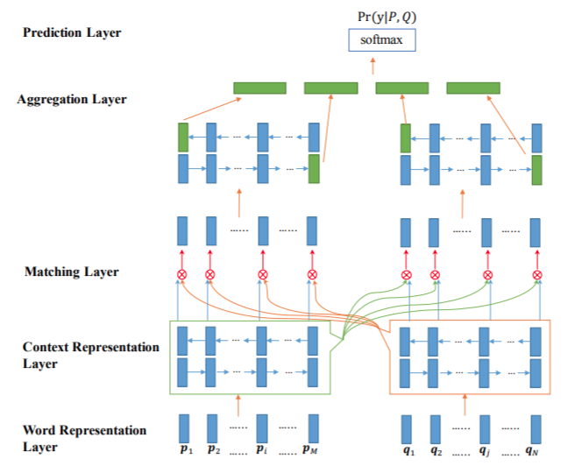

Slide 10

Architecture (Contd.)
Matching Layer : The goal of this layer is to compare each contextual embedding of one sentence against all contextual embeddings of the other sentence. We utilize a full matching layer in which each forward (or backward) contextual embedding is compared with the last time step of the forward (or backward) representation of the other sentence helps in comparing two sentences.
Aggregation Layer : This layer is employed to aggregate the two sequences of matching vectors into a fixed-length matching vector. Another BiLSTM model is applied to the two sequences of matching vectors individually. Then, a fixed-length matching vector is constructed by concatenating vectors from the last time-step of the BiLSTM models (shown in green in Fig. 1).

Slide 11
Architecture (Contd.)
Prediction Layer : The purpose of this layer is to evaluate the probability distribution Pr(y|P, Q). This layer consisted of a two layer feed-forward neural network to consume the fixed-length matching vector and softmax was applied in the output layer to give the final output which is a vector of size equal to the number of labels consisting of probabilities for each label.

Slide 12
BERT

Slide 13
Architecture
BERT makes use of Transformer, an attention mechanism that learns contextual relations between words (or sub-words) in a text. In its vanilla form, Transformer includes two separate mechanisms — an encoder that reads the text input and a decoder that produces a prediction for the task. Since BERT’s goal is to generate a language model, only the encoder mechanism is necessary.
As opposed to directional models, which read the text input sequentially (left-to-right or right-to-left), the Transformer encoder reads the entire sequence of words at once. This characteristic allows the model to learn the context of a word based on all of its surroundings (left and right of the word) with the help of positional embeddings. It is a masked Language model with 15% of the words in each sequence replaced with a [MASK].The model then attempts to predict the original value of the masked words, based on the context provided by the other, non-masked, words in the sequence , so it takes more time when compared to bidirectional models.

Slide 14
Architecture (Contd.)
The BERT loss function takes into consideration only the prediction of the masked values and ignores the prediction of the non-masked words. As a consequence, the model converges slower than directional models, a characteristic which is offset by its increased context awareness. Also in training next sentence prediction is also learnt by the model.When training the BERT model, Masked LM and Next Sentence Prediction are trained together, with the goal of minimizing the combined loss function of the two strategies.BERT and similar transformer models was easily fine tuned on our task of Semantic Textual Similarity.

Slide 15
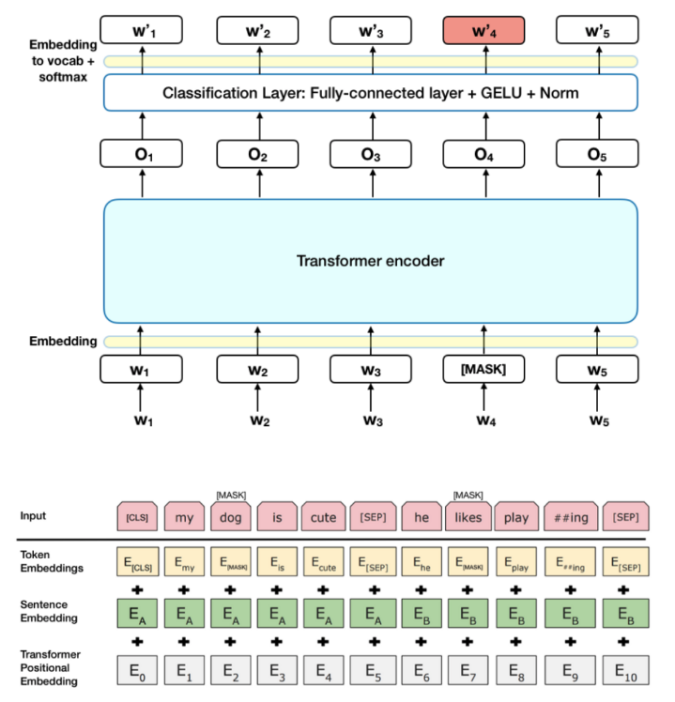

Slide 16
XLNET

Slide 17
Architecture
XLNet introduces permutation language modeling, where all tokens are predicted but in random order. This is in contrast to BERT’s masked language model where only the masked (15%) tokens are predicted. This helps the model to learn bidirectional relationships and therefore better handles dependencies and relations between words. In addition, Transformer XL was used as the base architecture, which showed good performance even in the absence of permutation-based training. It uses improved training methodology, larger data and more computational power to achieve better than BERT prediction metrics on 20 language tasks.

Slide 18
RoBERTa

Slide 19
Architecture
RoBERTa is an optimized BERT approach RoBERTa, is a retraining of BERT with improved training methodology, 1000% more data and compute power.RoBERTa removes the Next Sentence Prediction (NSP) task from BERT’s pre-training and introduces dynamic masking so that the masked token changes during the training epochs. Larger batch-training sizes were also found to be more useful in the training procedure. Due to this, RoBERTa outperforms both BERT and XLNet on GLUE benchmark results.
The batch size was taken as 128 and max length of sequence was considered as 128. We decided max length as 128 because the maximum sum of two sentences was only 120. We used the base transformer models as it is enough. We used the ADAMW optimizer with learning rate 2e-5. We also used adaptive learning rate with function lr*0.1^(epoch/40). We also add some weight decay as regularization to the main weight matrices.

Slide 20
RESULTS

Slide 21
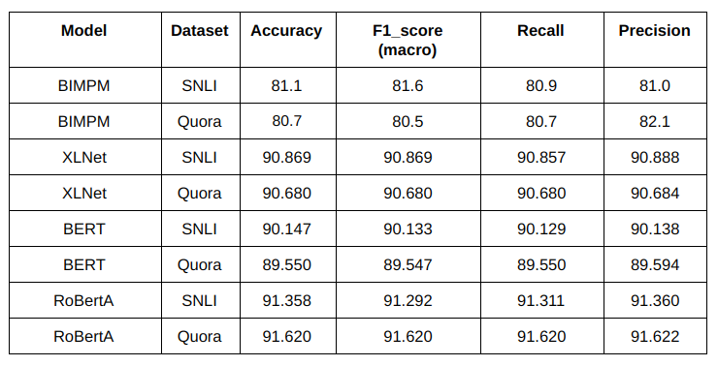

Slide 22
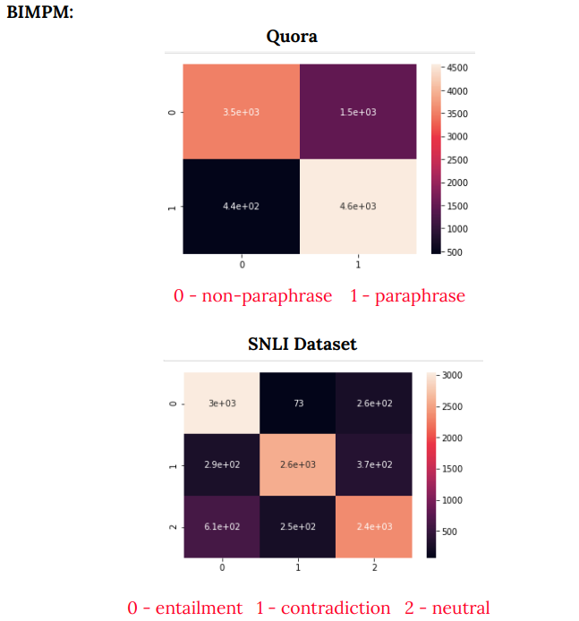

Slide 23
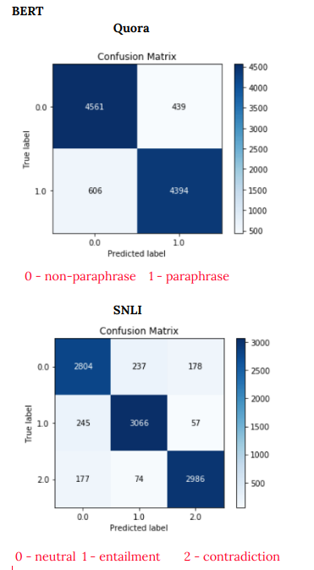
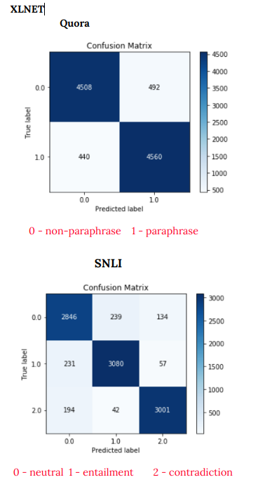
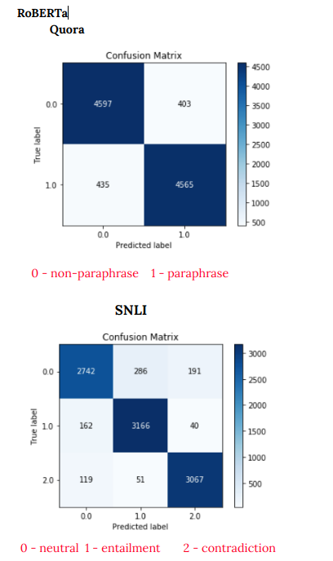

Slide 24
Analysis

Slide 25
Quora dataset
The task for this dataset was to predict whether the pair of questions were paraphrases of each other or not.
Out of 5000 non-paraphrases pairs about 30% (1479) of the pairs were predicted as paraphrases in the case of the BIMPM model but were predicted correctly for baseline+ models. Few of the examples are shown here:
How much revenue does it make ? q2: how much revenue does freeciv.net make ?
q1: what is the war on drugs ? q2: should we end the war on drugs ?
q1: difference between sociology and psychology ? q2: what is the difference between sociology and science
The above examples are the one where the question pairs become non-paraphrases of each other because of a single word inclusion.
Transformer models were able to correctly identify because they are better aware of the context and multi-head attention and positional embeddings both provide information about the relationship between different words. Non-sequential helps it to not to forget the information

Slide 26
Few examples of question pairs that were actually paraphrases of each other but were actually predicted as non-phrases are:
q1: how does one get uk-citizenship ? q2: how do i get uk citizenship ?
q1: what do you mean by science ? q2: what does science mean to you ?
q1: which is best iit in india ? q2: which is the best among iits ?
The above examples were identified correctly by the transformer architecture?
XLNet was able to capture longer dependencies when compared to BERT.
Label: 1 Pred: 0.0 Q1: Will I have an arranged or love marriage ? Q2:Will I have an arranged or love marriage ? I am Male , born 6th December , 1989 at 2:26 AM in Bicholim , Goa , India .
Adding a continuity in a question confuses BERT in determining it as a paraphrase.

Slide 27
SNLI dataset
The BIMPM model found difficulty in identifying contradictions whereas Baseline+ improved it significantly.
Baseline+ models along with BIMPM model found difficulty in differentiating entailment and neutral sentences.
Label: neutral Pred: entailment
Q1: The boy in pajama pants jumps off the sofa. Q2:The boy is bouncing on the sofa
Label: entailment Pred: neutral
Q1: Man jumping over a rusty fence on a blue bicycle. Q2:Man doing a trick riding his bicycle.

Slide 28
THANK YOU

