Slide 1


Assignment
Project Mentors :
Mrs. Priya R.L ,
Mrs. Nusrat Ansari
Group Number : 30
Group Members : J N Guru Akaash D17A 28
Ajay Nair D17A 55
Manigandan K D17A 47
Varun Tripathy D17A 69

Slide 2
Content
Introduction to the Assignment
Methodology employed (Solution)
Results and implementation screenshots
Conclusion

Slide 3
Introduction to the assignment
Task Given
Set uniform imgsz parameter to avoid stretching the image
Apply padding to all training and testing images for consistent results
Increase number of epochs for better predictions
Annotate remaining images in the dataset
Remove decimal points from the class set
Apply some image enhancement techniques to improve the accuracy
Tune the following hyperparameters in the predict function for better results:
Max det
NMS iou
Understand the background attribute in the confusion matrix.

Slide 4
Padding of Images and Annotations Modifications
All the frames (Images) front the video dataset, was converted into 960x960 pixels size by adding zeros at the top and bottom of the image.
The annotations file for each of the frames was updated.
Since the frame(Image) dimensions was changed to 960x960 so we had to change the annotations of the frame(Image) as well.

Slide 5
Epochs, Training Time and YOLO Model Parameter Tweaking
100 epochs were done.
50 epochs in one set and then another 50 epochs in another set.
Each set took around 8-9 hours to complete, so a total of around 16-18 hours to complete the full training of the custom dataset based YOLO v5 Model.
A batch size of 16 images was used.
model.iou=0.05
model.multi_label = False
model.conf=0.50
model.max_det = 18

Slide 6
Dataset and Class Modification
The video was made up of 3591 frames.
We used all the images for the training, validation and testing purposes.
Before the training of the YOLO Model, we removed the Decimal Point class (Class 10).
Now the dataset contains only 10 classes i.e.(Class 0, Class 1, Class 2, Class 3, Class 4, Class 5, Class 6, Class 7, Class 8, Class 9)

Slide 7
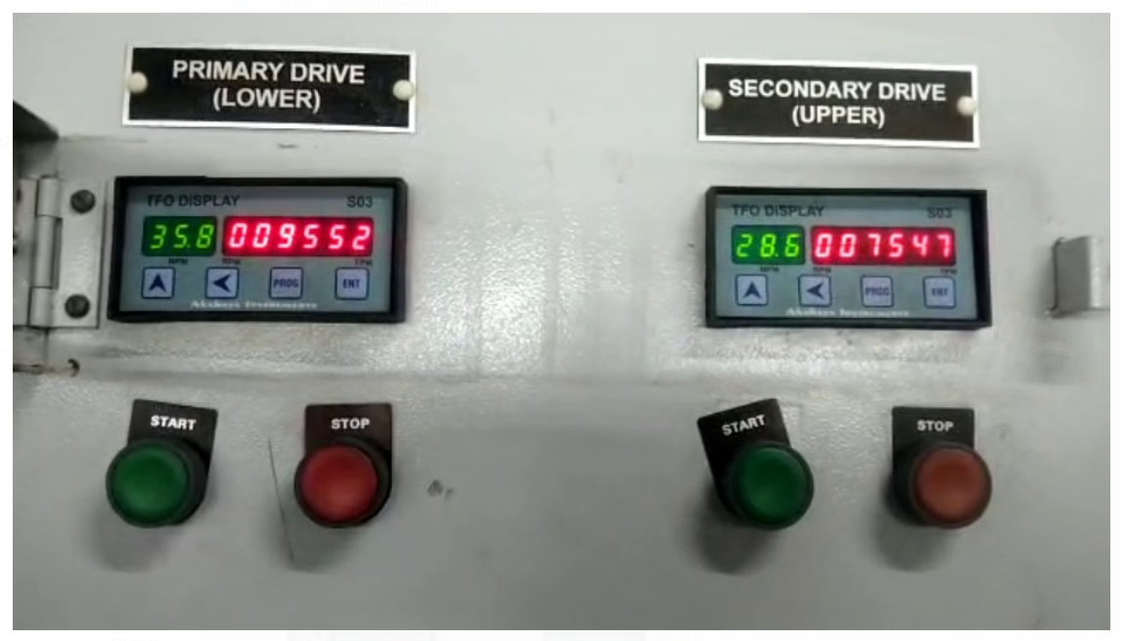
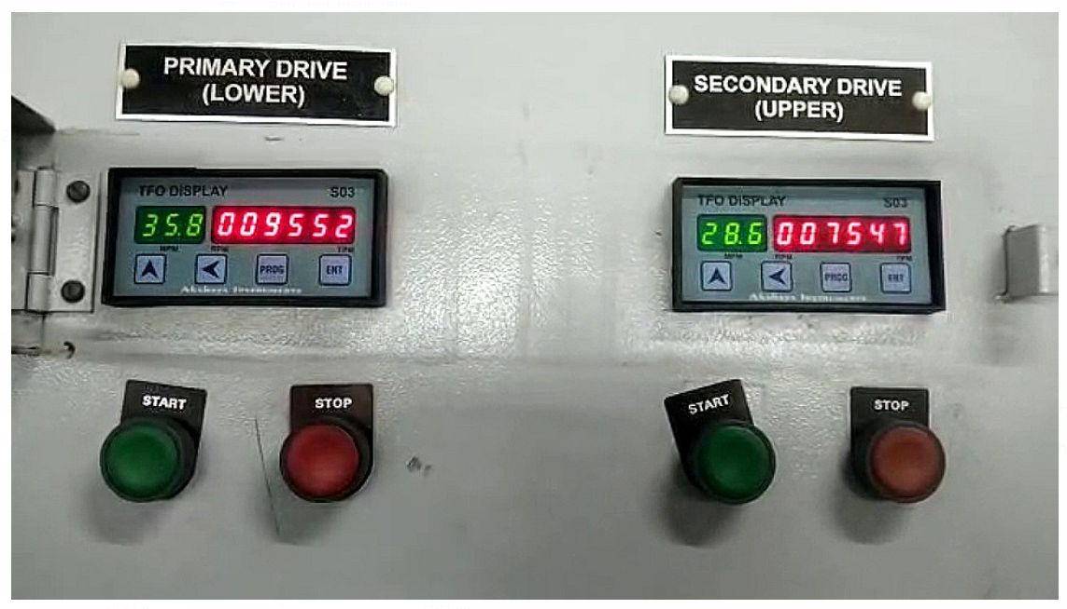
Image Enhancement
Original Image
Sharpen Image Enhancement Technique

Slide 8
Implementation on Single Test Image

Slide 9
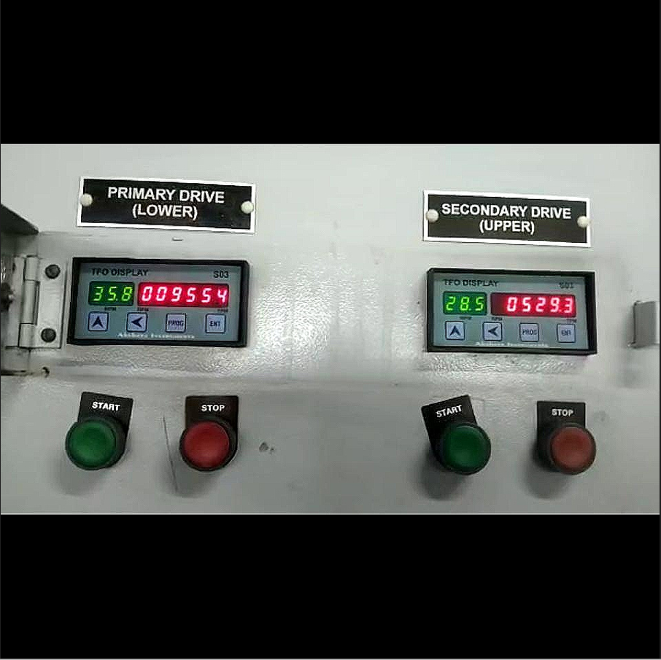
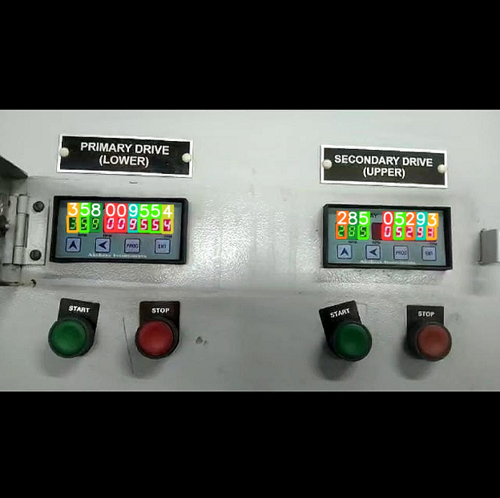
Implementation on single test image result
Original Frame Image
YOLO Model Predicted Bounding Boxes

Slide 10
Real Time YOLO Detection and Recognition Model

Slide 11
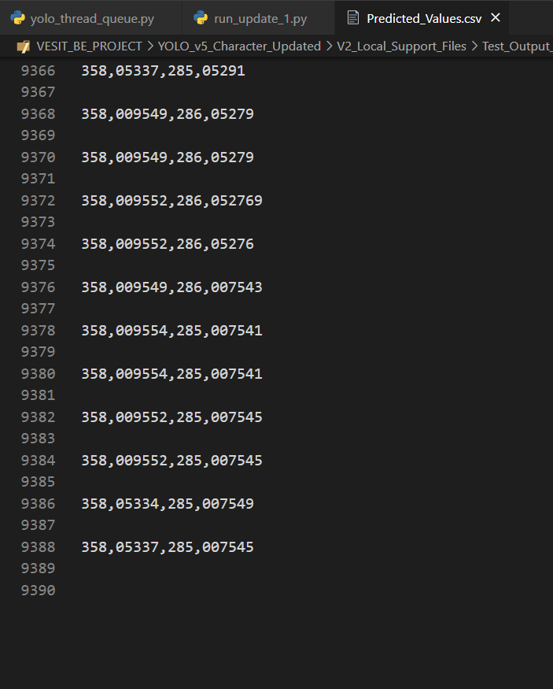
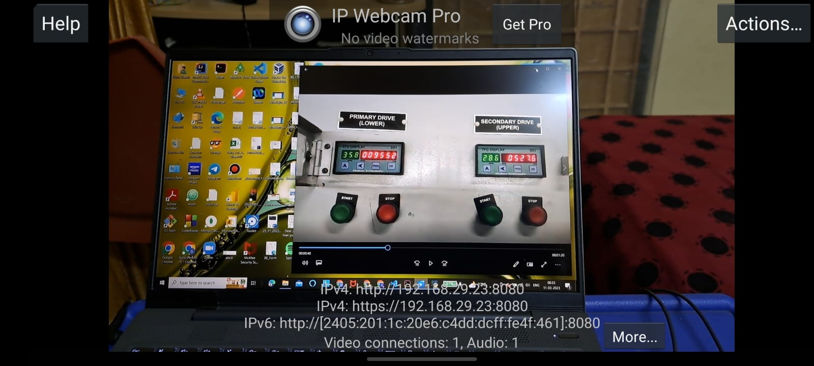
Real Time YOLO Detection and Recognition Model
IP Webcam Setup to extract real-time data from the video
Results obtained from each frame of the video added to .csv file

Slide 12
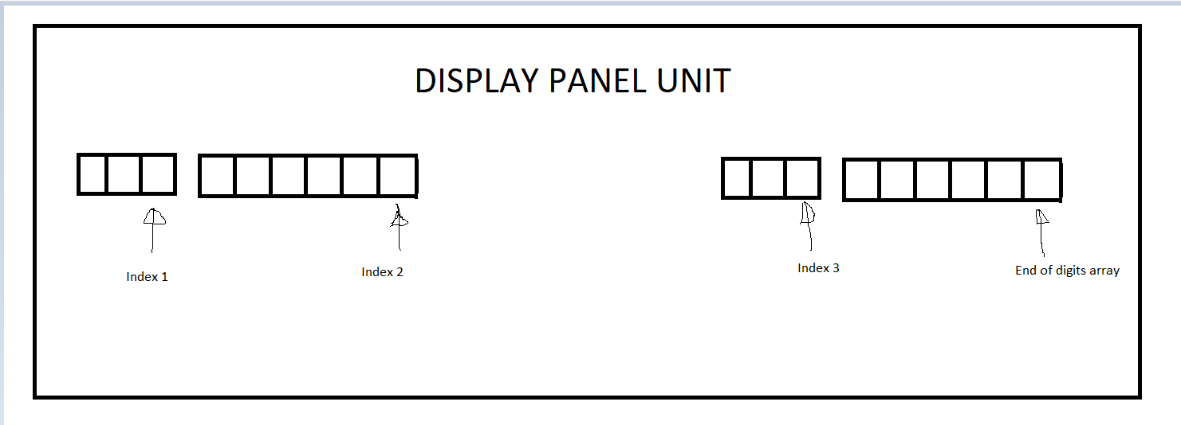
Merging Algorithm (To form a single valued number)

Slide 13
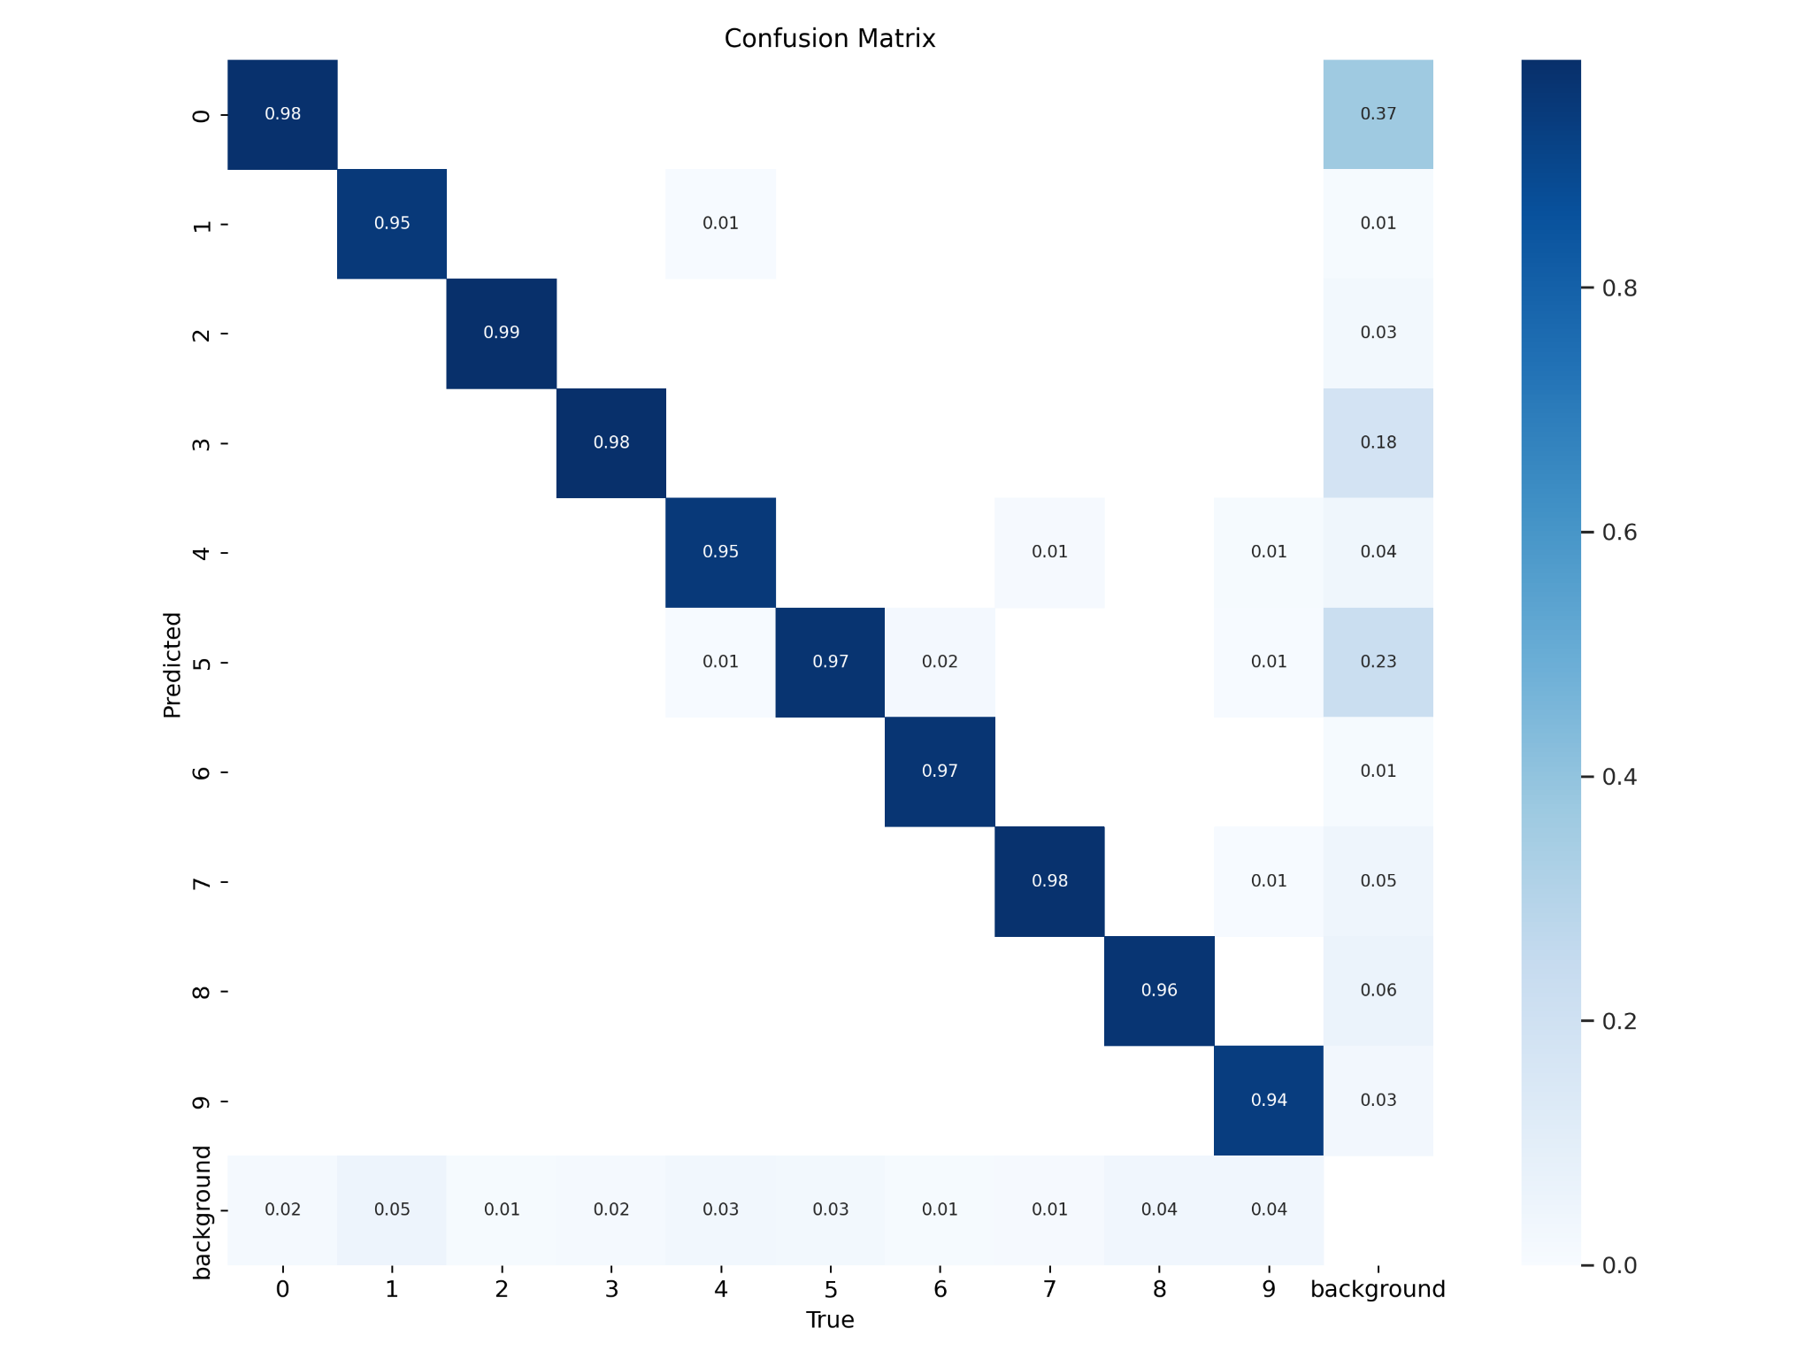
YOLO Model Performance Measures
Object detection is a bit different; understand it as follows.
Background FP refers to background objects that do not belong to either of the classes but detected as one of them.
Background FN refers to Trash or Non-trash objects missed by the detector and considered as some other background objects.
Overall Accuracy = 0.967 = 96.7%

Slide 14
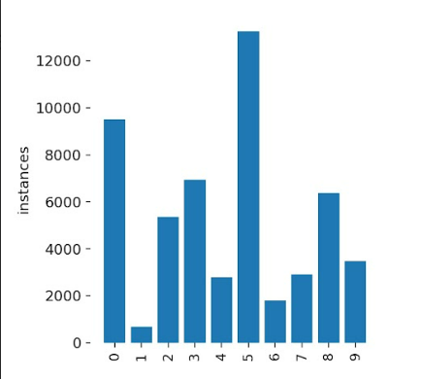
YOLO Model Label Instances

Slide 15
Conclusion
YOLO Model Pre-processing of data was done and implemented before training the Model.
Custom Dataset based YOLO Model training was Implemented successfully.
Digit Detection and Digit Recognition was implemented successfully.
Merging of the digits of each display (set) to form a single valued number was implemented successfully.
IP Webcam Integration with the custom trained YOLO Model was implemented successfully.
Real-Time YOLO Model for Digit Detection and Digit Recognition was implemented successfully.

