Slide 1


Facial recognition system using PyQt and OpenCV
Assignment 1
Project Mentors :
Mrs. Priya R.L ,
Mrs. Nusrat Ansari
Group Number : 31
Group Members : J N Guru Akaash D17A 28
Ajay Nair D17A 55
Manigandhan K D17A 47
Varun Tripathy D17A 69

Slide 2
Content
Introduction to Assignment
Methodology employed
Results and implementation screenshots
References

Slide 3
Introduction to the assignment
Task given
To create an image carousel that can read any images in a particular directory using PyQt and OpenCV and perform facial recognition on images by displaying a bounding box around the face.
Solution Introduction
The main aim of this assignment is to get a better understanding on the entire face detection process.
From a photo which can contain more than 1 faces, we will be detecting the face of the person using Python.
The final product will be a web-app which is built using PyQt, and the detection of the face is done using OpenCV.

Slide 4
Methodology Employed
The input to the project is a photo which can contain 1 or more then 1 person’s faces and the output is the bounding box around the faces of the person.
On the backend we convert the color image to grayscale, this step is done to reduce the noise in the image of the person.
Finally with the hello of OpenCV we try to detect the face.
The output in shown in the PyQt application.

Slide 5
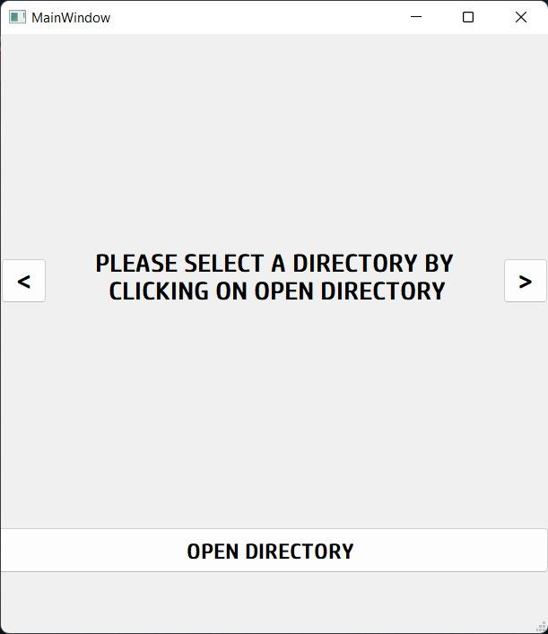
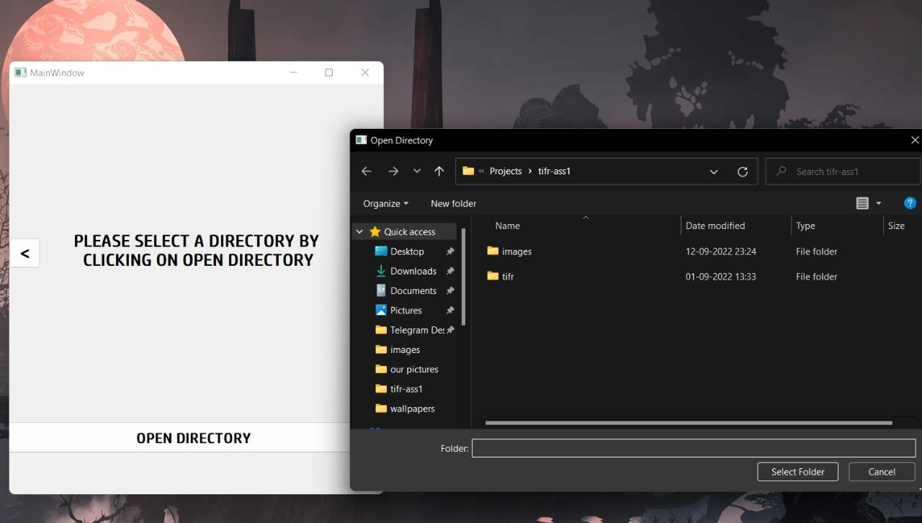
Results and implementation screenshots
Main Application
Opening the directory

Slide 6
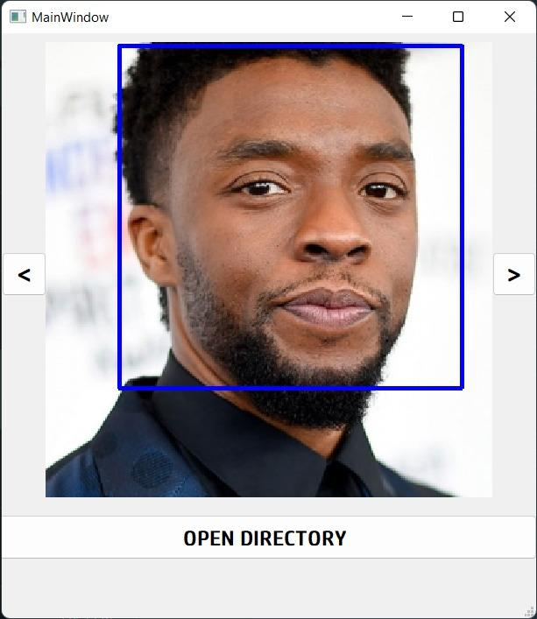
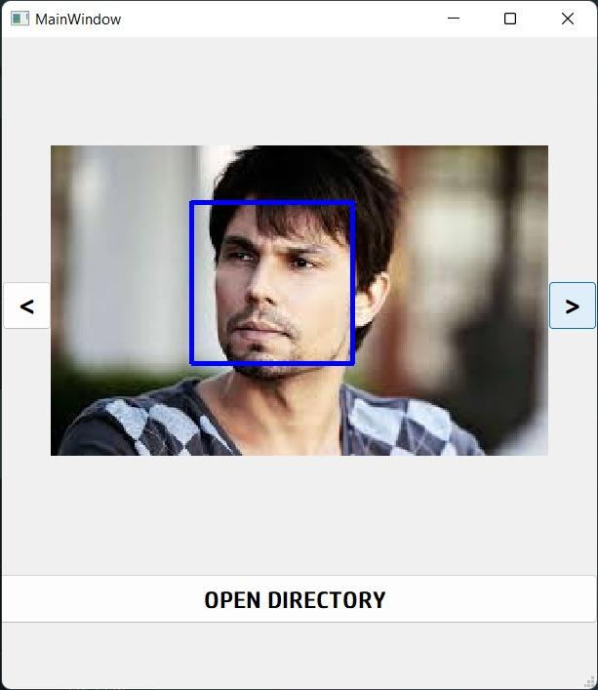
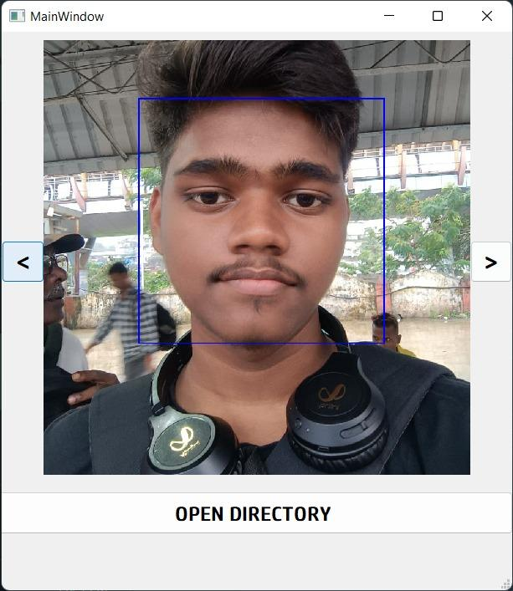
Results and implementation screenshots
Face detection
Carousel (next button)
Carousel (previous button)

Slide 7
References
https://github.com/opencv/opencv/tree/master/data/haarcascades
https://opencv.org/releases/
https://pypi.org/project/opencv-python/
https://www.analyticsvidhya.com/blog/2022/04/face-recognition-system-using-python/

Slide 8
Understanding Neural Networks
Assignment 2
Project Mentors :
Mrs. Priya R.L ,
Mrs. Nusrat Ansari
Group Number : 31
Group Members : J N Guru Akaash D17A 28
Ajay Nair D17A 55
Manigandhan K D17A 47
Varun Tripathy D17A 69

Slide 9
Content
Introduction to Assignment
Methodology employed
Results and implementation screenshots
References

Slide 10
Introduction to the assignment
Task given
Understanding Neural Networks
Solution Introduction
The main project had applications of Optical Character Recognition (OCR) for extracting data from display panel of complex machines.
So it was decided to perform a simple implementation of handwritten digit recognition from the popular MNIST dataset.

Slide 11
Methodology Employed
The MNIST Dataset in Keras was loaded directly to Colab file.
Prior to any modeling the pixel data was prepared.
Then a baseline convolutional neural network model was created for the problem.
The depth of the feature extractor part of the model was also increased.
The model was evaluated using five-fold cross-validation.
The results of the diagnostics of the learning behavior of the model during training and the estimation of the model performance.
A plot of the learning curves and a box and whisker plot were also created for evaluation.
The final model was saved and was used for predicting the new images.

Slide 12
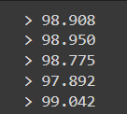
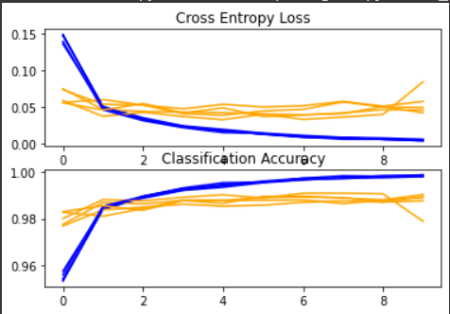
Results and implementation screenshots
Per-fold scores:
Final Results:
Final Model’s accuracy: 99.130
Mean Accuracy=98.713
std=0.420
n=5
Loss and Accuracy Learning Curves for the Deeper Model During k-Fold Cross-Validation

Slide 13
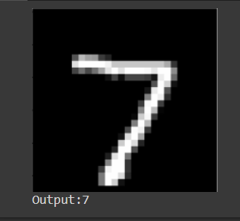
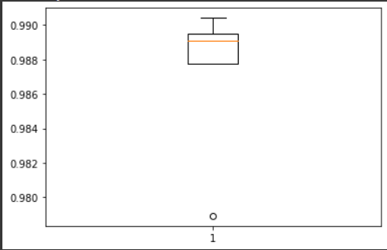
Results and implementation screenshots
Box and Whisker Plot of Accuracy Scores for the Model Evaluated Using k-Fold Cross-Validation
Testing:

Slide 14
References
https://machinelearningmastery.com/how-to-develop-a-convolutional-neural-network-from-scratch-for-mnist-handwritten-digit-classification/
https://machinelearningmastery.com/handwritten-digit-recognition-using-convolutional-neural-networks-python-keras/

