Slide 1


Assignment 7
Project Mentors :
Mrs. Priya R.L ,
Mrs. Nusrat Ansari
Group Number : 30
Group Members : J N Guru Akaash D17A 28
Ajay Nair D17A 55
Manigandhan K D17A 47
Varun Tripathy D17A 69

Slide 2
Content
Introduction to the Assignment - Ajay
Methodology employed - Guru
Results and implementation screenshots - Guru
Conclusion - Mani

Slide 3
Introduction to the assignment
Task Given
Train YOLO models for both text detection and recognition tasks.
Evaluate all trained models to choose the best for the application.
Evaluate the current Recognition model
Solution Introduction
YOLO Model Implementation is done for text detection task.
Evaluation of the YOLO Model is done.
Evaluation of the current Recognition model is done.

Slide 4
Methodology employed
For each image file (.jpg) a separate text file (.txt) will be created.
Each text file will contain the coordinates of the bounding boxes for the text areas identified in the image. There can be multiple text boxes in a single image.
These coordinates should be in YOLO Format.
The YOLO Format is as follows
[C, X, Y, W, H]
C = Class to which the object belongs
X = x coordinate of the center of the object’s bounding box
Y = y coordinate of the center of the object’s bounding box
W = width of the bounding box
H = height of the bounding box
All the values should be normalized to have values in the range of [0-1].

Slide 5
YOLO Model Training Parameters
YOLO v5 version is used for text detection.
YOLO Model is trained on the custom dataset which is created manually by performing annotations (bounding boxes) around the text areas.
The text annotations (bounding boxes) is performed using bbox annotations tool (labelImg tool can also be used).
The custom dataset contains around 5k images and their respective text files.
For the training of the YOLO v5 Model -
30 epochs were done and
a batch size of 16 was created.
The best weight file among the weights obtained after training phase is used for the testing purpose.

Slide 6
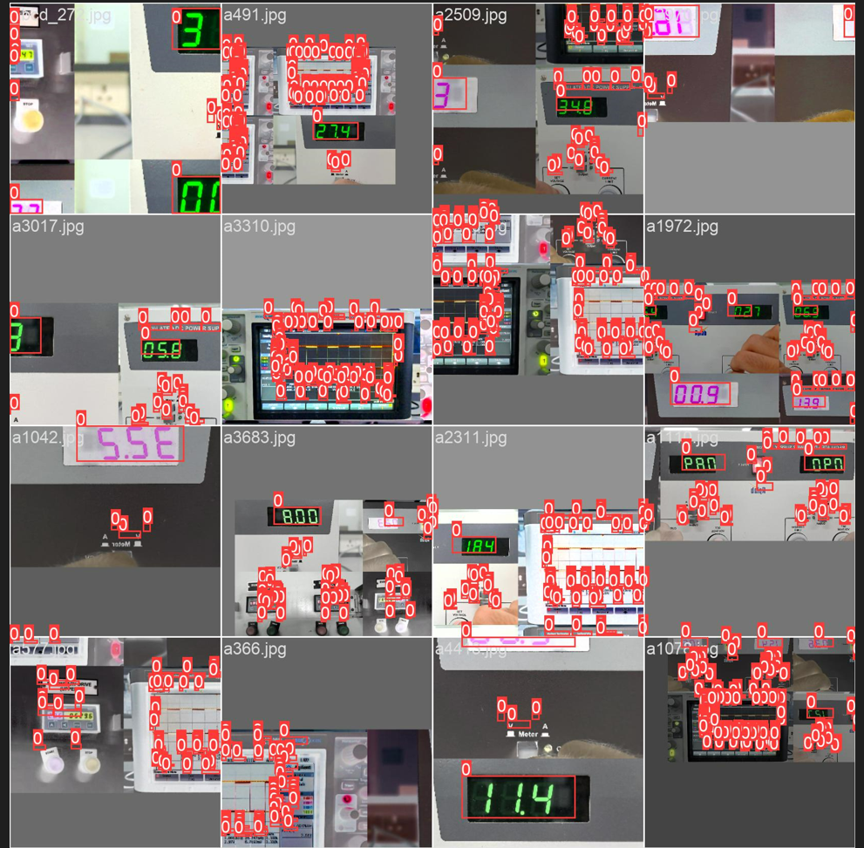
Results and implementation screenshots

Slide 7
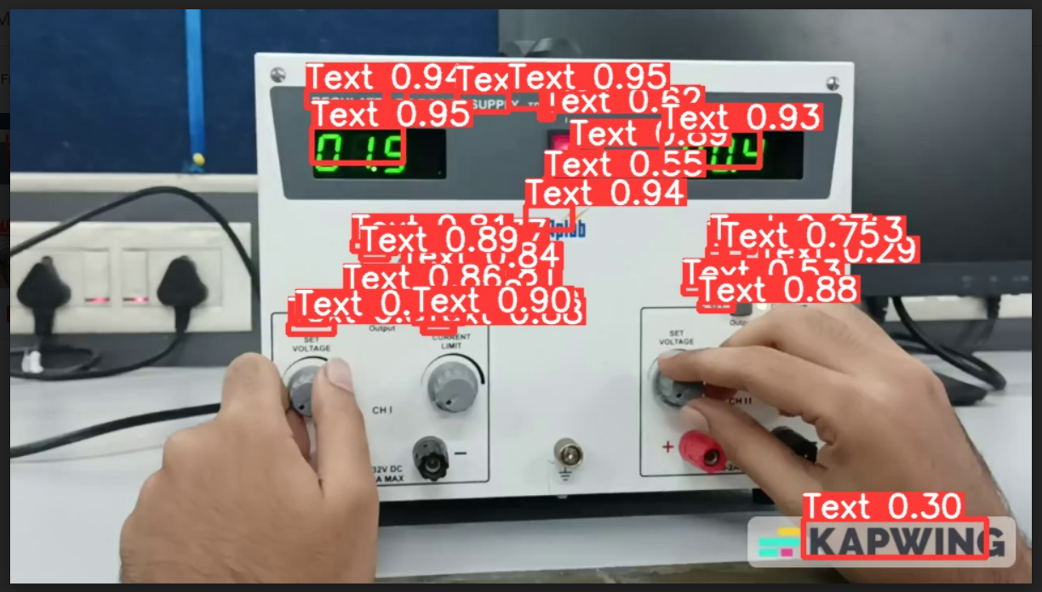
Results and Implementation Screenshots cont..

Slide 8
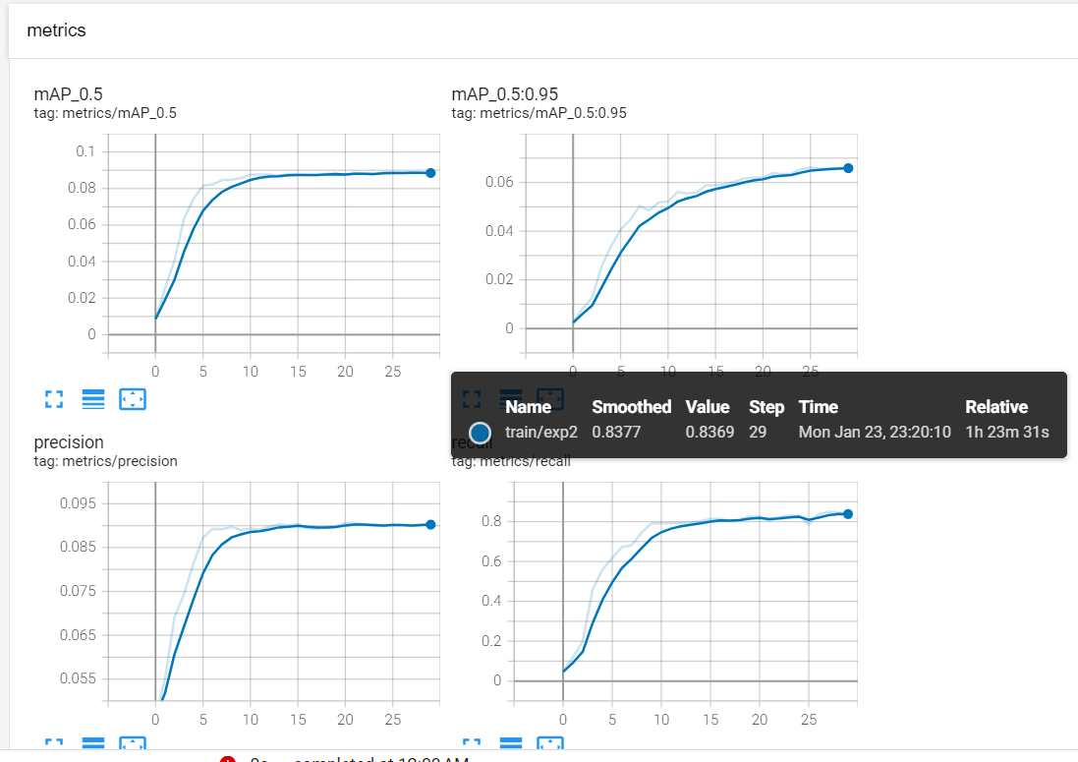
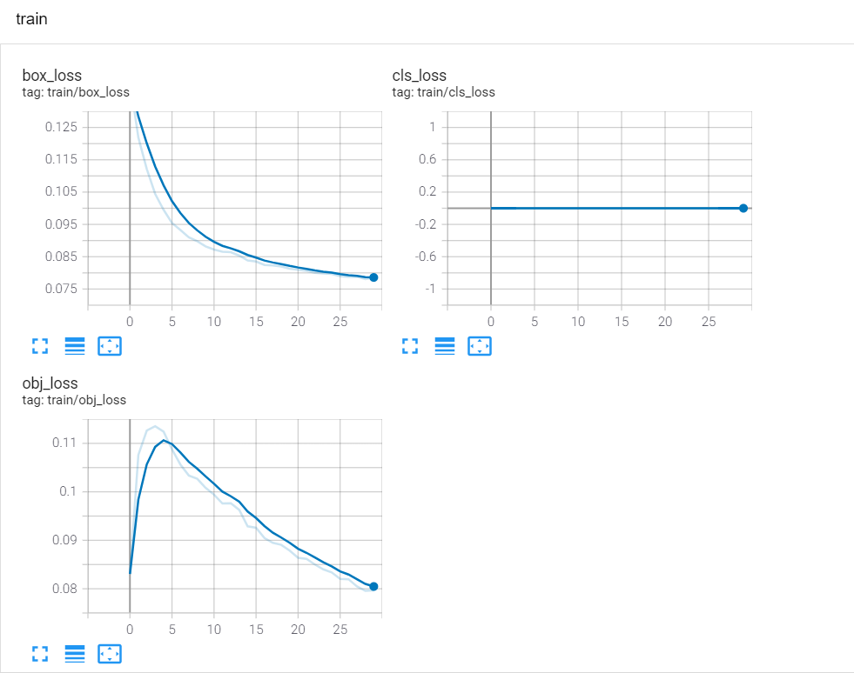
Performance Measures

Slide 9
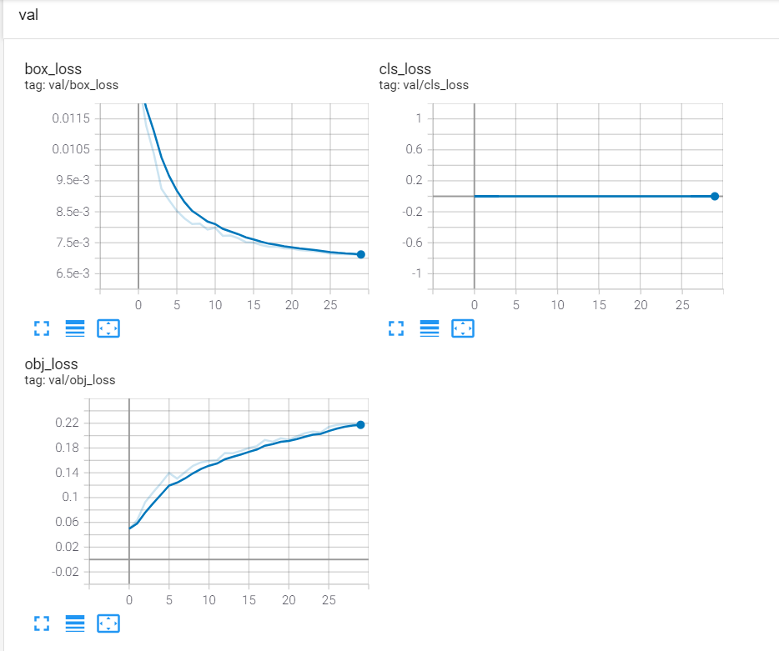
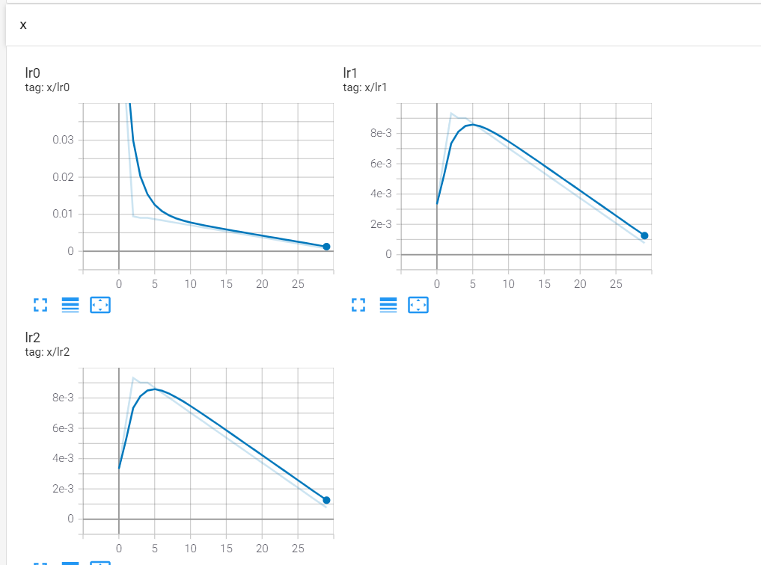
Performance Measures

Slide 10
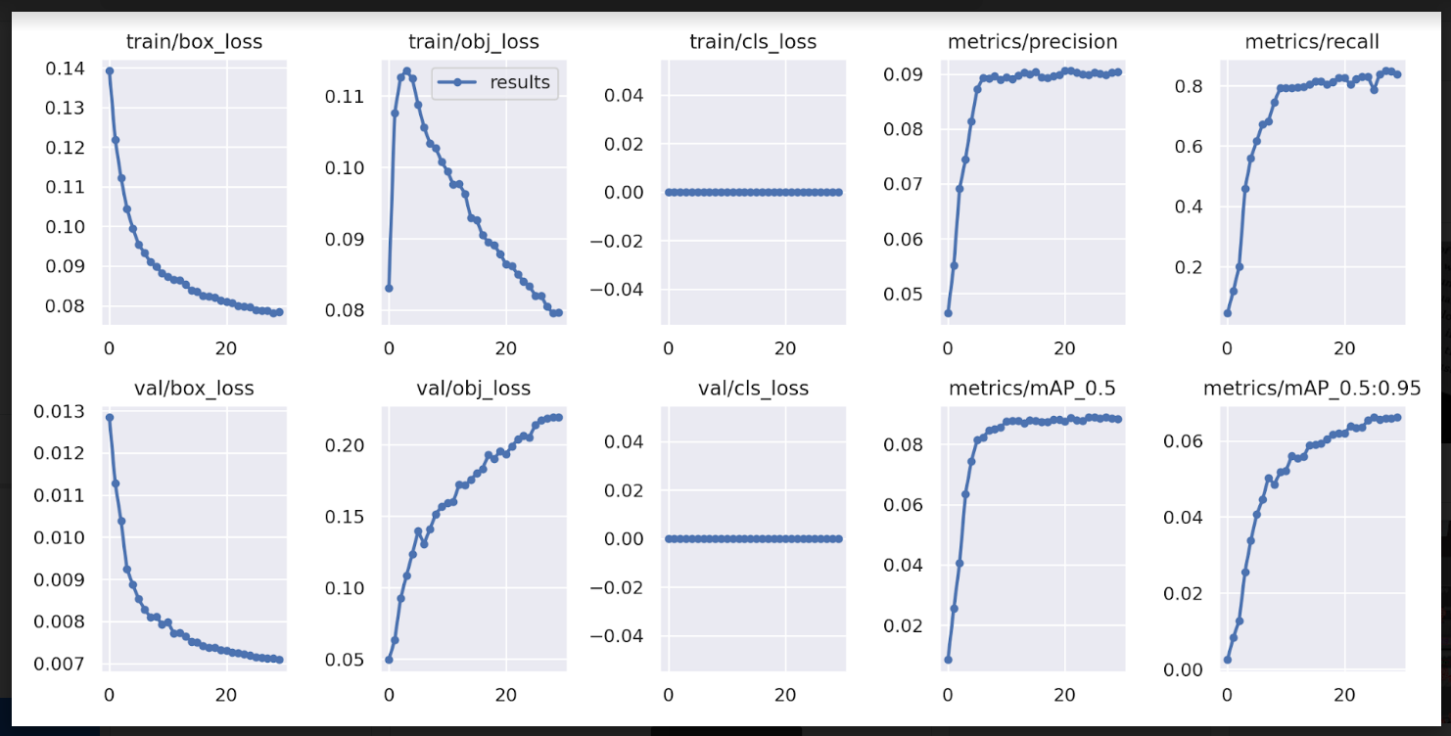
Performance Measures

Slide 11
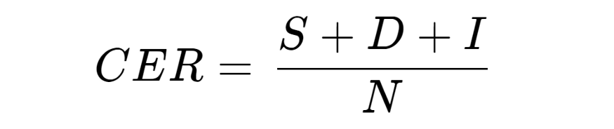
Evaluation of EasyOCR employed
For the evaluation of the EasyOCR recognition model we have used the Character Error Rate(CER), which can be given by the following formula
S = Number of Substitutions
D = Number of Deletions
I = Number of Insertions
N = Number of characters in reference text (aka ground truth)

Slide 12
Evaluation of EasyOCR
The output of this equation represents the percentage of characters in the reference text that was incorrectly predicted in the OCR output. The lower the CER value (with 0 being a perfect score), the better the performance of the OCR model.
There is no single benchmark for defining a good CER value, as it is highly dependent on the use case. Different scenarios and complexity (e.g., printed vs. handwritten text, type of content, etc.) can result in varying OCR performances.
However, an Australian newspaper digitization program came up with the benchmarks as follows
Good OCR accuracy: CER 1‐2% (i.e. 98–99% accurate)
Average OCR accuracy: CER 2-15%
Poor OCR accuracy: CER >15% (i.e. below 90% accurate)
For complex cases involving handwritten text with highly heterogeneous and out-of-vocabulary content (e.g., application forms), a CER value as high as around 20% can be considered satisfactory.

Slide 13
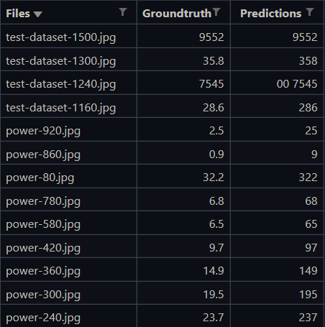
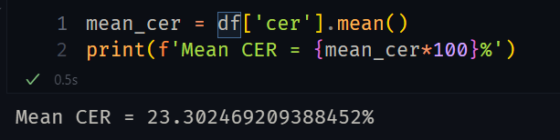
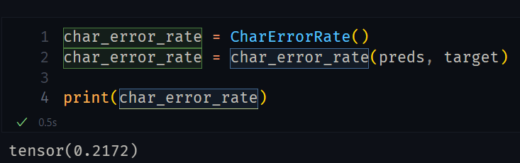
CER
CER using Pytorch module

Slide 14
Conclusion
YOLO v5 Model performed well on the images for text detection task.
Currently the model performed good for images with seven segment display screens since the training was done with segment display as the main focus.
The accuracy of the YOLO v5 Model can be increased further by creating more datasets which will contain both normal text and seven segment display text.
This YOLO v5 Model can be used for text detection purpose and the coordinates obtained for the bounding boxes of text will then be passed on to the Text Recognition phase, where the OCR implementation will be done.

