Slide 1


Integration of modular functions
Assignment 4
Project Mentors :
Mrs. Priya R.L ,
Mrs. Nusrat Ansari
Group Number : 31
Group Members : J N Guru Akaash D17A 28
Ajay Nair D17A 55
Manigandhan K D17A 47
Varun Tripathy D17A 69

Slide 2
Content
Introduction to the Assignment
Methodology employed
Results and implementation screenshots
Conclusion

Slide 3
Introduction to the assignment
Task given
Currently The OCR model was implemented on the image as a whole, now the task was assigned to implement ROI (Region Of Interest) and then apply OCR model individually on each of the ROI in the video for gathering multiple values.
The task of identifying the coordinates of each of the ROI Boxes and assigning names to each of the Boxes, so as to determine it uniquely.

Slide 4
Introduction to the assignment
Solution Introduction
ROI Implementation is done. Multiple ROI can be drawn on the same video, at the same time.
A video consists of frames. And this ROI remains constant for each of these frames, so the creation of ROI needs to be done only once at the start of the project run.
The Coordinates of each of the ROI is calculated from the bounding boxes created by the user.
A dictionary is created where each key represents the name of each of the ROIs and the values is a list which contains all the values which are detected through OCR in each of the frames.
For one ROI name (key) there will be a list of data detected (value) which depicts the display panel numbers detected through OCR model in each of the frames of the video.

Slide 5
Methodology employed
All the functional modules created previously were modified and integrated in a single file.
After splitting the input video into frames using OpenCV, the created frames are enhanced using either power or inverse transform.
The first created enhanced frame is shown to the user so that they can draw their ROI and enter corresponding name to it.
In all the remaining frames the same ROI is applied and finally the OCR is done on each cropped image.
All changing values corresponding to the entered name are gathered together and finally displayed.

Slide 6
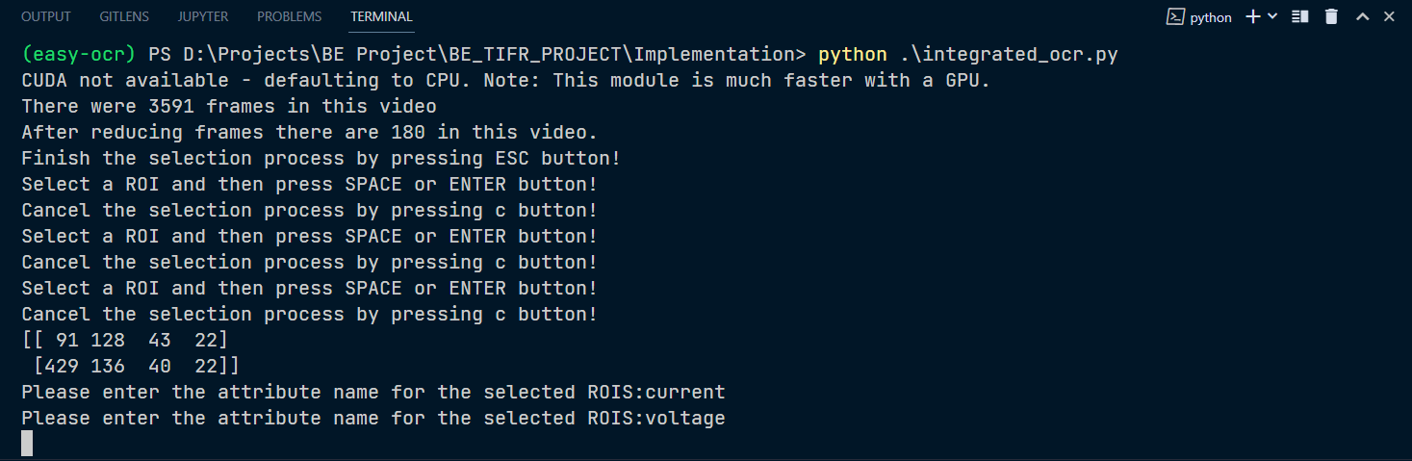
Results and implementation screenshots
Multiple ROIs on Enhanced Frames

Slide 7
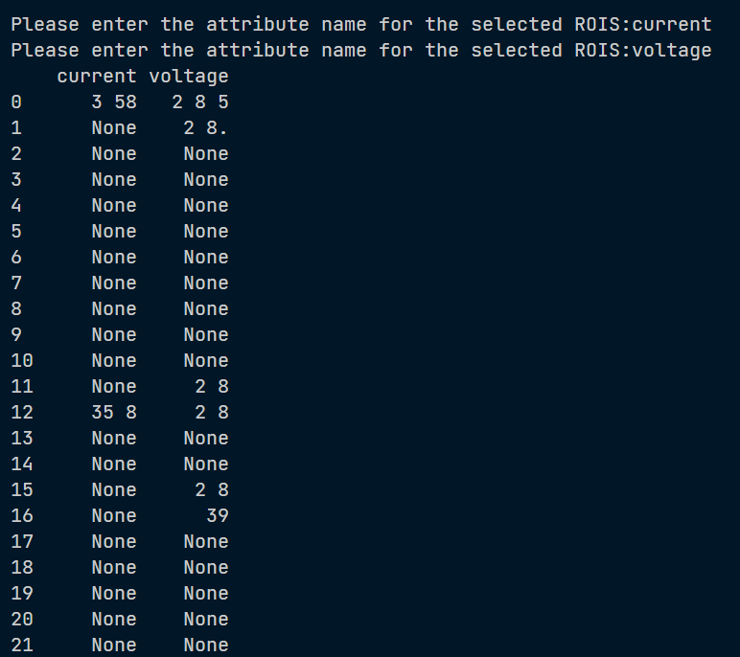
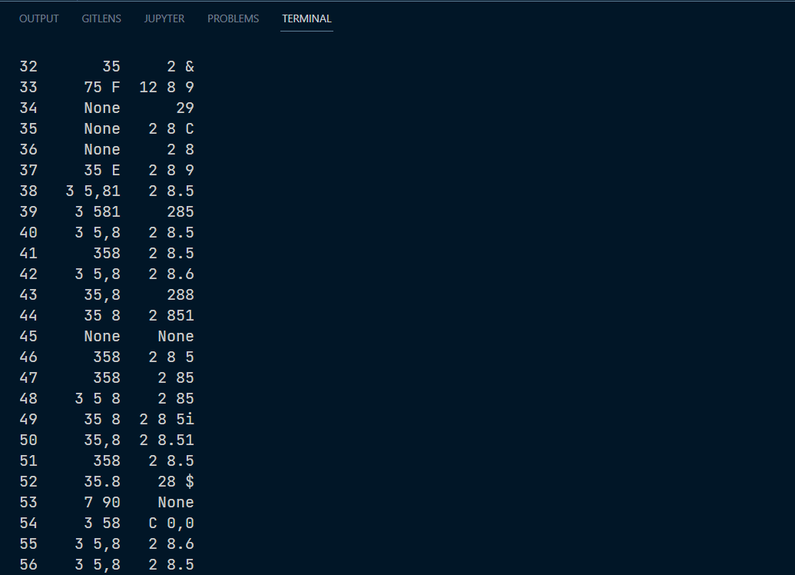
Results and implementation screenshots
Easy OCR Output

Slide 8
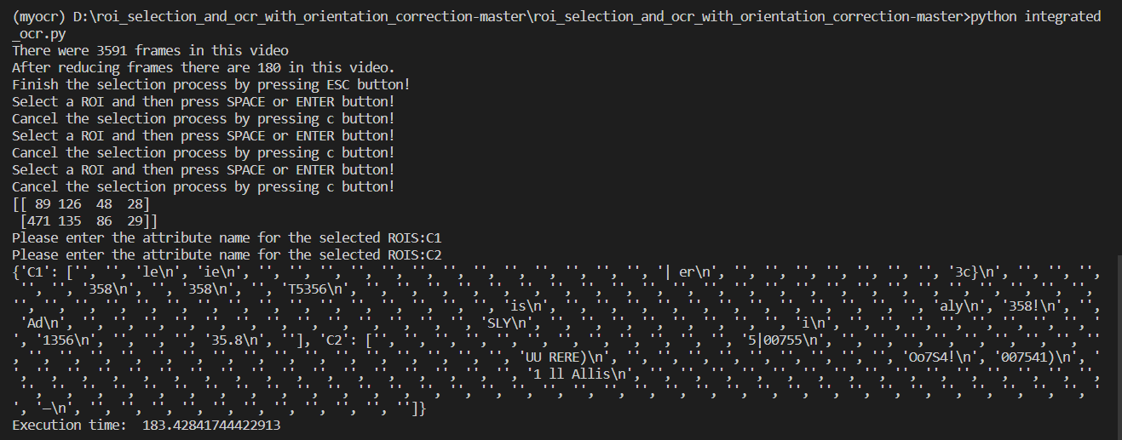
Results and implementation screenshots
Tesseract OCR Output

Slide 9
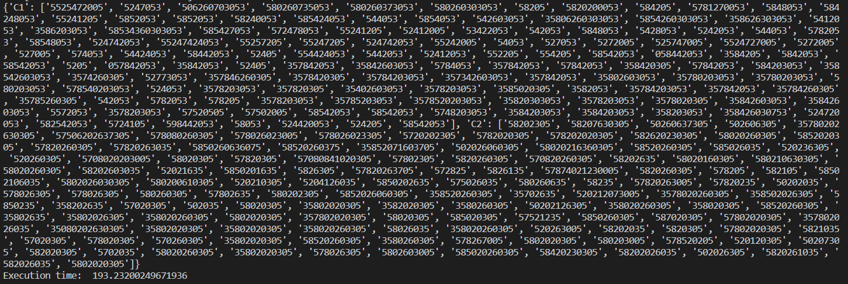
Results and implementation screenshots
Keras OCR Output

Slide 10
Conclusion
We were able to successfully integrate all the standalone modules and perform image enhancement followed by performing OCR on the machine display.
We were able to select multiple ROIs and perform OCRs on those selected Region of Interest.
Easy OCR performed much better when compared to Tesseract and Keras model.
So we have come to the conclusion that all the OCR models require training, the models would perform much better in case they are trained particularly for the seven segment displays.

