Slide 1


Assignment
Project Mentors :
Mrs. Priya R.L ,
Mrs. Nusrat Ansari
Group Number : 30
Group Members : Ajay Nair D17A 55
J N Guru Akaash D17A 28
Manigandan K D17A 47
Varun Tripathy D17A 69

Slide 2
Content
Introduction to the Assignment
Methodology employed (Solution)
Results and implementation screenshots
Conclusion

Slide 3
Introduction to the assignment
Task Given
Create a confusion matrix for YOLO model manually.
Use a low cost camera for handling video streams.
Provide support for adding and handling multiple video streams.
Add timestamp to all the changing values in the CSV output file.
Create rich GUI for the application.

Slide 4
Introduction to Solution
Manual Confusion matrix is created for inspection.
ESP32 Camera module was used as a cost effective solution to get real time video streams from the display panel unit.
Multi-threading is employed to handle multiple streams concurrently.
The application now supports multiple ESP32 webcams running simultaneously.
Login and signup features have been added to the application.
An annotations section has been included in the application.
Added an option to watch the changes made to csv file in real time.
Added timestamp to all the changing values in the CSV output file.

Slide 5
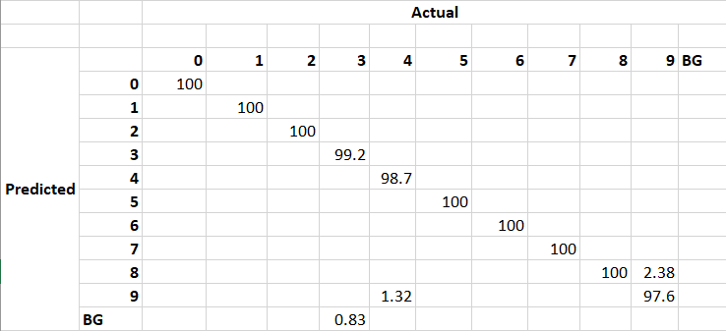
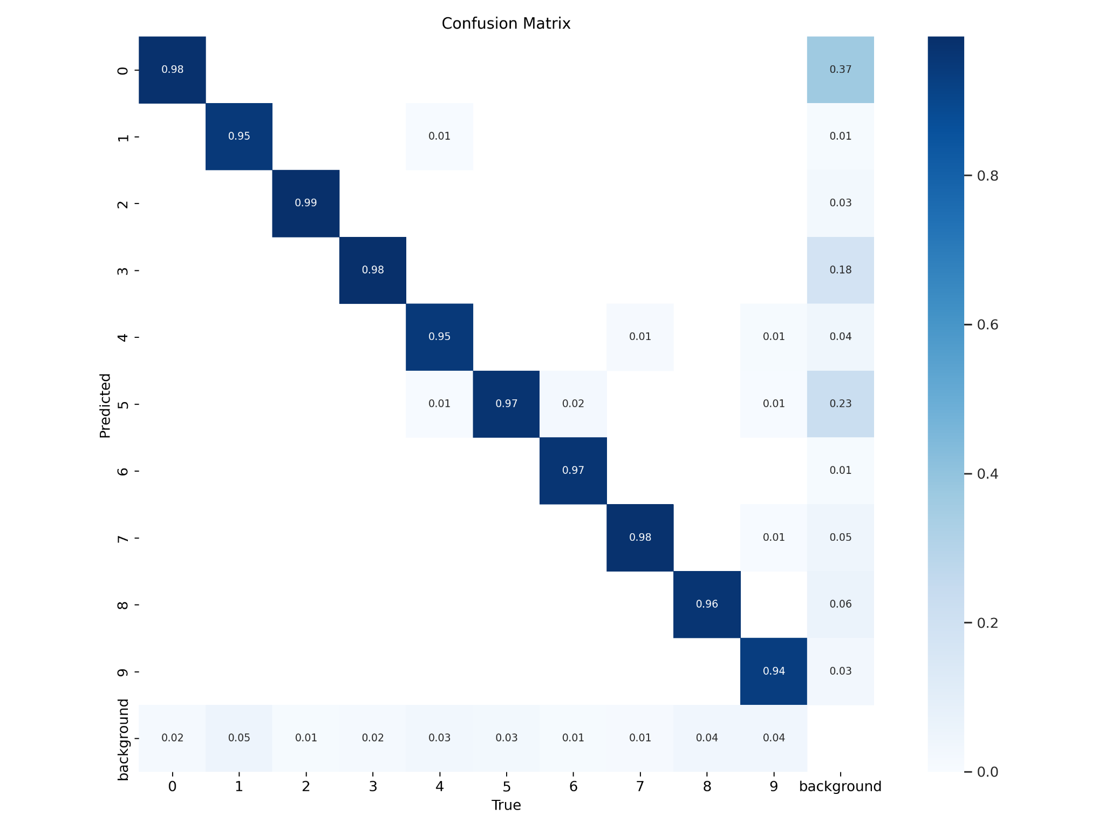
Manual Confusion Matrix
Overall Accuracy using YOLO model before = 0.967 = 96.7%
Overall accuracy for 50 samples after manual calculation = 99.55%

Slide 6
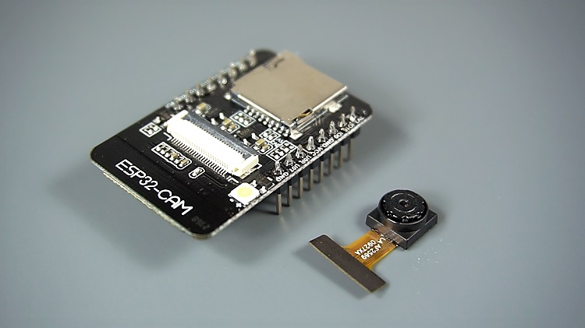
ESP32- Description
The ESP32-CAM is a small-sized camera module based on the ESP32 chip, which is manufactured by Espressif Systems
The module can work independently as the smallest system, with a size of only 27*40.5*4.5mm, and a deep sleep current as low as 6mA.
The ESP32-CAM board is power hungry! You need at least a 2A 5V power supply or the board will not boot up.
ESP32-CAM can be widely used in various IoT applications, suitable for home smart devices, industrial wireless control, wireless monitoring, etc.
ESP32-CAM adopts DIP package and can be used directly by plugging in the bottom plate, realizing the rapid production of products.
The ESP32-CAM is a very small camera module with the ESP32-S chip that costs approximately ₹500/-.
It has several GPIO pins to connect peripherals and supports OV2640 camera and microSD card.
Notes:
The ESP32-CAM is a small-sized camera module based on the ESP32 chip, which is manufactured by Espressif Systems, a Chinese company that specializes in the design and production of low-power wireless communication systems and IoT devices. The module can work independently as the smallest system, with a size of only 27*40.5*4.5mm, and a deep sleep current (the module consumes very little power when it is not actively processing data or performing tasks.) as low as 6mA.
ESP32-CAM can be widely used in various IoT applications, suitable for home smart devices, industrial wireless control, wireless monitoring, QR wireless identification, wireless positioning system signals and other IoT applications. It is an ideal solution for IoT applications .
ESP32-CAM adopts DIP (Dual in-line package) package and can be used directly by plugging in the bottom plate, realizing the rapid production of products, providing customers with high-reliability connection methods, which is convenient for application in various IoT hardware terminal occasions.
Besides the OV2640 camera, and several GPIOs to connect peripherals, it also features a microSD card slot that can be useful to store images taken with the camera or to store files to serve to clients.

Slide 7
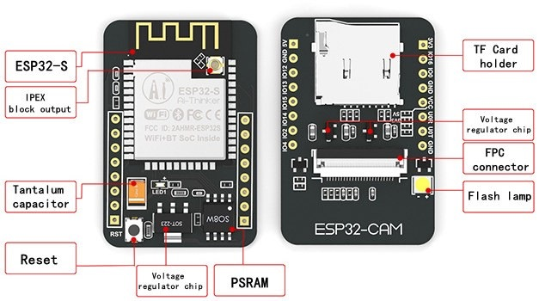
ESP32- Features
The smallest 802.11b/g/n Wi-Fi BT SoC module
Low power 32-bit CPU,can also serve the application processor
Up to 160MHz clock speed, summary computing power up to 600 DMIPS
Built-in 520 KB SRAM, external 4MB PSRAM
Supports UART/SPI/I2C/PWM/ADC/DAC
Support OV2640 and OV7670 cameras, built-in flash lamp
Support image WiFI upload
Support TF card
Supports multiple sleep modes
Embedded Lwip and FreeRTOS
Supports STA/AP/STA+AP operation mode
Support Smart Config/AirKiss technology
Support for serial port local and remote firmware upgrades (FOTA)
Notes:
1,2,3. Integrated system-on-chip (SoC) module allows the ESP32 camera module to connect to wireless networks and other devices easily. It enable the ESP32 camera module to perform image processing and analysis tasks quickly and efficiently, while also maintaining low power consumption for extended battery life.
4. Having both built-in SRAM [(Static Random Access Memory), which is a type of fast memory that is used for storing temporary data that is actively being processed by the chip] and external PSRAM [(Pseudo Static Random Access Memory). PSRAM is a type of fast memory that operates similarly to SRAM, but with a larger capacity] provides the ESP32-CAM with a sufficient amount of fast memory to perform various image processing tasks and store large amounts of data while minimizing the need to access slower storage such as an SD card.
5,6,7,8. Multiple communication interfaces that can be used to connect to other devices or peripherals like UART (Universal Asynchronous Receiver/Transmitter), SPI (Serial Peripheral Interface), I2C (Inter-Integrated Circuit), PWM (Pulse Width Modulation), ADC (Analog-to-Digital Converter), and DAC (Digital-to-Analog Converter). 2 popular cam modules remote access and sharing microSD card ( TF card). 9. different low-power sleep modes to conserve power
10. Lwip (Lightweight IP) and FreeRTOS (Real-Time Operating System) software libraries, which provide network connectivity and task scheduling capabilities, respectively.
11. different WiFi network modes, including Station (STA) mode for connecting to an existing WiFi network, Access Point (AP) mode for creating its own WiFi network, and STA+AP mode for both connecting to an existing network and creating its own network simultaneously.
12. two WiFi configuration technologies
13. receive firmware upgrades over a serial port or remotely
The IPEX output is a type of connector that is used to connect external antennas to the module.
the FPC connector is used to connect the camera module to the main circuit board.
Tantalum capacitors are small capacitors that are often used in electronic circuits to provide filtering, smoothing, and decoupling functions. They are known for their high stability, reliability, and tolerance to high temperatures, which makes them ideal for use in electronic devices like the ESP32-CAM module.

Slide 8
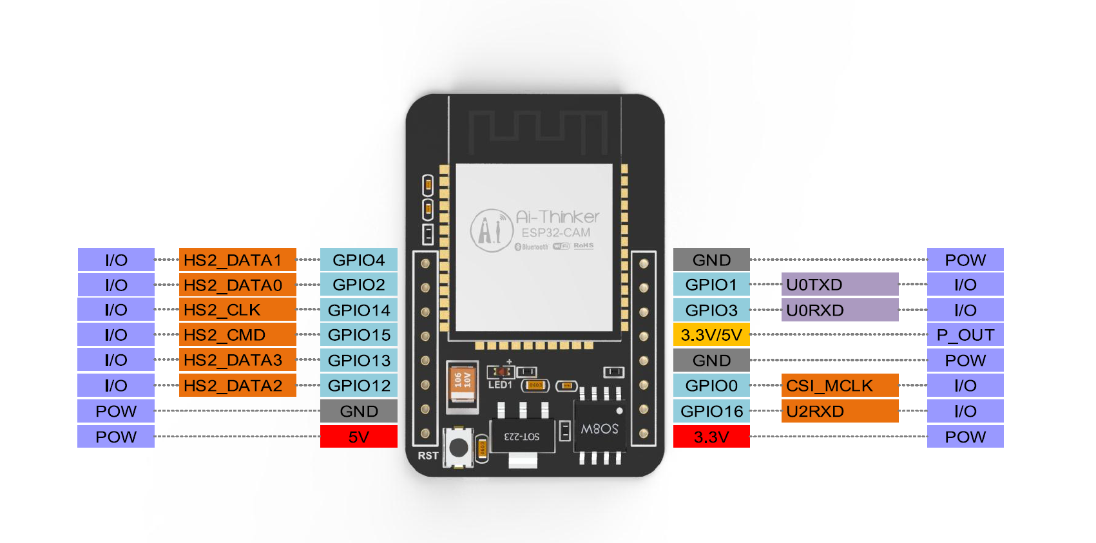
ESP32- Pinout Diagram

Slide 9
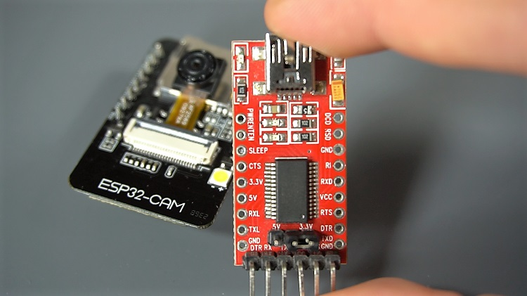
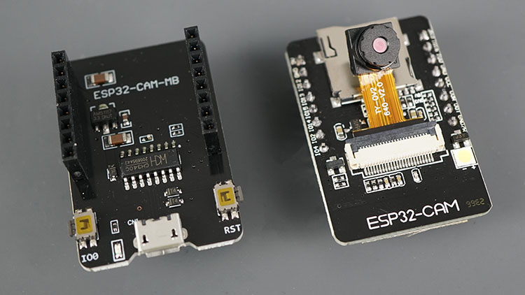
ESP32 - Programming
The ESP32-CAM doesn’t come with a USB connector, so we have 2 options:
Use a FTDI programmer to upload code through the U0R and U0T pins (serial pins).
Use a ESP32-CAM-MB USB Programmer and simply click on Upload button
Option a
Option b

Slide 10
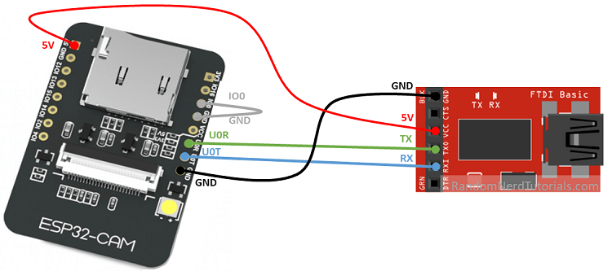
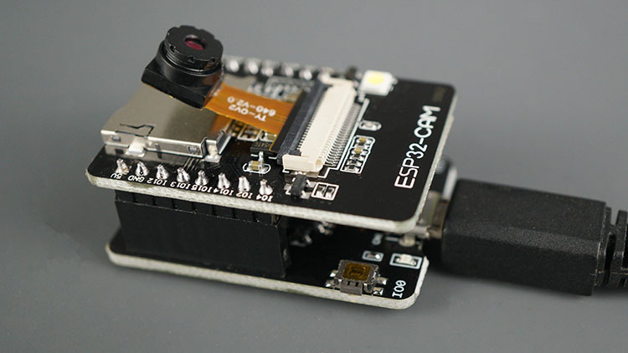
ESP32- Programming choice and reasons
FTDI Programmer | ESP32-CAM-MB USB Programmer
Supports manual programming mode only. | Supports both automatic and manual programming modes.
Requires a separate USB-to-serial converter to program the ESP32-CAM module. | Supports programming of the ESP32-CAM module via the USB port on the programmer.
Requires manual reset and boot mode selection using external wires or jumper cables. | Includes a reset button and boot mode jumper for easy programming.

Slide 11
Methodology employed
Connect ESP32 camera module to ESP32-CAM-MB USB Programmer and connect the programmer to laptop with USB data cable.
Check if proper CH340C drivers are installed and select appropriate ESP32 board and COM port and leave other options in Tools Menu default.
Write code and add required libraries in the sketchbook in Arduino IDE.
Click on Upload button to compile the sketches and flash the ESP32 cam module.
2 options are provided for streaming: Web server and RTSP server.
ESP32 starts a web server and on connection by a web browser sends images from the camera to the web browser. So it is more like a stream of images.
To run RTSP beside of a server a streamer (for streaming the video) and a session (to handle the RTP communication) is required. The wifi client is the handle for the connected RTSP client.
Open Serial monitor and copy the stream links to the application.

Slide 12
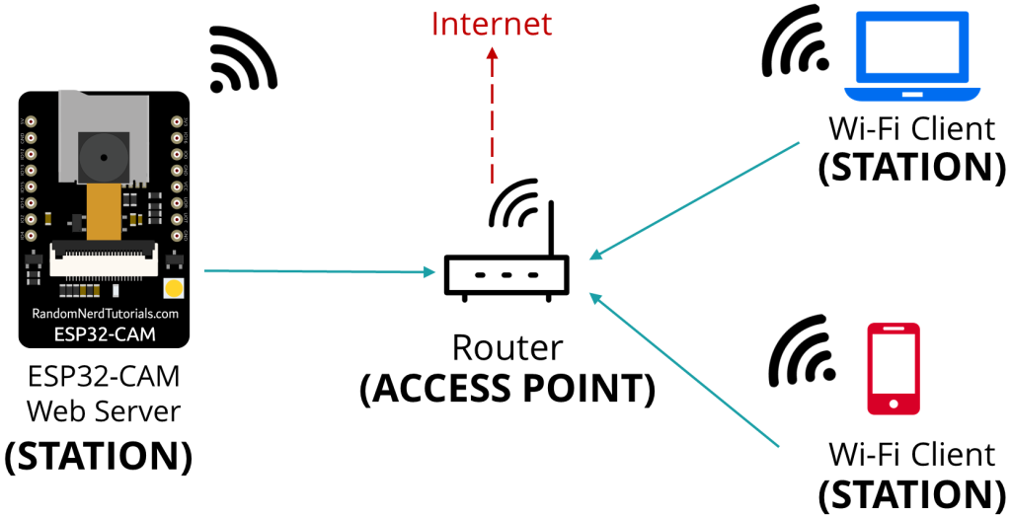
ESP32 - WiFi connections
Connect to ESP32 cam module’s soft access point at first and then configure the WiFi that you need to connect to

Slide 13
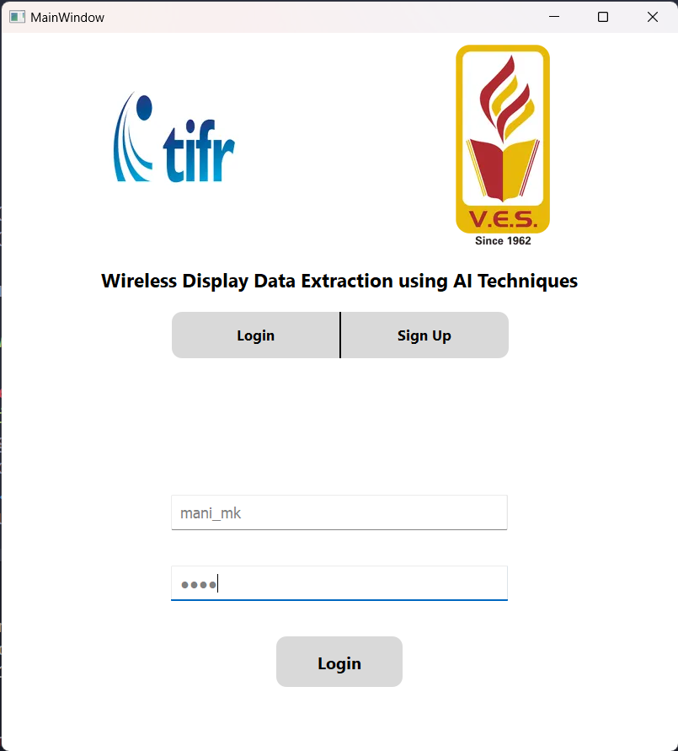
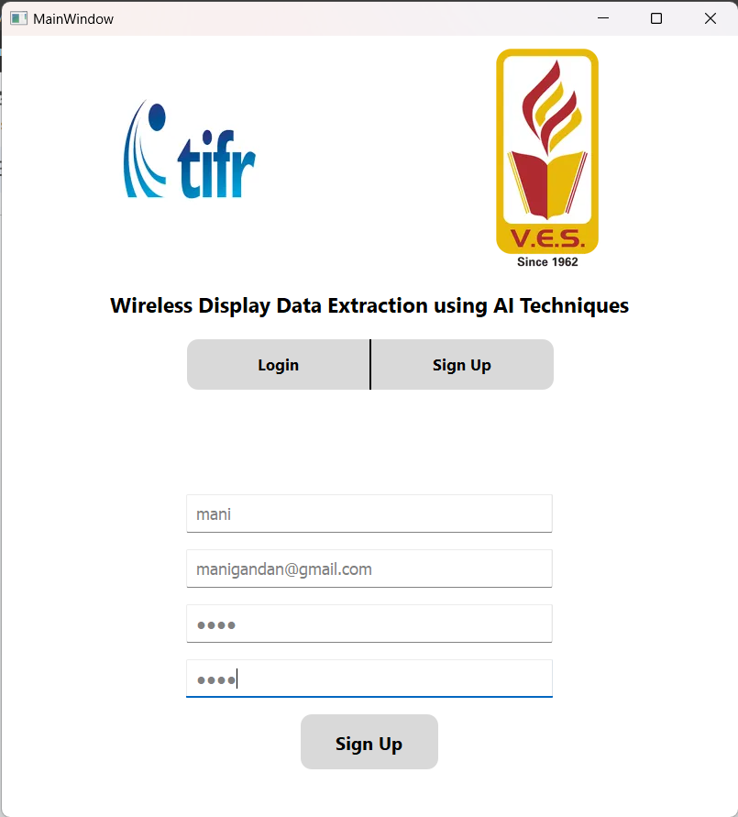
Results and Implementation screenshots
Login Page
Sign up Page

Slide 14
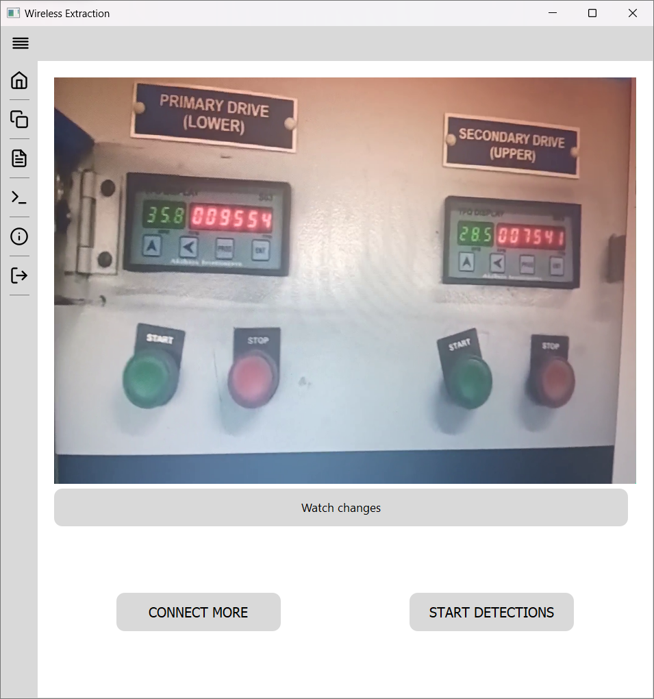
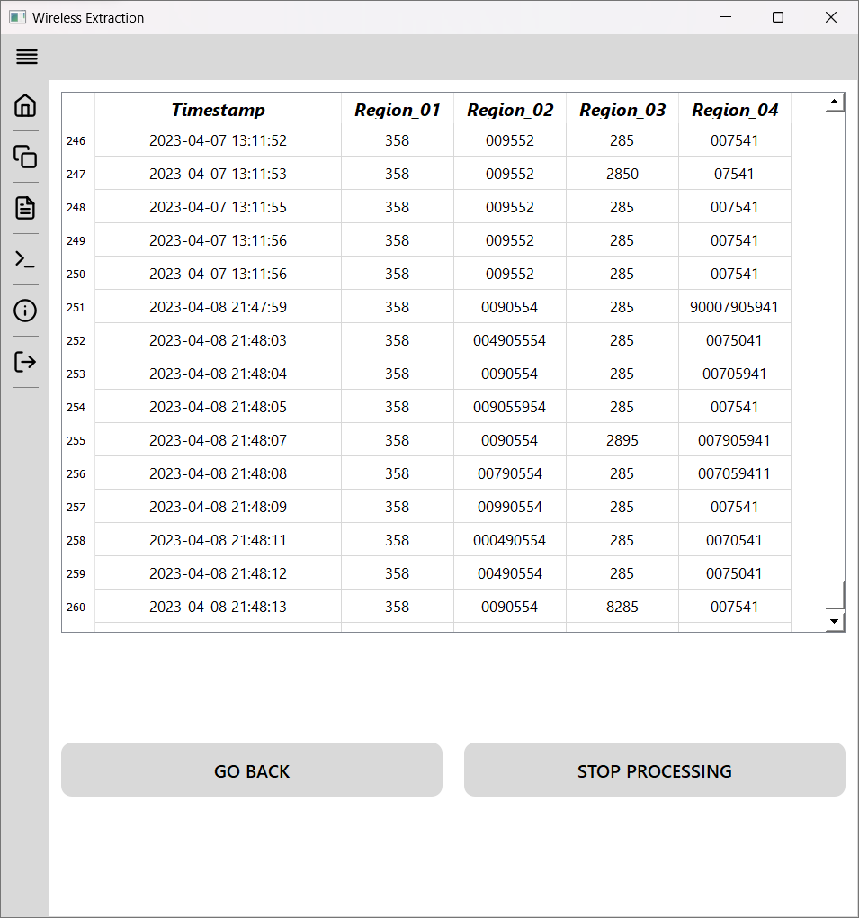
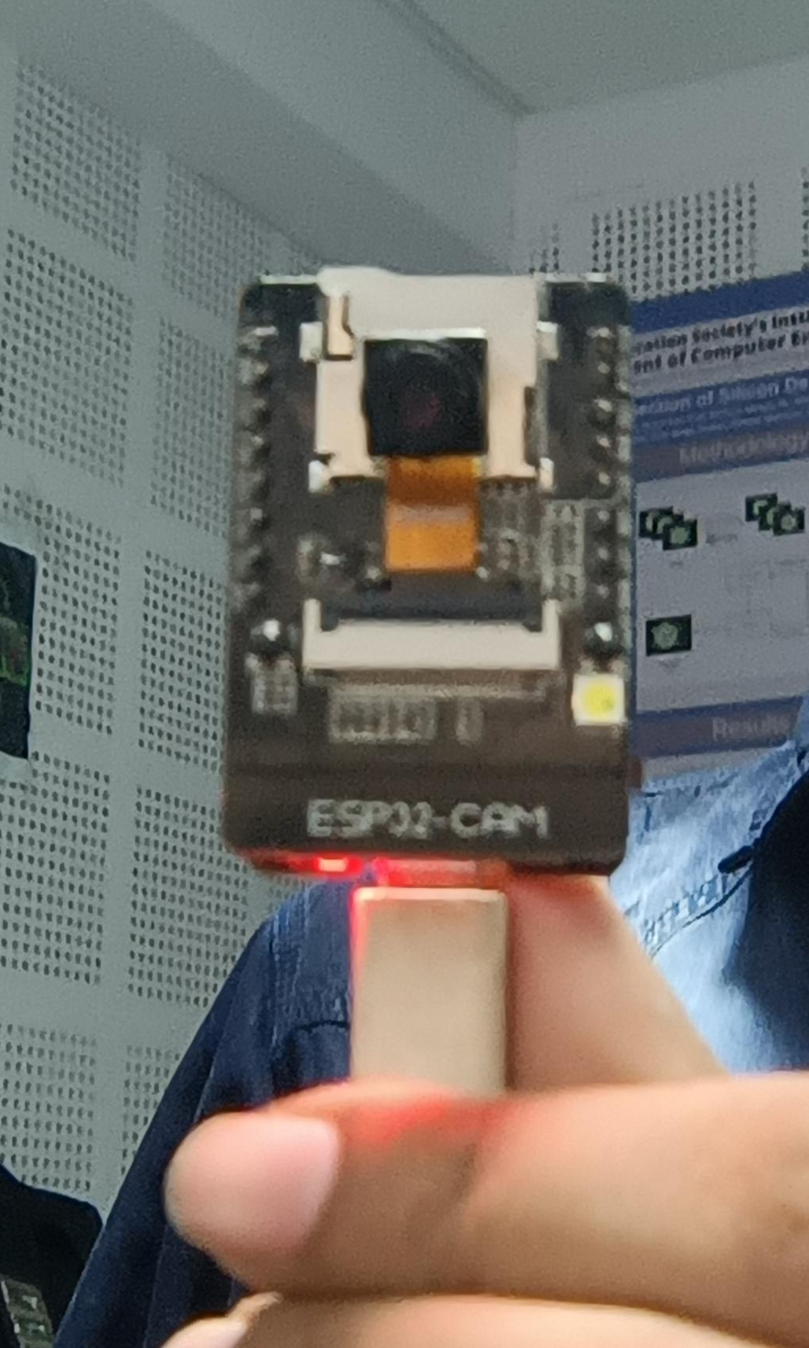
Results and Implementation screenshots

Slide 15
Conclusion
Video streaming using cost effective ESP32 camera module has been completed and integrated into the system.
Even multiple streams can be handled effectively now in the application.
Users can now log in to their account to view real-time detections.
Timestamps have been added to predictions, allowing for more accurate tracking.
Real-time updates have been implemented for a CSV file whenever changes are made to the watch values.

