Slide 1


Solution By: Fresh AI
PSID: INTL-IVA-01
Team Leader Name: J N Guru Akaash

Slide 2

Idea Introduction
IDEA TITLE- BASELINE
Tech Stack
1.
2.
3.
Resources Used
1.
2.
3.
Any Third Party API/Services used
Yes
2. No
IDEA-OUTCOME – HEADLINE-
Tell us in Detail, what will be the possible outcome of your solution and how similar it is going to be in sync with actual problem statement

Slide 3

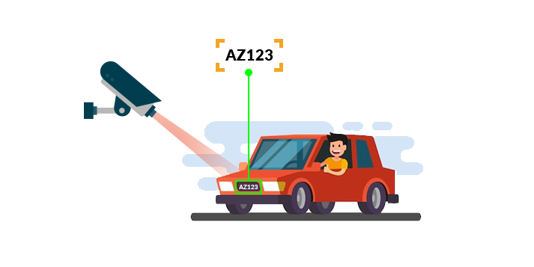
Your Approach Towards Idea
Write Your Approach in Brief below
Detection of number plate from image using image processing techniques and then implementing OCR model on the cropped image of the number plate.
With our approach , the Number plate can be detected of vehicles with speed more than 80Km/hr and having precision in recognition.
Customizing YOLO model with our own License Plate Detection model and after OCR implememting a Algorithm that will prioritise which is the correct license plate no in multiple frames
OpenCV
Yolo Model
Nvidia GPU
Label Img
Notes:
Use any image of your proposed solution here instead of this macbook image

Slide 4


Team Slide
Mentor 1
Mrs. Abha Tewari
9619808313
Member 1 (Team Leader)
J N Guru Akaash
9920327701
Member 2
Abinash Behera
7045582917
Member 3
Nihar Kenny
7977391127
Member 4
Yogesh Khatri
7264881708

Slide 5
Development Pipeline
Documents To be prepared for installation and evaluation
1.
2.
3.
4.
Any Third party API used, if yes please specify
Proposed Development Plan in pointers
1. Creating the
dataset
2. Customizing yolo
model
3. Dividing camera
view in n
sections.
4. Detection of
number plate
from image
frame in each
section.
5. Implementing
OCR on the
cropped image
6. Storing the
number in
database.
Repository Link or Any refrences link of folders
Proposed UI and functional flow in pointers
1.
2.
3.
4.
5.
Step A
Step B
Step C
Step D
Step E

Slide 6
Vision of Innovation/Idea/Solution
Explain How you developed Idea
How you idea is different and innovative form other ideas- a default comparison
How much time it will take in conversion as a final product
Any early stage innovation detected while developing the solution

