Slide 1

eKart: A Cloud-Based E-commerce Platform for Shopping deployed on AWS

Slide 2
Introduction
We present 'eKart' as a cutting-edge e-commerce platform hosted on Amazon Web Services (AWS), delivering a seamless shopping experience. Amazon Elastic Cloud Compute (EC2) will power our application for optimal performance and scalability, while Amazon Simple Storage Service (S3) ensures reliable storage of product data. Strict access controls will be implemented by AWS Identity and Access Management (IAM), protecting client data.
The integration of Amazon-S3, EC2 for content delivery. By leveraging AWS, 'eKart’ website aims to create a secure and scalable shopping ecosystem, providing customers a delightful and efficient online retail experience.

Slide 3
Work Flow
EKART
Web Application Deployment
Front End: HTML, CSS, Javascript
Cloud Deployment
Computng services - AWS EC2 (EBS Disk)
Business Logic for linking: PhP
Database: MySQL
Storage Servive-AWS S3
Access Control- AWS IAM
Monitoring Service-AWS Clound Watch
Notification Service-AWS SNS

Slide 4
AWS Cloud Services
Amazon EC2: Provides scalable computing capacity in the cloud, enabling the running of virtual servers for various applications.
Amazon S3: Offers scalable object storage, widely used for hosting static web content and backup.
Amazon EBS: Scalable block storage for use with EC2 instances, providing persistent block-level storage volumes.
Amazon IAM: Enables fine-grained control over access to services and resources, allowing management of users and groups.
Amazon SNS: A messaging service facilitating the distribution of messages such as email, SMS, or application alerts.
Amazon CloudWatch: A monitoring web service that provides insights and monitoring data for applications.

Slide 5
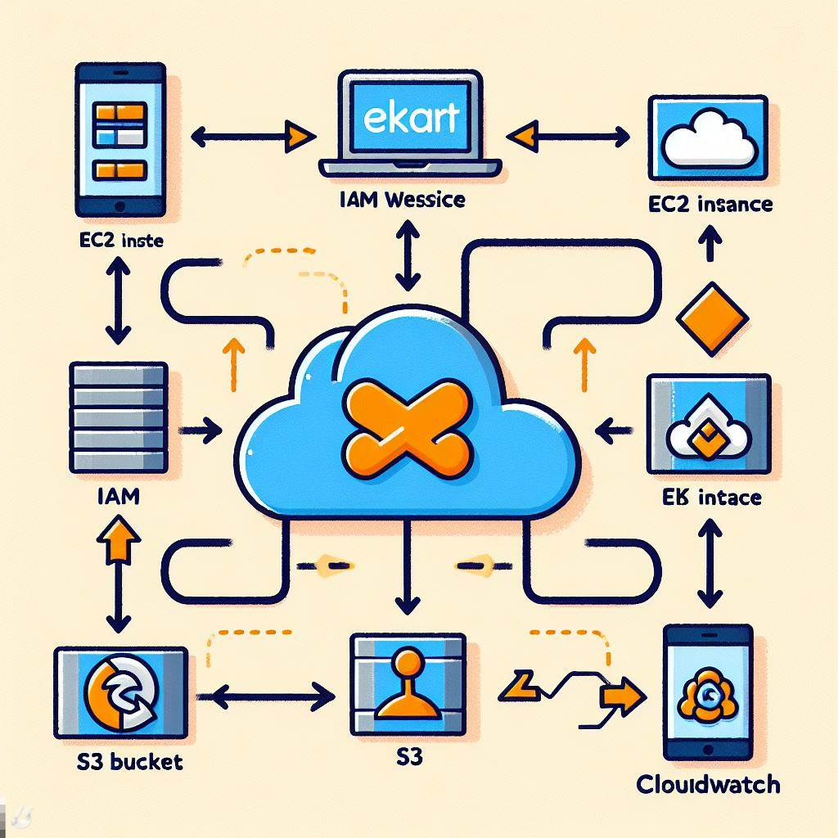
AWS Service Architecture

Slide 6
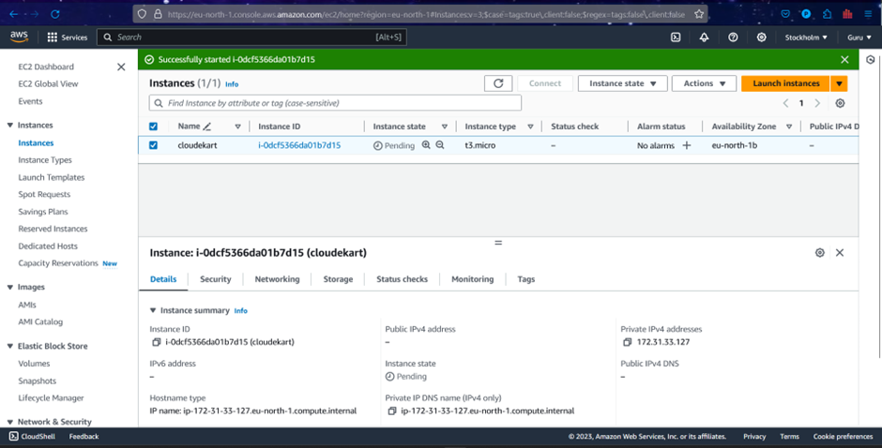
EC2 Instance Creation

Slide 7
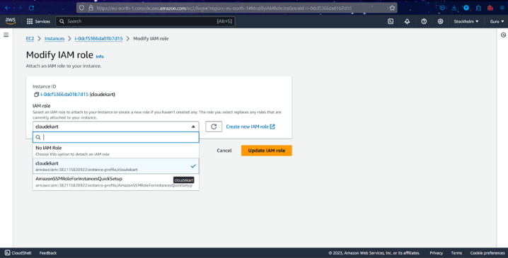
IAM Role Creation

Slide 8
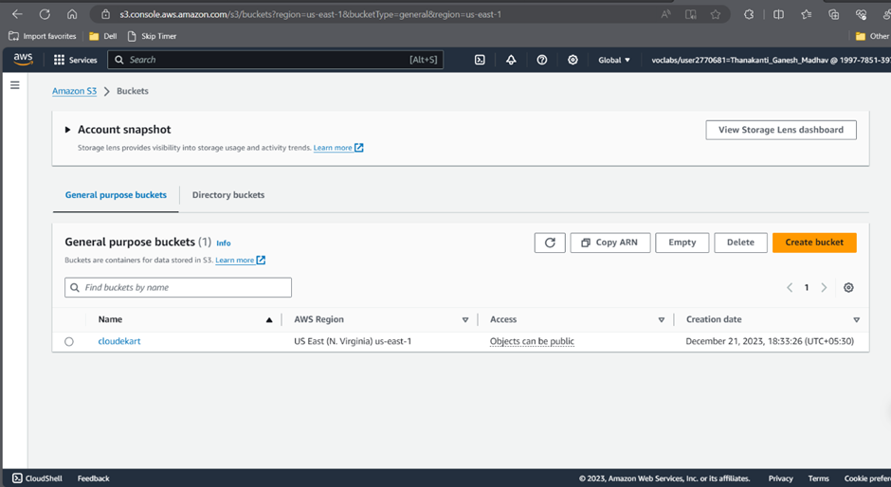
S3 Bucket Creation

Slide 9
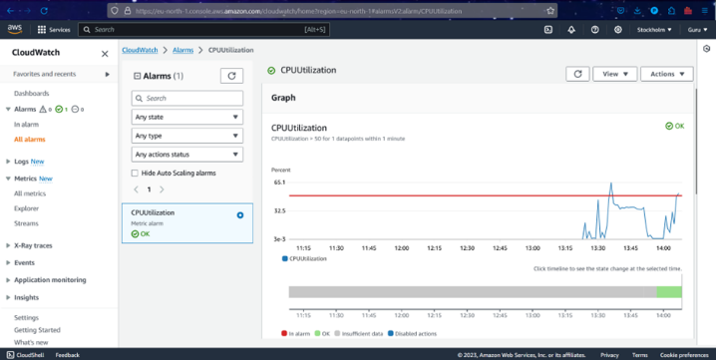
CloudWatch Monitoring

Slide 10
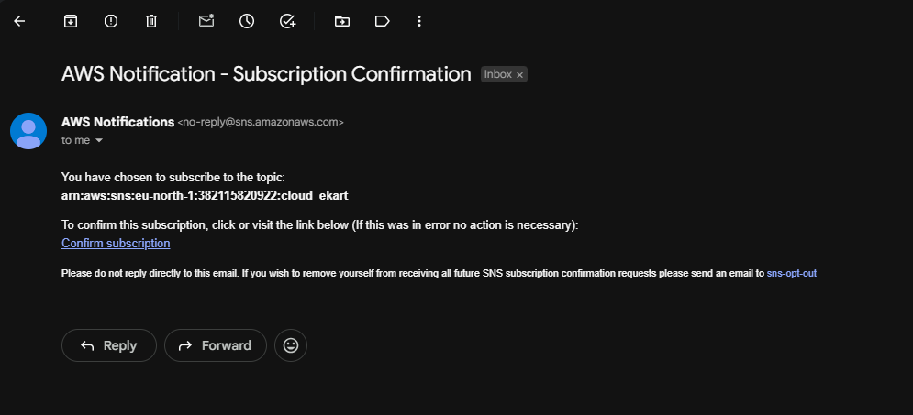
SNS(Notification Service)

Slide 11

SNS(Gmail Notification)

Slide 12
Benefits Of Integration
Integration for Scalability and User Experience:
Unique functionalities within the cloud-deployed application ensure scalability and a seamless user experience in dynamic environments.
Enhanced Security with Amazon IAM:
Amazon IAM provides fine-grained control over resource access.
Ensures secure protection of sensitive eKart data.
Enables precise management of access permissions for users and groups, reducing the risk of unauthorized access.
Cost Efficiency with Pay-as-You-Go:
Cloud platforms offer a pay-as-you-go model.
Enables eKart to optimize costs by paying only for consumed resources.

Slide 13
Benefits Of Integration
Reliability:
Cloud integration with AWS ensures robust infrastructure.
Minimizes downtime for continuous service availability.
Crucial for an online shopping platform where seamless access is expected.
Flexibility:
Cloud-based setup adapts to changing e-commerce demands.
Enables easy accommodation of new features or modifications.
Responds to evolving customer preferences and business requirements.
Automatic Updates:
Cloud platforms provide automated updates and maintenance.
Ensures e-Kart shopping site stays current with the latest features and security enhancements.
Maintains a secure and up-to-date online shopping experience for users.

Slide 14
Benefits Of Integration
Global Accessibility:
Cloud deployment allows users to access eKart shopping site globally.
Enhances reach and user base.
Caters to a diverse customer demographic.
Collaboration:
Cloud platforms support collaborative tools for eKart staff and vendors.
Fosters efficient communication and collaboration.
Manages product listings, inventory, and order fulfillment seamlessly.
Elasticity:
eKart platform adapts to fluctuations in user activity.
Automatically scales resources based on demand.
Ensures optimal performance during peak periods and cost savings during quieter times.

Slide 15
Conclusion
The e-Kart Management System, hosted on Amazon Web Services (AWS), revolutionizes and streamlines the e-commerce ecosystem.
The platform integrates a range of functions, including buying and selling, to cater to diverse customer needs, offering a comprehensive e-commerce solution.
Beyond technological advancements, the e-Kart Management System has a meaningful societal impact, marking a shift in the e-commerce landscape. It balances technological innovation with societal well-being.
Going beyond technological optimization, the system adopts a holistic approach aligning with the transformative nature of e-commerce and societal well-being, making it a forward-thinking and comprehensive solution for online shopping.

Slide 16
References
[1] M. A. A. Altemimi and A. H. H. Alasadi, "Ecommerce based on Cloud Computing: The Art of State," European Journal of Information Technologies and Computer Science, vol. 2, no. 5, pp. 1–7, Sep. 2022, doi: 10.24018/compute.2022.2.4.59.
[2] Arya M Nair. "Cloud Computing in E-commerce." International Research Journal of Engineering and Technology (IRJET), vol. 07, no. 04, Apr 2020, pp. 2936.
[3] H. Kalkha, A. Khiat, A. Bahnasse and H. Ouajji, "The Rising Trends of Smart E-Commerce Logistics," in IEEE Access, vol. 11, pp. 33839-33857, 2023, doi: 10.1109/ACCESS.2023.3252566.
[4] Yanting Li. "A Cloud Computing-Based Intelligent Forecasting Method for Cross-Border E-Commerce Logistics Costs." Advances in Mathematical Physics , Volume 2022, Article ID 3838293 2022, 10, https://doi.org/10.1155/2022/383829

