Slide 1
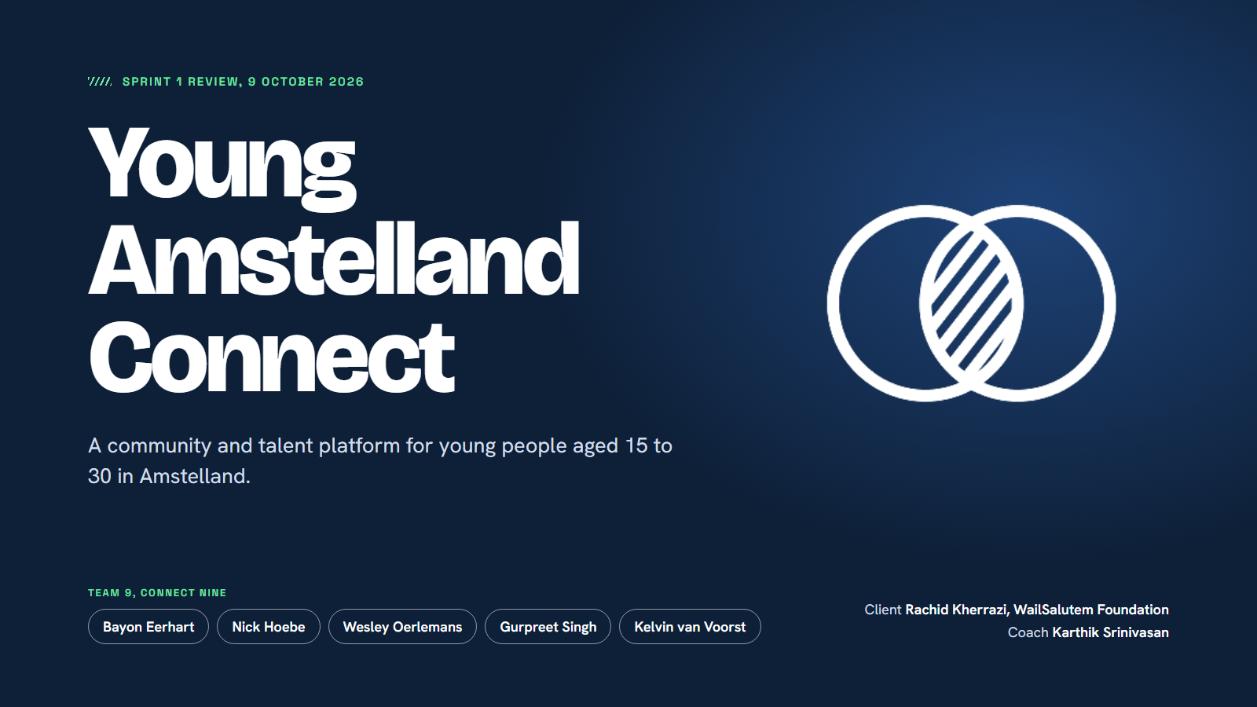
Notes:
Welcome. I'm Wesley, Scrum Master this sprint, and I'll lead this review. We're building Young Amstelland Connect, a community and talent platform for young people aged 15 to 30 in Amstelland. This review takes 15 minutes, and we've kept the last part for your questions and feedback.

Slide 2
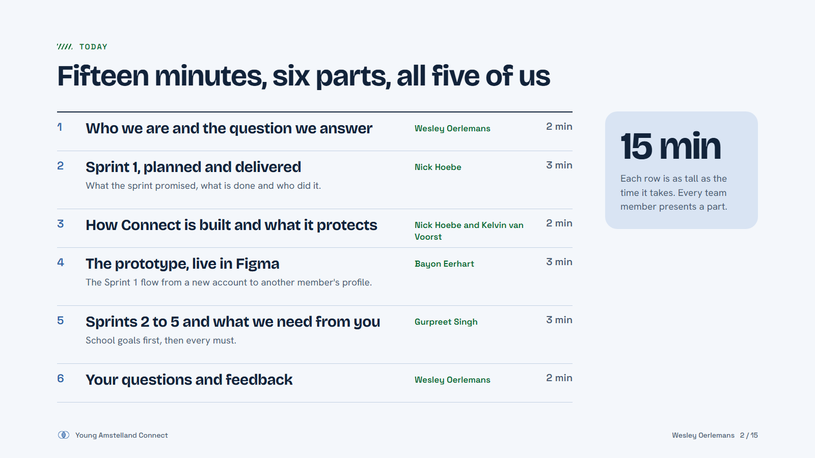
Notes:
Six parts and every one of us presents. Nick shows what we delivered, Nick and Kelvin how Connect is built and protected, Bayon the prototype, Gurpreet Sprint 2. I lead the questions at the end.

Slide 3
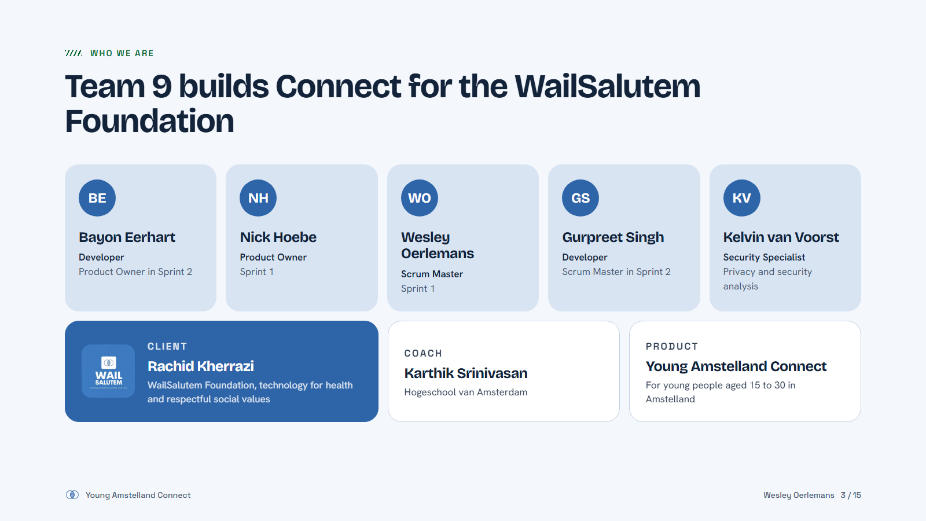
Notes:
Five of us. Nick was Product Owner and I was Scrum Master this sprint. In Sprint 2 Gurpreet is Scrum Master and Bayon Product Owner. Kelvin is our security specialist. Rachid is our client at the WailSalutem Foundation, Karthik our coach.

Slide 4
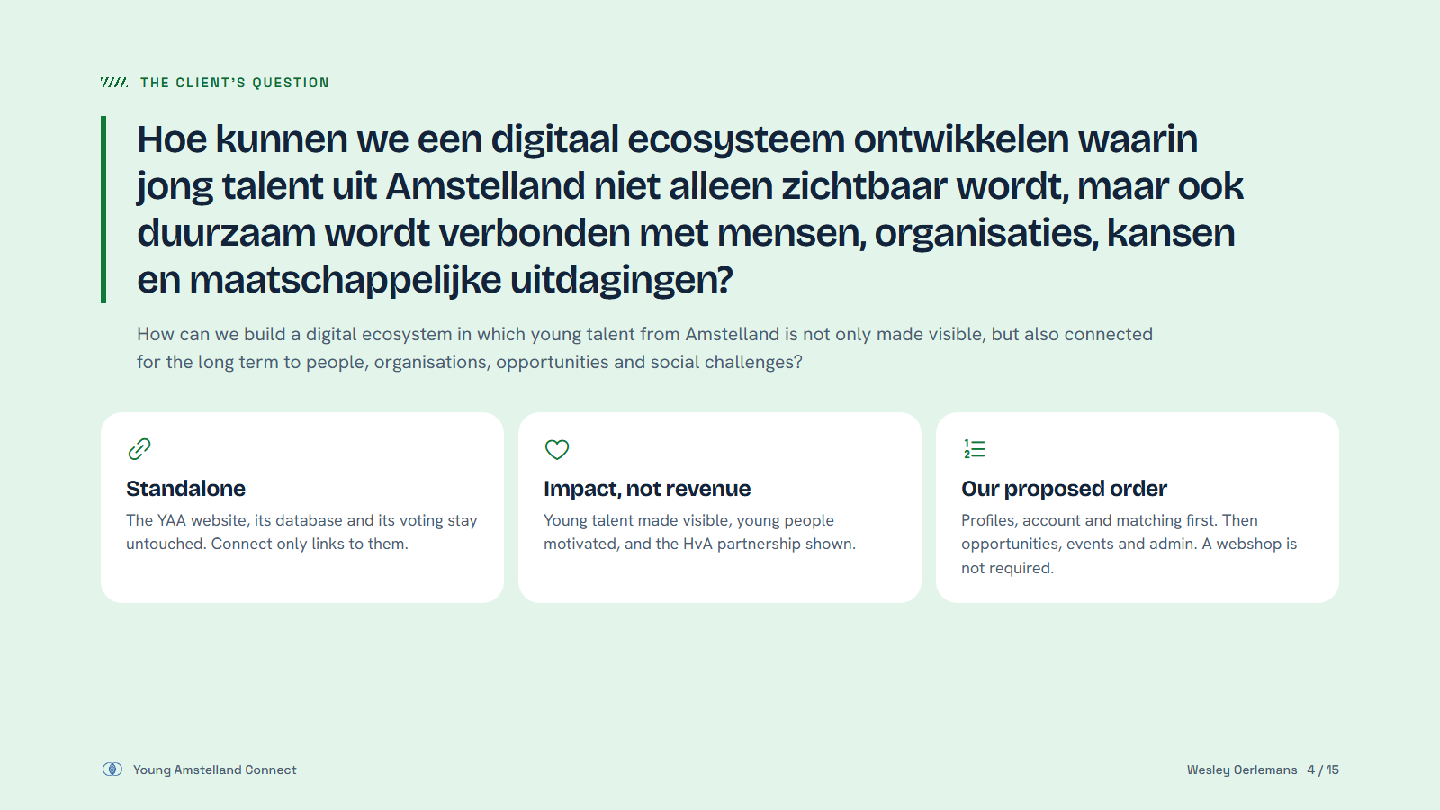
Notes:
This is your central question. Connect stands on its own, so nothing on the award website changes. The platform is about impact, not revenue. Our proposal is to build profiles, accounts and matching first. On 25 September you told us a webshop is not required.

Slide 5
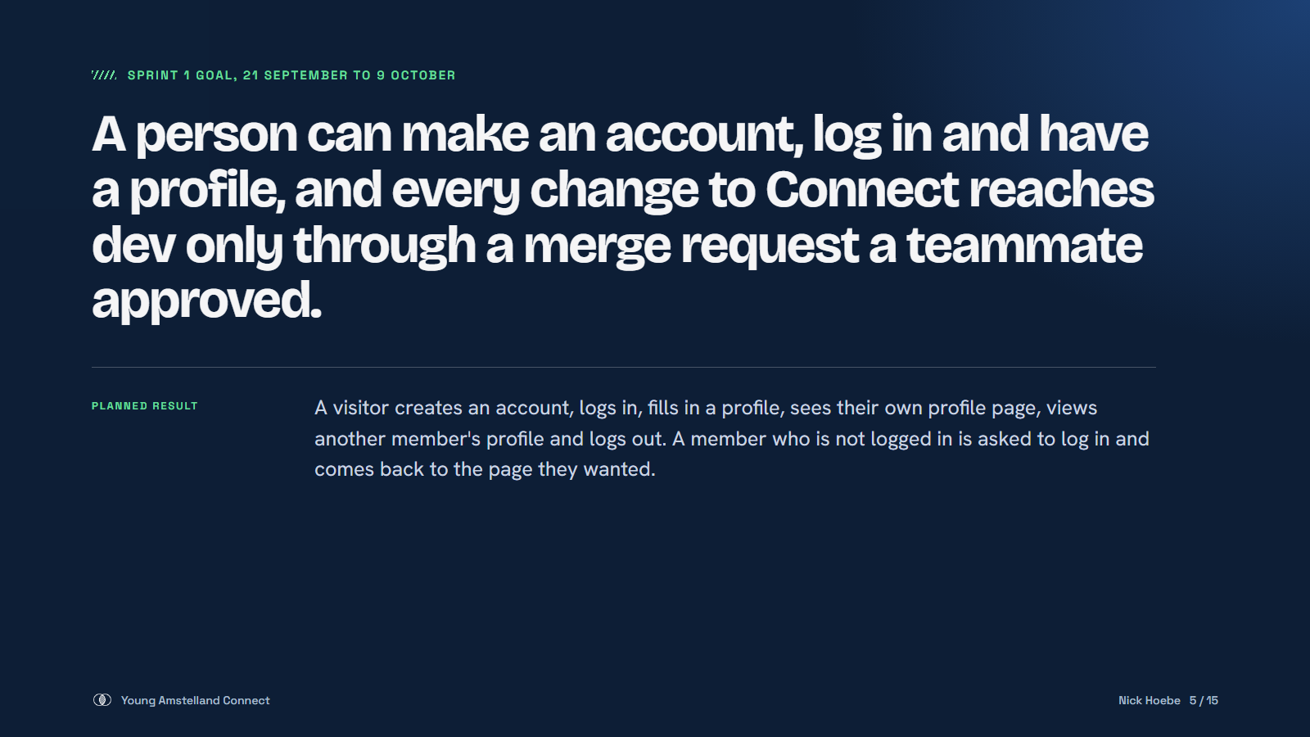
Notes:
Nick: this was the goal we set on 1 October. Two halves: the screens a young person uses, and a safe way of working underneath. Next slide shows what we got done.

Slide 6
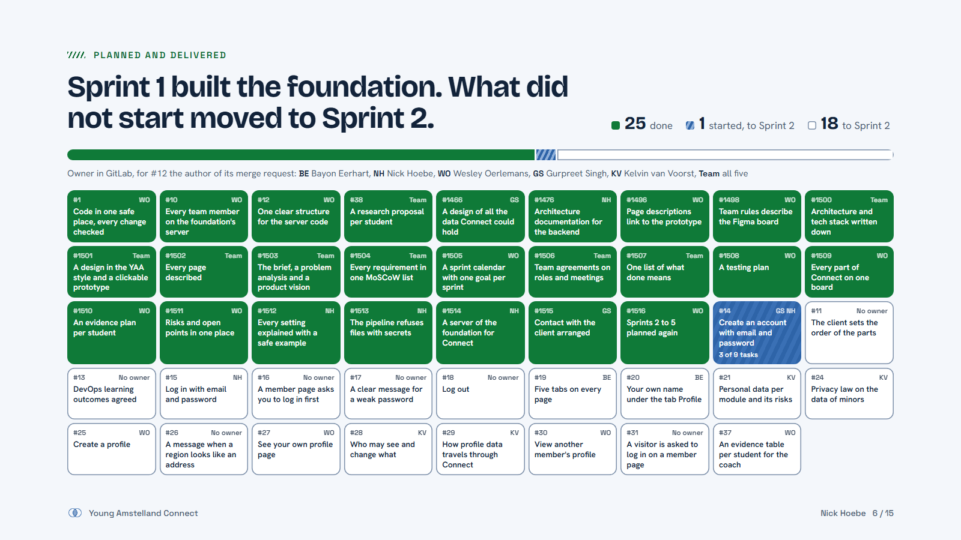
Notes:
Nick: 44 items on the Sprint 1 board, and 25 are done. That counts everything waiting in an open merge request. Done: the repository, the server, the structure, the design, the plans and the research. 16 of those were work we did before it had an issue; a teacher asked us to add them, so they are on the board now. The letters on each card show who owns it in GitLab, Team means all five of us. Creating an account has started: the backend structure, the local database and the account table are in. The 19 that had not finished, mostly the screens a young person uses, moved to Sprint 2 in the new plan.

Slide 7
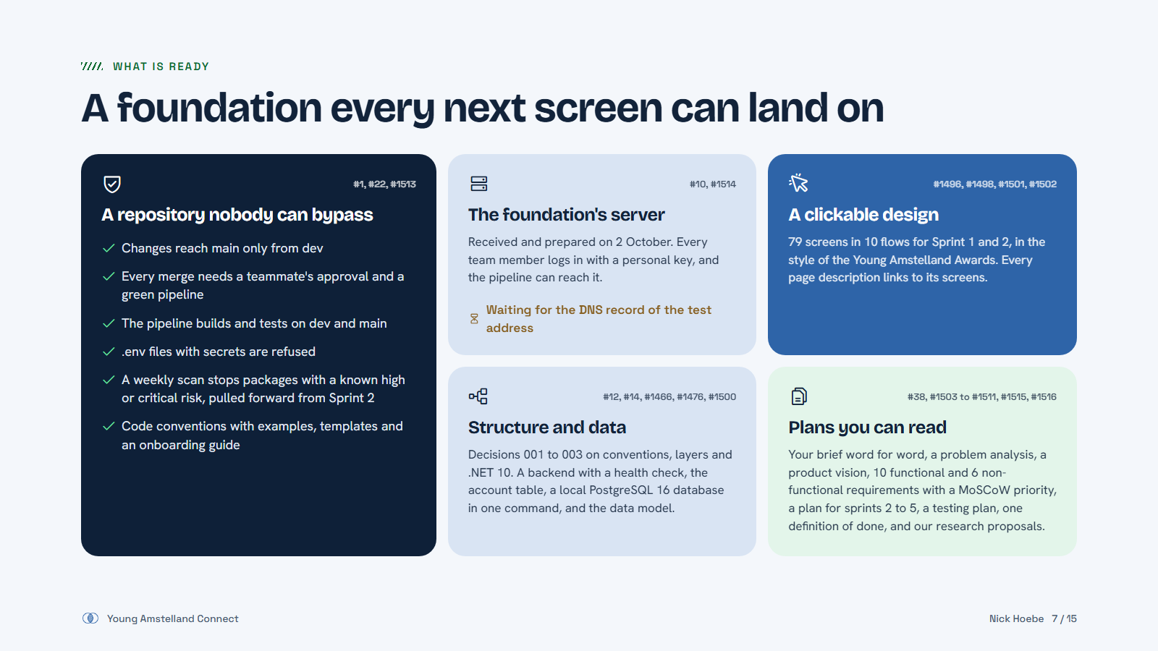
Notes:
Nick: this is what the foundation means. A repository where nothing gets in without a second pair of eyes and a green check. The foundation's server, ready since 2 October; we only wait for the DNS record. The design, decisions and the first backend and database work. 31 merge requests in this sprint.

Slide 8
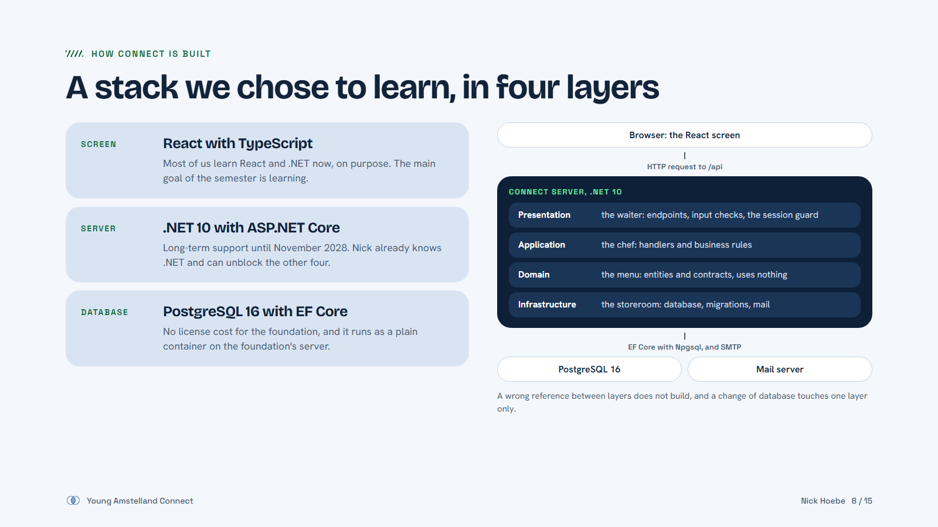
Notes:
Nick: React, .NET 10 and PostgreSQL 16. We picked a stack most of us do not know yet, because learning is the goal; I know .NET and help the others. The server has four layers. The arrows are project references, so a wrong one does not even build. When we switched from SQL Server to PostgreSQL on 26 September, only one layer was affected.

Slide 9
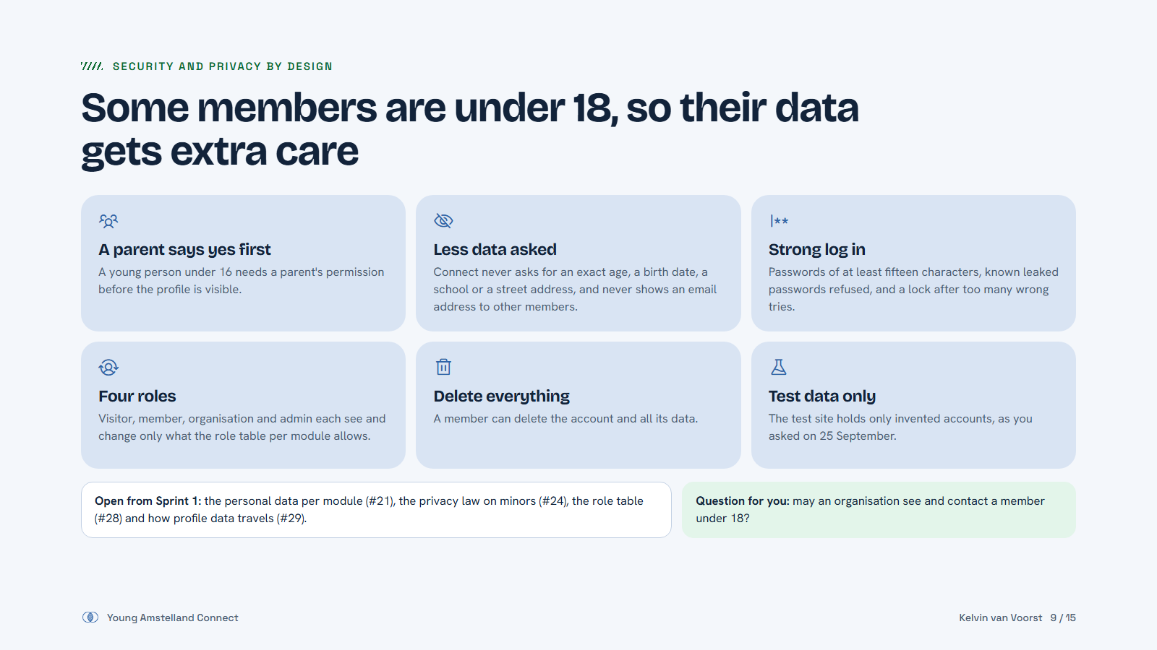
Notes:
Kelvin: our members are 15 to 30, so some are minors on an open platform. These six rules are in our requirements and in the prototype. Under 16 needs a parent. We ask as little as possible. Four roles, and a member can delete everything. The analysis behind it is still open from Sprint 1, and we need one answer from you: may an organisation contact a member under 18?

Slide 10
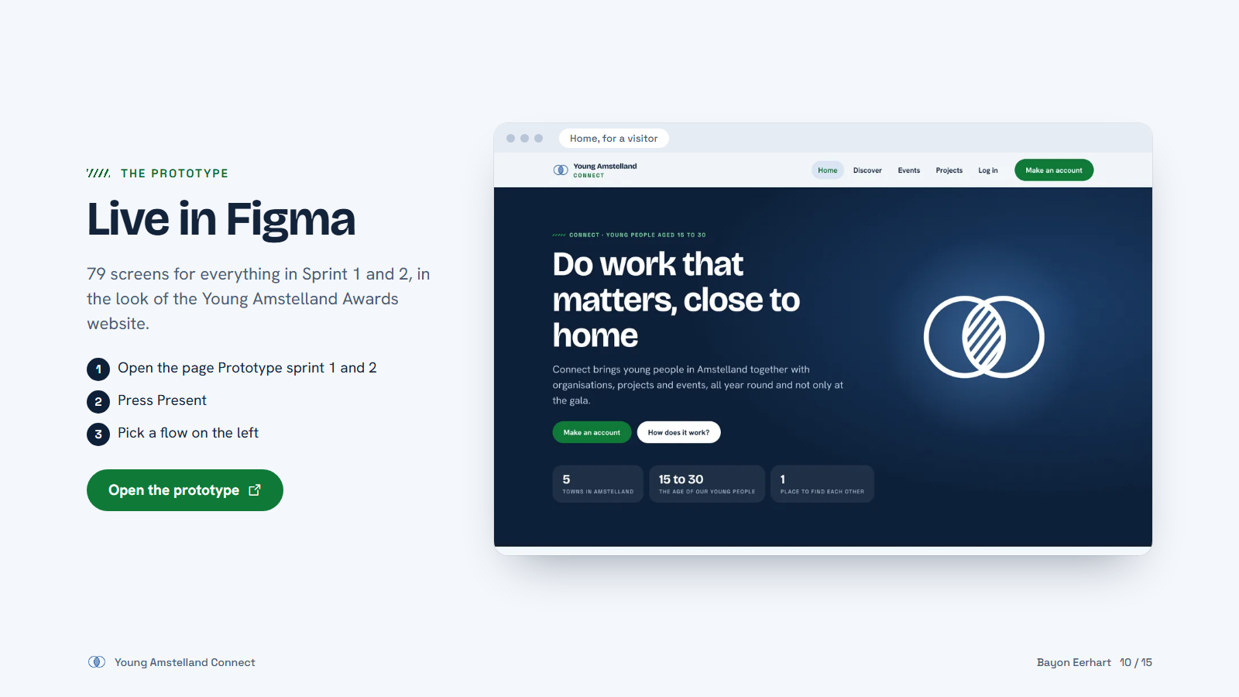
Notes:
Bayon: switch to Figma now. Show the Sprint 1 flow: make an account, create your profile, my profile, and the profile of another member. Figma asks for a free account before it opens the file.

Slide 11
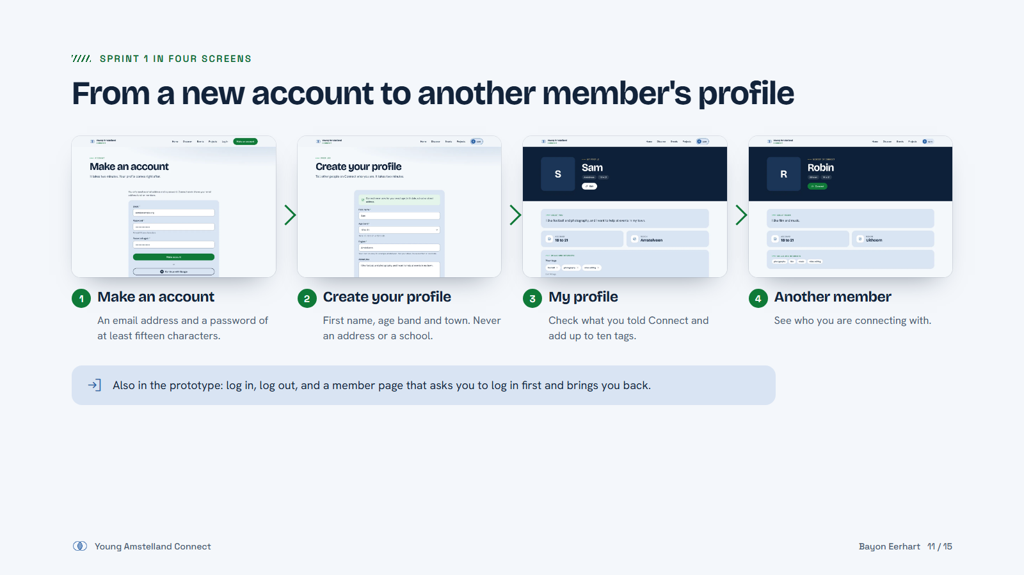
Notes:
Bayon: backup if Figma does not open. These four screens are the Sprint 1 promise for a young person.

Slide 12
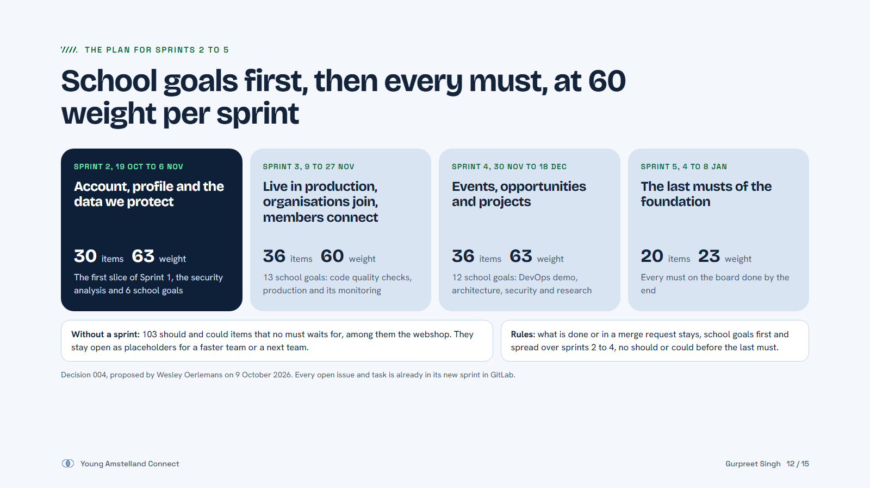
Notes:
Gurpreet: after Sprint 1 we planned the rest of the semester again. School goals come first, because every one of us is assessed on them, and they are spread: production and monitoring in Sprint 3, the DevOps demo, architecture and research in Sprint 4. Then every must of the foundation. Should and could items that nothing waits for, like the webshop, stay open without a sprint. We plan about 60 weight per sprint; Sprint 1 was preparation, so we expect to go faster now. Wesley made this plan as Scrum Master of Sprint 1, and we check it again after the Sprint 2 review.

Slide 13
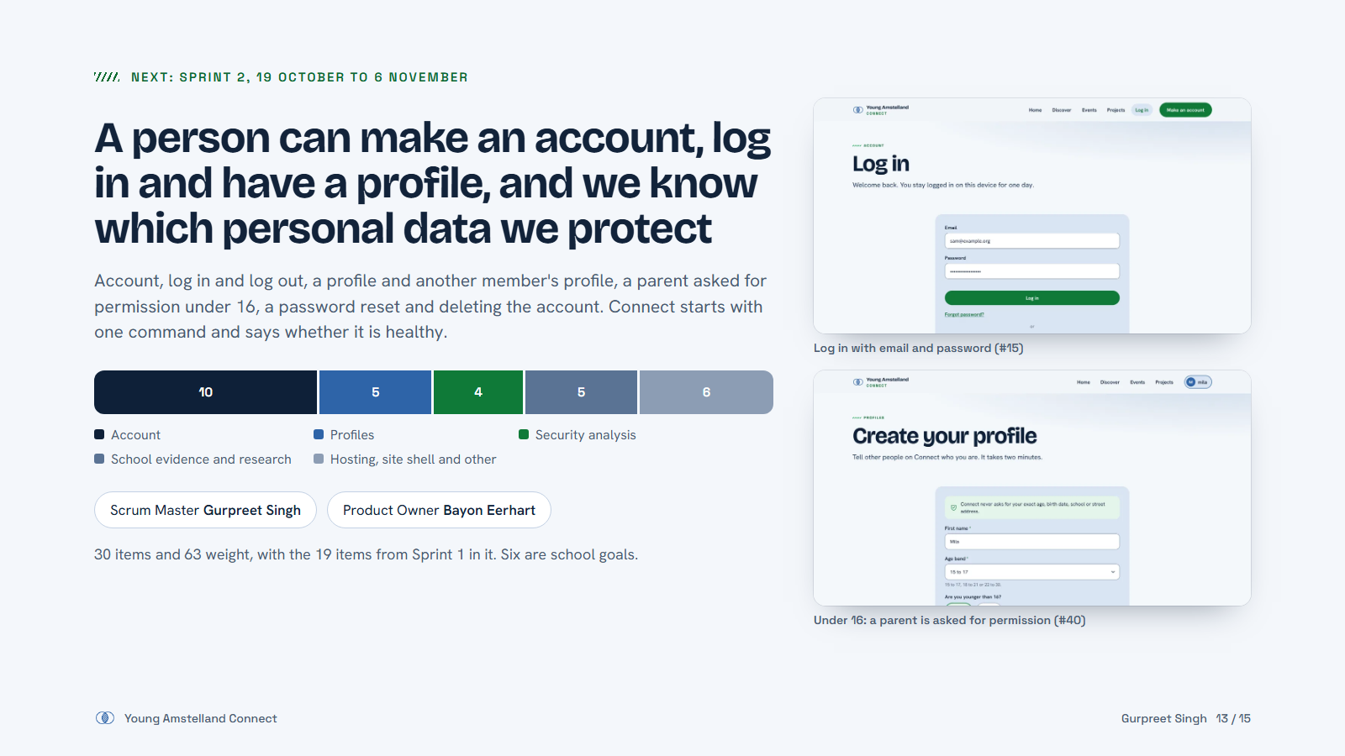
Notes:
Gurpreet: Sprint 2 finishes what a person needs to start: an account, logging in and out, a profile, and a parent asked for permission under 16. Kelvin finishes the security analysis, and six of the items are school goals. I am Scrum Master and Bayon is Product Owner.

Slide 14
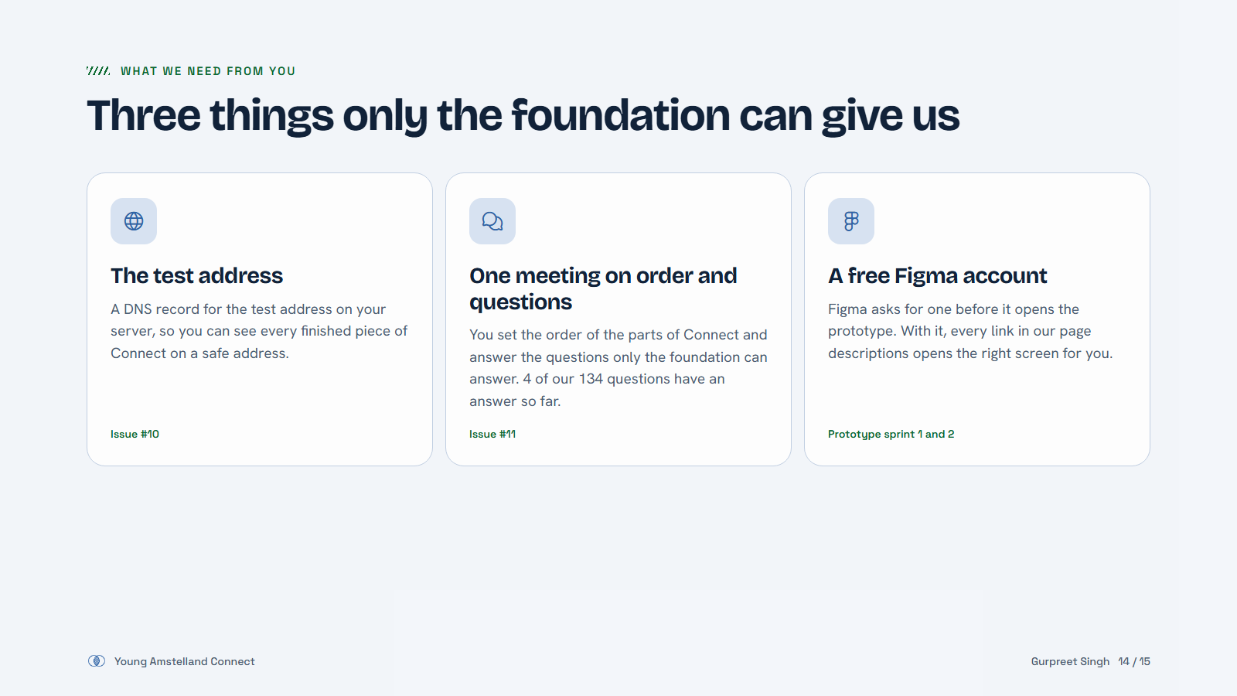
Notes:
Gurpreet: three asks. The DNS record unblocks the test address. One meeting to set the order and go through the open questions, starting with the Sprint 2 ones. And a free Figma account so you can click through yourself.

Slide 15
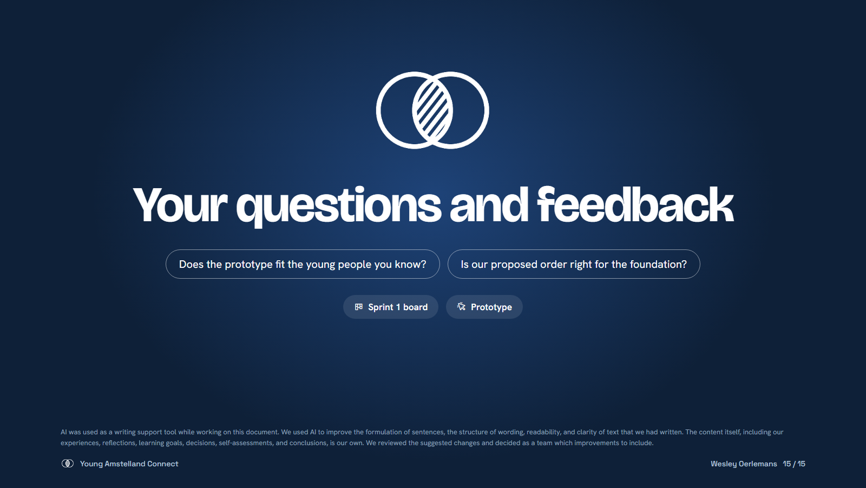
Notes:
Wesley: thank you. Any feedback or questions? Whoever takes the minutes writes down every answer, and we ask you to fill in the Sprint Review form.

