Slide 1


SMART INDIA HACKATHON 2026
Problem Statement ID –SIH26140
Problem Statement Title- AI-Powered Interactive Quantum Learning Platform
Theme-Emerging Technologies/Quantum Comptuing
PS Category- Software
Team ID-SIH26-A0H-T348
Team Name - Agentic Coven

Slide 2
Q-LEARN
Agentic Coven
Proposed Solution
AI-Powered Quantum Learning
A unified platform to learn, build, simulate and visualize quantum algorithms with AI-powered assistance.
How It Solves the Problem
Makes complex quantum concepts visual and hands-on
Enables experimentation without physical hardware
Provides instant simulation and AI guidance
Brings learning, coding and experimentation into one platform
Core Features
schoolLEARN
Interactive modules for qubits, quantum gates, algorithms and concepts.
constructionBUILD
Drag-and-drop quantum circuit builder with an integrated code editor.
play_circleSIMULATE
Execute quantum circuits and visualize states, results and probabilities in real time.
psychologyAI GUIDE
AI-powered explanations, hints, debugging and optimization support.
assignment_turned_inASSESS
Quizzes, coding challenges and personalized progress analytics.
Innovation & Uniqueness
Unified Workflow
Learn → Build → Simulate → AI Guide → Assess
Personalized AI-assisted learning
Multi-framework quantum simulation
Interactive visualization + coding challenges
Continuous feedback and progress tracking

Slide 3
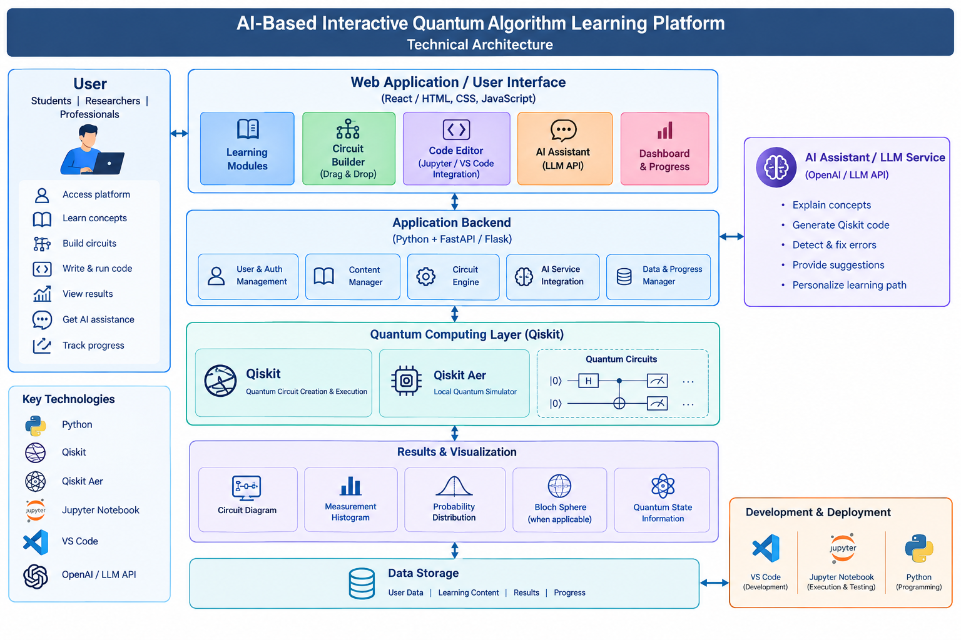
TECHNICAL APPROACH
Agentic Coven
Web Development: Full-Stack Web Application
Frontend: React.js
Backend: Python + Flask
Quantum: Qiskit + Qiskit Aer
AI: LLM-based AI Tutor
Database: MongoDB
Development: Jupyter Notebook + VS Code
Learn → Build Circuit / Code → Simulate → Visualize → AI Feedback → Assess

Slide 4
FEASIBILITY AND VIABILITY
Agentic Coven
Feasibility
Web-based & scalable
Uses existing Qiskit + Qiskit Aer
Runs on standard computing systems
No quantum hardware required for MVP
AI integration is technically achievable
Viability
Open-source quantum software reduces cost
Useful for students, educators & researchers
Interactive learning improves practical understanding
Can expand from simulation to real quantum hardware
Modular design supports future algorithms & QML
Challenges
Complex quantum concepts
AI explanation accuracy
Simulation resource requirements
Making advanced topics beginner-friendly

Slide 5
IMPACT AND BENEFITS
Agentic Coven
Target Audience
schoolStudents
scienceResearchers
business_centerProfessionals
co_presentInstructors
Impact
Interactive Learning
Makes complex quantum concepts highly interactive & accessible.
Hardware Independence
Reduces dependency on scarce and costly physical quantum hardware.
Workforce Preparedness
Builds a robust, quantum-ready workforce for future industries.
Key Benefits
check_circle
Hands-on Learning
Direct interactive circuit simulation.
check_circle
Personalized AI Guidance
Real-time explanations & assistance.
check_circle
Faster Skill Acquisition
Saves time on setup and core concepts.
check_circle
Progress Tracking
Monitor performance and milestones.

Slide 6
RESEARCH AND REFERENCES
Agentic Coven
References:
IBM Quantum / Qiskit https://quantum.ibm.com/
Cirq https://quantumai.google/cirq
qBraid https://qbraid.com/
AI Support Meets AR Visualization for Alice and Bob — EPJ Quantum Technology, 2025:
https://link.springer.com/article/10.1140/epjqt/s40507-025-00310-z?utm_source=chatgpt.com
Toward Personalizing Quantum Computing Education: An Evolutionary LLM-Powered Approach — 2025:
https://arxiv.org/abs/2504.18603?utm_source=chatgpt.com
Research Areas Quantum Education • Quantum Simulation • AI-Assisted Learning • Circuit Visualization • Interactive Learning • Quantum Algorithm Design

