Slide 1


SMART INDIA HACKATHON 2026
Team
Agentic Coven
Problem Statement ID – SIH26139
Problem Statement Title – Hybrid Quantum Machine Learning Platform for Early Disease Detection
Theme – MedTech / BioTech / HealthTech
PS Category – Software
Team ID – SIH26-A0H-T348
Team Name – Agentic Coven

Slide 2
Team
Agentic Coven
Q-DIAGNOSE
Proposed Solution:
A hybrid QML framework that incorporates classical preprocessing and feature extraction together with quantum algorithms to make early predictions of diseases.
The framework allows users to import biomedical datasets, preprocess them, extract features from them, train hybrid QML models, make predictions, and explain the models as well.
How it solves the problem:
Performs well on complex biomedical data by using the techniques of preprocessing, normalization, and noise reduction.
Reduces the high-dimensional biomedical data using the techniques of feature and dimensionality reductions.
Incorporates quantum machine learning algorithms such as VQC, QSVM, and QNN.
Makes predictions of diseases at an early stage with quantifiable measures of performance and confidence.
Explains the decisions made by QML models with the technique of feature importance and explainable AI.
Benchmarks the performance of QML algorithms with the performance of classical ML algorithms.
Core Features:
INGEST
Import and handle publicly available biomedical datasets.
PREPROCESS
Clean, normalize, and balance biomedical datasets.
RANK
Rank features, remove redundant features, and select quantum-compatible features based on the available qubit limit
SELECT
Remove redundant features and select quantum-compatible features based on available qubit limit.
QUANTUM
Encode selected features and prepare quantum circuits
MODEL SELECTION
Compare candidate classical and quantum ML models using validation metrics and select the best-performing model
PREDICT
Disease pattern detection and prediction.
EXPLAIN
Visualization of important features used in predictions.
BENCHMARK
Comparing classical ML and hybrid QML algorithms.
Innovation & Uniqueness:
Unified Workflow
Ingest → Preprocess → Rank→Select →Encode→Model Selection → Predict → Explain → Benchmark
Hybrid quantum-classical disease detection
Adapative quantum-aware feature selection based on feature relevance and available qubit budget
Performance-based selection of the most suitable classical or quantum ML model
Quantum-ready architecture for simulators and future hardware
Feature optimization to address limited qubit availability

Slide 3
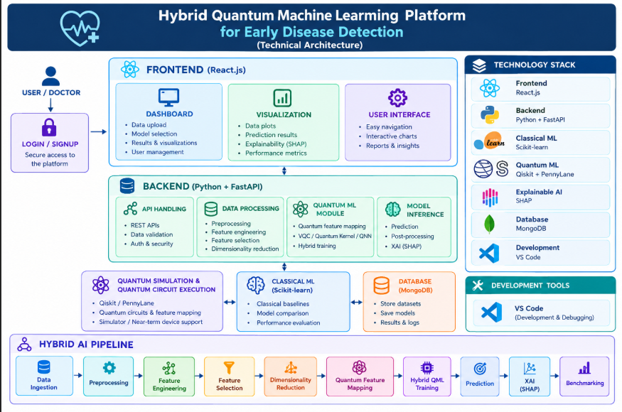
TECHNICAL APPROACH
Team
Agentic Coven
Final Tech Stack:
Frontend: React.js
Backend: Python + FastAPI
Classical ML: Scikit-learn
Quantum ML: Qiskit + PennyLane
QML Models: VQC / Quantum Kernel / QNN
Explainable AI: SHAP
Database: MongoDB
Development: VS Code
Hybrid AI Pipeline:
Data Ingestion → Preprocessing → Feature Engineering → Feature Ranking →Redundancy Removal→ Quantum-Aware Feature Selection → Qubit-Limit Check → Dimensionality Reduction → Quantum Feature Mapping → Quantum Feature Mapping → Classical + Quantum Model Training → Performance Evaluation →Best Model Selection → Prediction → XAI → Benchmarking

Slide 4
FEASIBILITY AND VIABILITY
Feasibility
Python + FastAPI backend with React-based web interface
Uses public/open biomedical datasets
Runs on standard systems using quantum simulators
No physical quantum hardware required
Qiskit and PennyLane support hybrid QML development
Classical ML provides practical baseline models
MongoDB enables structured data and result storage
Viability
Low-cost solution using simulators and open-source tools
Scalable hybrid quantum-classical architecture
Applicable to cancer, cardiovascular and neurological datasets
SHAP enables interpretable model predictions
Easy comparison between QML and classical ML
Can be extended to near-term quantum hardware
Suitable for researchers, healthcare applications and ML developers
Challenges
High dimensionality and noise in biomedical data
Limited quantum hardware and simulator scalability
Selecting suitable features for quantum encoding
Choosing effective quantum feature maps and QML models

Slide 5
IMPACT AND BENEFITS
Target Audience
Healthcare Professionals
Supports doctors with data-driven disease prediction and analysis.
Medical Researchers
Helps researchers evaluate new quantum-enhanced approaches for healthcare.
Data Scientists
Provides a platform to develop, test and benchmark ML and QML models.
Impact
Early Disease Detection
Identifies patterns in biomedical data that can support earlier diagnosis.
Advanced Medical Analysis
Handles complex and high-dimensional biomedical data using hybrid AI.
Explainable Predictions
Uses SHAP to identify the features influencing model predictions.
Key Benefits
Hybrid Intelligence
Combines classical ML with quantum-enhanced learning models.
Cost-Effective Development
Uses quantum simulators, reducing the need for physical quantum hardware.
Performance Benchmarking
Compares QML models with classical models using key healthcare metrics.
Scalable Platform
Can be extended to different diseases and biomedical datasets.

Slide 6
RESEARCH AND REFERENCES
Deliverable | Expected Output
Data Pipeline | Data ingestion, preprocessing & feature engineering
ML Models | Classical ML + VQC / Quantum Kernel / QNN
Hybrid Platform | React + FastAPI web application
Prediction Module | Disease risk classification and results
XAI Module | SHAP-based feature importance
Benchmarking | QML vs Classical ML performance
Database | MongoDB for datasets and results
Documentation | Setup guide, methodology and results
Demo | Working end-to-end disease detection platform
REFERENCES
Gupta et al., A systematic review of quantum machine learning for digital health, npj Digital Medicine, 2025. Article
Babu et al., Revolutionizing heart disease prediction with quantum-enhanced machine learning, Scientific Reports, 2024. Article
Ray et al., Coalition of explainable artificial intelligence and quantum computing in precision medicine, CSBJ, 2025. Article
Bukkarayasamudram et al., Quantum computing revolution in healthcare, Artificial Intelligence Review, 2025. Article
Nassir et al., Quantum computing and the implementation of precision medicine, npj Genomic Medicine, 2025. Article

