Slide 1

Movie Ticket
Booking System
ADMIT ONE
MOVIE TICKET • SEATS • SHOWTIME
Database: movie_booking_db • 4 Tables • 60 SQL Queries
Technologies: MySQL • MySQL Workbench • GitHub

Slide 2
1 Project Overview
C
Customer Management
M
Movie Management
T
Theatre Management
Stores customer name, gender, city and signup date.
Maintains movie name, genre, language and duration.
Stores theatre name, city and total seating capacity.
B
Booking Management
R
Revenue Analysis
P
Payment Tracking
Records customer, movie, theatre, show time, seats and amount.
Analyzes ticket revenue, booking value and performance.
Tracks payment methods and booking status.
Movie Ticket Booking System | 2

Slide 3
2 Problem Statement & Objectives
!
Problem
O
Objectives
A movie ticket business handles data about customers, movies, theatres and bookings. Without a relational database, this data causes problems:
1
Design a relational MySQL database
2
Link the tables with primary and foreign keys
Inconsistent and duplicated records
3
Analyze revenue, seats sold and booking value
4
Find top movies, theatres and customers
Bookings hard to trace to the right customer, movie and theatre
5
Compare completed and cancelled bookings
No reliable view of revenue and popularity
6
Apply SQL from basic queries to joins and subqueries
Movie Ticket Booking System | 3

Slide 4
3 Technology Stack
M
MySQL
W
MySQL Workbench
G
GitHub
Relational Database Management System to create and query booking data.
Database creation, SQL execution, table management and ER visualization.
Stores SQL scripts, project files and documentation.
Project Scope
Database: movie_booking_db • Tables: 4
SQL analysis: 60 queries across Simple, Medium and Hard levels
Focus: relational design + SQL analytics + business-oriented insights
Movie Ticket Booking System | 4

Slide 5
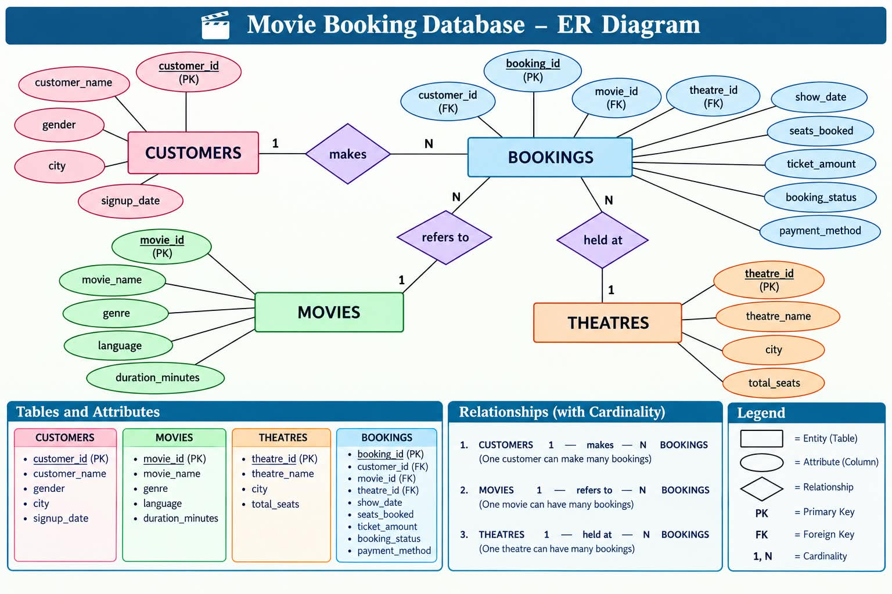
4 Entity Relationship Diagram
Customers → Bookings
One customer can make many bookings (1 : N).
Movies → Bookings
One movie can appear in many bookings (1 : N).
Theatres → Bookings
One theatre can host many bookings (1 : N).
Movie Ticket Booking System | 5

Slide 6
5 Database Schema
customers
movies
theatres
bookings
customer_id
PK
movie_id
PK
theatre_id
PK
booking_id
PK
customer_name
movie_name
theatre_name
customer_id
FK
gender
genre
city
movie_id
FK
city
language
total_seats
theatre_id
FK
signup_date
duration_minutes
show_date
seats_booked
ticket_amount
booking_status
payment_method
Movie Ticket Booking System | 6

Slide 7
6 Key Relationships & Data Integrity
1
CUSTOMERS → BOOKINGS
2
MOVIES → BOOKINGS
3
THEATRES → BOOKINGS
bookings.customer_id →
customers.customer_id
One customer, many bookings.
bookings.movie_id →
movies.movie_id
One movie, many bookings.
bookings.theatre_id →
theatres.theatre_id
One theatre, many bookings.
Data Integrity
Primary keys uniquely identify records (Cardinality 1 : N on every relationship)
Foreign keys maintain valid relationships
Referential integrity ties each booking to an existing customer, movie and theatre
Movie Ticket Booking System | 7

Slide 8
7 Database Implementation
CREATE DATABASE IF NOT EXISTS
movie_booking_db;
USE movie_booking_db;
1
Step 1
Create the database and select the schema.
SHOW TABLES;
SELECT * FROM customers;
SELECT * FROM movies;
SELECT * FROM theatres;
SELECT * FROM bookings;
2
Step 2
Create customers, movies and theatres first, then bookings (it holds the foreign keys).
3
Step 3
Insert sample data and verify records before running queries.
Movie Ticket Booking System | 8

Slide 9
8 Data Insertion & Verification
D
Data Inserted
V
Verification
Customer records
Movie records
Theatre records
Booking records
Show date and time
Seats booked and ticket amount
Booking status
Payment method
Run SHOW TABLES and SELECT queries to confirm records and relationships.
SHOW TABLES;
SELECT * FROM customers;
SELECT * FROM movies;
SELECT * FROM theatres;
SELECT * FROM bookings;
Movie Ticket Booking System | 9

Slide 10
9 SQL Analysis — Basic Queries
S
Simple Queries
-- Movies longer than 150 minutes
SELECT movie_name, duration_minutes
FROM movies
WHERE duration_minutes > 150;
SELECT • WHERE • LIKE • DISTINCT
ORDER BY • LIMIT
COUNT() • SUM()
Filters by city, genre, status and payment method
-- 10 highest-value bookings
SELECT booking_id, ticket_amount
FROM bookings
ORDER BY ticket_amount DESC
LIMIT 10;
?
What they answer
-- Total ticket revenue
SELECT SUM(ticket_amount) AS total_revenue
FROM bookings;
Browse the tables, filter movies and bookings, and find top bookings and total revenue.
Movie Ticket Booking System | 10

Slide 11
10 Revenue & Booking Analysis
-- Movies earning over 10,000
SELECT m.movie_name,
SUM(b.ticket_amount) AS total_revenue
FROM movies m
JOIN bookings b ON m.movie_id = b.movie_id
GROUP BY m.movie_id, m.movie_name
HAVING SUM(b.ticket_amount) > 10000;
What it answers
Which movies and cities earn the most from ticket sales?
SQL Concepts
JOIN • SUM() • GROUP BY
HAVING • ORDER BY
-- Total revenue by theatre city
SELECT t.city,
SUM(b.ticket_amount) AS total_revenue
FROM theatres t
JOIN bookings b ON t.theatre_id = b.theatre_id
GROUP BY t.city
ORDER BY total_revenue DESC;
Business Value
Shows which movies and cities drive revenue.
Movie Ticket Booking System | 11

Slide 12
11 Customer & Payment Analysis
-- Bookings made by each customer
SELECT c.customer_id, c.customer_name,
COUNT(b.booking_id) AS total_bookings
FROM customers c
LEFT JOIN bookings b
ON c.customer_id = b.customer_id
GROUP BY c.customer_id, c.customer_name;
C
Customer Analysis
LEFT JOIN keeps customers who have made no bookings.
P
Payment Analysis
-- Average ticket amount by payment method
SELECT payment_method,
AVG(ticket_amount) AS average_ticket_amount
FROM bookings
GROUP BY payment_method;
Compares the average ticket amount across payment methods.
Movie Ticket Booking System | 12

Slide 13
12 Business Questions Answered
M
Movies
C
Customers
T
Theatres
Highest-revenue movie
Most-booked movie
Movies never booked
Top spending customer
Repeat customers
Above-average spenders
Highest-revenue theatre
Busiest by seats booked
Theatres with 5+ bookings
B
Bookings
P
Payments & Status
R
Revenue & Time
Latest booking per customer
Bookings above average
High / Medium / Low tiers
Payment method averages
Bookings per status
Completed vs cancelled
Revenue by theatre city
Movie share of total revenue
Bookings by year and month
Movie Ticket Booking System | 13

Slide 14
13 End-to-End Project Workflow
1
2
3
4
5
6
Design Database
Create Tables
Insert Data
Verify Records
SQL Analysis
Business Insights
Implementation Flow
Create database → create related tables → insert data → verify data → execute SQL analysis (Simple → Medium → Hard) → generate business insights
Movie Ticket Booking System | 14

Slide 15
14 Results & Key Outcomes
D
Database Outcome
A
Analysis Outcome
T
Technical Skills
✓ 4 relational tables
✓ PK and FK relationships
✓ One-to-many links
✓ Bookings tied to customers, movies and theatres
✓ 60 SQL analysis queries
✓ Booking analysis
✓ Revenue analysis
✓ Movie & theatre performance
✓ Customer & payment analysis
✓ JOINs
✓ GROUP BY / HAVING
✓ Aggregates
✓ Subqueries
✓ CASE
Movie Ticket Booking System | 15

Slide 16
15 Future Enhancements
1
Seat-level booking — track individual seats
2
Show schedules — separate timings from bookings
3
Theatre screens — model individual screens
4
Seat-type pricing — price by seat category
5
Offers & discounts — coupons and promotions
6
Cancellations & refunds — track refund status
7
Reviews & ratings — customer feedback
8
Food & beverage — snack orders
9
Online payments — transaction details
10
Occupancy analysis — theatre-wise occupancy
Movie Ticket Booking System | 16

Slide 17
16 Conclusion
What This Project Demonstrates
A relational MySQL database for customers, movies, theatres and bookings, combined with SQL analysis that turns booking data into revenue, movie, theatre, customer and payment insights.
K
Key Learning
Database design + SQL querying + relational analysis + business insights
MySQL • Primary & Foreign Keys • JOINs
Movie Ticket Booking System | 17

Slide 18
Thank You
ADMIT ONE
Questions & Discussion
MOVIE TICKET • SEATS • SHOWTIME
Movie Ticket Booking System

