Slide 1
Intern Presentation
22nd June 2016
Girish Bathala

Slide 2
VHDL
UNIX
PERL
Overview– First Month
Index
Unix
Perl
Progress
VHDL

Slide 3
UNIX
Basic Unix Shell Commands .
Makefile Structure:
target: dependencies
Tab ↹ system command(s).
The make command saves time while executing programs & test cases. It automatically executes the commands based on time stamp of the dependencies.
Used the makefile to interlink files , dependencies and programs in different directories.

Slide 4
Perl Programming (Practical Extraction and Report Language)
Interpreted.
Scalars, arrays and Hash Tables.
Subroutines.
Passing command line arguments.
Creating references and dereferencing.
File operations.
Error handling- die and warn.

Slide 5
VHDL – (VHSIC HDL)
Code structure of vhdl.
-LIBRARY Declarations
-ENTITY
-ARCHITECTURE
Study on data types and how they are allowed, specified and used. Emphasis on data compatibility, synthesizability and data conversion.
Operators and Attributes- Learnt the basic operators and their compatibility with different data types. Attributes were useful in modeling sequential code and array data types.
Concurrent Code & Sequential Code
Analyzed statements such as WHEN , GENERATE; & PROCESS, CASE , IF etc.
Overview of Packages, Components and Functions.

Slide 6
Assisted Flow
Index
Objective
Work Flow
Work Done
Screenshots
Pros & Cons

Slide 7
Objective
To develop a graphic user interface application to provide users an automated, easy and efficient flow in entering data and values for different parameters pertaining to different protocols followed by masters, slaves, interfaces & data width converters to name a few, in a design architecture.

Slide 8
Work Flow
AMBA ( Advanced Microcontroller Bus Architecture ) AXI (Advance Extensible Interface) 3.0 Protocol.
Read the AXI 3 specification document and got an insight into it’s signal descriptions, channel handshakes, addressing options, data buses and so on.
It gave an understanding of how different masters and slaves communicate with each other in a design architecture .

Slide 9
Work Flow
2. GUI (Graphic User Interface) Hunt
Researched on the ideal code base required for the assisted flow GUI application based on complexity, uses, extendibility, support and limitations.
Came up with four results : Excel VBA
Perl Tk
Perl Gtk
Wx Perl
Proceeded with the implementation by using Excel VBA and Perl Tk.

Slide 10
Work Flow
3. Excel VBA ( Visual Basic For Applications)
Read tutorials on Excel VBA (Visual Basic for Applications)-it is the programming language of Excel and using it we can automate tasks in Excel by writing so called macros.
Built a basic GUI application for assisted flow using the userform, modules and classes features.

Slide 11
Work Flow
4. Perl Tk
Read the documentation and tutorials on Perl Tk. Tk is a free and open-source, cross-platform widget toolkit that provides a library of basic elements of GUI widgets for building a graphical user interface.
Tried out a few example programs using Perl Tk.
Implemented a prototype of the assisted flow application according to the required specs.

Slide 12
Specifications For The Prototype.
Save the number of masters in the architecture.
Save the number of slaves in the architecture.
Allow the user to enter the required number of protocols.
Track the protocols followed by the masters and the slaves.
Allow users to enter data pertaining to various signals in the protocol.
Save the data in the background in an excel file.
Help icon to assist the user on what needs to be done

Slide 13
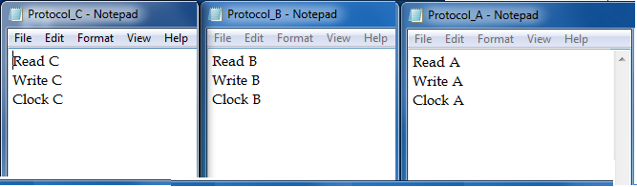
Assisted Flow Perl TK
Based on the different protocols that are required in a given design, the user can input the text files pertaining to each protocol.
Each text file can contain the signals or channels defined in each protocol.
Command:
make report "DEP1=I2C.txt" "DEP2=SPI.txt" "DEP3=AXI.txt“.

Slide 14
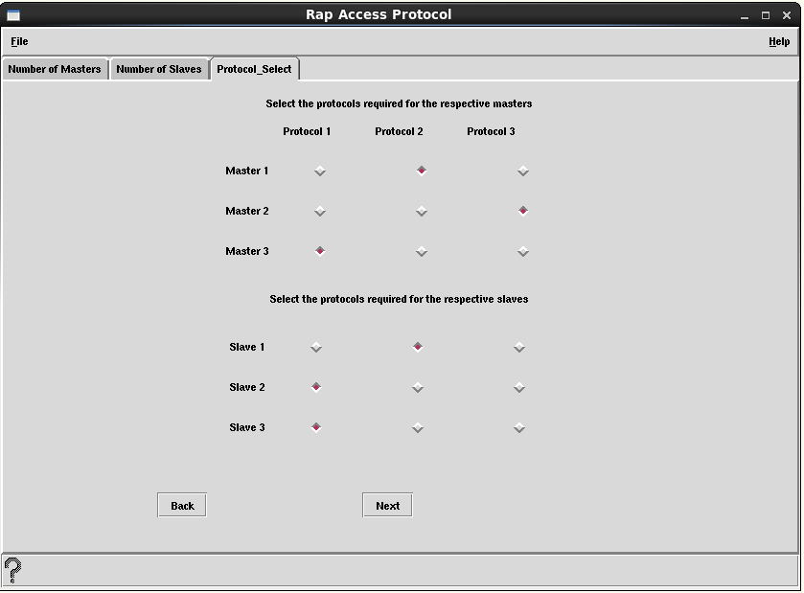
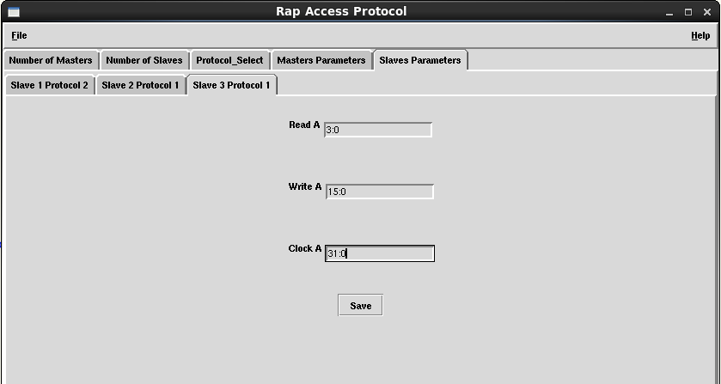
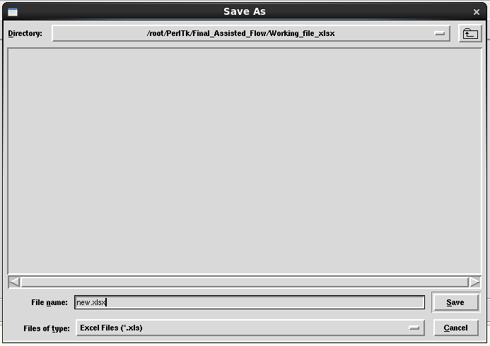
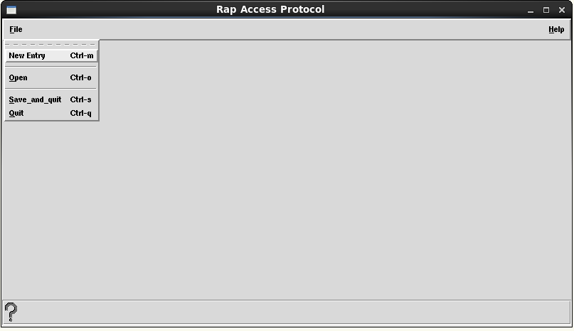
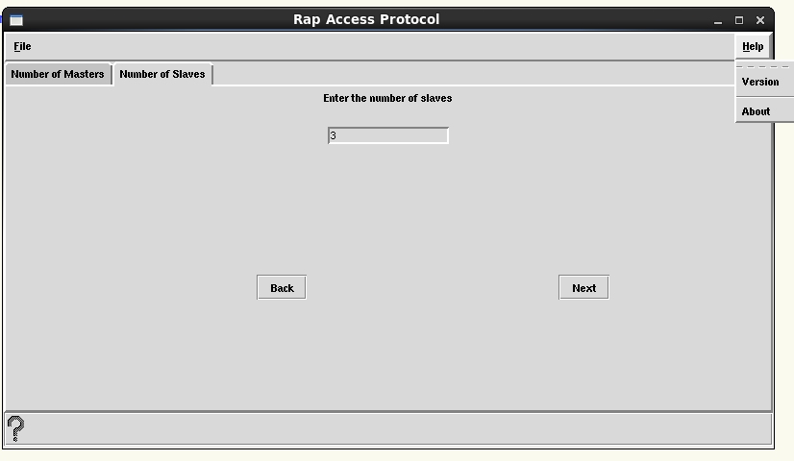
Screenshots – Perl TK
help

Slide 15
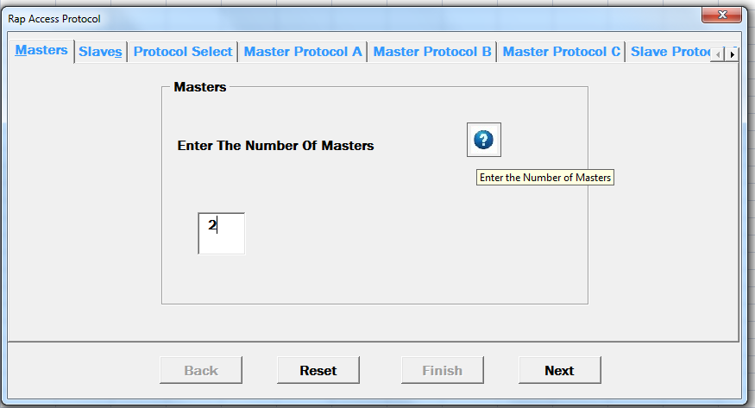
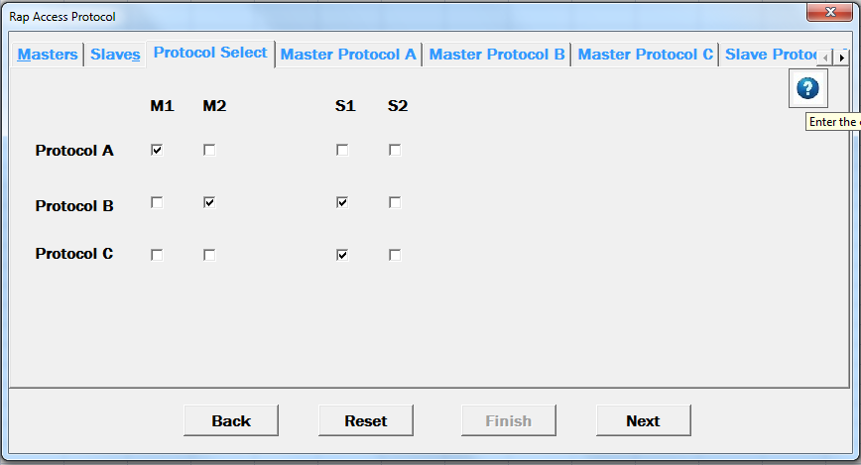
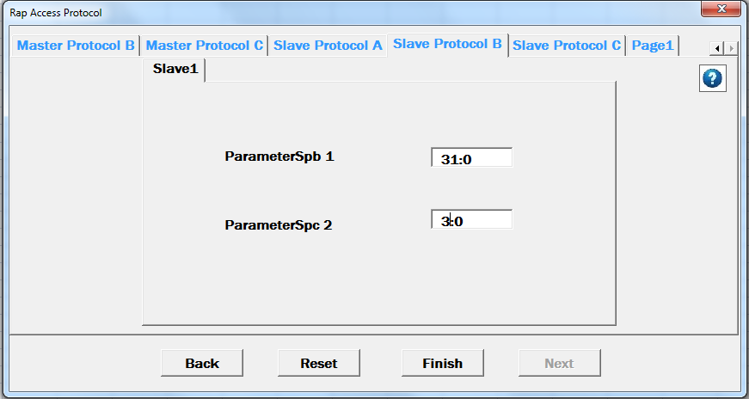
Screenshots – Excel VBA

Slide 16
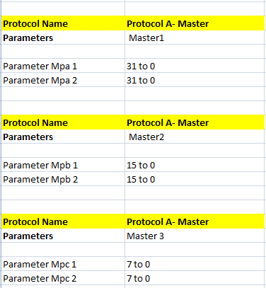
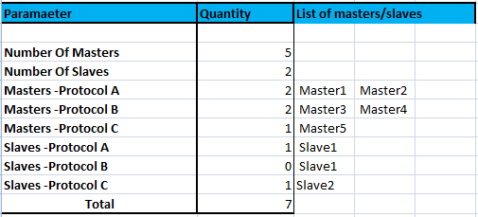
Screenshots- Excel Sheets

Slide 17
Pros
Perl Tk
Complexity of code is less.
Better control over all the widgets created –static as well as dynamic.
Can be used with a makefile for better automation.
Excel VBA
Easy to create layouts with the drag and drop option using the toolbox widgets
Better control over the excel sheet i.e., to access data, control workbooks & worksheets etc.

Slide 18
Cons
Perl Tk
Poor / No control with excel worksheet data while copying them or deleting them.
Excel VBA
Complex code.
Poor control over dynamically created widgets.

Slide 19
System Verilog
System Verilog Introduction
Features in System Verilog
Features Implemented in the Updown Counter Design.
VHDL vs Verilog vs System Verilog

Slide 20
System Verilog Introduction
SV is a combine Hardware Description Language and Hardware Verification Language based on extensions to verilog.
HDLs are intended to be synthesizable into a circuit, whereas HVL is intended to be run as software providing stimulus to the actual/simulated hardware.
HVL applies the OOPSs concept to the world of hardware verification, and gives more flexibility and ease .

Slide 21
Features in System Verilog
C type data types like int, typedef, struct, union, enum.
Dynamic data types : struct, classes, dynamic queues, dynamic arrays.
New operators and built in methods.
Enhanced flow control like, foreach, return, break, continue.
Semaphores, mailboxes, event extensions.
classes for object oriented programming.
Assertions.
Coverage.
Verilog Procedural Interface extensions

Slide 22
Up Down Counter DUT
Reset
N Bit
Up-Down Counter
DUT
Updown
N
Count
Load
N
Data
Clock

Slide 23
Feature Extraction
Reset Property : The reset pin is driven high and the count should be pulled to zero asynchronously.
Enable Property : The other functions of the counter should be enabled only when this pin is high. When low, output should hold its value.
Loading Property : When enabled and load is high, the value on the data should be sent to the output synchronously.
Roll Over Property : The count should roll over from the max/min value while up or down counting respectively.
Up/Down Counting Property : The output should count either up or down synchronously depending on the clock.

Slide 24
SV Features used
Constrain Randomization Verification (CRV) to generate the values in the stimulus generation plan.
Interface : to connect the DUT and the testbench.
Assertion Coverage: To assert if all the features and functions are covered.
Covergroup Coverage: To check if all the above cases are provided as stimulus to the DUT.

Slide 25
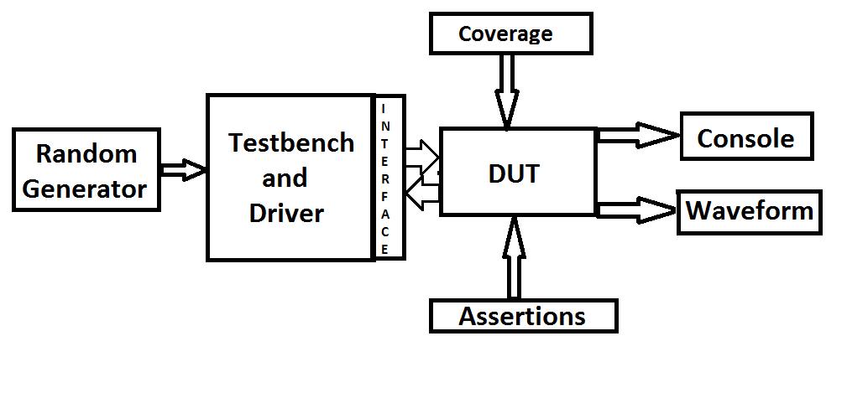
Overview- Updown Counter Verification Plan

Slide 26
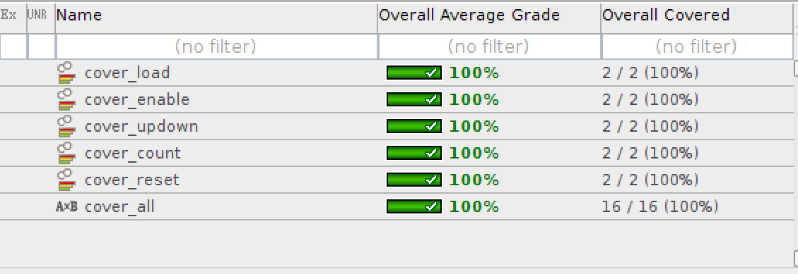
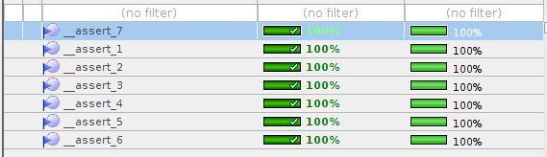
Covergroup and Assertion Coverage

Slide 27
Options
Regression
Test
Frtl
Ftb
Inclist
Deflist
Options
Tool
Vtimescale
Vip_library
Excel
Uvm_verbosity
Seed
Stop_time
Log
Gui
Deflist
Sim_mode
Licenses
Help

Slide 28
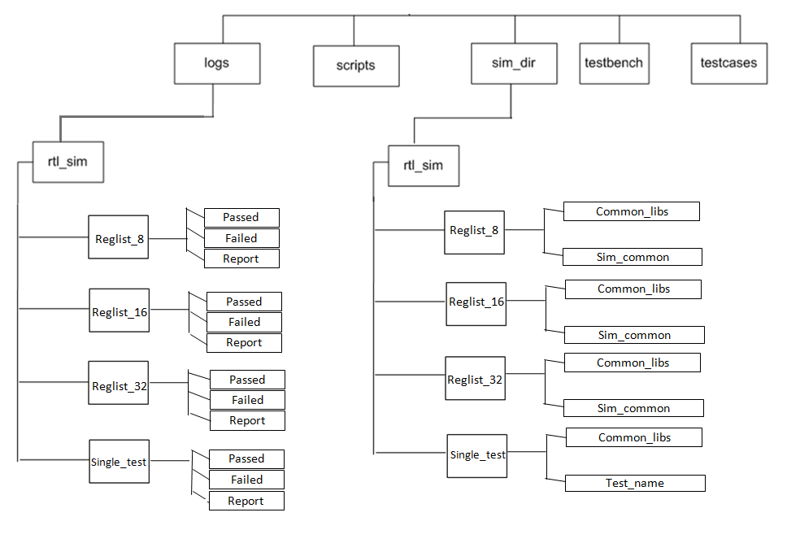
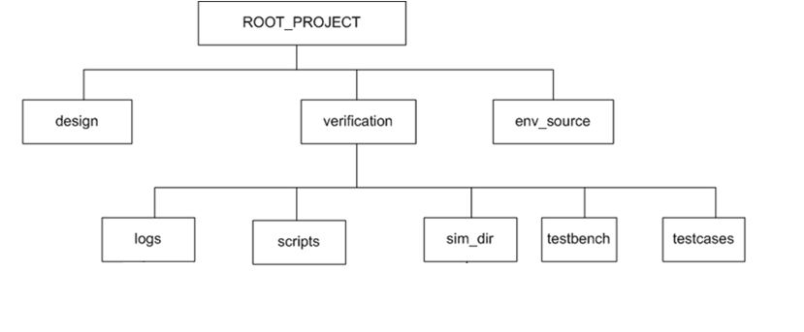
Directory Structure
Verification Directory

Slide 29
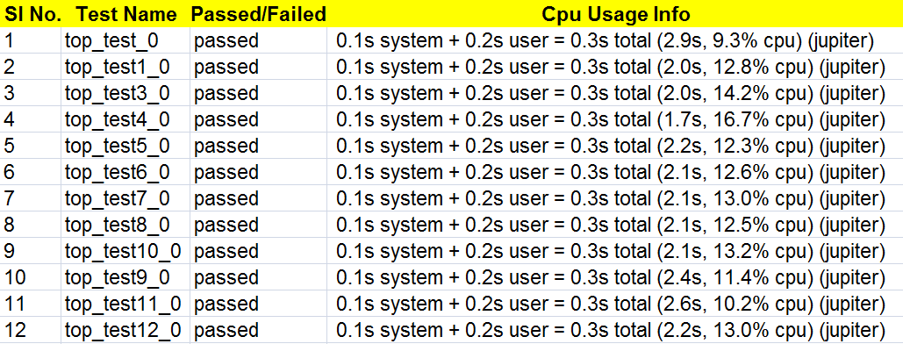
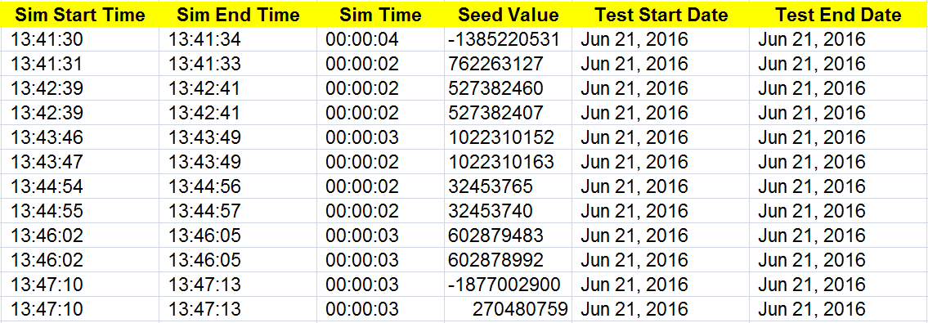
Report Generated
Report Generated (Cont..)

Slide 30
References/Links
Perl
Perl Maven http://perlmaven.com/
Comprehensive perl archive network http://www.cpan.org/
Tutorial Point -http://tutorialspoint.com/perl/
Tutorial Point -http://tutorialspoint.com/unix
VHDL
Circuit Design with VHDL Volnei A. Pedroni – Ebook
Test Bench Example
http://www.csun.edu/edaasic/roosta/VHDL_Examples.pdf

Slide 31
References/Links
Excel VBA
http://www.excel-easy.com/vba.html
http://www.tutorialspoint.com/vba/vba_input_box.htm
http://www.globaliconnect.com/excel/
Perl TK
http://rio.murmansk.ru/doc/tk/index.htm
https://metacpan.org/pod/Tk
http://www.perl.com/pub/1999/10/perltk/sld001.htm

