Slide 1
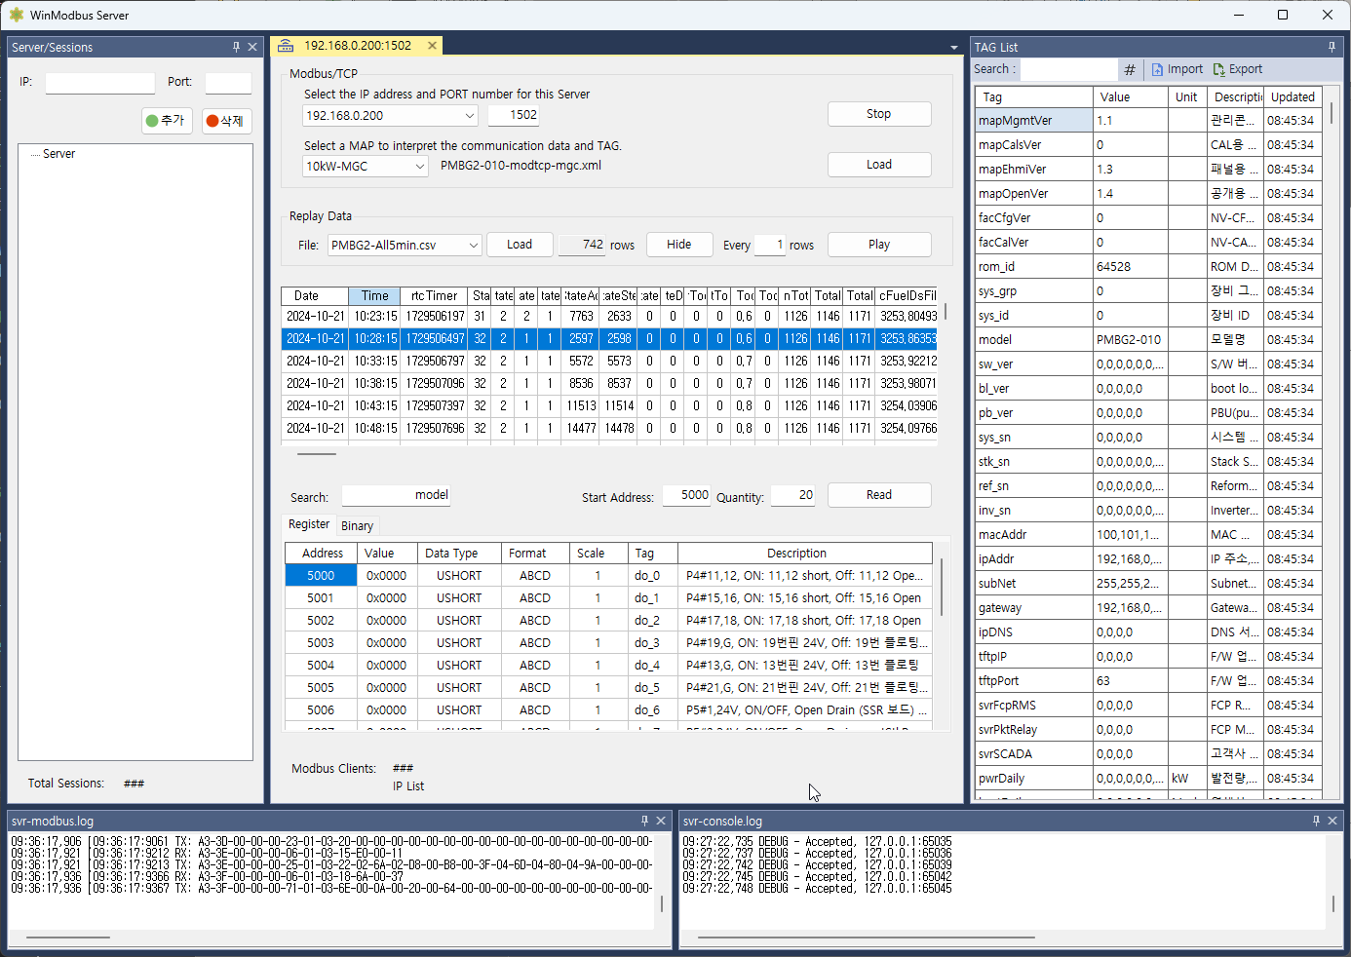
Overview
Session list
Managing Modbus Server
Managing Data
Show Log Messages
2
3
1
4

