Slide 1
Distraction Detector
CSE7101- Capstone Project Review-1
Batch Number : CSD_37
Under the Supervision of,
Dr. Srabana Pramanik
Professor / Associate Professor / Assistant Professor
School of Computer Science and Engineering Presidency University
Name of the Program: B.Tech - CSE ( Data Science ) Name of the HoD: Dr. Pravinthraja S
Name of the Program Project Coordinator: Dr. H M Manjula
Name of the School Project Coordinators: Dr. Sampath A K , Dr. Geetha A
Roll Number | Student Name
20221CSD0099 | K Guru Dheeraj Reddy
20221CSD0089 | Md Sadid
20221CSD0097 | Rohith D Raj

Slide 2
Problem Statement Number: NA
Organization : Presidency University
Category: Hardware&Software
Problem Description :
The project detects if students are using mobile phones in class.
A camera (cctv/webcam) records the classroom in real-time.
An AI model (YOLO) is used to identify both students and mobile phones.
Tracking is used to follow each student during the class.
A timer checks how long a student is using a mobile phone.
If the usage is more than 30 seconds, it is marked as a violation.
The system records a short video clip of the incident.
An automatic email is sent to the class teacher.
The email contains the video clip as proof.
This helps teachers monitor and reduce mobile phone distractions in class.

Slide 3
Objectives :
1. To develop a system that can automatically detect students using mobile phones in classrooms.
2. To track individual students and monitor their mobile phone usage duration.
3. To set a threshold of 30 seconds for continuous mobile usage.
4. To record video evidence whenever a violation occurs.
5. To generate automated alerts without manual intervention.
6. To send email notifications to class teachers with proof of the incident.
7. To help teachers maintain discipline and minimize classroom distractions.
8. To create a reliable, real-time monitoring system using AI and computer vision.

Slide 4
Background and Related work for title Selection
Classroom Distractions – Mobile phone usage in classrooms has become a common issue, reducing students’ focus and affecting overall learning outcomes.
2. Manual Monitoring Limitations – Teachers cannot continuously observe every student, especially in large classrooms, making it hard to identify prolonged mobile usage.
3. Use of AI in Education – Recent advancements in computer vision and AI have enabled automated classroom monitoring systems for attendance, posture detection, and attention tracking.
4. Object Detection Models – Algorithms like YOLO (You Only Look Once) have been widely used in real-time applications such as mask detection, traffic monitoring, and workplace safety.
5. Existing Mobile Phone Detection – Some studies have applied phone detection in restricted areas (like exams or offices), but most focus only on identifying the presence of a phone, not the usage duration.
6. Gap for Real-Time Alerts – Very few works integrate continuous phone usage tracking with automated alerts (e.g., email + video evidence), which makes your project unique and justifies the chosen title.

Slide 5
Analysis of Problem Statement
Challenges Identified:
Detecting both students and mobile phones accurately in different lighting and classroom conditions.
Tracking each student continuously without losing their identity when they move.
Measuring the exact duration of mobile phone usage (continuous 30 seconds).
Automatically recording and sending alerts without false positives or system delays.
Technical Needs:
A robust AI model (YOLO) for real-time detection of students and mobile phones.
A reliable tracking algorithm (e.g., DeepSORT/ByteTrack) to follow each student.
A timer and logic system to check continuous usage beyond 30 seconds.
An automated alert mechanism (email with video clip) for teachers.

Slide 6
Analysis of Problem Statement (contd...)
Software Requirements:
Programming language: python
Libraries/Frameworks: YOLOv8, OpenCV, DeepSORT/ByteTrack, SMTP
IDE/Tools: Jupyter Notebook/colab.
Hardware Requirement:
HD webcam

Slide 7
Innovation or Novel Contributions
Time-Based Detection – Unlike normal phone detection, this system checks if a student uses a mobile phone continuously for more than 30 seconds, not just for a moment.
Automated Evidence Collection – The system automatically records a video clip of the violation instead of just sending a text alert.
Email Alert with Proof – Teachers receive an email notification with the video clip attached, making the alert more reliable and useful.
Student Tracking in Real-Time – By using object tracking, the system can follow each student and avoid confusion even if they move around in class.
Practical Classroom Application – The system is designed for real-time classroom monitoring, which is less explored compared to exam halls or workplace monitoring.

Slide 8
Technology Stack Components:
Programming language:
Python
Frameworks:
YOLOv8
OpenCV
Tracking Algorithm:
DeepSORT/ByteTrack
Backend Logic:
Timer System
Violation handling module
Alert & Notification System:
SMTP
Hardware Components:
HD Webcam

Slide 9
Github Link
https://github.com/gurudheeraj/Distraction-Detector

Slide 10
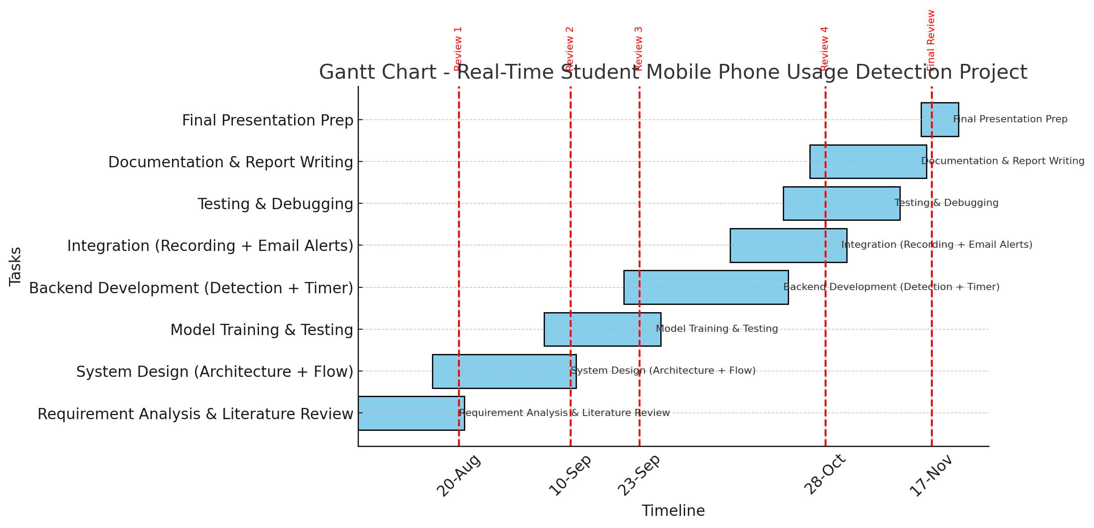
Timeline of the Project (Gantt Chart)

Slide 11
References (IEEE Paper format)
[1] S. Raschka, J. Patterson, and C. Nolet, “Machine Learning in Python : Main Developments and Technology Trends in Data Science , Machine Learning , and Artificial Intelligence,” Information, vol. 11, no. 4, p. 193, 2020, doi: 10.3390/info11040193.
[2] H. O. K. Sugianto, M. A. D. Widyadara, and A. B. Setiawan, “Implementation of Face Recognition for Attendance Using Yolo V3 Method,” Semin. Nas. Inov. Teknol., vol. 6, no. 2, pp. 50–55, 2022, [Online]. Available: https://proceeding.unpkediri.ac.id/index.php/inotek/article/view/2559
[3] J. W. Chen, W. J. Lin, H. J. Cheng, C. L. Hung, C. Y. Lin, and S. P. Chen, “A Smartphone-Based Application for Scale Pest Detection Using Multiple-Object Detection Methods,” Electron., vol. 10, no. 4, pp. 1–14, 2021, doi: 10.3390/electronics10040372.
[4] P. Kowalczyk, J. Izydorczyk, and M. Szelest, “Evaluation Methodology for Object Detection and Tracking in Bounding Box Based Perception Modules,” Electron., vol. 11, no. 8, pp. 1–26, 2022, doi: 10.3390/electronics11081182.

Slide 12


