Slide 1
CSE7302- University Project Review-2
rydFixr
Batch Number : CSD_26
Under the Supervision of,
Dr. Wasim Yasin
Professor / Associate Professor / Assistant Professor
School of Computer Science and Engineering Presidency University
Name of the Program: B.Tech - CSE ( Data Science ) Name of the HoD: Dr. Pravinthraja S
Name of the Program Project Coordinator: Dr. H M Manjula
Name of the School Project Coordinators: Dr. Sampath A K , Dr. Geetha A
Roll Number | Student Name
20221CSD0099 | K Guru Dheeraj Reddy
20221CSD0097 | Rohith D Raj

Slide 2
Problem Statement Number: NA
Git-hub Link : https://github.com/gurudheeraj/rydFixr_app
Category : Software
Abstract :
rydFixr is a trust-centric, service-based platform that connects bike owners with verified mechanics (Fixperts), inspectors, and emergency service providers through a single centralized backend system.
The platform ensures transparent and fair pricing by separating labour and spare parts costs, applying platform fees only on labour, and guaranteeing Fixpert take-home earnings.
Secure escrow-based payments and proof-based service execution ensure that customers pay only after repair verification and service approval.
A structured rework-only warranty model replaces refunds, promoting quality repairs while keeping the platform financially sustainable.Triggers automatic alerts if usage exceeds threshold.
rydFixr introduces a documented and verifiable service lifecycle, including digital repair records, inspector validation, and structured escalation workflows, improving accountability and trust.

Slide 3
Objectives :
To create a trusted digital platform that connects bike owners with verified mechanics and service partners.
2. To make bike repair pricing clear and fair by separating labour charges and spare parts costs.
3. To ensure secure and transparent payments using escrow so payment is released only after service completion.
4. To improve repair quality and accountability through proof-based work, digital service records, and rework assurance.
5. To reduce disputes and fraud by following structured workflows and admin-controlled service processes.
6. To provide a scalable, real-world solution that balances customer safety, mechanic dignity, and platform sustainability.

Slide 4
Drawbacks & Existing methods
Unclear and inconsistent pricing, leading to overcharging or disputes.
No service proof or documentation, so customers cannot verify the work done.
No guarantee or structured rework policy if the same problem occurs again.
Customers have no protection mechanism in case of poor or incomplete service.
Bike owners visit local garages or roadside mechanics for repairs.
There is no digital service record or proof of the repair work.
Customer safety and post-repair responsibility are not formally handled.
Pricing is usually decided verbally after inspection.

Slide 5
Advantages & Disadvantages
Advantages:
Secure payment after service completion
Better repair quality with service proof
Digital record of bike services
Clear and transparent repair pricing
Disadvantages:
No refund option (only rework)
Requires internet connection
Mechanics need basic app training
Inspector service may delay repairs

Slide 6
Proposed Method & Feasibility Study
Proposed Method:
Customers book bike repair services through the rydFixr platform.
Nearby verified mechanics (Fixperts) receive and accept service requests.
Repair cost is shown with separate labour and spare parts pricing.
Customer approves the quotation and makes secure escrow-based payment.
Fixpert performs the repair and uploads photos/videos as proof.
Customer verifies the work and approves service completion.
Payment is released and digital service records are stored.

Slide 7
Proposed Method & Feasibility Study contd..
Feasibility Study:
Technical Feasibility:
Can be developed using existing web and mobile technologies.
Uses a centralized backend with role-based access.
Economic Feasibility:
Low initial cost compared to physical infrastructure.
Platform earns through service fees on labour.
Sustainable model without heavy discounts or refunds.
Operational Feasibility:
Simple interfaces for customers and mechanics.
Easy onboarding and training for Fixperts..
Legal & Ethical Feasibility:
Builds trust between customers and mechanics.
Ensures fair earnings for mechanics.
Improves service accountability and transparency.

Slide 8
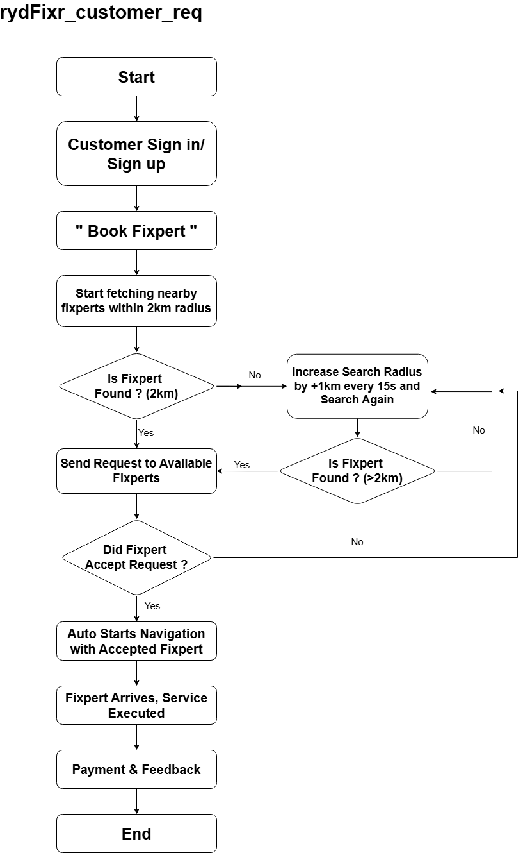
Architecture Diagram

Slide 9
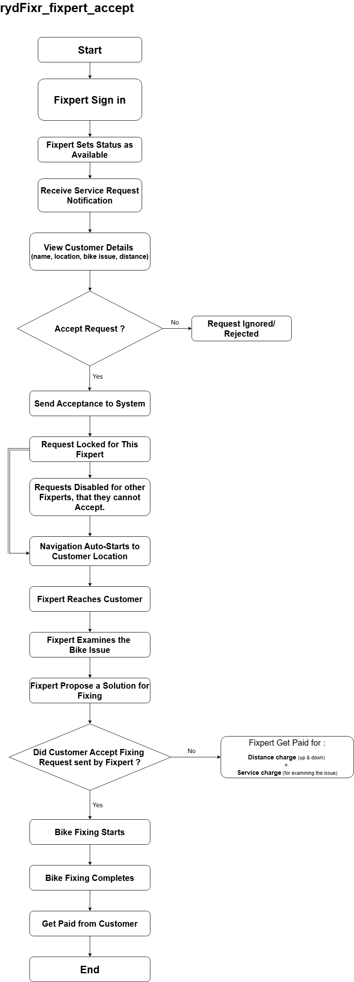
Architecture Diagram

Slide 10
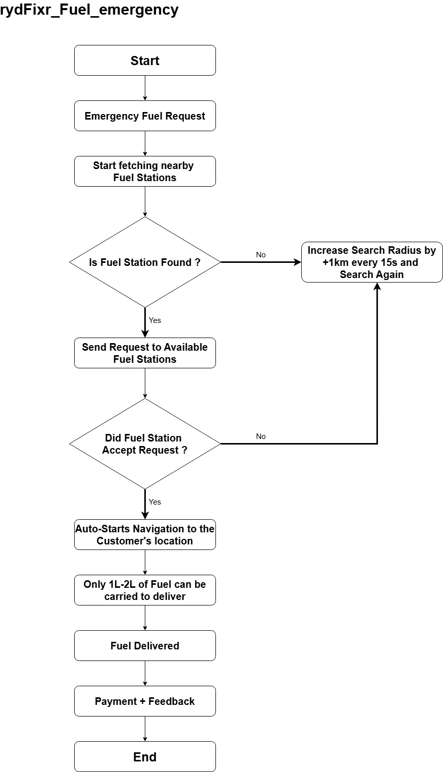
Architecture Diagram

Slide 11
Hardware & Software
Frontend:
HTML / XML (for app dev UI design)
CSS
JavaScript / Kotlin (for app dev)
React.js
Backend:
Node.js
Express.js
Database:
MongoDB
Tools & Platforms:
Visual Studio Code
Android Studio
Git & Github
Cloud Platform (AWS/ Render/ Firebase)
Hardware Components:
Desktop (for development & admin use)
Smartphone (for customers & mechanics

Slide 12
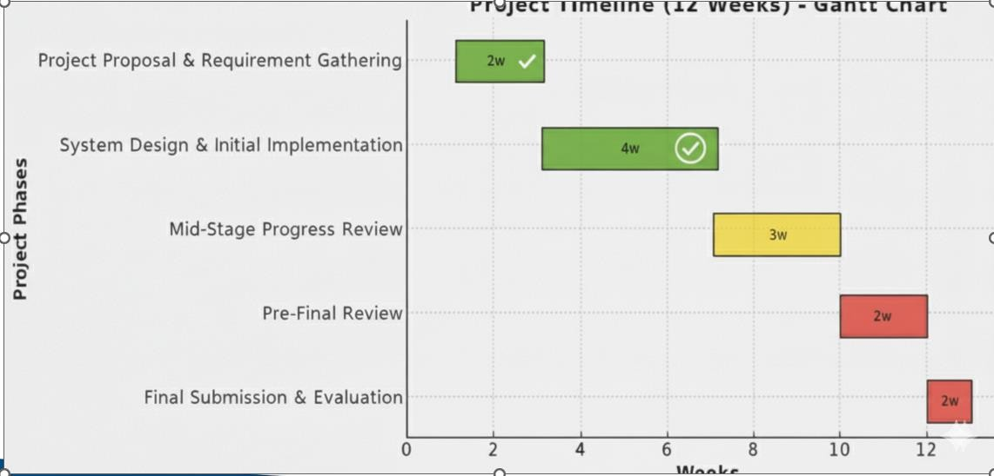
Timeline

Slide 13
Modules
1. User Management Module
Customer registration and login
Fixpert (mechanic) registration and verification
Role-based access control
Profile management
2. Service Booking Module
Bike repair and service request creation
Selection of issue type (engine, electrical, service, etc.)
Location-based Fixpert discovery
Job request notification to Fixperts
3. Pricing & Quotation Module
Separate entry of labour cost and spare parts cost
Transparent price breakup for customers
Quote approval or rejection by customer
Platform fee calculation on labour only

Slide 14
Modules [contd..]
4. Payment & Escrow Module
Secure payment collection from customers
Escrow-based payment holding
Automatic payment release after service approval
Transaction and payment history
5. Repair Execution & Proof Module
Job status tracking (accepted, in progress, completed)
Upload of repair photos and videos
Proof validation for completed work
Digital repair documentation
6. Rework & Warranty Module
Rework request within allowed time window
Validation of rework eligibility
Free rework by the same Fixpert
Rework completion tracking

Slide 15
Modules [contd..]
7. Inspector (Verified Assist) Module
Assignment of inspector for high-risk repairs
Independent repair verification
Upload of inspection proof
Submission of verification reports
8. Admin & Monitoring Module
Fixpert and partner approval/suspension
Dispute handling and escalation
Job and payment state management
Platform analytics and reporting
9. Notification & Communication Module
Job alerts and status notifications
Payment and approval notifications
System updates and reminders

Slide 16
References (IEEE Paper format)
[1] Suleymanberdiyev, M., K. Orazmyradov, and I. Tagangylyjov. "BIKE SERVICING APP." ОБРАЗОВАНИЕ И НАУКА В XXI ВЕКЕ 62-2 (том 5) (2025).
[2] R. G. Suresh Kumar, R. Karthik, J. SathishKumar, G. Gowtham, and M. Shanmugadasan, “Roadside Assistance for Vehicle Breakdown,” International Journal for Research in Applied Science & Engineering Technology (IJRASET), vol. 13, no. 5, May 2025, doi: 10.22214/ijraset.2025.70634.
[3] P. Wagh, K. Patil, K. Kosrabe, and C. Padole, "On Road Vehicle Breakdown Assistance Management System," International Journal for Research in Applied Science & Engineering Technology (IJRASET), vol. 12, no. 4, pp. 2713-2718, Apr. 2024
[4] Mrs. S. Angamuthu, V. Deepika, S. Akash Chandru, K. Surendar, and R. Kavin, “Vehicle Breakdown Assistance Management System,” International Scientific Journal of Engineering and Management (ISJEM), vol. 2, no. 4, Apr. 2023, doi: 10.55041/ISJEM00330

Slide 17
References [contd..]
[5] M. A. Zainodin and H. Aman, “On-Road Car Breakdown Assistant Finder,” Applied Information Technology and Computer Science, vol. 1, no. 1, pp. 210–231, Dec. 2020, doi: 10.30880/aitcs.2020.01.01.021.
[6] C. S. Aravinthan and M. Hemalatha, “On Road Vehicle Breakdown Help Assistance Web Application,” International Journal of Scientific Research in Science and Technology (IJSRST), vol. 11, no. 2, pp. 392–394, Mar.–Apr. 2024, doi: 10.32628/IJSRST52411274.
[7] M. A. D. Wickrama, U. M. I. S. Ekanayake, D. S. C. Dharmakeerthi, M. P. Gamage, S. A. Balasooriya, and N. Amarasena, “Mobile Based Solution for Vehicle Assistance,” in Proc. 3rd Int. Conf. on Advancements in Computing (ICAC), 2021, pp. 31–36, doi: 10.1109/ICAC54203.2021.9671196.
[8] S. N. Udapure, P. S. Goswami, R. V. Bhusari, R. M. Donarwar, and R. R. Naitam, “On Road Vehicle Breakdown Assistance Search,” International Journal of Innovations in Engineering and Science, vol. 8, no. 6, pp. 79–81, May 2023, doi: 10.46335/IJIES.2023.8.6.18.

Slide 18
References [contd..]
[9] M. Vasuki, T. Amalraj Victoire, A. Karunamurthy, M. Prathiba, and M. Prathiba, “On Road Vehicle Breakdown
Assistant Management,” International Journal of Progressive Research in Engineering Management and Science
(IJPREMS), vol. 3, no. 7, pp. 194–198, Jul. 2023, doi: 10.58257/IJPREMS31797.
[10] P. P. Deshmukh, Y. S. Puraswani, A. D. Attal, P. G. Murhekar, V. A. Katole, and V. M. Wankhade, “Review
Paper on On Road Vehicle Breakdown Assistance System,” International Journal of Engineering Applied Sciences
and Technology, vol. 4, no. 11, pp. 199–202, Mar. 2020.

Slide 19


