Slide 1
HTML
Copyright © 1999-2014 Ellis Horowitz

Slide 2
What is HTML
Hypertext Markup Language (HTML) is a language in which one can describe:
  The display and format of text
  The display of graphics
  Pointers to other html files
  Pointers to files containing graphics, digitized video and sound
  Forms that capture information from the viewer
HTML was developed by Tim Berners-Lee of CERN around 1990
HTML is understood by WWW browsers—e.g. Internet Explorer, Firefox, Chrome, Safari, many others — which interpret and display the output to the viewer
http://en.wikipedia.org/wiki/List_of_web_browsers
Copyright © 1999-2014 Ellis Horowitz

Slide 3
Versions of HTML
Version 0, 1990, was the original, minimum set of HTML
Version 1 includes all Version 0 features plus highlighting and images
Version 2, November, 1995, includes all Version 0 and Version 1 features, plus forms
Version 3.2, January 1997, was released by WWW Consortium and included such features as tables
HTML 4.01, December 1999, is the current draft of HTML; the document can be found at
http://www.w3.org/TR/html401/
There is a draft of HTML 5 and 5.1 at the w3c:
V 5.0 see http://www.w3.org/TR/html5/
V 5.1 see http://www.w3.org/html/wg/drafts/html/master/
HTML is controlled by the World Wide Web Consortium, W3C, located at http://www.w3.org
NOTE: some of the examples shown here are extracted from the HTML4.0 specification. This document is copyrighted according to: "Copyright © World Wide Web Consortium. All Rights Reserved. http://www.w3.org/Consortium/Legal/"
Copyright © 1999-2014 Ellis Horowitz

Slide 4
An Example
The nine planets of the solar system are
mercury,
venus,
earth,
mars,
jupiter, saturn, uranus, neptune and pluto.
The very nearest star is about 7,000 times farther away than pluto is to our sun.
Save this file as example1.txt
Save this file as example1.html
Copyright © 1999-2014 Ellis Horowitz

Slide 5
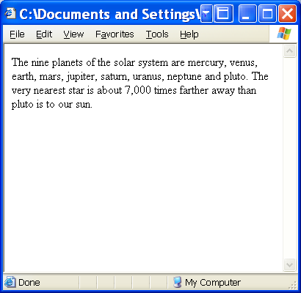
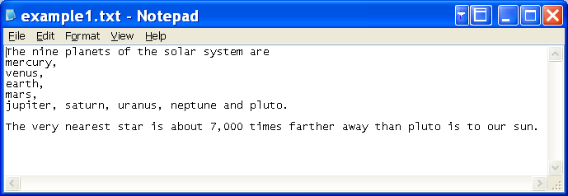
Browser Output - Example 1
example1.html
example1.txt
Copyright © 1999-2014 Ellis Horowitz

Slide 6
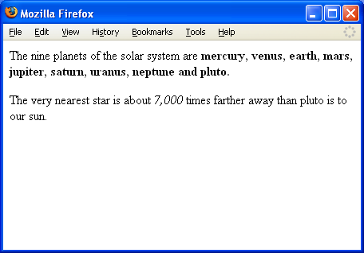
Example 2: Adding Some Markup
<P>The nine planets of the solar system are <B>mercury, venus, earth, mars, jupiter, saturn, uranus, neptune and pluto.</B></P>
<P>The very nearest star is about <I>7,000</I> times farther away than pluto is to our sun. </P>
Copyright © 1999-2014 Ellis Horowitz

Slide 7
General Structure
HTML documents have a head and body
  head should contain a title
  body may have paragraphs
A leading line indicates which version of HTML this document conforms to
<!DOCTYPE HTML PUBLIC "-//W3C//DTD HTML 4.0//EN"
"http://www.w3.org/TR/REC-html40/strict.dtd">
<HTML>
<HEAD>
<TITLE>The Solar System</TITLE>
</HEAD>
<BODY>
<P>The nine planets of the solar system are...
</BODY>
</HTML>
Copyright © 1999-2014 Ellis Horowitz

Slide 8
Browsers Are Tolerant
Browsers follow the rule of being tolerant of mistakes in the input
  They ignore markup they don’t understand
E.g. Internet Explorer/Firefox are tolerant browsers
  They do not insist that the HTML document begin and end with <HTML>
  <HEAD> and/or <BODY> tags are not required
  But, there is no guarantee that this behavior will be the same for all browsers
Copyright © 1999-2014 Ellis Horowitz

Slide 9
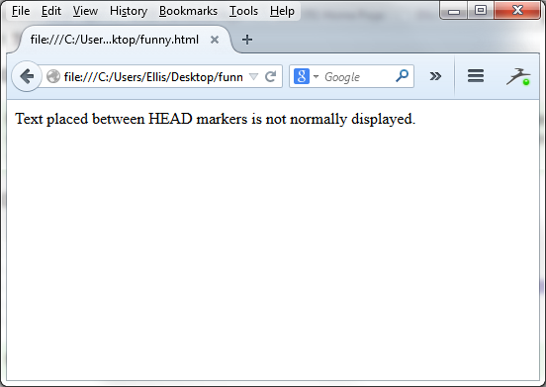
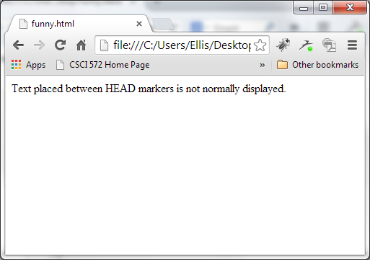
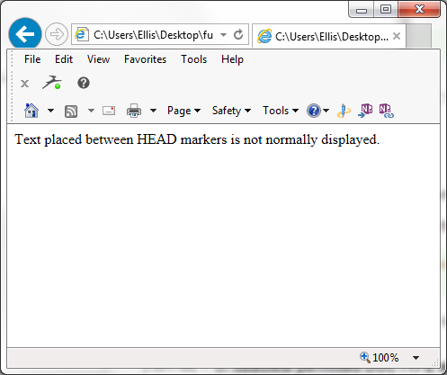
Example - Browsers are Tolerant
Suppose the entire document is one line, such as:
<HEAD>Text placed between <ODDTAG> HEAD markers is not normally displayed.</HEAD>
Firefox Chrome Internet Explorer
Copyright © 1999-2014 Ellis Horowitz

Slide 10
HTML Elements
Each element consists of a start tag, content, and an end tag
E.g. <BODY> some text </BODY>
A slash (/) after the “<“ indicates an end tag
Some elements do not require end tags,
e.g. <P> paragraph tag
Some elements do not require content,
e.g. <HR>
horizontal rule tag places a straight line across the page
Copyright © 1999-2014 Ellis Horowitz

Slide 11
Attributes
Elements may have parameters, called attributes
Attributes are placed in the start tag before the final ">"
Attributes have the form name=value
E.g. <H1> is the first heading tag
<H1 id="Chapter1">
Start of Chapter 1
</H1>
Attribute values are often enclosed in quotes, either double or single
Quotes are not required when the value contains only letters, digits, hyphens, and periods.
Attribute names are case insensitive, but not necessarily attribute values
Copyright © 1999-2014 Ellis Horowitz

Slide 12
Comments in HTML
Comments start with
  <!--
  and end with
  -->
Comments cannot be nested
  White space is permitted between the -- and the closing angle bracket, >
  It is not permitted between the opening angle bracket, exclamation point, and the --
E.g.
<BODY>
<!-- This is a comment
and hence not displayed -->
But this will be displayed
</BODY>
Copyright © 1999-2014 Ellis Horowitz

Slide 13
Complete Set of <BODY> tag attributes
id, assigns a unique name to an element
e.g. <P id=mystart>This is my starting paragraph...
class, assigns one or more names to an element
lang, a language code that identifies a natural language spoken, written, or otherwise used
title, a short description of the body
style, inline display information
bgcolor, background color
Events include
onload, onunload onclick, ondblclick, onmousedown, onmouseup, onmouseover, onmousemove, onmouseout, onkeypress onkeydown, onkeyup
Deprecated elements include:
background, text, link, vlink, alink
See http://www.w3.org/TR/html4/struct/global.html#edef-BODY, and
http://www.w3.org/html/wg/drafts/html/master/sections.html#the-body-element
Copyright © 1999-2014 Ellis Horowitz

Slide 14
Composing HTML
Conventional editors let you compose HTML directly
  e.g. emacs, vi, NotePad, TextPad, etc.
  use the tools when you are writing HTML directly
Word Processors include a File SaveAs option which saves your document in HTML format
  e.g. Microsoft Word, Corel WordPerfect, etc.
  use this when creating “simple” web pages
There are several free HTML-specific editors, e.g.
  Brackets, http://brackets.io/?lang=en
  Microsoft Expression Web 4, http://www.microsoft.com/en-us/download/details.aspx?id=36179
There are several commercial HTML editors, e.g.
  Microsoft Blend (included in Visual Studio)
  Adobe Dreamweaver
For a complete list see http://en.wikipedia.org/wiki/List_of_HTML_editors
Copyright © 1999-2014 Ellis Horowitz

Slide 15
Lists
HTML lists are very common in everyday web development.
Perhaps the most commonly used are
  unordered lists (<ul>) and
  ordered lists (<ol>)
but there are a few other list options
  definition list (<dl>), and
  the menu (<menu>) element,
  both were deprecated in HTML4, but reintroduced in HTML5
All lists follow the same pattern:
  <start tag of list>
  <list item tag>
  <list item tag>
  <list item tag>
  </ end tag of list>
Copyright © 1999-2014 Ellis Horowitz

Slide 16
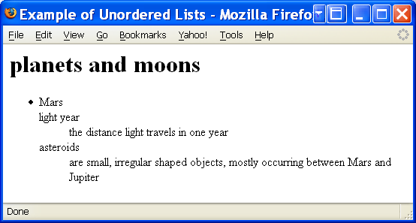
Definition Lists
<DL>
  <DT>light year<DD>the distance light travels in one year
  <DT>asteroids<DD>are small, irregular shaped objects, mostly occurring between Mars and Jupiter
  </DL>
Copyright © 1999-2014 Ellis Horowitz

Slide 17
Example - Unordered Lists
        <HTML><HEAD><TITLE>
        Example of Unordered Lists</TITLE></HEAD>
        <BODY><H1>planets and moons</H1>
        <UL>
        <LI>Mars
        <UL><LI> deimos
        <UL> <LI>orbit: 23,459 km from Mars
        <LI>diameter: 12.6 km
        <LI>mass: 1.8e15 kg
        </UL>
        <LI>phobos
        </UL>
        <LI>Jupiter
        <UL><LI>callisto<LI>europa<LI>ganymede<LI>io</UL>
        </UL></BODY></HTML>
Copyright © 1999-2014 Ellis Horowitz

Slide 18
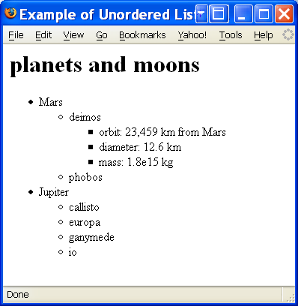
Browser Output of Unordered Lists
Copyright © 1999-2014 Ellis Horowitz

Slide 19
Ordered Lists
Has the general form
<OL><LI> first list item<LI> second list item</OL>
START attribute can initialize the sequence to a number other than 1
TYPE attribute can be used to select the numbering style
Type Name Style
1 arabic 1, 2, 3, ...
a lower alpha a, b, c, ...
A upper alpha A, B, C, ...
i lower roman i, ii, iii
I upper roman I, II, III,
However, the type attribute is deprecated and list styles should be handled through style sheets, e.g.
<STYLE type="text/css">
OL.withroman {list-style-type: lower-roman}</STYLE>
Copyright © 1999-2014 Ellis Horowitz

Slide 20
Example - Ordered Lists
        <HTML><HEAD><TITLE>
        Example of Ordered Lists</TITLE></HEAD>
        <BODY><H1>Planets and Moons as Ordered Lists</H1>
        <OL START=4>
        <LI>Mars
        <OL type=A><LI>deimos
        <OL type=I><LI>orbit: 23,459 km from Mars
        <LI>diameter: 12.6 km
        <LI>mass: 1.8e15 kg
        </OL>
        <LI>phobos
        </OL>
        <LI>Jupiter
        <OL type=A><LI>callisto<LI>europa<LI>ganymede
        <LI>io</OL></OL></BODY></HTML>
Copyright © 1999-2014 Ellis Horowitz

Slide 21
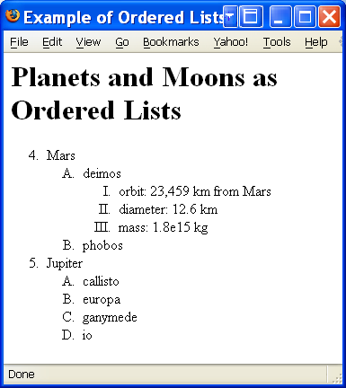
Browser Output
Copyright © 1999-2014 Ellis Horowitz

Slide 22
Table Elements
<TABLE>, a tag used to define a table
<CAPTION>, a tag to label a table
  Its attributes are ALIGN = top, bottom, left, right
<TH></TH> or <TD></TD>, tags that identify a table header cell and table data cell
  Headers are the same as data except they use bold font and are centered
<TR>, a tag that identifies a container for a row of table cells
  Same attributes as TH and TD
Copyright © 1999-2014 Ellis Horowitz

Slide 23
Facts about Tables
Table data can be text, lists, images, forms, figures, or even tables
Table headers are typically rendered in boldface, and table data is typically rendered in the regular font and point size
A table has an optional caption followed by rows
Table rows are said to contain table headers and table data
The browser will set the number of columns to be the greatest number of columns in all of the rows
Blank cells are used to fill extra columns in the rows
Copyright © 1999-2014 Ellis Horowitz

Slide 24
Example - 3 rows x 2 cols
        <HTML>
        <HEAD>
        <TITLE>Table: 3 rows 2 Cols</TITLE>
        </HEAD>
        <BODY>
        <H1>Table: 3 Rows 2 Cols</H1>
        <TABLE BORDER="2">
        <CAPTION>MIME Content-Types</CAPTION>
        <TR><TD>application/postscript</TD><TD>Postscript</TD>
        <TR><TD>application/rtf</TD><TD>MS Rich Text Format</TD>
        <TR><TD>application/x-pdf</TD><TD>Adobe Acrobat Format</TD>
        </TABLE></BODY></HTML>
Copyright © 1999-2014 Ellis Horowitz

Slide 25
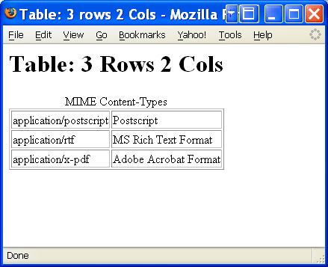
Browser Output
Copyright © 1999-2014 Ellis Horowitz

Slide 26
Table Example Rowspan colspan
        <HTML><HEAD>
        <TITLE>Table: Rowspan and Colspan</TITLE>
        </HEAD>
        <BODY>
        <H1>Table: RowSpan and ColSpan</H1>
        <TABLE BORDER="2">
        <CAPTION>MIME Content-Types</CAPTION>
        <TR><TH ROWSPAN=4>Items</TH><TH colspan=2>Types and Their Meaning</TH>
        <TR><TD>application/postscript</TD><TD>Postscript</TD>
        <TR><TD>application/rtf</TD><TD>MS Rich Text Format</TD>
        <TR><TD>application/x-pdf</TD><TD>Adobe Acrobat Format</TD>
        </TABLE></BODY></HTML>
Copyright © 1999-2014 Ellis Horowitz

Slide 27
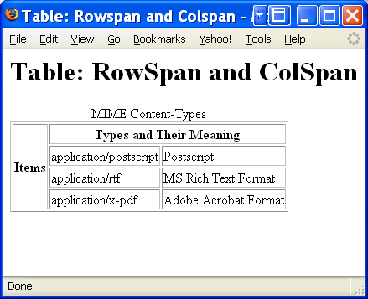
Browser Output
Copyright © 1999-2014 Ellis Horowitz

Slide 28
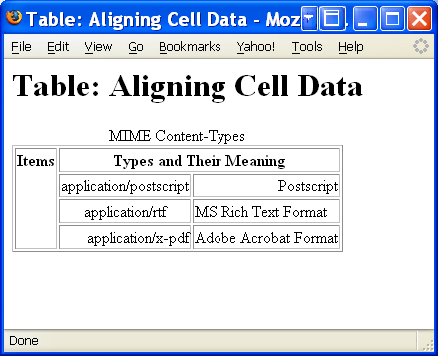
Arranging Data in a Table
Originally data in a table could be manipulated using attributes: align left, align right, align center, valign top, valign middle and valign bottom
the above attributes are now deprecated in favor of Cascading Style Sheets (CSS) settings
see the next slide lecture
valign top
valign right
valign center
Copyright © 1999-2014 Ellis Horowitz

Slide 29
Table Example: Surprise Quiz
        <HTML><HEAD><TITLE>Table: Pop Quiz</TITLE>
        </HEAD><BODY><H1>Table: Pop Quiz</H1>
        <H2>Draw the table described here</H2>
        <TABLE BORDER="2">
        <TR><TD>Datal</TD><TD rowspan=2>Data2</TD>
        <TD>Data3</TD>
        <TR><TD>Data4</TD><TD>Data5</TD></TABLE>
        <H2>Draw the table described here</H2>
        <TABLE BORDER>
        <TR><TH Rowspan=2 colspan=2></TH>
        <TH colspan=2>Average</TH>
        <TR><TH>Cost</TH><TH>Time</TH>
        <TR><TH Rowspan=2>Projects</TH>
        <TH>P1</TH><TD>100</TD><TD>7</TD>
        <TR><TH>P2</TH><TD>250</TD><TD>15</TD>
        </TABLE></BODY></HTML>
Copyright © 1999-2014 Ellis Horowitz

Slide 30
HTML Character Set
HTML uses the Universal Character Set (UCS), defined in [ISO10646]. This standard defines a repertoire of thousands of characters used by communities all over the world.
  Its specification can be found at
  http://www.unicode.org/faq/unicode_iso.html
HTML must also specify how characters are encoded during transmission.
Commonly used character encodings on the Web include
  ISO-8859-1 (also referred to as "Latin-1"; usable for most Western European languages),
  ISO-8859-5 (which supports Cyrillic),
  SHIFT_JIS (a Japanese encoding),
A browser is informed of the encoding by a line
Content-Type: text/html; charset=EUC-JP
Copyright © 1999-2014 Ellis Horowitz

Slide 31
Character references
Character references in HTML may appear in two forms:
  Numeric character references (either decimal or hexadecimal)
    &#229; (in decimal) represents the letter "a" with a small circle above it (used, for example, in Norwegian).
    &#60; represents left angle bracket
    &#62; represents right angle bracket
    &#38; represents ampersand sign
    &#34; represents double quote
  Character entity references.
    "&lt;" represents the < sign.
    "&gt;" represents the > sign.
    "&amp;" represents the & sign.
    "&quot; represents the " mark.
Copyright © 1999-2014 Ellis Horowitz

Slide 32
Example - Character References
<HTML><HEAD><TITLE>Example of Character References</TITLE></HEAD>
<BODY>
An unordered list in HTML starts with &lt;UL&gt;, ends with &#60;/UL&#62; and every list item should begin with &lt;LI&gt;. The &lt;/LI&gt; is optional. For an attribute such as START="5&#34; the double quotes are optional.
</BODY></HTML>
Copyright © 1999-2014 Ellis Horowitz

Slide 33
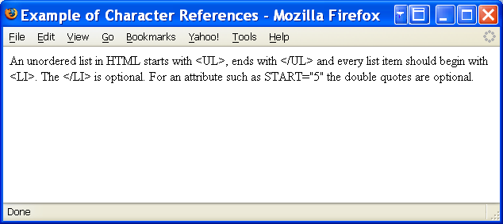
Browser Output of Character References
Copyright © 1999-2014 Ellis Horowitz

Slide 34
Anchors Away
An anchor is a way to designate a link to another document or to a specific place in the same document
Begins with <A> and ends with </A>
The link location is given by the attribute HREF (Hypertext Reference); e.g.,
See <A HREF="http://cs-server.usc.edu:45678/index.html">Class Home Page</A> for a description of the class project
Hypertext links are displayed using underlining, color, and/or highlighting
  Depends on the browser defaults or the use of style settings
  Once a link is taken, it should change color
Copyright © 1999-2014 Ellis Horowitz

Slide 35
Syntax of Anchor Names
An anchor name is the value of either the name or id attribute when used in the context of anchors.
Anchor names must observe the following rules:
  Uniqueness: Anchor names must be unique within a document. Anchor names that differ only in case may not appear in the same document.
  String matching: Comparisons between fragment identifiers and anchor names must be done by exact (case-sensitive) match.
Copyright © 1999-2014 Ellis Horowitz

Slide 36
Defining Anchors Using the id Attribute
The id attribute may be used to create an anchor at the start tag of any element (including the A element).
Example: the id attribute places an anchor in an H2 element.
  You may read more about this in
  <A href="#section2">Section Two</A>.
  . . . more text . . .
  <H2 id="section2">Section Two</H2>
  . . . more text
  <P>Please refer to <A href="#section2">Section Two</A> above for more details.
The id and name attributes share the same name space. They cannot both define an anchor with the same name in the same document. Try this example in IE and Firefox:
  <P><A href="#label1">...</A>
  ...more document...
  <P><A name="LABEL1">...</A>
NOTE: browsers work
differently
Copyright © 1999-2014 Ellis Horowitz

Slide 37
Examples of Anchors
<A href=myfile.html> a file in the same directory and same domain as the current page
<A href=http://nunki.usc.edu/mydocs/book.doc> a file in directory mydocs on machine nunki.usc.edu, a WWW site
<A href=news:comp.compilers> the newsgroup computers.compilers
<A href=mailto:sales@xyz.com> opens an an e-mail window for sending a message
<A HREF="ftp://ds.internic.net/rfc/rfc1866.txt">
Download RFC1866 </A> executes the ftp program to fetch a file
Given the current position, this <HREF> moves up one directory, connects to Docs/Style/ and displays the document Overview.html
  <A HREF="../Docs/Style/Overview.html"> … </A>
Connects to lycos and runs pursuit with three arguments
  <A HREF="http://www.lycos.com/cgi-bin/pursuit?
  Hypertext+Markup+Language"> … </A>
Copyright © 1999-2014 Ellis Horowitz

Slide 38
Anchor Titles
The title attribute may be set to add information about the nature of a link.
This information may be spoken by a user agent, rendered as a tool tip, cause a change in cursor image, etc.
<BODY>
...some text...
<P>You'll find a lot more in <A href="chapter2.html"
title="Go to chapter two">chapter two</A>.
See also this <A href="../images/solarsystem.gif"
title="GIF image of solar system">view of the solar system.</A>
</BODY>
Copyright © 1999-2014 Ellis Horowitz

Slide 39
Universal Resource Identifier
URIs typically consist of three pieces:
  The scheme of the mechanism used to access the resource.
  The name of the machine hosting the resource.
  The name of the resource itself, given as a path
  E.g. http://www.usc.edu/dept/cs/index.html
Fragment identifiers are URIs that refer to a location within a resource
  e.g. http://www.usc.edu/dept/cs/index.html#section2
Relative URIs have a path that refers to a resource on the same machine as the current document.e.g., ".." means one level up
See:
http://www.ietf.org/rfc/rfc3986.txt
Copyright © 1999-2014 Ellis Horowitz

Slide 40
The <LINK> Element
Should only appear in the HEAD
It may appear any number of times
It conveys relationship information that may be rendered in a variety of ways (e.g., a tool-bar with a drop-down menu of links)
Example - The current document is "Chapter2.html". The rel attribute specifies the relationship of the linked document with the current document.
<HTML> <HEAD>
<TITLE>Chapter 2</TITLE>
<LINK rel="Index" href="../index.html">
<LINK rel="Next" href="Chapter3.html">
<LINK rel="Prev" href="Chapter1.html">
</HEAD>
...the rest of the document...
Copyright © 1999-2014 Ellis Horowitz

Slide 41
How is <LINK> Used
To provide a variety of information to search engines:
  Links to alternate versions of a document, written in another human language, e.g.
<LINK lang="fr" title="La documentation en Fran&ccedil;ais” type="text/html"
rel="alternate" hreflang="fr"
href="http://domain/manual/french.html">
  Links to alternate versions of a document, designed for different media
<LINK media="print" title="The manual in postscript” type="application/postscript"
rel="alternate” href="http://domain/manual/usermanual.ps">
  Links to the starting page of a collection of documents.
Copyright © 1999-2014 Ellis Horowitz

Slide 42
Creating Graphics
Digital cameras & Smartphones
  Snap and the image is digitized and can be transferred to a computer
  Typical resolutions are 1280x720 (Samsung Galaxy S III) and 1136x640 (iPhone 5)
Graphic editors
  Permit the combination of text, drawing, and color
  For example, Corel PhotoPaint, Adobe Photoshop
Scanners
  Convert text and graphics into machine readable form
Copyright © 1999-2014 Ellis Horowitz

Slide 43
Image Formats
Four image formats are always supported by Web browsers
  x-pixelmaps (obsolete)
    Similar to x-bitmaps, but 8 bits are given to each pixel, permitting 256 colors in the image
  Graphic Interchange Format (GIF)
    Support black and white, grayscale, and color
    Patented by Unisys (expired, abandoned)
  Joint Photographic Experts Group (JPEG)
    Designed for photographic images
    Includes image compression
  Portable Network Graphics (PNG)
    An open, extensible image format with Lossless Compression
    Patent-free replacement for GIF and TIFF
    A W3C Recommendation: http://www.w3.org/TR/PNG/
Copyright © 1999-2014 Ellis Horowitz

Slide 44
<IMG> Element
The IMG element embeds an image in the current document, e.g. <IMG SRC="file.gif">
Some attributes of <IMG> include
  Align=top, middle, or bottom to align text around an image
  border to place a border around an image
    If set to 1 or higher, places a black box around the image
    If set to 0, leaves no surrounding box
  height and width to control the dimensions of the image
  Alt to replace an image with text, if the image is unavailable or a text browser is used; e.g.,
  <IMG SRC="eiffel.gif" ALT="picture of the Eiffel Tower">
Copyright © 1999-2014 Ellis Horowitz

Slide 45
Example - Images
        <HTML><HEAD><TITLE>Example of Images</TITLE></HEAD>
        <BODY>
        <H1>Example of Images</H1>
        <table border=5><tr>
        <td><IMG SRC="ferrari.jpg" ALT="Ferrari" BORDER=0 WIDTH=50 HEIGHT=50>
        <td><IMG SRC="ferrari.jpg" ALT="Ferrari" BORDER=10 WIDTH=50 HEIGHT=50>
        <td><IMG SRC="ferrari.jpg" ALT="Ferrari" BORDER=10 WIDTH=100 HEIGHT=100>
        <td><IMG SRC="ferrari.jpg" ALT="Ferrari" BORDER=50 WIDTH=200 HEIGHT=300>
        <td><IMG SRC="xferrari.jpg" ALT="Ferrari" BORDER=10 WIDTH=50 HEIGHT=50></tr>
        <tr>
        <td>50 x 50, no border</td>
        <td>50 x 50, border=10</td>
        <td>100 x 100, border=10</td>
        <td>200 x 300, border=50</td>
        <td>incorrect file name, 50 x 50, border=10</td>
        </tr>
        </table>
        </BODY></HTML>
Copyright © 1999-2014 Ellis Horowitz

Slide 46
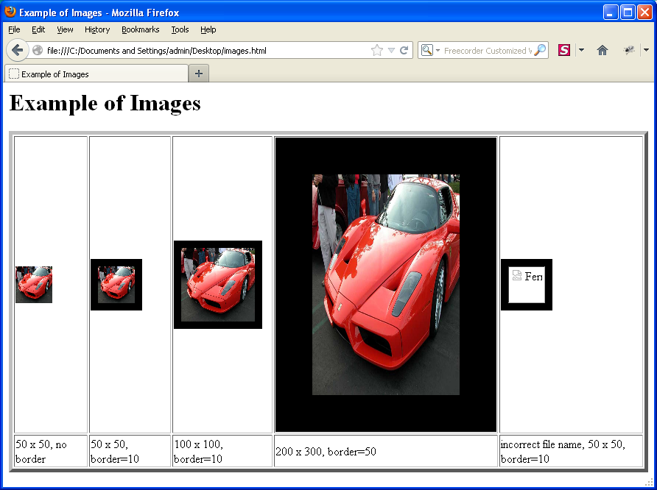
Browser Output
Copyright © 1999-2014 Ellis Horowitz

Slide 47
Active Images
Active images are images that can be clicked and, just like an anchor, they act as a hypertext link
  <A HREF="http://sunset.usc.edu:8080/index.html">
  <IMG SRC="USCimage.gif"> </A>
  Active images have a border around them and the cursor changes shape when passed over
Copyright © 1999-2014 Ellis Horowitz

Slide 48
Image Maps
Image maps are active images with multiple clickable regions
each region can be associated with a specific action (e.g., retrieve a document, run a program, etc.)
When the region is activated by the user, e.g. by a mouse click, the action is taken
  the pixel coordinates are interpreted by the browser (USEMAP).
Copyright © 1999-2014 Ellis Horowitz

Slide 49
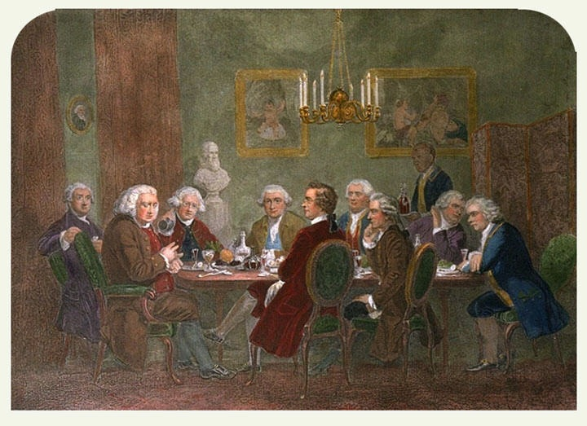
An ImageMap Example from Wikipedia
<img class="thumbimage" width="720" height="523"
usemap="#ImageMap_1_2013620197"
src="//upload.wikimedia.org/wikipedia/commons
/b/ba/JoshuaReynoldsParty.jpg" alt="">
<map id="ImageMap_1_2013620197"
name="ImageMap_1_2013620197">
<area title="Dr Johnson – Dictionary writer"
alt="Dr Johnson – Dictionary writer"
coords="133,343,124,287,159,224,189,228,195,291,222,
311,209,343,209,354,243,362,292,466,250,463"
shape="poly" href="/wiki/Samuel_Johnson">
<area title="Boswell – Biographer" alt="Boswell"
coords="76,224,84,255,43,302,62,400,123,423,121,361,
137,344,122,290,111,234,96,225"
shape="poly" href="/wiki/James_Boswell">
<area title="Sir Joshua Reynolds – Host"
alt="Sir Joshua Reynolds – Host"
coords="190,276,208,240,229,228,247,238,250,258,286,
319,282,323,223,323,220,301,200,295"
shape="poly" href="/wiki/Joshua_Reynolds">
To see the ImageMap work
go to
http://en.wikipedia.org/wiki/Image_map
and click on each of the individuals
at the table
Copyright © 1999-2014 Ellis Horowitz

Slide 50
Imagemaps
Add USEMAP attribute to <IMG> tag to indicate a client-side imagemap, e.g.
  <IMG SRC="images/banner.gif” USEMAP=”#bannerbar">
Different regions of the image are described using <MAP> tag, e.g.
<MAP NAME="bannerbar">
<AREA SHAPE="RECT" COORDS="10,10,50,50” HREF="p1.html">
<AREA SHAPE="RECT" COORDS="50,10,90,50" HREF="p2.html">
<AREA SHAPE="RECT" COORDS="90,10,130,50" HREF="p3.html">
<AREA NOHREF SHAPE=default>
</MAP>
Possible values for SHAPE are:
  default: Specifies the entire region.
  rect: Defines a rectangular region.
  circle: Defines a circular region.
  poly: Defines a polygonal region.
Copyright © 1999-2014 Ellis Horowitz

Slide 51
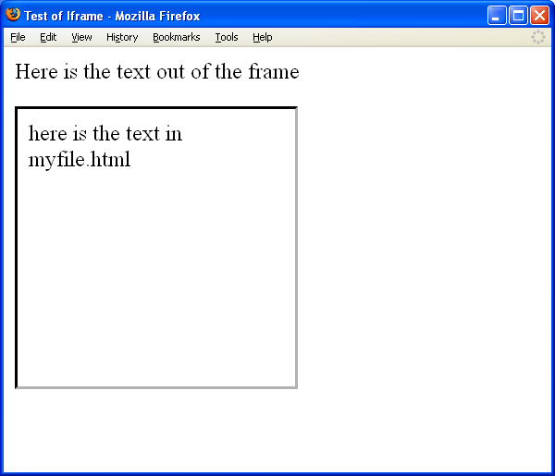
Inline Frames (IFRAME Element)
Insert a frame within a block of text; information is designated by SRC attribute;
<title>Test of Iframe</title>
<body>Here is the text out of the frame
<p><IFRAME src=myfile.html
width=200 height=200
scrolling=auto
frameborder=1>
</IFRAME> </body>
Copyright © 1999-2014 Ellis Horowitz

Slide 52
<META> Element
allows you to insert Name/Value pairs describing document properties, e.g.
  <META NAME="Author" CONTENT="Ellis Horowitz">
USC CS dept home page header
<META name = "description" content = "The Computer Science Department at the University of Southern California, Los Angeles (USC) provides education leading to the Bachelors, Masters and Ph.D. degrees in Computer Science.">
<META name = "keywords" content = "USC, computer science, computer science research, computer science teaching">
<META name = "author" content = "Ellis Horowitz">
Copyright © 1999-2014 Ellis Horowitz

Slide 53
<META> Element
Moving a Web page to a new site
<HTML><HEAD>
<META HTTP-EQUIV="REFRESH" CONTENT=”5; URL=http://www.usc.edu/dept/cs/">
<META NAME="GENERATOR" CONTENT="Mozilla/4.04 [en] (Win95; I) [Netscape]">
<TITLE>This site has moved</TITLE></HEAD>
<BODY><CENTER>This site has moved to a new location which is:
<A HREF="http://www.usc.edu/dept/cs/">http://www.usc.edu/dept/cs/</A> <BR>
Your browser should automatically move to the correct URL in five seconds.
</CENTER></BODY></HTML>
Copyright © 1999-2014 Ellis Horowitz

Slide 54
Meta Tag and Robot Exclusion
<meta name="robots" content="noindex,nofollow">
<title>...</title> </head> <body> ...
The content of the Robots META tag contains directives separated by commas.
The currently defined directives are
  [NO]INDEX. The INDEX directive specifies if an indexing robot should index the page.
  [NO]FOLLOW The FOLLOW directive specifies if a robot is to follow links on the page.
  The defaults are INDEX and FOLLOW. The values ALL and NONE set all directives on or off: ALL=INDEX,FOLLOW and NONE=NOINDEX,NOFOLLOW.
Some examples:
<meta name="robots" content="index,follow">
<meta name="robots" content="noindex,follow">
<meta name="robots" content="index,nofollow">
<meta name="robots" content="noindex,nofollow"> Note the "robots" name of the tag and the content are case insensitive.
Copyright © 1999-2014 Ellis Horowitz

Slide 55
Validating Your HTML
The reasons for validation
  Browsers display HTML differently
  Browsers treat HTML errors differently
What validators do
  Flag syntax errors with respect to HTML DTD
  Compare your pages to HTML 4.x, XHTML, and even HTML 5.0 (experimental)
Some tools are downloaded to your site; others read your Web page from a URL
HTML validation tools can be found at:
  http://search.yahoo.com/bin/search?p=html+validation
W3C Markup Validation Service:
  http://validator.w3.org/
Copyright © 1999-2014 Ellis Horowitz

Slide 56
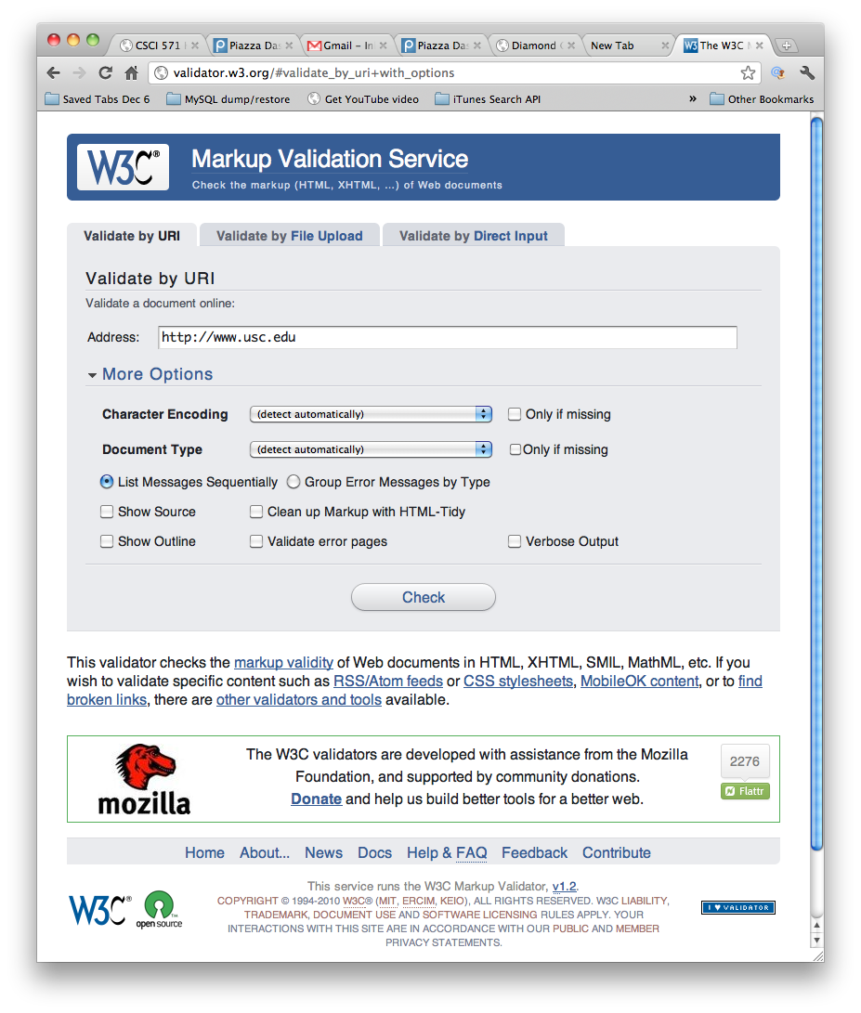
W3C Markup Validation Service
Options: character encoding & Document type
Copyright © 1999-2014 Ellis Horowitz

Slide 57
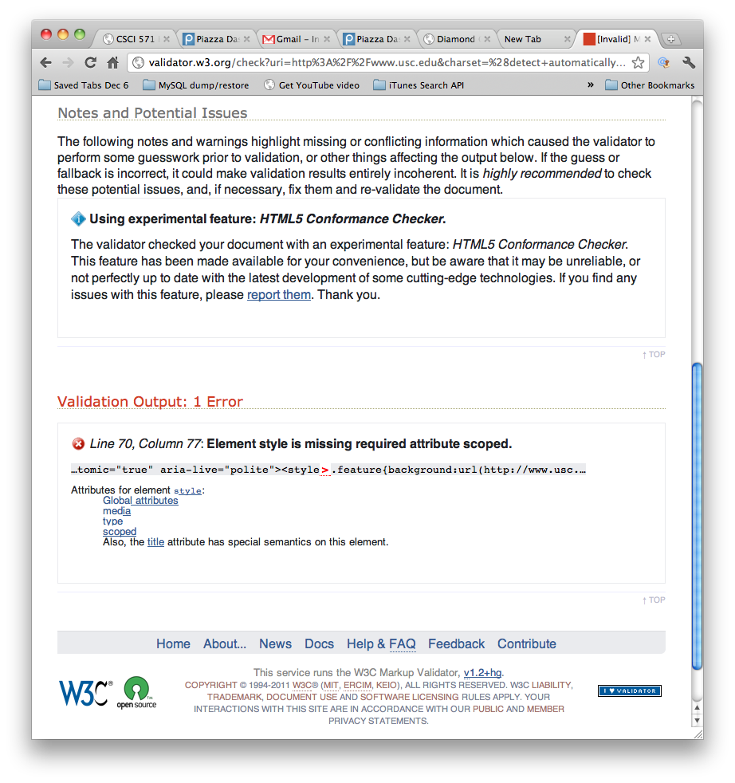
Validating Your HTML
Sample output
Copyright © 1999-2014 Ellis Horowitz

Slide 58
<APPLET> and <EMBED> Elements
<APPLET> allows designers to embed a Java applet in an HTML document
It has been deprecated in favor of the EMBED element
EMBED has attributed: height, width, src, type (MIME)
An example,
<embed type="video/quicktime" src="movie.mov" width="640" height="480">
<embed width="400" height="50" src="bookmark.swf">
high profile video-sharing web sites like YouTube promote embed markup
<embed width="420" height="345"
src="http://www.youtube.com/v/XGSy3_Czz8k"
type="application/x-shockwave-flash">
Copyright © 1999-2014 Ellis Horowitz

Slide 59
HTML Tidy
a W3C open source program for fixing HTML
converts presentation markup to CSS
cleans up HTML produced by Microsoft Word
converts HTML to XHTML standards, e.g.
<h1>heading
<h2>subheading</h3>
is converted to
<h1>heading</h1>
<h2>subheading</h2>
Supported by W3C Markup Validator Service
located at:
  http://www.w3.org/People/Raggett/tidy/
Copyright © 1999-2014 Ellis Horowitz

