Slide 1
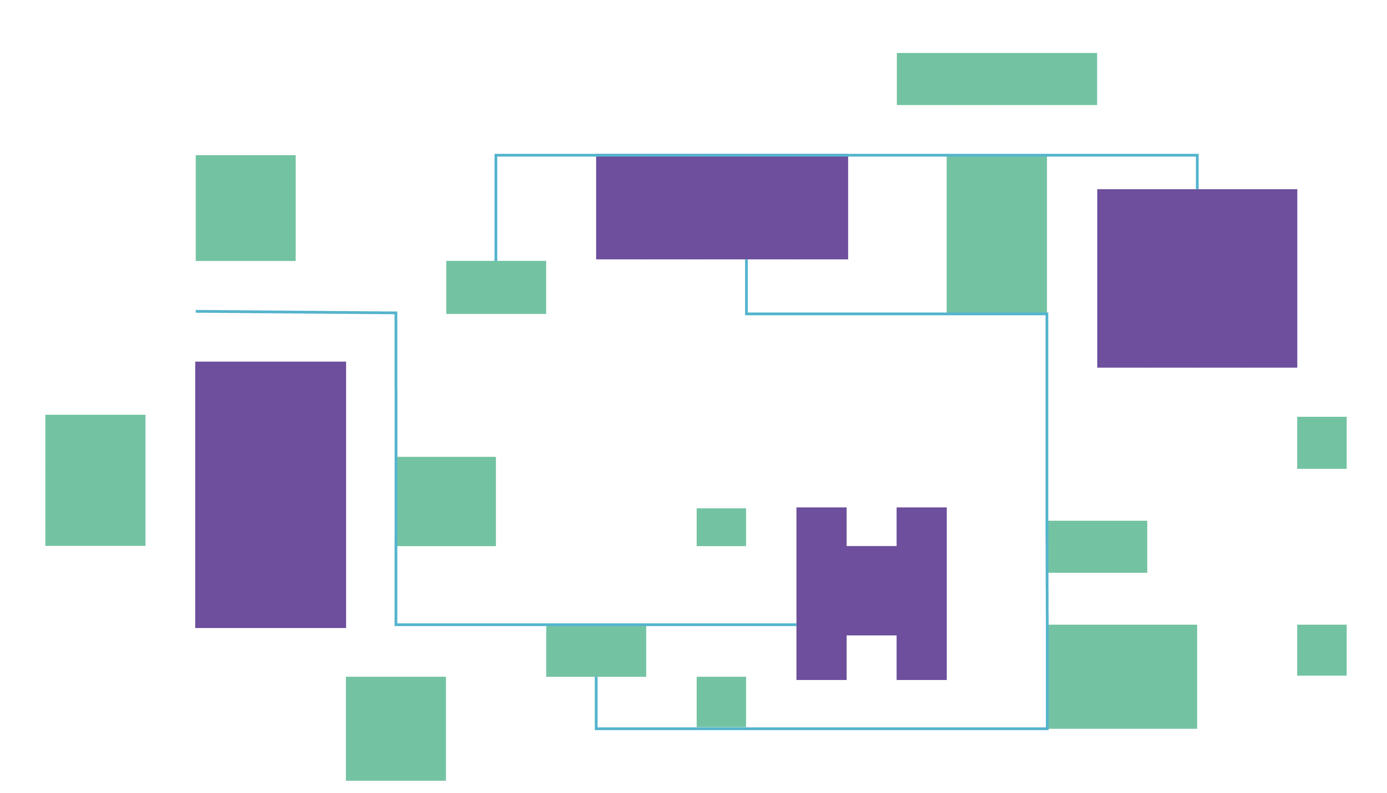
The Bartlett School of Architecture , UCL
BARC0034 Morphogenetic Programming
COMFORT IN SIGHT
Using NSGA-II to Optimize Residential Green Space Layout
CREATED BY: Rui Gu

Slide 2
NSGA-II ALGORITHM FOR GREEN SPACE OPTIMIZATION
^{Main Workflow}
^{// 1. Data Preparation}
greenSurfaces = CreateEffectiveGreenAreas(greenBoundaries, buildingFootprints) // Boolean difference: green - buildings
samplePoints = SampleAlongPaths(paths, 5.0) // One sample every 5 meters
grid = CreateUniformGrid(greenSurfaces) // Divide green areas into grid cells
// 2. Define Fitness Functions (CORE)
function CalculateFitness(genes): // Genes: Boolean array representing green state (true=green)
// Objective 1: Green View Score (maximize)
greenViewScore = CalculateGreenView(genes, grid, samplePoints, buildingFootprints)
// Objective 2: Area Difference from Target (minimize)
areaDifference = CalculateAreaDifference(genes, grid, targetArea)
// Objective 3: Distribution Uniformity (minimize)
distributionPenalty = CalculateDistributionPenalty(genes, grid)
return [greenViewScore, areaDifference + distributionPenalty]
}
^{Two Optimization Objectives}
1) Maximize Path Green View Index
2) Minimize Deviation from Target Green Area
^{// 3. Optimize using NSGA-II}
paretoSet = RunNSGA2(CalculateFitness, grid.Count)
bestSolution = SelectCompromiseSolution(paretoSet)
return ConvertToGeometry(bestSolution, grid)
Notes:
The motivation for the project is that there are many studies have shown that green spaces are beneficial for human health, especially for the elderly, and that green viewsheds have a significant impact on the health of the elderly. So given to this, I started my project.
The optimization has two optimization objectives: maximizing the green visibility on the path in residential area
and minimizing deviation from target green area which means maximizing the total green space area.
The main workflow can be divided into three main parts:
The first step is about data preparation
The next is to set my three core fitness functions.
They are defined to compute the green view score, area variance, and distribution uniformity to make sure each region has some green space distributed in it;
Finally running the NSGA-II algorithm to obtain solutions

Slide 3
NSGA-II ALGORITHM FOR GREEN SPACE OPTIMIZATION
// Core Function 1: Green View Calculation
function CalculateGreenView(genes, grid, samplePoints, buildings):
// Convert active genes to green geometry
^{greenGeometry = []}
^{for i = 0 to genes.Length-1:}
^{if genes[i] == true:}
greenGeometry.Add(CreateRectangle(grid[i].centerPoint, gridSize))
^{visibleGreenRayCount = 0}
totalRayCount = samplePoints.Count * 30 // 30 rays per sample point
// Cast rays from each sample point to check green visibility
^{foreach point in samplePoints:}
rays = GenerateRays(point, 30, 90.0) // 30 rays with radius 90m
^{foreach ray in rays:}
// Check if ray intersects green and is not blocked by buildings
if RayIntersectsGreen(ray, greenGeometry) and
!RayIsBlockedByBuildings(ray, buildings, greenGeometry):
^{visibleGreenRayCount++}
return visibleGreenRayCount / totalRayCount // Normalized score (0-1)
// Core Function 2: Area Difference Calculation
function CalculateAreaDifference(genes, grid, targetArea):
activeCount = CountTrueValues(genes)
actualArea = activeCount * gridSize * gridSize
return |actualArea - targetArea| // Absolute difference, smaller is better
// Core Function 3: Distribution Penalty Calculation
function CalculateDistributionPenalty(genes, grid):
// Calculate green ratio for each region
regionGreenRatios = CalculateRegionGreenRatios(genes, grid)
^{penalty = 0}
foreach region in regionGreenRatios:
// Heavy penalty for regions with no green
^{if region.ratio == 0:}
^{penalty += 1.0}
// Light penalty for regions with low green ratio
^{else if region.ratio < 0.1:}
penalty += (0.1 - region.ratio) * 5.0
^{return penalty}
Notes:
Here comes to some details about how I set my core function
Core Function 1: The green field of view calculation function on the left converts Boolean genomes to geometric shapes,
then emits 30 90-meter-long rays from the path sampling point and calculates the proportion of rays that can see the green space and are not blocked by buildings,
with a score ranging from 0 to 1, the higher the better.
Core Function 2: The area difference calculation function on the top right counts the number of activated green space grids,
multiplies them by the grid size to get the actual area, and then calculates the absolute difference from the target area, the smaller the better.
Core Function 3: the distribution penalty function on the lower right ensures that green space is evenly distributed in each area

Slide 4
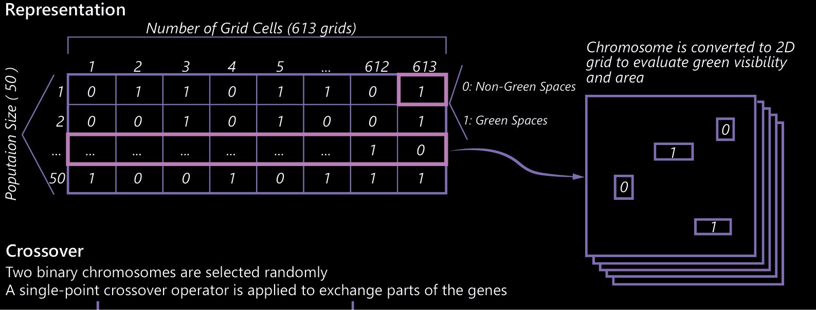
NSGA-II ALGORITHM FOR GREEN SPACE OPTIMIZATION
// NSGA-II Algorithm Simplified
function RunNSGA2(fitnessFunction, geneLength):
// Representation: Binary array (true/false) for grid cells
population = GenerateRandomPopulation(100, geneLength) // 100 solutions
for generation = 1 to 50: // Evolve for 50 generations
// Selection: Binary tournament based on non-dominated ranking and crowding
// Crossover: Uniform crossover exchanging genes between parents
// Mutation: Low-probability bit-flip mutation changing individual grid states
offspring = CreateOffspring(population)
// Combine and sort by non-domination relationship
combinedPopulation = population + offspring
sortedPopulation = NonDominatedSort(combinedPopulation)
^{// Select new generation}
population = SelectNewGeneration(sortedPopulation, 100)
// Return Pareto-optimal solutions
return GetParetoFront(population)
Notes:
This is a simplified flow of the genetic algorithm applied to green space optimization illustrating the core steps of the algorithm:
The illustration on the right side illustrates the representation of the solutions:
each chromosome is a Boolean array corresponding to 613 grid cells,
with 1 indicating a green field and 0 a non-green field.
These Boolean values are eventually converted into a 2D layout for evaluating the two optimization objectives of green field of view and area

Slide 5
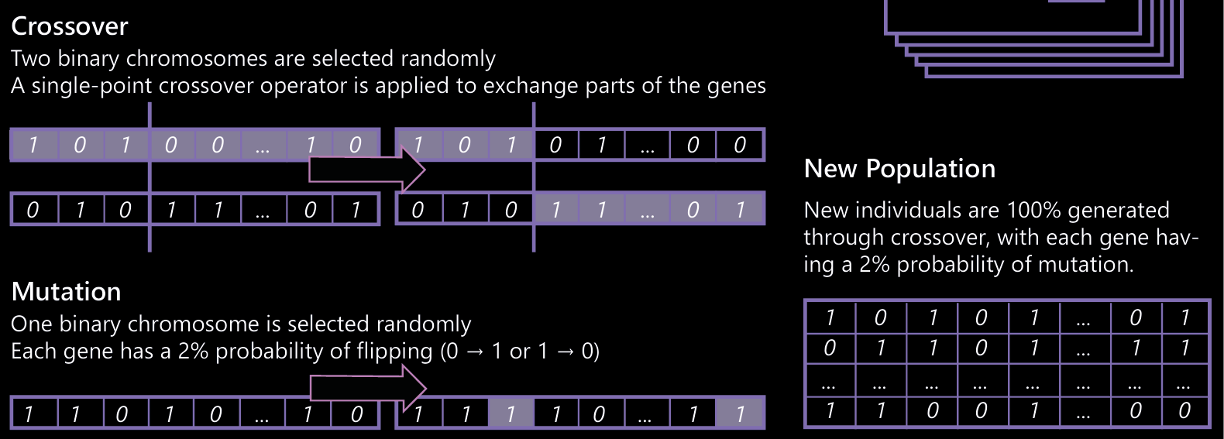
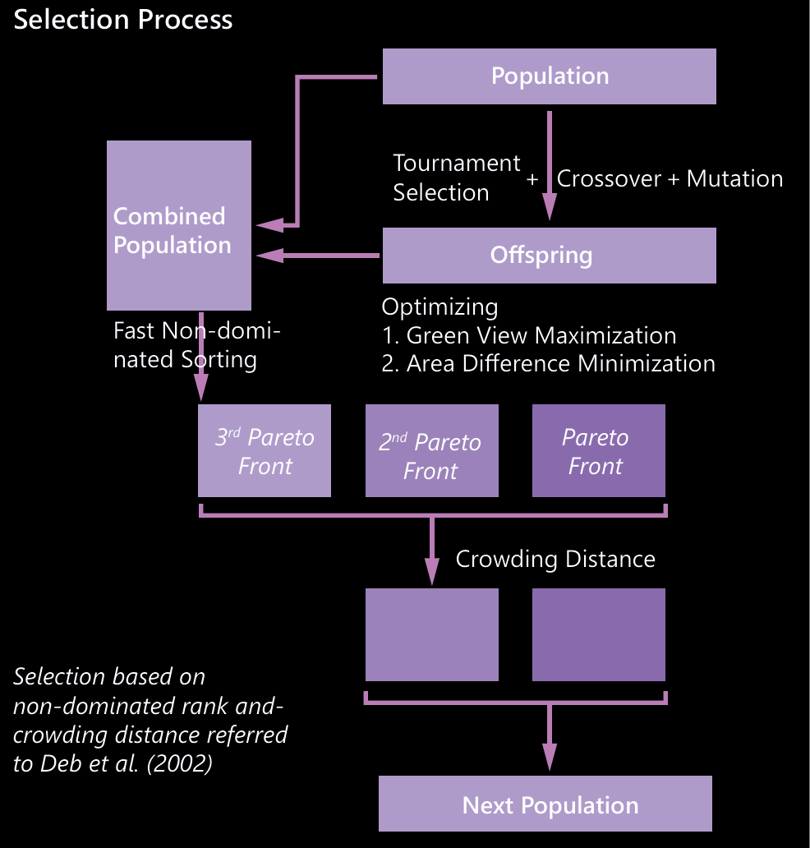
NSGA-II ALGORITHM FOR GREEN SPACE OPTIMIZATION
// NSGA-II Algorithm Simplified
function RunNSGA2(fitnessFunction, geneLength):
// Representation: Binary array (true/false) for grid cells
population = GenerateRandomPopulation(100, geneLength) // 100 solutions
for generation = 1 to 50: // Evolve for 50 generations
// Selection: Binary tournament based on non-dominated ranking and crowding
// Crossover: Uniform crossover exchanging genes between parents
// Mutation: Low-probability bit-flip mutation changing individual grid states
offspring = CreateOffspring(population)
// Combine and sort by non-domination relationship
combinedPopulation = population + offspring
sortedPopulation = NonDominatedSort(combinedPopulation)
^{// Select new generation}
population = SelectNewGeneration(sortedPopulation, 100)
// Return Pareto-optimal solutions
return GetParetoFront(population)
Notes:
On the left side is the same simplified pseudo-code of the algorithm
The illustration on the right side shows the specific genetic operations: the customized mutation, crossover and selection process
The whole optimization process considers both the objectives of maximizing the green visibility and minimizing the area difference which is maximizing the green space area, referring to the method proposed by Deb et al. 2002.

Slide 6
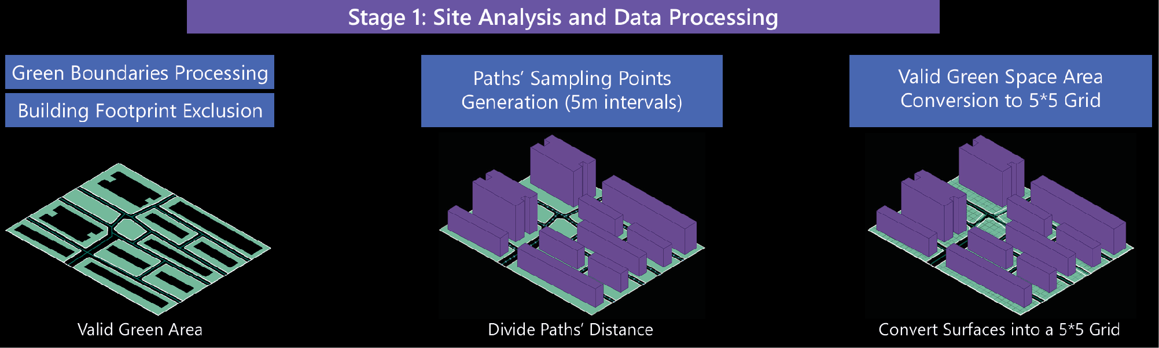
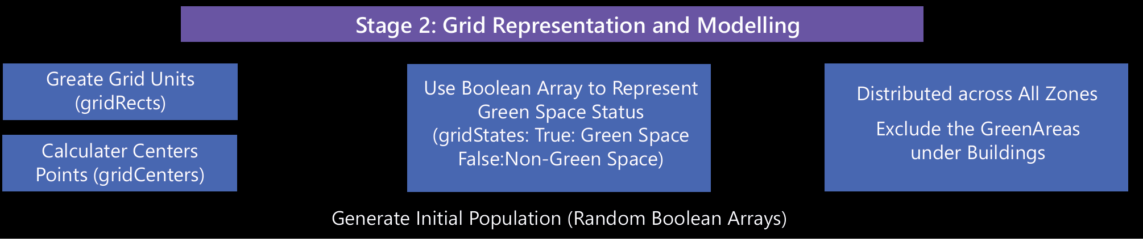
METHODOLOGY FRAMEWORK
Notes:
The first stage is site analysis and data processing: processing the greenspace boundaries excluding the building footprints, and generating visual sampling poits on the paths,turn the valid green space area into 5*% grid network
The second stage is grid representation and modeling: it’s more about create grid units and calculate the grid centers, and them goes to using the Boolean array to represent green space status, then distributed those green areas evenly in nearby residential buildings

Slide 7
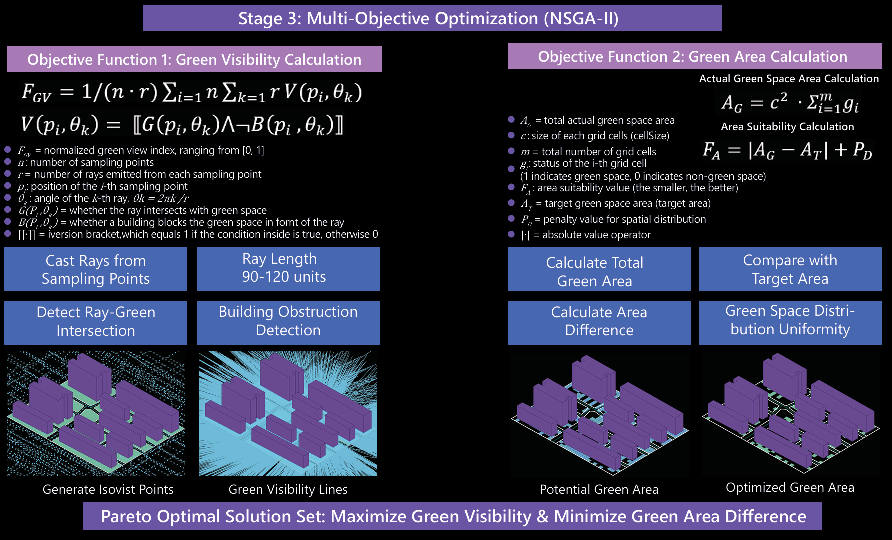
METHODOLOGY FRAMEWORK
Notes:
On the left side is about the objective function for green field of view calculation: casting the rays from sampling points, detecting those rays hits the greenspaces or not and excluding those hitting buildings
On the right is the objective function for green area calculation: calculating the generated total green area, and then minus the target area, to achieve the smaller the better goal. As well as to make sure those green space areas distribute evenly here
Bottom summarizes the Pareto optimal solution set: to find the best solution for the two optimization goals

Slide 8
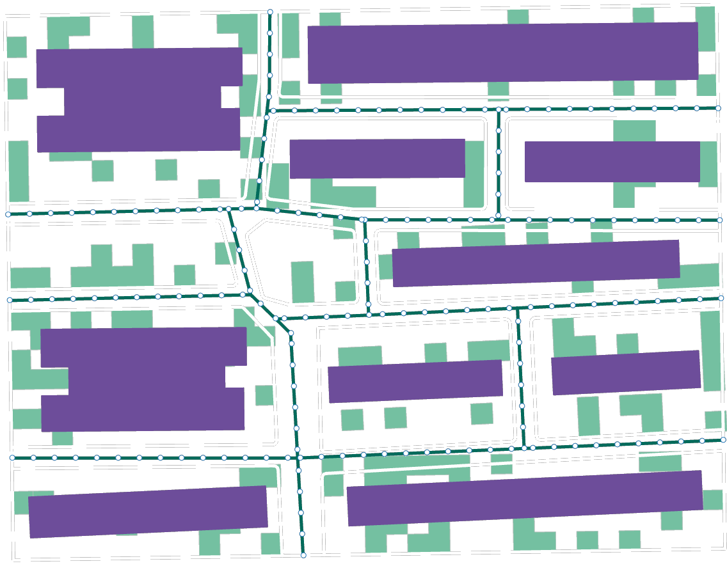
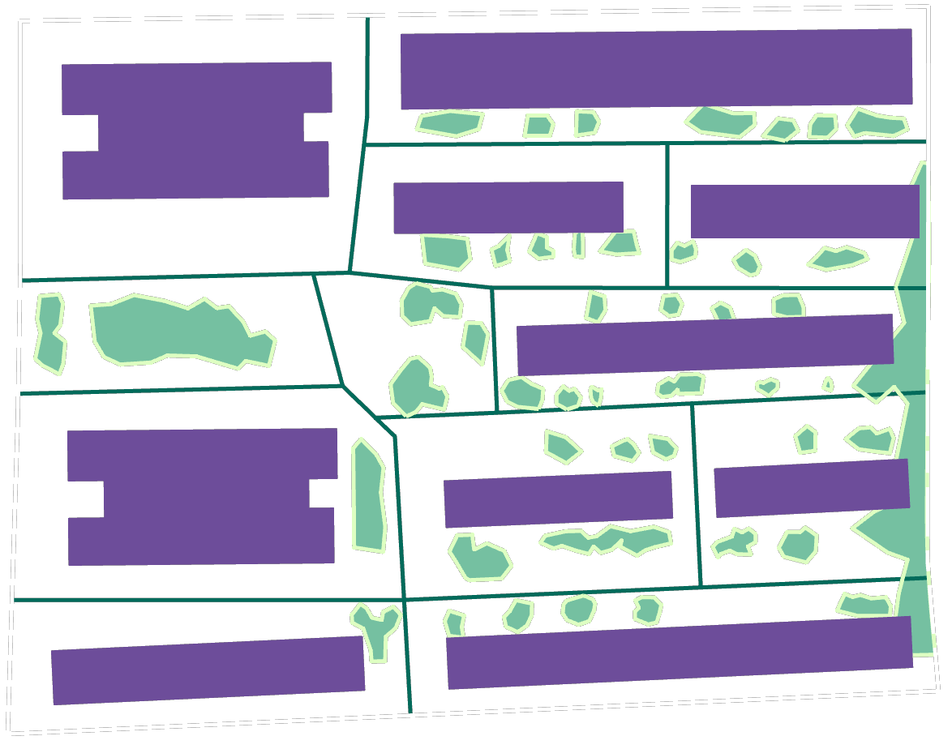
BEFORE AND AFTER OPTIMISATION
^{Current Status Of The Site}
^{Optimized Green Space Layout}
Green Visibility: 0.753
Planned Area: 6476
Green Visibility: 0.972
Green Area: 2488.193
Area Difference: 3987.806
Green Area: 5239.824
Area Difference: 1236.175
Notes:
On the left is a simple depiction of the current state of the green space layout in the study area,
and on the right is one of optimization solutions which achieves to balance both two optimization goals
Through comparing the before and after optimized layout, it shows that the optimized green space layout achieves to be more evenly distributed along the community paths and next to the community houses compared to the current state of the site, showing an effective result

Slide 9
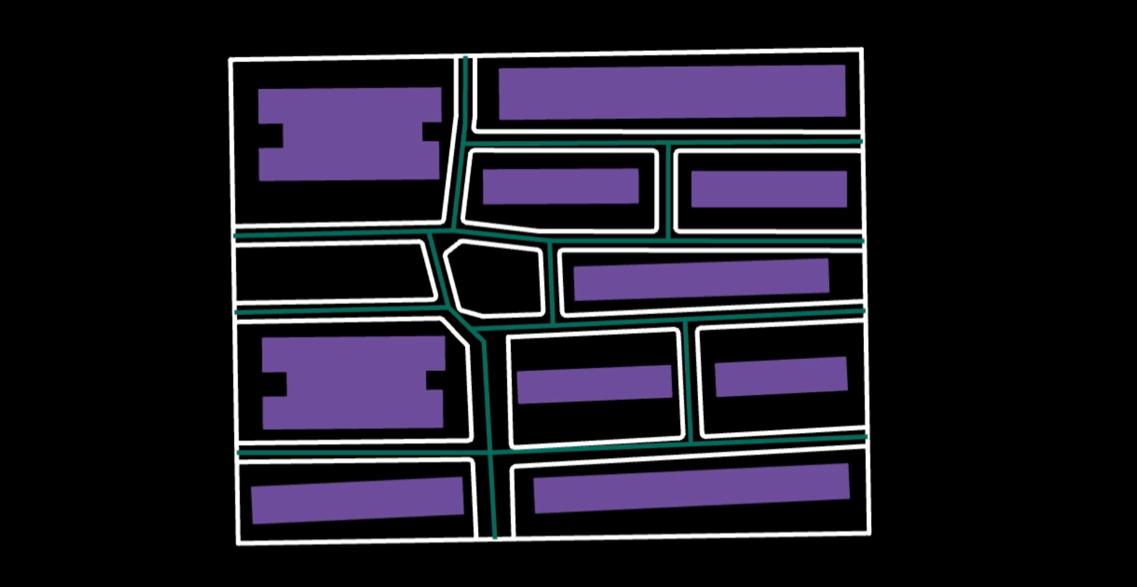
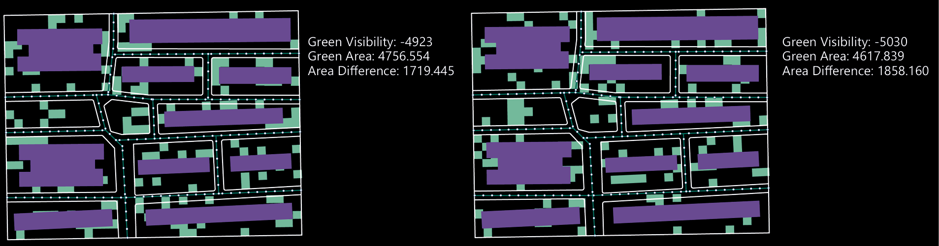
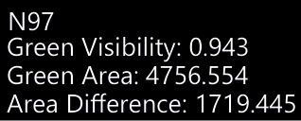
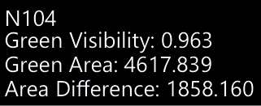
EVALUATE SOLUTIONS
Notes:
Here I chose two of the Pareto frontiers solutions
Through comparing them, I found that, in fact, it is not that the larger the green space area, the better the green visual field value obtained.
So here comes to my project’s limitations

Slide 10
FUTURE WORK & LIMITATIONS
Lack of Parameter Calibration in View Analysis
No Control Over Spatial Continuity or Shape of Green Areas
No integration with Environmental or Behavioral Data:
The optimization is static and does not respond to external data such as sunlight, wind, or pedestrian movement, Future work could integrate real-time or context-aware inputs to enable adaptive green space planning
Limited Evaluation Dimensions:
The optimization currently considers only visual exposure and area compliance. Other important aspects such as accessibility usability, sunlight exposure, and acoustic buffering are not yet incorporated into the fitness evaluation.
Notes:
There are still a lot of shortcomings in this project, like the choice of the fitness function and lack of consideration of other elements like the building layouts.
And only 2D layout can not indicate the green field of view is good or bad,
the green field of view is only reflected in the figures,
or need to be combined with the plants in the 3D space.
That’s all about my project.

Slide 11
THANKS FOR LISTENING
Rui Gu

