Slide 1
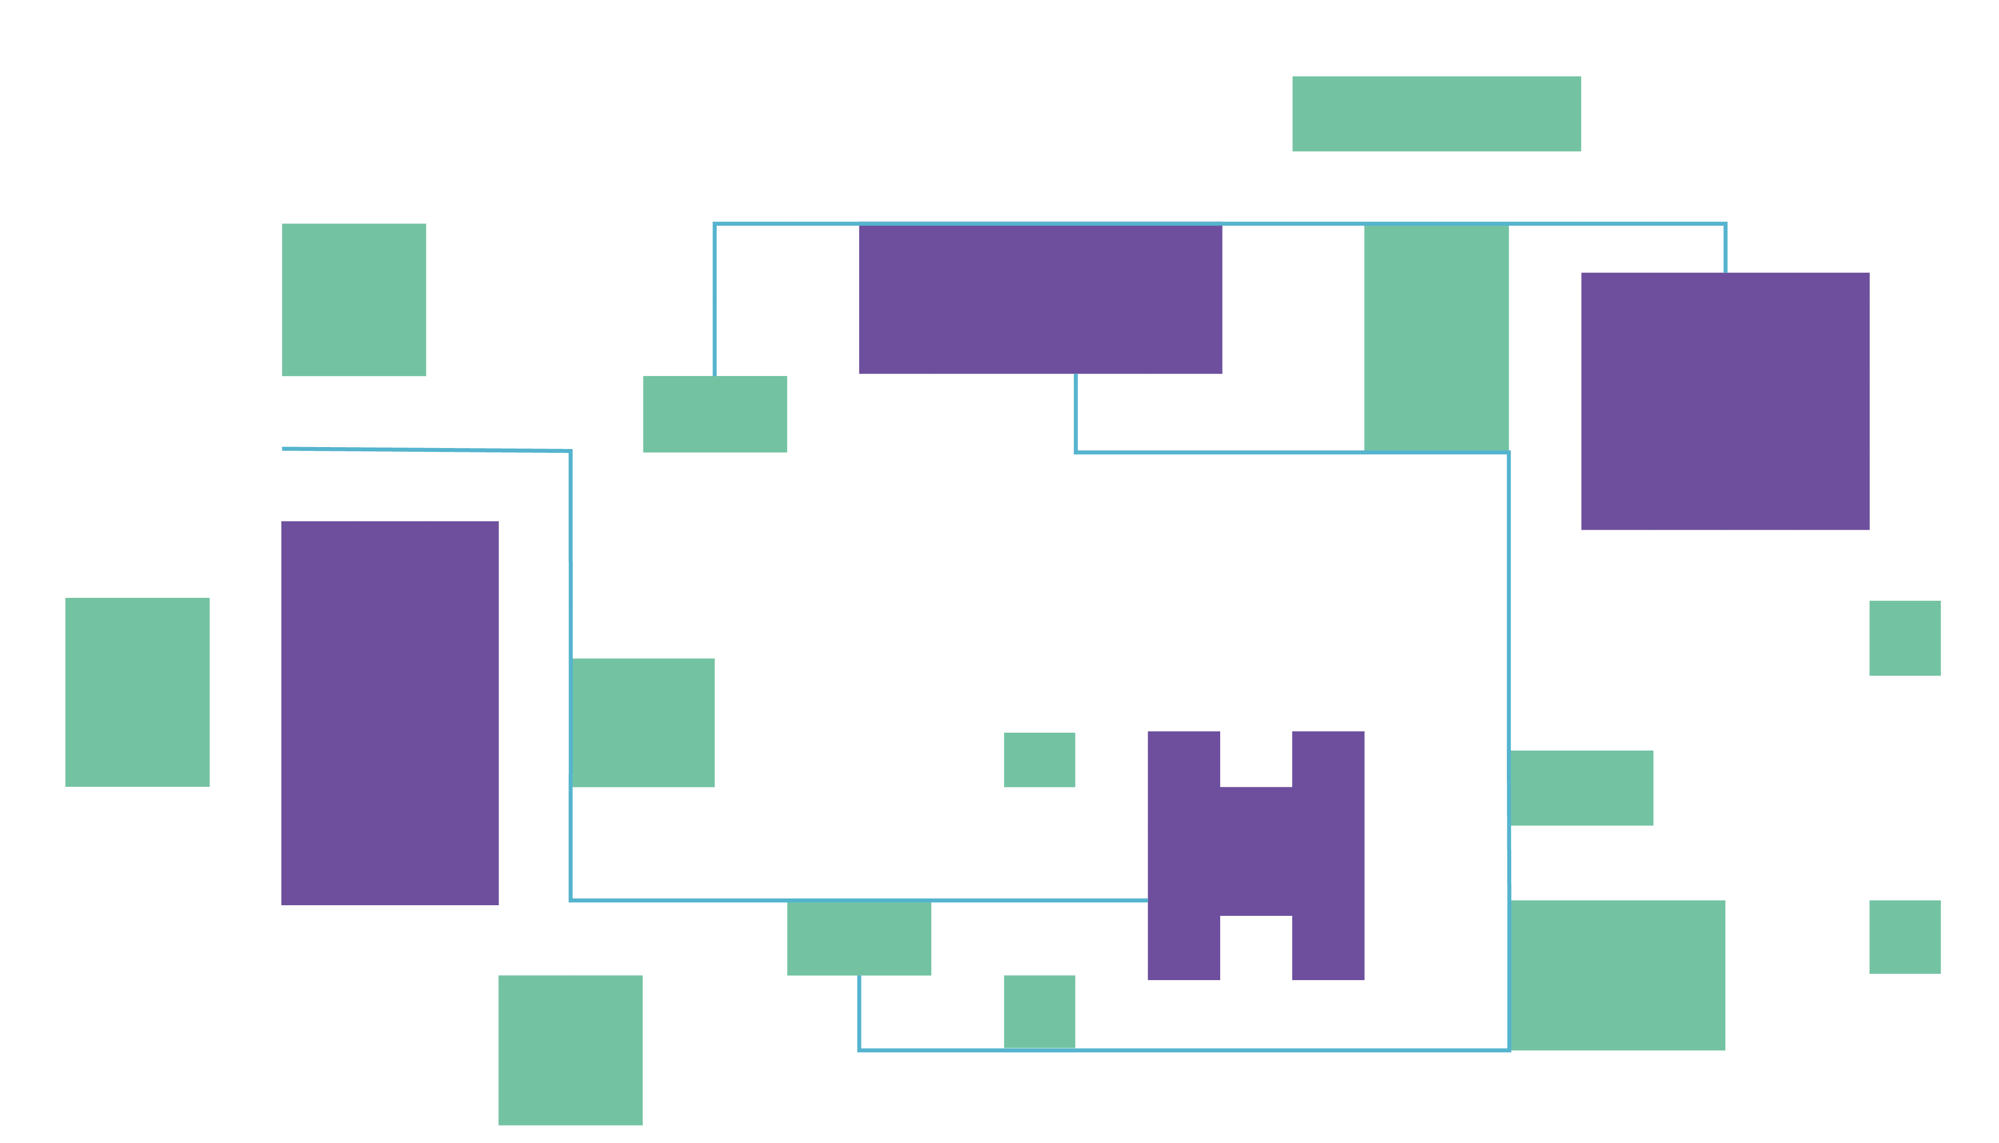
The Bartlett School of Architecture , UCL
BARC0034 Morphogenetic Programming
COMFORT IN SIGHT
CREATED BY: Rui Gu

Slide 2
OVERVIEW OF NON-DOMINATED GENETIC ALGORITH II
Constructing NSGA-II Optimization Algorithm Logic

Slide 3
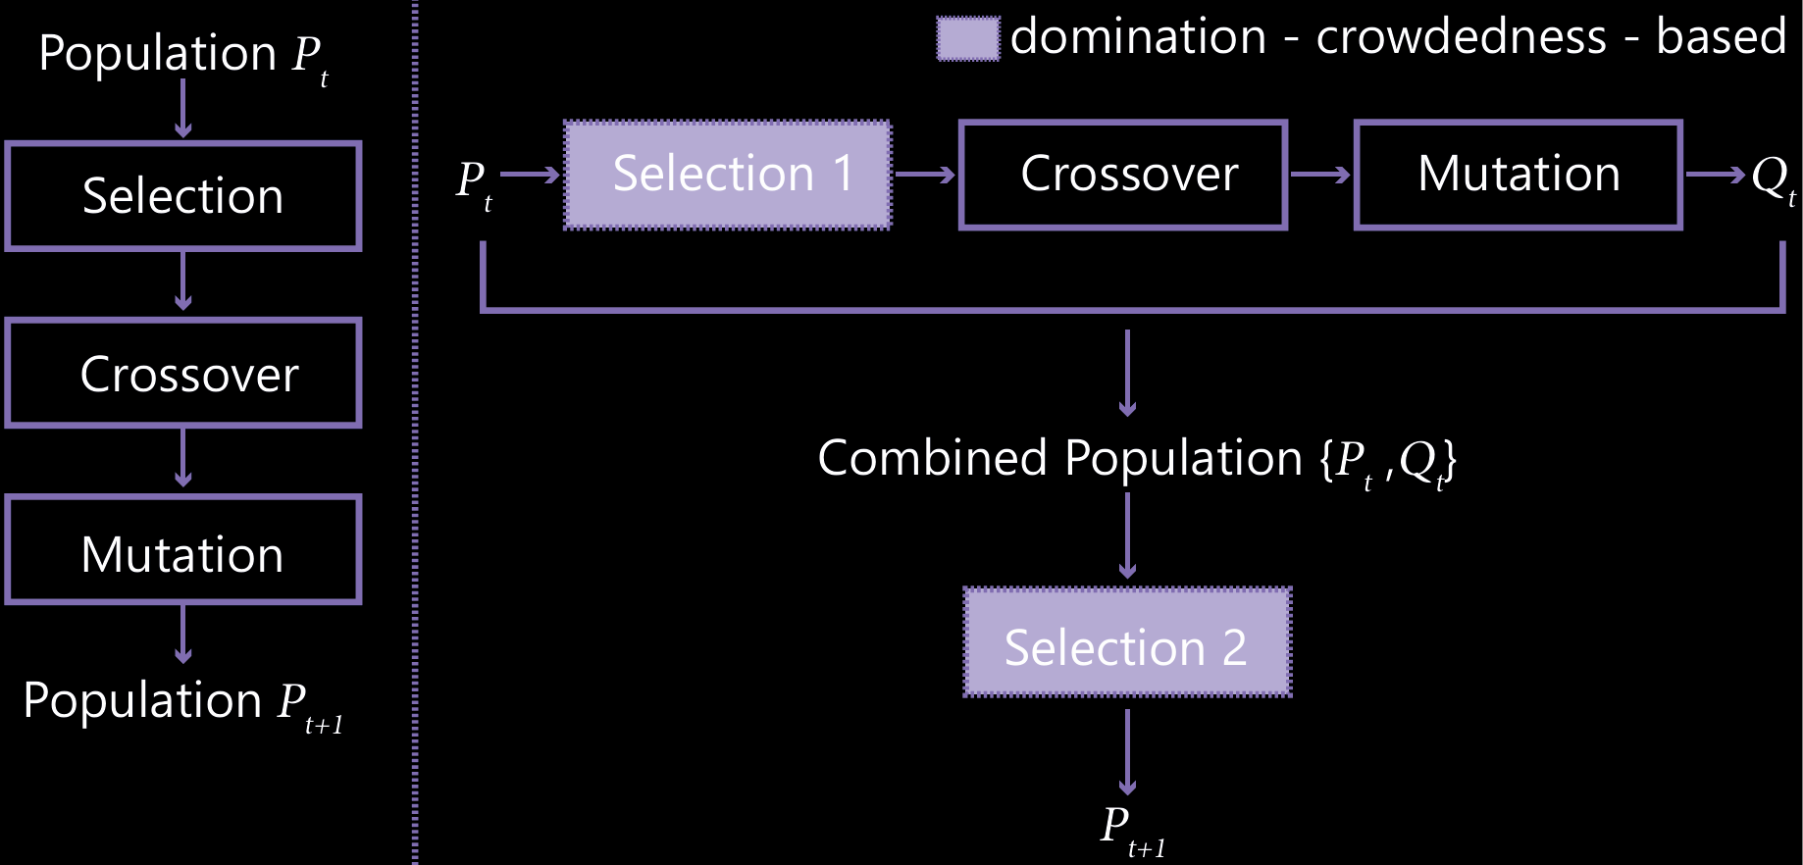
COMPARISON BETWEEN ORDINARY ALGORITHM AND NSGA-II
NSGA-II (Non-dominated Sorting Genetic Algorithm II) is an evolutionary optimization technique that simulates natural selection to solve complex problems. It evolves a population of solutions over multiple generations by:
Maintaining diversity through crowding distance metrics
Efficiently ranking solutions using fast non-dominated sorting
Preserving elite solutions between generations
Balancing multiple competing objectives simultaneously
This approach is ideal for green space optimization, allowing us to maximize visibility and achieve target coverage without predefined weightings between objectives.
^{Referred to Gao. 2011}

Slide 4
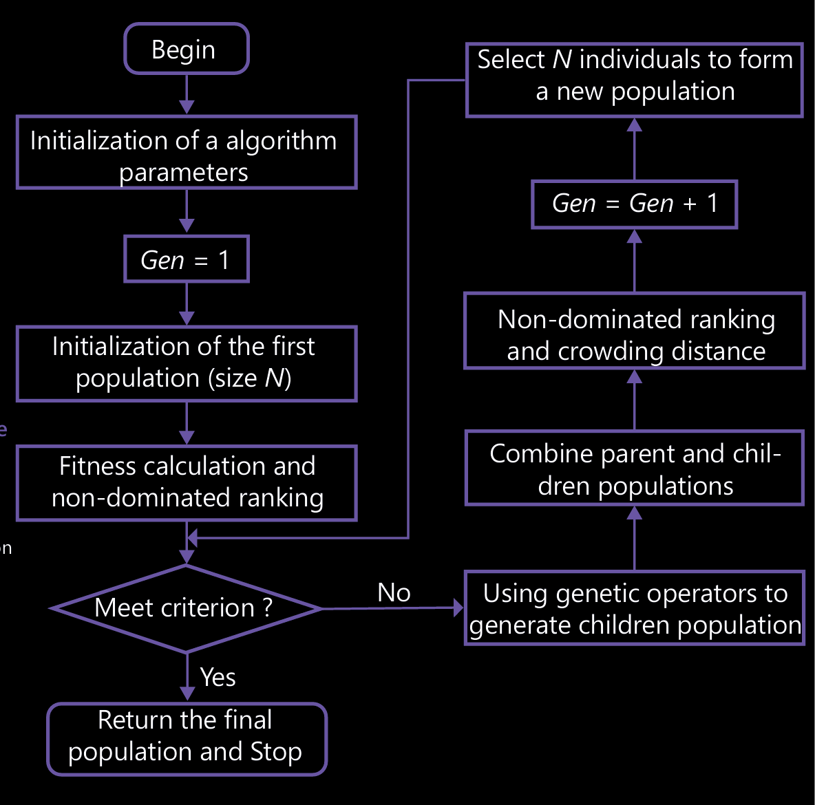
FLOWCHART OF NSGA-II
^{// Initialization phase}
function NSGA-II(N, max_generations):
// Initialize algorithm parameters
^{population_size = N}
^{max_gen = max_generations}
^{gen = 1}
// Initialize the first population
P = generate_random_population(population_size)
evaluate_fitness_functions(P) // Green visibility and area difference
fronts = fast_non_dominated_sort(P)
calculate_crowding_distance(fronts)
// Apply mutation with probability mutation_rate
child1 = mutation(child1, mutation_rate)
child2 = mutation(child2, mutation_rate)
^{// Add to offspring population}
^{Q.add(child1)}
^{Q.add(child2)}
// Evaluate fitness of offspring
^{evaluate_fitness_functions(Q)}
// Combine parent and children’ populations
^{R = P ∪ Q}
// Non-dominated ranking and crowding distance
fronts = fast_non_dominated_sort(R)
calculate_crowding_distance(fronts)
// Select N individuals to form new population
P = select_next_generation(fronts, N)
// Increment generation counter
^{gen = gen + 1}
// Return the final population (Pareto front)
return fronts[1] // First front contains non-dominated solutions
^{// Main evolutionary loop}
while gen ≤ max_gen and !termination_criterion():
// Using genetic operators to generate children population
^{Q = empty_population()}
^{for i = 1 to N/2:}
// Select parents using tournament selection
parent1 = tournament_selection(P)
parent2 = tournament_selection(P)
// Apply crossover with probability crossover_rate
^{if random() < crossover_rate:}
child1, child2 = crossover(parent1, parent2)
^{else:}
child1, child2 = parent1, parent2
Referred to Liu et al.2020

Slide 5
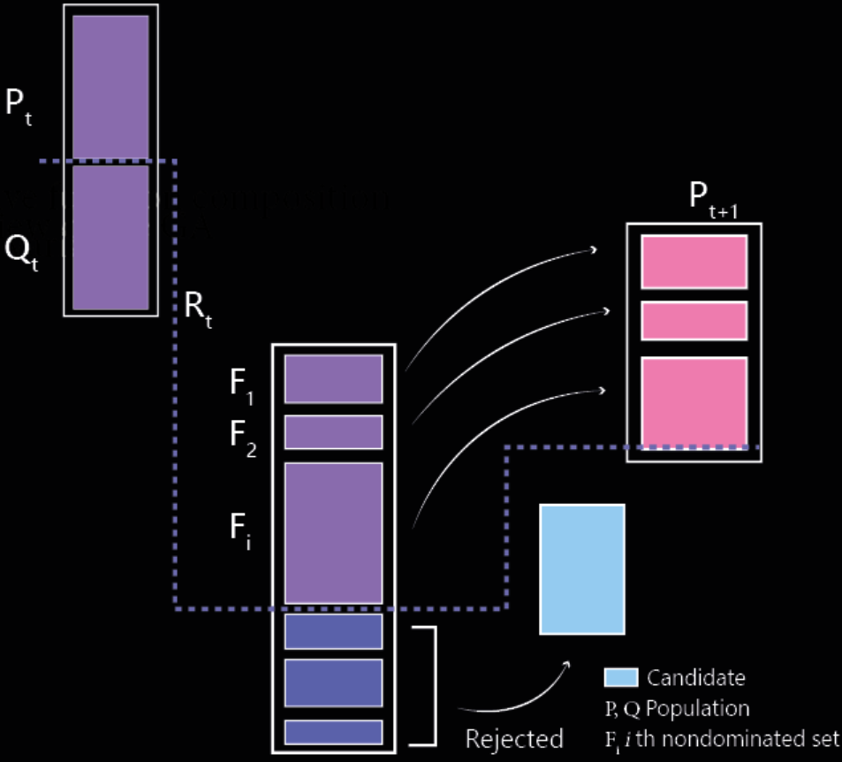
NSGA-II SECOND SELECTION STRATEGY
// Step 1: Non-dominated sorting
Function Fast-Non-Dominated-Sort(R):
Initialize empty fronts F₁, F₂, ...
^{For each solution p in R:}
^{For each solution q in R:}
^{If p dominates q: Add q to Sp}
^{If q dominates p: Increment np}
^{If np = 0: Add p to F₁}
^{i = 1}
^{While Fi not empty:}
^{For each p in Fi:}
^{For each q in Sp:}
^{Decrement nq}
^{If nq = 0: Add q to Fi+1}
^{i = i + 1}
^{Return all fronts F₁, F₂, ...}
// Step 2: Crowding distance sorting
Function Calculate-Crowding-Distance(F):
^{n = |F|}
For each solution in F: distance = 0
^{For each objective m:}
^{Sort F by objective m}
F[1].distance = F[n].distance = ∞
^{For i = 2 to n-1:}
F[i].distance += (F[i+1].m - F[i-1].m)
// Step 3: Elite selection for next generation
Function Select-Next-Generation(F₁, F₂, ..., N):
^{P = ∅}
^{i = 1}
^{While |P| + |Fi| ≤ N:}
^{Add Fi to P}
^{i = i + 1}
Sort Fi by crowding distance (descending)
Add first (N - |P|) solutions from Fi to P
Referred to Deb K.2002

Slide 6
NSGA-II ALGORITHM FOR GREEN SPACE OPTIMIZATION
Optimizing the Residential Green Space Layout
^{Main Workflow}
Green Space has been proved to be beneficial to human health especially to the elderly. Meanwhile, there is an increasing number of studies showing that the green visibility impacts the health of elderly greatly.
Therefore, according to this, the project chose a residential area located in Guangdong Province, China as the research target.
This project is trying to promote data-driven and user-oriented urban design, particularly for aging societies, where green space configurations are no longer arbitrarily designed but intelligently optimized for well-being, inclusiveness, and long-term livability.
^{// 1. Data Preparation}
greenSurfaces = CreateEffectiveGreenAreas(greenBoundaries, buildingFootprints) // Boolean difference: green - buildings
samplePoints = SampleAlongPaths(paths, 5.0) // One sample every 5 meters
grid = CreateUniformGrid(greenSurfaces) // Divide green areas into grid cells
// 2. Define Fitness Functions (CORE)
function CalculateFitness(genes): // Genes: Boolean array representing green state (true=green)
// Objective 1: Green View Score (maximize)
greenViewScore = CalculateGreenView(genes, grid, samplePoints, buildingFootprints)
// Objective 2: Area Difference from Target (minimize)
areaDifference = CalculateAreaDifference(genes, grid, targetArea)
// Objective 3: Distribution Uniformity (minimize)
distributionPenalty = CalculateDistributionPenalty(genes, grid)
return [greenViewScore, areaDifference + distributionPenalty]
}
^{// 3. Optimize using NSGA-II}
paretoSet = RunNSGA2(CalculateFitness, grid.Count)
bestSolution = SelectCompromiseSolution(paretoSet)
return ConvertToGeometry(bestSolution, grid)
^{Two Optimization Objectives}
1) Maximize Path Green View Index
2) Minimize Deviation from Target Green Area

Slide 7
NSGA-II ALGORITHM FOR GREEN SPACE OPTIMIZATION
// Core Function 1: Green View Calculation
function CalculateGreenView(genes, grid, samplePoints, buildings):
// Convert active genes to green geometry
^{greenGeometry = []}
^{for i = 0 to genes.Length-1:}
^{if genes[i] == true:}
greenGeometry.Add(CreateRectangle(grid[i].centerPoint, gridSize))
^{visibleGreenRayCount = 0}
totalRayCount = samplePoints.Count * 30 // 30 rays per sample point
// Cast rays from each sample point to check green visibility
^{foreach point in samplePoints:}
rays = GenerateRays(point, 30, 90.0) // 30 rays with radius 90m
^{foreach ray in rays:}
// Check if ray intersects green and is not blocked by buildings
if RayIntersectsGreen(ray, greenGeometry) and
!RayIsBlockedByBuildings(ray, buildings, greenGeometry):
^{visibleGreenRayCount++}
return visibleGreenRayCount / totalRayCount // Normalized score (0-1)
// Core Function 2: Area Difference Calculation
function CalculateAreaDifference(genes, grid, targetArea):
activeCount = CountTrueValues(genes)
actualArea = activeCount * gridSize * gridSize
return |actualArea - targetArea| // Absolute difference, smaller is better
// Core Function 3: Distribution Penalty Calculation
function CalculateDistributionPenalty(genes, grid):
// Calculate green ratio for each region
regionGreenRatios = CalculateRegionGreenRatios(genes, grid)
^{penalty = 0}
foreach region in regionGreenRatios:
// Heavy penalty for regions with no green
^{if region.ratio == 0:}
^{penalty += 1.0}
// Light penalty for regions with low green ratio
^{else if region.ratio < 0.1:}
penalty += (0.1 - region.ratio) * 5.0
^{return penalty}

Slide 8
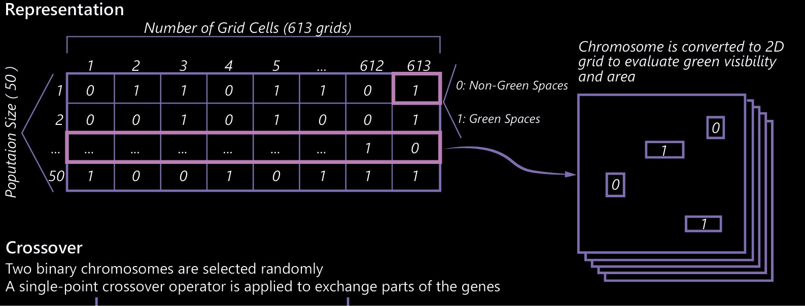
NSGA-II ALGORITHM FOR GREEN SPACE OPTIMIZATION
// NSGA-II Algorithm Simplified
function RunNSGA2(fitnessFunction, geneLength):
// Representation: Binary array (true/false) for grid cells
population = GenerateRandomPopulation(100, geneLength) // 100 solutions
for generation = 1 to 50: // Evolve for 50 generations
// Selection: Binary tournament based on non-dominated ranking and crowding
// Crossover: Uniform crossover exchanging genes between parents
// Mutation: Low-probability bit-flip mutation changing individual grid states
offspring = CreateOffspring(population)
// Combine and sort by non-domination relationship
combinedPopulation = population + offspring
sortedPopulation = NonDominatedSort(combinedPopulation)
^{// Select new generation}
population = SelectNewGeneration(sortedPopulation, 100)
// Return Pareto-optimal solutions
return GetParetoFront(population)

Slide 9
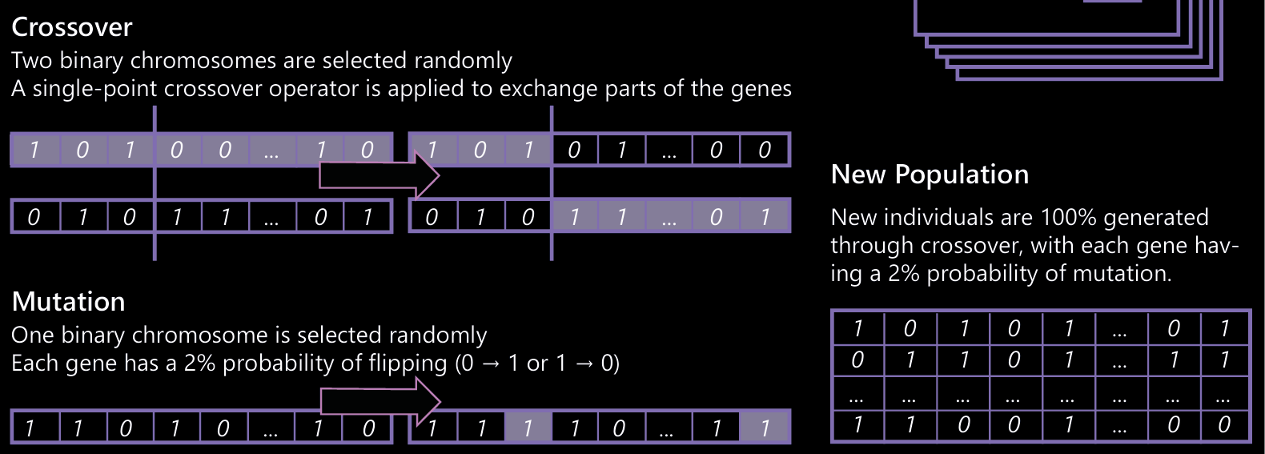
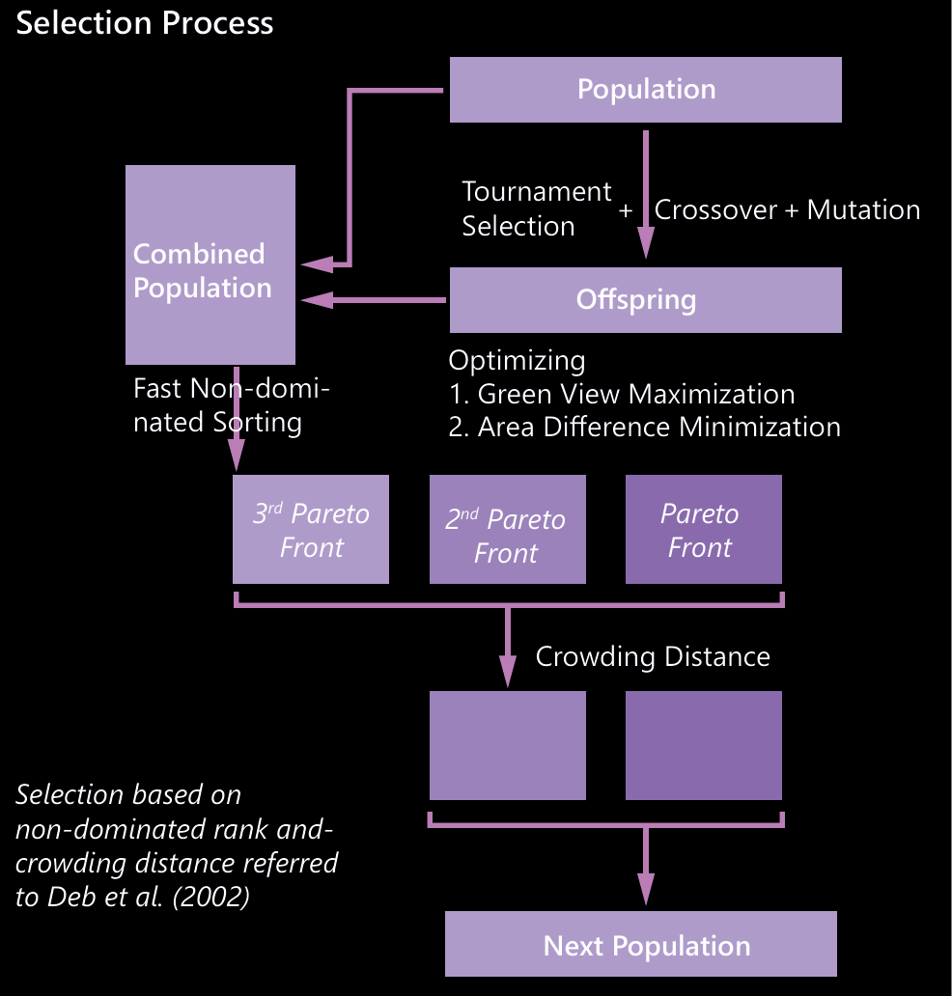
NSGA-II ALGORITHM FOR GREEN SPACE OPTIMIZATION
// NSGA-II Algorithm Simplified
function RunNSGA2(fitnessFunction, geneLength):
// Representation: Binary array (true/false) for grid cells
population = GenerateRandomPopulation(100, geneLength) // 100 solutions
for generation = 1 to 50: // Evolve for 50 generations
// Selection: Binary tournament based on non-dominated ranking and crowding
// Crossover: Uniform crossover exchanging genes between parents
// Mutation: Low-probability bit-flip mutation changing individual grid states
offspring = CreateOffspring(population)
// Combine and sort by non-domination relationship
combinedPopulation = population + offspring
sortedPopulation = NonDominatedSort(combinedPopulation)
^{// Select new generation}
population = SelectNewGeneration(sortedPopulation, 100)
// Return Pareto-optimal solutions
return GetParetoFront(population)

Slide 10
REVIEW OF METHODS
Adapting Layouts through Visual Analysis and Evolutionary Logic

Slide 11
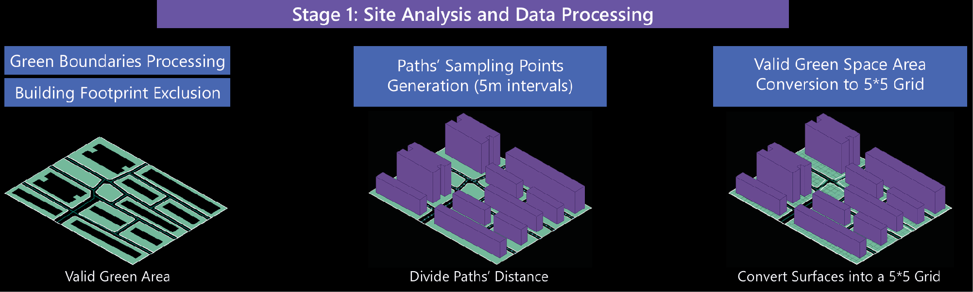
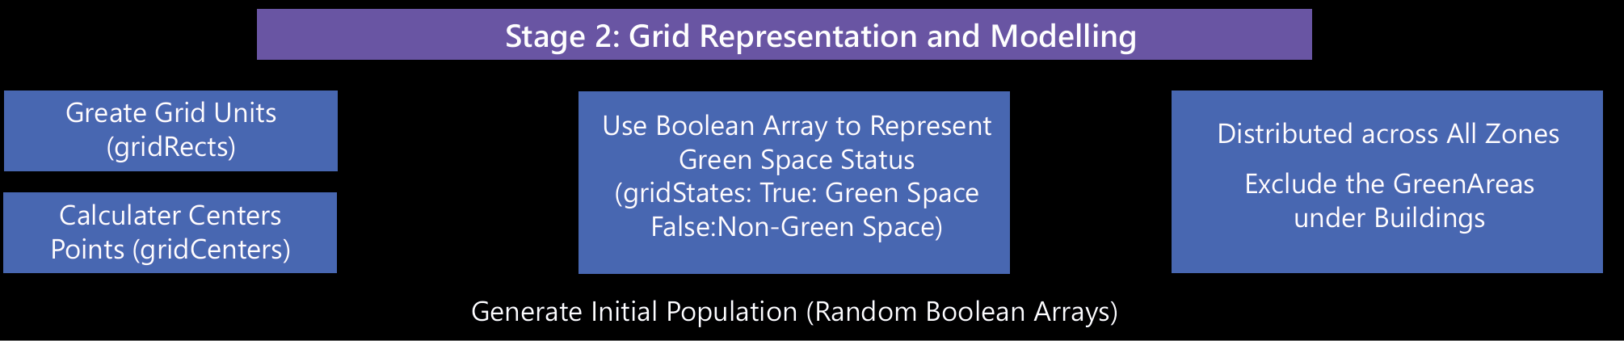
METHODOLOGY FRAMEWORK

Slide 12
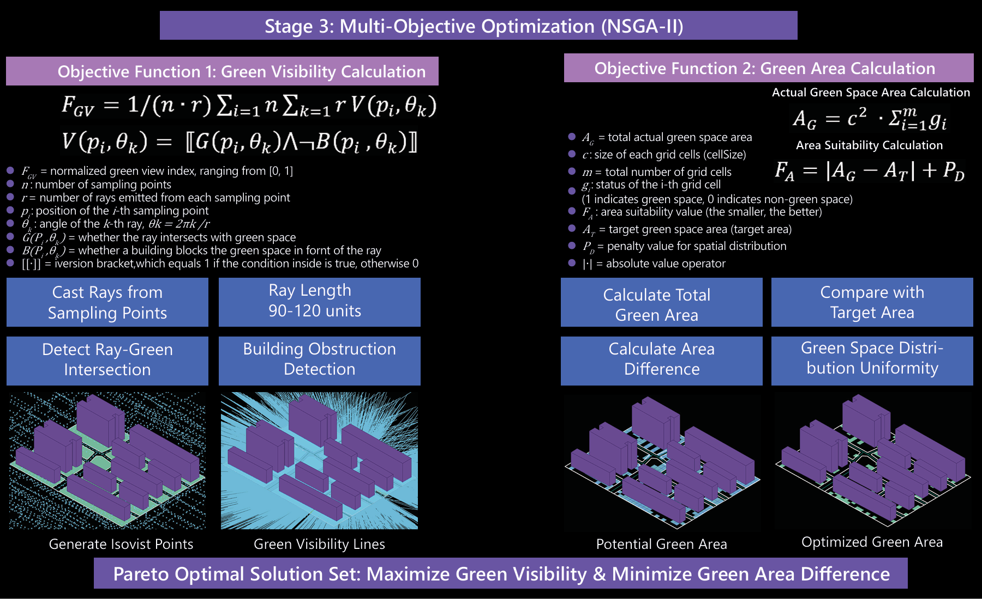
METHODOLOGY FRAMEWORK

Slide 13
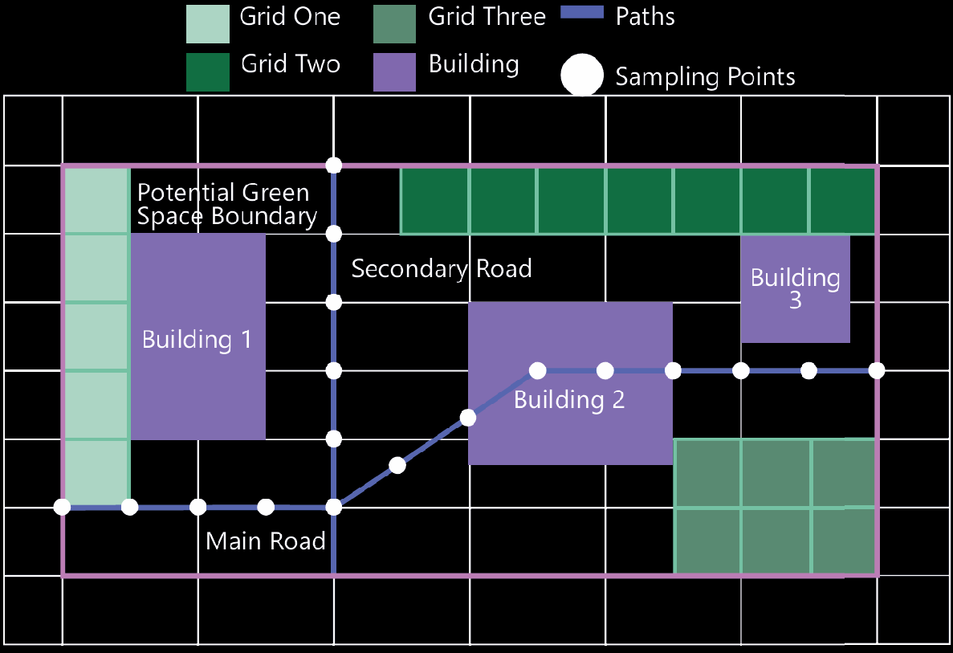
ADAPTATION PROCESS
Environmental Adaptation Mechanism
Spatial Recognition and Constraints
Building Adaptation: Automatically identify areas relative to building footprints
Path Sampling: Optimize sampling point generation along walking paths
Regional Adaptation: Automatically recognize and differentiate multiple zones
^{Green Visibility Evaluation}
Ray-casting Simulation: Simulate human vision through ray emission to detect green visibility
Occlusion Consideration: Account for building occlusions impacting green view

Slide 14
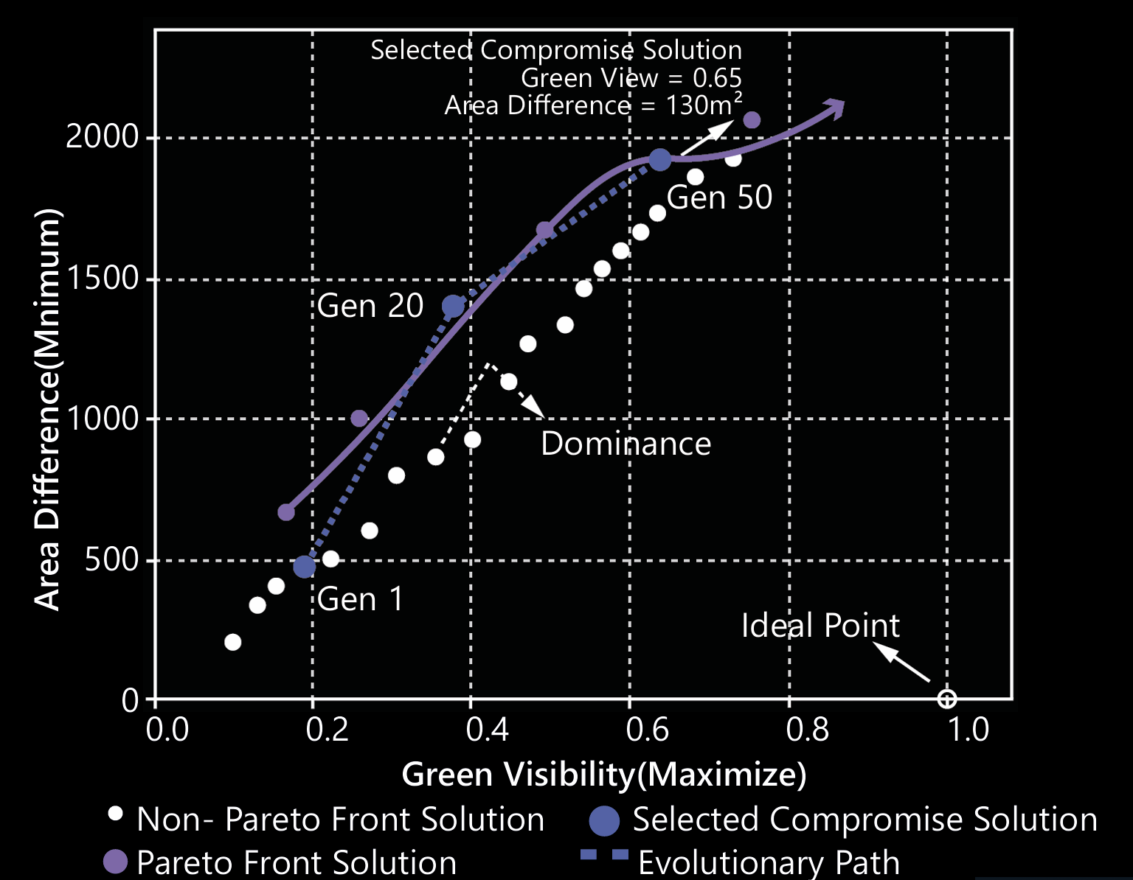
ADAPTATION PROCESS
Multi-objective Optimization Process
NSGA-II Algorithm Implementation
Population Initialization: Generate initial green layouts randomly
Multi-objective Fitness: Calculate green view gain and green area variance
Regional Balancing: Use penalty factors to ensure green space distribution balance
Non-dominated Sorting: Rank solutions based on Pareto optimality
^{Trade-off Solution Selection}
Calculate distance to ideal objectives and select a well-balanced solution

Slide 15
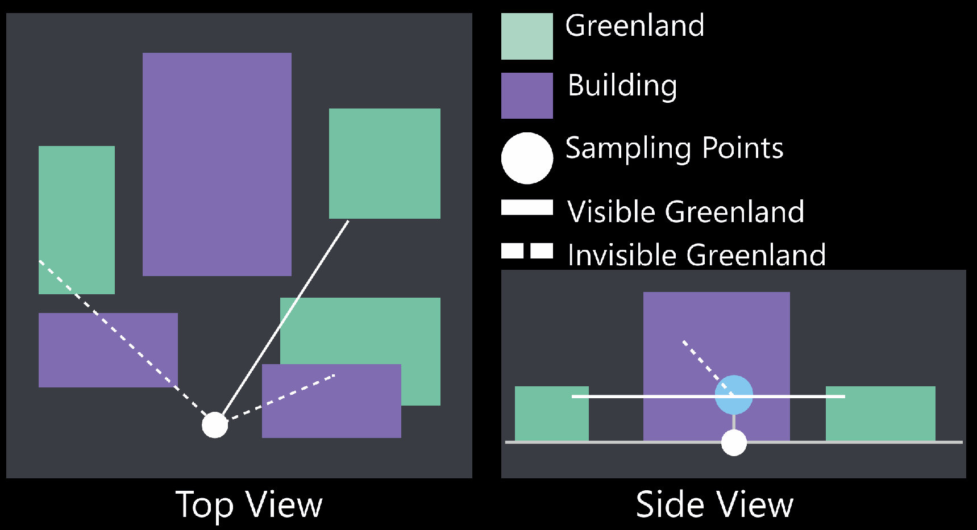
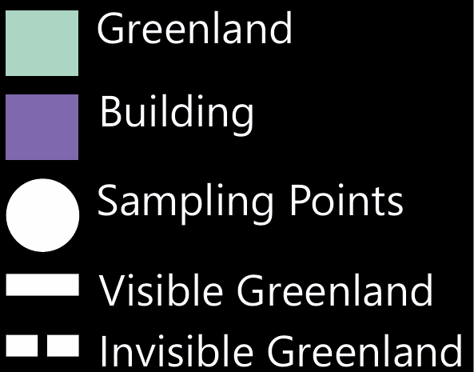
ADAPTATION PROCESS
Green Visibility Evaluation Mechanism
Top View
Green view evaluation is the core adaptation mechanism, ensuring optimization results match human perceptual experiences
Each sampling point emits rays to assess visibility and building occlusion impacts, providing a perceptual-based green view ratio
Side View

Slide 16
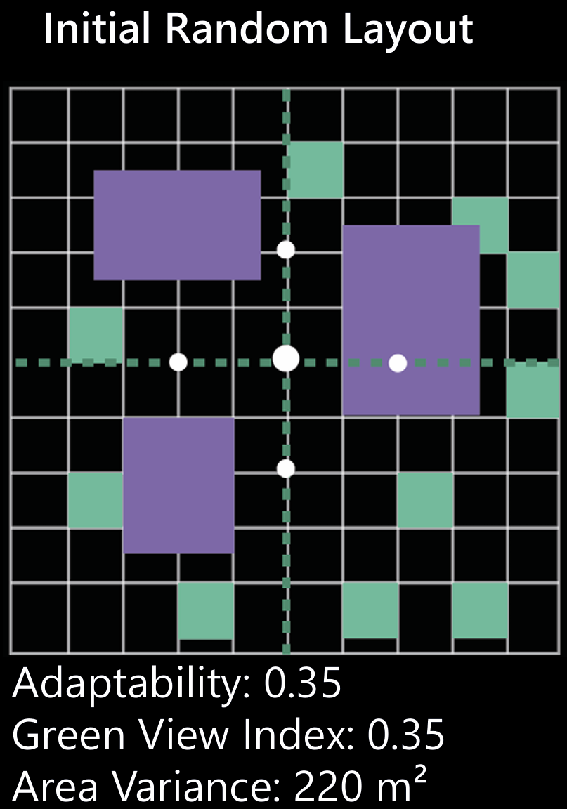
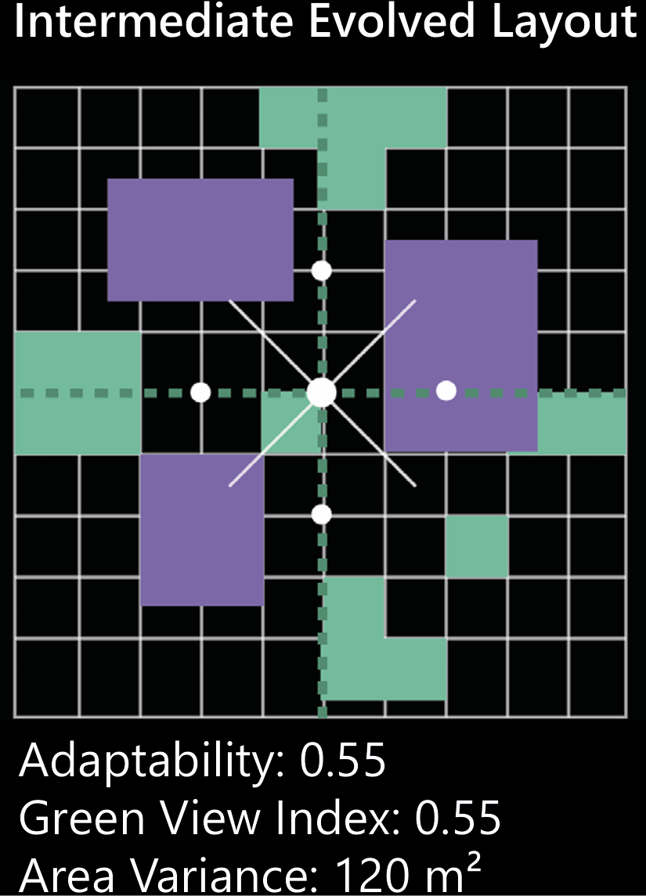
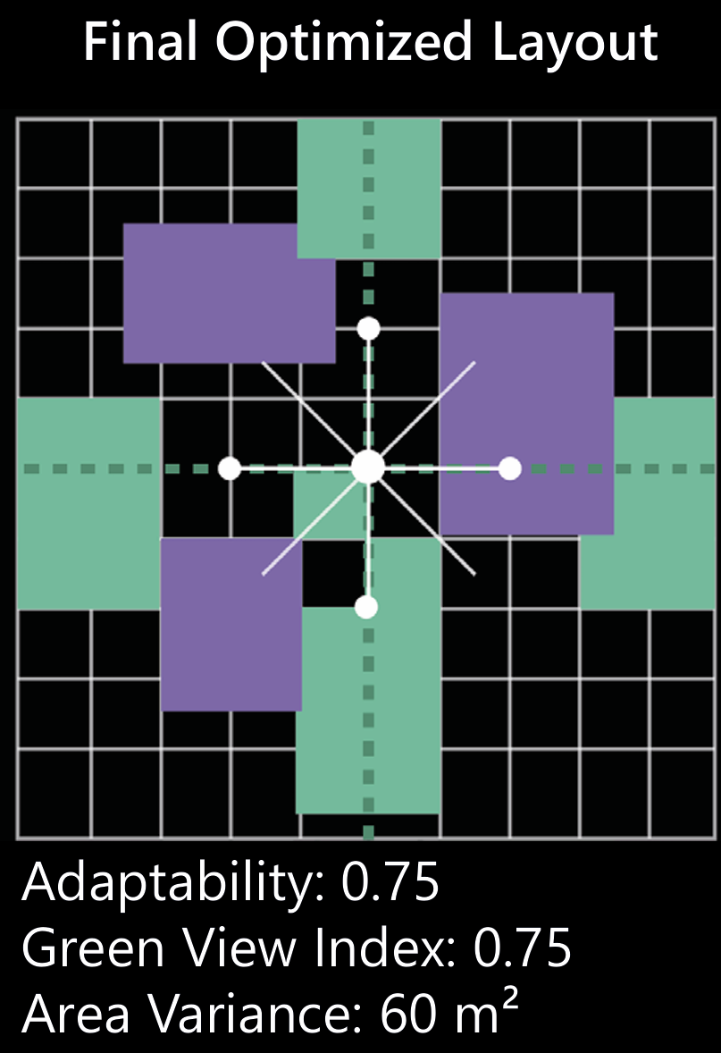
ADAPTATION PROCESS
^{Green Space Layout Adaptation}
Through iterative optimization, the green space layout gradually adapts to the spatial needs of the community environment.
From the initial random distribution to the final optimized state, the layout evolves into a more balanced pattern along pedestrian paths.
The system dynamically balances two competing objectives—green view improvement and area equality—meeting both perceptual experience needs and planning requirements.
Each region receives a reasonable allocation of green spaces, avoiding uneven distribution issues.

Slide 17
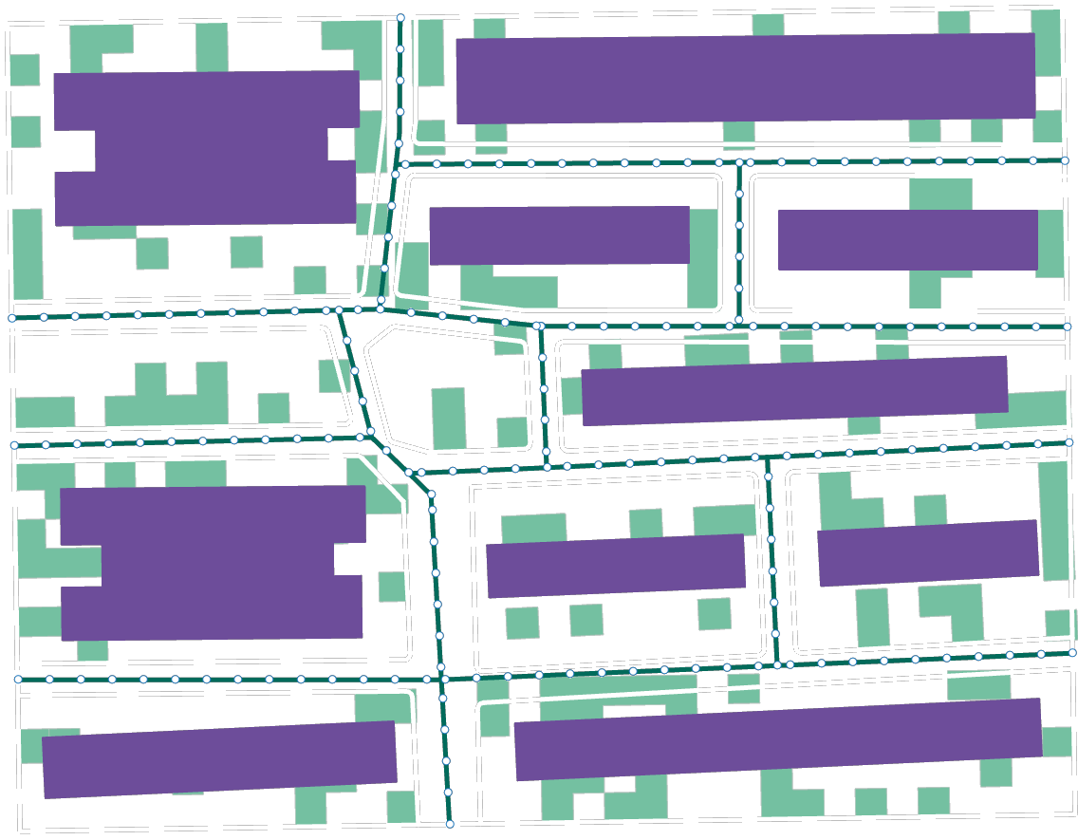
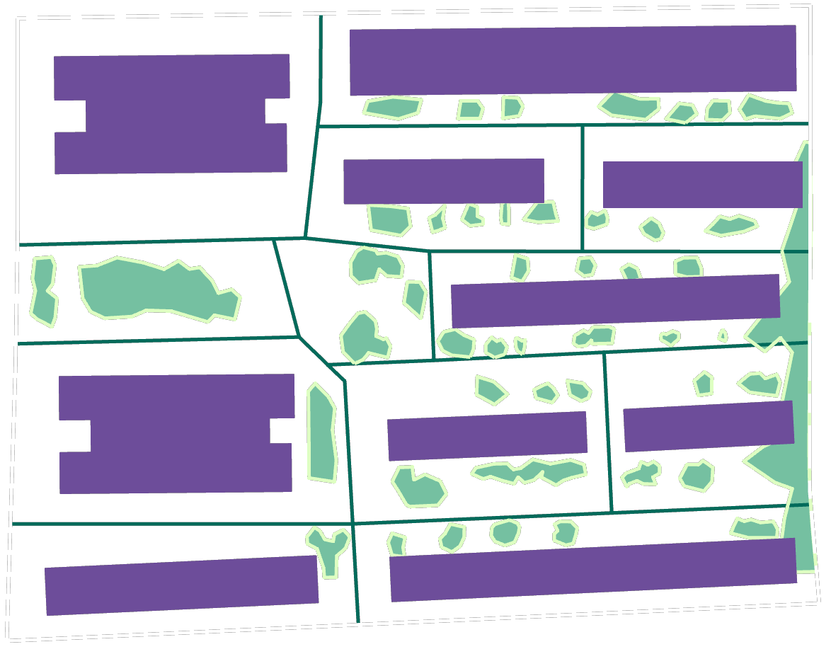
BEFORE AND AFTER OPTIMISATION
^{Current Status Of The Site}
^{Optimized Green Space Layout}
Green Visibility: 0.753
Planned Area: 6476
Green Visibility: 0.972
Green Area: 2488.193
Area Difference: 3987.806
Green Area: 5239.824
Area Difference: 1236.175

Slide 18
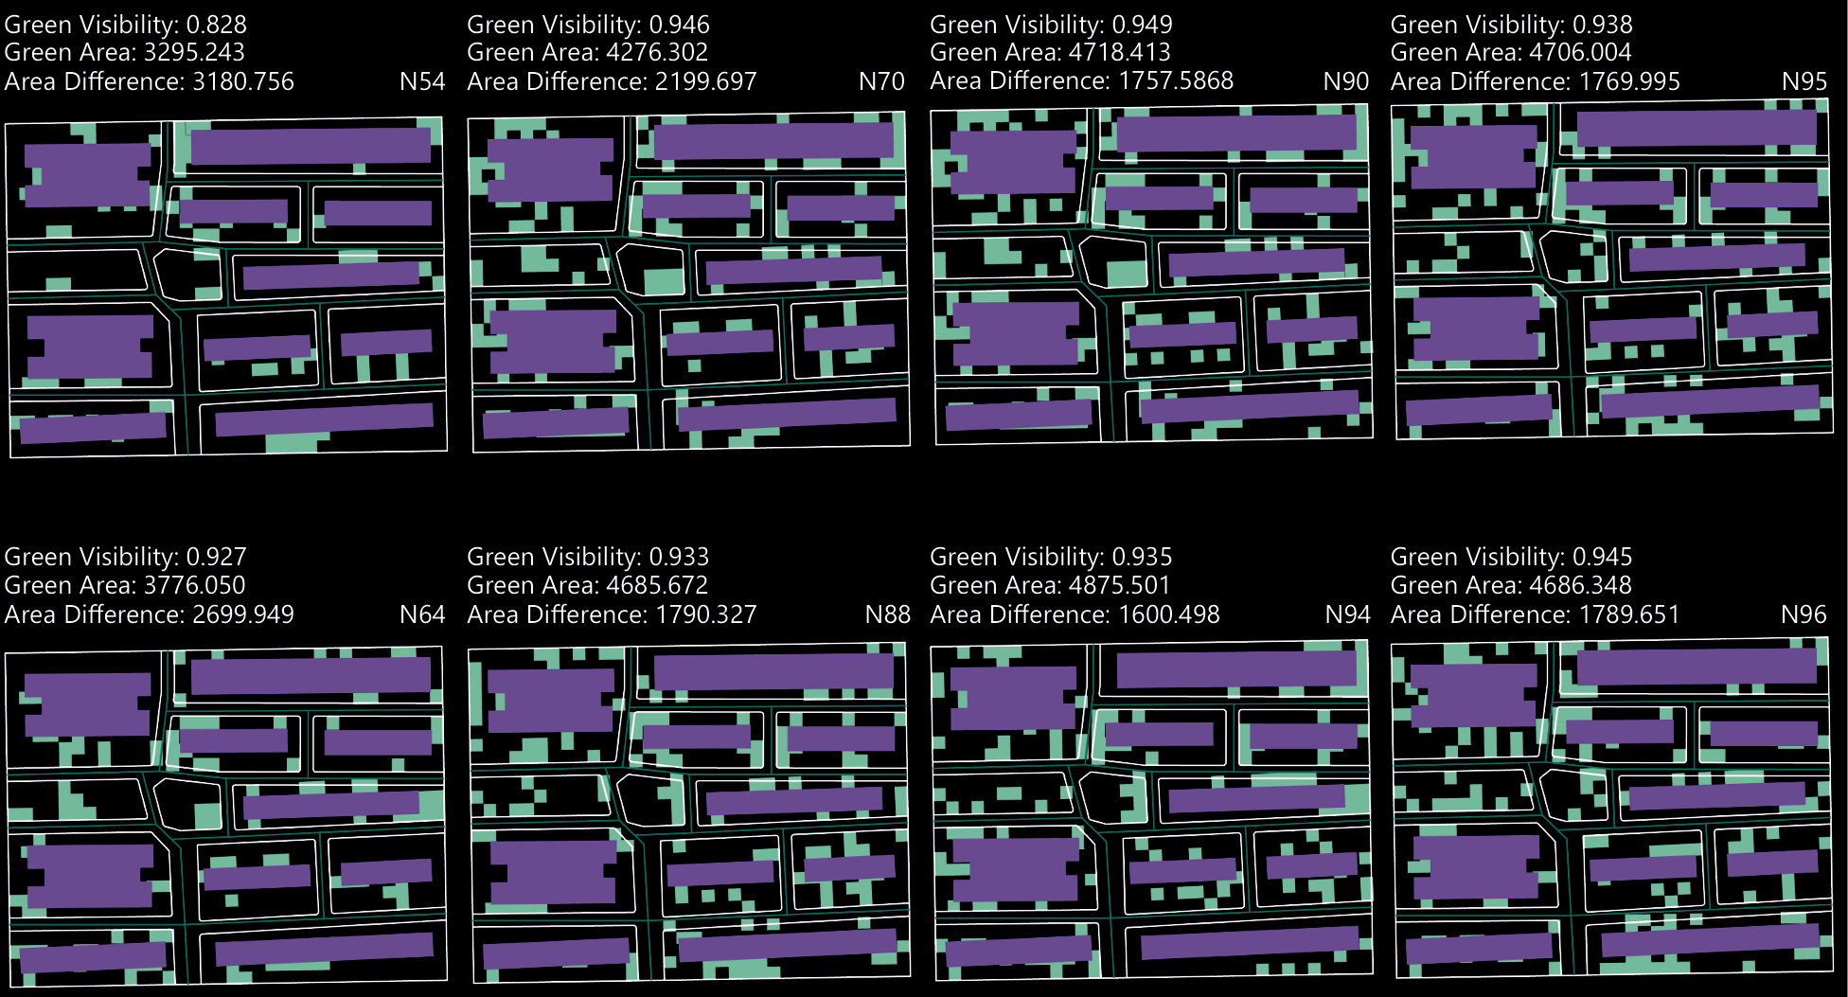
INBETWEEN GENERATED RESULTS COMPARISONS

Slide 19
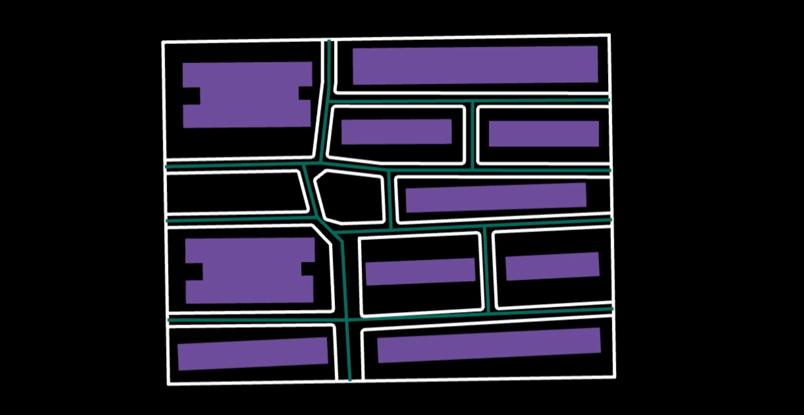
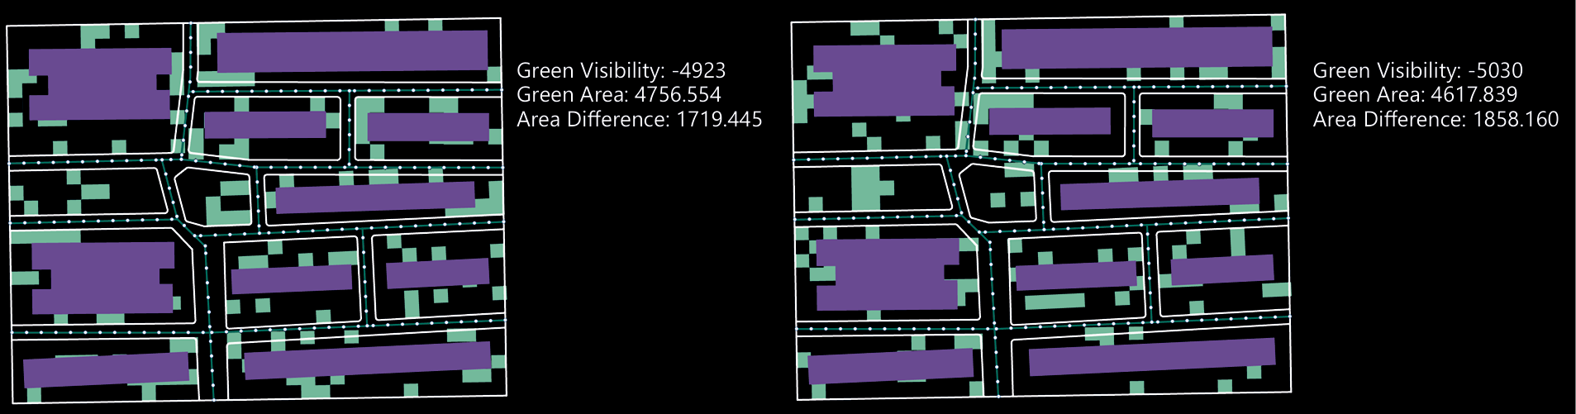
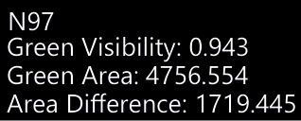
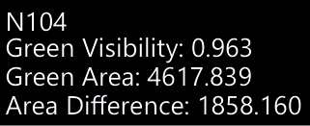
EVALUATE SOLUTIONS

Slide 20
FUTURE WORK & LIMITATIONS
Lack of Parameter Calibration in View Analysis
No Control Over Spatial Continuity or Shape of Green Areas
No integration with Environmental or Behavioral Data:
The optimization is static and does not respond to external data such as sunlight, wind, or pedestrian movement, Future work could integrate real-time or context-aware inputs to enable adaptive green space planning
Limited Evaluation Dimensions:
The optimization currently considers only visual exposure and area compliance. Other important aspects such as accessibility usability, sunlight exposure, and acoustic buffering are not yet incorporated into the fitness evaluation.

Slide 21
THANKS FOR LISTENING
Rui Gu

