Slide 1
Data Structures and Algorithms (CSE2001)
MODULE 4
INTRODUCTION TO ALGORITHMS
1-<number>

Slide 2
What is an algorithm?
An algorithm is a sequence of unambiguous instructions for solving a problem, i.e., for obtaining a required output for any legitimate input in a finite amount of time.
Notion of Algorithm
problem
algorithm
input
“computer”
output
1-<number>

Slide 3
Features/ Properties of Algorithm
Input: Should accept 0 or more inputs
Output: Should produce at least one output
Effectiveness: Every instruction should transform the given I/P to desired output
Finiteness/termination: Algorithm should terminate after finite number of steps
Definiteness: Each Instruction should be clear and unambiguous
1-<number>

Slide 4
Why study algorithms?
Theoretical importance
  the core of computer science
Practical importance
  A practitioner’s toolkit of known algorithms
  Framework for designing and analyzing algorithms for new problems
Example: Google’s PageRank Technology
1-<number>

Slide 5
Analysis of algorithms
How good is the algorithm?
  time efficiency
  space efficiency
Does there exist a better algorithm?
  lower bounds
  optimality
1-<number>

Slide 6
Algorithm design strategies
Brute force
Divide and conquer
Decrease and conquer
Transform and conquer
Greedy approach
Dynamic programming
Backtracking and branch-and-bound
Space and time tradeoffs
1-<number>

Slide 7
Theoretical analysis of time efficiency
Time efficiency is analyzed by determining the number of
repetitions of the basic operation as a function of input size
Basic operation: the operation that contributes the most towards the running time of the algorithm
T(n) ≈ c_{op}C(n)
input size
running time
execution time
for basic operation
or cost
Number of times basic operation is executed
Note: Different basic operations may cost differently!

Slide 8
Input size and basic operation examples
Problem | Input size measure | Basic operation
Searching for key in a list of n items | Number of list’s items, i.e. n | Key comparison
Multiplication of two matrices | Matrix dimensions or total number of elements | Multiplication of two numbers
Checking primality of a given integer n | n’size = number of digits (in binary representation) | Division
Typical graph problem | #vertices and/or edges | Visiting a vertex or traversing an edge

Slide 9
Best-case, average-case, worst-case
For some algorithms, efficiency depends on form of input:
Worst case: C_{worst}(n) – maximum over inputs of size n
Best case: C_{best}(n) – minimum over inputs of size n
Average case: C_{avg}(n) – “average” over inputs of size n
  Number of times the basic operation will be executed on typical input
  NOT the average of worst and best case

Slide 10
Order of growth
As the value of n(input size) increases, time required for execution also increases i.e., behavior of algorithm changes with the increase in the value of n. This change in the behavior is called orders of growth
Most important: Order of growth within a constant multiple as n→∞
Example:
  How much faster will algorithm run on computer that is twice as fast?
  How much longer does it take to solve problem of double input size?
Notes:
Example: cn²
how much faster on twice as fast computer? (2)
how much longer for 2n? (4)

Slide 11
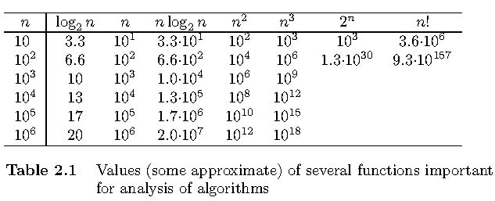
Values of some important functions as n → ∞

Slide 12
Basic asymptotic efficiency classes
1 | constant
log n | logarithmic
n | linear
n log n | n-log-n
n² | quadratic
n³ | cubic
2^{n} | exponential
n! | factorial

Slide 13
Asymptotic order of growth
A way of comparing functions that ignores constant factors and small input sizes (because?)
O(g(n)): class of functions f(n) that grow no faster than g(n)
Θ(g(n)): class of functions f(n) that grow at same rate as g(n)
Ω(g(n)): class of functions f(n) that grow at least as fast as g(n)

Slide 14
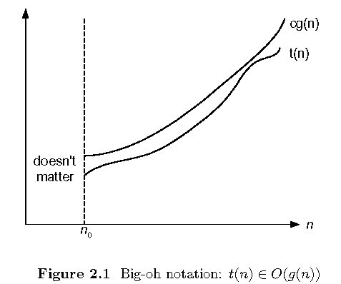
Big-oh

Slide 15
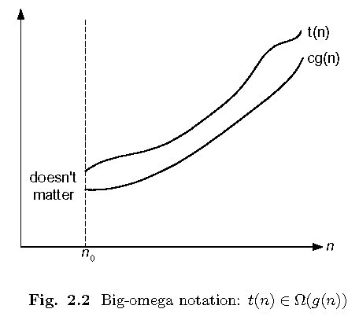
Big-omega

Slide 16
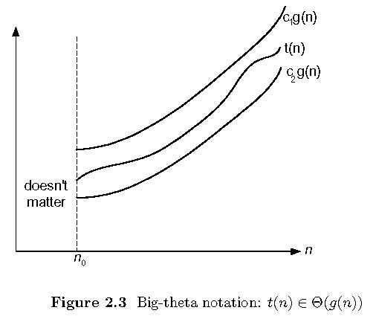
Big-theta

Slide 17
Establishing order of growth using the definition
Definition: f(n) is in O(g(n)), denoted f(n) ∈ O(g(n)), if order of growth of f(n) ≤ order of growth of g(n) (within constant multiple), i.e., there exist positive constant c and non-negative integer n₀ such that
f(n) ≤ c g(n) for every n ≥ n₀
Examples:
10n is in O(n²)
5n+20 is in O(25n)
Notes:
Examples:
10n is O(n²)
since 10n ≤ 10n² for n ≥ 1 or 10n ≤ n² for n ≥ 10
c n₀
5n+20 is O(10n)
since 5n+20 ≤ 10 n for n ≥ 4
c n₀

Slide 18
O-notation
Formal definition
  A function t(n) is said to be in O(g(n)), denoted t(n) ∈ O(g(n)), if t(n) is bounded above by some constant multiple of g(n) for all large n, i.e., if there exist some positive constant c and some nonnegative integer n₀ such that
  t(n) <= cg(n) for all n ≥ n₀
Exercises: prove the following using the above definition
  10n² ∈ Ω(n²)
  0.1n²∈ Ω(n³)

Slide 19
Ω-notation
Formal definition
  A function t(n) is said to be in Ω(g(n)), denoted t(n) ∈ Ω(g(n)), if t(n) is bounded below by some constant multiple of g(n) for all large n, i.e., if there exist some positive constant c and some nonnegative integer n₀ such that
  t(n) ≥ cg(n) for all n ≥ n₀
Exercises: prove the following using the above definition
  10n² ∈ Ω(n²)
  0.3n² - 2n ∈ Ω(n²)
  0.1n³ ∈ Ω(n²)

Slide 20
Θ-notation
Formal definition
  A function t(n) is said to be in Θ(g(n)), denoted t(n) ∈ Θ(g(n)), if t(n) is bounded both above and below by some positive constant multiples of g(n) for all large n, i.e., if there exist some positive constant c₁ and c₂ and some nonnegative integer n₀ such that
  c₂ g(n) ≤ t(n) ≤ c₁ g(n) for all n ≥ n₀
Exercises: prove the following using the above definition
  10n² ∈ Θ(n²)
  (1/2)n(n+1) ∈ Θ(n²)

Slide 21
Time efficiency of nonrecursive algorithms
General Plan for Analysis
Decide on parameter n indicating input size
Identify algorithm’s basic operation
Determine worst, average, and best cases for input of size n
Set up a sum for the number of times the basic operation is executed. Apply rules/formulas to deduce efficiency and represent the same using asymptotic notations

Slide 22
Useful summation formulas and rules
Σ_{l≤i≤n}1 = 1+1+…+1 = n - l + 1
In particular, Σ_{l≤i≤n}1 = n - 1 + 1 = n ∈ Θ(n)
Σ_{1≤i≤n} i = 1+2+…+n = n(n+1)/2 ≈ n²/2 ∈ Θ(n²)
Σ_{1≤i≤n} i² = 1²+2²+…+n² = n(n+1)(2n+1)/6 ≈ n³/3 ∈ Θ(n³)
Σ_{0≤i≤n} a^{i} = 1 + a +…+ a^{n} = (a^{n+1} - 1)/(a - 1) for any a ≠ 1
In particular, Σ_{0≤i≤n} 2^{i} = 2⁰ + 2¹ +…+ 2^{n} = 2^{n+1} - 1 ∈ Θ(2^{n} )
Σ(a_{i} ± b_{i} ) = Σa_{i} ± Σb_{i} Σca_{i} = cΣa_{i} Σ_{l≤i≤u}a_{i} = Σ_{l≤i≤m}a_{i} + Σ_{m+1≤i≤u}a_{i}

Slide 23
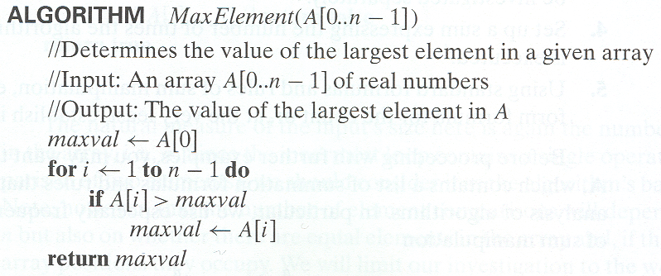
Example 1: Maximum element
T(n) = Σ1≤i≤n-1 1 = n-1 = Θ(n) comparisons

Slide 24
Plan for Analysis of Recursive Algorithms
Decide on a parameter indicating an input’s size.
Identify the algorithm’s basic operation.
Check whether the number of times the basic op. is executed may vary on different inputs of the same size. (If it may, the worst, average, and best cases must be investigated separately.)
Set up a recurrence relation with an appropriate initial condition expressing the number of times the basic op. is executed.
Solve the recurrence (or, at the very least, establish its solution’s order of growth) by backward substitutions or another method.

Slide 25
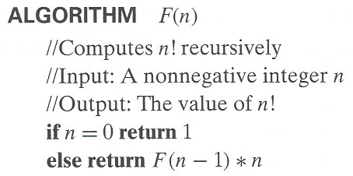
Example 1: Recursive evaluation of n!
Definition: n ! = 1 ∗ 2 ∗ … ∗(n-1) ∗ n for n ≥ 1 and 0! = 1
Recursive definition of n!: F(n) = F(n-1) ∗ n for n ≥ 1 and
F(0) = 1
Size: n
Basic operation:
multiplication
Recurrence relation:
M(n)=M(n-1) + 1
M(0) = 0
Notes:
Note the difference between the two recurrences. Students often confuse these!
F(n) = F(n-1) n
F(0) = 1
for the values of n!
------------
M(n) =M(n-1) + 1
M(0) = 0
for the number of multiplications made by this algorithm

Slide 26
Solving the recurrence for M(n)
M(n) = M(n-1) + 1, M(0) = 0
M(n) = M(n-1) + 1
= (M(n-2) + 1) + 1 = M(n-2) + 2
= (M(n-3) + 1) + 2 = M(n-3) + 3
…
= M(n-i) + i
= M(0) + n
= n
The method is called backward substitution.

Slide 27
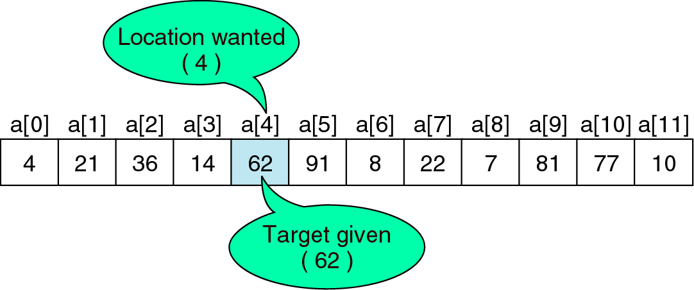
Searching
The process uses to find the location of a target among the list of objects. In array, find the location ( index) of the first element in the array given the value.
Searching algorithms:
1. Sequential Search – used when list is unordered
2. Binary Search – list is ordered
Search Concept

Slide 28
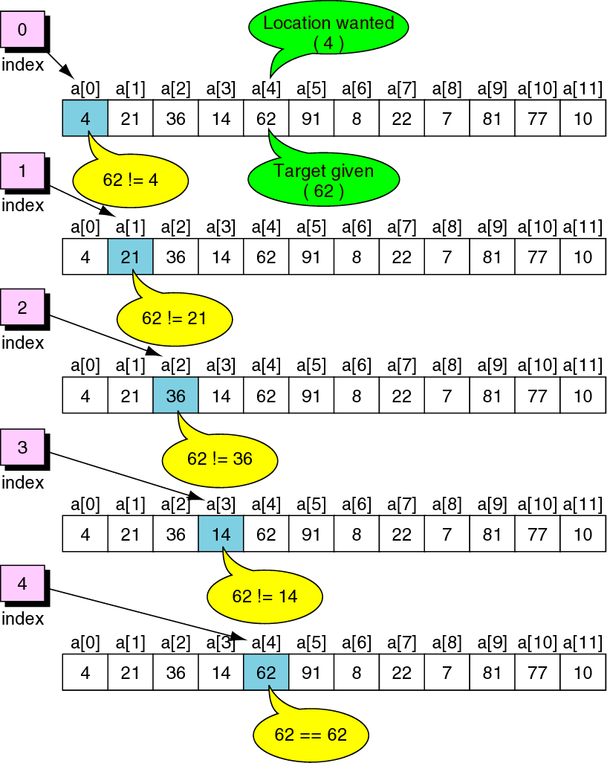
Sequential Search concept – Locating data in unordered list

Slide 29
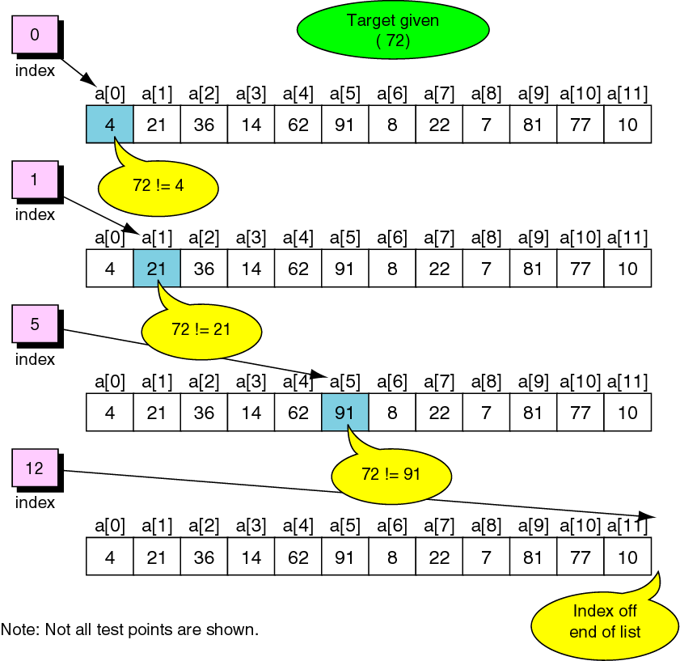
Sequential Search concept – Unsuccessful search in unordered list

Slide 30
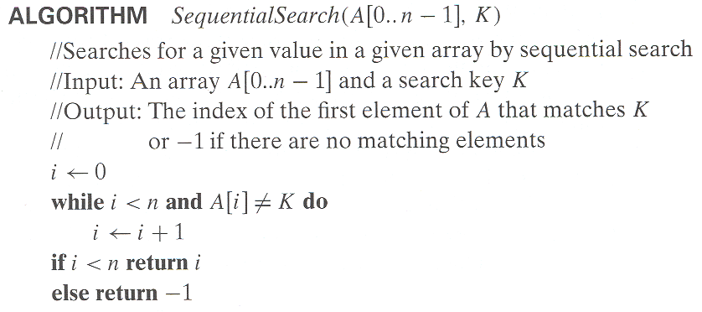
Sequential Search Algorithm and Efficiency
Efficiency:
Worst case : n key comparisons. O(n)
Best case : 1 key comparison. Ω(1)
Average case: (n+1)/2, key comparisions. Θ(n/2)
(assuming Search is successful)

Slide 31
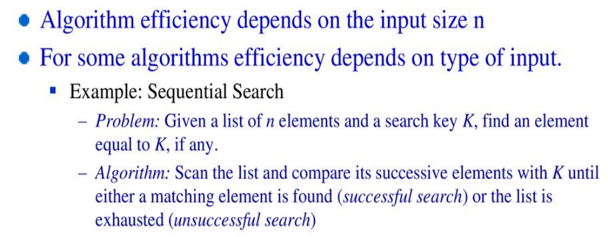
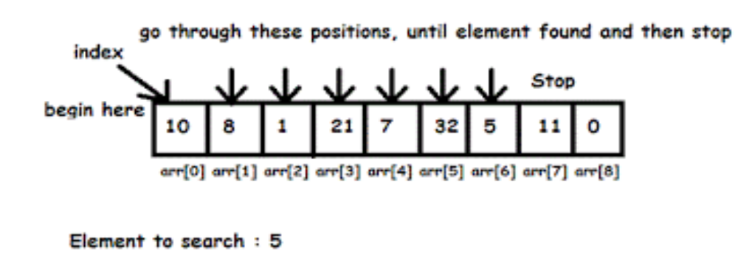
Sequential Search (Uses Brute Force Technique)
Example

Slide 32
Binary Search
Very efficient algorithm for searching in sorted array:
K
vs
A[0] . . . A[m] . . . A[n-1]
If K = A[m], stop (successful search); otherwise, continue
searching by the same method in A[0..m-1] if K < A[m]
and in A[m+1..n-1] if K > A[m]
l ← 0; r ← n-1
while l ≤ r do
m ← ⎣(l+r)/2⎦
if K = A[m] return m
else if K < A[m] r ← m-1
else l ← m+1
return -1

Slide 33
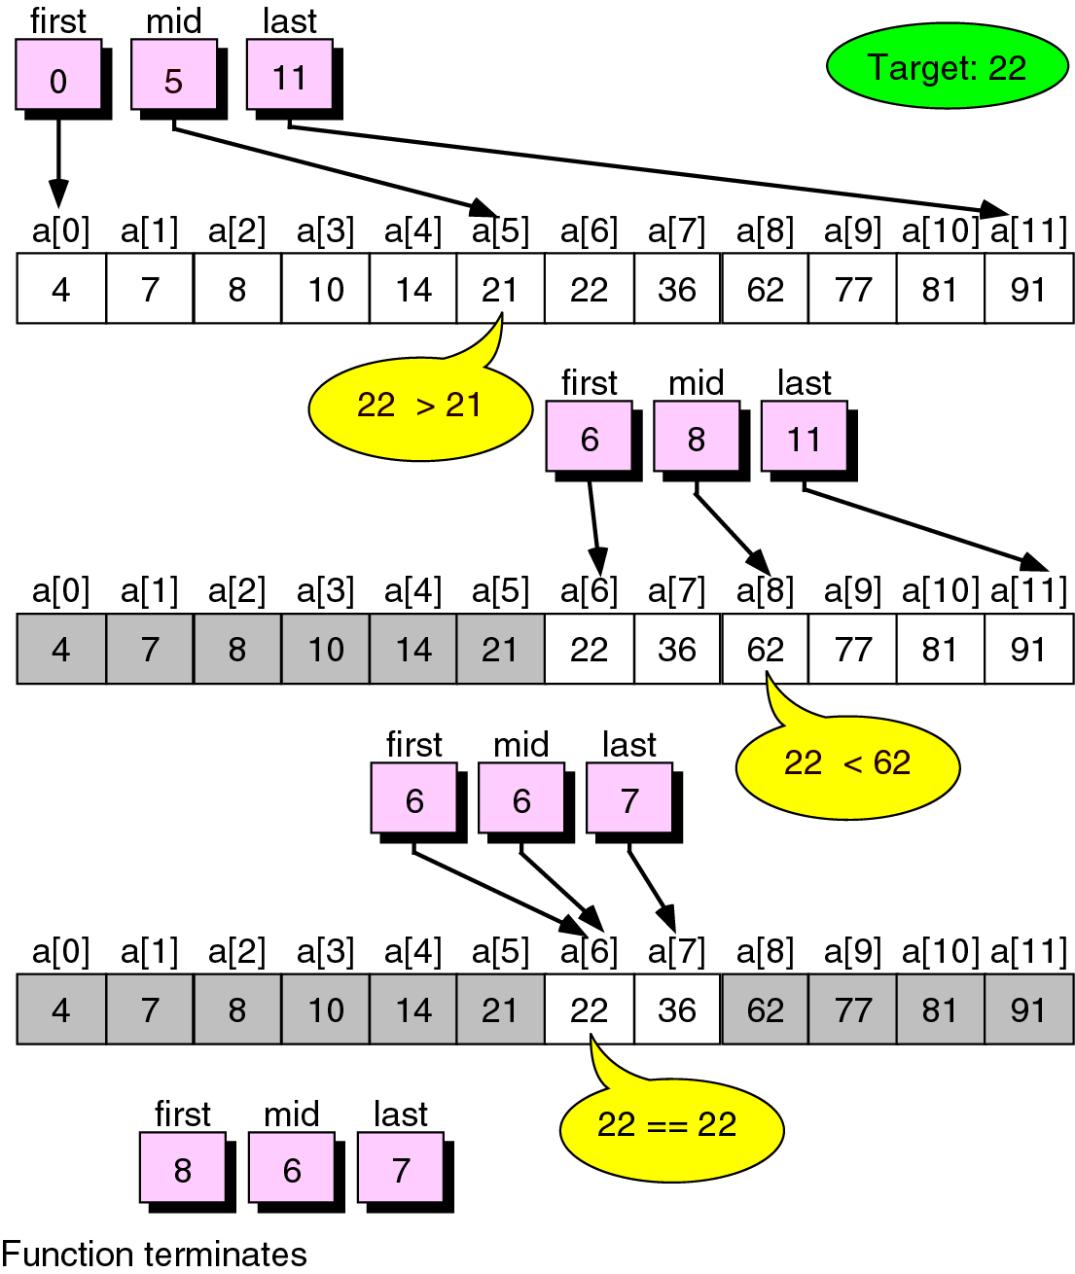
Binary Search Example

Slide 34
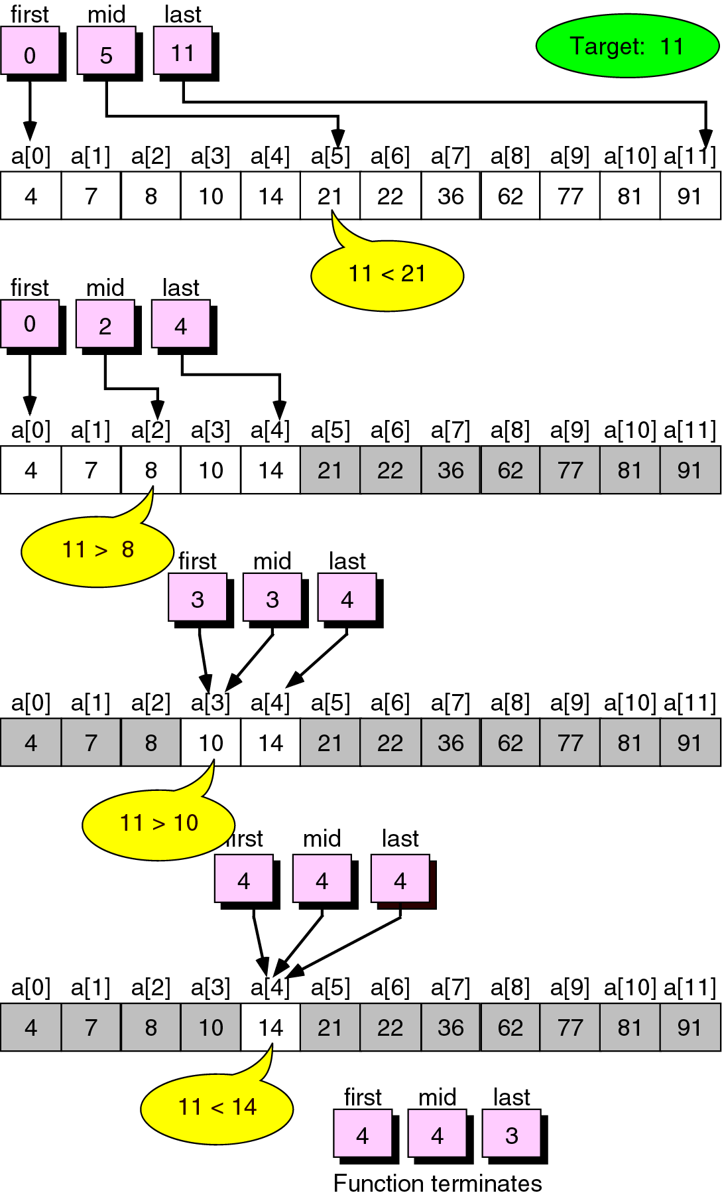
Unsuccessful Binary Search Example

Slide 35
Analysis of Binary Search
Time efficiency
  worst-case using recurrence equation:
  T(n)= 1 if n=1
  T(n/2) +1 otherwise
  Where,
  T(n/2) : time required to search either left or right part of the array
  1 represents time required to compare middle element
  By using recurrence equation:
  T(n)= T(n/2)+1……(1)
  Solve Eq (1) using Master’s theorem
  a=1, b=2 and d= 0 (Because 1 in eq (1) can be written as n^0=1
  a=b=1 So case If a = b^{d},
  T(n) ∈O(n^{d} log n)
  T(n) ∈ O(n⁰ log n)
  T(n) ∈ O(log n)

Slide 36
Average case is: Θ(log n)
Best case is: Ω(1) the best case occurs when the element to be searched is present in the middle of the array.
Optimal for searching a sorted array
Limitations: must be a sorted array (not linked list)
Bad (degenerate) example of divide-and-conquer
because only one of the sub-instances is solved

Slide 37
Insertion Sort
Idea: like sorting a hand of playing cards
Start with an empty left hand and the cards facing down on the table.
Remove one card at a time from the table, and insert it into the correct position in the left hand
compare it with each of the cards already in the hand, from right to left
The cards held in the left hand are sorted
these cards were originally the top cards of the pile on the table

Slide 38
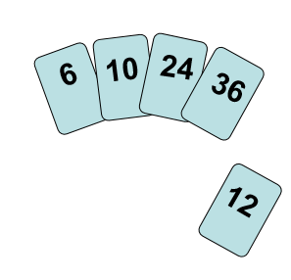
To insert 12, we need to make room for it by moving first 36 and then 24.

Slide 39
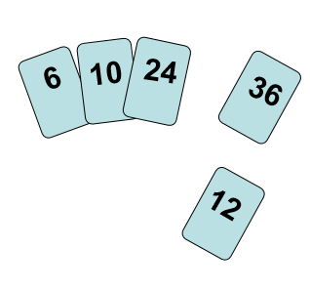
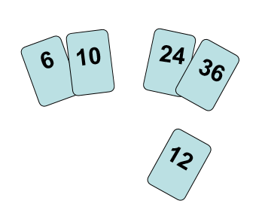

Slide 40
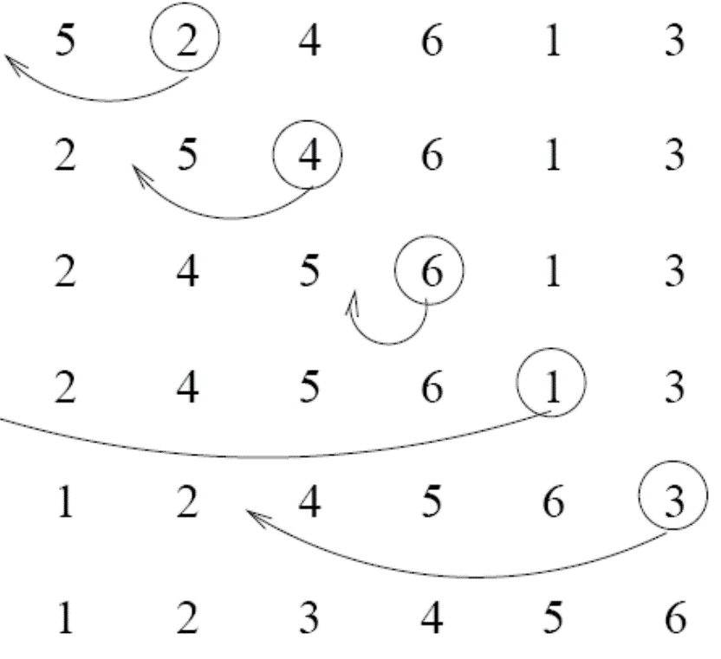





Example

Slide 41
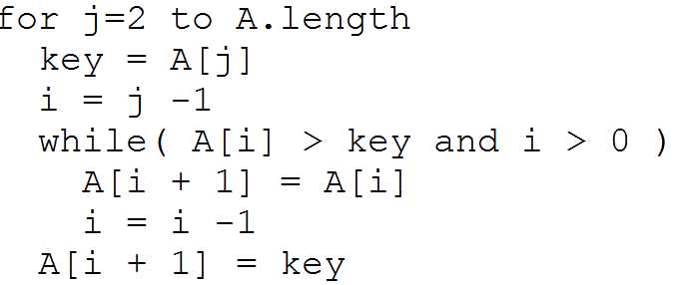
Insertion Sort Algorithm
  Θ(n²) running time in worst and average case

Slide 42
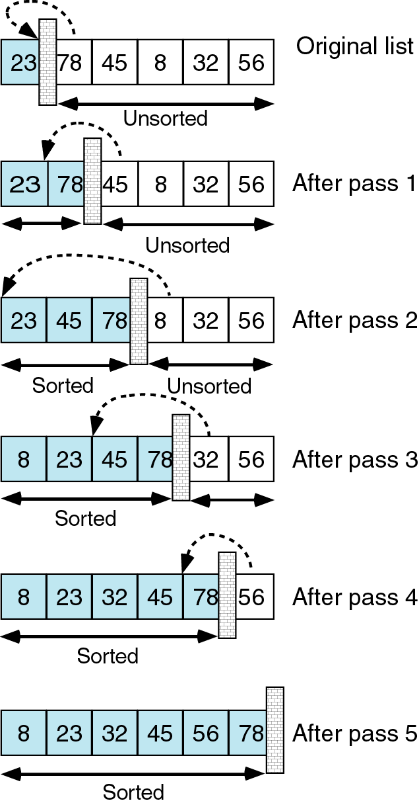
Insertion Sort Example

Slide 43
Selection Sort
Algorithm SelectionSort(A[0..n-1])
//The algorithm sorts a given array by selection sort
//Input: An array A[0..n-1] of orderable elements
//Output: Array A[0..n-1] sorted in ascending order
for i ← 0 to n – 2 do
min ← i
for j ← i + 1 to n – 1 do
if A[j] < A[min]
min ← j
swap A[i] and A[min]
1-<number>

Slide 44
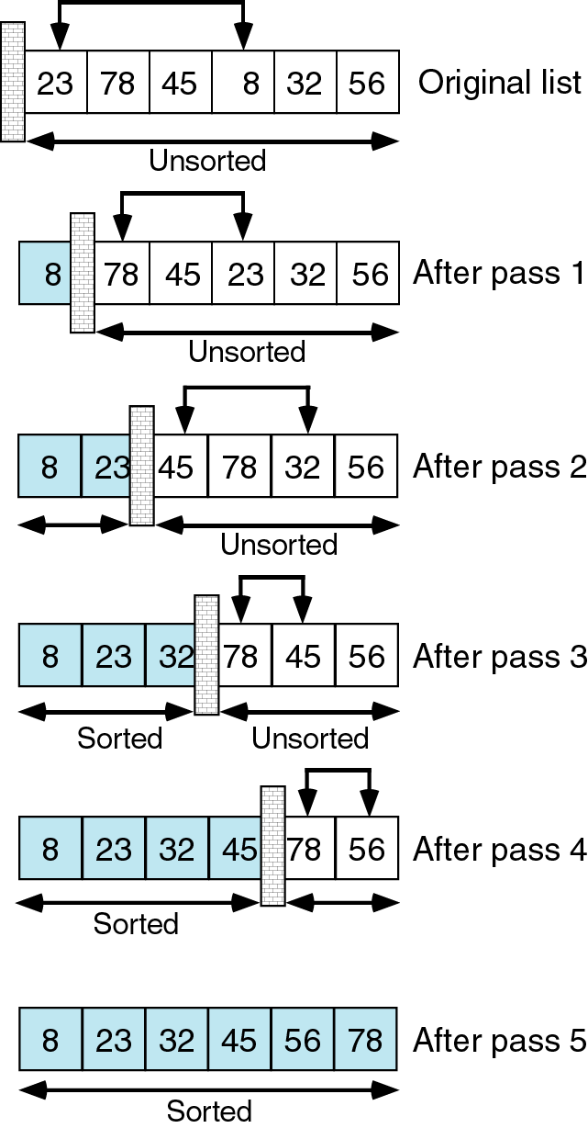
Selection Sort Example

Slide 45
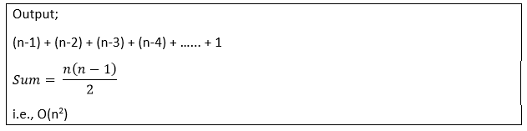
Complexity Analysis of Selection Sort
Input: Given n input elements.
Output: Number of steps incurred to sort a list.
Logic: If we are given n elements, then in the first pass, it will do n-1 comparisons; in the second pass, it will do n-2; in the third pass, it will do n-3 and so on. Thus, the total number of comparisons can be found by;

