Slide 1
Introduction to Graph Theory
1

Slide 2
Graph Theory
A branch of mathematics that explores the relationships between various entities, represented as nodes, connected by edges.
1

Slide 3
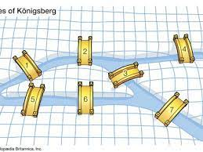
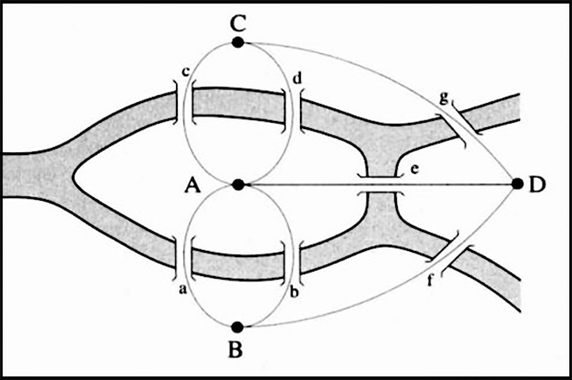
Origin
Euler's Problem (1736):
Graph theory originated from Euler's Seven Bridges of Königsberg problem, where he aimed to find a walk through the city that would cross each of its seven bridges once and only once.
1

Slide 4
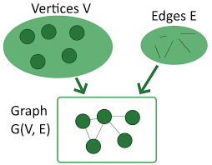
Basic Concepts
Vertex (Node): Represents an object or entity.
Edge: Represents a connection between vertices.
Graph: A graph G is a pair (V, E). It is collection of vertices and edges.
V: set of vertices
E: set of edges connecting the vertices in V
1

Slide 5
The graph has 4 vertices namely v1, v2, v3, v4
& 6 edges namely e1, e2, e3, e4, e5, e6
Then e1=(v1, v2)
Similarly for other edges.
In short, we can represent G=(V,E)
where V=(v1, v2, v3, v4) &
E=(e1, e2, e3, e4, e5, e6 )
_{v1}
e1
e2
_{v2}
_{v4}
e3
e5
e4
_{v3}
e6

Slide 6
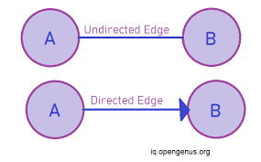
Definitions
Directed edge:
The edge with arc / directions/ arrow is referred to directed edge.
Each directed edge connects an ordered pair of vertices, indicating a one-way relationship or connection from one vertex to another.
Undirected edge:
The edge with out arc / directions/ arrow is referred to undirected edge.
instead, they simply connect pairs of vertices, indicating a mutual connection or relationship.

Slide 7
Types of Graphs
Directed Graph (Digraph)
Undirected Graph
Weighted Graph
Unweighted Graph
Bipartite Graph
1

Slide 8
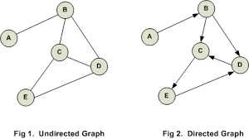
When the edges in a graph have no direction, thegraph is called
undirected
Directed Graph (Digraph)
A graph in which all the edges are directed is called as a directed graph.
In other words, all the edges of a directed graph contain some direction.
Directed graphs are also called as digraphs.
1

Slide 9
Undirected Graph (Simple Graph)
A graph in which all the edges are undirected is called as a non-directed graph.
In other words, edges of an undirected graph do not contain any direction.

Slide 10
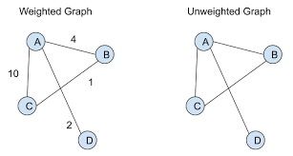
Weighted Graph
A graph in which a number (the weight) is assigned to each edge is called as weighted graph.
Such weights might represent for example costs, lengths or capacities, depending on the problem at hand.

Slide 11
Unweighted Graph
A graph in which no weight is assigned to edges is called as unweighted graph.

Slide 12
Bipartite Graph
In a simple graph G, if V can be partitioned into two disjoint sets V₁ and V₂ such that every edge in the graph connects a vertex in V₁ and a vertex V₂ (so that no edge in G connects either two vertices in V₁ or two vertices in V₂)
Example: V₁ = {v₁, v₂, v₃} and V₂ = {v₄, v₅, v₆},
v₁
v₄
v₂
v₅
v₃
v₆

Slide 13
Terminology
Loop: A loop is an edge whose endpoints are equal i.e., an edge joining a vertex to it self is called a loop. Represented as {u, u} = {u}
Multiple Edges: Two or more edges joining the same pair of vertices.
u

Slide 14
Terminology – Undirected graphs
u and v are adjacent if {u, v} has an edge. Then, e is called incident with u and v. u and v are called endpoints.
Degree of Vertex (deg (v)): The number of edges incident on a vertex.
Pendant Vertex: deg (v) =1
Isolated Vertex: deg (k) = 0
Example: For V = {u, v, w} , E = { {u, w}, {u, v} }, deg (u) = 2, deg (v) = 1, deg (w) = 1, deg (k) = 0, w and v are pendant , k is isolated
u
v
k
w

Slide 15
Terminology – Directed graphs
For the edge (u, v), u is adjacent to v OR v is adjacent from u, u – Initial vertex, v – Terminal vertex
In-degree (deg⁻ (u)): number of edges for which u is terminal vertex
Out-degree (deg⁺ (u)): number of edges for which u is initial vertex
Note: A loop contributes 1 to both in-degree and out-degree (why?)
Example: For V = {u, v, w} , E = { (u, w), ( v, w), (u, v) }, deg⁻ (u) = 0, deg⁺ (u) = 2, deg⁻ (v) = 1, deg⁺ (v) = 1, and deg⁻ (w) = 2, deg⁺ (u) = 0
u
v
w

Slide 16
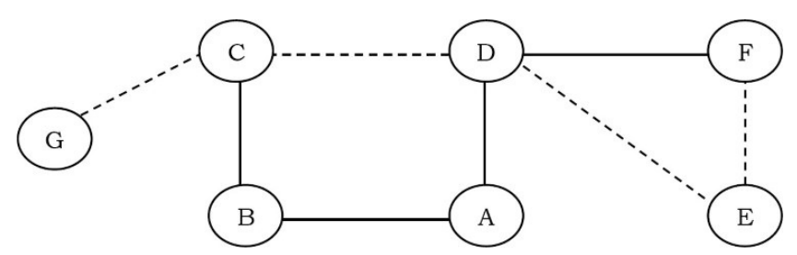
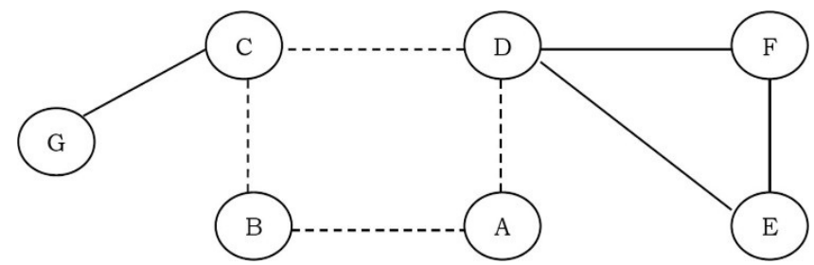
Terminology
Path: A path in a graph is a sequence of adjacent vertices. Simple path is a path with no repeated vertices. In the graph below, the dotted lines represent a path from G to E.
Cycle: A cycle is a path where the first and last vertices are the same. A simple cycle is a cycle with no repeated vertices or edges (except the first and last vertices).

Slide 17
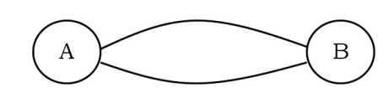
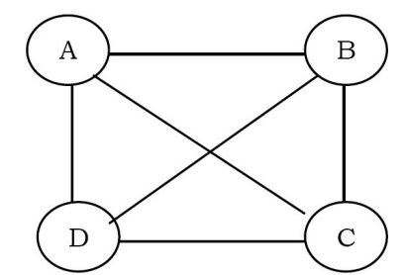
Terminology
Parallel Edges: Two edges are parallel if they connect the same pair of vertices
Complete graph: is an undirected graph in which every pair of distinct vertices is connected by a unique edge.

Slide 18
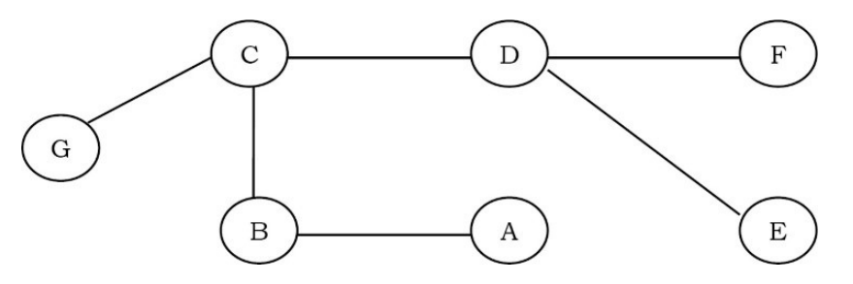
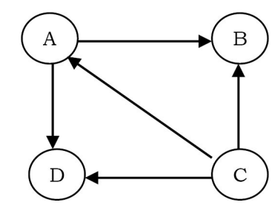
Terminology
Acyclic Graph : A graph with no cycles. A tree is an acyclic connected graph.
Directed acyclic graph [DAG]: A directed graph with no cycles.

Slide 19
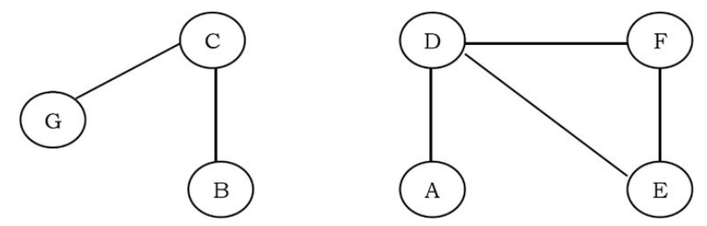
Terminology
Connected Graph: A graph is connected if there is a path from every vertex to every other vertex.
• If a graph is not connected then it consists of a set of connected components.

Slide 20
Graph Representation
To manipulate graphs we need to represent them in some useful form.
There are three ways of doing this:
• Adjacency Matrix
• Adjacency List
• Adjacency Set

Slide 21
Adjacency Matrix
An N x N matrix, where |V| = N , the Adjacenct Matrix (NxN) A = [a_{ij}]
For undirected graph
For directed graph
This makes it easier to find subgraphs, and to reverse graphs if needed.
The adjacency matrix representation is good if the graphs are dense.

Slide 22
Adjacency Matrix (Contd..)
Example: Undirected Graph G (V, E)
 | v | u | w
v | 0 | 1 | 1
u | 1 | 0 | 1
w | 1 | 1 | 0
u
v
w

Slide 23
Adjacency Matrix (Contd..)
Example: Directed Graph G (V, E)
 | v | u | w
v | 0 | 1 | 0
u | 0 | 0 | 1
w | 1 | 0 | 0
u
v
w

Slide 24
Adjacency List
This representation is implemented with linked lists
All the vertices connected to a vertex u are listed on an adjacency list for that vertex u.
For each vertex u we use a linked list and list nodes represents the connections between u and other vertices to which u has an edge.
The total number of linked lists is equal to the number of vertices in the graph

Slide 25
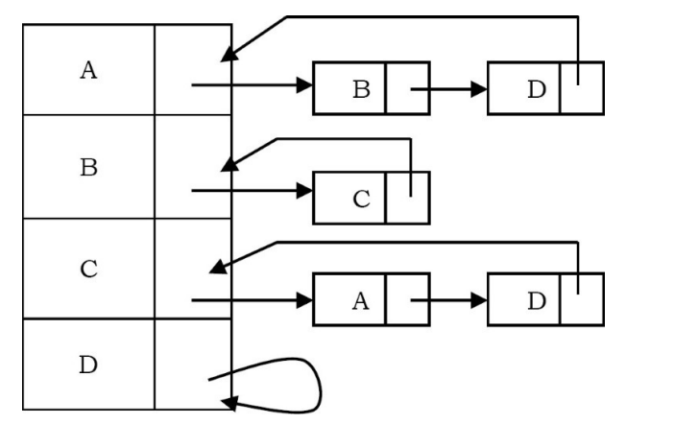
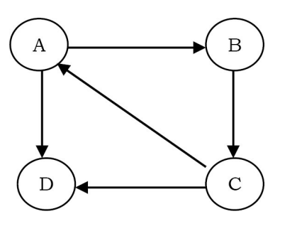
Adjacency List(Contd..)
Example
a. Graph
b. Representation Using Adjacency List
Using adjacency list representation we cannot perform some operations efficiently.

Slide 26
Adjacency Set
It is very much similar to adjacency list but instead of using Linked lists, Disjoint Sets are used.
Example
A
B
D
B
C
C
A
D
D

Slide 27
Applications of Graphs
• Representing relationships between components in electronic circuits • Transportation networks: Highway network, Flight network
• Computer networks: Local area network, Internet, Web
• Databases: For representing ER (Entity Relationship) diagrams in databases, for representing dependency of tables in databases

