Slide 1
DEEPFAKE DETECTION USING DEEP LEARNING
NAME :GURUNATHAN M
ROLL NO : 2019202015
GUIDE BY
Dr. SAIRAMESH L

Slide 2
Objective:
To design and develop a system to classify whether the video is fake or real by using dee learning algorithms.
Notes:
Give a brief overview of the presentation. Describe the major focus of the presentation and why it is important.
Introduce each of the major topics.
To provide a road map for the audience, you can repeat this Overview slide throughout the presentation, highlighting the particular topic you will discuss next.

Slide 3
Why Deep Fake Detection?
Avoid Financial Fraud
Avoid Politician Fake Video
Spreading Fake News
Notes:
Give a brief overview of the presentation. Describe the major focus of the presentation and why it is important.
Introduce each of the major topics.
To provide a road map for the audience, you can repeat this Overview slide throughout the presentation, highlighting the particular topic you will discuss next.

Slide 4
Abstract
It will be a web-based platform for the user to upload the video and classify it as fake or real.
Our method detects such artifacts by comparing the generated face areas and their surrounding regions by splitting the video into frames.
Notes:
Give a brief overview of the presentation. Describe the major focus of the presentation and why it is important.
Introduce each of the major topics.
To provide a road map for the audience, you can repeat this Overview slide throughout the presentation, highlighting the particular topic you will discuss next.

Slide 5
And extracting the features with a ResNext Convolutional Neural Network (CNN) and using Long Short Term Memory(LSTM) capture the temporal inconsistencies between frames.
To train the ResNext CNN model, we simplify the process by simulating the resolution.
Notes:
Give a brief overview of the presentation. Describe the major focus of the presentation and why it is important.
Introduce each of the major topics.
To provide a road map for the audience, you can repeat this Overview slide throughout the presentation, highlighting the particular topic you will discuss next.

Slide 6
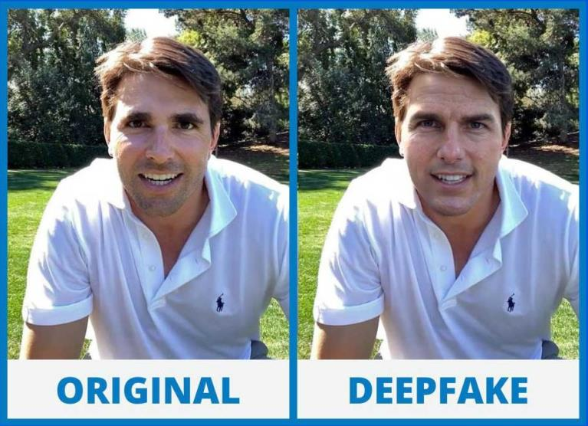
Real and Deepfake video images:
Notes:
Give a brief overview of the presentation. Describe the major focus of the presentation and why it is important.
Introduce each of the major topics.
To provide a road map for the audience, you can repeat this Overview slide throughout the presentation, highlighting the particular topic you will discuss next.

Slide 7
Preprocessing
Splitting video into frames
Face Detection
Face cropping
Creating face cropped video
Notes:
Give a brief overview of the presentation. Describe the major focus of the presentation and why it is important.
Introduce each of the major topics.
To provide a road map for the audience, you can repeat this Overview slide throughout the presentation, highlighting the particular topic you will discuss next.

Slide 8
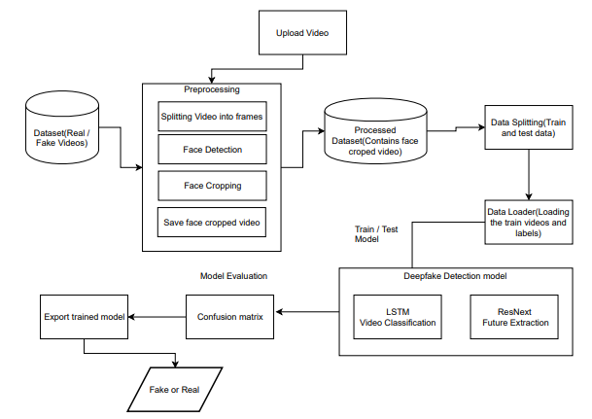
Architecture:
Notes:
Give a brief overview of the presentation. Describe the major focus of the presentation and why it is important.
Introduce each of the major topics.
To provide a road map for the audience, you can repeat this Overview slide throughout the presentation, highlighting the particular topic you will discuss next.

Slide 9
Tools and Technologies
Framework – Django
Development tools – Visual Studio Code,
Google Colab.
Coding Language – python
Notes:
Give a brief overview of the presentation. Describe the major focus of the presentation and why it is important.
Introduce each of the major topics.
To provide a road map for the audience, you can repeat this Overview slide throughout the presentation, highlighting the particular topic you will discuss next.

Slide 10
REFERENCE:
[1] Yuezun Li, Ming-Ching Chang and Siwei Lyu “Exposing AI Created Fake
Videos by Detecting Eye Blinking” in arxiv.
[2] Abhijit Jadhav, Abhishek Patange, Jay Patel, Hitendra Patil, Manjushri Mahajan
“DeepFake Videos using neural networks”in IEEE,2020.
[3] R. Raghavendra, Kiran B. Raja, Sushma Venkatesh, and Christoph Busch, “Transferable deep-CNN features for detecting digital and print-scanned morphed face images,” in CVPRW. IEEE, 2017.
[4] https://www.kaggle.com/c/deepfake-detection-challenge/data

Slide 11
THANK YOU

