Slide 1
1 Carbon bonding and hybridisation
1.1 Carbon and Its Tetravalency
1.2 Hybridisation in Organic Compounds
1.2.1 Types of Carbon Hybridisation
1.3 Determination of Hybridisation
1.3.1 Method I — Number of π Bonds
1.3.2 Method $II$ — Electron-Pair / Steric-Number Method
1.4 Applications of Hybridisation
1.4.1 Size and s-Character of Hybrid Orbitals
1.4.2 Electronegativity of Hybridised Carbon
1.4.2.1 Effect of Hybridisation on C–H Bond Polarisation
1.4.2.2 Effect of Hybridisation on Acidity of C–H Bonds
1.4.3 Bond-Length Variation
1.4.4 Bond Strength in Hydrocarbons

Slide 2
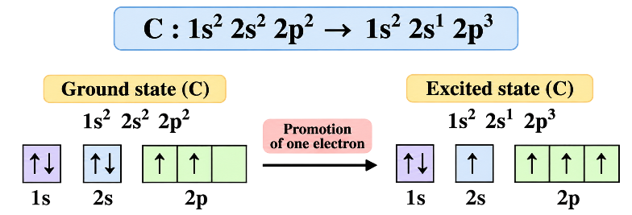
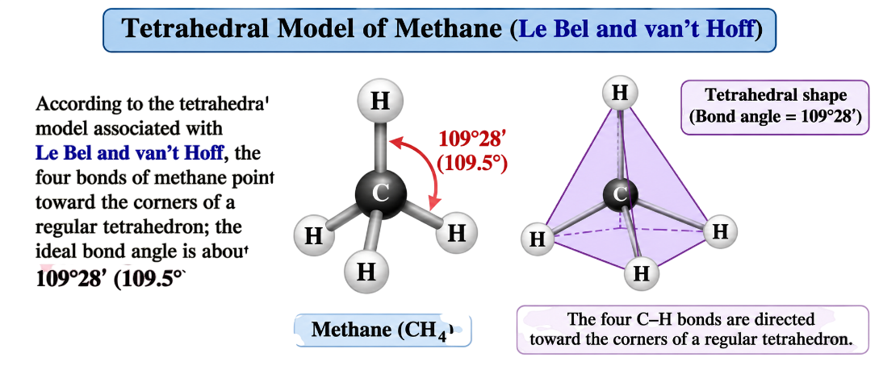
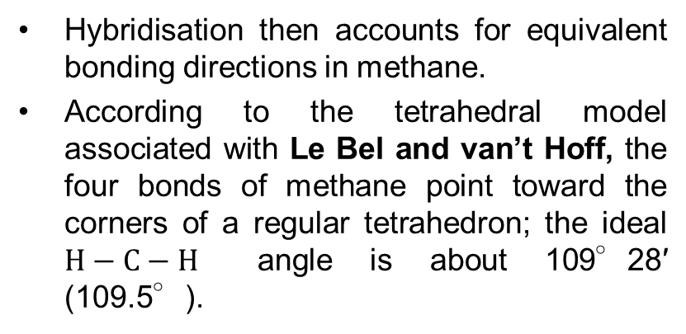
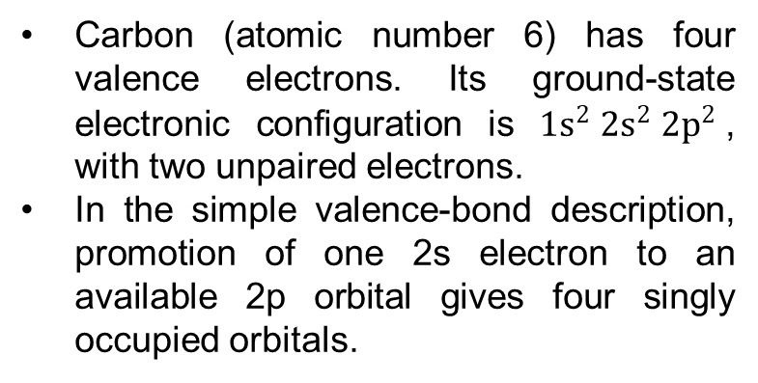
1.1 Carbon and Its Tetravalency
Carbon (atomic number 6) has four valence electrons. Its ground-state electronic configuration is ${1s}^{2} {2s}^{2} {2p}^{2}$, with two unpaired electrons.
In the simple valence-bond description, promotion of one 2s electron to an available 2p orbital gives four singly occupied orbitals.
Hybridisation then accounts for equivalent bonding directions in methane.
According to the tetrahedral model associated with Le Bel and van’t Hoff, the four bonds of methane point toward the corners of a regular tetrahedron; the ideal $H−C−H$ angle is about 109°28′ (109.5°).

Slide 3
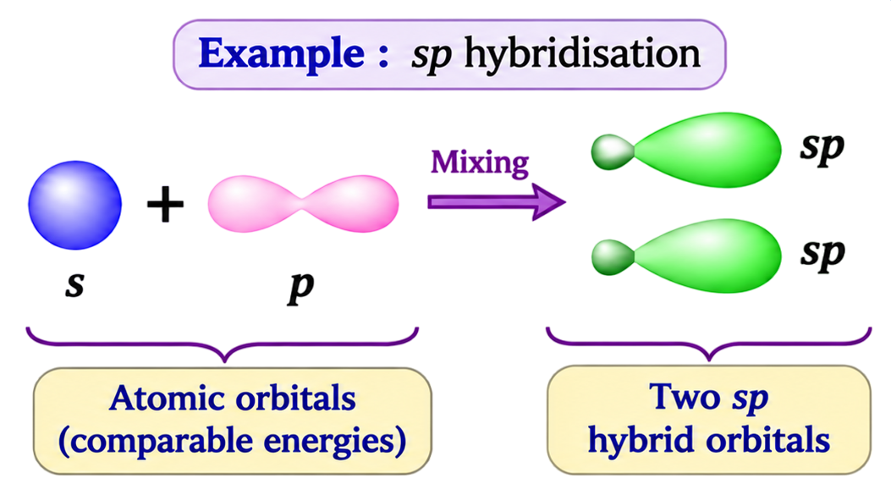
1.2 Hybridisation in Organic Compounds
Hybridisation is the mixing of atomic orbitals of comparable energies on the same atom to produce new orbitals oriented for bonding.
The number of hybrid orbitals formed equals the number of atomic orbitals mixed.

Slide 4
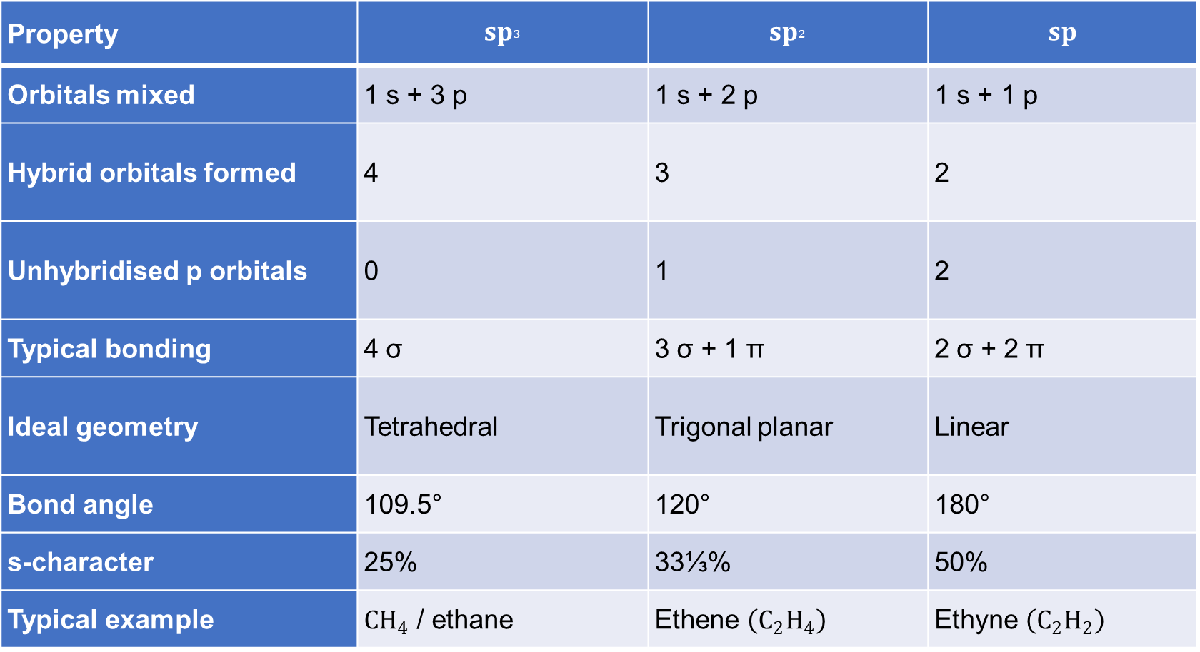
1.2.1 Types of Carbon Hybridisation
Property | $$sp_{³}$$ | $$sp_{²}$$ | $$sp$$
Orbitals mixed | 1 s + 3 p | 1 s + 2 p | 1 s + 1 p
Hybrid orbitals formed | 4 | 3 | 2
Unhybridised p orbitals | 0 | 1 | 2
Typical bonding | 4 σ | 3 σ + 1 π | 2 σ + 2 π
Ideal geometry | Tetrahedral | Trigonal planar | Linear
Bond angle | 109.5° | 120° | 180°
s-character | 25% | 33⅓% | 50%
Typical example | $CH_{4}$ / ethane | Ethene $\left(C_{2}H_{4}\right)$ | Ethyne $\left(C_{2}H_{2}\right)$

Slide 5
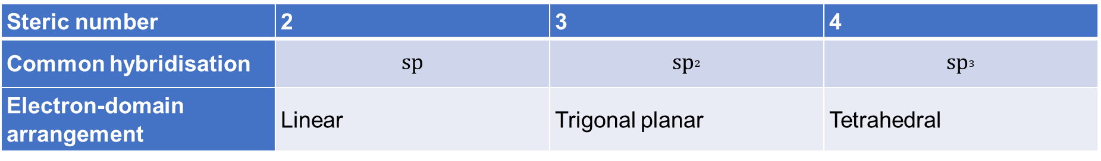
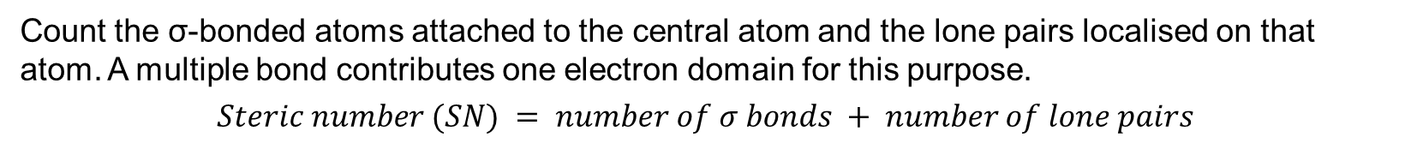
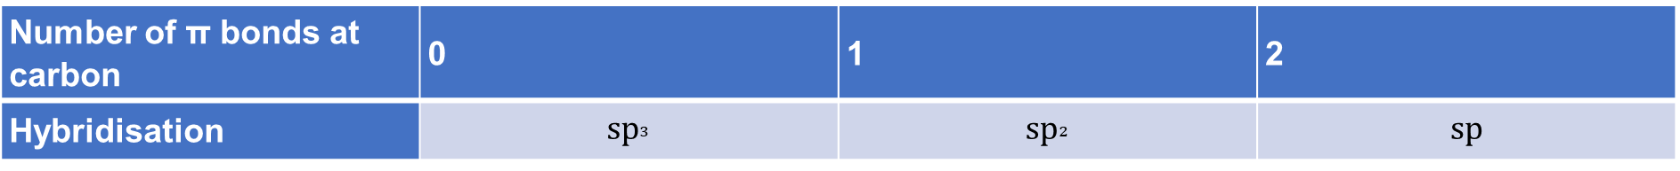
1.3 Determination of Hybridisation
1.3.1 Method I — Number of π Bonds
For a neutral carbon in ordinary hydrocarbons with four bond-order units, the following quick rule is useful:
Number of π bonds at carbon | 0 | 1 | 2
Hybridisation | $$sp_{³}$$ | $$sp_{²}$$ | $$sp$$
1.3.2 Method $II$ — Electron-Pair / Steric-Number Method
Count the σ-bonded atoms attached to the central atom and the lone pairs localised on that atom. A multiple bond contributes one electron domain for this purpose.
$$Steric number (SN) = number of σ bonds + number of lone pairs$$
Steric number | 2 | 3 | 4
Common hybridisation | $$sp$$ | $$sp_{²}$$ | $$sp_{³}$$
Electron-domain arrangement | Linear | Trigonal planar | Tetrahedral

Slide 6

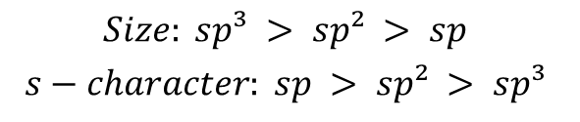
1.4 Applications of Hybridisation
1.4.1 Size and s-Character of Hybrid Orbitals
An orbital with greater s-character is, on average, more concentrated near the nucleus. For carbon hybrid orbitals, the qualitative order of radial extent is:
$$Size: sp³ > sp² > sp$$
$$s−character: sp > sp² > sp³$$
1.4.2 Electronegativity of Hybridised Carbon
Greater s-character holds bonding electrons closer to the carbon nucleus.
Its electrons are held more strongly by the carbon nucleus.
The hybrid orbital is generally more contracted.
Carbon attracts the shared bonding electrons more strongly.
Hence the effective electronegativity of carbon in comparable bonds generally increases in the order:
$$sp > sp² > sp³$$
1.4.2.1 Effect of Hybridisation on C–H Bond Polarisation
1.4.2.2 Effect of Hybridisation on Acidity of C–H Bonds

Slide 7
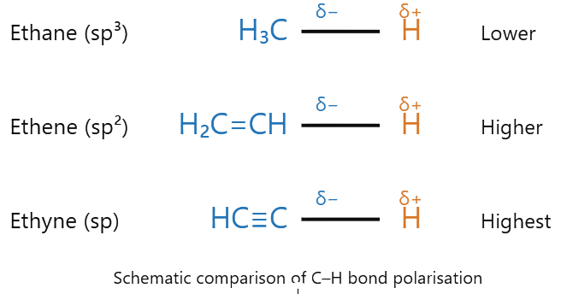
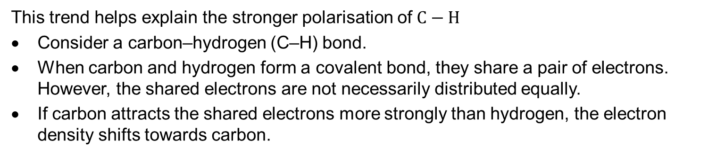
1.4.2.1 Effect of Hybridisation on C–H Bond Polarisation
This trend helps explain the stronger polarisation of $C−H$
Consider a carbon–hydrogen (C–H) bond.
When carbon and hydrogen form a covalent bond, they share a pair of electrons. However, the shared electrons are not necessarily distributed equally.
If carbon attracts the shared electrons more strongly than hydrogen, the electron density shifts towards carbon.
Consequently:
Carbon develops a partial negative charge (δ−).
Hydrogen develops a partial positive charge (δ+).
The C–H bond becomes polarised.
Now compare three hydrocarbons.
Ethane, ethene and ethyne
In comparable situations, the carbon atom in ethyne has greater effective electronegativity because it is sp-hybridised.
Therefore, the general tendency for C–H bond polarisation is:
$$\boxed{C\left(sp^{3}\right)−H<C\left(sp^{2}\right)−H<C\left(sp\right)−H}$$

Slide 8

1.4.2.2 Effect of Hybridisation on Acidity of C–H Bonds
Terminal alkynes more acidic
Consider three compounds:
Ethane: CH₃–CH₃ (sp³ carbon)
Ethene: CH₂=CH₂ (sp² carbon)
Ethyne: HC≡CH (sp carbon)
When a hydrogen atom is removed as a proton (H⁺), the remaining carbon species carries a negative charge.
For ethyne:
However, hybridisation is not the only factor that determines the stability of a negatively charged carbon atom or the acidity of a C–H bond. Formal charge, electron-withdrawing substituents and resonance can significantly modify the expected trend.
$$HC≡CH⇌HC≡C^{−}+H^{+}$$
The negatively charged carbon is sp-hybridised.
Because sp-hybridised carbon has 50% s-character, it holds the negative charge closer to the nucleus and stabilises it more effectively.
In comparison, an sp³-hybridised carbon has only 25% s-character and is less effective at stabilising a negative charge.
Important principle: The more stable the conjugate base formed after losing H⁺, the stronger the acid.
(i) Effect of Resonance
(ii) Effect of Electron-Withdrawing Substituents (−I Effect)
(iii) Effect of Formal Charge

Slide 9
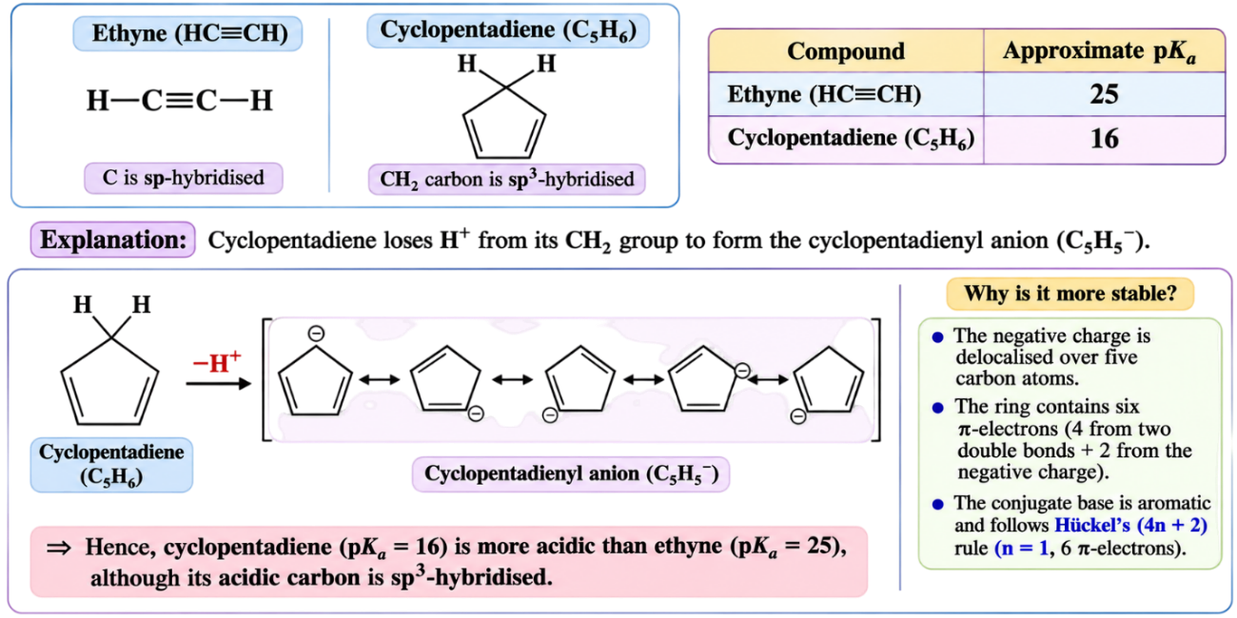
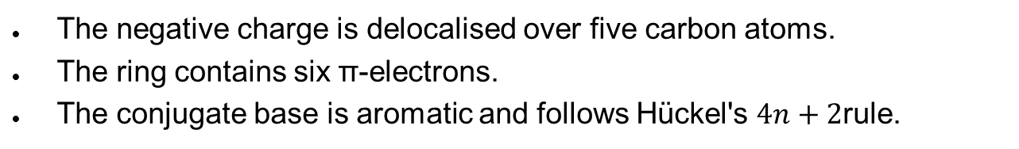

(i) Effect of Resonance
Compound | Approximate pKa
Ethyne | 25
Cyclopentadiene | 16
Example: Ethyne and cyclopentadiene
Ethyne (HC≡CH) contains sp-hybridised carbon, whereas cyclopentadiene (C₅H₆) contains an sp³-hybridised CH₂ carbon.
According to hybridisation alone, we might expect ethyne to be more acidic.
However:
Explanation:
When cyclopentadiene loses H⁺ from its CH₂ group, it forms the cyclopentadienyl anion (C₅H₅⁻).
This anion is exceptionally stable because:
The negative charge is delocalised over five carbon atoms.
The ring contains six π-electrons.
The conjugate base is aromatic and follows Hückel's $4n+2$rule.
In contrast, the acetylide ion (HC≡C⁻) is stabilised by the high s-character of its sp-hybridised carbon, but it does not have comparable aromatic resonance stabilisation.
Therefore,
Conclusion: Resonance and aromatic stabilisation can outweigh the effect of hybridisation
$$\boxed{\text{Cyclopentadiene > Ethyne}}$$

Slide 10
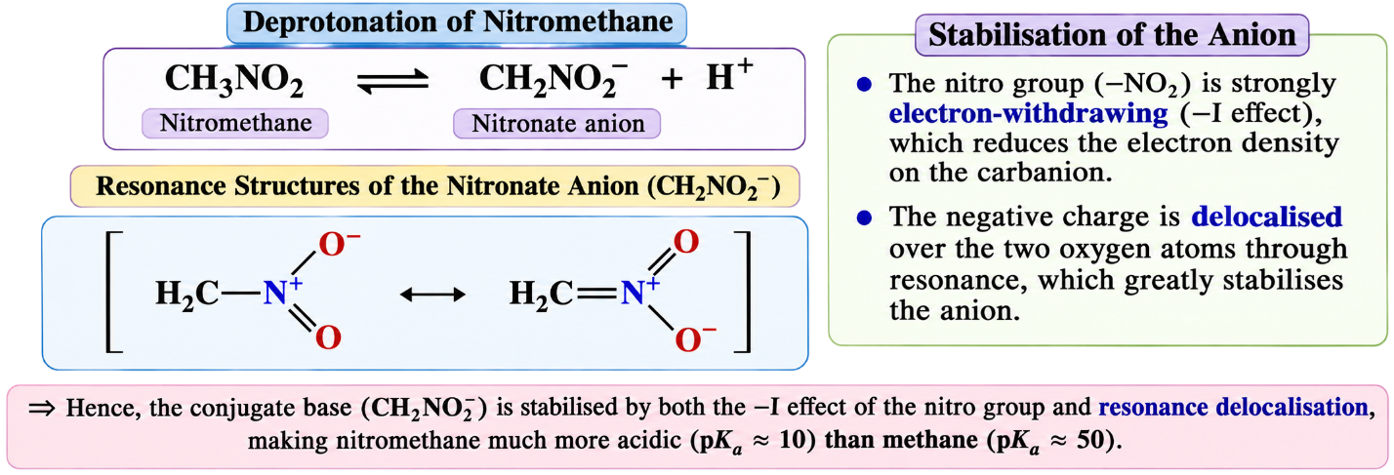


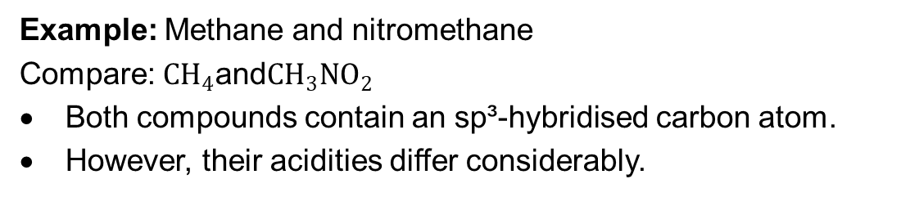
(ii) Effect of Electron-Withdrawing Substituents (−I Effect)
Example: Methane and nitromethane
Compare: $CH_{4}\text{and}CH_{3}NO_{2}$
Both compounds contain an sp³-hybridised carbon atom.
However, their acidities differ considerably.
Compound | Approximate pKa
Methane | 50
Nitromethane | 10 (aqueous)
The nitro group (−NO₂) is strongly electron-withdrawing.
When nitromethane loses H⁺, it forms a nitronate anion:
$$CH_{3}NO_{2}⇌CH_{2}NO_{2}^{−}+H^{+}$$
The negative charge is stabilised by the electron-withdrawing effect of the nitro group and, importantly, by resonance delocalisation involving the oxygen atoms.
Therefore,
Conclusion: Electron-withdrawing substituents can greatly increase acidity even when the original C–H carbon has the same hybridisation.
$$\boxed{\text{Nitromethane > Methane}}$$

Slide 11
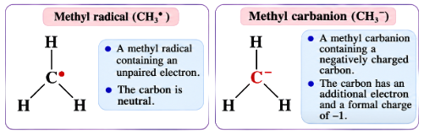

(iii) Effect of Formal Charge
Example: Neutral carbon and negatively charged carbon
Consider the following species:
$$CH_{3}^{∙} \text{and} CH_{3}^{−}$$
CH₃• is a methyl radical containing an unpaired electron.
CH₃⁻ is a methyl carbanion containing a negatively charged carbon.
In CH₃⁻, the carbon atom has an additional electron and a formal charge of −1.
This negative charge changes the electron distribution and makes the carbon centre strongly electron-rich.
Consequently, CH₃⁻ behaves as a strong base and nucleophile.
Important: The electronegativity trend for neutral hybridised carbon cannot be applied directly to charged species without considering their electronic structures. Formal charge also affects basicity, nucleophilicity and stability; it does not, by itself, establish an acidity order.

Slide 12
1.4.3 Bond-Length Variation
As bond order increases, $C−C$ bonds generally become shorter. Greater s-character also tends to shorten comparable $C−H$ bonds.
1.4.4 Bond Strength in Hydrocarbons
In otherwise comparable bonds, shorter bonds are often stronger because of more effective orbital overlap.
Bond strength also depends on bond order and molecular environment.
Bond dissociation enthalpy is defined for a specified bond-breaking process and physical state. Average bond enthalpies are different quantities.
A double bond is not twice as strong as a single bond, and a triple bond is not three times as strong. Compare named molecules and consistent data definitions.

Slide 13
2 Steric effects

Slide 14
2.1 Definition of Steric Effect
The steric effect is the phenomenon in which the presence of bulky atoms or groups near a reaction centre creates spatial obstruction, making it difficult for an attacking reagent to approach the reaction site.
As a result, the reaction may become slower or may follow a different reaction mechanism. This phenomenon is called steric hindrance.
Important points:
Steric hindrance arises due to the large size and spatial arrangement of atoms or groups.
Bulky groups near the reaction centre obstruct the approach of attacking reagents.
Steric hindrance particularly affects substitution, elimination and resonance.
It may decrease the rate of a reaction or favour an alternative reaction pathway.

Slide 15
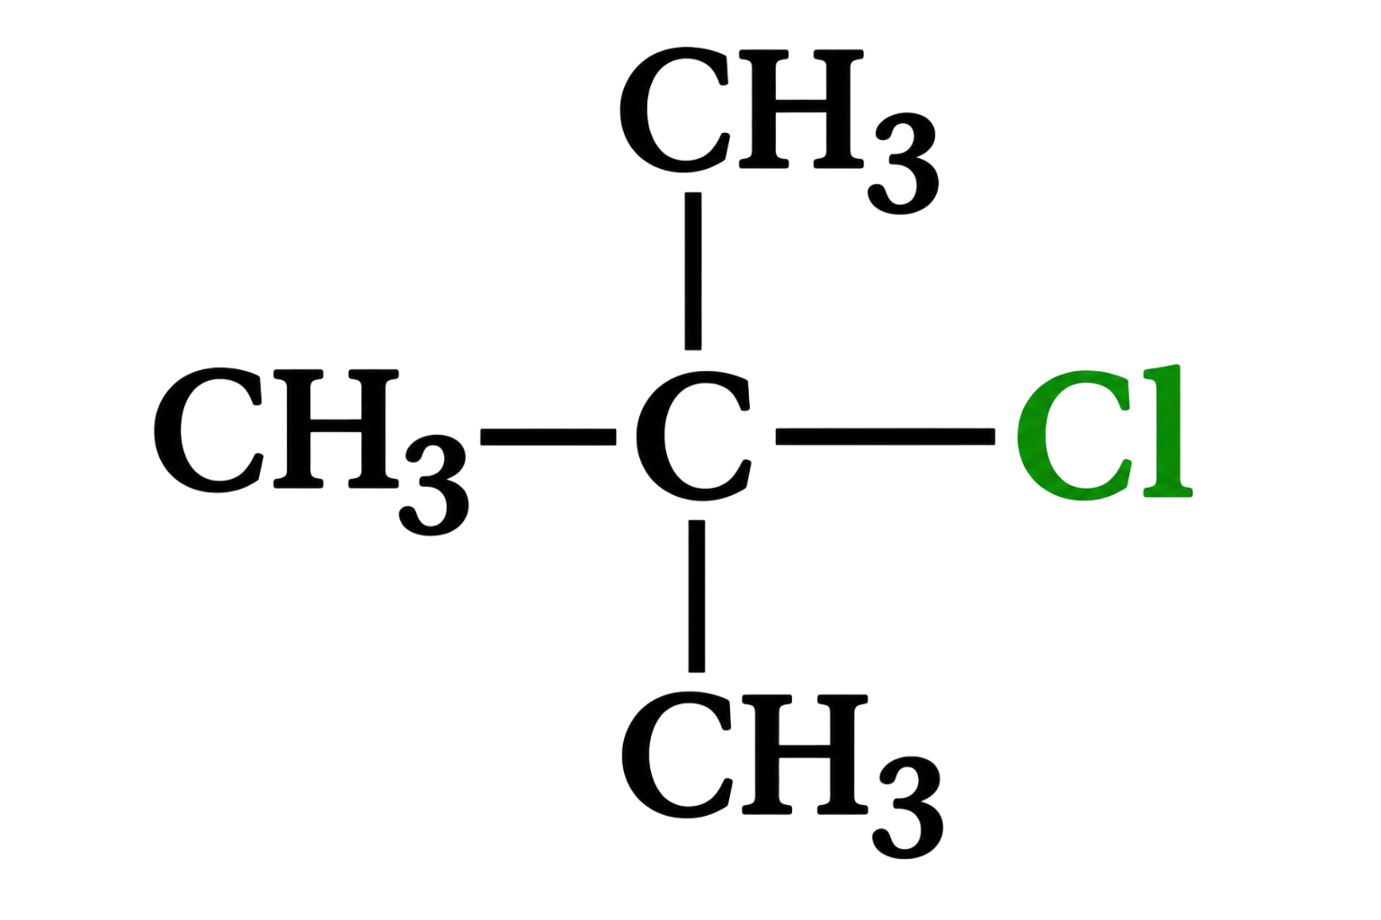
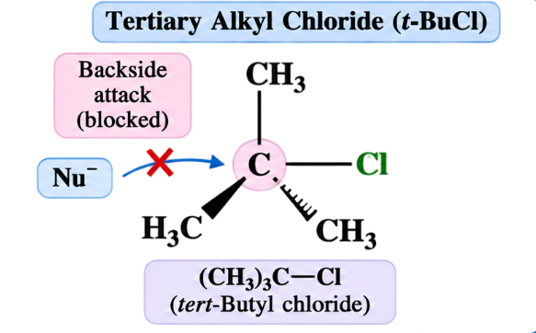
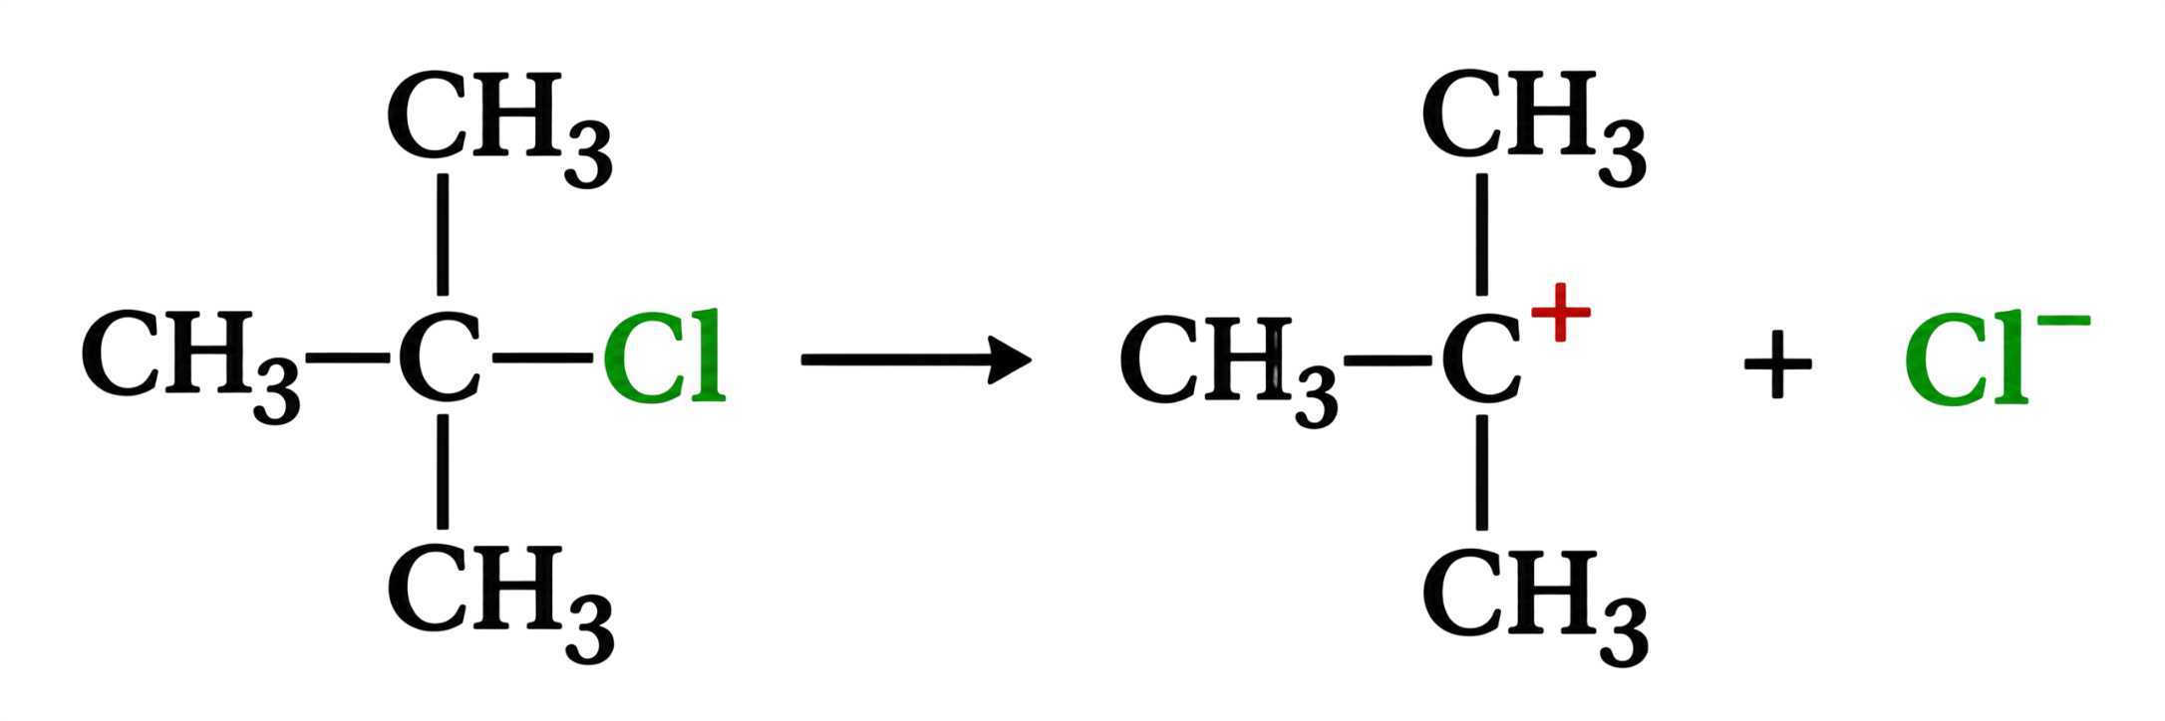

2.2 Effect of Steric Hindrance on Alkyl Halides
(i) Tertiary Alkyl Halides
Tertiary alkyl halides contain three alkyl groups attached to the carbon atom bearing the halogen. For example, tert-butyl chloride:
Due to the presence of three bulky methyl groups, the carbon bearing chlorine is sterically crowded.
Therefore, the direct attack of a nucleophile from the backside becomes difficult, making the Sₙ2 mechanism highly unfavorable.
However, tertiary alkyl halides can undergo hydrolysis through the Sₙ1 mechanism, particularly in polar protic solvents.
Formation of carbocation:
The tertiary carbocation is relatively stable because of the +I effect and hyperconjugation of the three methyl groups.
The carbocation then reacts with water to form an alcohol.
$$(CH₃)₃C⁺ + H₂O → (CH₃)₃COH₂⁺$$
$$(CH₃)₃COH₂⁺ → (CH₃)₃COH + H⁺$$

Slide 16

2.3 Steric Hindrance in Primary Alkyl Halides Containing a Quaternary β-Carbon
Consider neopentyl chloride:
$$(CH₃)₃C−CH₂−Cl$$
Although neopentyl chloride is a primary alkyl halide, it undergoes nucleophilic substitution very slowly.
Reason:
The α-carbon is attached directly to chlorine.
The adjacent β-carbon is bonded to three methyl groups and the α-carbon.
These bulky groups create considerable steric hindrance near the reaction centre.
Consequently, the nucleophile cannot easily approach the α-carbon from the backside.
Therefore, formation of the Sₙ2 transition state is highly difficult, and the reaction is extremely slow.
Important concept: Neopentyl chloride does not readily undergo an ordinary Sₙ1 reaction either, because direct ionisation would produce an unstable primary carbocation.

Slide 17
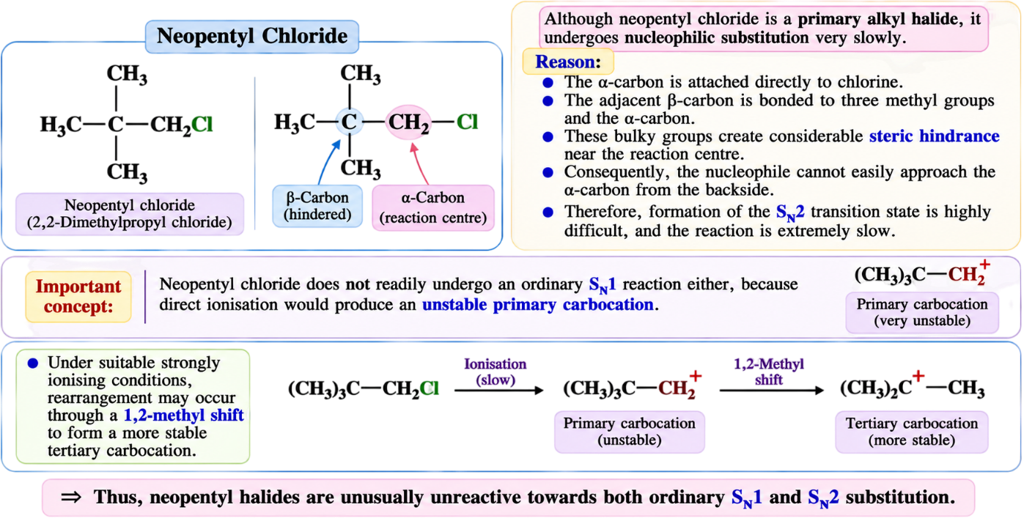
2.3 Steric Hindrance in Primary Alkyl Halides Containing a Quaternary β-Carbon
Under suitable strongly ionising conditions (Lewis acid such as Ag⁺, Strongly polar, weakly nucleophilic solvents (HCOOH), (HFIP), (CF₃COOH), rearrangement may occur through a 1,2-methyl shift to form a more stable tertiary carbocation.
However, this does not mean that neopentyl chloride readily forms a carbocation during normal hydrolysis.
Thus, neopentyl halides are unusually unreactive towards both ordinary Sₙ1 and Sₙ2 substitution.

Slide 18
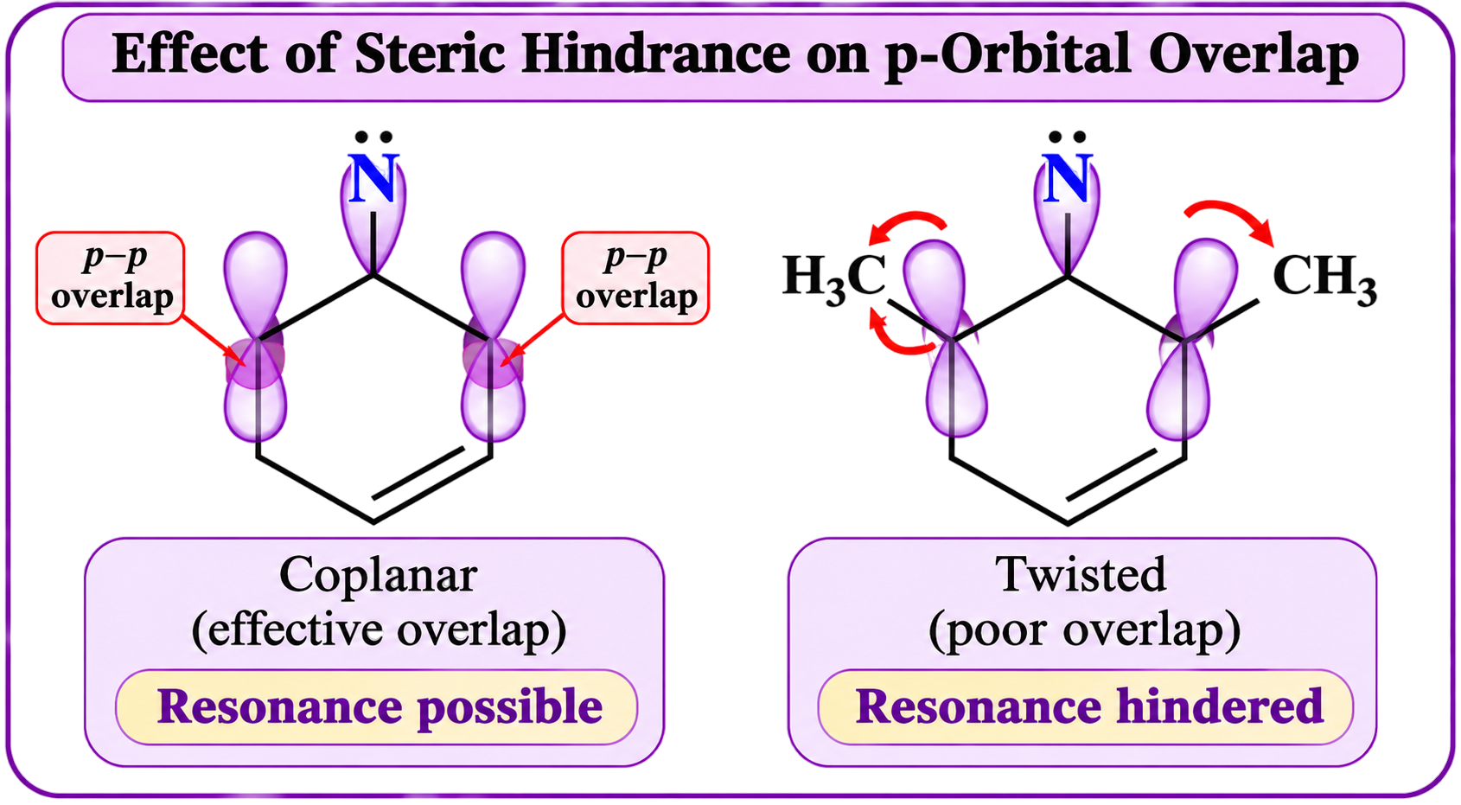
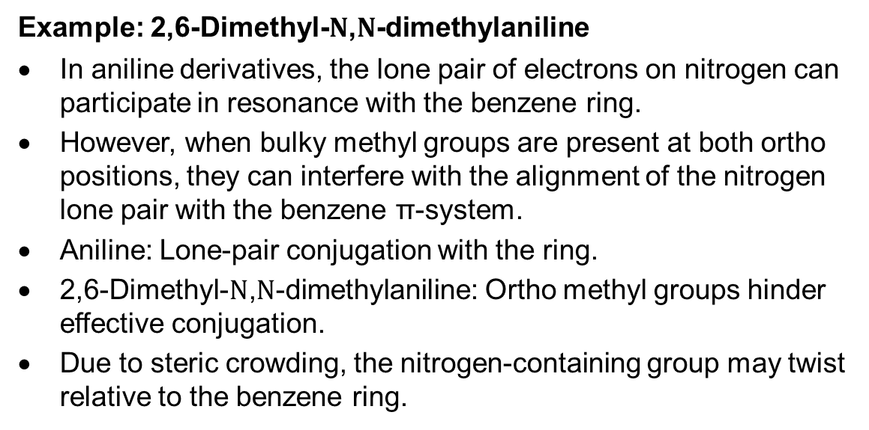
2.4 Steric Inhibition of Resonance $\left(SIR\right)$
Definition: Steric inhibition of resonance is the phenomenon in which bulky groups prevent two conjugated groups from attaining the coplanar arrangement required for effective orbital overlap, thereby decreasing or preventing resonance.
For resonance to occur effectively, the participating p-orbitals must be properly aligned.
When bulky groups are present near the conjugated system, steric repulsion may force the groups to twist out of the same plane.
As a result, overlap between the p-orbitals decreases and resonance becomes weaker.
Example: 2,6-Dimethyl-$N$,$N$-dimethylaniline
In aniline derivatives, the lone pair of electrons on nitrogen can participate in resonance with the benzene ring.
However, when bulky methyl groups are present at both ortho positions, they can interfere with the alignment of the nitrogen lone pair with the benzene π-system.
Aniline: Lone-pair conjugation with the ring.
2,6-Dimethyl-$N$,$N$-dimethylaniline: Ortho methyl groups hinder effective conjugation.
Due to steric crowding, the nitrogen-containing group may twist relative to the benzene ring.
This reduces the overlap between the nitrogen lone pair and the π-electron system. Consequently, the resonance interaction becomes weaker.

Slide 19
3 Inductive effect and its applications

Slide 20
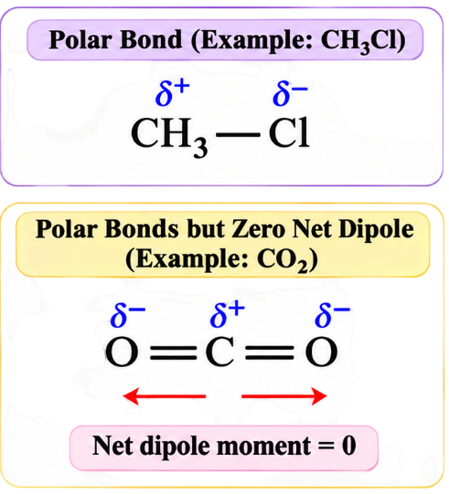
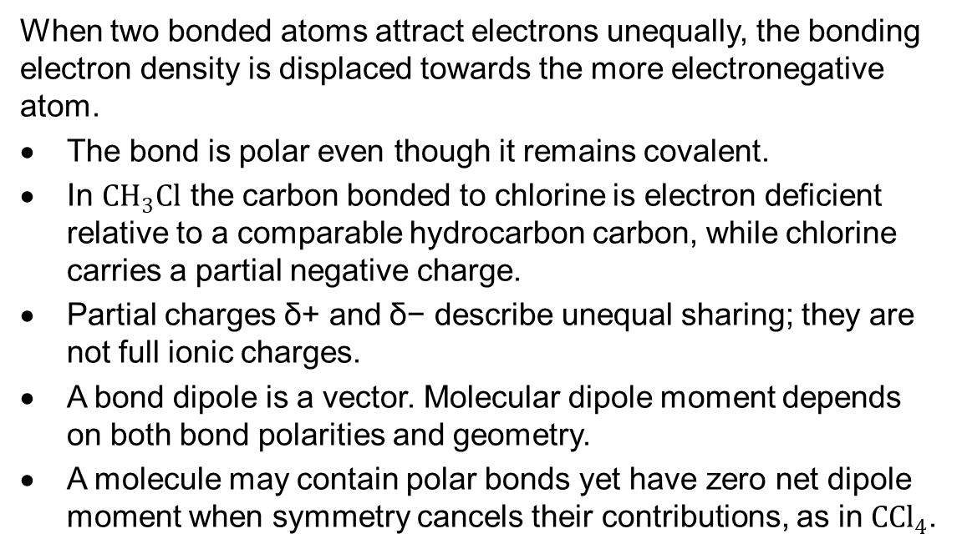
3.1 Bond polarity and electronegativity
When two bonded atoms attract electrons unequally, the bonding electron density is displaced towards the more electronegative atom.
The bond is polar even though it remains covalent.
In $CH_{3}Cl$ the carbon bonded to chlorine is electron deficient relative to a comparable hydrocarbon carbon, while chlorine carries a partial negative charge.
Partial charges δ+ and δ− describe unequal sharing; they are not full ionic charges.
A bond dipole is a vector. Molecular dipole moment depends on both bond polarities and geometry.
A molecule may contain polar bonds yet have zero net dipole moment when symmetry cancels their contributions, as in $C{Cl}_{4}$.

Slide 21
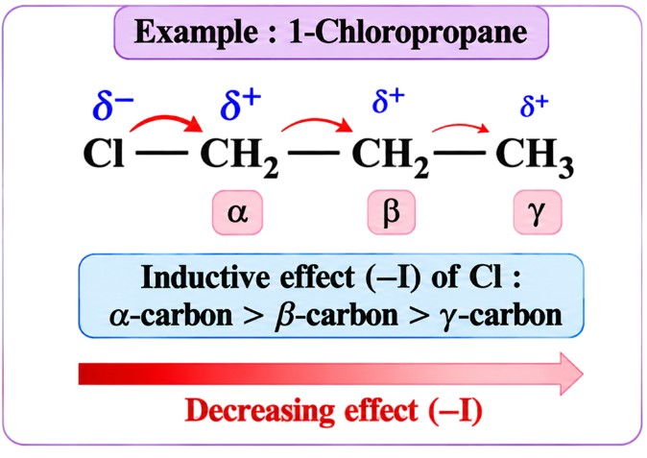


3.2 Definition and transmission of the inductive effect
Inductive Effect (I-Effect)
The inductive effect is the permanent polarisation of σ-bonds caused by an electron-withdrawing or electron-releasing atom or group, resulting in a change in electron distribution along the molecular framework.
Important Characteristics of the Inductive Effect
1. Permanent effect: The inductive effect is a permanent electronic effect arising from differences in the electron-attracting tendencies of atoms or groups.
2. Transmission through σ-bonds: In the conventional model, the inductive effect is transmitted through σ-bonds connecting atoms in a molecule.
3. Decreases with distance: The effect is strongest near the substituent and decreases rapidly as the number of intervening σ-bonds increases.
For example, in 1-chloropropane:
$$Cl−CH_{2}−CH_{2}−CH_{3}$$
Chlorine withdraws electron density through its −I effect. Its influence decreases progressively along the carbon chain.
$$\boxed{α\text{−carbon}>β\text{−carbon}>γ\text{−carbon}}$$

Slide 22
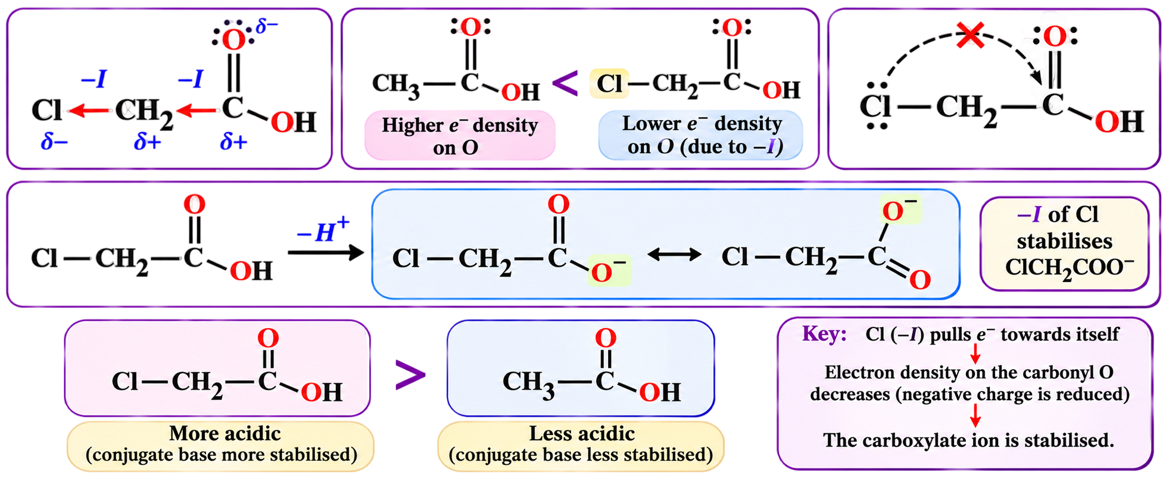


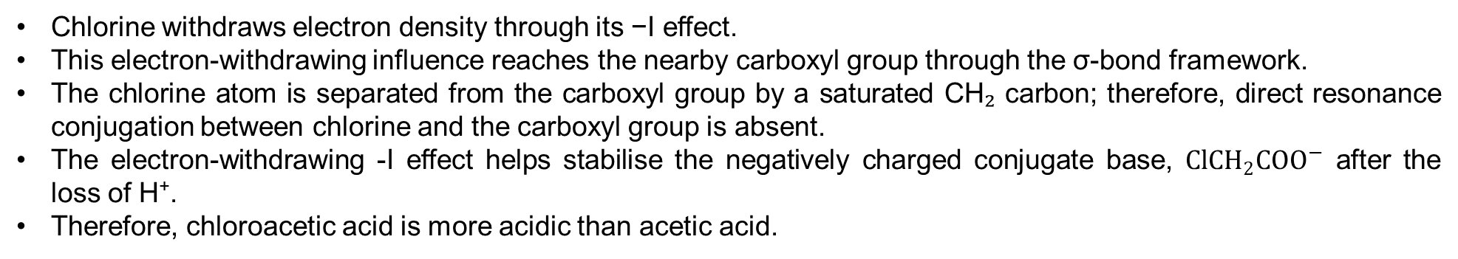
Important Characteristics of the Inductive Effect
4. No π-system required: The inductive effect operates through σ-bonds and does not require double bonds, triple bonds or a conjugated π-system.
5. No attacking reagent required: The inductive effect exists in the molecule even in the absence of an attacking reagent.
6. Influence on nearby functional groups: An electron-withdrawing substituent can influence a nearby functional group without being directly conjugated with it.
Example: Chloroacetic acid
$$Cl−CH_{2}−COOH$$
Chlorine withdraws electron density through its −I effect.
This electron-withdrawing influence reaches the nearby carboxyl group through the σ-bond framework.
The chlorine atom is separated from the carboxyl group by a saturated CH₂ carbon; therefore, direct resonance conjugation between chlorine and the carboxyl group is absent.
The electron-withdrawing -I effect helps stabilise the negatively charged conjugate base, $ClCH_{2}COO^{−}$ after the loss of H⁺.
Therefore, chloroacetic acid is more acidic than acetic acid.
$$\boxed{ClCH_{2}COOH>CH_{3}COOH}$$

Slide 23
3.3 Electron-Withdrawing Groups and the Negative Inductive Effect (−I Effect)
The negative inductive effect (−I effect) is the permanent electron-withdrawing effect produced by an atom or group that attracts electron density through the σ-bond framework relative to hydrogen in a comparable molecular environment.
Important Characteristics of the −I Effect
1. Electron-withdrawing nature: Groups exhibiting the −I effect attract electron density towards themselves through σ-bonds, making the neighbouring atoms relatively electron-deficient.
2. Common electron-withdrawing groups: Some important groups showing the −I effect are:
Positively charged ammonium groups (−NR₃⁺)
Nitro group (−NO₂)
Cyano group (−CN)
Carbonyl-containing groups (such as −CHO, −COR and −COOH)
Halogens (−F, −Cl, −Br and −I)
3. Dependence on molecular environment: The strength of the −I effect depends on the nature of the electron-withdrawing group, its point of attachment and the surrounding molecular environment.

Slide 24

3.3.1 Negative Inductive Effect of Halogens
Halogens are more electronegative than carbon and therefore withdraw electron density through σ-bonds.
For halogens attached through the same type of bond, the usual qualitative order of the −I effect is:
$$\boxed{−F>−Cl>−Br>−I}$$
Explanation:
Fluorine is the most electronegative halogen and generally exhibits the strongest −I effect.
Chlorine has a weaker −I effect than fluorine.
Bromine has a weaker −I effect than chlorine.
Iodine generally exhibits the weakest −I effect among these halogens.

Slide 25
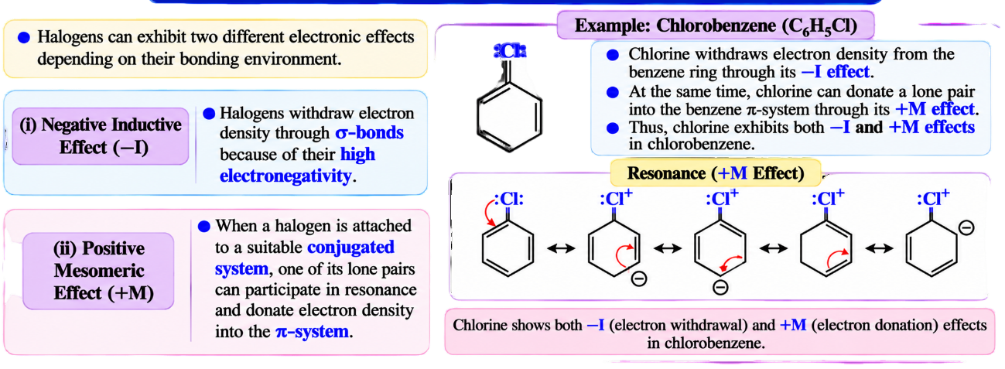
3.3.2 Inductive Effect and Resonance Effect of Halogens
Halogens can exhibit two different electronic effects depending on their bonding environment.
1. Negative inductive effect (−I): Halogens withdraw electron density through σ-bonds because of their high electronegativity.
2. Positive mesomeric effect (+M): When a halogen is attached to a suitable conjugated system, one of its lone pairs can participate in resonance and donate electron density into the π-system.
Example 1 :
Chlorobenzene (C₆H₅Cl)

Slide 26


Example 2. Vinyl Chloride (Chloroethene)
$$\boxed{CH_{2}=CH−Cl}$$
Vinyl chloride is an important example of a halogen attached directly to an alkene carbon.
Explanation:
Chlorine is directly attached to an sp²-hybridised carbon.
Chlorine possesses three lone pairs of electrons.
A suitably oriented lone pair on chlorine can overlap with the adjacent π-system.
Consequently, chlorine can donate electron density through resonance (+M effect).
At the same time, chlorine withdraws electron density through the σ-bond (−I effect).
The resonance can be represented as:
$$CH_{2}=CH−Cl ↔ ^{−}CH_{2}−CH=Cl^{+}$$
The charge-separated structure is a minor resonance contributor.
Thus, vinyl chloride exhibits both −I and +M effects.
Result : Due to resonance, the C–Cl bond acquires partial double-bond character, making it shorter and generally stronger than an ordinary C(sp³)–Cl bond

Slide 27
3.4 Electron-Releasing Groups and the Positive Inductive Effect (+I Effect)
The positive inductive effect (+I effect) is the permanent electron-releasing effect produced by an atom or group that pushes electron density towards the attached molecular framework through σ-bonds, relative to hydrogen in a comparable molecular environment.
Important Characteristics of the +I Effect
1. Electron-releasing nature: Groups exhibiting the +I effect increase electron density in the neighbouring molecular framework through σ-bond polarisation.
2. Permanent effect: The +I effect is a permanent electronic effect and does not require an attacking reagent.
3. Transmission through σ-bonds: In the conventional model, the +I effect is transmitted through σ-bonds and decreases rapidly with increasing bond distance.
4. Common +I groups: Alkyl groups such as −CH₃, −C₂H₅, −CH(CH₃)₂ and −C(CH₃)₃ are commonly treated as electron-releasing groups.
5. Relative to hydrogen: The electron-releasing tendency is conventionally compared with hydrogen, which is taken as the reference group (hydrogen is assigned a zero inductive effect for comparison purposes).

Slide 28
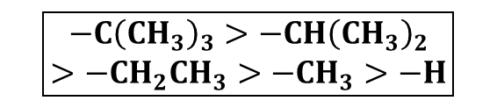
3.4.1 Order of +I Effect of Alkyl Groups
$$\boxed{\begin{aligned}−C{\left(CH_{3}\right)}_{3}>−CH{\left(CH_{3}\right)}_{2} \\ >−CH_{2}CH_{3}>−CH_{3}>−H\end{aligned}}$$
The conventional qualitative order of the +I effect of alkyl groups is:
3.4.2 The +I Effect of Alkyl Groups Not a Universal Rule
This means that, in the elementary model, a tertiary alkyl group has a stronger electron-releasing inductive influence than a secondary or primary alkyl group.
But does this mean that a compound containing a tertiary alkyl group will always be more stable, more reactive or more basic?
No. The +I effect is only one factor that influences the properties of organic compounds.
Other factors, such as hyperconjugation, steric hindrance, solvation and molecular geometry, may reinforce or oppose its influence.

Slide 29
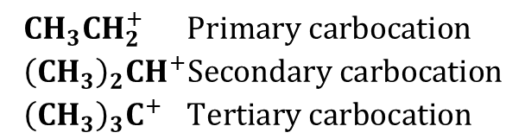
Let us understand this with examples.
(i) Hyperconjugation — Why +I Effect Alone Cannot Explain Stability
Consider three carbocations:
$$\begin{aligned}&CH_{3}CH_{2}^{+}&&\text{Primary carbocation} \\ &{\left(CH_{3}\right)}_{2}CH^{+}&&\text{Secondary carbocation} \\ &{\left(CH_{3}\right)}_{3}C^{+} &&\text{Tertiary carbocation}\end{aligned}$$
Why is the tertiary carbocation generally more stable?
There are two important reasons.
B. Hyperconjugation
Hyperconjugation is the delocalisation of electrons from a suitably aligned σ-bond into an adjacent vacant p-orbital or π-system.
In a carbocation, the positively charged carbon has an empty p-orbital.
An adjacent C–H σ-bond can overlap with this empty p-orbital, allowing electron density to become delocalised.
For simple methyl-substituted carbocations:
A. Positive inductive effect (+I)
Alkyl groups release electron density towards the positively charged carbon.
This helps reduce its electron deficiency.
A tertiary carbocation has three alkyl groups attached to the positively charged carbon.
Therefore, it receives a greater electron-releasing inductive influence in the conventional model.
Therefore, the tertiary carbocation is stabilised by both the +I effect and hyperconjugation.

Slide 30


(ii) Steric Effect — Why a Stronger +I Effect Does Not Always Mean Faster Reaction
Consider two alkyl chlorides.
Ethyl chloride (Primary alkyl halide)
The carbon bearing chlorine is relatively accessible to an attacking nucleophile.
$$CH_{3}CH_{2}Cl$$
$${\left(CH_{3}\right)}_{3}CCl$$
tert-Butyl chloride (Tertiary alkyl halide)
The carbon bearing chlorine is surrounded by three bulky methyl groups.
In an Sₙ2 reaction, the nucleophile must approach the carbon bearing chlorine from the side opposite the C–Cl bond.
Conclusion: Although tert-butyl has a stronger conventional +I effect than ethyl, tert-butyl chloride undergoes Sₙ2 substitution much more slowly because steric hindrance dominates.

Slide 31
(iii) Solvation — How a Solvent Can Change Acidity or Basicity
Solvation is the process by which solvent molecules surround and stabilise dissolved molecules or ions. When water acts as the solvent, this process is called hydration.
In aqueous solution, the basicity of amines depends not only on the electron-releasing inductive effect (+I) of alkyl groups but also on the stabilisation of the protonated amine by water molecules.
1. Effect of the +I Effect on Basicity
Consider methylamine and dimethylamine:
Methylamine: CH₃NH₂ and Dimethylamine: (CH₃)₂NH
Both contain electron-releasing methyl groups.
According to the +I effect:
Dimethylamine contains two methyl groups, whereas methylamine contains only one.
Methyl groups donate electron density towards nitrogen through the +I effect.
Therefore, dimethylamine generally has greater electron density available at nitrogen.
This favours the acceptance of H⁺ by dimethylamine.
Thus, based on the +I effect alone:
Dimethylamine > Methylamine

Slide 32
2. Effect of Solvation on Basicity
When an amine accepts a proton (H⁺), it forms a positively charged conjugate acid.
Methylamine:
CH₃NH₂ + H⁺ ⇌ CH₃NH₃⁺
Dimethylamine:
(CH₃)₂NH + H⁺ ⇌ (CH₃)₂NH₂⁺
The positively charged ammonium ions are stabilised by surrounding water molecules through hydrogen bonding and ion–dipole interactions.
Explanation:
Water molecules surround the protonated amine and stabilise its positive charge.
The oxygen atom of water can form hydrogen bonds with the N–H bonds of the protonated amine.
Methylammonium ion (CH₃NH₃⁺) has three N–H bonds and can form favourable hydrogen bonds with water.
Dimethylammonium ion ((CH₃)₂NH₂⁺) has two N–H bonds and can also undergo effective hydration.
Although methylammonium generally has greater hydrogen-bonding accessibility, the stronger +I effect of two methyl groups in dimethylamine contributes sufficiently to make dimethylamine more basic overall.

Slide 33
3. Example: Dimethylamine and Trimethylamine
Consider:
Dimethylamine: (CH₃)₂NH — secondary amine
Trimethylamine: (CH₃)₃N — tertiary amine
According to the +I effect alone, trimethylamine might be expected to be more basic because it contains three electron-releasing methyl groups.
However, in aqueous solution, dimethylamine is generally more basic than trimethylamine at room temperature.
Explanation:
Trimethylamine has a stronger electron-releasing inductive influence due to its three methyl groups.
However, its protonated form, (CH₃)₃NH⁺, is relatively sterically crowded and has only one N–H bond.
The protonated form of dimethylamine, (CH₃)₂NH₂⁺, has two N–H bonds and is generally more accessible to water molecules.
Therefore, the conjugate acid of dimethylamine can be hydrated more effectively.
This favourable hydration contributes to dimethylamine being more basic than trimethylamine in water.
Thus, the basicity order is:
Dimethylamine > Trimethylamine

Slide 34
(iv) Molecular Geometry — Why Orbital Alignment Matters
Consider hyperconjugation again.
For effective hyperconjugation, a suitable σ-bond must be properly aligned with an adjacent p-orbital or π-system.
Favourable orbital alignment allows effective overlap.
Factor effecting the alignment:
Rotation around a C–C single bond,
Molecular rigidity: In some cyclic or rigid molecules, rotation around certain bonds is restricted.
Steric hindrance: Bulky groups may favour particular molecular conformations, which can influence orbital alignment.
Poor orbital alignment reduces overlap.
Restricted molecular geometry may therefore weaken hyperconjugation even when electron-releasing alkyl groups are present.
Consequently, two molecules with similar alkyl substitution may exhibit different stability or reactivity because of differences in molecular geometry.

Slide 35
(iv) Molecular Geometry — Why Orbital Alignment Matters
Consider hyperconjugation again.
For effective hyperconjugation, a suitable σ-bond must be properly aligned with an adjacent p-orbital or π-system.
Favourable orbital alignment allows effective overlap.
Factor effecting the alignment:
Rotation around a C–C single bond,
Molecular rigidity: In some cyclic or rigid molecules, rotation around certain bonds is restricted.
Steric hindrance: Bulky groups may favour particular molecular conformations, which can influence orbital alignment.
Poor orbital alignment reduces overlap.
Restricted molecular geometry may therefore weaken hyperconjugation even when electron-releasing alkyl groups are present.
Consequently, two molecules with similar alkyl substitution may exhibit different stability or reactivity because of differences in molecular geometry.

Slide 36
4 Resonance and the mesomeric effect

Slide 37
4.1 Introduction
In organic compounds, electrons present in covalent bonds may undergo displacement due to the influence of neighbouring atoms or groups.
In certain molecules, particularly those containing conjugated double bonds or lone pairs of electrons adjacent to multiple bonds, the electrons are not confined to a particular bond or atom. Instead, they become delocalized over two or more adjacent atoms.
This phenomenon is known as resonance or mesomerism.
4.2 Important Points:
1. Resonance involves the delocalization of electrons within a molecule or ion.
2. Only π-electrons, lone pairs of electrons, and, in suitable systems, electrons in certain σ-bonds can participate in resonance.
3. The positions of the nuclei remain unchanged during resonance.
4. Resonance does not involve the actual movement of atoms from one position to another.
5. The actual molecule is represented by a resonance hybrid of contributing canonical structures.
6. Electron delocalization generally increases the stability of a molecule or ion.

Slide 38
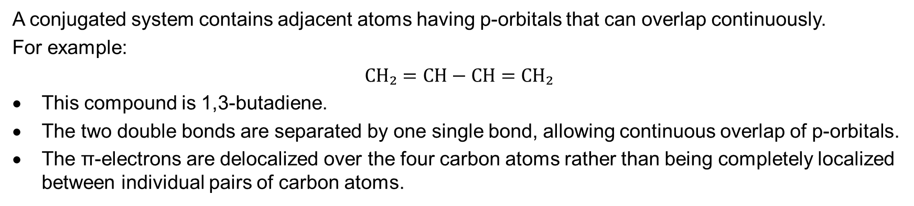
4.3 Conditions Necessary for Mesomeric Effect
(i) Presence of a Conjugated System
A conjugated system contains adjacent atoms having p-orbitals that can overlap continuously.
For example:
$$CH₂=CH−CH=CH₂$$
This compound is 1,3-butadiene.
The two double bonds are separated by one single bond, allowing continuous overlap of p-orbitals.
The π-electrons are delocalized over the four carbon atoms rather than being completely localized between individual pairs of carbon atoms.

Slide 39
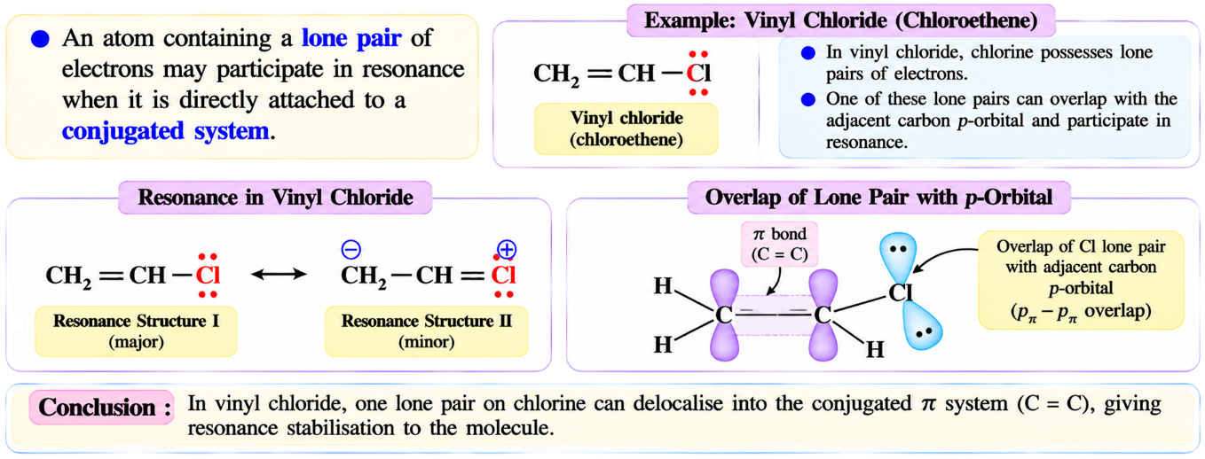
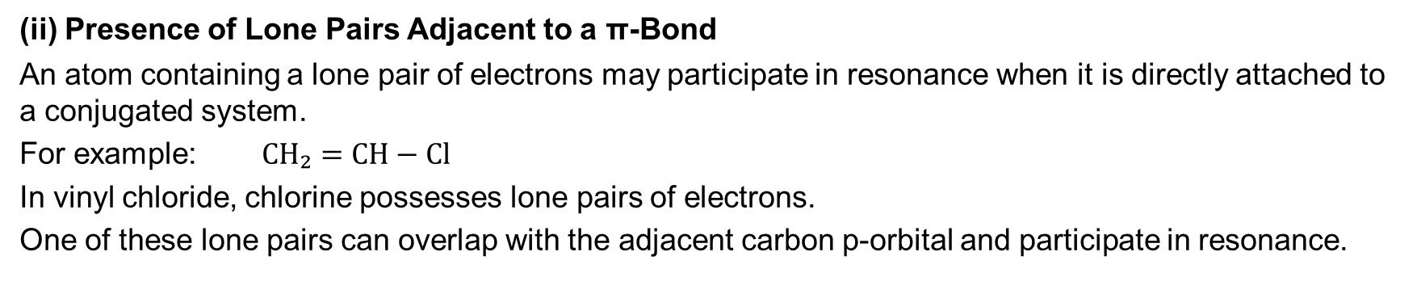
(ii) Presence of Lone Pairs Adjacent to a π-Bond
An atom containing a lone pair of electrons may participate in resonance when it is directly attached to a conjugated system.
For example: $CH₂=CH−Cl$
In vinyl chloride, chlorine possesses lone pairs of electrons.
One of these lone pairs can overlap with the adjacent carbon p-orbital and participate in resonance.

Slide 40
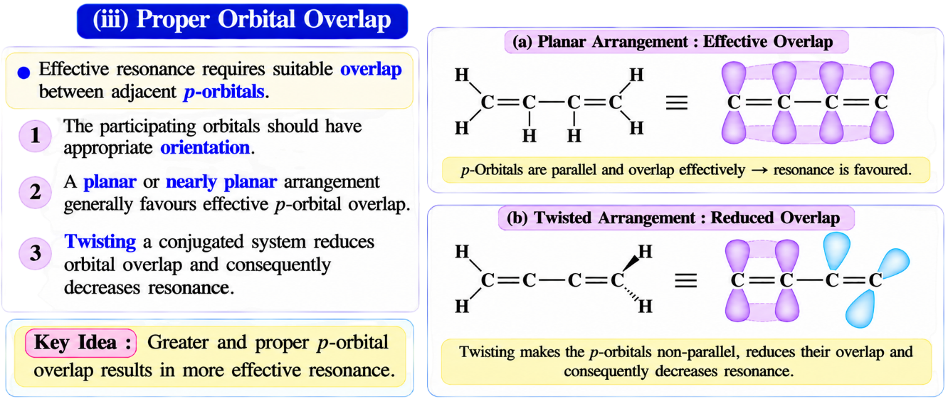
(iii) Proper Orbital Overlap
Effective resonance requires suitable overlap between adjacent p-orbitals.
1. The participating orbitals should have appropriate orientation.
2. A planar or nearly planar arrangement generally favours effective p-orbital overlap.
3. Twisting a conjugated system reduces orbital overlap and consequently decreases resonance.

Slide 41
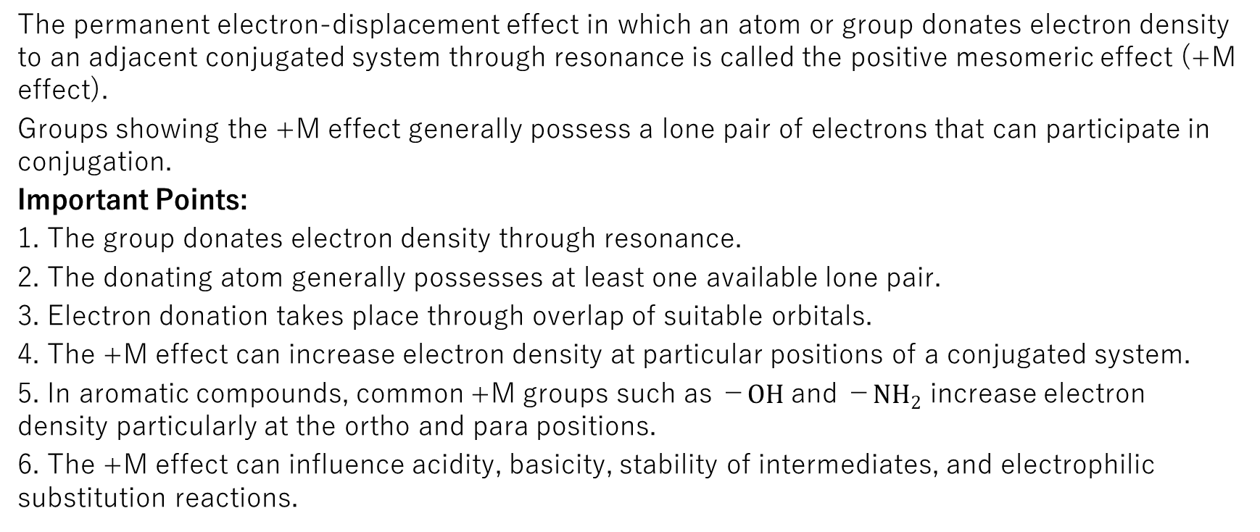
4.4 Types of Mesomeric Effect
1. Positive mesomeric effect (+M effect).
2. Negative mesomeric effect (−M effect).
4.5 Positive Mesomeric Effect (+M or +R Effect)
The permanent electron-displacement effect in which an atom or group donates electron density to an adjacent conjugated system through resonance is called the positive mesomeric effect (+M effect).
Groups showing the +M effect generally possess a lone pair of electrons that can participate in conjugation.
Important Points:
1. The group donates electron density through resonance.
2. The donating atom generally possesses at least one available lone pair.
3. Electron donation takes place through overlap of suitable orbitals.
4. The +M effect can increase electron density at particular positions of a conjugated system.
5. In aromatic compounds, common +M groups such as −$OH$ and −$NH_{2}$ increase electron density particularly at the ortho and para positions.
6. The +M effect can influence acidity, basicity, stability of intermediates, and electrophilic substitution reactions.

Slide 42
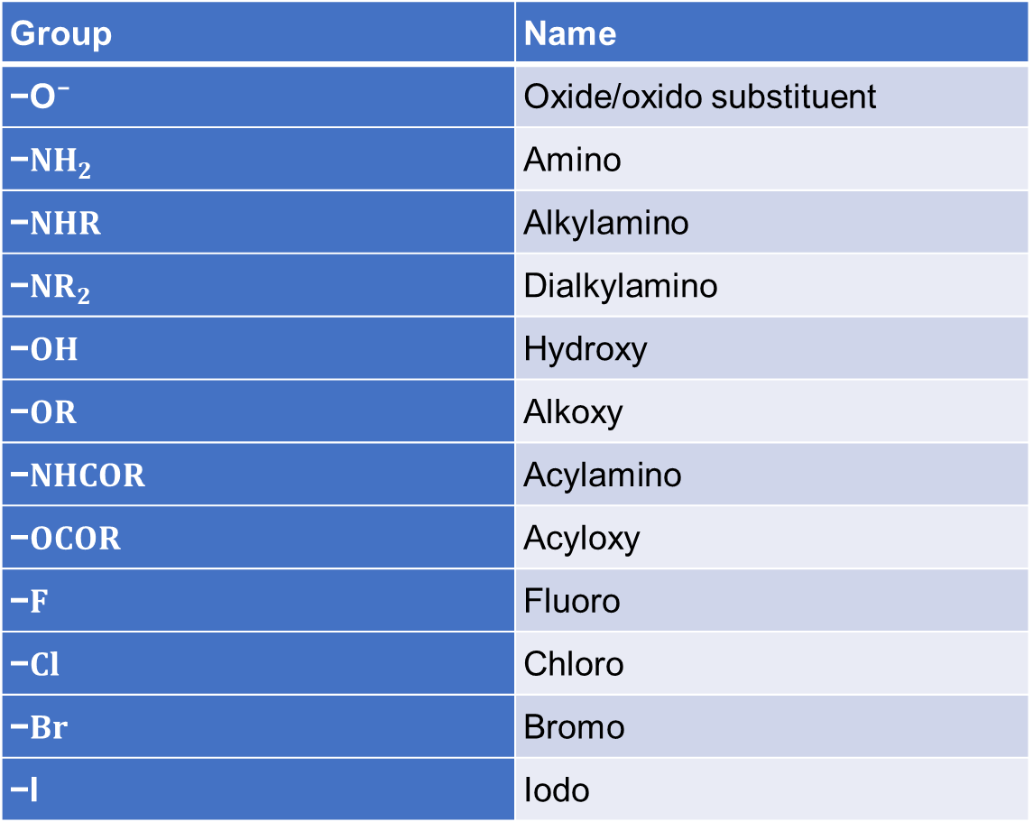
4.5.2 Common Groups Showing +M Effect
Group | Name
−O⁻ | Oxide/oxido substituent
−$NH_{2}$ | Amino
−$NHR$ | Alkylamino
−$NR_{2}$ | Dialkylamino
−$OH$ | Hydroxy
−$OR$ | Alkoxy
−$NHCOR$ | Acylamino
−$OCOR$ | Acyloxy
−$F$ | Fluoro
−$Cl$ | Chloro
−$Br$ | Bromo
−I | Iodo

Slide 43
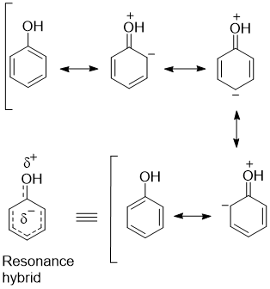

4.5.3 Explanation of +M Effect with an Example
Phenol $\left(C_{6}H_{5}OH\right)$
Important Concept:
Although oxygen is highly electronegative and exhibits a −I effect, it also shows a strong +M effect when attached directly to a benzene ring.
For phenol, the electron-donating resonance effect dominates its influence on electrophilic aromatic substitution.
Therefore, phenol is more reactive than benzene towards electrophilic aromatic substitution.

Slide 44
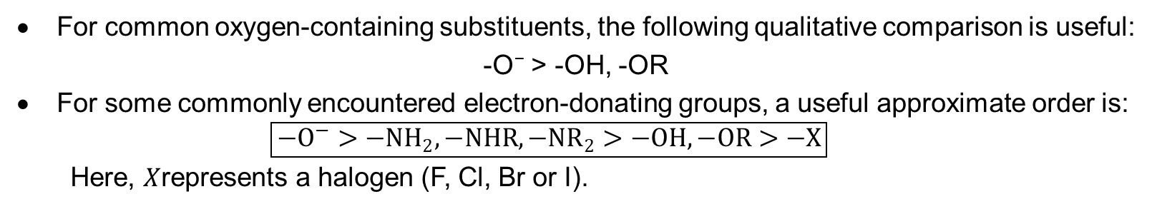
4.5.4 Order of +M Effect
For common oxygen-containing substituents, the following qualitative comparison is useful:
-O⁻ > -OH, -OR
For some commonly encountered electron-donating groups, a useful approximate order is:
$$\boxed{−O^{−}>−NH_{2}, −NHR, −NR_{2}>−OH, −OR>−X}$$
Here, $X$represents a halogen (F, Cl, Br or I).

Slide 46
4.6 Negative Mesomeric Effect (−M or −R Effect)
The permanent electron-displacement effect in which an atom or group withdraws electron density from an adjacent conjugated system through resonance is called the negative mesomeric effect (−M effect).
Groups exhibiting the −M effect generally contain an electron-accepting π-system or a suitable vacant orbital capable of accepting electron density from the conjugated system.
Important Points:
1. The group withdraws electron density through resonance.
2. Such groups commonly contain multiple bonds involving electronegative atoms.
3. The −M effect decreases electron density at particular positions of the conjugated system.
4. In benzene derivatives, common −M groups decrease electron density particularly at the ortho and para positions.
5. Most common −M groups deactivate benzene rings towards electrophilic aromatic substitution.
6. The −M effect can stabilize certain negatively charged intermediates through electron delocalization.

Slide 47
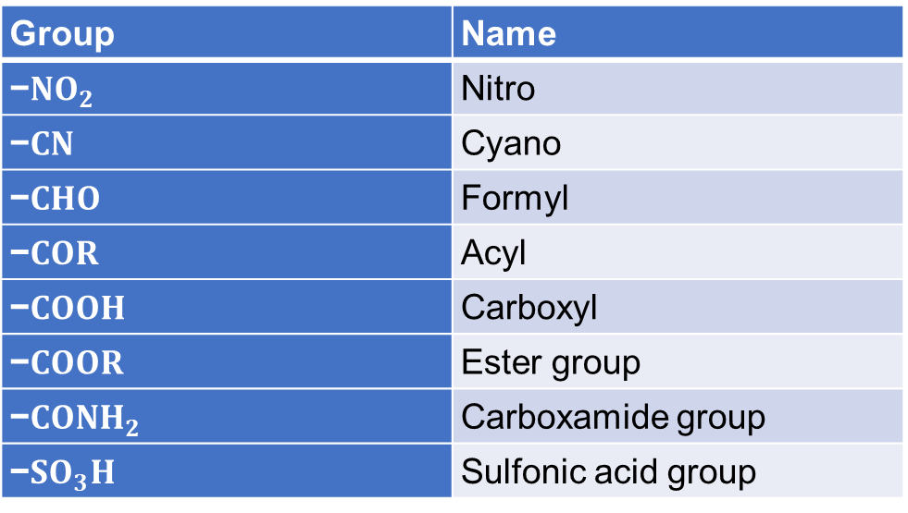
4.6.2 Common Groups Showing −M Effect
Group | Name
−$NO_{2}$ | Nitro
−$CN$ | Cyano
−$CHO$ | Formyl
−$COR$ | Acyl
−$COOH$ | Carboxyl
−$COOR$ | Ester group
−$CONH_{2}$ | Carboxamide group
−$SO_{3}H$ | Sulfonic acid group

Slide 48
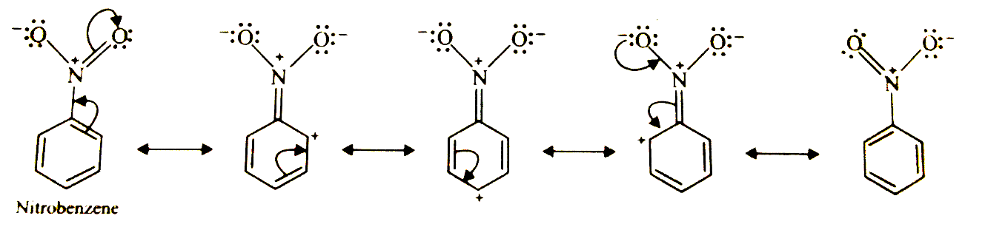

4.6.3 Explanation of −M Effect with an Example
4.6.4 Order of −M Effect
For several common substituents, a useful qualitative trend is:
$$−NO₂, −CN: strong −M groups$$
$$−CHO, −COR, −COOR, −COOH: carbonyl based −M groups$$

Slide 49
5 Applications of resonance
5.1 Combined Effect of Inductive and Mesomeric Effects
Important Points:
When both effects operate in the same direction, they reinforce each other.
5. When they operate in opposite directions, their relative strengths determine the overall electronic influence of the substituent.
6. In many conjugated systems, resonance has a stronger influence on particular properties than the inductive effect. However, this is not a universal rule.

Slide 50
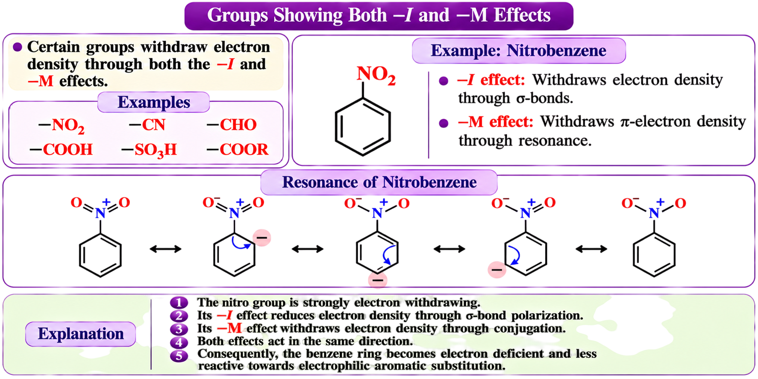
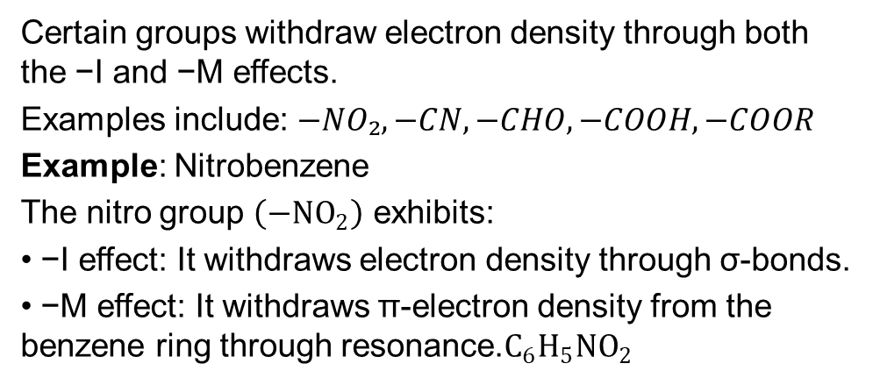
5.1.1 When Inductive and Mesomeric Effects Act in the Same Direction
Certain groups withdraw electron density through both the −I and −M effects.
Examples include: $−NO₂, −CN, −CHO, −COOH, −COOR$
Example: Nitrobenzene
The nitro group $\left(−NO_{2}\right)$ exhibits:
• −I effect: It withdraws electron density through σ-bonds.
• −M effect: It withdraws π-electron density from the benzene ring through resonance.$C_{6}H_{5}NO_{2}$
Explanation:
1. The nitro group is strongly electron withdrawing.
2. Its −I effect reduces electron density through σ-bond polarization.
3. Its −M effect withdraws electron density through conjugation with the benzene ring.
4. Both effects act in the same direction.
5. Consequently, the benzene ring becomes electron deficient and less reactive towards electrophilic aromatic substitution.
Important Concept: Nitrobenzene undergoes electrophilic aromatic substitution more slowly than benzene and predominantly gives meta-substituted products.

Slide 51
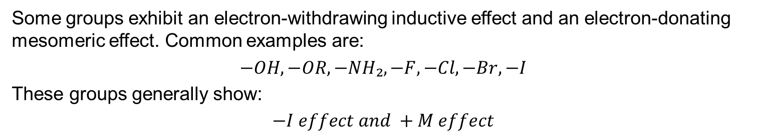
5.1.2 When Inductive and Mesomeric Effects Act in Opposite Directions
Some groups exhibit an electron-withdrawing inductive effect and an electron-donating mesomeric effect. Common examples are:
$$−OH, −OR, −NH₂, −F, −Cl, −Br, −I$$
These groups generally show:
$$−I effect and +M effect$$
However, the relative importance of these effects varies from one group to another.
Example 1: Phenol
Example 2: Chlorobenzene
Note:
Both phenol and chlorobenzene exhibit the same types of electronic effects, namely the negative inductive effect (−I) and the positive mesomeric effect (+M). However, their reactivities towards electrophilic aromatic substitution are opposite when compared with benzene.

Slide 52
Note: Both phenol and chlorobenzene exhibit the same types of electronic effects, namely the negative inductive effect (−I) and the positive mesomeric effect (+M). However, their reactivities towards electrophilic aromatic substitution are opposite when compared with benzene.
In phenol: The oxygen atom of the −OH group donates its lone pair into the benzene ring through effective overlap between oxygen's 2p orbital and carbon's 2p orbitals. The strong +M effect outweighs the deactivating −I effect. Consequently, phenol is more reactive than benzene.
In chlorobenzene: Chlorine also donates a lone pair through resonance. However, its relatively diffuse 3p orbitals overlap less effectively with the carbon 2p orbitals of the benzene ring. Consequently, its resonance donation is comparatively weak and cannot overcome its overall electron-withdrawing influence. Therefore, chlorobenzene is less reactive than benzene.
However, chlorine remains an ortho-para directing group because its resonance donation stabilizes the ortho and para substitution intermediates relative to the meta intermediate.

Slide 53
5.2 Mesomeric and Inductive Effects in Vinyl Chloride
Vinyl chloride (CH₂=CH–Cl) is an important example of a compound in which chlorine exhibits both the negative inductive effect (−I) and the positive mesomeric effect (+M).
In vinyl chloride, chlorine is directly attached to an sp²-hybridised carbon atom of the C=C double bond. Consequently, chlorine withdraws electron density through the σ-bond and donates electron density through resonance.
5.2.1 Inductive Effect (−I) in Vinyl Chloride
$$CH_{2}=CH^{δ+}−Cl^{δ−}$$
5.2.2 Mesomeric Effect (+M) in Vinyl Chloride
$$CH_{2}=CH−Cl ⟷ ​^{−}CH_{2}−CH=Cl^{+}$$

Slide 54
5.2.3 Consequences of Resonance in Vinyl Chloride
1. Partial double-bond character: The C–Cl bond acquires some double-bond character due to resonance.
2. Bond length and strength: The C–Cl bond is shorter and generally stronger than an ordinary comparable C(sp³)–Cl single bond.
3. Restricted rotation: Rotation about the C–Cl bond becomes more restricted because of its partial π-bond character.
4. Conjugation: A lone pair of chlorine participates in conjugation with the adjacent C=C double bond.
5. Chemical reactivity: Vinyl chloride is relatively resistant to ordinary nucleophilic substitution compared with typical alkyl chlorides.

Slide 55
5.5 Difference Between Resonance and Mesomeric Effect
Basis | Resonance | Mesomeric Effect (+M / −M)
1. Definition | Delocalisation of electrons within a molecule or ion. | Donation or withdrawal of electron density by a substituent through resonance.
2. Main purpose | Explains the actual electronic structure of a molecule. | Explains how an attached group influences electron distribution in a conjugated system.
3. Requirement | Requires suitable orbital overlap for electron delocalisation. | Requires a substituent conjugated with the rest of the molecule.
4. Electron movement | Electrons are delocalised over several atoms. | Electrons are donated or withdrawn by a particular group through conjugation.
5. Types | Not generally classified as +M or −M. | Two types: positive (+M) and negative (−M).
6. Substituent necessary? | No. | Yes, when discussing the electronic influence of a substituent.
7. Effect on stability | Delocalisation generally contributes to stability. | Can stabilise or destabilise particular intermediates depending on the system.
8. Examples | Benzene, 1,3-butadiene, carbonate ion. | −OH (+M), −NH₂ (+M), −NO₂ (−M), −CHO (−M).

Slide 56
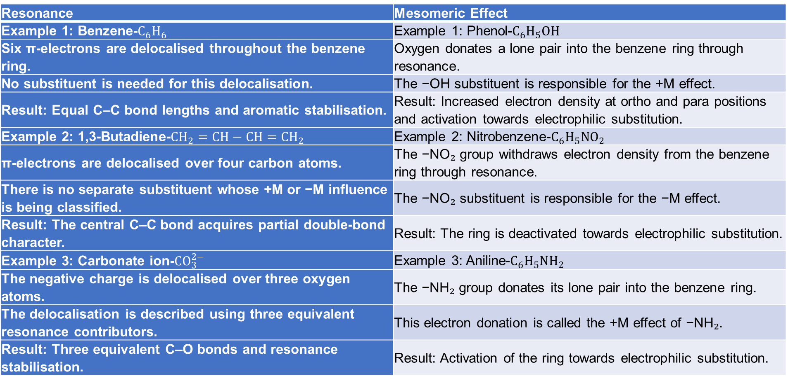
5.5.2 Difference Through Examples (Side by Side)
Resonance | Mesomeric Effect
Example 1: Benzene-$C_{6}H_{6}$ | Example 1: Phenol-$C_{6}H_{5}OH$
Six π-electrons are delocalised throughout the benzene ring. | Oxygen donates a lone pair into the benzene ring through resonance.
No substituent is needed for this delocalisation. | The −OH substituent is responsible for the +M effect.
Result: Equal C–C bond lengths and aromatic stabilisation. | Result: Increased electron density at ortho and para positions and activation towards electrophilic substitution.
Example 2: 1,3-Butadiene-$CH_{2}=CH−CH=CH_{2}$ | Example 2: Nitrobenzene-$C_{6}H_{5}NO_{2}$
π-electrons are delocalised over four carbon atoms. | The −NO₂ group withdraws electron density from the benzene ring through resonance.
There is no separate substituent whose +M or −M influence is being classified. | The −NO₂ substituent is responsible for the −M effect.
Result: The central C–C bond acquires partial double-bond character. | Result: The ring is deactivated towards electrophilic substitution.
Example 3: Carbonate ion-$CO_{3}^{2−}$ | Example 3: Aniline-$C_{6}H_{5}NH_{2}$
The negative charge is delocalised over three oxygen atoms. | The −NH₂ group donates its lone pair into the benzene ring.
The delocalisation is described using three equivalent resonance contributors. | This electron donation is called the +M effect of −NH₂.
Result: Three equivalent C–O bonds and resonance stabilisation. | Result: Activation of the ring towards electrophilic substitution.

Slide 57
6 Hyperconjugation

Slide 58
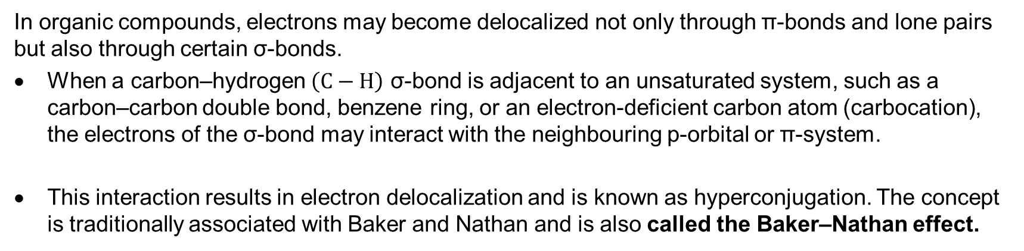
6.1 Introduction
In organic compounds, electrons may become delocalized not only through π-bonds and lone pairs but also through certain σ-bonds.
When a carbon–hydrogen $\left(C−H\right)$ σ-bond is adjacent to an unsaturated system, such as a carbon–carbon double bond, benzene ring, or an electron-deficient carbon atom (carbocation), the electrons of the σ-bond may interact with the neighbouring p-orbital or π-system.
This interaction results in electron delocalization and is known as hyperconjugation. The concept is traditionally associated with Baker and Nathan and is also called the Baker–Nathan effect.

Slide 59
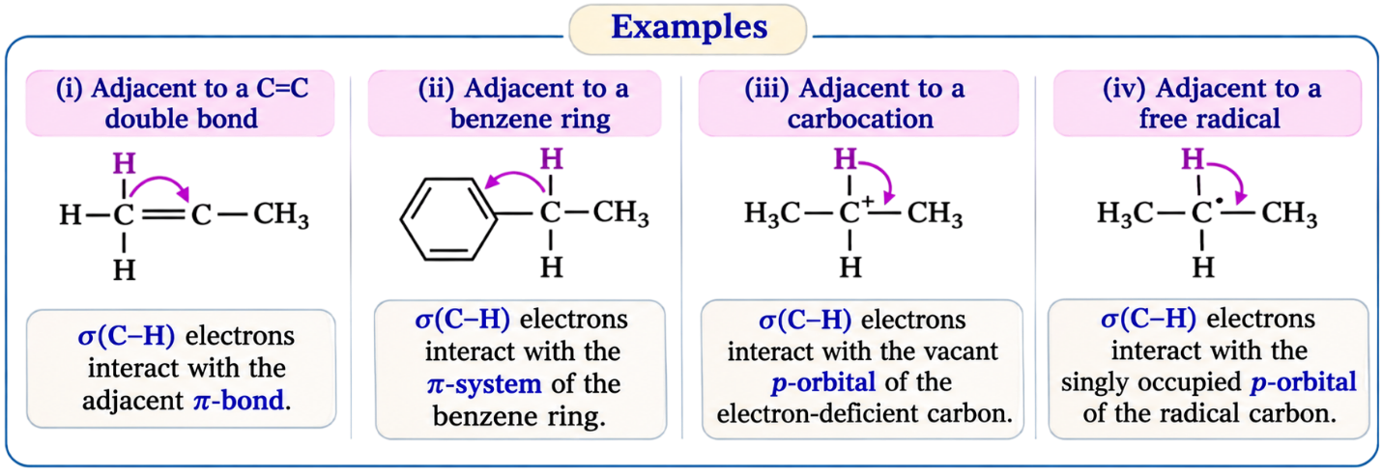
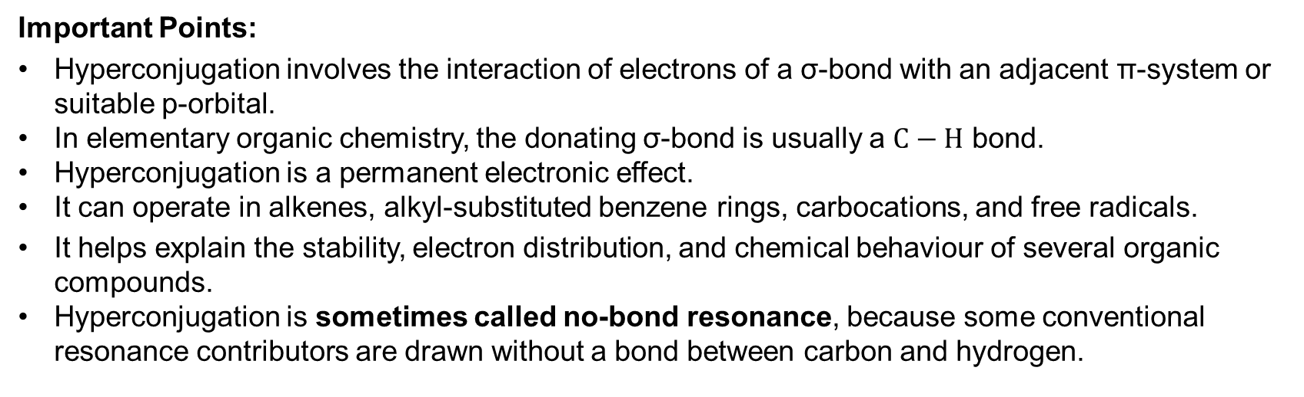
Important Points:
Hyperconjugation involves the interaction of electrons of a σ-bond with an adjacent π-system or suitable p-orbital.
In elementary organic chemistry, the donating σ-bond is usually a $C−H$ bond.
Hyperconjugation is a permanent electronic effect.
It can operate in alkenes, alkyl-substituted benzene rings, carbocations, and free radicals.
It helps explain the stability, electron distribution, and chemical behaviour of several organic compounds.
Hyperconjugation is sometimes called no-bond resonance, because some conventional resonance contributors are drawn without a bond between carbon and hydrogen.

Slide 60
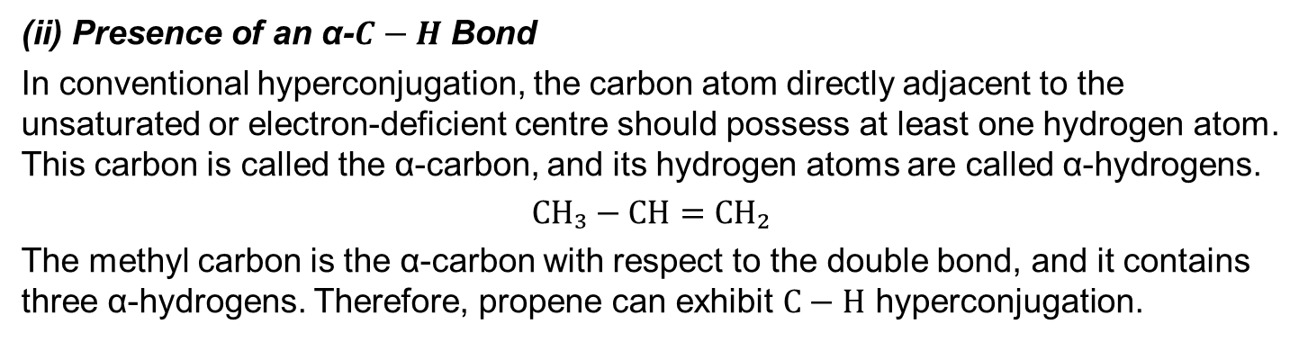
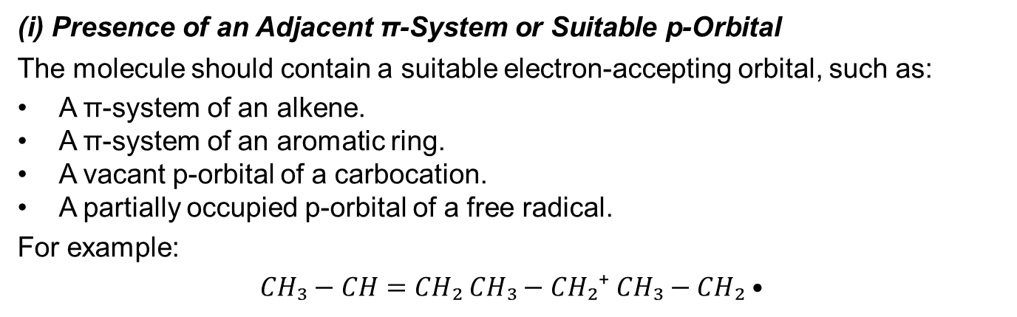
6.2 Structural Requirements for Hyperconjugation
(i) Presence of an Adjacent π-System or Suitable p-Orbital
The molecule should contain a suitable electron-accepting orbital, such as:
A π-system of an alkene.
A π-system of an aromatic ring.
A vacant p-orbital of a carbocation.
A partially occupied p-orbital of a free radical.
For example:
$$CH₃−CH=CH₂ CH₃−CH₂⁺ CH₃−CH₂•$$
(ii) Presence of an α-$C−H$ Bond
In conventional hyperconjugation, the carbon atom directly adjacent to the unsaturated or electron-deficient centre should possess at least one hydrogen atom. This carbon is called the α-carbon, and its hydrogen atoms are called α-hydrogens.
$$CH₃−CH=CH₂$$
The methyl carbon is the α-carbon with respect to the double bond, and it contains three α-hydrogens. Therefore, propene can exhibit $C−H$ hyperconjugation.

Slide 61
(iii) Proper Orbital Orientation
Effective orbital overlap is necessary.
Greater orbital overlap generally produces stronger hyperconjugative interaction.
Molecular geometry and bond rotation can influence the extent of hyperconjugation

Slide 62


6.5 Types of Hyperconjugation
6.5.1 σ–π Hyperconjugation
This occurs when electrons of a σ-bond interact with an adjacent π-system. Example: Propene
$$CH₃−CH=CH₂$$
The $C−H$ σ-bonds of the methyl group interact with the adjacent carbon–carbon π-bond. This interaction contributes to the stability of the alkene.
This occurs when a σ-bond interacts with an adjacent vacant or partially occupied p-orbital.
Example: Ethyl Carbocation
$$CH₃−CH₂⁺$$
The positively charged carbon possesses a vacant p-orbital. The adjacent methyl $C−H$ σ-bonds can donate electron density into this vacant orbital. This stabilizes the carbocation.
Example: Ethyl Free Radical
$$CH₃−CH₂•$$
The radical carbon possesses a partially occupied p-orbital. Interaction with adjacent $C−H$ σ-bonds contributes to radical stabilization.

Slide 63
6.5.3 Negative Hyperconjugation (Reverse Hyperconjugation)
Negative hyperconjugation involves the donation of electron density from a filled orbital, such as a lone pair (n) or π-orbital, into an adjacent antibonding σ* orbital.
What Happens in Negative Hyperconjugation?
Consider a molecule containing:
A filled orbital, such as a lone pair on oxygen or nitrogen.
A nearby σ-bond, such as C–F or C–Cl.
An unoccupied antibonding σ* orbital associated with that bond.
Every σ-bond has a corresponding antibonding orbital, represented by σ*.
For example, the C–F bond has:
σ(C–F): A filled bonding orbital.
σ(C–F):* An unoccupied antibonding orbital in the usual ground-state description.
If a neighbouring lone pair is suitably oriented, it can donate electron density into the σ*(C–F) orbital.

Slide 64


Slide 65
Why Is It Called Reverse Hyperconjugation?
Ordinary Hyperconjugation | Negative Hyperconjugation
σ-bond acts as an electron donor. | σ* orbital acts as an electron acceptor.
Electrons are donated from a filled σ-orbital. | Electron density is donated into an antibonding σ* orbital.
Example: σ(C–H) → p(C⁺) | Example: n(O) → σ*(C–F)
Helps stabilise carbocations and substituted alkenes. | Helps explain the anomeric effect and certain stereoelectronic effects.
Consequences of Negative Hyperconjugation
Electron donation into a σ* orbital can weaken and lengthen the corresponding σ-bond.
Favourable donor–acceptor orbital interaction can stabilise the overall molecule.
The strength of the interaction depends on effective orbital overlap and the relative orientation of the orbitals.

Slide 66

6.6 Number of Hyperconjugative Structures
In the traditional no-bond resonance model, each suitable α-hydrogen may give rise to a separate hyperconjugative contributor.
$$Number of no−bond contributors = Number of α−hydrogens$$
Including the original conventional structure:
$$Total structures = Number of α−hydrogens + 1$$
Example 1: Propene
$$CH₃−CH=CH₂$$
Number of α-hydrogens = 3.
$$Total structures = 3 + 1 = 4$$
Example 2: 2-Methylpropene
$$CH₂=C(CH₃)₂$$
There are two methyl groups attached to the double-bonded carbon. Number of α-hydrogens:
$$3 + 3 = 6$$
$$Total structures = 6 + 1 = 7$$

Slide 67
6.7 Applications of Hyperconjugation
6.7.1 Stability of Alkenes
Important Points:
Alkyl groups can stabilize adjacent double bonds through hyperconjugation.
A greater number of suitable α-C–H bonds often allows more hyperconjugative interactions.
Alkyl substitution also affects alkene stability through other electronic and steric effects.
Therefore, alkene stability cannot always be predicted using only the number of α-hydrogens.

Slide 68

Example: Comparison of Monosubstituted Alkenes
(i) Propene$CH₃−CH=CH₂$
Number of α-hydrogens = 3.
(ii) But-1-ene$CH₃−CH₂−CH=CH₂$
Number of α-hydrogens = 2.
(iii) 3-Methylbut-1-ene$(CH₃)₂CH−CH=CH₂$
Number of α-hydrogens = 1.
According to the simple α-hydrogen counting model, the hyperconjugative contribution is predicted to decrease as:
$$CH₃CH=CH₂ > CH₃CH₂CH=CH₂ > (CH₃)₂CHCH=CH₂$$
This order compares the expected conventional $C−H$ hyperconjugative contribution, not necessarily the experimentally measured overall thermodynamic stability of the three alkenes.
Important Concept:
For predicting alkene stability, consider degree of alkyl substitution, hyperconjugation, steric repulsion, geometrical isomerism, conjugation with other π-systems, and ring strain where applicable. Trans-but-2-ene is generally more stable than cis-but-2-ene because of reduced steric repulsion.
Therefore, we cannot reliably conclude that propene is the most stable and 3-methylbut-1-ene is the least stable merely by counting α-hydrogens.

Slide 69

6.7.4 Stability of Alkyl Free Radicals
A free radical contains an unpaired electron. In many carbon-centred radicals, the unpaired electron occupies a p-orbital or an orbital with substantial p-character. Adjacent σ-bonds can interact with this orbital through hyperconjugation.
Example:
$$(CH₃)₃C• > (CH₃)₂CH• > CH₃CH₂• > CH₃•$$
This is the usual qualitative stability order for simple alkyl radicals.

Slide 70


6.7.5 Electron-Releasing Power of Alkyl Groups in Alkylbenzenes
Alkyl groups attached to benzene rings generally increase the electron density of the aromatic system. For example, toluene contains a methyl group directly attached to benzene.
$$C₆H₅−CH₃$$
The methyl group donates electron density through the +I effect and hyperconjugation.
Explanation:
The methyl group contains three $C−H$ bonds adjacent to the aromatic π-system.
These bonds can interact with the benzene π-orbitals.
Hyperconjugation contributes to electron donation into the ring.
Electron density increases particularly at the ortho and para positions in the conventional resonance representation.
Therefore, the methyl group activates the benzene ring towards electrophilic aromatic substitution.
According to the conventional $C−H$ hyperconjugation model, their hyperconjugative donation tendency follows:
$$−CH₃ > −CH₂CH₃ > −CH(CH₃)₂ > −C(CH₃)₃$$
However, the electron-donating inductive effect generally increases with increasing alkyl substitution.

Slide 71

6.7.6 Heat of Hydrogenation
The heat of hydrogenation is the heat released when an unsaturated compound reacts with hydrogen to form a saturated compound. For example:
$$CH₂=CH₂ + H₂ → CH₃CH₃$$
Hydrogenation of a typical alkene is exothermic.
Relationship Between Alkene Stability and Heat of Hydrogenation: When comparable alkenes hydrogenate to the same saturated product, the more stable alkene generally releases less heat during hydrogenation.
$$Greater alkene stability ⇒ Smaller magnitude of heat of hydrogenation$$

Slide 72

Explanation:
Hyperconjugation can stabilize an alkene.
A more stable alkene has a lower initial energy.
If two alkenes form the same hydrogenation product, the more stable starting alkene generally releases less heat, and show is less reactive
Thus, heat of hydrogenation can be used to compare the relative thermodynamic stability of suitable alkenes.

Slide 73

6.7.7 Effect of Hyperconjugation on Dipole Moment
Hyperconjugation can influence the distribution of electron density within a molecule and consequently affect its dipole moment.
Dipole moment is a measure of the separation of positive and negative charges.
$$μ = q × d$$
where μ = dipole moment; q = magnitude of separated charge; d = distance between the centres of charge.
Example: Formaldehyde and Acetaldehyde
Formaldehyde:
$$HCHO μ ≈ 2.27 D$$
Acetaldehyde:
$$CH₃CHO μ ≈ 2.72 D$$
The methyl group in acetaldehyde can interact with the carbonyl π-system through hyperconjugation.

Slide 74

Explanation:
Formaldehyde contains a polar $C=O$ bond.
Acetaldehyde also contains a polar $C=O$ bond.
In acetaldehyde, the adjacent methyl group introduces additional electronic interactions.
Hyperconjugation can contribute to changes in the electron distribution of the carbonyl group.
Consequently, the overall molecular dipole moment differs from that of formaldehyde.
Important: The dipole moment of a molecule depends on its complete electron distribution and molecular geometry. The difference between the dipole moments of formaldehyde and acetaldehyde cannot be attributed exclusively to hyperconjugation.

Slide 75

6.7.8 Orienting Influence of Alkyl Groups in Benzene
Example :
$−CH₃: Activating, ortho−para directing$
Orienting Influence of the –$CCl$₃ Group: The trichloromethyl group (–$CCl$₃) has a strong electron-withdrawing inductive effect. It generally deactivates the benzene ring and directs electrophilic substitution predominantly towards the meta position.
$$−CCl₃: Deactivating, meta directing$$
This behaviour is commonly explained primarily by its strong −I effect, with additional stereoelectronic interactions considered in more advanced treatments.

Slide 76
7. Electromeric effects

Slide 77

7.1.1 Definition
The electromeric effect (E-effect) is a temporary electronic effect involving the complete transfer of a π-electron pair of a multiple bond towards one of the bonded atoms under the influence of an attacking reagent.
It is observed in compounds containing multiple bonds, particularly carbon–carbon double bonds and carbonyl groups.
Important Points:
1. The electromeric effect is a temporary electronic effect.
2. It occurs in compounds containing multiple bonds.
3. It involves the complete displacement of a π-electron pair in the conventional representation.
4. The effect is produced under the influence of an attacking reagent.
5. The electron-pair movement is represented by a curved arrow.
6. The effect may produce charge separation or facilitate the formation of a new bond.
7. It is classified into positive electromeric effect (+E) and negative electromeric effect $\left(−E\right)$.

Slide 78

7.1.2 Representation of Electromeric Effect
Consider a generalized multiple bond:
$$A=B$$
Under the influence of an attacking reagent, the π-electron pair may be transferred towards one atom. For example:
$$A=B → A⁺−B⁻$$
Here, the π-electron pair is formally transferred towards B.
Explanation:
1. Initially, A and B are connected by a multiple bond.
2. The attacking reagent influences the electron distribution.
3. The π-electron pair shifts towards one of the bonded atoms.
4. One atom becomes electron deficient, while the other becomes electron rich in the formal representation.
5. The resulting electronic arrangement facilitates the subsequent reaction.
Important: The displayed charged structure is a formal representation of electron-pair movement. It does not necessarily represent an independently existing intermediate.

Slide 79
7.2 Types of Electromeric Effect
Depending on the direction of electron-pair movement relative to the attacking reagent, the electromeric effect is classified into:
1. Positive electromeric effect (+E effect).
2. Negative electromeric effect (−E effect).

Slide 80


7.2.1 Positive Electromeric Effect (+E Effect)
The temporary electronic effect in which the π-electron pair of a multiple bond is transferred towards the atom to which the attacking reagent becomes attached is called the positive electromeric effect (+E effect).
It is commonly illustrated by the addition of an electrophile to an alkene.
Example: Addition of $H^{+}$ to Propene
Consider propene:
$$CH₃−CH=CH₂$$
Propene contains a carbon–carbon double bond. When a proton approaches the double bond, the π-electrons can participate in forming a new $C−H$ bond.
The reaction may be represented as:
$$CH₃−CH=CH₂ + H⁺ → CH₃−CH⁺−CH₃$$
The major carbocation formed is the secondary carbocation, which is more stable than the alternative primary carbocation.
The carbocation is:
$$CH₃−CH⁺−CH₃$$

Slide 81

Why Is the Secondary Carbocation Formed Preferentially?
The secondary carbocation is more stable because:
1. Two methyl groups donate electron density through the +I effect.
2. Adjacent $C−H$ σ-bonds provide hyperconjugative stabilization.
3. The positive charge is better stabilized than in the primary carbocation.
Therefore, protonation preferentially produces the secondary carbocation.

Slide 82

7.2.2 Negative Electromeric Effect (−E Effect)
The temporary electronic effect in which the π-electron pair of a multiple bond is transferred away from the atom to which the attacking reagent becomes attached is called the negative electromeric effect (−E effect).
It is commonly illustrated by the nucleophilic addition of a reagent to a carbonyl compound.
Example: Addition of Cyanide Ion to a Carbonyl Compound
Consider a carbonyl compound:
$$R₂C=O$$
The carbonyl group is polarized because oxygen is more electronegative than carbon. Therefore:
$$Cᵟ⁺=Oᵟ⁻$$
When cyanide ion $\left(CN^{−}\right)$ approaches the carbonyl carbon, it attacks the electron-deficient carbon atom.
The reaction is:
$$R₂C=O + CN⁻ → R₂C(CN)−O⁻$$

Slide 83


Explanation:
1. The carbonyl carbon carries a partial positive charge.
2. The cyanide ion is a nucleophile and possesses an electron pair available for bond formation.
3. The carbon end of cyanide attacks the carbonyl carbon.
4. Simultaneously, the π-electron pair of the $C=O$ bond shifts towards oxygen.
5. A new carbon–carbon σ-bond forms between the carbonyl carbon and cyanide.
6. Oxygen acquires a negative formal charge, forming an alkoxide intermediate.
7. Subsequent protonation of the alkoxide produces a cyanohydrin.
The protonation step is:
$$R₂C(CN)−O⁻ + H⁺ → R₂C(OH)−CN$$
Important Concept: Nucleophilic addition to aldehydes and ketones is a fundamental reaction of carbonyl compounds. The movement of π-electrons towards oxygen is a key step in the mechanism.

Slide 84

7.4 Direction of Electron-Pair Shift
7.4.1 When Similar Groups Are Attached to the Multiple Bond
If the two ends of a multiple bond are chemically equivalent, electron-pair movement towards either end may lead to equivalent products.
Example: Ethene
$$CH₂=CH₂$$
7.4.2 When Dissimilar Groups Are Attached to the Multiple Bond
If the groups attached to the two ends of a multiple bond are different, the direction of electron-pair movement may be influenced by:
1. Inductive effects of the substituents.
2. Resonance effects.
3. Hyperconjugation.
4. Stability of the intermediate or transition state.
5. Nature of the attacking reagent.
6. Reaction conditions.

