Slide 1
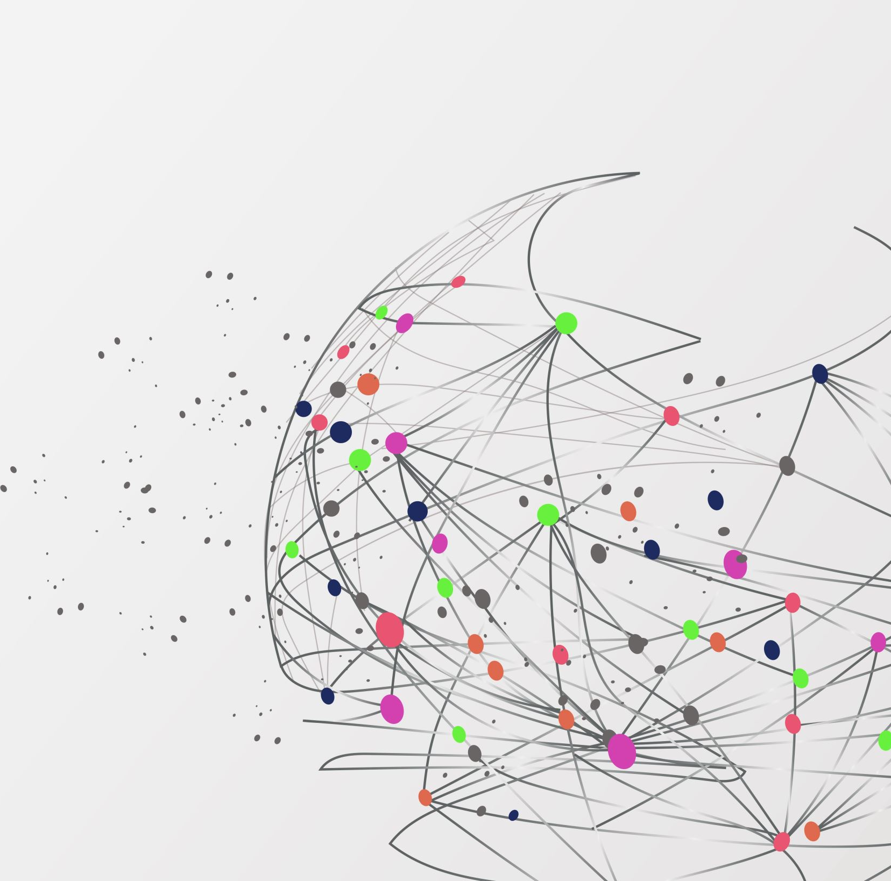

Validation and Reliability Assessment of Autopsy Forensic Suite
Ensuring Data Integrity in Open-Source Digital Forensics
Gurumanie singh dhiman
Notes:
Hello everyone. Today I will be presenting a validation study on Autopsy (v4.22.1), one of the most widely used open-source digital forensic tools. While large government agencies have resources for expensive tools like EnCase, many small labs rely on Autopsy. This research asks a critical question: Can small labs prove their tool is reliable in court without a massive budget?

Slide 2
The Problem & Motivation
The Challenge:
Courts require scientific reliability (Daubert Standard).
Commercial tools are "Black Boxes" (cannot see their code).
Open-source tools need validation, but NIST tests are often too complex/outdated for small labs.
The Goal:
Create a simple and repeatable “Ground Truth” test.
Verify the File Location, Metadata Accuracy, and Repeatability.
Notes:
In digital forensics, evidence is scrutinized closely. Under standards like the Daubert rule, we must show our methods are reliable. The problem is that official validation tests from NIST are often too complicated for a standard student or small lab to perform quickly. Furthermore, many investigators assume tools work perfectly, which is dangerous. This study aims to fill that gap by creating a straightforward experiment to verify if Autopsy can accurately locate files and report metadata correctly.

Slide 3
Methodology
Environment:
Windows 10 VM, 2GB NTFS Virtual Drive.
Dataset (55 Files Total):
25 Documents (docx,.pdf,.txt)
30 Images (jpg,.png).
Deletion Scenarios:
Standard Files: Moved to the Recycle Bin.
Permanent Files: "Shift + Delete" (Bypassing Recycle Bin).
Verification:
Cryptographic Hashes (SHA-256) compared to a Master List.
Notes:
Speaker Notes (1:00): "To test the tool, I couldn't just use a random hard drive. I needed a 'Ground Truth' dataset—meaning I built the drive from scratch, so I knew exactly what was on it. I populated a clean NTFS drive with 55 files—documents and images. Crucially, I created specific scenarios to trigger errors. I used 'Shift+Delete' on a file named Secrets.txt to bypass the recycle bin and force immediate table updates. Finally, I generated hash values for every file to act as a master key for verification."

Slide 4
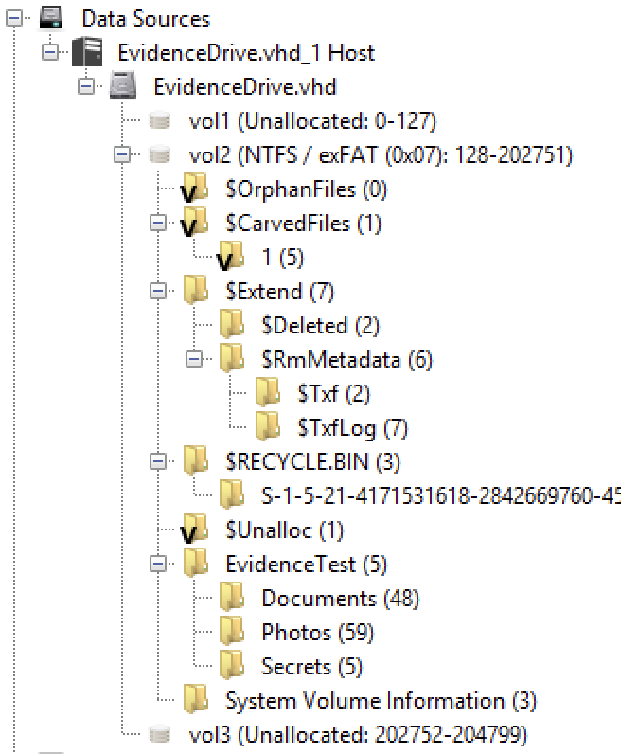
Results - Pros
Allocated (Active) Files: 98.2% Accuracy.
Directory Structure: Reconstructed Perfectly.
Visual Evidence: Autopsy correctly identified the folder tree, including folders such as Secrets even after files were deleted.
Notes:
Speaker Notes (0:45): "Let's look at the results. For files that were still present on the disk (allocated), Autopsy performed exceptionally well with over 98% accuracy. As you can see from the directory tree analysis, Autopsy successfully rebuilt the folder structure. It even located the 'Secrets' folder. This is vital in court because proving a folder named 'Secrets' existed helps establish user intent, even if the files inside are missing."

Slide 5
Results - Cons
Deleted File Recovery: Only 80% Accuracy.
01
The "Shift + Delete" Failure for Secrets.txt:
02
Metadata: Present (File listed as recovered).
Content: Corrupted (Hex view shows binary noise).
System Files: desktop.ini was completely lost/overwritten.
03
Notes:
Speaker Notes (1:15): "However, the tool struggled with deleted files, achieving only 80% accuracy. This is the most critical finding: The 'Shift+Delete' scenario caused a dangerous inconsistency. Autopsy listed the file Secrets.txt as recovered and showed its metadata. But, when I looked at the Hex View—the actual raw data—the text 'The secret password is...' was gone. It was replaced by random binary noise. The OS had reused the space immediately. If an investigator didn't check the Hex, they would present false evidence to the court. We also found that system files like desktop.ini were overwritten much faster than user files, making recovery unpredictable."

Slide 6

Timestamp Issues
Issue: Discrepancy between the File System Time and Local Time.
Example:
EXIF Data: 2:00 PM (Actual).
Autopsy Display: 8:00 AM (Adjusted for examiner's time zone).
Risk: Establishing a false timeline/alibi in court.
Notes:
Speaker Notes (0:45): "Another major issue was timeline reconstruction. Autopsy often defaults to the examiner's local time rather than the file system time. In my test, an image taken at 2:00 PM showed up as 8:00 AM in the file list. Without validating these timezone settings, an investigator could make a timeline error of several hours, which could ruin a suspect's alibi or a prosecution's case."

Slide 7
Proposed Solution
Adaptive Forensic Verification Protocol (AFVP):
Locate: Use Autopsy to find files.
Hex Check: Manually verify file signatures and don't trust the filename.
Double Check: Use command-line tools (Sleuth Kit) for independent verification.
Recommendation for Small Labs:
Maintain a "Golden Image" USB drive for quarterly reliability checks.
Notes:
Speaker Notes (1:00): "So, how do we fix this? I propose a 'Lightweight Validation Protocol' for small labs. We call it the Adaptive Forensic Verification Protocol. First, do not blindly trust a 'Recovered' status. Second, you must look at the Hex view to ensure the file header matches the file type. Third, small labs should keep a 'Golden Image'—a USB drive with known data—and test their tools against it quarterly to catch these updates and errors before they happen in a real case."

Slide 8

Conclusion
Summary:
Autopsy is reliable for active files (100% accuracy).
"Shift + Delete" creates "Ghost Entries” where the metadata exists, but the data is gone.
Key Takeaway: Trust the tool but verify the data.
Future Work: Testing SSDs (TRIM command) and Encryption (BitLocker).
Notes:
Speaker Notes (0:30): "In conclusion, Autopsy is a solid tool, but it has blind spots. It excels at finding active files, but the 'Shift+Delete' test proves you cannot trust the file list alone. The metadata might be there while the content is gone.Our final recommendation is simple: Trust the tool, but verify the data. Future research will expand this to Solid State Drives and Encrypted volumes. Thank you."

