Slide 1
Neuroqueering Play Therapy: What My Clients Have Helped Me Understand
Kelly Bishop (she/her)
Master of Arts in Clinical Mental Health Counseling Candidate
Transpersonal Wilderness Therapy Program
Naropa University
May 8th, 2025

Slide 2
Neurodiversity
Neurodiversity: the natural and valuable variation of human neurocognitive functioning; the biological reality that no two human brains/nervous systems/minds are exactly alike (Walker, 2021; Walker & Raymaker, 2021)
Origin & History
Emerged in the 1990s within the discourse of early online autistic communities (Chapman & Botha, 2022)
Conceptualized variation of human neurocognitive functioning as a dimension of biological diversity; emphasized the importance of preserving it by applying an ecological lens (Dekker, 2022)
Developing terminology helps correct hermeneutical injustice (Fricker, 2007; Chapman & Botha, 2022; Pearson & Rose, 2023; Walker, 2021), which is a type of epistemic injustice (Fricker, 2007)

Slide 3
Epistemic Injustice & Ongoing Oppression
Certain sociocultural contexts
Early autism constructs emerged within sociocultural contexts characterized by pathologization of difference, white supremacy, and eugenic thought (Pearson & Rose, 2023; Green & Shaughnessy, 2023)
Epistemic injustice
Pathologization of human diversity and difference: improper application of the medical model, erroneous assumptions (Pearson & Rose, 2023; Green & Shaughnessy, 2023; Botha, 2021)
Exclusion of autistic voices/experience (Pearson & Rose, 2023; Green & Shaughnessy, 2023; Botha, 2021)
Ongoing oppression…& hope
The medicalization of autism & oppression of autistic people continue (Pearson & Rose, 2023; Green & Shaughnessy, 2023; Yergeau, 2018; Walker, 2021; Price, 2022; Nerenberg, 2020)
→ inaccurate, dehumanizing, & self-reifying constructs (Pearson & Rose, 2023; Green & Shaughnessy, 2023; Botha, 2021)
Building evidence indicates that constructs are flawed (Pearson & Rose, 2023; Green & Shaughnessy, 2023; Yergeau, 2018; Walker, 2021; Price, 2022; Nerenberg, 2020)

Slide 4
A Paradigm Shift:
Paradigm shift: a fundamental change in the basic concepts & experimental practices of a scientific model in response to phenomena incompatible with the old paradigm (“Paradigm shift”, 2025)
—A concept introduced by physicist-philosopher Thomas Kuhn in The Structure of Scientific Revolutions (1962)
Has since been extended to fields beyond the natural sciences to describe a profound change in a set of underlying assumptions within bodies of academic work
In 2012, Nick Walker, autistic Professor of Psychology at CIIS, introduced a new philosophical framework for approaching and understanding neurodiversity.
Pathology Paradigm
Neurodiversity Paradigm
Pathology Paradigm | Neurodiversity Paradigm
The dominant philosophical framework underlying medicalized approaches to cognitive, learning, & developmental disabilities, which promulgate their pathologization | Rejects pathologization of forms of neurodivergence that are “intrinsic and pervasive factors in an individual’s psyche, personality, and fundamental way of relating to the world” (Walker, 2021, p. 39)
Applies a species-norm for human cognitive functioning, assuming this extrapolation is valid | Posits inadequate uniformity for justifying application of a species-norm
Asserts that deviation from the species-norm is not normal, justifying its prevention, remediation, & cure | Asserts that cognitive diversity is natural & valuable
(Walker, 2021; Walker & Raymaker, 2021; Chapman & Botha, 2022)
Notes:
Draw upon Walker & Raymaker, 2021!! Maybe also Pearson & Rose, Walker, 2021, Chapman & Botha
EXCERPT FROM CHAPMAN & BOTHA: n 2012, Walker distinguished between the pathology paradigm and the neurodiversity paradigm.² The pathology paradigm is the dominant paradigm encompassing medicalized approaches to cognitive, learning, and developmental disabilities across the psychological sciences. It is defined by the reliance on a relatively restricted norm when it comes to cognitive functioning. Under the medicalized model, deviation from the norm is considered as disorder, disease, or dysfunction and there is a focus on remediation, prevention, and cure.^{18, 19} By contrast, the neurodiversity paradigm conceptually frames cognitive diversity itself as normal, rather than viewing it from the assumption that there is enough uniformity across the species to justify the use of a species-norm.
Walker also summarized neurodiversity paradigm terminology that has been widely (but not universally) adopted by neurodiversity proponents. On the neurodiversity paradigm, people are either closer, albeit in an endless variety of ways, to being more ‘neurotypical’ or more ‘neurodivergent’, depending on how well they conform to normative expectations of a given society. Some neurodivergent groups form ‘neurominorities’, which refers to minority neurocognitive groups who are disadvantaged in a particular society. This reconceptualizes disabilities such as autism, ADHD, and developmental coordination disorder in line with how cultural, ethnic, and sexual minorities are conceptualized. Walker's framework helped develop the philosophical basis of the movement and allow the neurodiversity concept to be utilized beyond the autistic community for those with other diagnoses.

Slide 5
The Neurodiversity Movement
A social justice and civil rights movement led by and for people with neurocognitive, developmental, and psychological disabilities
Aims to end the default pathologization of neurodivergence and advocate for acceptance and accommodation of neurodiversity
An identity-based movement modeled after similar social justice movements, particularly those of the queer and deaf communities
Started within the autism rights movement but does not equate to it
Adopted by other neurominority groups and neurodivergent activists, including people diagnosed with ADHD, developmental coordination disorder, and dyslexia
(Chapman & Botha, 2022; Walker, 2021)
Notes:
KEEP THIS AS BRIEF AS POSSIBLE
Draw upon Walker & Raymaker, Walker, Chapman & Botha, Green & Shaughnessy, etc.
²⁰The neurodiversity movement is a social justice and civil rights movement led by and for people with neurocognitive, developmental, and psychological disabilities.¹ Neurodiversity theory proposes that divergence from expected functioning (such as autism, attention-deficit/hyperactivity disorder [ADHD], developmental coordination disorder, or dyslexia) are natural variations of human minds, and those who diverge from the norm (neurominorities) are equally deserving of dignity, respect, and accommodation. Views among neurodiversity proponents are varied and the theory underlying the neurodiversity paradigm is still emerging. Neurodiversity started as an identity-based movement which centred neurodivergence at the core of a person's identity. The concept of neurodiversity initially arose among autistic communities in the late 1990s but has since been adopted by many activists and advocates with other diagnoses, including ADHD, developmental coordination disorder, and dyslexia. In general, though, neurodiversity proponents tend to promote moving towards a non-pathologizing perspective regarding neurocognitive disability that begins with the acknowledgement of neurocognitive diversity as natural, valuable, and in need of support. Proponents also tend to embrace the identity of ‘disability’ even while moving away from notions of ‘illness’ or ‘disorder’. Alongside this, social models of disability tend to be favoured to explain neurodivergent disablement and distress in terms of societal barriers rather than as individual medical problems. The term ‘neurodiversity paradigm’² refers to the emerging framework for understanding human mental variation, ability, and disability that the neurodiversity movement is based on. Overall, the shift is away from a medicalized approach that associates recovery with functional normalcy, and towards a disability justice paradigm that takes neurocognitive diversity itself to be normal.

Slide 6
Neuroqueer Theory
Emerged from the intersection of queer theory, crip theory, and neurodiversity
Critiques how society constructs or defines normalcy, especially regarding gender, sexual orientation, and dis/ability
Neuroqueer extends queer into the intersectional realm
Coined and developed by Athena Lynn Michaels-Dillon, Nick Walker, & Remi Yergeau who had each arrived at roughly the same idea by 2014
Just as the prevailing culture entrains and pushes people into the embodied performance of heteronormative gender roles, it also entrains and pushes us into the embodied performance of neurotypicality—the performance of what the dominant culture considers a “normal’’ bodymind. And just as heteronormativity can be queered, so can neurotypicality: we can subvert, disrupt and deviate from the performance of being neurocognitively “normal.”
(Walker & Raymaker, 2021, p. 9)
(Walker, 2021; Walker & Raymaker, 2021; “Neuroqueer theory”, 2025)

Slide 7
Defining(?) Neuroqueering
Neuroqueering: to engage in the practice of queering—that is, subverting, defying, disrupting, liberating oneself from—neuronormativity and heteronormativity simultaneously
Yergeau, Walker, & Michaels-Dillon conceptualized neuroqueering, which encompasses eight types of interwoven practices:
Being both neurodivergent & queer with some degree of awareness/exploration of these identities’ entwinement/interactions
Embodying & expressing one’s neurodivergence in ways that also queer one’s performance of gender, sexuality, ethnicity, etc.
Engaging in practices intended to undo/subvert one’s cultural conditioning & ingrained habits of neuronormative and heteronormative performance, with the aim of reclaiming capacity to express one’s uniquely weird potential/inclinations
Engaging in the queering of one’s neurological processes (& related embodiment/expression) by intentionally altering them in ways that increase divergence from cultural standards of heteronormativity/neuronormativity.
Approaching/embodying/experiencing one’s neurodivergence as a form of queerness (e.g., in ways inspired by, or similar to, how queerness is understood and approached in Queer Theory, Gender Studies, and/or queer activism).
Producing literature, art, scholarship &/or cultural artifacts that foreground neuroqueer experiences, perspectives, and voices.
Producing critical responses to literature and/or other cultural artifacts, focusing on intentional/unintentional characterizations of neuroqueerness and how those characterizations illuminate and/or are illuminated by actual neuroqueer lives and experiences.
Working to transform social & cultural environments to create spaces & communities—& ultimately a society—in which engagement in any or all of the above practices is permitted, accepted, supported, & encouraged.
(Walker, 2021, pp. 160-163)
“Part of the idea of neuroqueerness is that heteronormativity and neurotypicality are inextricably entwined with one another, and to queer one is inevitably to queer the other to some degree” (Walker & Raymaker, 2021, p. 9).

Slide 8
Neuroqueering Continued
The authentic embodiment or expression of neurological queerness (i.e., neuroqueer identity; embraced neurodivergence) is, in and of itself, neuroqueering (Yergeau, 2018)
In her book, Neuroqueer Heresies, Walker argues that autistic people, by virtue of their difference, queer expectations of neuronormativity…She proposes that ‘neuroqueering’ can provide an emancipatory platform for anyone (autistic and non-autistic alike) to reject normative social standards (including the idea of as heterosexual, cisgender, white, etc as the default and anything else as ‘variations’ on the norm) in order to flourish.
(Pearson & Rose, 2023, p. 22)

Slide 9
Neurodivergence-Informed Therapy (NIT)
(Chapman & Botha, 2022)
NIT arose from discourse within the autistic community with the aims of improving service for—and preventing harm toward—autistic populations
Proposed by Robert Chapman & Monique Botha, two neurodivergent scholar-activists
A concept aimed at promoting the integration of neurodiversity theory into clinical practice with neurodivergent people
Proposed three themes to guide therapists’ implementation:
Reconceptualization of dysfunction as relational rather than individual
The importance of neurodivergence acceptance and pride, and disability community and culture to emancipate neurodivergent people from neuro-normativity
The need for therapists to cultivate a relational epistemic humility regarding difference experiences of neurodiversity and disablement
(Chapman & Botha, 2022, p. 310) (bolded font added for emphasis).
epistemic humility: an intellectual virtue that involves recognizing knowledge as provisional and incomplete; acknowledging the limitations of perspective; bringing openness to other possibilities, including others’ perspectives and experiences; willingness to revise our beliefs when new evidence emerges; and engaging in critical reflection upon our beliefs and biases (Fricker, 2007)

Slide 10
Synergetic Play Therapy (SPT)
(Dion, 2018)
Created by Lisa Dion
Naropa alum, founder/President of the Synergetic Play Therapy Institute, teacher, author, coach, and mother
Draws upon interpersonal neurobiology, physics, attachment, & mindfulness; emphasizes authenticity of the therapist
Neuroception of safety (that is, a sense of being safe enough) is foundational to therapeutic process
Therapeutic Process
“The test”
Building awareness of “the challenge”
Gradually moving toward “the challenge” while supporting regulation→ opportunities for new experiences → shifting perceptions, empowerment, & client’s rewiring of threat response patterns
4 Types of Threats
3 out of 4 of these are non-physical in nature—that is, “challenges of the brain” (e.g., “should”s)
Regulation Strategies: mindful awareness, breath, movement, naming experience (i.e., aspects of our own embodied experience)
Key Processes: co-regulation, limbic resonance, modeling, bringing awareness to the client’s “offering” (aka “the set-up”)
Notes:
Draw upon Aggression in Play Therapy
CONDENSE THIS A BUNCH!

Slide 11
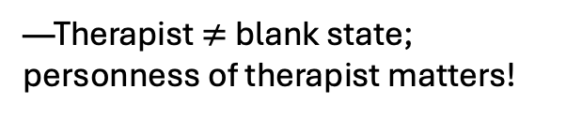
Improving Therapeutic Services for ND Kids
NIT: Improving Therapy for ND People
SPT: Refining Play Therapy
—Emphasizes difference of experience (relational epistemic humility, minority identity pride/community) & social systems
—Intersubjective lens & systems-oriented awareness
—Emphasizes commonality of experience (such as through limbic resonance) and interpersonal relationality/systems (e.g. IPNB)
—Client as expert; client-led; non-pathologizing
—Proposes that we all want to be seen/known & that modeling is part of the therapist’s role
—Incorporates epistemology; Dx→ identity; dysfunction as relational
—Through embracing ND identity and disability community/culture; emancipation from neuro-normativity
—Aims to promote empowerment & respects client’s autonomy
—By providing opportunities for new experiences of “the challenge” & trusting client’s process/timeline/inherent wisdom
—Emphasizes relevance of Th’s identities, esp. ND & disability
—Therapist $≠$ blank state; personness of therapist matters!
—Emphasizes relevance of Th’s embodied experience; authenticity essential to safety
—Brings awareness to common trauma within ND pop., such as inaccessibility, violations of agency, & relational trauma
—Trauma-informed
—Brings awareness to 4 types of threats; emphasizes neuroception of safety & NS states
—Aims to support acceptance/integration of all parts
—Emphasizes the importance of not shaming (e.g., ideas for redirecting play w/o shaming; only redirecting when necessary, etc.)
—Emphasizes identity pride, reclaiming identity labels, etc.
—Challenges unhelpful assumptions of prior/prominent theories; offers vial reframes
—Reframes: “therapeutic” aim of normalization, dysfunction as relational, & more
—Reframes: countertransference, the purpose of boundaries, the nature of resistance & more
—Esp. as related to social justice, civil rights, resistance to neuronormativity
—Extends far beyond the therapy room
—Esp. as a way of being in relationship (with others & oneself), relational insights, regulation
Notes:
SPT/NIT Venn Diagram

Slide 12

Neuroqueering Play Therapy: A Case Study
What My Clients Have Helped Me Understand

Slide 13
Case Study: Background Information
My Process: Mapping Out Examples of Neuroqueering
Internship Site: Louisville Family Center
Primary Clinical Population: ND kids
Case Study: I drew upon my clinical experiences with 7 neurodivergent kids/young adolescents (ages 2-13).
Based upon a plethora of examples of what I’d perceived as clients’ brilliant subversion of neuronormative expectations in the therapy room, and which have meaningfully contributed to my understanding of neuroaffirming care
Today: We’ll focus on 2 case examples instead for the sake of providing adequate depth.
Components | Dimensions
Play | —Essence/Social Dynamics —Toys —“The Rules”
Interpersonal Connection | —Continuity/Intensity —Connection —Modes/Avenues
Therapeutic Relationship | —Roles/Power Dynamics —Self-Disclosure
Therapeutic Process | —Self-Reflective Processes —Regulation Strategies —The Heart of the Matter
The Structure of Therapy | —Time and Place —Online Etiquette —Aims/What We’re Doing
Other Conventions | —Sand Tray Play —Shoes

Slide 14
Case Example 1: self-Disclosure via Process
The Client: 11-year-old, White-passing* autistic cisgender female
*race & ethnicity not disclosed
Neurocognitive Identity/Profile: autistic, sensory sensitivities, PDA characteristics
Relevant Context: autistic burnout, applying to art school, my difficulty gathering info for reference letter
The Experience: inspired show-and-tell self-disclosure process about her passion; monotropic style
Neuronormative Expectations: self-disclosure involves talking about oneself; the therapeutic process is primarily interpersonal…AND this should look a certain way (e.g., monotropic style is not interpersonal/okay)
Pathology Lens: She’s talking about her “special interest” and not letting anyone else talk. She needs help developing “social skills”/interrupting hyperfocus. She’s distracting from the important issues at hand.
What Client Helped Me Understand (Neurodiversity Lens): self-disclosure process (showing>telling);words are an abstraction; passions are immensely valuable & full of potential; interpersonal connection needn’t be the primary focus—and interpersonal connection can transcend neuronormative rules
Transpersonal Components: shared present-moment state & shared understanding of the state of engaging with passions; witnessing aspects of client’s essence; focus on showing (i.e., experiencing) rather than talking about/conceptualizing/abstracting; connecting with/from “i” rather than “I”; self as verb; locating self within self-environment interface (i.e., her artistic process/engagement with her passion)

Slide 15
Case Example 2: Liberation via Sand
The Client: 6-year-old, White cisgender female
Neurocognitive Identity/Profile: monotropic style, autistic and ADHD characteristics, alexithymic
Relevant Context: treatment goal of naming her “pent-up frustration”; client’s ongoing demonstration of a process characterized by containment, building pressure, underlying tension, intense effort, perfectionism, heavy silence, & unavailability for (neuronormative) interpersonal connection
SPT Developmental Themes: Do I exist? & Am I okay?
The Experience: letting go, relief, messiness, laughter, silliness, mirroring, attunement, rebellion, empowerment, liberation
Neuronormative Expectations: It’s important to learn how to name feelings (i..e, spoken verbal communication should be the primary mode of communication). “Good behavior” is very important.
Pathology Lens: She’s containing her “frustration” and refusing to talk about it. She’s being “resistant”/“defiant”. She doesn’t know how to connect with her feelings/others. …What unacceptable behavior with the sand!!!!!!
What Client Helped Me Understand (Neurodiversity Lens): “Frustrated” didn’t cut it. We didn’t need to name feelings; we needed an experience instead. Patience, acceptance, & trust (in the client & in the client’s process) are super duper important. I needed to support organic state shift (not guide/direct it).
Transpersonal (TP) Components: This was essentially a TP experience—so impactful! Also: cycles rather than linearity; states rather than “feelings”; some states/aspects of experience are beyond words
Alexithymia: without words for emotions

Slide 16
What My Clients Have Helped Me Understand
Ten Takeaways from My Internship Experiences

Slide 17
1. Reframe “resistance”.
SPT Lens
No such thing as resistance. Instead: What we’ve offered hasn’t landed
Consider: mismatch between what we’ve offered & the client’s values?
Neurodiversity /NIT Lens
Relational models of disability: mismatch between neurotype and environment→ hindered ability to satisfy essential needs → threatened wellbeing →threat responses (i.e., “resistance”)
NIT: “Resistance to normalization is a core feature of neurodiversity advocacy” (Chapman & Botha, 2022, p. 314).
Key Takeaway: We need to accept & honor clients’ resistance and meet it with curiosity.
By doing so, we can glean valuable information about contextually relevant relationships & systems
Responding to clients’ resistance as if it were an oppositional force/trying to override it→ “misses” + detracts from clients’ sense of safety/trust + potential for agency violation (harmful!)
Traditional /Pathology Lens: Resistance is bad. It arises from within individuals, & we need to “help” clients get past it.
Reframe: Resistance is inherently a form of social justice.
Yes, even resistance in the therapy room.

Slide 18
2. Autonomy is of the human essence.
Traditional/Neuronormative/Pathology Lens: Learning how to get along, share, and be liked by others is very important. ND people need to adapt to these standards—that is, learn how to be more “likable”/“cooperative”.
SPT Lens: Aggressive play isn’t bad; it can actually be a key part of integrating emotional intensity.
Tuning into our own embodied experience is an essential avenue for gaining understanding of our clients’ experiences/worlds.
Neurodiversity/NIT Lens
Pathology paradigm → medical model of disability → devaluing & pathologizing ND’s people’s differences & “justified” prevention, remediation, & cure of such differences (Walker, 2021; Chapman & Botha, 2022; Pearson & Rose, 2023)
Behaviorist approaches like ABA violate clients’ agency (Pearson & Rose, 2023; Chapman & Botha, 2022; Price, 2020)
NIT: Respecting our clients’ agency is paramount!; We need to bring awareness to matters of agency & trauma (Chapman & Botha, 2022)
Key Takeaways: Autonomy is an essential human need.
Threats to autonomy (including therapy itself) can evoke life threat responses in our clients.
“Figuring out why” is not our priority—supporting return to a neuroception of safety is
Reframe: Respecting clients’ agency is paramount, and this needs to be reflected throughout our approach

Slide 19
3. Honoring sensory sensitivities and meeting sensory needs are not optional.
Neurodiversity/NIT Lens
Our experiences are as unique as our neurotypes.
Differences in sensory processing, sensitivity, and/or integration are fundamental to many kinds of ND experience.
NIT: Reframe dysfunction as relational.
Key Takeaways: Clients already have a vast array of skills & strategies, which reflect their unique neurotype & experiences.
SPT Lens Therapists apply regulation skills to support neuroception of safety and for modeling (not teaching) regulation skills.
Traditional/Neuronormative/Pathology Lens:
“Self-stimulatory behavior” isn’t okay, and therapy can/should be used to redirect it.
The increased dysregulation that many ND people experience primarily indicates a lack of regulation skills, which they need to learn.
It’s our job (as therapists) to teach regulation skills, and a one-size-fits-all approach can work for this.
Reframe: Rather than pathologizing stimming, framing dysregulation as a skill deficit, and/or assuming the role of “teacher”/“expert”, let’s:
(1) acknowledge sensory differences and integrate this awareness into practice (essential to accessibility!)
(2) recognize, reflect, & support the skills that our clients already have
(3) consider regulation/dysregulation & adaptiveness through a relational lens

Slide 20
4. Recognize your communication biases & expand your repertoire.
Traditional/Neuronormative/Pathology Lens:
Spoken verbal communication + following certain (i.e., neuronormative) rules = the best/most acceptable/necessary/socially mandated mode of communication in most contexts
Not adhering (i.e., conforming) to the implied expectations listed above = a communication “deficit”
Reframe: facilitating communication between all parties, which can look more like a translator role
SPT Lens: Play is an important, natural, & primary mode of communication for kids.
—Also emphasizes other kinds of nonverbal communication
Neurodiversity Lens: Differences not deficits (Milton, 2012; Walker, 2021)
NIT: Emphasizes the importance of cultivating a relational epistemic humility
Key Takeaway: I’ve internalized neuronormative communication biases, and I can expand beyond them.
Examples: using Chat feature and/or Whiteboard feature during online sessions; sessions with <15 verbal exchanges; creative/abstract interactive exchanges within (& between) parallel play processes; co-creating games without verbally defining the aims or “rules” (& indications of mutual understanding of those aims/“rules”); tuning in to some incredible metaphors
Coins as Attention: attention is very valuable & needed for survival. Also demonstrated client’s scarcity mindset
Fences as Autonomy/Control: a self-explanatory metaphor
In one case, a client’s use of this metaphor demonstrated striking similarities to a conceptualization introduced by eco-psychologist Chellis Glendinning.

Slide 21
5. We don’t have to “talk about our feelings”.
Key Takeaways
Example: recall 6-year-old flinging sand
Neuroception of safety is foundational for integrating emotional intensity (Dion, 2018)
…AND “feelings” words might not actually be necessary*
*for building trust within self to be with all states/aspects of experience
Neurodiversity Lens
Different neurotypes implicate different ways of experiencing, processing, relating to, and expressing emotions (Milton, 2012)
NIT: Emphasizes the importance of relational epistemic humility
SPT Lens
Emphasizes focusing on nervous system states & supporting neuroception of safety
Creating a neuroception of safety is a prerequisite for “feelings” words to be of any use.
Reframe: Tune in to state, accept whatever state is there, & support the client’s process.
An Ecopsych Aside: Don’t try to mechanize or control these natural processes—respect them!
Traditional/Neuronormative Lens:
Therapy approaches are rife with neuronormative assumptions & related mandates, such as: We need to “deepen somatically” (and the therapist needs to guide this process). We need to “slow down the process” & focus on sensations. We need to verbally express feelings and/or sensations.

Slide 22
6. Bring a keen eye to the client’s values, styles, and strengths.
Neurodiversity Lens
Monotropism
Conceptualized by Dinah Murray, Wenn Lawson, & Mike Lesser, 3 autistic scholars, as a fundamental component of autistic experience
Monotropic styles/modes are not bad and can be an immense asset for developing strengths…
“Spiky Profiles”
Autistic experience generally involves more “spiky profiles” of strengths & vulnerabilities (Pearson & Rose, 2023)
These profiles change over time & are inherently influenced by environment
Enactivist approach to neurodiversity (Jurgens, 2020)
Therapeutic Aim: Supporting our clients in acting in alignment with their values
When humans act out of alignment with values, it causes distress.
SPT Lens
No such thing as resistance; consider mismatches in values (Dion, 2018)
Key Takeaways
To support ND clients (& all clients, really), let’s:
1) Recognize our clients’ values
A necessary first step for supporting clients’ alignment with them
Involves bringing awareness to our own values and biases
2) Approach different styles with a value-neutral stance
De-pathologize ND styles including (but not limited to) monotropism
3) Recognize & reflect our clients’ strengths
Can help promote self-acceptance, self-efficacy/empowerment, ND identity pride, and more

Slide 23
7. Embrace neurodivergent interpersonal styles.
Traditional/Neuronormative/Pathology Lens
Neurodiversity Lens
NT people have normal social communication skills while ND people have social communication deficits
Thus, NT social communication styles/modes are better or more valuable than ND social communication styles/modes.
NT Styles: primarily focusing on the other person; expressing empathy in certain (NT) ways; prioritizing adherence to social rules over depth/authenticity; using the “right” amount of eye contact; focusing on spoken verbal language
ND Styles: everything that diverges from the NT styles. Some examples:
Connecting through mutual interest/joint attention (e.g., “ping-ponging processes”—see below)
Connecting through mutual activity (e.g., parallel play, competitive play, engaging with passions)
Connecting through a shared state (e.g., parallel play, engaging with passions, monotropic states, competitive play)
A ‘double empathy problem’ (DEP) (Milton, 2012)
Reframed what autism constructs and other neurological ‘disorders’ have framed as deficits (i.e., in empathy, social communication, and social insight) as differences
Argued that topics like social communication, empathy, and social insight are inherently relational/intersubjective in nature and therefore must be approached with an intersubjective lens
Applying a cognitive-behavioral lens to such topics is incoherent
Autistic people sense and experience emotions, relate to the world, communicate, and form relationships differently from non-autistic people. Empathy gap (i.e., between groups) arises from different life experiences & different styles.
Research suggests similarities between autist-to-autist social communication & non-autist-to-non-autist social communication.
Meta Example: Consider your experience of this presentation.
Have you felt like things are moving too quickly, unsure of what to focus on, or overwhelmed by too much info? If so, this parallels common aspects of my daily experience in a neurotypically-oriented world. For me, info-dumping is second-nature & nuance is vital, though grocery shopping & laundry often overwhelm me.
Key Takeaways:
Don’t devalue parallel play.
Can be a channel of interpersonal connection, such as through shared states
Lean into “ping-ponging processes”.
Clinical Example: (co-)regulation & empathic connection through mutual delegation of alternating attention between storm clouds & the other person
This also provides an example of the natural environment serving as co-regulator and co-facilitator.
Reconsider competitive play.
My clients have helped me understand competitive play’s potential for serving as the following: a neurodivergently interpersonal autotelic state; a powerful avenue of mutual nowness; a mode of experiencing mutual values and aims; an avenue conveying mutual respect; and even an avenue of repair (in the attachment-based sense).

Slide 24
8. We’re not here to “fix the client”.
Well, what are we here for then???
Supporting—and prioritizing— neuroception of safety
Respecting clients’ autonomy and reflecting their agency
Modeling trust—both in our clients/their inherent wisdom and in ourselves/our own
Being in relationship, which includes navigating rupture and repair
Embodying curiosity, openness, compassion, and acceptance
Witnessing our clients and reflecting aspects of their experiences
Bringing awareness to our clients’ inherent strengths, identities, styles, parts, & states
Bringing awareness to systems, dynamics, & patterns
Examples of systems: family systems, internal family systems, social systems, ecological systems
Examples of dynamics: intrapersonal dynamics, interpersonal dynamics, social dynamics, environmental dynamics
Examples of patterns: threat response patterns; coping/self-protective/regulation strategies; the influence such strategies tend to have on systems/dynamics
Bringing awareness to possibilities for shifting the mentioned systems, dynamics, & patterns
Note: systems, dynamics, and patterns are inextricably related; none can be fully understood without consideration of the others
Example: bringing awareness to client’s intrapersonal dynamics related to ND identity and possibilities for shifting these dynamics
Example: bringing awareness to current response patterns and other possible response options
Taking the client’s lead regarding further exploration/implementation of the mentioned possibilities (or not!) and supporting the client’s process
Advocating for our clients, including within their family systems and broader social contexts

Slide 25
8. We’re not here to “fix the client”.
ACA Ethics
Client advocacy is an important part of our role & our ethical responsibility.
NIT Lens
Embracing ND identity is the path of healing.
Our Role
Helping shift a “fix the client” stance to an “accept the client” stance
Case Study 1
Examples: This school environment isn’t a good fit because___. Doing chores at home might not happen right now. Prompts for getting out the door might be necessary right now.
Aim: supporting clients’ emancipation from neuronormativity
…AND recommending an important shift to the treatment approach.

Slide 26

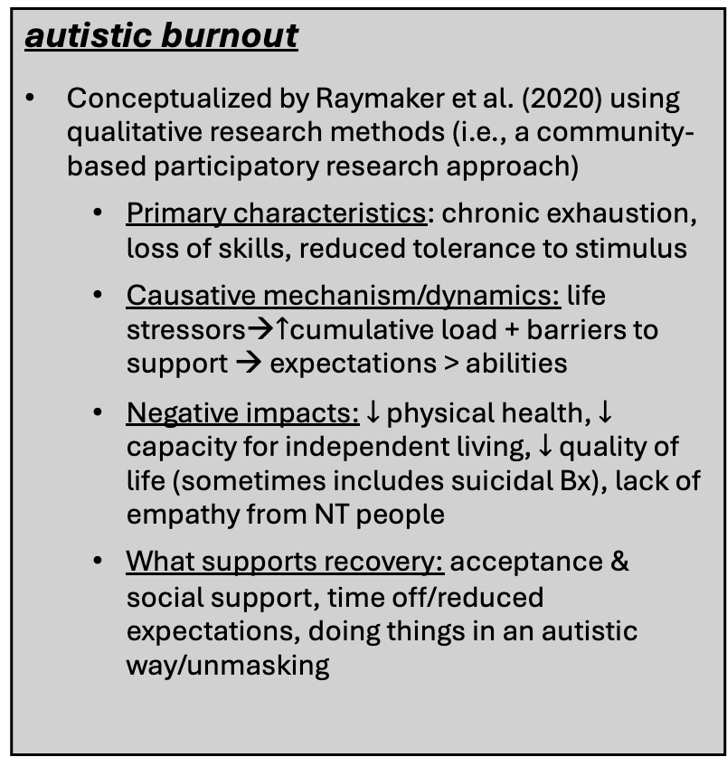
9. Consider that therapy might not be “the answer”.
autistic burnout
Conceptualized by Raymaker et al. (2020) using qualitative research methods (i.e., a community-based participatory research approach)
Primary characteristics: chronic exhaustion, loss of skills, reduced tolerance to stimulus
Causative mechanism/dynamics: life stressors→$↑$cumulative load + barriers to support → expectations > abilities
Negative impacts: $↓$ physical health, $↓$ capacity for independent living, $↓$ quality of life (sometimes includes suicidal Bx), lack of empathy from NT people
What supports recovery: acceptance & social support, time off/reduced expectations, doing things in an autistic way/unmasking
Psychotherapy as a field emerged with the aim (i.e., as a mode) of homogenizing toward a socially constructed norm (Watters, 2010; Chapman, 2023).
When we (as therapists &/or parents) fall into the “fix the client” stance, the client is more likely to perceive therapy as a threat (which isn’t really all that surprising).
Autistic Burnout & the Threat of Therapy: Dynamics that Can Emerge
$↑$perception of therapy as a threat$↔$ $↑$threat responses + $↑$cumulative load $↔ ↑$autistic burnout]
chronic exhaustion + reduced tolerance to stimulus → $↑$sensitivity to aspects of therapy (e.g, showing up, being seen, activating sensory stimuli, self-protective masking, etc.)→ $↑$perception & experience of therapy as a threat→ $↑$threat responses + $↑$cumulative load $→ ↑$autistic burnout
forced continued participation in therapy→ $↑$ discrepancy between expectations & abilities (expectations>>abilities) and/or $↑$ threat to autonomy → $↑$ perception & experience of therapy as a threat→ $↑$threat responses & $↑$cumulative load $→↑$autistic burnout

Slide 27
9. Consider that therapy might not be “the answer”.
Maybe this therapy right now isn’t “the answer”.
Therapy may, in and of itself, contribute to burnout.
Options to consider:
Switching from child therapy to parent support sessions
Ethical concerns related to scope: therapist may lack expertise/experience necessary for supporting client
Perhaps there’s a greater need for acceptance than change (and there are factors that hinder the therapist’s/therapeutic context’s ability to convey emphasis on acceptance over change to the child client)
Referral to another clinician
Termination—has therapeutic potential if handled with congruence, compassion, & consent
Can convey/model/support: prioritizing rest & regulation, honoring capacity, respecting boundaries, accepting limitations, conveys trust in client’s inherent wisdom & resources

Slide 28
10. We are mirrors of each other…
SPT
We can’t do this work without being changed through it.
NIT
Chapman & Botha (2022) underscore the need more neurodivergent therapists.
Experiences
Countless moments of “getting it”, understanding through shared process & similar styles, being “on the same wavelength” in a way I can’t really put into words
Synergetics: the study of systems in transformation Coined by physicist Buckminster Fuller
…and mirrors reflect light.

Slide 29
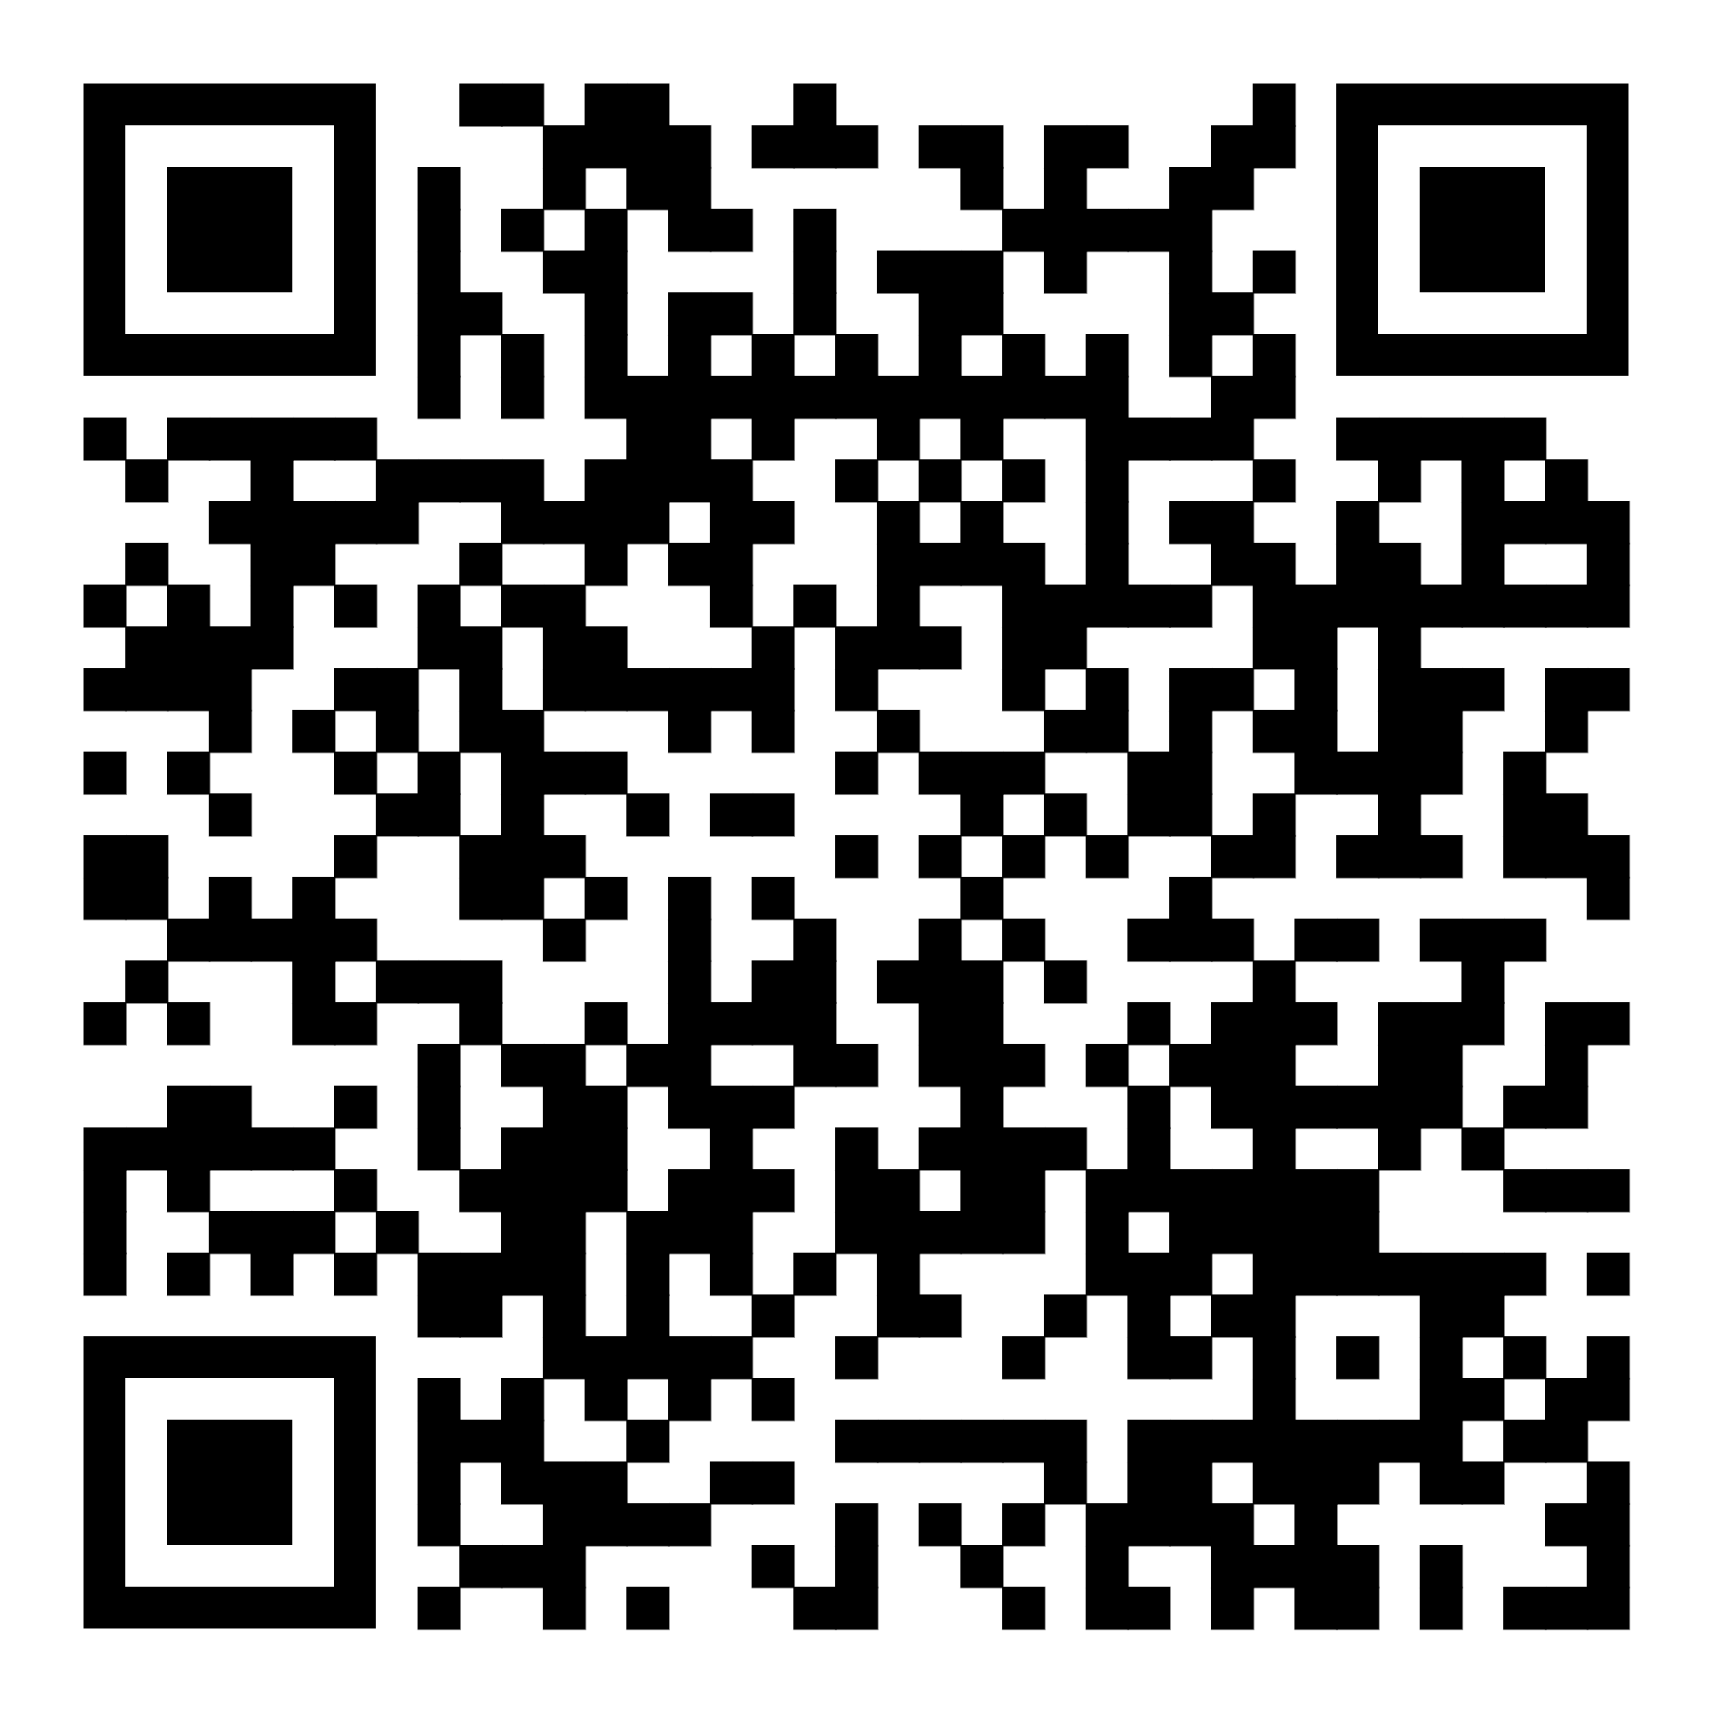
Acknowledgements
Michele Beach & Christy Lochary (site supervisors) & LFC colleagues
For co-creating a neuroaffirming and radically relational professional environment; for helping me show up as I am and take my seat as a therapist; for all your acceptance, encouragement, & contributions to my development
Christy & Michele: for all the wise mentorship & compassionate guidance that you’ve provided; for your above-and-beyond support, including with this project; and for all the ways you’ve helped me build more trust within myself
Dr. Cogburn
For helping me shift gears (more than once) with this project; for all the valuable reframes you’ve offered; and for your generous encouragement & support
Líf
For your authenticity & friendship; for “getting it” and catalyzing vital reframes to my perspective; and for all the invaluable conversation, collaboration, inspiration & support you’ve provided, including (but not limited to) with this project
Ethan
For well-timed fast walks, body doubling, & reflecting the heart of the matter; for your patience, Canva support, & extraordinary acceptance; & for your friendship
My clients and their parents
For embarking on the therapeutic journey with me
For all the light you’ve allowed me to witness and the reflections you’ve offered
For helping me understand
QR Code to Access Slides

Slide 30
References
Botha, M. (2021). Academic, activist, or advocate? Angry, entangled, and emerging: A critical reflection on autism knowledge production. Frontiers in Psychology, 12, 1-12. https://doi.org/10.3389/fpsyg.2021.727542
Chapman, R. (2023). Empire of normality: Neurodiversity and capitalism. Pluto Press. https://doi.org/10.2307/jj.8501594
Chapman R., & Botha M. (2023). Neurodivergence-informed therapy. Dev Med Child Neurol., 65(3): 310–317. https://doi.org/10.1111/dmcn.15384
Diekman, A. (2023). Low-demand parenting: Dropping demands, restoring calm, and finding connection with your uniquely wired child. Jessica Kingsley Publishers.
Dion, L. (2018). Aggression in play therapy: A neurobiological approach for integrating intensity. W.W. Norton & Company.
Fricker, M. (2007). Epistemic injustice: Power and the ethics of knowing. Oxford University Press.
Green, J. & Shaughnessy, N. (2023). Autistic phenomenology: Past, present, and potential future. Frontiers in Psychology, 14, 1-15. https://doi.org/10.3389/fpsyg.2023.1287209
Jurgens, A. (2020). Neurodiversity in a neurotypical world. In R. Bertilsdotter Rosqvist & A. Stenning (Eds.), Neurodiversity Studies: A new critical paradigm (pp. 73-88). Routledge.
Milton, D. E. M. (2012). On the ontological status of autism: The ‘double empathy problem’. Disability & Society, 27(6), 883–887. https://doi.org/10.1080/09687599.2012.710008
Murray, D. (2018). Monotropism – An interest based account of autism. In F. R. Volkmar (Ed.), Encyclopedia of autism spectrum disorders. Springer. https://doi.org/10.1007/978-1-4614-6435-8_102269-1
Murray, D., Lesser, M., & Lawson, W. (2005). Attention, monotropism and the diagnostic criteria for autism. Autism: The International Journal of Research and Practice, 9(2), 139–156. https://doi.org/10.1177/1362361305051398
Nerenberg, J. (2020). Divergent mind: Thriving in a world that wasn't designed for you. HarperOne.
Neuroqueer theory. (2025, April 3). In Wikipedia. https://en.wikipedia.org/wiki/Neuroqueer_theory
Paradigm shift. (2025, April 2). In Wikipedia. https://en.wikipedia.org/wiki/Paradigm_shift
Pearson A. & Rose, K. (2023). Autistic masking: Understanding identity management and the role of stigma. Pavilion Publishing.
Price, D. (2020). Unmasking autism: Discovering the new faces of neurodiversity. Harmony Books.
Raymaker, D. M., Teo, A. R., Steckler, N. A., Lentz, B., Scharer, M., Delos Santos, A., Kapp, S. K., Hunter, M., Joyce, A., & Nicolaidis, C. (2020). "Having all of your internal resources exhausted beyond measure and being left with no clean-up crew": Defining autistic burnout. Autism in Adulthood: Challenges and Management, 2(2), 132–143. https://doi.org/10.1089/aut.2019.0079
Walker, N. (2021). Neuroqueer heresies: Notes on the neurodiversity paradigm, autistic empowerment, and postnormal possibilities. Autonomous Press.
Walker, N., & Raymaker, D. M. (2021). Toward a neuroqueer future: An interview with Nick Walker. Autism in Adulthood: Challenges and Management, 3(1), 5–10. https://doi.org/10.1089/aut.2020.29014.njw
Watters, E. (2010). Crazy like us: The globalization of the American psyche. Free press.
Yergeau, M. R. (2017). Authoring autism: On rhetoric and neurological queerness. Duke University Press. https://doi.org/10.1215/9780822372189

