Slide 1
Neuroqueering Play Therapy: What My Clients Have Helped Me Understand
Kelly Bishop
Master of Arts in Clinical Mental Health Counseling Candidate
Transpersonal Wilderness Therapy Program
Naropa University
May 8th, 2025

Slide 2
Neurodiversity
Neurodiversity: the natural and valuable variation of human neurocognitive functioning; the biological reality that no two human brains/nervous systems/minds are exactly alike (Walker, 2021; Walker & Raymaker, 2021)
Origin & History
Emerged in the 1990s within the discourse of early online autistic communities (Chapman & Botha, 2022)
Conceptualized variation of human neurocognitive functioning as a dimension of biological diversity; emphasized the importance of preserving it by applying an ecological lens (Dekker, 2022)
Developing terminology helps correct hermeneutical injustice (Fricker, 2007; Chapman & Botha, 2022; Pearson & Rose, 2023; Walker, 2021), which is a type of epistemic injustice (Fricker, 2007)

Slide 3
Epistemic Injustice & Ongoing Oppression
Certain sociocultural contexts
Early autism constructs emerged within sociocultural contexts characterized by pathologization of difference, white supremacy, and eugenic thought (Pearson & Rose, 2023; Green & Shaughnessy, 2023)
Epistemic injustice
Pathologization of human diversity and difference: improper application of the medical model, erroneous assumptions (Pearson & Rose, 2023; Green & Shaughnessy, 2023; Botha, 2021)
Exclusion of autistic voices/experience (Pearson & Rose, 2023; Green & Shaughnessy, 2023; Botha, 2021)
Ongoing oppression…& hope
The medicalization of autism & oppression of autistic people continue (Pearson & Rose, 2023; Green & Shaughnessy, 2023; Yergeau, 2018; Walker, 2021; Price, 2022; Nerenberg, 2020)
→ inaccurate, dehumanizing, & self-reifying constructs (Pearson & Rose, 2023; Green & Shaughnessy, 2023; Botha, 2021)
Building evidence indicates that constructs are flawed (Pearson & Rose, 2023; Green & Shaughnessy, 2023; Yergeau, 2018; Walker, 2021; Price, 2022; Nerenberg, 2020)

Slide 4
A Paradigm Shift:
Paradigm shift: a fundamental change in the basic concepts & experimental practices of a scientific model in response to phenomena incompatible with the old paradigm (“Paradigm shift”, 2025)
—A concept introduced by physicist-philosopher Thomas Kuhn in The Structure of Scientific Revolutions (1962)
Has since been extended to fields beyond the natural sciences to describe a profound change in a set of underlying assumptions within bodies of academic work
In 2012, Nick Walker, autistic Professor of Psychology at CIIS, introduced a new philosophical framework for approaching and understanding neurodiversity.
Pathology Paradigm
Neurodiversity Paradigm
Pathology Paradigm | Neurodiversity Paradigm
The dominant philosophical framework underlying medicalized approaches to cognitive, learning, & developmental disabilities, which promulgate their pathologization | Rejects pathologization of forms of neurodivergence that are “intrinsic and pervasive factors in an individual’s psyche, personality, and fundamental way of relating to the world” (Walker, 2021, p. 39)
Applies a species-norm for human cognitive functioning, assuming this extrapolation is valid | Posits inadequate uniformity for justifying application of a species-norm
Asserts that deviation from the species-norm is not normal, justifying its prevention, remediation, & cure | Asserts that cognitive diversity is natural & valuable
(Walker, 2021; Walker & Raymaker, 2021; Chapman & Botha, 2022)
Notes:
Draw upon Walker & Raymaker, 2021!! Maybe also Pearson & Rose, Walker, 2021, Chapman & Botha
EXCERPT FROM CHAPMAN & BOTHA: n 2012, Walker distinguished between the pathology paradigm and the neurodiversity paradigm.² The pathology paradigm is the dominant paradigm encompassing medicalized approaches to cognitive, learning, and developmental disabilities across the psychological sciences. It is defined by the reliance on a relatively restricted norm when it comes to cognitive functioning. Under the medicalized model, deviation from the norm is considered as disorder, disease, or dysfunction and there is a focus on remediation, prevention, and cure.^{18, 19} By contrast, the neurodiversity paradigm conceptually frames cognitive diversity itself as normal, rather than viewing it from the assumption that there is enough uniformity across the species to justify the use of a species-norm.
Walker also summarized neurodiversity paradigm terminology that has been widely (but not universally) adopted by neurodiversity proponents. On the neurodiversity paradigm, people are either closer, albeit in an endless variety of ways, to being more ‘neurotypical’ or more ‘neurodivergent’, depending on how well they conform to normative expectations of a given society. Some neurodivergent groups form ‘neurominorities’, which refers to minority neurocognitive groups who are disadvantaged in a particular society. This reconceptualizes disabilities such as autism, ADHD, and developmental coordination disorder in line with how cultural, ethnic, and sexual minorities are conceptualized. Walker's framework helped develop the philosophical basis of the movement and allow the neurodiversity concept to be utilized beyond the autistic community for those with other diagnoses.

Slide 5
The Neurodiversity Movement
A social justice and civil rights movement led by and for people with neurocognitive, developmental, and psychological disabilities
Aims to end the default pathologization of neurodivergence and advocate for acceptance and accommodation of neurodiversity
An identity-based movement modeled after similar social justice movements, particularly those of the queer and deaf communities
Started within the autism rights movement but does not equate to it
Adopted by other neurominority groups and neurodivergent activists, including people diagnosed with ADHD, developmental coordination disorder, and dyslexia
(Chapman & Botha, 2022; Walker, 2021)
Notes:
KEEP THIS AS BRIEF AS POSSIBLE
Draw upon Walker & Raymaker, Walker, Chapman & Botha, Green & Shaughnessy, etc.
²⁰The neurodiversity movement is a social justice and civil rights movement led by and for people with neurocognitive, developmental, and psychological disabilities.¹ Neurodiversity theory proposes that divergence from expected functioning (such as autism, attention-deficit/hyperactivity disorder [ADHD], developmental coordination disorder, or dyslexia) are natural variations of human minds, and those who diverge from the norm (neurominorities) are equally deserving of dignity, respect, and accommodation. Views among neurodiversity proponents are varied and the theory underlying the neurodiversity paradigm is still emerging. Neurodiversity started as an identity-based movement which centred neurodivergence at the core of a person's identity. The concept of neurodiversity initially arose among autistic communities in the late 1990s but has since been adopted by many activists and advocates with other diagnoses, including ADHD, developmental coordination disorder, and dyslexia. In general, though, neurodiversity proponents tend to promote moving towards a non-pathologizing perspective regarding neurocognitive disability that begins with the acknowledgement of neurocognitive diversity as natural, valuable, and in need of support. Proponents also tend to embrace the identity of ‘disability’ even while moving away from notions of ‘illness’ or ‘disorder’. Alongside this, social models of disability tend to be favoured to explain neurodivergent disablement and distress in terms of societal barriers rather than as individual medical problems. The term ‘neurodiversity paradigm’² refers to the emerging framework for understanding human mental variation, ability, and disability that the neurodiversity movement is based on. Overall, the shift is away from a medicalized approach that associates recovery with functional normalcy, and towards a disability justice paradigm that takes neurocognitive diversity itself to be normal.

Slide 6
Neuroqueer Theory
Emerged from the intersection of queer theory, crip theory, and neurodiversity
Critiques how society constructs or defines normalcy, especially regarding gender, sexual orientation, and dis/ability
Neuroqueer extends queer into the intersectional realm
Coined and developed by Athena Lynn Michaels-Dillon, Nick Walker, & Remi Yergeau who had each arrived at roughly the same idea by 2014
Just as the prevailing culture entrains and pushes people into the embodied performance of heteronormative gender roles, it also entrains and pushes us into the embodied performance of neurotypicality—the performance of what the dominant culture considers a “normal’’ bodymind. And just as heteronormativity can be queered, so can neurotypicality: we can subvert, disrupt and deviate from the performance of being neurocognitively “normal.”
(Walker, 2021; Walker & Raymaker, 2021; “Neuroqueer theory”, 2025)

Slide 7
Defining(?) Neuroqueering
Neuroqueering: to engage in the practice of queering (subverting, defying, disrupting, liberating oneself from) neuronormativity and heteronormativity simultaneously
Yergeau, Walker, & Michaels-Dillon conceptualized neuroqueering (v.), which encompassing eight types of interwoven practices:
Being both neurodivergent & queer with some degree of awareness/exploration of these identities’ entwinement/interactions
Embodying & expressing one’s neurodivergence in ways that also queer one’s performance of gender, sexuality, ethnicity, etc.
Engaging in practices intended to undo/subvert one’s cultural conditioning & ingrained habits of neuronormative and heteronormative performance, with the aim of reclaiming capacity to express one’s uniquely weird potential/inclinations
Engaging in the queering of one’s neurological processes (& related embodiment/expression) by intentionally altering them in ways that increase divergence from cultural standards of heteronormativity/neuronormativity.
Approaching/embodying/experiencing one’s neurodivergence as a form of queerness (e.g., in ways inspired by, or similar to, how queerness is understood and approached in Queer Theory, Gender Studies, and/or queer activism).
Producing literature, art, scholarship &/or cultural artifacts that foreground neuroqueer experiences, perspectives, and voices.
Producing critical responses to literature and/or other cultural artifacts, focusing on intentional/unintentional characterizations of neuroqueerness and how those characterizations illuminate and/or are illuminated by actual neuroqueer lives and experiences.
Working to transform social & cultural environments to create spaces & communities—& ultimately a society—in which engagement in any or all of the above practices is permitted, accepted, supported, & encouraged.
(Walker, 2021, pp. 160-163)
“Part of the idea of neuroqueerness is that heteronormativity and neurotypicality are inextricably entwined with one another, and to queer one is inevitably to queer the other to some degree” (Walker & Raymaker, 2021, p. 9).

Slide 8
Neuroqueering Continued
The authentic embodiment or expression of neurological queerness (i.e., neuroqueer identity; neurodivergence) is, in and of itself, neuroqueering (Yergeau, 2018)
In her book, Neuroqueer Heresies, Walker argues that autistic people, by virtue of their difference, queer expectations of neuronormativity…She proposes that ‘neuroqueering’ can provide an emancipatory platform for anyone (autistic and non-autistic alike) to reject normative social standards (including the idea of as heterosexual, cisgender, white, etc as the default and anything else as ‘variations’ on the norm) in order to flourish.
(Pearson & Rose, 2023, p. 22)

Slide 9
Neurodivergence-Informed Therapy (NIT)
(Chapman & Botha, 2022)
Arose from discourse within the autistic community with the aims of improving service for—and preventing harm toward—autistic populations
Proposed by Robert Chapman & Monique Botha, two neurodivergent scholar-activists
A concept aimed at promoting the integration of neurodiversity theory within clinical practice with neurodivergent people
Proposed three themes to guide therapists’ implementation:
Reconceptualization of dysfunction as relational rather than individual
The importance of neurodivergence acceptance and pride, and disability community and culture to emancipate neurodivergent people from neuro-normativity
The need for therapists to cultivate a relational epistemic humility regarding difference experiences of neurodiversity and disablement
(Chapman & Botha, 2022, p. 310) (bolded font added for emphasis).
epistemic humility: an intellectual virtue that involves recognizing knowledge as provisional and incomplete; acknowledging the limitations of perspective; bringing openness to other possibilities, including others’ perspectives and experiences; willingness to revise our beliefs when new evidence emerges; and engaging in critical reflection upon our beliefs and biases (Fricker, 2007)

Slide 10
Synergetic Play Therapy (SPT)
(Dion, 2018)
Created by Lisa Dion
Naropa alum, founder/President of the Synergetic Play Therapy Institute, teacher, author, coach, and mother
Draws upon interpersonal neurobiology, physics, attachment, & mindfulness; emphasizes Th authenticity
Neuroception of safety (that is, safe enough) is foundational to therapeutic process
Therapeutic Process
“The test”
Building awareness of “the challenge”
Gradually moving toward “the challenge” while supporting regulation→ opportunities for new experiences → shifting perceptions, empowerment, & client’s rewiring of threat response patterns
4 Types of Threats
3 out of 4 of these are non-physical in nature—that is, “challenges of the brain” (e.g., shoulds)
Regulation Strategies: mindful awareness, breath, movement, naming experience (i.e., aspects of our own embodied experience)
Key Processes: co-regulation, limbic resonance, modeling, the “set-up”/“offering”
Notes:
Draw upon Aggression in Play Therapy
CONDENSE THIS A BUNCH!

Slide 11
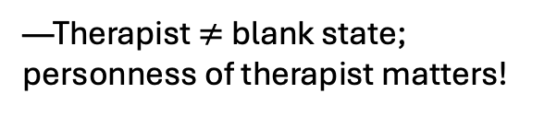
Improving Therapy for ND People
Improving Play Therapy with ND Kids
A Play Therapy Modality for Kids
NIT
SPT
—Emphasizes difference of experience (relational epistemic humility, minority identity pride/community) & social systems
—Intersubjective lens & systems-oriented awareness
—Emphasizes commonality of experience (such as through limbic resonance) and interpersonal relationality/systems (e.g. IPNB)
—Client as expert; client-led; non-pathologizing
—Proposes that we all want to be seen/known & that modeling is part of the therapist’s role
—Incorporates epistemology; Dx→ identity; dysfunction as relational
—Through embracing ND identity and disability community/culture; emancipation from neuro-normativity
—Aims to promote empowerment & respects client’s autonomy
—By providing opportunities for new experiences of “the challenge” & trusting client’s process/timeline/inherent wisdom
—Emphasizes relevance of Th’s identities, esp. ND & disability
—Therapist $≠$ blank state; personness of therapist matters!
—Emphasizes relevance of Th’s embodied experience; authenticity essential to safety
—Brings awareness to common trauma within ND pop., such as exclusion/inaccess., violations of agency, & relational trauma
—Trauma-informed
—Brings awareness to 4 types of threats; emphasizes neuroception of safety & NS states
—Aims to support acceptance/integration of all parts
—Emphasizes the importance of not shaming (e.g., ideas for redirecting play w/o shaming; only redirect when necessary, etc.)
—Emphasizes identity pride, reclaiming identity labels, etc.
—Challenges unhelpful assumptions of prior/prominent theories; offers vial reframes
—Reframes: “therapeutic” aim of normalization, dysfunction as relational, & more
—Reframes: countertransference, the purpose of boundaries, the nature of resistance & more
—Esp. as related to social justice, civil rights, resistance to neuronormativity
—Extends far beyond the therapy room
—Esp. as a way of being in relationship (with others & oneself), relational insights, regulation
Notes:
SPT/NIT Venn Diagram

Slide 12

Neuroqueering Play Therapy: A Case Study
What My Clients Have Helped Me Understand

Slide 13
Case Study: Background Information
My Process: Mapping Out Case Examples of Neuroqueering
Internship Site: Louisville Family Center
Primary Clinical Population: ND kids
Case Study: drew upon my clinical experiences with 7 neurodivergent kids/young adolescents (ages 2-13)
I identified a plethora of examples of what I’d perceived as clients’ brilliant subversion of neuronormative expectations and which had meaningfully contributed to my understanding.
Today: We’ll focus on 2 case examples instead.
Components | Dimensions
Play | —Essence/Social Dynamics —Toys —“The Rules”
Interpersonal Connection | —Continuity/Intensity —Connection —Modes/Avenues
Therapeutic Relationship | —Roles/Power Dynamics —Self-Disclosure
Therapeutic Process | —Self-Reflective Processes —Regulation Strategies —The Heart of the Matter
The Structure of Therapy | —Time and Place —Online Etiquette —Aims/What We’re Doing
Other Conventions | —Sand Tray Play —Shoes

Slide 14
Case Example 1: self-Disclosure via Process
The Client: 11-year-old, White-passing* autistic cisgender female
*race & ethnicity not disclosed
Neurocognitive Identity/Profile: autistic, sensory sensitivities, PDA characteristics
Relevant Context: autistic burnout, applying to art school, difficulty gathering info for reference letter
The Experience: inspired show-and-tell self-disclosure process about her passion; monotropic style
Neuronormative Expectations: self-disclosure involves talking about oneself; therapeutic process is primarily interpersonal—& this should look a certain way (e.g., monotropism/hyperfocus not okay)
Pathology Lens: She’s talking about her “special interest” and not letting anyone else talk; needs help developing “social skills”/interrupting hyperfocus; avoiding/distracting from the important issues at hand
What Client Helped Me Understand (Neurodiversity Lens): self-disclosure process (showing>telling);words are an abstraction; immense value & potential of passions; interpersonal connection needn’t be the primary focus—AND interpersonal connection can transcend neuronormative rules
Transpersonal Components: shared state/empathic connection; witnessing aspects of client’s essence; showing/experiencing rather than talking/conceptualizing/abstracting; i not I; self as verb; locating self within self-environment interface/artistic process/passion

Slide 15
Case Example 2: Liberation via Sand
The Client: 6-year-old, White cisgender female
Neurocognitive Identity/Profile: monotropic style, autistic and ADHD characteristics, alexithymic
Relevant Context: treatment goal of naming “frustration”; client’s ongoing demonstration of a process characterized by containment, building pressure, tension, intense effort, heavy silence, disconnection, & perfectionism
SPT Developmental Themes: Do I exist? & Am I okay?
The Experience: letting go, relief, messiness, laughter, silliness, mirroring, attunement, rebellion, liberation
Neuronormative Expectations: important to learn how to name feelings; spoken verbal communication = primary mode of communication; “good behavior” is important; sand stays in the sand tray
Pathology Lens: She’s containing her “frustration” and refusing to talk about it; being “resistant”&/or “defiant”; doesn’t know how to connect with her feelings/others; What unacceptable behavior with the sand!!!!!!
What Client Helped Me Understand (Neurodiversity Lens): “frustrated” didn’t cut it; we didn’t need to name feelings (needed an experience instead); patience, acceptance, & trust (in client/client’s process) are super important; needed to support organic state shift (not guide/direct it)
Transpersonal Components: essentially a TP experience—super impactful! cycles rather than linearity; states rather than “feelings”; some states/aspects of experience are beyond words
Alexithymia: without words for emotions

Slide 16
What My Clients Have Helped Me Understand
Ten Takeaways from My Internship Experiences

Slide 17
1. Reframe “resistance”.
SPT Lens
Instead: offering hasn’t landed
Consider: mismatch between offering & client’s values?
Neurodiversity /NIT Lens
Relational models of disability: mismatch between neurotype and environment→ disablement/hindered ability to satisfy essential needs→distress/threat→ threat responses
NIT: “Resistance to normalization is a core feature of neurodiversity advocacy” (Chapman & Botha, 2022, p. 314).
Key Takeaway: We need to accept/honor clients’ resistance and meet it with curiosity.
By doing so, we can glean valuable information about the contextually relevant relationships & systems
Responding to clients’ resistance as if it were an oppositional force/trying to override it→ “misses” + detracts from clients’ sense of safety/trust + potential for agency violation/harm
Traditional /Pathology Lens: Resistance is bad.
—It arises from within individuals, & we need to get past it.
Reframe: Resistance is inherently a form of social justice.
—Yes, even in the therapy room

Slide 18
2. Autonomy is of the human essence.
Traditional/Neuronormative/Pathology Lens: Learning how to get along, share, and be liked by others is v. important.
—ND people need to adapt to these standards—learn how to be more “likable”/“cooperative”.
SPT Lens: Aggressive play isn’t bad—can actually be a key/essential part of integrating intensity
Tuning into our own embodied experience =essential avenue of increasing understanding of our clients’ experiences/worlds (Dion, 2018)
Neurodiversity/NIT Lens
Pathology paradigm→medical model→devaluing & pathologizing ND’s people’s differences & “justified” prevention, remediation, & cure (Walker, 2021; Chapman & Botha, 2022; Pearson & Rose, 2023)
Approaches like ABA violate clients’ agency (Pearson & Rose, 2023; Chapman & Botha, 2022; Price, 2020)
NIT: Respecting clients’ agency is paramount!; need to bring awareness to matters of agency & trauma (Chapman & Botha, 2022)
Key Takeaways: Autonomy is an essential human need.
Threats to autonomy (including therapy itself) can evoke life threat responses in our clients
“Figuring out why” is not our priority—restoring neuroception of safety is
Reframe: Respecting clients’ agency is paramount, and this needs to be reflected throughout our approach

Slide 19
3. Honoring sensory sensitivities and meeting sensory needs are not optional.
Neurodiversity/NIT Lens:
Our experiences are as unique as our neurotypes.
Differences in sensory processing, sensitivity, and/or integration- fundamental to ND experience.
NIT: reframe dysfunction as relational
Key Takeaways: Clients already have a vast array of skills/strategies, tailored to their unique neurotype & experiences
SPT Lens: Therapists apply regulation skills for creating neuroception of safety and modeling (not teaching) regulation skills.
Traditional/Neuronormative/Pathology Lens:
“Self-stimulatory behavior” isn’t okay, and therapy can/should be used to redirect it.
The increased dysregulation that many ND people experience primarily indicates a lack of regulation skills, which they need to learn.
It’s our job (as therapists) to teach regulation skills, and a one-size-fits-all approach can work for this.
Reframe: Rather than pathologizing stimming, framing dysregulation as a skill deficit, and/or taking a “teaching” approach,
(1) acknowledge sensory differences and integrate this awareness into practice
(2) recognize, reflect, & support the skills that our clients already have
(3) consider regulation/dysregulation through a relational lens

Slide 20
4. Recognize your communication biases & expand your repertoire.
Traditional/Neuronormative/Pathology Lens:
Spoken verbal communication (+ following certain (neuronormative) rules) is the best/necessary mode of communication in most contexts
Not adhering/conforming to this (see above) = communication “deficit”
Reframe: facilitating communication between all parties, which can look more like a translator role
SPT Lens: play = an important/natural mode of communication for kids
Recognizes the value/relevance of nonverbal communication
Neurodiversity Lens: differences not deficits (Milton, 2012; Walker, 2021)
NIT: “the need for therapists to cultivate a relational epistemic humility” (Chapman & Botha, 2022, p. 310)
Key Takeaway: I’ve internalized neuronormative communication biases, and I can expand beyond them
Examples: using Chat feature and/or Whiteboard feature during online sessions, sessions with <15 verbal exchanges, creative/abstract interactive exchanges within (& between) parallel play processes, co-creating games without verbally defining the aims or “rules” (& indications of mutual understanding of those aims/“rules”), tuning in to metaphors in play
Metaphors: coins & attention (valuable, needed to survive, scarcity mindset); fences & autonomy/control (self-explanatory—&, in one case, also uncannily aligned with an eco-psych theory proposed by Chellis Glendinning)

Slide 21
5. We don’t have to “talk about our feelings”.
Key Takeaways
Example: recall 6-year-old w/ sand
—Neuroception of safety foundational for integrating emotional intensity (Dion, 2018)
…AND “feelings” words might not actually be necessary*
*for building trust within trust in self to be with all states & experiences and trust that there is space for them all of them to be & move
Neurodiversity Lens:
—Different neurotypes→ different ways of experiencing, processing, relating to, and expressing emotions (Milton, 2012)
NIT: relational epistemic humility (Chapman & Botha, 2022)
SPT Lens: (Dion, 2018)
—Emphasis on nervous system states & neuroception of safety
—Neuroception of safety is essential before using “feelings” words
Reframe: tune in to state, accept whatever state is there, & support the client’s process
An Ecopsych Aside: Don’t try to mechanize or control these natural processes; respect them!
Traditional/Neuronormative Lens:
Assumptions within therapy approaches: needing to deepen somatically (and the therapist needs to guide or direct this process); needing to verbally express feelings; needing to slow down the process

Slide 22
6. Bring a keen eye to the client’s values, styles, and strengths.
Neurodiversity/NIT Lens:
Monotropism
Conceptualized by Dinah Murray, Wenn Lawson, & Mike Lesser, 3 autistic scholars, as a fundamental component of autistic experience
Monotropic styles/modes are not bad and can be an immense asset for developing strengths…
…ND people tend to have more “spiky profiles” of strengths & vulnerabilities (Pearson & Rose, 2023)
These profiles change over time & are inherently influenced by environment; enactivist approach to neurodiversity (Jurgens, 2020)
NIT: importance of relational epistemic humility; reframing dysfunction as relational; ND identity acceptance & pride are foundational parts of therapy (Chapman & Botha, 2022)
A Logical Extension (of the above notion): Therapeutic aim of supporting our clients in acting in alignment with their values.
Generally Accepted Notion: When humans act out of alignment with values, it causes distress.
SPT Lens: No such thing as resistance; instead consider mismatches in values and/or styles (Dion, 2018)
Key Takeaways: To support ND clients (& all clients, really), we need to:
1) Recognize our client’s values
A necessary first step in supporting clients’ alignment with them
Involves bringing awareness to our values and working with our biases
2) Approach different styles with a value-neutral stance & a relational lens
De-pathologize ND styles, including (but not limited to) monotropism (e.g., going deep into one topic over having a breadth of experiences)
3) Recognize & reflect our clients’ strengths
Can help promote self-acceptance, self-efficacy/empowerment, ND identity pride, and more

Slide 23
7. Embrace neurodivergent interpersonal styles.
Traditional/Neuronormative/Pathology Lens
Neurodiversity Lens
NT people have normal social communication skills and ND people have deficits
NT styles of social communication/interpersonal relating are better than/more valuable than ND styles of social communication/interpersonal relating
NT Styles: primarily focusing on the other person; expressing empathy in certain (NT) ways; following social rules over depth/authenticity; using the “right” amount of eye contact; prioritizing spoken verbal language
ND Styles: everything that diverges from the NT styles. Examples:
Connecting through mutual interest/joint attention (e.g., “ping-ponging processes”—see below)
Connecting through mutual activity (e.g., parallel play, competitive play, engaging with passions)
Connecting through a shared state (e.g., parallel play, engaging with passions, monotropic states, competitive play
A ‘double empathy problem’ (DEP) (Milton, 2012)
Reframed what autism constructs and other neurological ‘disorders’ (i.e., derivatives of cognitive-behavioral lenses) have framed as deficits in empathy, social communication, and social insight as differences
Argued that topics like social communication, empathy, and social insight are inherently relational/intersubjective in nature and therefore must be approached with an intersubjective lens
Applying a cognitive-behavioral lens to such topics is incoherent
Autistic people sense and experience emotions, relate to the world, communicate, and form relationships differently from non-autistic people→ different life experiences→different styles of relating AND empathy “gap” arising from different life experiences
Thus, a gap, not a deficiency of one group; a “double” problem because the communication barrier runs both ways
Research suggests similarities between autist-to-autist social communication & non-autist-to-non-autist social communication.
Key Takeaways:
Meta Example: Consider your experience of this presentation.
Don’t devalue parallel play.
Can be an avenue of meaningful interpersonal connection
Lean into “ping-ponging processes”.
Example: (co-)regulation & empathic connection through mutual delegation of alternating attention to storm clouds & the other person
Natural environment as co-regulator and co-facilitator of an experience of shared state, mutual interest, and mutual process
Reconsider competitive play.
Example: pool noodle sword fight
My clients have helped me understand competitive play’s potential as: a neurodivergently interpersonal autotelic state; a powerful avenue of mutual nowness; a mode of experiencing mutual values and aims; an avenue conveying mutual respect; an avenue of repair (in the attachment-based sense)

Slide 24
8. We’re not here to “fix the client”.
Well, what are we here for then???
Supporting—and prioritizing— neuroception of safety
Respecting clients’ autonomy and reflecting their agency
Modeling trust—both in our clients/their inherent wisdom and in ourselves/our own
Being in relationship, which includes navigating rupture and repair
Embodying curiosity, openness, compassion, and acceptance
Witnessing our clients and reflecting aspects of their experiences
Bringing awareness to our clients’ inherent strengths, identities, styles, parts, & states
Bringing awareness to systems, dynamics, & patterns
Examples of systems: family systems, internal family systems, social systems, ecological systems
Examples of dynamics: intrapersonal dynamics, interpersonal dynamics, social dynamics, environmental dynamics
Examples of patterns: threat response patterns; coping/self-protective/regulation strategies; the influence such strategies tend to have on systems/dynamics
Bringing awareness to possibilities for shifting the mentioned systems, dynamics, & patterns
Note: systems, dynamics, and patterns are inextricably related; none can be fully understood without consideration of the others
Example: bringing awareness to client’s intrapersonal dynamics related to ND identity and possibilities for shifting these dynamics
Example: bringing awareness to current response patterns and other possible response options
Taking the client’s lead regarding further exploration/implementation of the mentioned possibilities (or not!) and supporting the client’s process
Advocating for our clients, including within their family systems and broader social contexts

Slide 25
8. We’re not here to “fix the client”.
Ethical Responsibility
Client advocacy
NIT Lens
Embracing ND identity is the path of healing (Chapman & Botha, 2022)
Aim of supporting clients’ emancipation from neuronormativity
Therapy Aim
Shifting “fix the client” stance→ “accept the client” stance
Case Example
Examples with parents: “This (i.e., current) school environment isn’t going to be a good fit.” “Doing chores at home might not happen.” “Prompts for getting out the door might be necessary right now.”
…& recommending that the client pause therapy and parents do counseling instead for now…

Slide 26

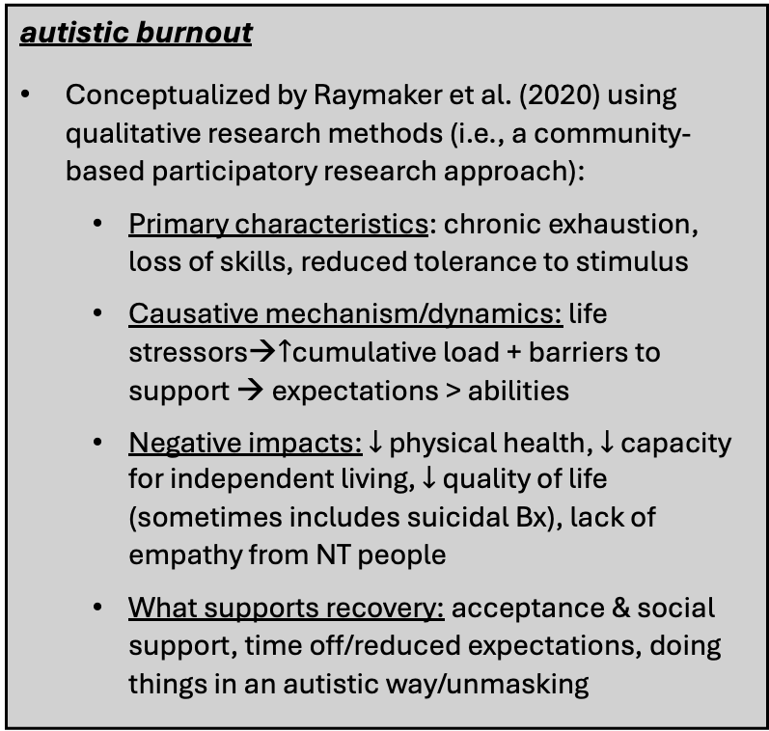
9. Consider that therapy might not be “the answer”.
—Psychotherapy as a field emerged with the aim/as mode of homogenizing toward a socially constructed norm (Watters, 2010; Chapman, 2023).
—When we (therapists &/or parents) fall into the “fix the client” stance, the client is more likely to perceive therapy as a threat (…not really all that surprising)
Possible Dynamics Involving Perception of Therapy as a Threat &/or Autistic Burnout
$↑$perception of therapy as a threat$↔$ $↑$threat responses & $↑$cumulative load $↔↑$autistic burnout
chronic exhaustion &/or reduced tolerance to stimulus→$↑$sensitivity to expectations/demands inherent to therapy (e.g., showing up, being seen, participating, lighting, structure)→ $↑$perception and/or experience of therapy as a threat→ $↑$threat responses & $↑$cumulative load $→↑$autistic burnout
forced continued participation in therapy→ $↑$ discrepancy between expectations & abilities &/or $↑$ threat to autonomy→ $↑$ perception and/or experience of therapy as a threat→ $↑$threat responses & $↑$cumulative load $→↑$autistic burnout
autistic burnout
Conceptualized by Raymaker et al. (2020) using qualitative research methods (i.e., a community-based participatory research approach):
Primary characteristics: chronic exhaustion, loss of skills, reduced tolerance to stimulus
Causative mechanism/dynamics: life stressors→$↑$cumulative load + barriers to support → expectations > abilities
Negative impacts: $↓$ physical health, $↓$ capacity for independent living, $↓$ quality of life (sometimes includes suicidal Bx), lack of empathy from NT people
What supports recovery: acceptance & social support, time off/reduced expectations, doing things in an autistic way/unmasking

Slide 27
9. Consider that therapy might not be “the answer”.
Maybe this therapy right now isn’t “the answer”
Therapy may, in and of itself, contribute to burnout.
Options to consider:
Switching to child therapy to parent support
Ethical concerns related to scope: therapist may lack expertise/experience necessary for supporting client
Acceptance needed more than change
Referral to another clinician
Termination has therapeutic potential if handled with congruence, compassion, & consent
Prioritizing rest & regulation, honoring capacity, respecting boundaries, accepting limitations, conveys trust in client’s inherent wisdom & resources

Slide 28
10. We are mirrors of each other…
SPT:
We can’t do this work and without being impacted. Why?
Synergetics: the study of systems in transformation —Coined by physicist Buckminster Fuller
Examples:
ND interpersonal & transpersonal experience
A “double empathy solution” of sorts
NIT:
We need more ND therapists!
…and mirrors reflect light.

Slide 29
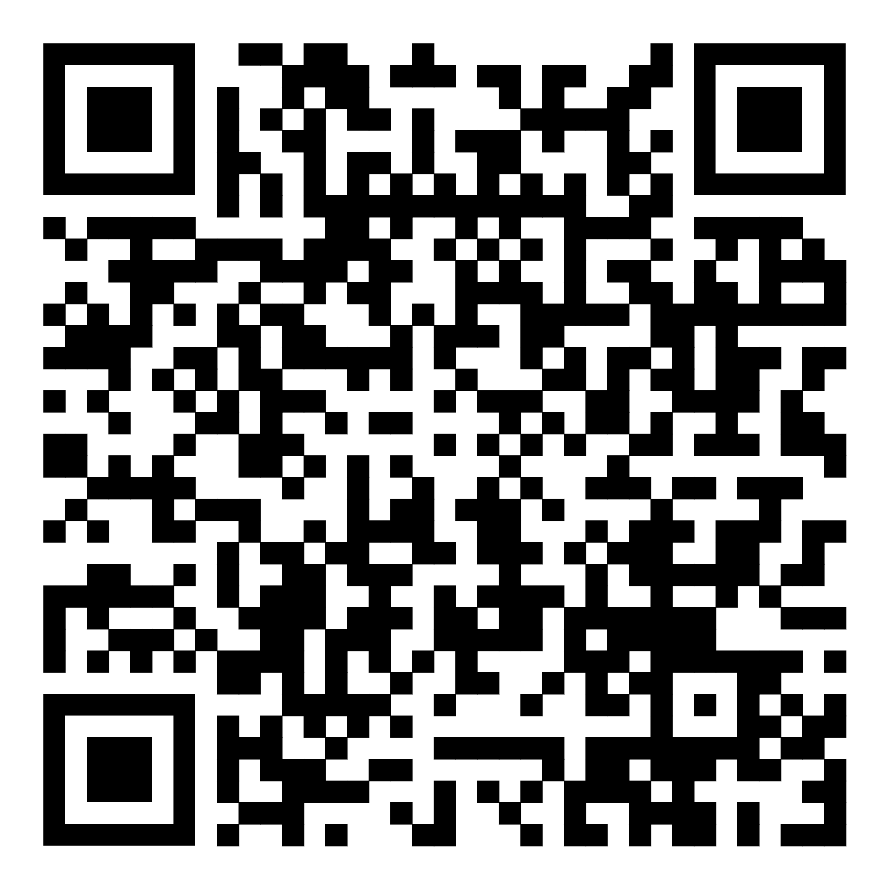
Acknowledgements
Michele Beach & Christy Lochary (site supervisors) & LFC colleagues
For cultivating a neurodiversity affirming and radically relational professional environment; for helping me show up as I am and take my seat as a therapist; for your acceptance, encouragement, and all your contributions to my professional/personal development process
Christy & Michele: for all the wise mentorship & compassionate guidance that you’ve provided; for your above-and-beyond support, including with this project; and for all the ways you’ve helped me build more trust within myself
Dr. Cogburn
For your valuable reframes; for helping me shift gears (more than once) with this project; and for all the encouragement, guidance, and support you’ve provided during my internship
Líf
For your authenticity & friendship; for “getting it” and catalyzing vital reframes to my perspective; for all the inspiration validation you’ve offered, and for invaluable conversation, collaboration, & support, including with this project
Ethan
For well-timed fast walks, body doubling, & reflecting the heart of the matter; for your patience, Canva support, & extraordinary acceptance; & for your friendship
My clients and their parents
For embarking on the therapeutic journey with me; for your time, trust, & allowing me to witness your light; and for all the reflections you’ve offered
For helping me understand
QR Code to Access Slides

Slide 30
References
Botha, M. (2021). Academic, activist, or advocate? Angry, entangled, and emerging: A critical reflection on autism knowledge production. Frontiers in Psychology, 12, 1-12. https://doi.org/10.3389/fpsyg.2021.727542
Chapman, R. (2023). Empire of normality: Neurodiversity and capitalism. Pluto Press. https://doi.org/10.2307/jj.8501594
Chapman R., & Botha M. (2023). Neurodivergence-informed therapy. Dev Med Child Neurol., 65(3): 310–317. https://doi.org/10.1111/dmcn.15384
Diekman, A. (2023). Low-demand parenting: Dropping demands, restoring calm, and finding connection with your uniquely wired child. Jessica Kingsley Publishers.
Dion, L. (2018). Aggression in play therapy: A neurobiological approach for integrating intensity. W.W. Norton & Company.
Fricker, M. (2007). Epistemic injustice: Power and the ethics of knowing. Oxford University Press.
Green, J. & Shaughnessy, N. (2023). Autistic phenomenology: Past, present, and potential future. Frontiers in Psychology, 14, 1-15. https://doi.org/10.3389/fpsyg.2023.1287209
Jurgens, A. (2020). Neurodiversity in a neurotypical world. In R. Bertilsdotter Rosqvist & A. Stenning (Eds.), Neurodiversity Studies: A new critical paradigm (pp. 73-88). Routledge.
Milton, D. E. M. (2012). On the ontological status of autism: The ‘double empathy problem’. Disability & Society, 27(6), 883–887. https://doi.org/10.1080/09687599.2012.710008
Murray, D. (2018). Monotropism – An interest based account of autism. In F. R. Volkmar (Ed.), Encyclopedia of autism spectrum disorders. Springer. https://doi.org/10.1007/978-1-4614-6435-8_102269-1
Murray, D., Lesser, M., & Lawson, W. (2005). Attention, monotropism and the diagnostic criteria for autism. Autism: The International Journal of Research and Practice, 9(2), 139–156. https://doi.org/10.1177/1362361305051398
Nerenberg, J. (2020). Divergent mind: Thriving in a world that wasn't designed for you. HarperOne.
Neuroqueer theory. (2025, April 3). In Wikipedia. https://en.wikipedia.org/wiki/Neuroqueer_theory
Paradigm shift. (2025, April 2). In Wikipedia. https://en.wikipedia.org/wiki/Paradigm_shift
Pearson A. & Rose, K. (2023). Autistic masking: Understanding identity management and the role of stigma. Pavilion Publishing.
Price, D. (2020). Unmasking autism: Discovering the new faces of neurodiversity. Harmony Books.
Raymaker, D. M., Teo, A. R., Steckler, N. A., Lentz, B., Scharer, M., Delos Santos, A., Kapp, S. K., Hunter, M., Joyce, A., & Nicolaidis, C. (2020). "Having all of your internal resources exhausted beyond measure and being left with no clean-up crew": Defining autistic burnout. Autism in Adulthood: Challenges and Management, 2(2), 132–143. https://doi.org/10.1089/aut.2019.0079
Walker, N. (2021). Neuroqueer heresies: Notes on the neurodiversity paradigm, autistic empowerment, and postnormal possibilities. Autonomous Press.
Walker, N., & Raymaker, D. M. (2021). Toward a neuroqueer future: An interview with Nick Walker. Autism in Adulthood: Challenges and Management, 3(1), 5–10. https://doi.org/10.1089/aut.2020.29014.njw
Watters, E. (2010). Crazy like us: The globalization of the American psyche. Free press.
Yergeau, M. R. (2017). Authoring autism: On rhetoric and neurological queerness. Duke University Press. https://doi.org/10.1215/9780822372189

